Slide 2
Goodbye, Things:
The New Japanese Minimalism
by Fumio Sasaki

Slide 3


Author
Content
Review

Slide 4
Author

Slide 5
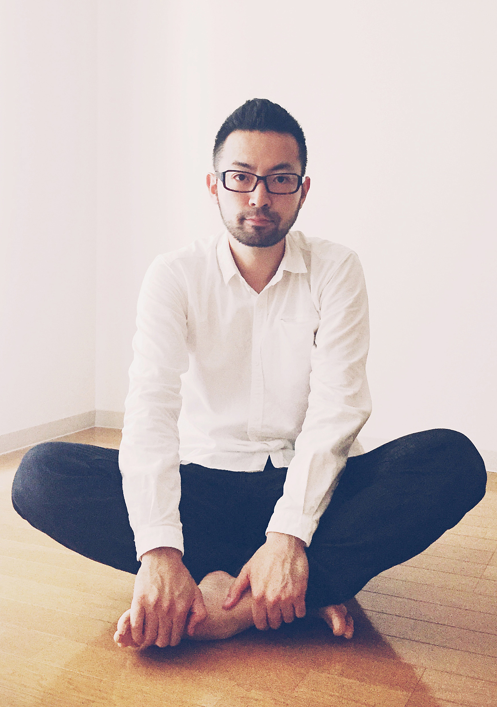
Fumio Sasaki
Japanese author, editor, minimalism expert
Cofounder of the website Minimalism
Books:
Hello, habits
Goodbye, things

Slide 6
Contents

Slide 7
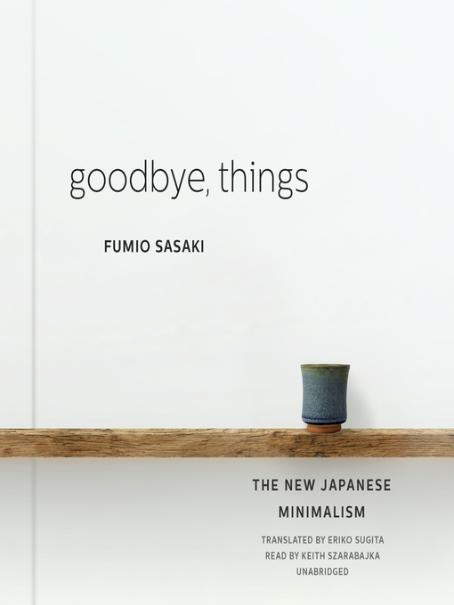
Index
Why minimalism ?
Why we accumulate so many things ?
Tips on minimizing process
Benefits

Slide 8


Why minimalism?

Slide 9

Minimalist
Definition:
Truly essential
Why?
Material effects

Slide 10
Why we accumulate so many things?

Slide 11


Many things
New things:
Boredom
Self-worth:
Feelings
Convey

Slide 12
Tips on minimizing process

Slide 13

Significant Tips
Throwing out things:
Have a lot
Have not been used for a year
Keep unused space empty

Slide 14
Benefits

Slide 15
More time
More enjoy
More freedom
Benefits

Slide 16
Review

Slide 17
Reviews
Breath of fresh air
Practical way of understanding minimalism

Slide 18

Author
Japanese author
Minimalism expert
Content
Why minimalism ?
Why we accumulate many thing ?
Tips on minimizing process
Benefits
Conclusion
Reviews:
Breath of fresh air
Practical way of understanding minimalism

Slide 19

References
https://www.amazon.com/Goodbye-Things-New-Japanese-Minimalism-ebook/product-reviews/B01HDSU7KE
https://www.sloww.co/goodbye-things-fumio-sasaki-book-summary/
https://www.goodreads.com/book/show/30231806-goodbye-things
https://www.goodreads.com/author/show/15267855.Fumio_Sasaki
https://www.apartmenttherapy.com/is-goodbye-things-the-new-life-changing-magic-243066

Slide 20
Thanks for listening!

