Slide 1
Documentation and metadata
Laura Standaert, PhD - Data Steward at UGent

Slide 2










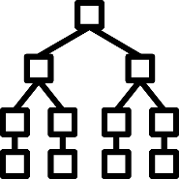




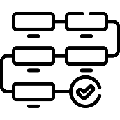

FAIR data principles
Persistent identifiers (PIDs)
Rich metadata, includes PID
Machine readable metadata
Can people (and machines) easily find my data?
FINDABLE
Authentication & authorization procedures
Data access via PID & standard comm. protocol
Metadata is always available
Once found, is it clear who can access it and how?
ACCESSIBLE
Metadata standards
Vocabularies & ontologies
Linked metadata
Can it be easily integrated with other data? Is my data in common formats and uses terms everyone understands?
INTEROPERABLE
Metadata includes license
Metadata includes provenance
(Meta)data community standards
Can someone else understand and use my data? Did I provide clear descriptions, instructions, and license for reuse?
REUSABLE

Slide 3







documentatioN
WHY?
Facilitate research review, verification and reproducibility.
Enable data to be found, understood and reused.
WHAT
WHO
WHY
WHERE
WHEN
HOW

Slide 4




Levels of data documentation
DOCUMENTATION LEVEL
WHAT TO DOCUMENT
WHERE TO DOCUMENT
Item
Variable
Methods, units, possible values,
synonyms, abbreviations
Codebook, data dictionary
Sample
Study object
Study object, method, instrument
settings, time, place
(Register) table, protocol, notebook
File or database
File inventory and relations, database structure
Readme, database schema,
data listings (qualitative data)
Project or study
Subject, grant, contributors, methods, process, workflow
Notebook (e-, code), document, protocol, readme, data inventory table
https://www.ugent.be/en/research/datamanagement/during-research/documentation.htm

Slide 5
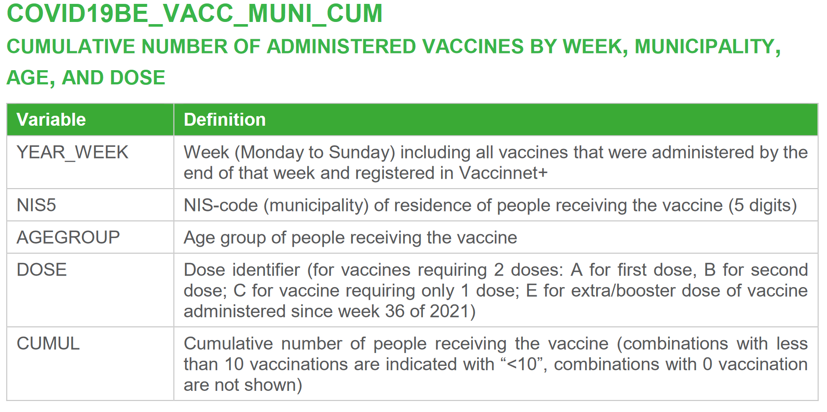
Codebook example
Covid data: https://epistat.wiv-isp.be/covid/
https://epistat.sciensano.be/docs/COVID19BE_codebook.pdf

Slide 6
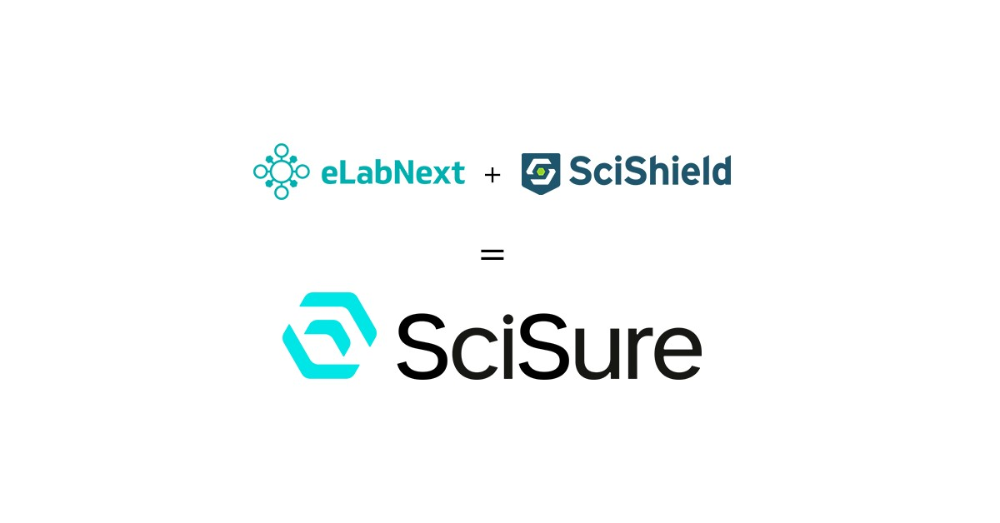
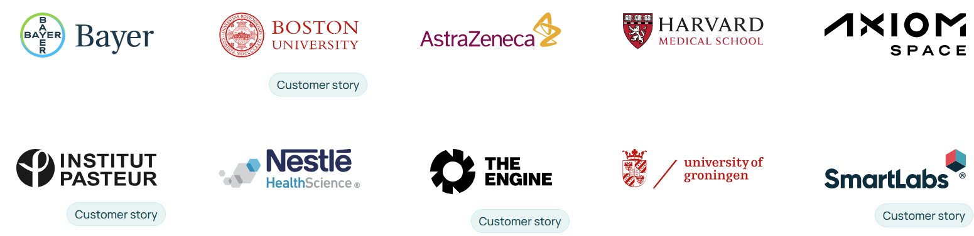






Originally Dutch (eLabNext merged with SciShield to form SciSure)
SciSure is the world’s first Scientific Management Platform (SMP)
Created by scientists, for scientists (our input is taken by the company to update their services)
Support over 800 organizations with more than 550,000 users globally.
Notes:
Key message: the platform is successful and widely used (social opportunity)
Secondary message: the platform may be called by different names due to mergers and partnerships. Voiceover: The eLabNext is a dedicated platform for scientists by scientists. It is used by some of the largest and most prominent institutions (Sanofi, NIH, Memorial Sloan Kettering, HP, CDC, BMS, etc).

Slide 7

The platform in 3 key modules
Journal
Protocols
Inventory
VIB Training & Conferences - Events

Slide 8
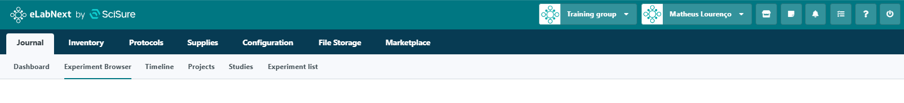
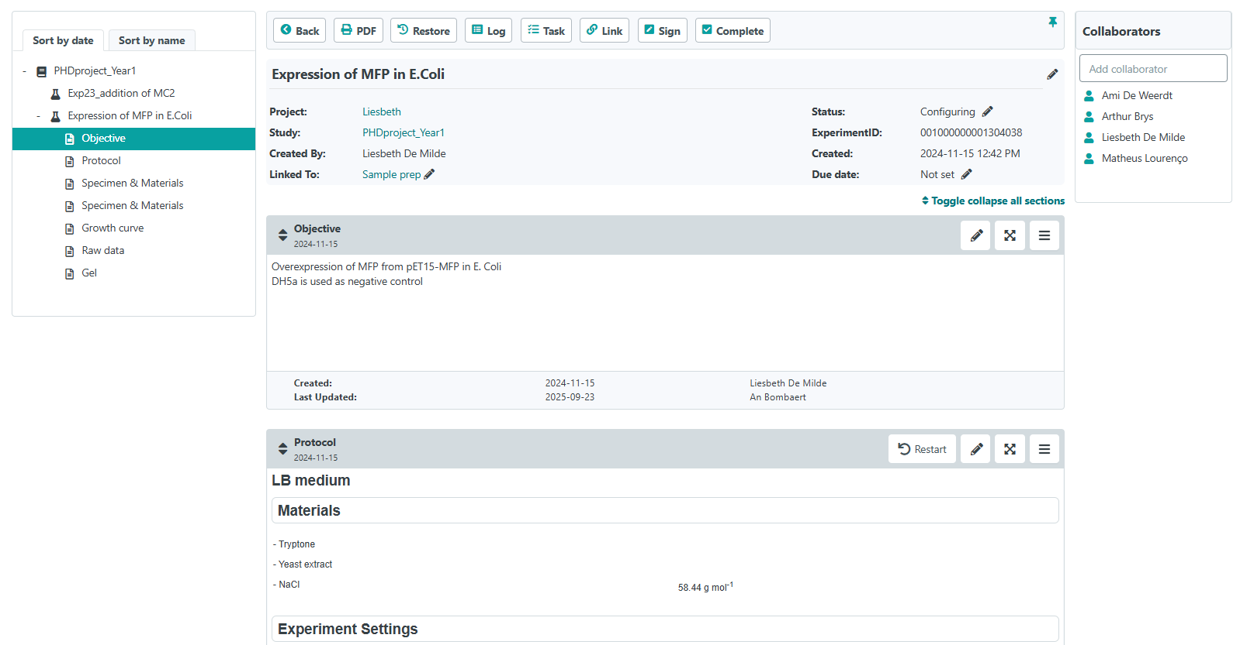
Structured documentation platform, with different access rights and embedded versioning at all levels

Slide 9

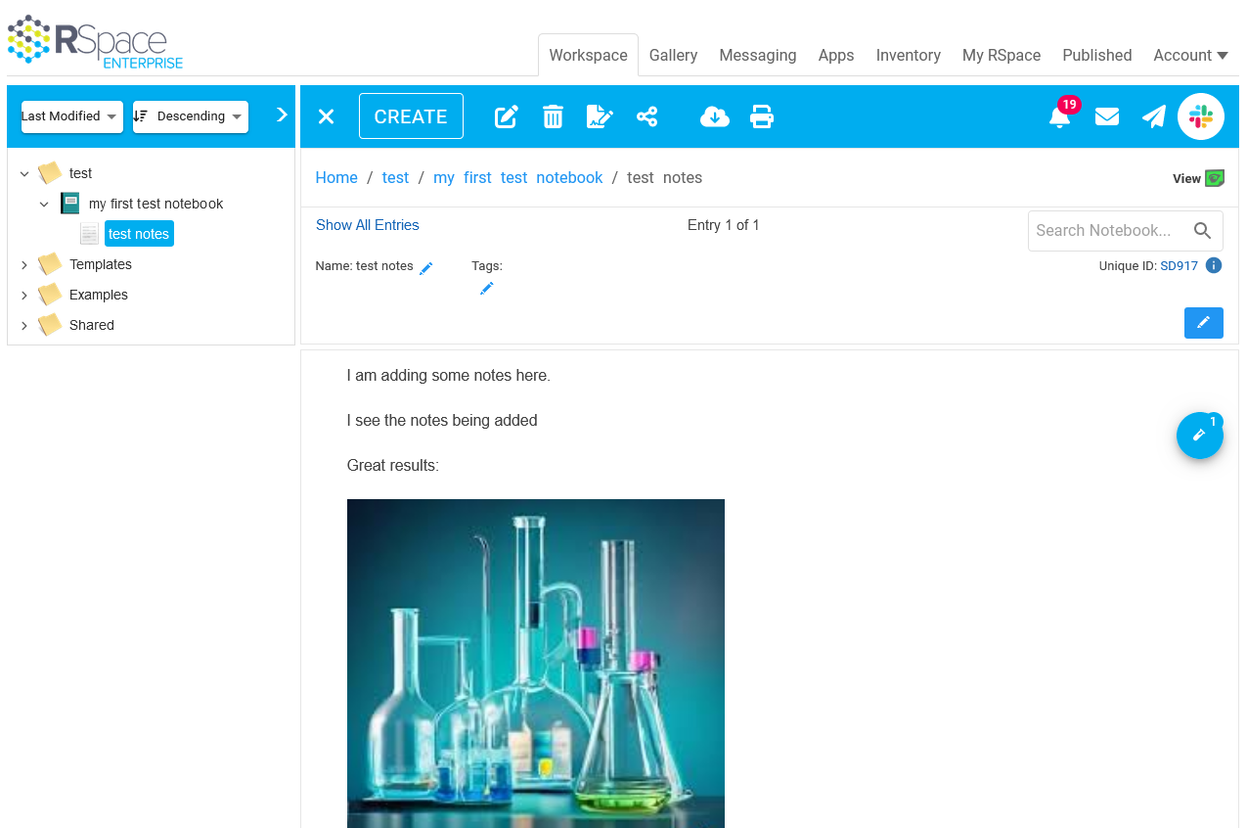
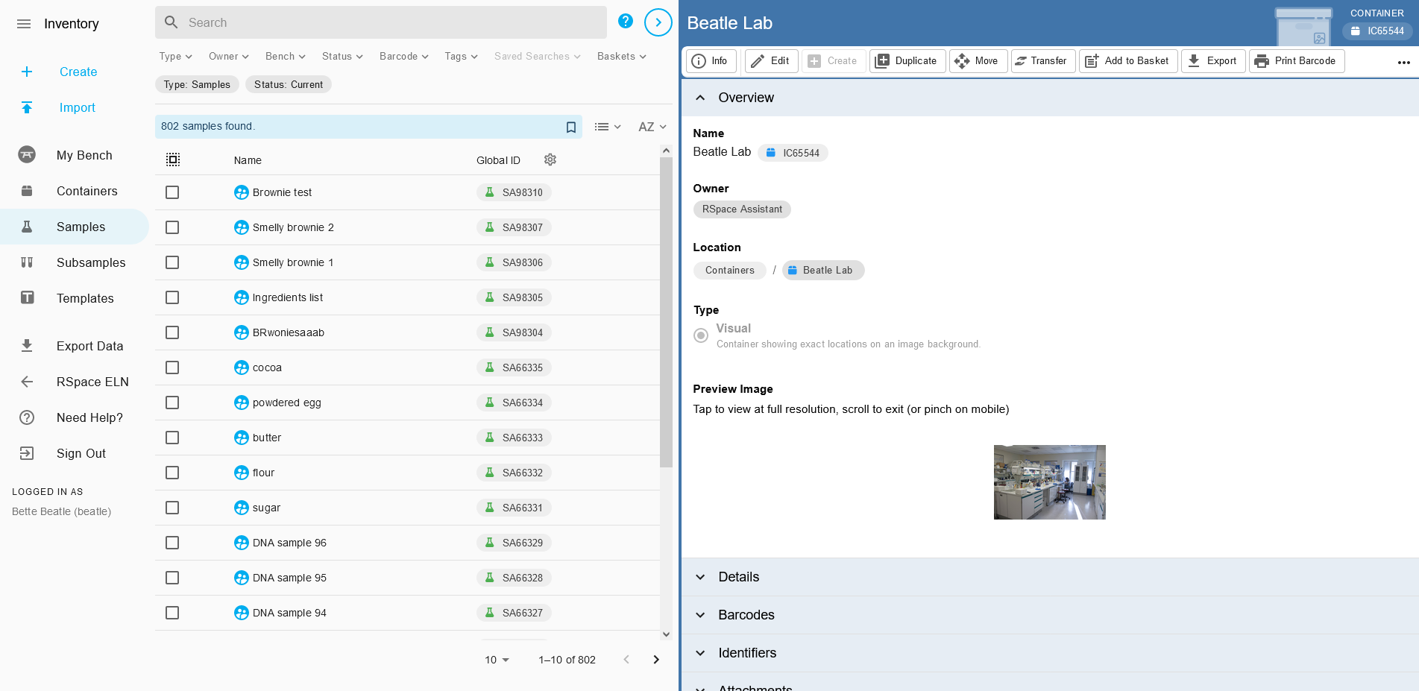
Electronic lab notebook (ELN): RSpace
Flexible note keeping tool, incl. API
Suitable for multiple disciplines
Integrated inventory management
https://onderzoektips.ugent.be/en/tips/00002245/
UGent setup
access anywhere via browser
login via single sign-on
no cost for researchers
Legal, IT security and privacy requirements covered (Compliance GDPR, 21 CFR part 11, SOC 2 Type II...)
Notes:
Ghent University has recently purchased Rspace to be centrally offered to researchers. Rspace is an electronic laboratory notebook (ELN), which has multiple advantages:
RSpace offers flexibility in note-taking, but keeping notes organized in a structured and searchable way.
It is designed to accommodate for different disciplines
RSpace offers integrated inventory management functionality.
Ghent University's setup of Rspace, some advantages:
RSpace will be accessible from anywhere via a web browser (lab, office, or home).
Integration with the university's authentication system (no new credentials/account needed)
There is no direct cost for researchers to use RSpace
Compliance: RSpace meets legal, IT security, and privacy requirements, including compliance with regulations such as GDPR.

Slide 10
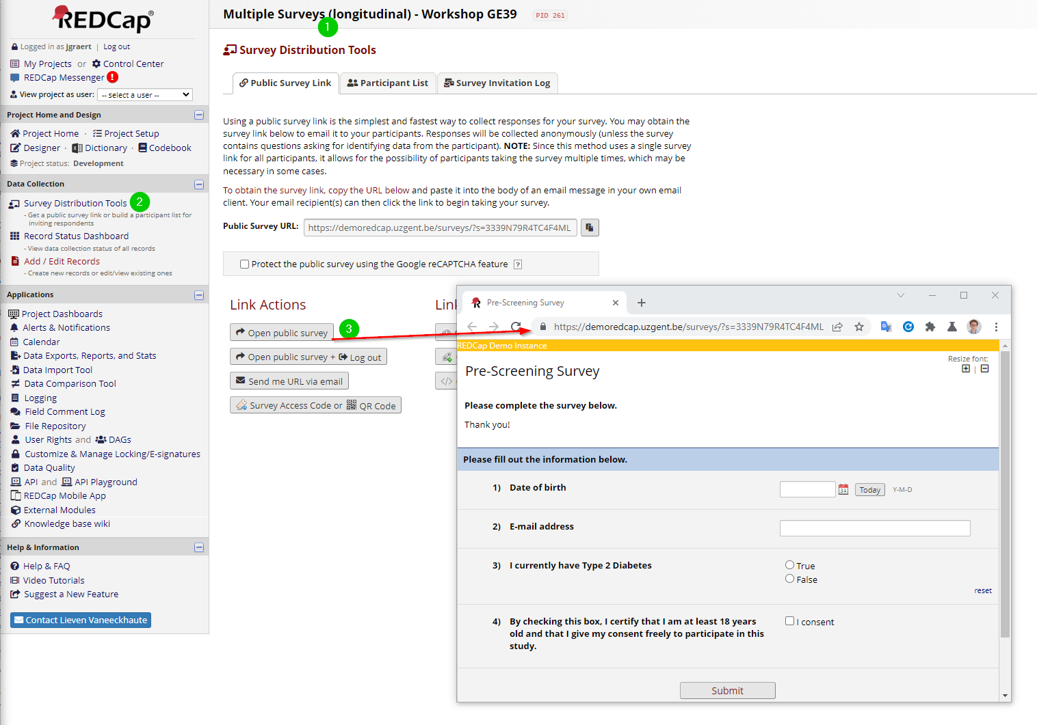
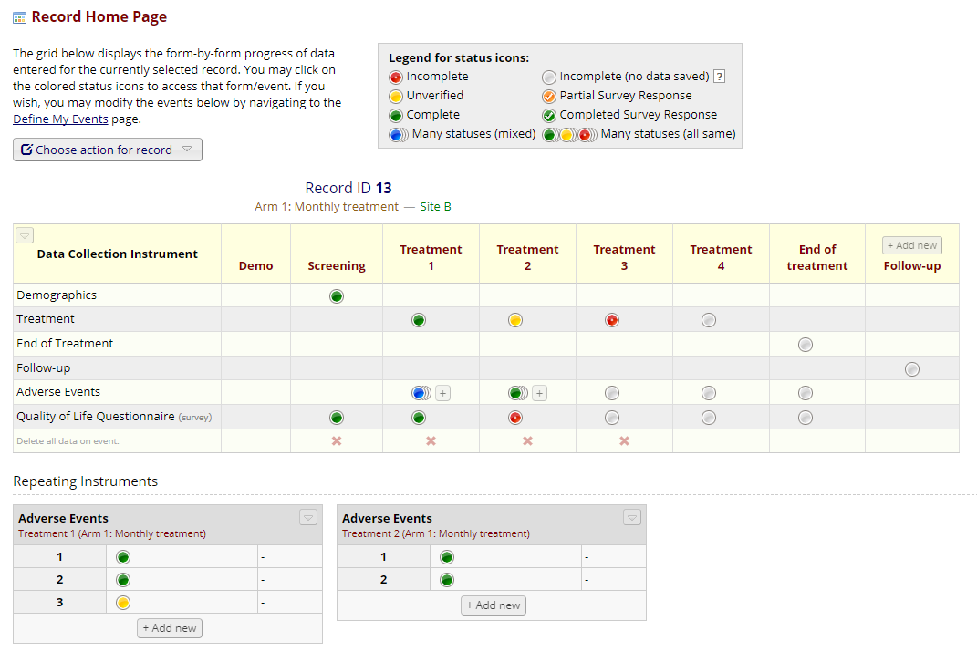
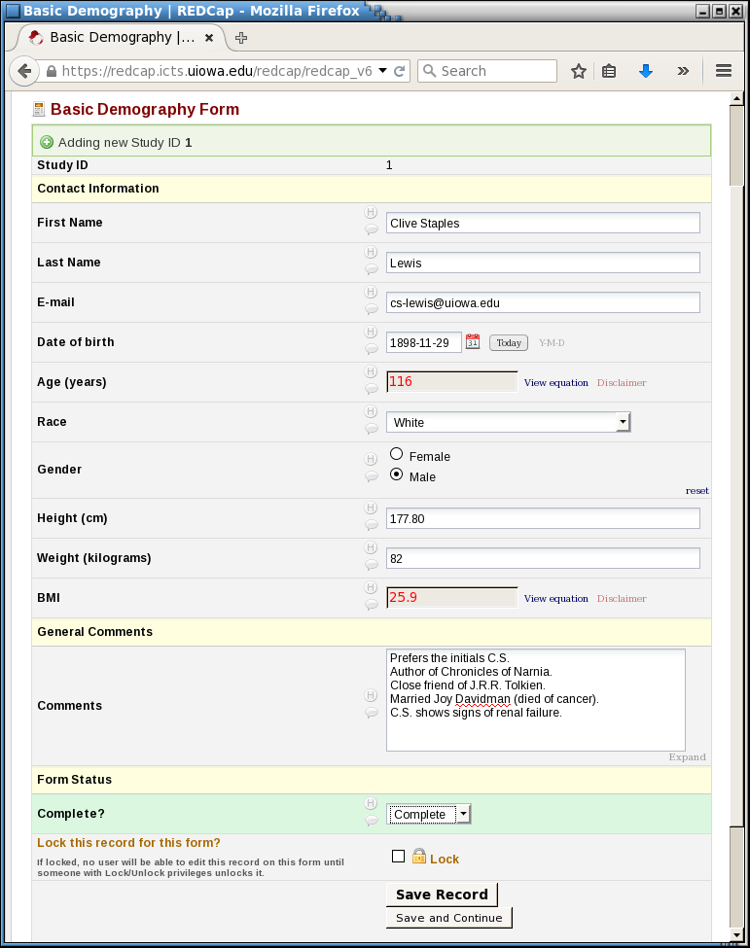
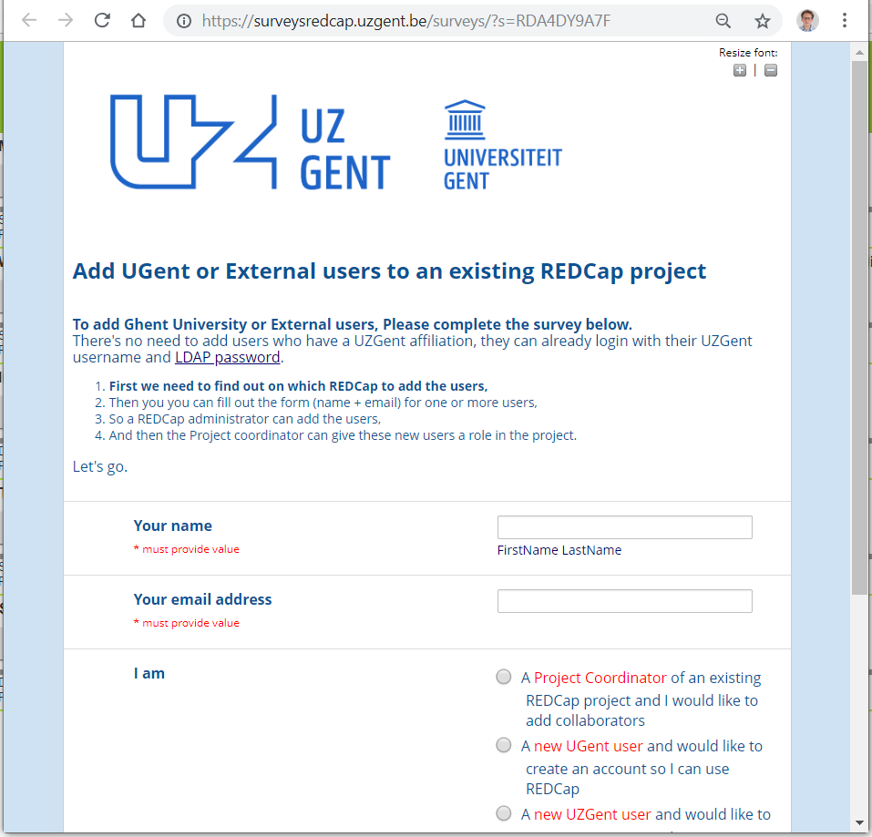
REDCAP: data collection and management Instrument / Form and Survey
eCRF
Survey
https://hiruz.be/dmu/
Notes:
Electronic data capture software RedCap
Electronic case report form for follow up of patients during clinical trials
Hiruz data management unit for support on RedCap

Slide 11
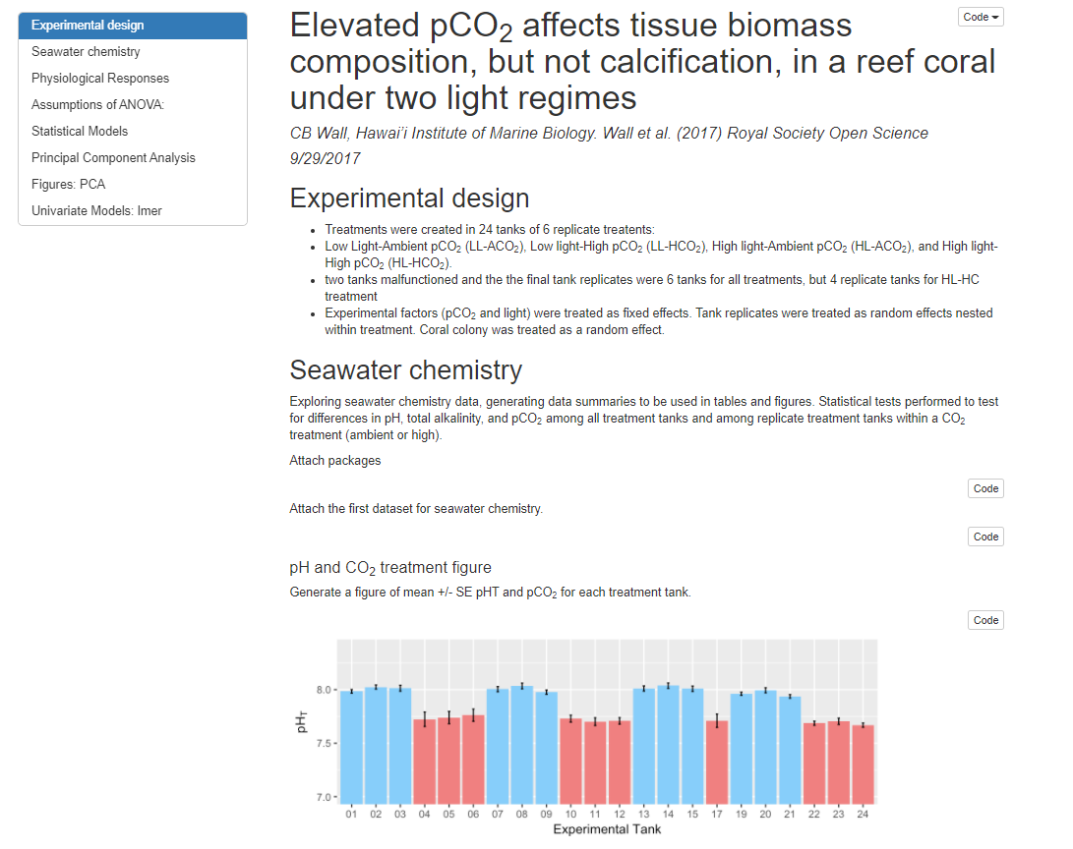
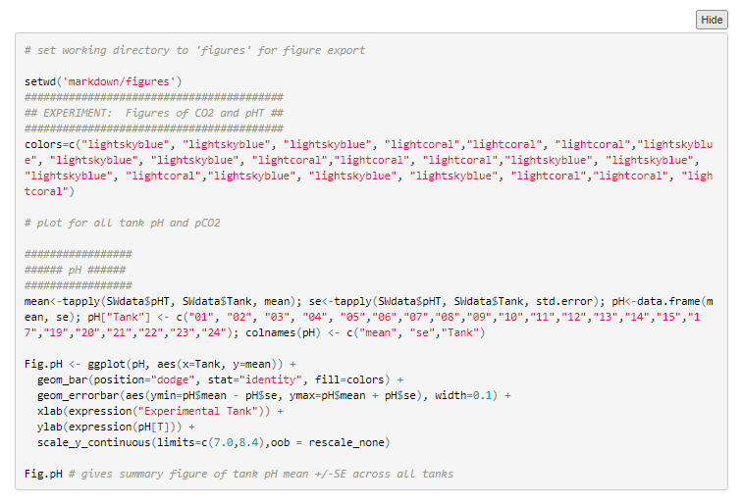
Processing & analysis scripts
Code annotations
(Online) code notebooks (e.g. Jupyter notebook, R markdown)
Create and share documents that contain live code, equations, visualizations and explanatory text
Open, reproducible research
From DMP Example 2 (supplementary material): https://doi.org/10.5061/dryad.5vg70

Slide 12
Documentation guidelines Minimal information about a … experiment
For example MINSEQE (Minimum Information About a Next-generation Sequencing Experiment) guidelines
This includes:
Raw data for each assay (e.g., FASTQ files)
Final processed (normalized) data for the set of assays in the study (e.g., the gene expression data count matrix used to draw the conclusions in the study)
Essential sample annotation (e.g., tissue, sex and age) and the experimental factors and their values (e.g., compound and dose in a dose response study)
Experimental design including sample data relationships (e.g., which raw data file relates to which sample, which assays are technical, which are biological replicates)
Sufficient annotation of the array or sequence features examined (e.g., gene identifiers, genomic coordinates)
Essential laboratory and data processing protocols (e.g., what normalization method has been used to obtain the final processed data)
https://en.wikipedia.org/wiki/Minimum_information_standard

Slide 13






Documentation vs. Metadata
WHAT
WHEN
WHERE
HOW
WHO
WHY
DOCUMENTATION: any contextual information that allows data to be understandable and reusable.
METADATA: information about data, in a highly structured way, using a set of defined fields to be machine readable.
The dataset…
llllllllllllllll lllllllllllll
Title
llllllllllllllll lllllllllllll
lllllllllllllllllllllllllllllllllll
llllllllll llllllllllllllllll
Creator
lllllllllll lllllllllll
Abstract
lllllllllllllllllllllllllllllllllll
llllllllll llllllllllllllllll
Keywords
llllllllllllllllllll lllllllllllllll
Temporal scope
llllllllllllllllllll
File type
llllllll
License
lllllllllllll
Related publication
llllllllllllllllllllllllllllllllll
llllllllllllllll llllllllllllll

Slide 14
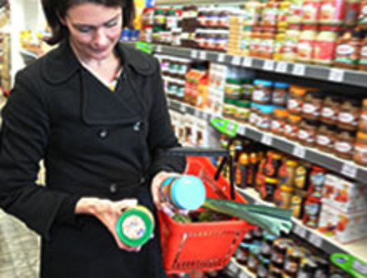
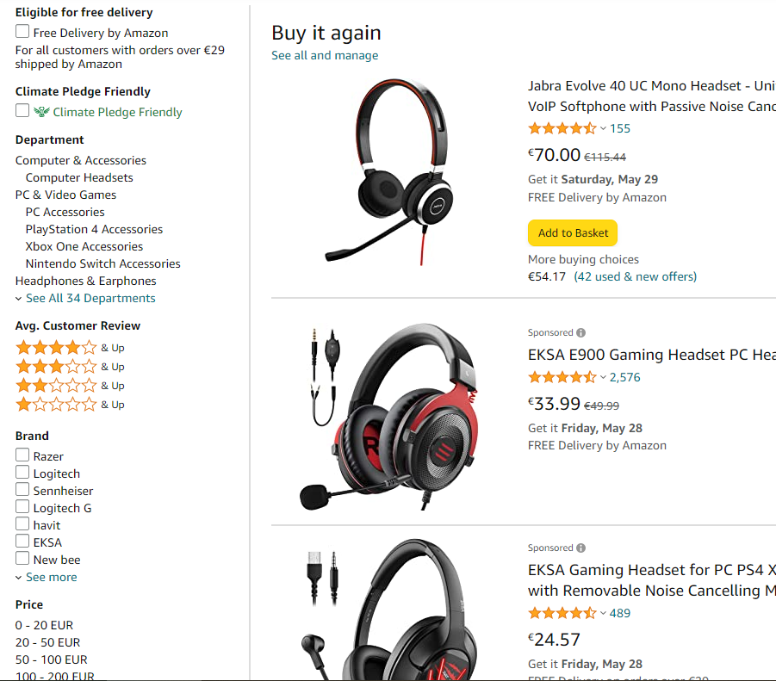
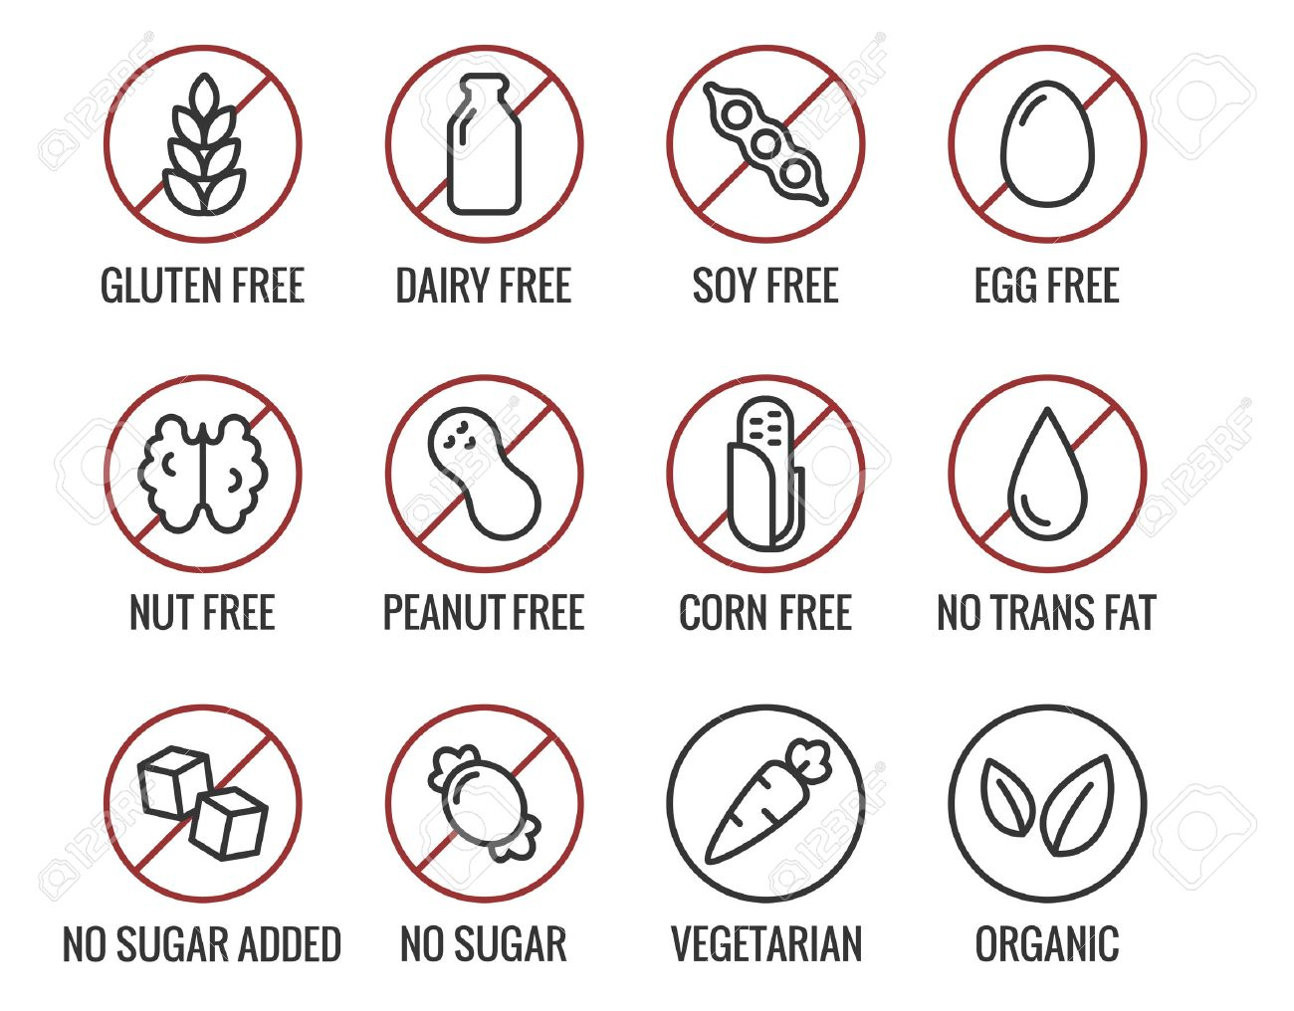
TAGGING AND FiLTERING

Slide 15
Metadata standards: generic vs. discipline specific
Metadata standard: when a community agrees on a set of metadata fields or elements, obligatoriness & cardinality, their meaning, allowed values (e.g. from a list of controlled vocabularies) & formats.
Discipline standards: to satisfy the needs of a particular scientific domain.
Typically contain additional elements & rules.
DataCite
EML (Ecologic Metadata Language)
*Identifier
packageID
Used in discipline- specific data repositories (e.g. GBIF)
Generic fields used in domain-agnostic data repositories
*Creator
creator
*Title
title
*PublicationYear
pubDate
GeoLocation
geographicCoverage
n/a
taxonomicCoverage

Slide 16
Standards & Controlled vocabularies

Slide 17
FAIR data principles
Persistent identifiers (PIDs)
Rich metadata, includes PID
Machine readable metadata
Can people (and machines) easily find my data?
FINDABLE
Authentication & authorization procedures
Data access via PID & standard comm. protocol
Metadata is always available
Once found, is it clear who can access it and how?
ACCESSIBLE
Metadata standards
Vocabularies & ontologies
Linked metadata
Can it be easily integrated with other data? Is my data in common formats and uses terms everyone understands?
INTEROPERABLE
Metadata includes license
Metadata includes provenance
(Meta)data community standards
Can someone else understand and use my data? Did I provide clear descriptions, instructions, and license for reuse?
REUSABLE

Slide 18

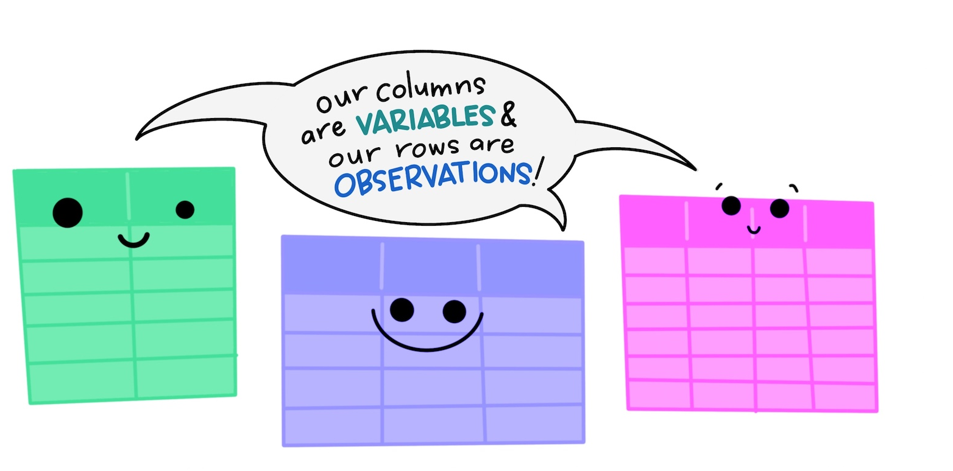
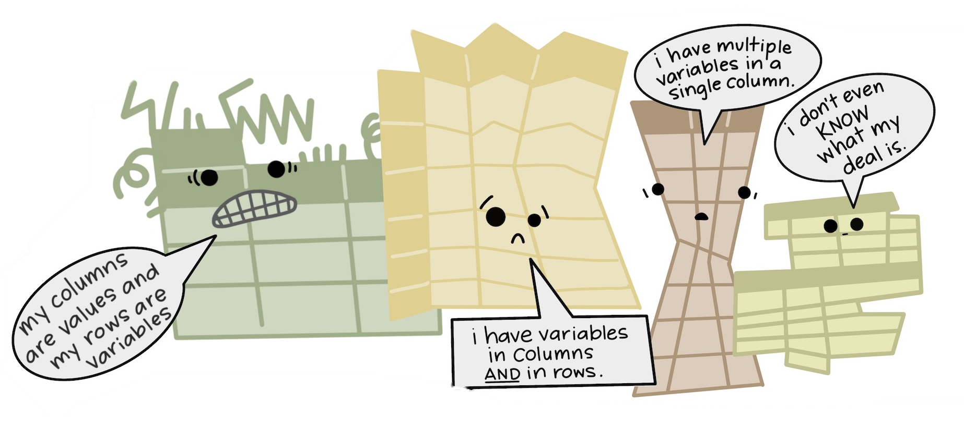
Common issues on understandability
May, 4th?
ISO standard (YYYYMMDD or YYYY-MM-DD)
1985-04-05
April,5th?
05/04/85

Slide 19



Standards & Controlled vocabularies
Standards: Rules that govern how data is structured, formatted, shared, and exchanged across systems.
Controlled vocabularies: Define agreed-upon terms to ensure consistency in describing variables, values, units, etc.
Why?
2
兩
Unambiguity
Everyone uses the same terms for the same concepts
Interoperability
Data from different researchers and disciplines can be easily integrated
Machine actionability
Computers can process data more effectively when data is standardized

Slide 20
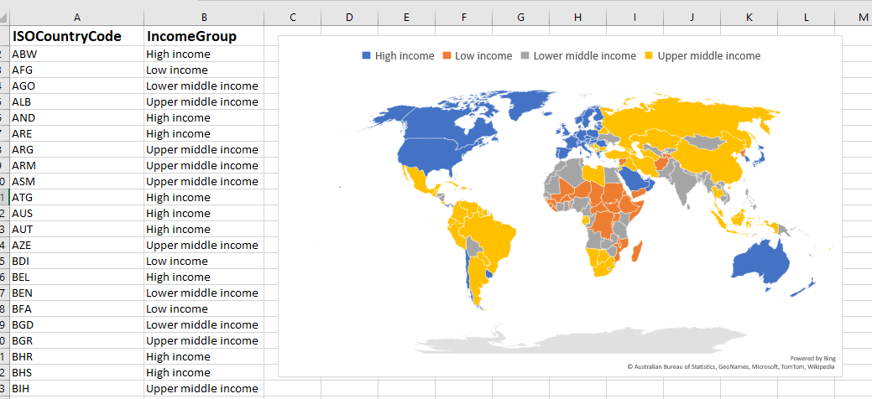

Standard vocabularies & ontologies
Enable machine readability (use might be required in some domain repositories)
Day-to-day example:
MS Excel recognizes ISO Country codes (or other place names in geonames.org) to automatically create maps

Slide 21

Vocabularies and standards
STANDARDIZED METADATA
Metadata fields or
elements
Metadata values
Vocabularies, ontologies, ISO standards
Title
llllllllllllllll lllllllllllll
Creator
ORCID
Description
lllllllllllllllllllllllllllllllllll
llllllllll llllllllllllllllll
Subject
llllllllllllllllllll lllllllllllllll
Date
ISO-…
Format
llllllll
Rights
lllllllllllll
Related identifier
llllllllllllllllllllllllllllllllll
llllllllllllllll llllllllllllll

Slide 22
Vocabularies in life sciences
In clinical context often referred to as 'coding'
Clinical medicine: https://prsinfo.clinicaltrials.gov/definitions.html
Clinical ontologies in REDCap: http://bioportal.bioontology.org/
Clinical established vocabularies or ontologies
e.g. as listed in https://www.ebi.ac.uk/ols/index
or agreed terminology such as ICD-10, SNOMED, …
Bioassay ontology, eg for small molecule screening
https://bioportal.bioontology.org/ontologies/BAO
The EGA recommends using the Experimental Factor Ontology Database for describing your sample phenotypes and MONDO for disease classification
Example dataset on EGA: https://ega-archive.org/datasets/EGAD00001000002

Slide 23
Registering output

Slide 24
UGEnt policy on scholarly publishing (as of Jan 2023)
Mandatory registration of published research datasets, i.e. entering and/or validating the required bibliographic details ('metadata') of your published research output.
Research datasets published via a data repository, with at least one Ghent University creator at the time of publication, and which support publications from 2023 or later.
Journal article
Research dataset
Deposit in a data repository
Registration in Biblio data register
https://www.ugent.be/intranet/en/research/impact/schol-publishing/policy-ugent.htm

Slide 25








Sharing and registering research data
Option 1: Domain-specific repository (preferred)
DATA AND
OTHER RESEARCH
OUTPUT
Institutional data register
Step 1
Step 2
Register metadata of published datasets in
Biblio
+
DOCUMENTATION
METADATA
Option 2: Generic repository
Recommendations:
Share within UGent for scientific review and more widely if possible (RDM policy framework)
Share as openly as possible, as closed as necessary, in line with the FAIR principles (ALLEA)
Use domain-specific repository for sharing outside of UGent when available
Notes:
One of the main goals of everything that we've talked about today is maximizing the re-use of data and other research outputs. As we've discussed, that means first describing your data with detailed and accurate metadata (as seen in leftmost panel). Once you have this data package, the next steps are to register your data in a reputable data repository, preferably domain-specific but generic repositories are fine as well. Then, as per the new publication policy, the next step is to register that published dataset and link it with any relevant publications to ensure that you get the appropriate credit for your research outputs.
What I'll present now is a quick explanation of the simplest pipeline that you can follow to satisfy these requirements and have to share your data.

Slide 26

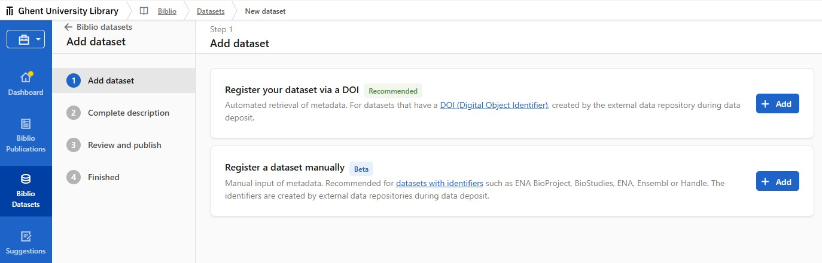
REGISTRATION OF PUBLISHED RESEARCH DATA AND SOFTWARE IN BIBLIO
Register published research datasets in Biblio
Mandatory with new UGent policy
Link your research project
Enhance findability of your research outputs by linking datasets to publications
👉 More on UGent policy on scholarly publishing

Slide 27
TWO METHODS FOR REGISTRATION OF PUBLISHED RESEARCH DATASETS
Method 1 (recommended): Semi-automated registration using DOI as persistent identifier (demo)
Automated harvesting of several metadata fields
Complete/verify metadata
Method 2: Manual registration using an alternative persistent identifier or accession number
Select persistent identifier type and provide identifier of dataset
Complete all metadata manually
👉 More on How to register my dataset?, Step-by-step registration of published datasets
and PID: What is a persistent identifier for publications and datasets?

Slide 28
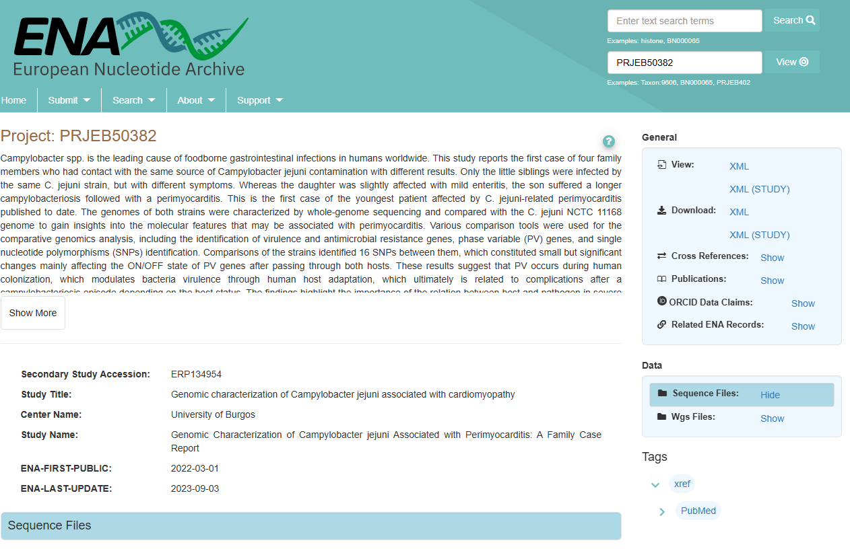
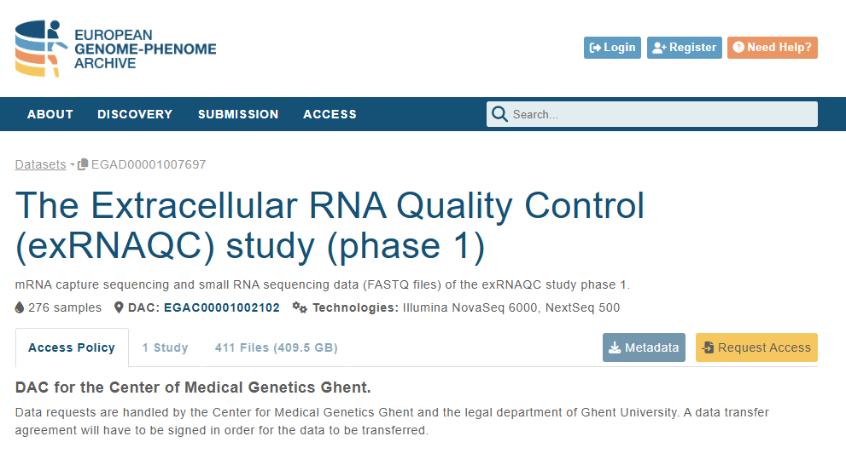
LIFE SCIENCES DATASETS OFTEN DO NOT HAVE A DOI

Slide 29
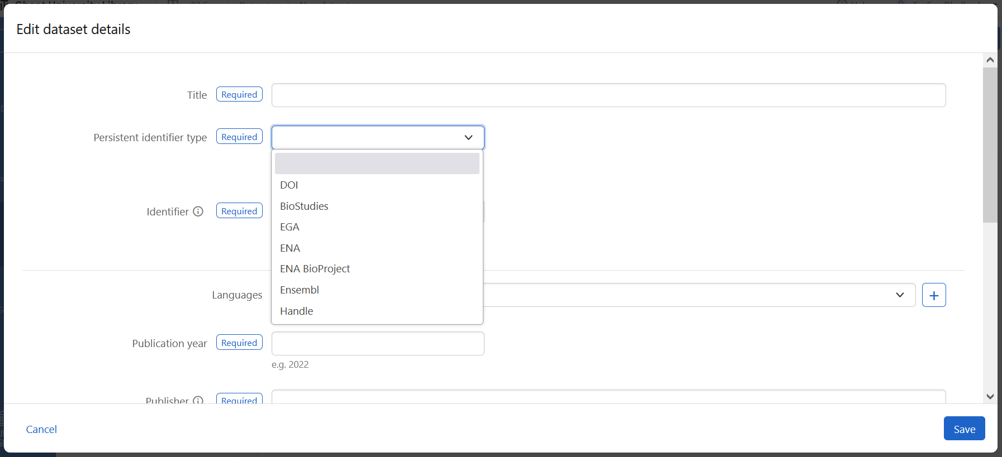
MANUAL REGISTRATION OF LIFE SCIENCES DATASETS PERSISTENT IDENTIFIERS OR ACCESSION NUMBERS OTHER THAN DOI
If your persistent identifier type is not available yet, contact the Data Curators at rdm.support@ugent.be.
👉 More on How to register my dataset?, Step-by-step registration of published datasets
and PID: What is a persistent identifier for publications and datasets?

Slide 30
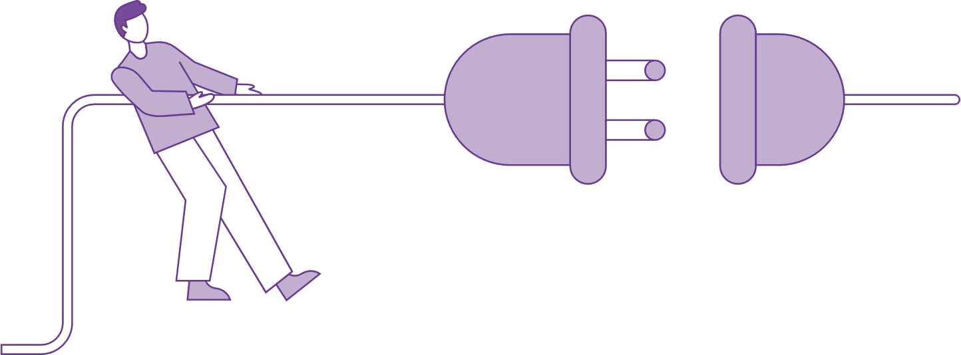
Break
Disconnect for 10 mins

Slide 31





UGent Data Stewards UNIVERSITY SERVICES – RESEARCH TEAM OPen Science
openscience@ugent.be / rdm.support@ugent.be / biblio@ugent.be @ugentopenscience.bsky.social
boekentoren.gent/UGent_OS ugentbe.sharepoint.com/UGent_OS_training
youtube.com/UGent_OS

