Slide 1
Storing research information safely

Slide 2
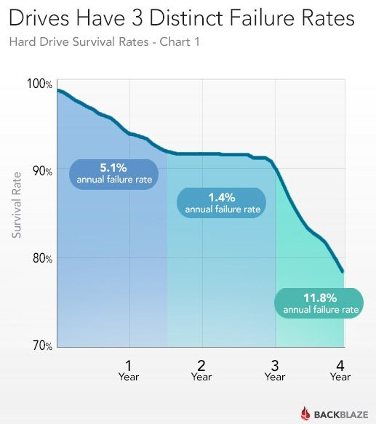


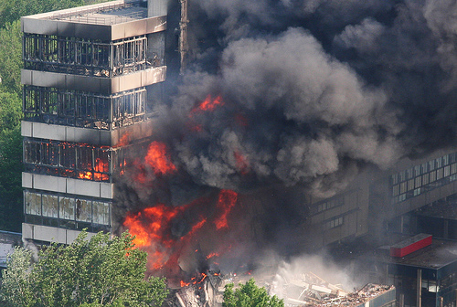
Things go wrong
Hacking/ransomware attacks
Hard disk crashes
Inferno
Theft

Slide 3




INFORMATION SECURITY CORE PRINCIPLES
CONFIDENTIALITY
INTEGRITY
AVAILABILITY
Notes:
But when can we say that our data is secure?
To secure data, we need to consider the three core information security principles: Confidentiality, Integrity and availability .
Handhaving van de vertrouwelijkheid betekent dat er passende technische en organisatorische maatregelen moeten worden genomen, zodat de juiste informatie alleen in de juiste handen terechtkomt.
Maar welke gegevens zijn vertrouwelijk?
Bij de beoordeling van de vertrouwelijkheid van gegevens is het belangrijk om in termen van risico's te denken. Vaak zijn vertrouwelijke gegevens gegevens waarvan de ongewenste openbaarmaking negatieve of schadelijke gevolgen heeft. Het kan bijvoorbeeld de deelnemers aan een onderzoek schaden, of het kan het valorisatiepotentieel in gevaar brengen.
In feite zijn er drie veel voorkomende redenen waarom onderzoeksgegevens vertrouwelijk zijn.
Ten eerste: persoonsgegevens of, met andere woorden, gegevens die betrekking hebben op een geïdentificeerde of identificeerbare persoon. Het risico hiervan is een inbreuk op de privacyrechten. Dit is bijvoorbeeld van belang voor speciale categorieën van persoonsgegevens zoals patiëntgegevens.
Een tweede reden om gegevens als vertrouwelijk te bestempelen is omdat we intellectuele eigendom willen veiligstellen, bijvoorbeeld door het indienen van een octrooiaanvraag. Het risico hiervan heeft betrekking op het ondermijnen van het valorisatiepotentieel van onze onderzoeksresultaten.
En ten derde kunnen gegevens vertrouwelijk zijn wanneer contracten met derden bepaalde beperkingen opleggen aan wie wel of niet toegang heeft tot de onderzoeksgegevens. Het risico dat we hier willen afdekken is het niet nakomen van contractuele verplichtingen.
Wat de reden ook is om gegevens als vertrouwelijk te beschouwen, de implicatie is altijd dat ze niet openbaar mogen worden gemaakt aan of toegankelijk zijn voor onbevoegden.
Nu, hoe zit het met het tweede principe, integriteit?
Integriteit betekent dat we moeten garanderen dat de gegevens gedurende de hele levenscyclus accuraat en volledig blijven. Dat ze niet onbedoeld gewijzigd worden Risico's voor de integriteit kunnen voortkomen uit technische problemen of menselijk handelen.
Problemen van technische aard zijn meestal het gevolg van onvoorziene hardwarefouten, degradatie of misconfiguratie, en kunnen leiden tot gegevenscorruptie of -verlies.
Aan de andere kant kunnen integriteitsproblemen, veroorzaakt door menselijk ingrijpen, zowel opzettelijk als onopzettelijk zijn.
Onderzoekers kunnen bijvoorbeeld per ongeluk gegevens wijzigen in een databestand.
Dat brengt ons bij het laatste principe van informatiebeveiliging: Beschikbaarheid.
In het ideale geval moeten gegevens direct beschikbaar zijn wanneer ze nodig zijn, waar ze nodig zijn en in de vorm waarin je ze verwacht.
Maar... zo is het niet altijd. Data of hardware kan verloren gaan of gestolen worden, er kunnen storingen zijn in het netwerk, of in de beschikbaarheid van een clouddienst.
Conclusie
Dus, zoals je ziet, zijn er een paar risico's die de veiligheid van onze gegevens bedreigen. De vraag is dan ook wat we kunnen doen om deze risico's te minimaliseren.

Slide 4

Keeping data safe
Data for which the unwanted disclosure will have negative or harmful consequences* (may be unlawful, put participants at risk, put business processes at risk)…
RISKS
MEASURES

Slide 5
Exercise
Data security: categorize the Do’s and Don’ts
Notes:
with post its or digital white board in teams chat

Slide 6
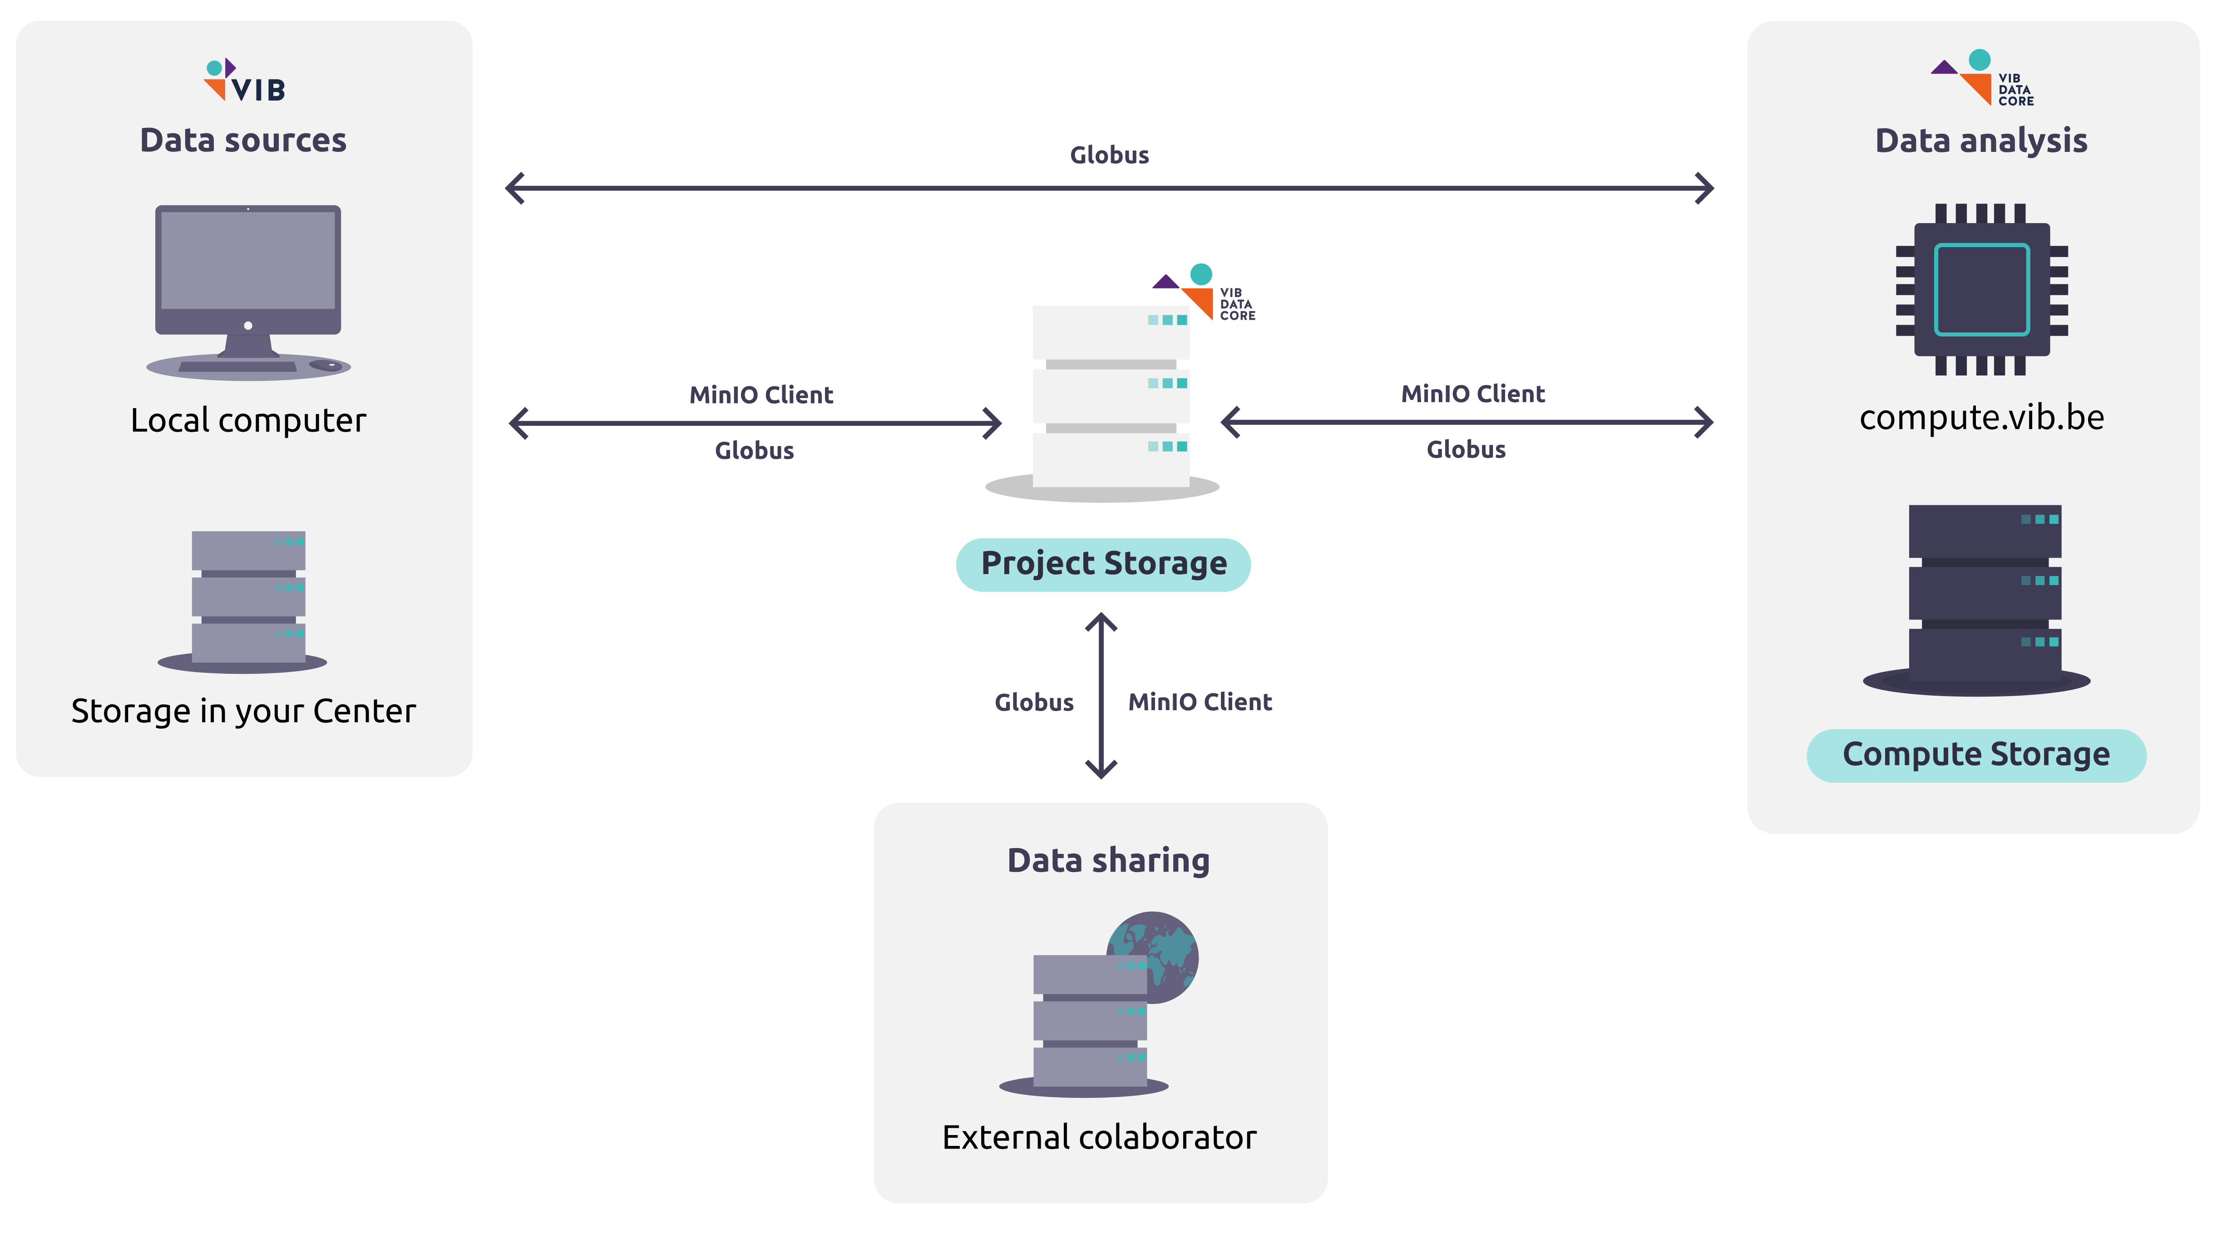


Data Core storage solutions
Ideal for large files
Ideal for collaborations between departments
More info?
Data Storage | VIB Data Core Documentation
datacore.help@vib.be

Slide 7
recommended practices: UGent platforms
Where to store research data during projects?
Project Share → share with promotor
→ work directly on the shares
Sharepoint Online / Teams → share with promotor
! Avoid external cloud providers (Google Drive, Dropbox)
If you have to => Encryption!
Useful guidelines:
Requesting a project share
Mounting network drives
Retrieving snapshots
ACL shares and Adjusting permissions on ACL shares
Requesting a Team or SharePoint site
M365 Kennisplatform
Microsoft Teams
Encryption guidelines

Slide 8
File formats file organization & version control

Slide 9
File formats

Slide 10





FILE FORMATs
A file format describes how information is stored (“encoded”) within a digital file
Can be recognized by file extension (e.g. *.docx, *.jpg, *.pdf)
Choosing a file format might be influenced by different factors:
Domain norms & software
Previous work & colleagues
Hardware & instrumentation
Facilitate collaboration
Vulnerability to obsolescence
Notes:
What is a file format?
A file format determines how information is stored (or "encoded") within a digital file.
Examples can be identified by their file extensions, such as .docx, .jpg, .pdf.
Factors influencing file format choice:
Domain norms & software: Some fields have preferred formats (e.g., .fasta for bioinformatics or .dicom for medical imaging).
Previous work & colleagues: Consistency with existing data or ensuring compatibility with collaborators' tools.
Hardware & instrumentation: Certain formats are dictated by the equipment or software used to generate the data.
Facilitate collaboration: Choosing formats that are widely used and accessible ensures smoother collaboration.
Vulnerability to obsolescence: Consider whether the format is likely to become outdated or if it will remain accessible in the future.
Key takeaway:
Choosing the right file format is essential for data compatibility, longevity, and collaboration.

Slide 11






FILE FORMATs: Open vs. closed
CLOSED FORMATS
OPEN FORMATS
Proprietary
Dependence on third-party software
Limited compatibility between versions
High vulnerability to obsolescence
Proprietary &
non-proprietary
Platform and software independent: maximize interoperability & reuse
Compatibility between versions by design
Low vulnerability to obsolescence
Icons made by Freepik from www.flaticon.com
Notes:
Closed Formats
Definition: Proprietary formats controlled by specific companies or organizations.
Characteristics:
Dependence on third-party software to access or edit files (e.g., WMA, PSD).
Limited compatibility between different software versions.
High vulnerability to obsolescence, as the format might not be supported in the future.
Open Formats
Definition: Formats that are platform- and software-independent, designed for interoperability and reuse.
Characteristics:
Can be either proprietary or non-proprietary but are widely accessible (e.g., PDF, CSV, PNG, TIFF).
Platform and software independent, maximizing usability across tools.
Designed for compatibility between versions to ensure long-term accessibility.
Low vulnerability to obsolescence, making them better for archiving and sharing.
Key takeaway
Use open formats whenever possible, especially for sharing and archiving data, to ensure compatibility and future access.
Rely on closed formats only when necessary, such as for specific tools or workflows.

Slide 12







file migration & compression
Possible loss of content, metadata & quality
Be aware of the risks
Keep a copy of the original
Check & repair damage
Loss of formulas, embedded charts & comments, visual formatting…
Other problems: multiple tables in worksheet, not rectangular tables, merged cells, dates…
Lossless compression formats: allows the original data to be perfectly reconstructed from the compressed data
Lossy compression: uses inexact approximations and partial data discarding to represent the content.
Notes:
Sometimes we might need to migrate files to a different format. How can be make sure we preserve data quality?
File migration risks
Possible loss of content, metadata, and quality:
For example, converting XLSX to CSV:
Loss of formulas, embedded charts, comments, and visual formatting.
Other issues: Misalignment due to multiple tables, merged cells, or dates not properly formatted.
Strategies:
Always keep a copy of the original file to revert to in case of data loss.
Check and repair damage after migration to ensure the integrity of the data.
Compression types
Lossless compression:
Formats like TIFF allow perfect reconstruction of the original data after decompression.
Useful for data where quality and accuracy must be maintained (e.g., research data or high-quality images).
Lossy compression:
Formats like JPG use approximations, discarding some data to reduce file size.
Suitable for applications where slight quality loss is acceptable (e.g., web images).
Key takeaways
Always be aware of the risks when migrating or compressing files.
Use lossless formats for critical data and lossy formats when smaller file sizes are more important than precision.
Regularly validate the integrity of migrated or compressed files.

Slide 13
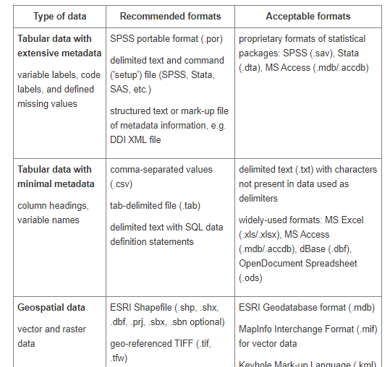
FILE FORMATs: recommended file formats
Examples of recommended file formats:
DANS, File formats
UK Data Service, Recommended formats
Curation for preservation tips for different formats:
DCN Data Curation Primers
E.g. from xlsx -> csv (what to consider, what to avoid, what to document, etc.)

Slide 14
Domain specific data standards: examples
FITS (.fits): Flexible Image Transport System, widely used for storing astronomical data, images, and metadata
ASCII (.txt): Simple, plain text format for data sharing.
CIF (.cif): Crystallographic Information File for crystal structure data.
MOL (.mol, .sdf): Representations of molecules and chemical structures.
GeoTIFF (.tif, .tiff): Tagged Image File Format with georeferencing information, used in GIS and remote sensing.
Shapefile (.shp, .shx, .dbf): Standard format for vector data (points, lines, polygons) in GIS.
NetCDF (.nc): Network Common Data Format, used for multidimensional geospatial datasets like climate models.
DEM (.dem): Digital Elevation Model, used for topography and terrain analysis.
FASTA (.fasta, .fa): Text-based format for nucleotide or amino acid sequences.
MATLAB (.mat, .m): Proprietary format for computational models, simulations, and data analysis.
AutoCAD (.dwg, .dxf):Proprietary formats for engineering drawings and architectural plans.
Notes:
In NS + BSE
FITS (.fits): Flexible Image Transport System, widely used for storing astronomical data, images, and metadata
ASCII (.txt): Simple, plain text format for data sharing.
CIF (.cif): Crystallographic Information File for crystal structure data.
MOL (.mol, .sdf): Representations of molecules and chemical structures.
GeoTIFF (.tif, .tiff): Tagged Image File Format with georeferencing information, used in GIS and remote sensing.
Shapefile (.shp, .shx, .dbf): Standard format for vector data (points, lines, polygons) in GIS.
NetCDF (.nc): Network Common Data Format, used for multidimensional geospatial datasets like climate models.
DEM (.dem): Digital Elevation Model, used for topography and terrain analysis.
FASTA (.fasta, .fa):Text-based format for nucleotide or amino acid sequences.
MATLAB (.mat, .m):Proprietary format for computational models, simulations, and data analysis.
AutoCAD (.dwg, .dxf):Proprietary formats for engineering drawings and architectural plans.

Slide 15
File organization

Slide 16
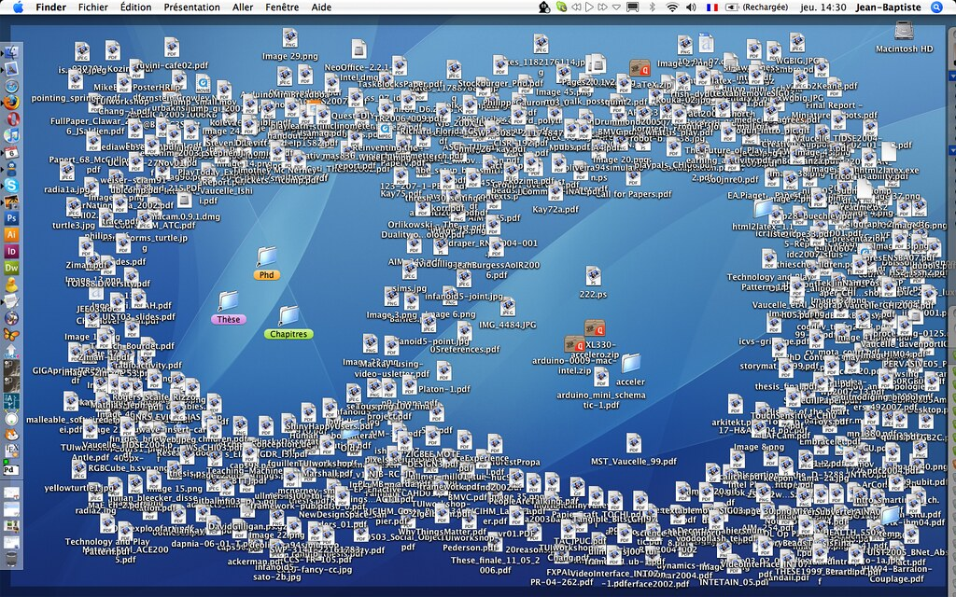
Notes:
Challenges of poor file organization:
Cluttered workspace: A disorganized desktop makes it difficult to locate files quickly.
Inefficient workflows: Wastes time searching for the correct document or resource.
Risk of data loss: Important files may accidentally be deleted or overlooked.
Stress and frustration: A messy digital environment can negatively affect productivity and focus.

Slide 17
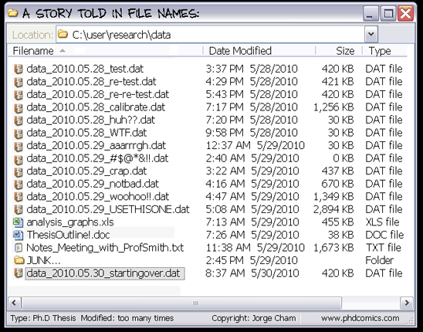
file organization: WHAT AND Why
What?
Folder structure
File naming
Versioning
Why?
As documentation
To make files more useful
To locate a file more easily
To enable “someone” to look at your files and understand what was done
(Hint: that someone is you!)
Increase productivity
Any system is better than no system
Harvard RDM working group, CC-BY (https://osf.io/hjntb/)
Notes:
What?
Folder structure: organizing files into a logical hierarchy of folders to group related files.
File naming: using clear, descriptive, and consistent names for files.
Versioning: keeping track of changes over time
Why?
As documentation:
Makes files easier to use and locate.
Helps you (or others) understand your work at a later time, reduces confusion.
Hint: “That someone” who needs to understand your files is often your future self.
To increase productivity:
Saves time spent searching for misplaced or ambiguously named files.
Key takeaway
Any system is better than no system: Even basic organization improves file management compared to leaving everything scattered.

Slide 18
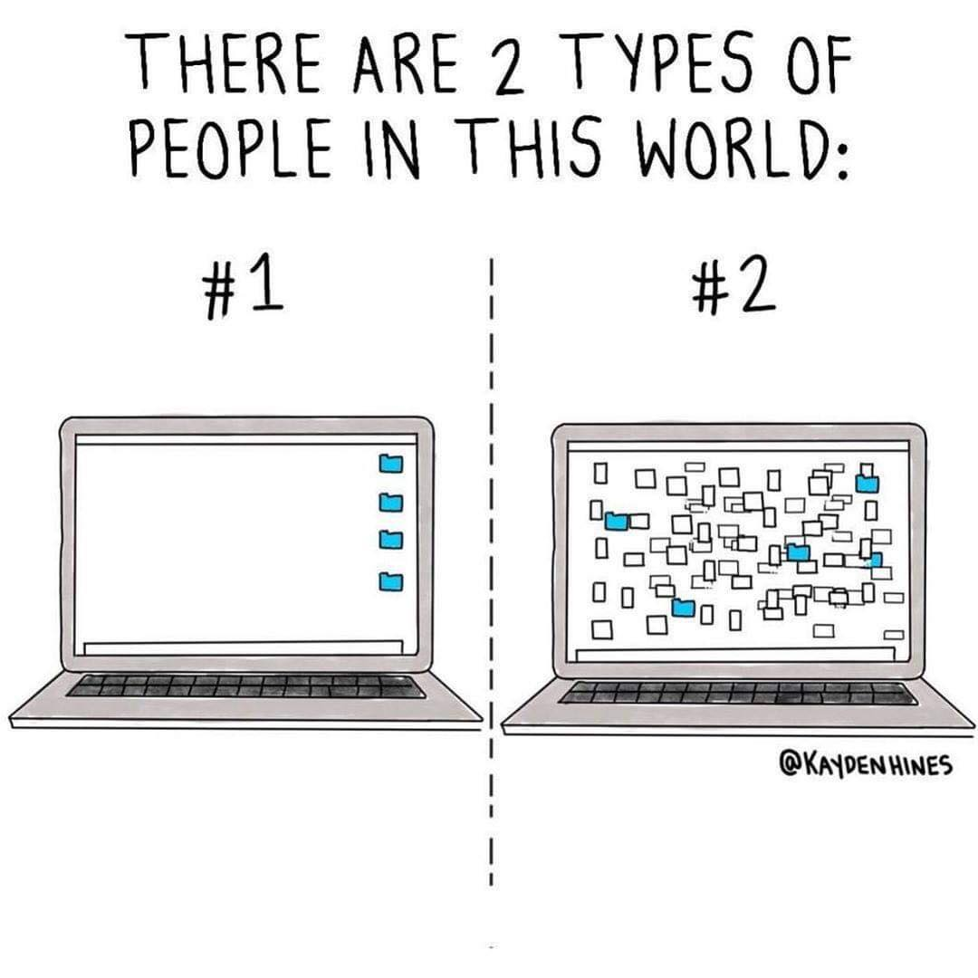
file organization: HOW
How?
Make a file organization plan
Plan folder hierarchy
Develop file naming convention
Develop versioning strategy
Document the file organization system
Use the system consistently
Harvard RDM working group, CC-BY (https://osf.io/hjntb/)

Slide 19
File naming

Slide 20

Develop file naming convention
Think of the current and expected files
Use unique characteristics reflecting the file content, possibly status and version​
File name = principal identiﬁer of ﬁle, used to uniquely identify a file​
Be consistent
Data type | Unique characteristics | Multiple files or versions? | File format | Draft naming schema
Microscope image | Date collected Experiment number Sample type Microscope settings | >50 images per day | TIFF | YYYYMMDD_exp01_samplecode_001 YYYYMMDD_samplecode_exp01_001
DMP: data summary or data description
Adapted from Worksheet: Naming and Organizing your Files and Folders by MIT Libraries Data Management Services, CC-BY,
Notes:
Steps to organize files:
Make a file organization plan:
Plan folder hierarchy: define a logical structure (e.g., by project, year, or category).
Develop file naming conventions: use clear, consistent names (e.g., ProjectName_Date_v1.docx).
Develop a versioning strategy: use version numbers or dates to track changes (e.g., v1, v2, or Final).
Document the file organization system: create a guide or document to explain the structure and conventions to yourself and collaborators.
Use the system consistently: stick to the plan for all new files and folders to ensure long-term organization.

Slide 21
File naming: Best practices
LENGTH | Avoid long names, remove unnecessary elements
SPECIAL CHARACTERS |   | Spaces Special characters: \ / : * ? " < > | ! % & - ; = () + , . Underscores camelCase |   | name date v1.txt name.date.v1.txt name/date&v1.txt name_date.txt nameDate.txt
DATES |  | Use ISO8601 YYYYMMDD |  | 20201008_name_v01.txt
NUMBERING |  | Use leading zeroes for sequential numbering |   | nameDate_1 nameData_001.txt, nameDate_010.txt

Slide 22
Tools for bulk renaming
Windows:
Ant Renamer (www.antp.be/software/renamer)
Bulk Rename Utility (www.bulkrenameutility.co.uk/)
Total Commander (https://www.ghisler.com/deutsch.htm)
Mac:
Renamer 5 (for Mac) (https://renamer.com/)
Name Changer (https://mrrsoftware.com/namechanger/)
ExifRenamer (https://www.qdev.de/?location=mac/exifrenamer)
Linux:
GNOME Commander (www.nongnu.org/gcmd/)
GPRename (http://gprename.sourceforge.net/)
Unix:
Rename command
From: https://doi.org/10.5281/zenodo.1212496

Slide 23
Folder hierarchy

Slide 24


Plan Folder hierarchy
Identify ways to divide files into categories or attributes
Project: one project = one folder
Date / time
Location
Instrument or method
Project stage
Data type: data (raw vs. processed), processing code, results, findings
What is the most important attribute? -> Top level organization
Create nested folders according to importance / usefulness of category
Avoid overlapping categories and keep file names in mind
Balance: folders not too large vs. structure not too deep
File inventory
Folder hierarchy
Adapted from Harvard RDM working group, CC-BY (https://osf.io/hjntb/)

Slide 25
Creating a systematic file folder hierarchy
Top level organization is for the most important attribute (subjective!)
Treatment
Assay
01_raw
01_invitro_viability
comp357
01_raw
01_invitro_viability
MTT
comp9001
FACS
Adapted from Harvard RDM working group, CC-BY (https://osf.io/hjntb/)
Notes:
Top-level organization should reflect the most important attribute of the data. This is subjective and depends on the context (e.g., treatment type, assay type, experiment date).

Slide 26
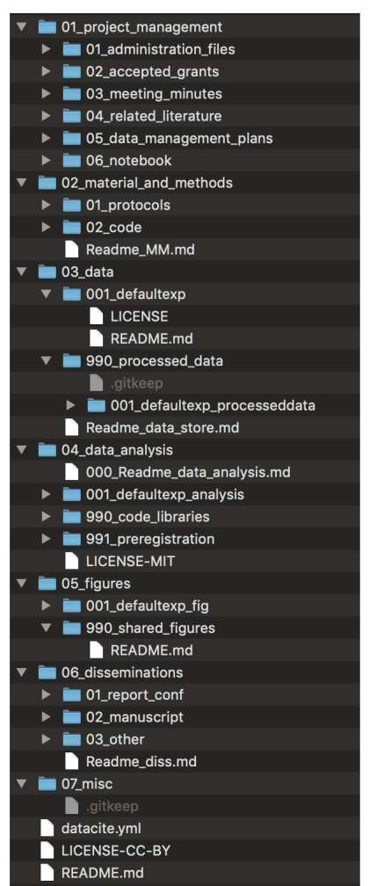
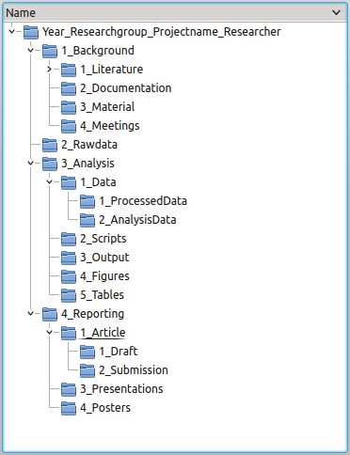
Plan Folder hierarchy: examples
README.txt (project context)
Literature
Data
README.txt (data structure)
01_raw
02_processed
03_analysed (figures and tables)
04_external
Reports
01_draft
02_submission
Meetings
Scripts

Slide 27
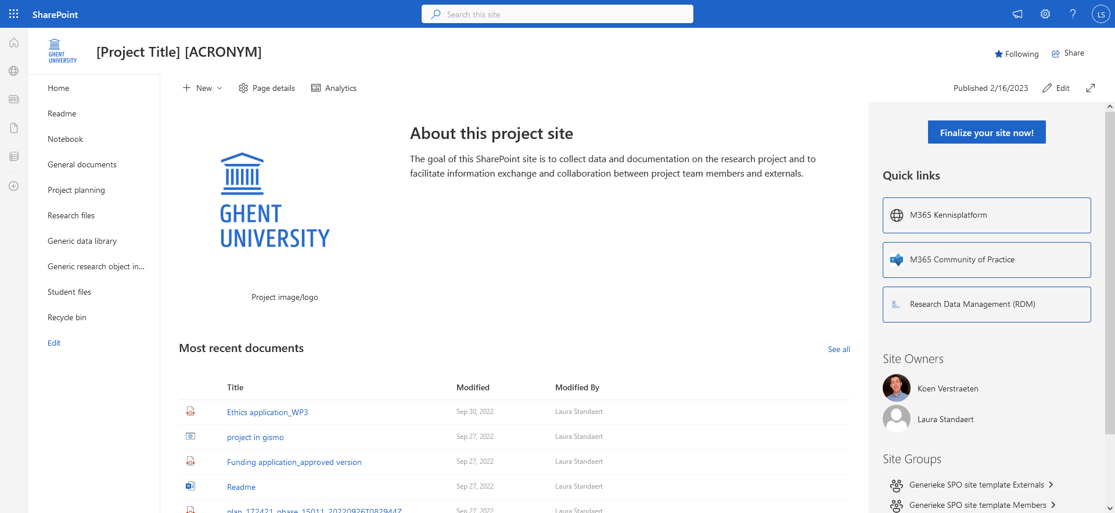
Sharepoint template: Research Data Management workspace
Designed for a research project, as a workspace for research data management
Storage organized in libraries and lists
No Teams attached
Notes:
Introduced yesterday in S4 (Storage and security)

Slide 28
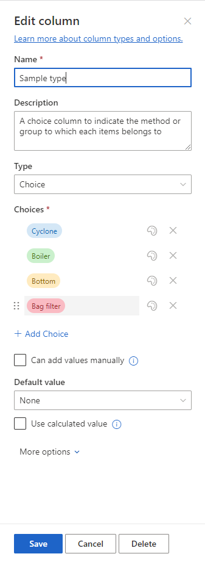
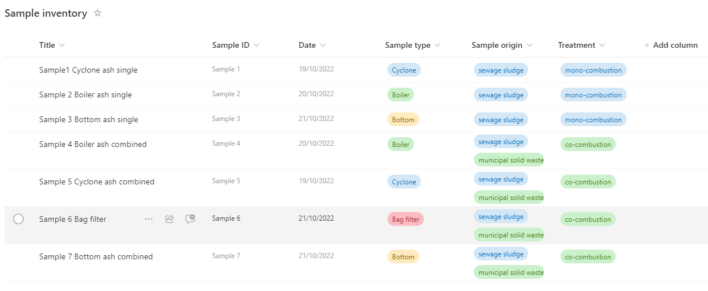
Metadata in sharepoint
Example: Nutrient Recycle RDM workspace
Notes:
Metadata provides structured information about your data files, enabling better organization, discoverability, and usability within the SharePoint environment.
To find and track data & files, filtering and sorting
Nutrient Recycle RDM Workspace:
To demonstrate how SharePoint is used effectively in managing data inventories.
It shows custom metadata fields tailored to project needs.

Slide 29

Folder structure vs. metadata
FOLDERS
METADATA
Condition
Treatment
Condition
Treatment
In vitro
Compound 357
01_raw
01_invitro_viability
comp357
In vitro
Compound 9001
In vivo, In vitro
Compound 357
comp9001
In vivo
Compound 357
02_invivo_viability
In vivo
Compound 9001
Examples:
Folder hierarchy on project share
Library and subfolders on SharePoint site
Examples:
Library on SharePoint site
List on SharePoint site

Slide 30
File organisation and documentation
FOLDERS
METADATA
Location
Time
Location
Time
Belgium
2022
01_raw
01_belgium
2022
Belgium
2023
Belgium, Spain
2023
2023
Spain
2022
Spain
2023
02_spain
Examples:
Folder hierarchy on project share
Library and subfolders on SharePoint site
Examples:
Library on SharePoint site
List on SharePoint site
Notes:
Folder structure:
Hierarchical organization: Data is stored in nested folders based on attributes (e.g. condition, treatment, or other criteria).
Static structure: The arrangement is fixed; finding data often requires knowing the folder hierarchy.
Metadata:
Dynamic labelling: Information about the files is tagged rather than embedded in the structure.
Searchable and flexible: Allows filtering and querying files across categories without navigating through folders.
Supports overlaps: One file can have multiple tags (e.g., a file tagged with both “Belgium" and “Spain").
Key differences:
Flexibility: Metadata allows for multiple classifications per file, unlike the rigid single-path folder structure.
Scalability: Metadata can easily scale with large datasets; folder structures become cumbersome.
Search & filtering: Metadata enables advanced search and filtering across multiple parameters.
SharePoint allows you to combine both approaches (for optimal data management), using libraries to organize and tag files effectively. E.g.:
Use folders for broad, high-level organization (e.g., separating projects or major categories).
Use metadata for detailed and flexible labelling, enabling efficient search, filtering, and cross-referencing.

Slide 31
Version control

Slide 32
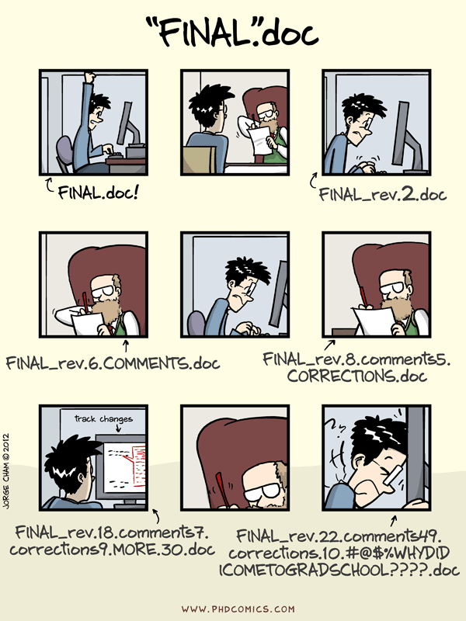
Version control
Notes:
The comic reflects the frustration of managing multiple revisions without a proper versioning strategy.
Common issues:
Confusion over which file is the most recent or accurate.
Overwriting or losing earlier versions.
Difficulty collaborating when changes are not tracked systematically.

Slide 33
Version control
HOW
When writing a paper
Track changes
Office or Sharepoint history
Understandable, systematic file names
When describing methods
Protocol in word (see above)
Analysis scripts in git or similar
When processing/analyzing data
Git or similar
Understandable, systematic file names
When publishing/reporting data
Unique and persistent identifiers
Documented and stable version numbers in data repository or git
WHAT
continuously making records of data and files as you work on them
WHY
to locate correct version
to track history (what, when, who, why)
to review changes
to avoid data loss
Notes:
What
Continuously making records of data and files as you work on them.
Why
To locate the correct version of a file.
To track the history of changes (what, when, who, why).
To review changes made over time.
To avoid data loss.
How
When writing a paper:
Use Track Changes in Word or equivalent tools.
Use Office or SharePoint version history.
Adopt clear, systematic file naming conventions.
When describing methods:
If you write protocols in Word, use versioning features described above.
Use Git or similar tools for analysis scripts.
When processing/analyzing data:
Use Git or other version control tools.
Ensure file names are clear and systematic.
When publishing/reporting data:
Assign unique and persistent identifiers (e.g., DOIs).
Use stable version numbers in data repositories or Git to ensure reproducibility.
Key takeaway
Implementing version control is essential for managing changes, improving collaboration, and ensuring data integrity throughout the research lifecycle.

Slide 34
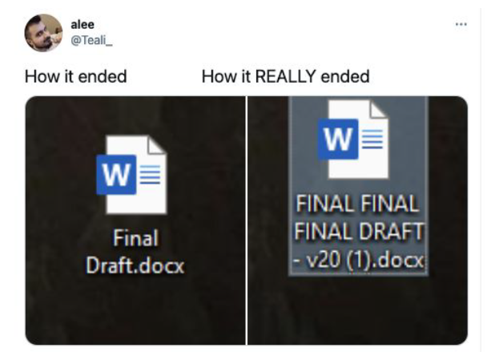
Version control – strategies
Manual change log
Automatic change log (tools, software, platforms)

Slide 35
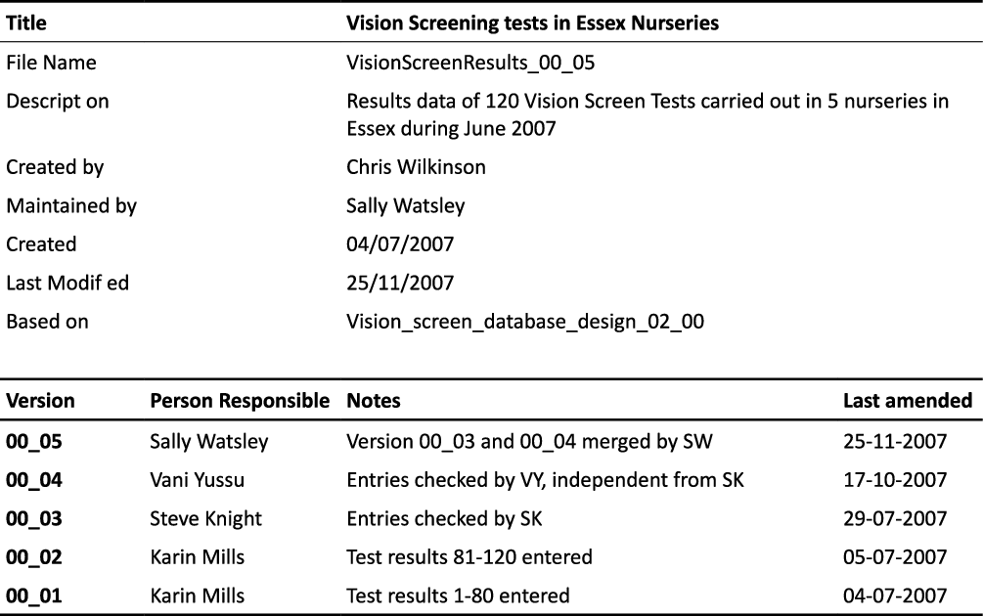
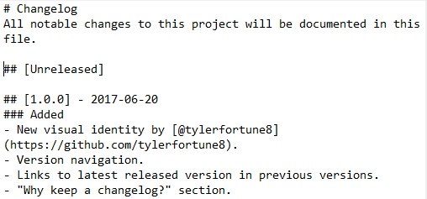
Manual change logs
Record versions, dates, authors and details of changes to ﬁles
1. File name:
based on date: HealthTest_20080406.docx
based on version number: HealthTest_v02.docx
3. Version control table within document
2. File header
https://keepachangelog.com/en/1.0.0/

Slide 36





AUTOMATIC CHANGE LOGS
Version control can also be maintained through:
Version control functionality within software (e.g. MS Ofﬁce)
Cloud storage with version control (e.g. OneDrive, Sharepoint)
Special purpose platforms (e.g. Open Science Framework)
Version control software (e.g. Git and Github)

Slide 37
Version control – best practices
When possible, use platforms with automatic change logs
If not,
identify milestone versions of ﬁles to keep.
avoid clutter
use a systematic naming convention
record version and status (e.g. raw, cleaned) of a data ﬁle
When collaborating
use a common ‘workspace’ (e.g. shared folder) to avoid different versions of ﬁles on different locations
do not use e-mail to share data

Slide 38
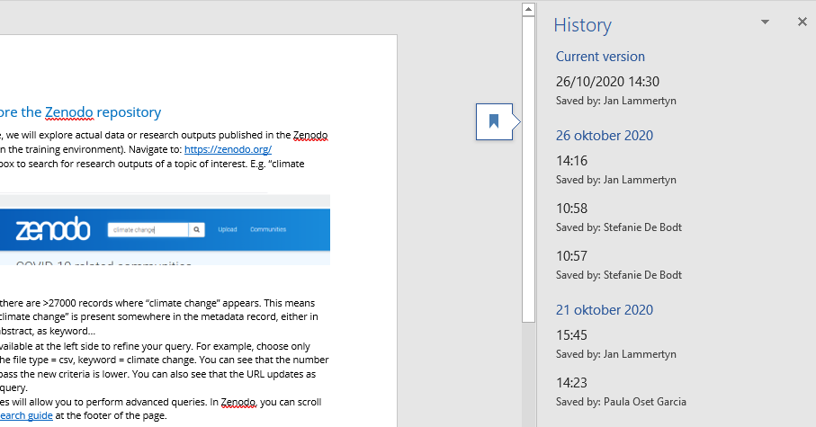
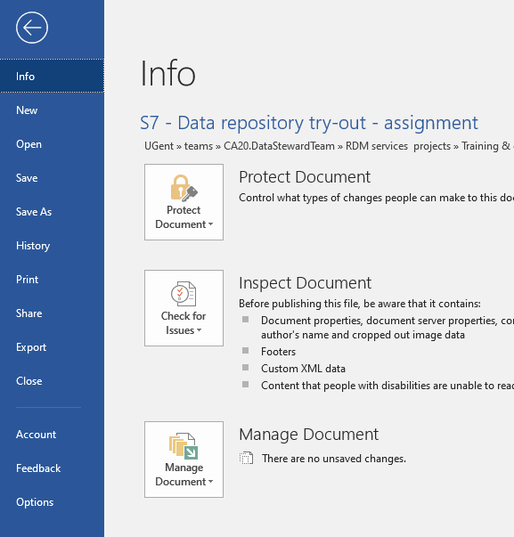
Version control in M365 (sharepoint / onedrive)
Learn more: View previous versions of Office files

Slide 39
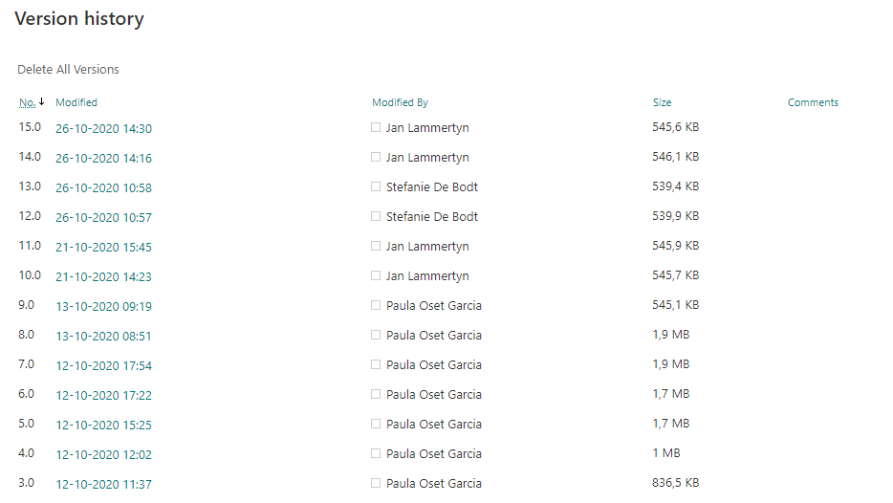
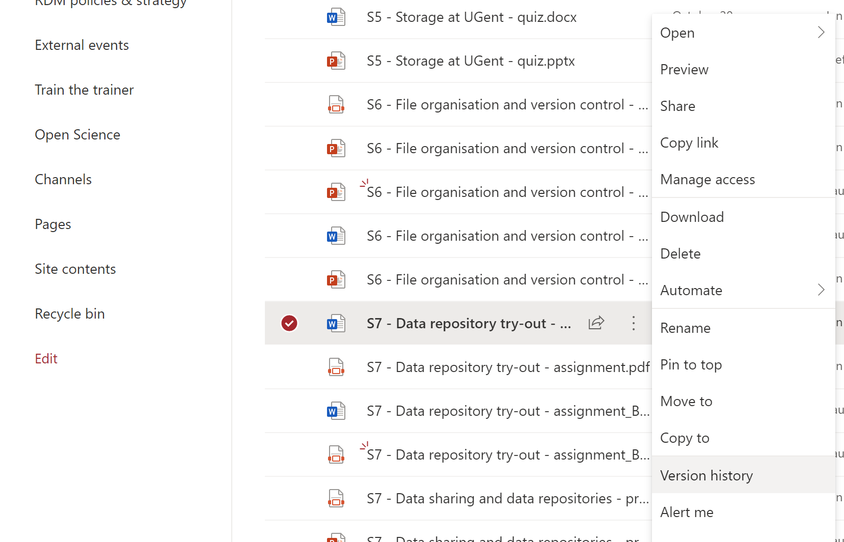
Cloud storage with version control
Do not use version numbers in file names
Learn more: How versioning works in Sharepoint lists and libraries

Slide 40
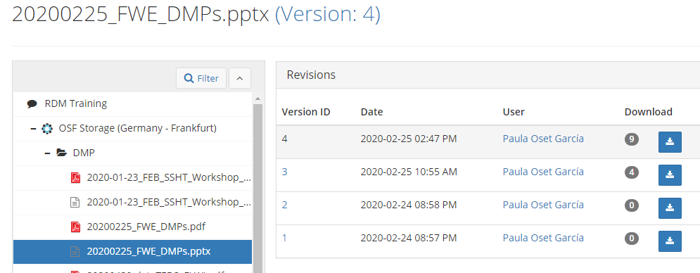
Version control in OSF (ugent supported platform)
Learn more: How versioning works in Sharepoint lists and libraries

Slide 41
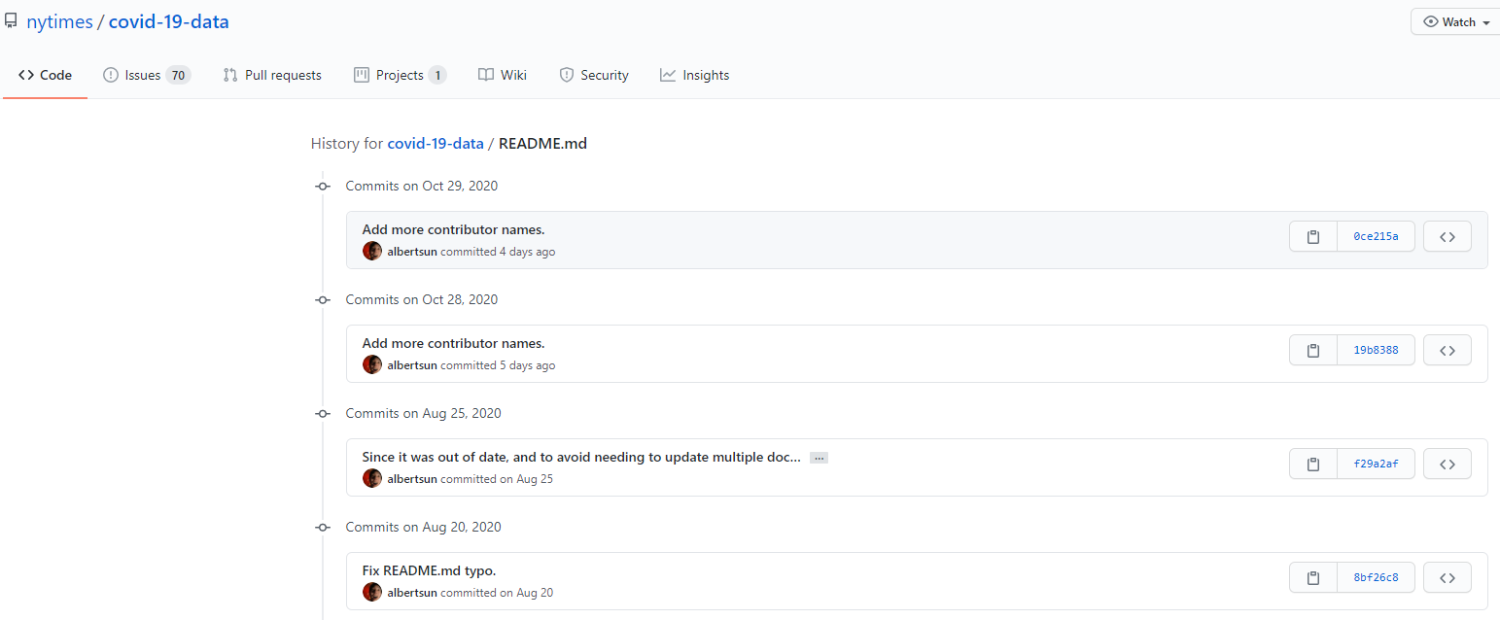
Version control in github
Learn more: Version control with Git (course), by the Software carpentries

Slide 42
Summary

Slide 43
Take-home messages
Organization is a key aspect of data management
Keep the project on track by saving time and storage, and prevent data loss
Plan!
Create* a folder structure, decide on file naming, think about versioning and document what you decided
*or apply an approach decided by your department

Slide 44
EXERCISE

Slide 45
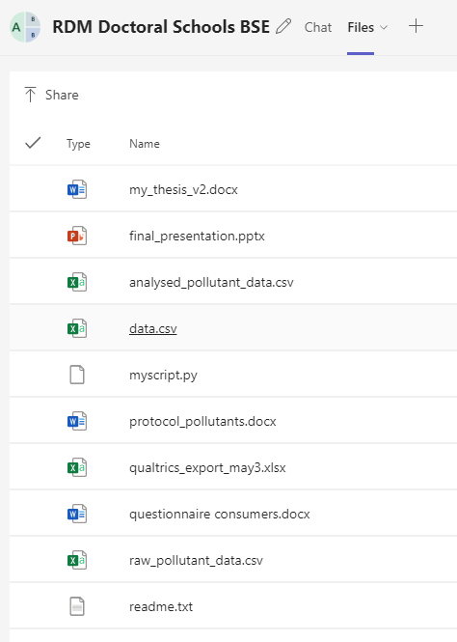
Organize sewage sludge files in folders
Download files
Create a folder with your name: SURNAME_NAME within the corresponding library in the OneDrive site
Revise file names and improve if necessary
Develop folder hierarchy and organize files in folders
Files can be found via the Filesender link

Slide 46
TIPS FOR EXERCISE

Slide 47
File naming and organization
Part A. Defining your organizational needs
Preferably at the start of the project but it is never too late.
Reflect on current approach to organize (folder structure) and name files. Who are you designing the system for?
Part B. Creating a file naming schema
Part C. Creating a systematic file folder hierarchy

Slide 48
Creating a file naming schema
File name
Principal identiﬁer of ﬁle, used to uniquely identify a file
Should let you know what the content of the file is
Should be made of a few descriptive elements & keywords
What do you include?
[ ? ]_[ ? ]_[ ? ].xlsx
What keywords, elements or unique characteristics would be best to reflect the content of your file?

Slide 49
Creating a file naming schema
Concatenate relevant elements to create a file naming schema.
Think about which order do you want them sorted in your folder?
[ ? ]_[ ? ]_[ ? ].jpeg
MTT_COMP357_WT_20190415_IMG0001.jpeg
20190415_IMG0001_ MTT_COMP357_WT.jpeg

Slide 50
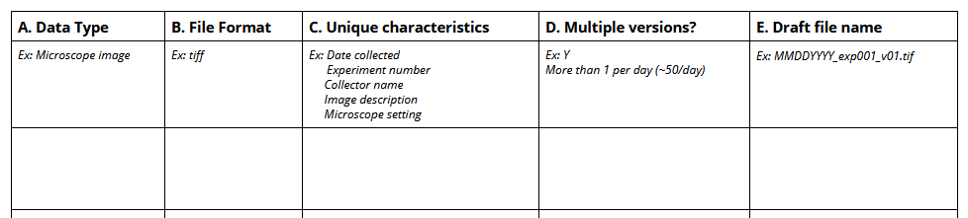
Creating a file naming schema

Slide 51
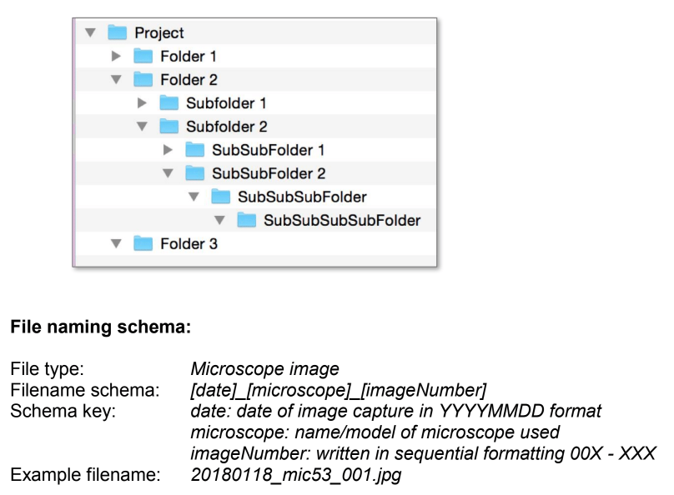
document the file organization system
File naming convention: create a high-level inventory table for the different data types (DMP)
Folder hierarchy: describe reasoning and give examples
Version control: manual or automatic, if manual how?

Slide 52


File naming: examples
FG1_CONS_20150309.rtf
Interview transcript of the ﬁrst focus group with consumers, on 2015-03-09
GC-MS1_20180912_POLY03.ms
Polymer 3 measured on GC-MS machine 1 on the September 12 2018​
FMHSurvey_Procedures_04.docx
Version 4 of the survey procedures for the Flemish Mental Health survey​
Health & Safety Procedures1 (no extension)
Spaces, special character and no extension​
SrvMthdDraft.doc, SrvMthdFinal.doc, SrvMthdFinalV4.doc
Use consistent versioning, unable to identify the real last one​
Focus Group consumers 12+13 Feb.mp3
Spaces and special character​
mydata.txt, script.R, analysis.py
Unique?​
Notes:
Afbeelding: duim omhoog en duim omlaag

Slide 53
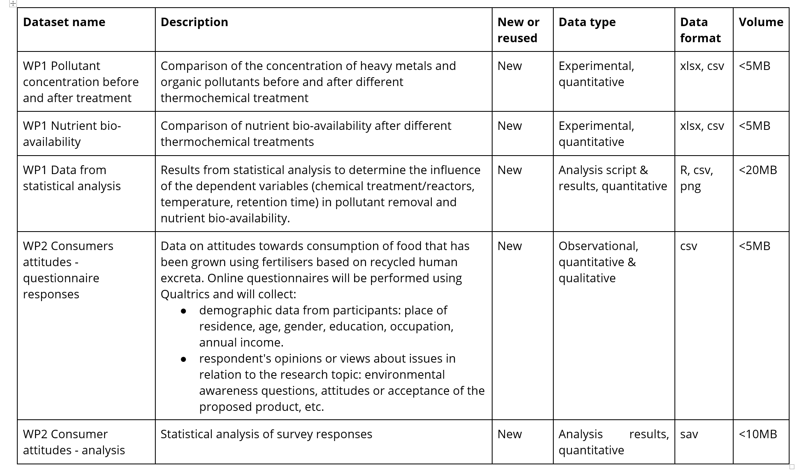
Sewage sludge project

Slide 54
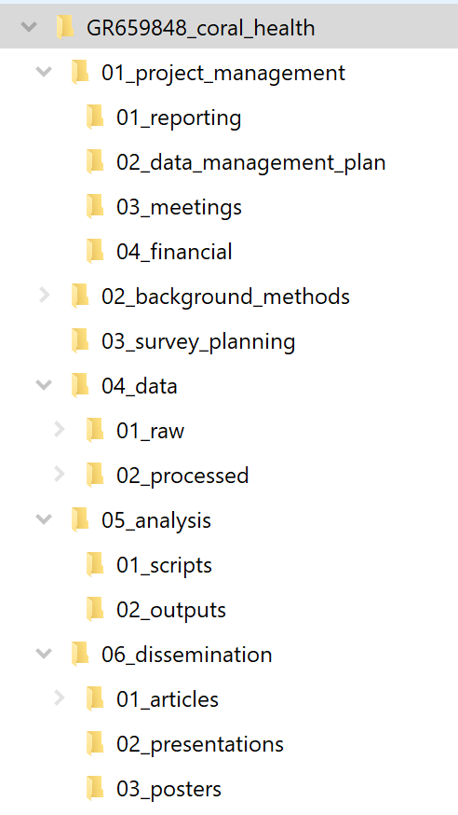
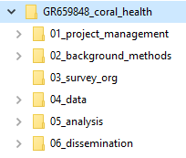
Example

Slide 55
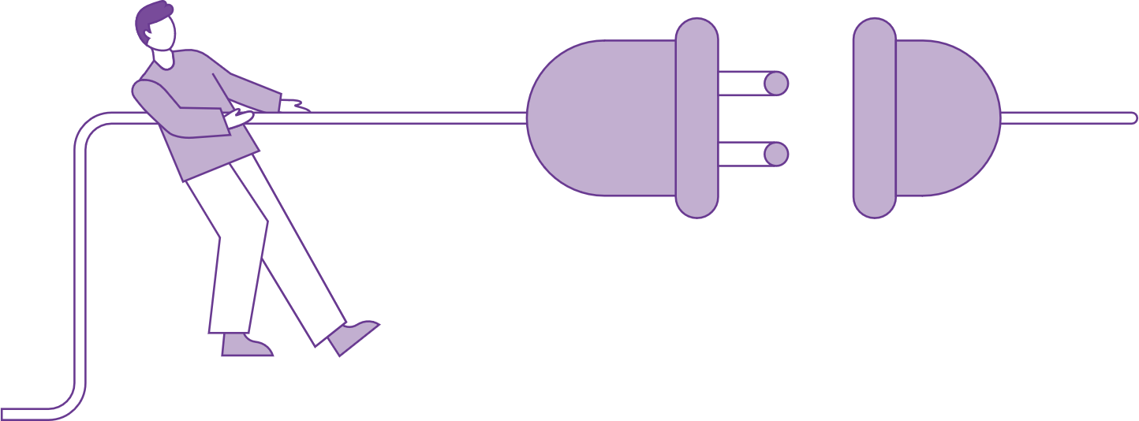
Break
Disconnect for 10 mins

