Slide 1

Introduction to Research Data Management (RDM) in Life Sciences
Session 1: Key terms and concepts
Matheus Lourenço, PhD
October 17, 2025
Notes:
Manage expectations and main objective of the training:
1- This is an introductory course
2- For you to know ahead of time necessary steps and available resources for you to turn policy into action, benefiting your research

Slide 2

Before we begin
Computers are unnecessary for discussion moments
Computers open for exercises with closed apps (teams, outlook, WhatsApp, etc)
Notes:
Ground rules

Slide 3
First things first: Who we are
Notes:
Round of introductions.
Participants must also introduce themselves: name, position, have they published before.

Slide 4
Introduction to Research Data Management (RDM) in Life Sciences
Session 1: Key terms and concepts
Session 2: DMPs
Session 3: How to choose a repository
Lunch
Session 4: Metadata
Session 5: Documentation
Session 6: Organization
Notes:
First an agenda on the day
There are always short breaks between each session (5-10mins)

Slide 5

Session 1: key terms and concepts
RDM and its lifecycle
FAIR principles
GDPR basics
Why
The RDM kit (by )
Notes:
Only three key topics in the introduction.

Slide 6
01
RDM and it’s lifecycle
Notes:
Start with “post it” exercise (encourage people to stand up and be active early): What is RDM?

Slide 7
One term at a time
Research:
The systematic investigation into and study of materials and sources in order to establish facts and reach new conclusions
Data:
Any recorded information (whether on purpose or not)
Management:
The process of dealing with or controlling things or people
Process:
A series of actions or steps taken in order to achieve a particular end
Notes:
Takeaway message: RDM is a series of actions taken to control recorded info that is used in a systematic investigation.

Slide 8
One term at a time
Research:
The systematic investigation into and study of materials and sources in order to establish facts and reach new conclusions
Data:
Any recorded information (whether on purpose or not)
Management:
The process of dealing with or controlling things or people
Process:
A series of actions or steps taken in order to achieve a particular end
Notes:
Takeaway message: RDM is a series of actions taken to control recorded info that is used in a systematic investigation.

Slide 9
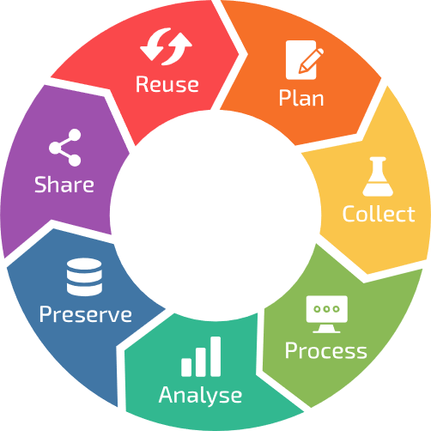
The RDM lifecycle
Where and which actions take place in each phase of the RDM cycle?
Notes:
Discussion moment: start to gather simple examples from the participants on RDM practices.
How having a lifecyle is helpful.
Link to next topic (FAIR): why would you want to do good RDM?

Slide 10
02
FAIR Principles

Slide 11




The FAIR principles

Slide 12
Findable
Metadata
keywords
identifiers
machine-actionable (SEO, etc)
Access procedure
e.g., DAC
authentication, identification
…
Accessible
Interoperable
Standards
Ontologies
For humans and machines
Re-usable
Documentation
Licence
Notes:
Quick introduction on FAIR and how it can manifest with the side examples (which will be tackled during the day).

Slide 13
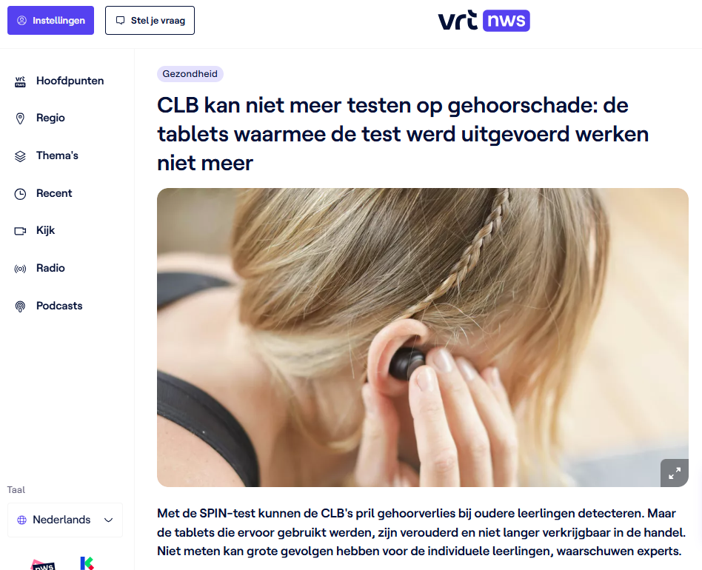
Real world consequences
Summary: Flemish students are temporarily no longer being tested for hearing damage because the tablets used for the SPIN-test (Speech In Noise) have become outdated and are no longer available. This interruption may lead to missed early detection of hearing loss, with potential long-term consequences for students' academic performance and future opportunities.
What missing FAIR principle is illustrated by this story?
Notes:
Discussion moment.
Question for the audience: When do you think this happened? (Answer: reported on Sept 12, 2025). Highlight recency and impact.

Slide 14
Summary
All the actions that you take to control your data throughout its lifecycle to ensure that they are FAIR.

Slide 15
03
GDPR basics

Slide 16
What is personal data?
Personal data is any data (i.e. any recorded information) about a person that you can identify, either directly or indirectly (https://gdpr-info.eu/art-4-gdpr/)
Notes:
Discussion moment then definition.

Slide 17

Notes:
Ground rules

Slide 18
Guess who!
ID | Age | Profession | Gender | Instagram followers (millions)
HHF73KK02051985M | 40 | Athlete | Not disclosed | 600-700
JKF34KK05021972M | 53 | Actor | Male | 200-600
IIL37IK09171950M | NA | Politician | Not disclosed | 90+
Certain data points can become identifying when they are unique or rare, specially when combined with other data sources. Think of rare diseases, specific job titles like “CEO of a Fortune 500 company”, unusual combinations of hobbies and locations, or publication records in niche academic fields.
Notes:
Exercise. Key message: some data might be personal pending their uniqueness/universe. Attention is important. Some data might not be as anonymous as you think (see ID and link it to the idea that any ID number is by definition an identifier if a key exists: more on this in the next slide).
AI warning: ask who used AI to find the answer. How fast it can merge and combine data sources.

Slide 19
Notes:
Ground rules

Slide 20
Pseudonymized and Anonymized data
Pseudonymized personal data that has been altered so that it cannot be linked to a specific person without additional information (i.e. key).
Only when personal data had been irreversibly changed or removed in a manner that no one can identify the person it belongs to, the data can be considered anonymized.
Notes:
Pseudonymized data is still considered personal data under the GDPR.
Here are a few practical examples on data anonymization:
Removing names, ID numbers, and contact details.
Removing or generalizing dates (e.g. replace exact birthdate with age range).
Removing location data or replacing it with broad regions (e.g. Flanders instead of Gent).
Small groups are merged to avoid singling out individuals.
Truly anonymized data is not considered personal data and therefore, is not subject to the GDPR.
Link to following slide: Special category data must be pseudonymized before being used.

Slide 21
Special category data
Within personal data exists special categories of data. These types of personal data can expose individuals to significant risks, such as discrimination, identity theft, privacy invasion, and social or economic harm. The special categories of personal data refer to:
Racial or ethnic origin
Political opinions
Religious/philosophical beliefs
Trade union membership
Genetic data
Biometric data
Health data
Sex life or sexual orientation
Notes:
What is specially important for us at VIB/UGent in life sciences? (Genetic/health data).

Slide 22
So what is sensitive data?
Notes:
Discussion moment. Sesntive data is not defined in the GDPR and widely used to fere to personal and/or special category data (and more, such as financial data, cvs, etc). Be sure to clarify with who you are talking to.

Slide 23
The GDPR - General Data Protection Regulation
As technology advanced, more and more personal and special category data was being collected, shared, and stored, often without clear rules or protections.
To ensure that EU data is protected, even when it’s processed outside the EU.
It gives people more control over their data and sets clear responsibilities for organizations that use it.
Notes:
As we’ve seen so far, data is any recorded information. Some data can be used to identify a person (personal data), and some types of data, like health or genetic information, can even be used to harm or discriminate against someone (special category data).

Slide 24
The DPO
The Data Protection Officer (DPO) is a role within organizations that help interpret and apply the GDPR into companies and institutes. They are the experts and go to person for any questions, breaches, etc.
Contact: dpo@vib.be

Slide 25
04
Why

Slide 26
Carrot or stick?
Notes:
Reasons to be FAIR and to proper GDPR.
For the next slides let’s think about benefits and negative consequences.

Slide 27
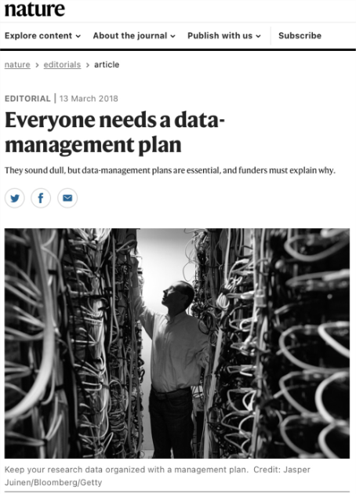
Essential
For funders (i.e. DMP, open, data, etc)
For journals: No data, no paper

Slide 28
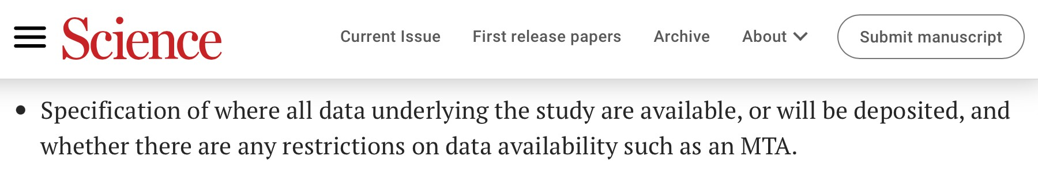
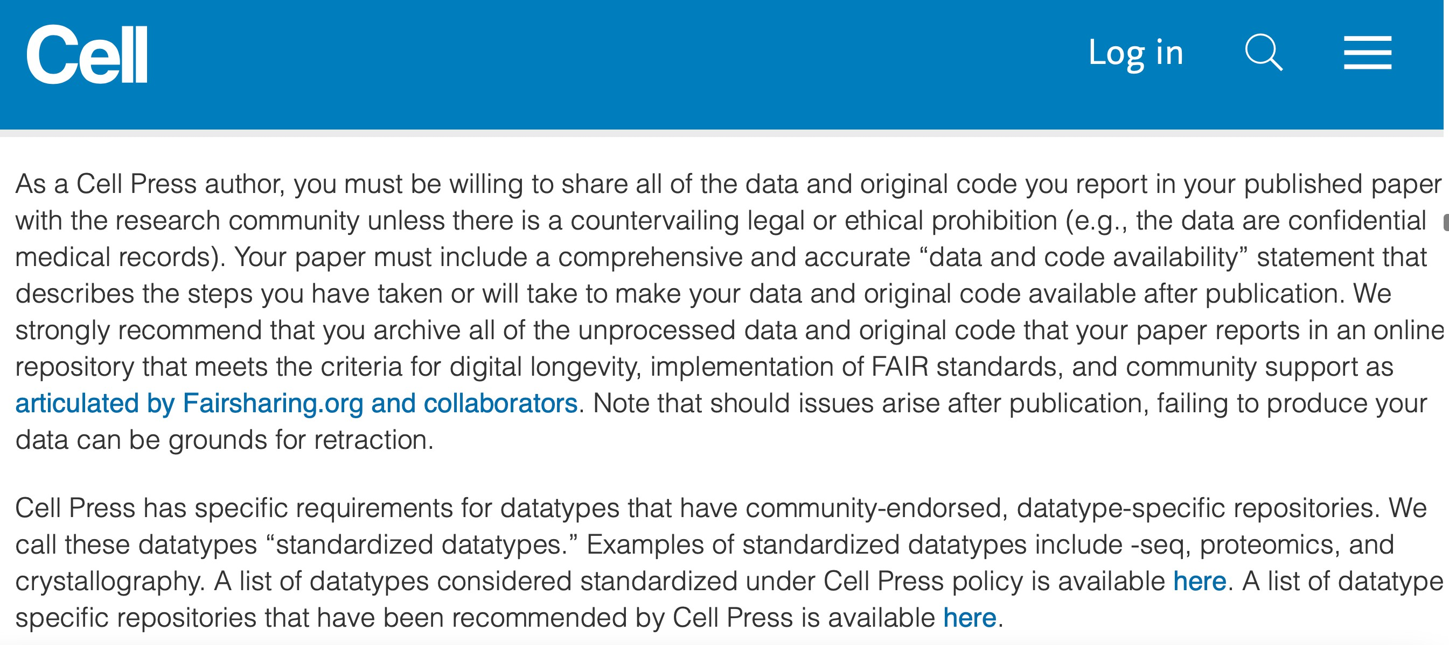
Journals request FAIR data
https://www.science.org/content/page/science-information-authors
https://www.cell.com/cell/authors

Slide 29
Some benefits
Reduce the risk of data loss​
Less time (and money) spent​
Increase efficiency and smooth collaboration in a team (easier and faster way for sharing information)​
More control over data access (who, when, how, etc.)​
More clear documentation for people onboarding the team and by
people leave the team​
Easier data reuse (samples, raw data, scripts, analysis etc.)​
Notes:
Discussion moment: have you ever thought ‘what did I do with that data?’

Slide 30
Other benefits
Transparent and trustworthy data and science (and paper)
Higher impact in scientific community
More citations​
New discoveries at a lower cost by reusing high quality existing data​
Less duplication of work​
Notes:
Discussion moment: have you ever thought ‘what did I do with that data?’

Slide 31
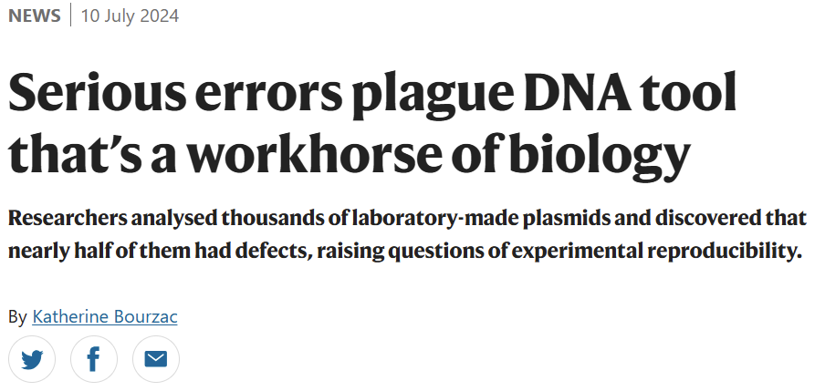
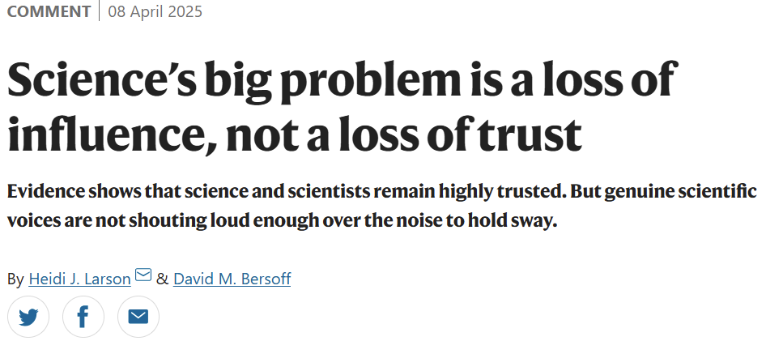
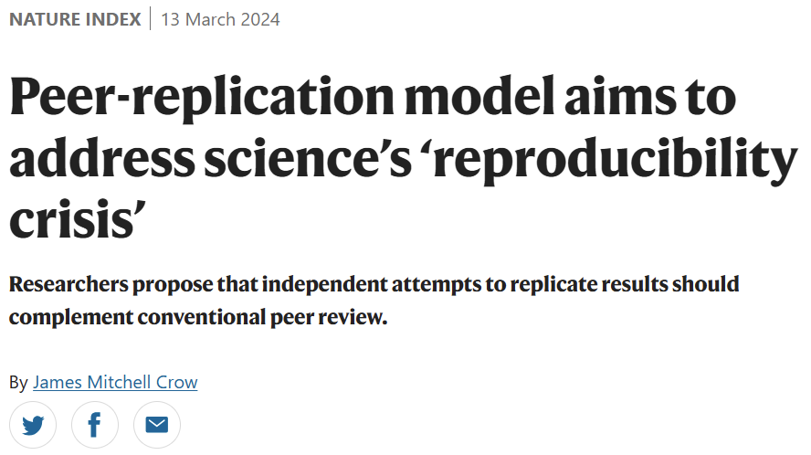
Scientific Integrity
Why are you in science?
What about the reproducibility crisis?
Strengthen public trust through communication.

Slide 32
Experiment replicability

Slide 33
Carrot or stick?
Notes:
Reflection: identification of participants as VIB researchers (high standards expected)

Slide 34
Notes:
Ground rules

Slide 35

Key Resource
https://rdmkit.elixir-europe.org/
Notes:
Let’s explore the RDMkit!
1- by role
2- resource list
3- lyfecycle

Slide 36
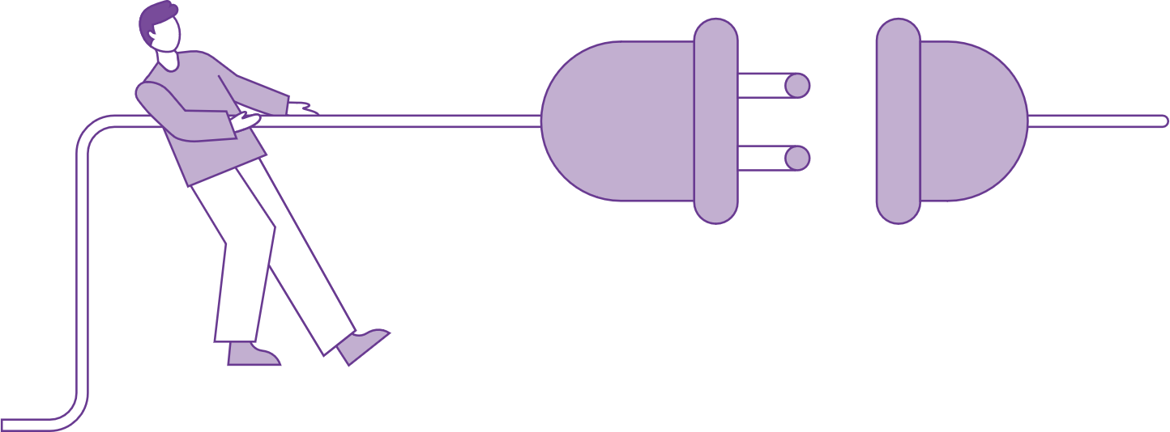
Break
Disconnect for 10 mins

Slide 37
Matheus Lourenço
Matheus.lourenco@vib.be

