Slide 1
Data management planning for efficient research
Niels Geudens, PhD – Data Steward at VIB

Slide 2
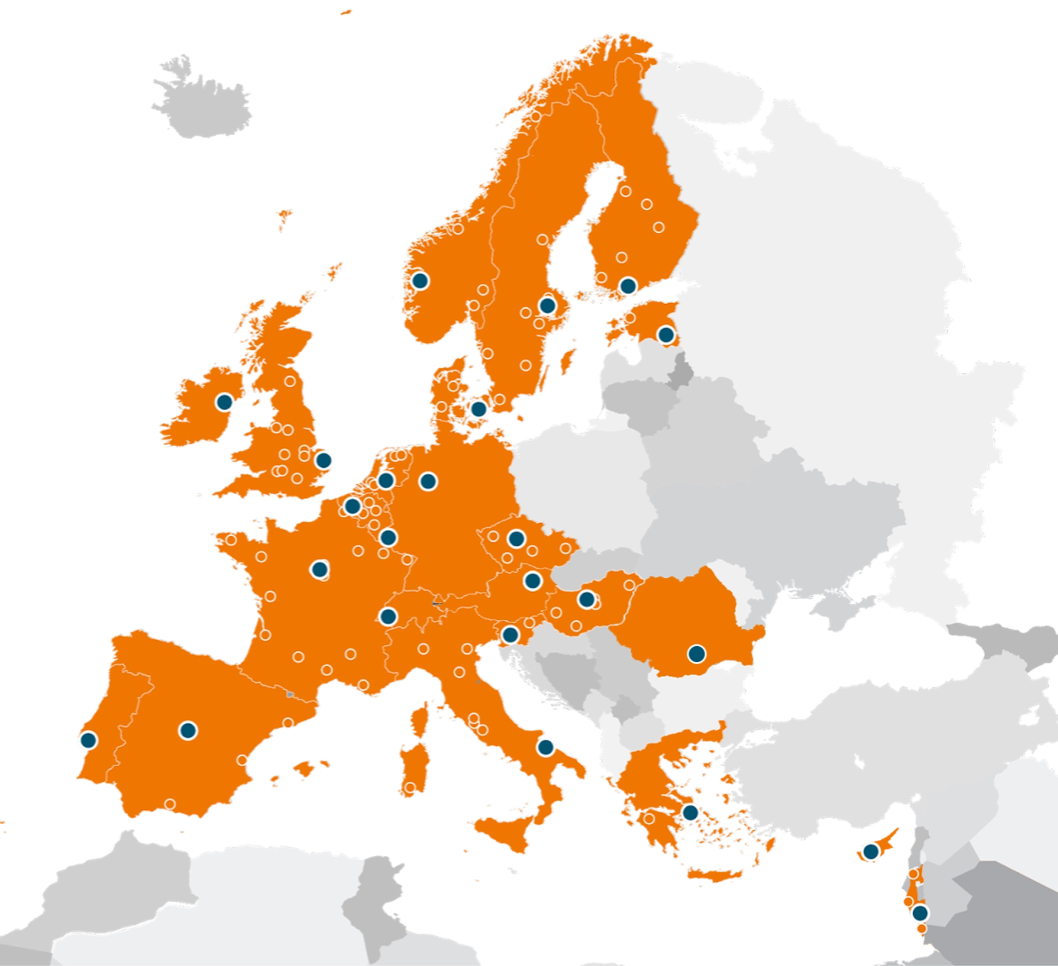
ELIXIR Europe and Elixir Belgium
Europe’s distributed infrastructure for life-science data.
Connects national nodes + EMBL-EBI to make data, tools, training, and compute Findable, Accessible, Interoperable, Reusable (FAIR).
Focus areas include data deposition, standards/metadata, cloud/compute, interoperability, and training.
The Belgian node coordinated by VIB with partners across Flemish and French-speaking universities & institutes.

Slide 3
Research Data Management (RDM)
RDM involves planning, collecting, documenting, storing, sharing, and preserving research data throughout its lifecycle.
RDM practices promote reproducibility of research and facilitate collaboration among scientists.
RDM starts before data collection and continues after project completion, ensuring ongoing data integrity.

Slide 4
DMPs help make RDM tangible
DMPs make research data management less abstract by making you think about all aspects related to your data
Questions about:
the description of data and their associated explanatory metadata;
the storage and long-term preservation of the data;
the designation of responsible persons;
the indication of costs involved;
the handling of sensitive data;
the open access to and sharing of research data.
Aligning plans with FAIR principles maximizes data findability, accessibility, interoperability, and reuse.
Starting the data management plan early improves planning and resource allocation throughout the project.​

Slide 5
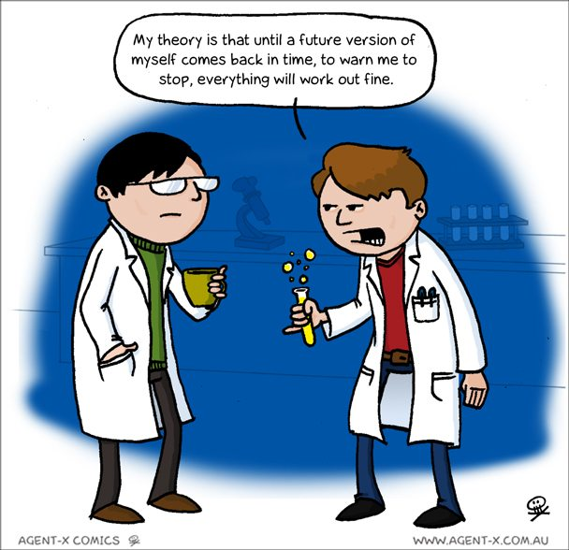
Without planning…
Teams/labs often lose data when researchers leave
Working with data from collaborators can be problematic
There often is no budget allocated to maintaining data(bases) beyond a project’s end
Gaining consent for archiving and sharing data is often forgotten
…
DMPs take some time & effort upfront but can save you headaches later on!

Slide 6


DMP funder policies
Typically, the requirement of having a DMP originates from the funding body
Host institution can impose additional requirements e.g., mid-term version of DMP.
Funder | Proposal | Initial DMP (month 6) | Final DMP (end of project)
FWO | Answer 6 RDM questions
EOS | Answer 6 RDM questions
BOF/IOF
BELSPO | Provisional DMP
Horizon Europe | RDM for FAIR data and Open Science practices
H2020 | RDM for FAIR data

Slide 7
Lifecycle of DMPs
Proposal Stage Input​
Researchers answer preliminary data management questions to outline initial data handling plans. This helps funders assess project feasibility and responsibility.​
Initial DMP Submission​
Within six months, researchers submit detailed plans covering data types, formats, storage, metadata, and ethical compliance such as GDPR.​
Mid-Term Updates​
DMP is updated to reflect changes in data collection, collaborations, or sharing strategies, keeping the plan responsive and current.​
Final DMP Submission​
At project end, a final DMP confirms data management, preservation, and accessibility, ensuring long-term stewardship and open science compliance.​

Slide 8
DMP: first version
Data Management Plan First submission
First scope of reusability.
Basic information about your data.
Data storage and back up vs. long term preservation.
Initial idea about metadata standards and dedicated archive / repository.
Identification of legal and/or ethical issues.
Establishing responsibilities.
Adapted from: Jasmin Böhmer. (2019, September). UBC RDM Workshop 1 - Data Management Planning (Version V2). Zenodo. http://doi.org/10.5281/zenodo.3469953

Slide 9
DMP: first version vs. last version
Data Management Plan First submission
Data Management Plan Final submission
First scope of reusability.
Basic information about your data.
Data storage and back up vs. long term preservation.
Initial idea about metadata standards and dedicated archive / repository.
Identification of legal and/or ethical issues.
Establishing responsibilities.
Definite selection of reusable outputs.
Precise description of all data types.
Clear long-term preservation strategy: selected data archive(s) and/or repository(ies).
FAIR data and open data (“As open as possible, as closed as necessary”).
Adapted from: Jasmin Böhmer. (2019, September). UBC RDM Workshop 1 - Data Management Planning (Version V2). Zenodo. http://doi.org/10.5281/zenodo.3469953

Slide 10


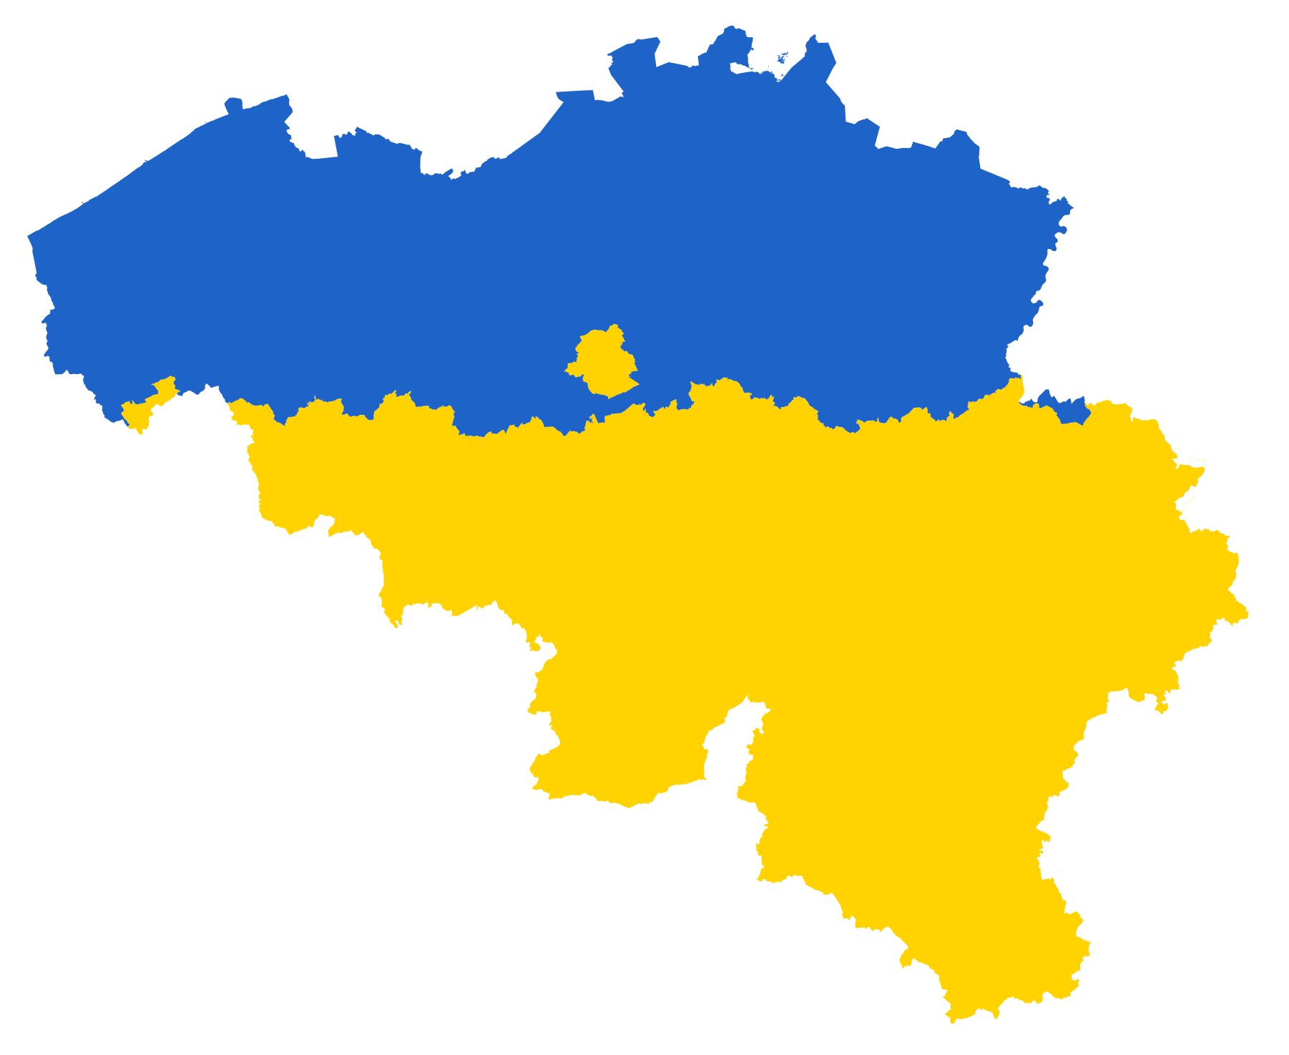


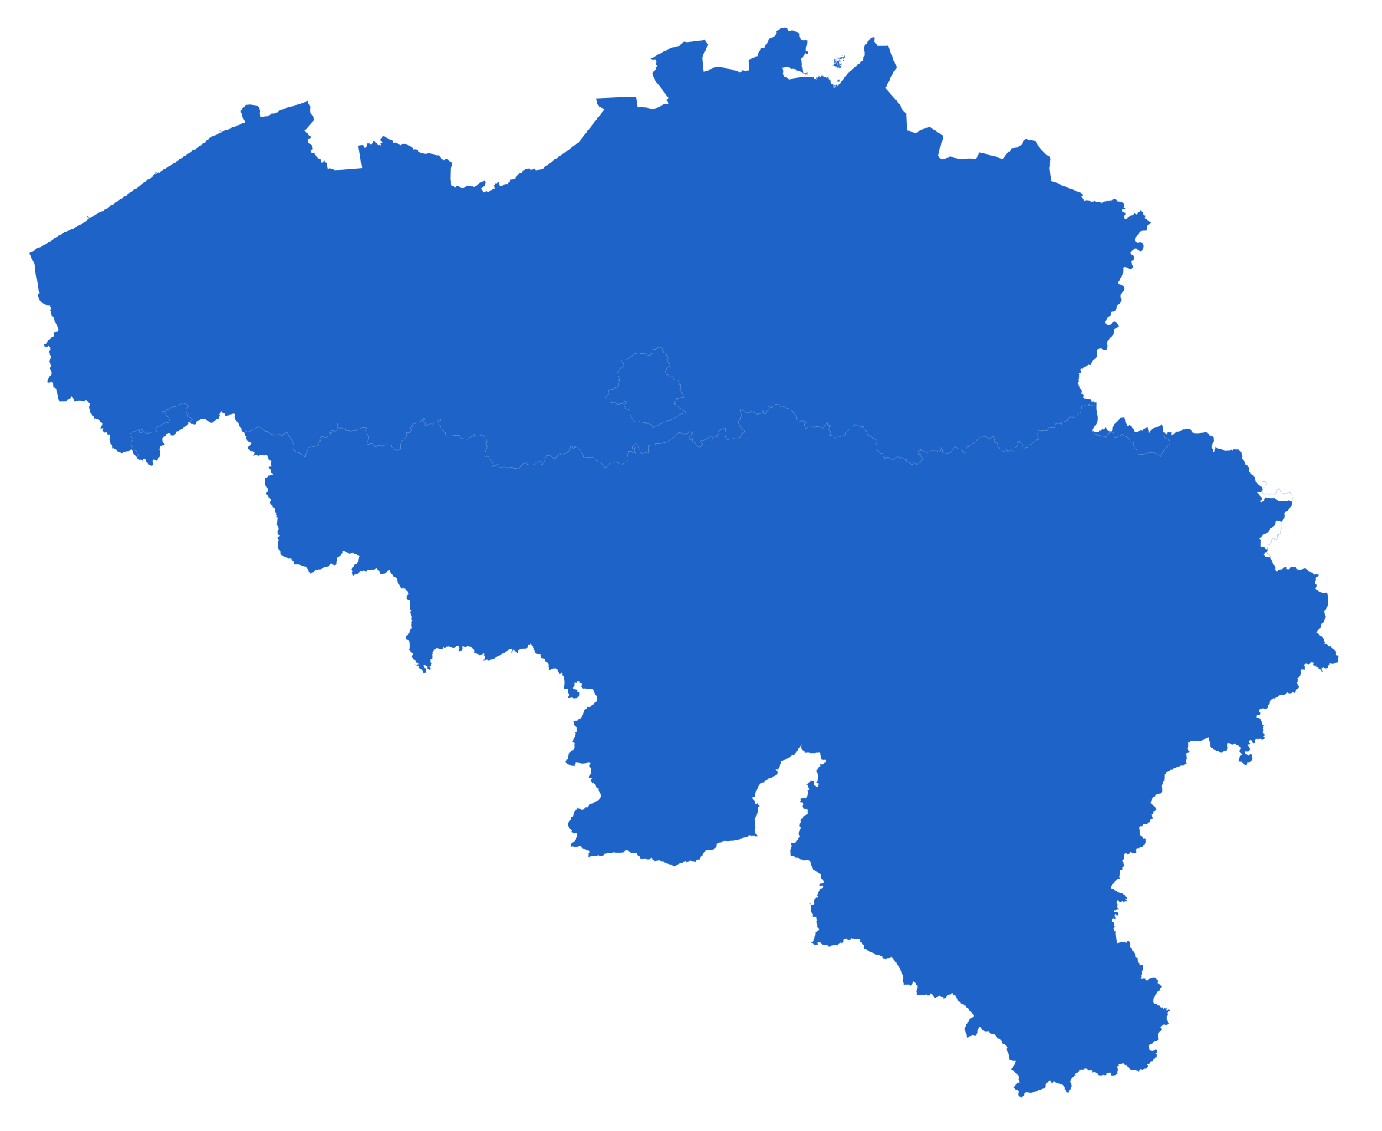
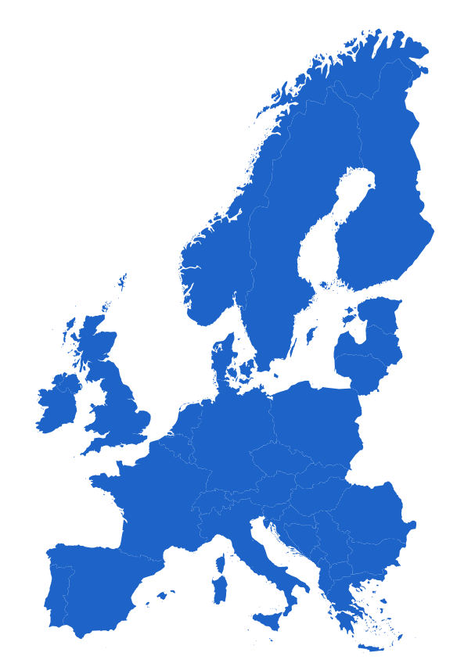
Submitting a dmp: WHEN & HOW
Project lifetime
Proposal stage
Post-award
Updated versions of the DMP
Light DMP
Month 6
Final DMP
FWO
FWO e-loket
BOF/IOF
GISMO
dmp.admin@ugent.be
VLAIO cSBO
VLAIO e-portal
BELSPO
BELSPO programme administrator
* Project DMP
BELSPO programme administrator
HEUROPE
* Project DMP
Funding & Tenders portal
Funding & Tenders portal
ERC
* ERC WP25
PhD & OTHER
dmp.admin@ugent.be
dmp.admin@ugent.be
https://onderzoektips.ugent.be/en/tips/00002193/
Notes:
Different funders have unique requirements and submission portals.
Stages of Submission
Proposal stage: Some funders (e.g., FWO, HEUROPE, ERC) require a light DMP at the proposal stage to provide a basic framework for data management.
Post-award: By Month 6, an updated DMP is typically required to reflect detailed project planning. How/where to submit depends on the funder, as can been seen in the figure below.
Project Lifetime: Final DMP submission is expected at the end of the project to document the outcomes and adherence to data management practices.
Project vs. PhD
When your PhD research is funded through a project for which a DMP exist, as a PhD student you need to submit a PhD-specific DMP which can be based on the project's DMP.
Project DMP might have to be submitted through a different venue. PhD DMP -> dmp.admin@ugent.be
The Education & Examination Code requires all PhD candidates to write a DMP and submit it no later than six months after first enrollment by sending your DMP to dmp.admin@ugent.be. PhD candidates with an FWO PhD fellowship need to upload their DMP to GISMO to comply with the FWO requirements.
Ghent University regulations stipulate that you must submit your initial DMP no later than 6 months after your first enrolment. Your funding body may also have regulations regarding research data management, so make sure to inform yourself. If you already have a DMP for your project (e.g. because your funding body requires one), you may submit that DMP instead of creating a new one. To submit your DMP, upload it in GISMO as part of your BOF/IOF, FWO or cSBO VLAIO project information. In all other cases, submit your DMP by sending it to dmp.admin@ugent.be.

Slide 11
Aspects of a DMP
Data summary / description
Ethical and legal issues
Documentation and metadata
Resources and Responsibilities
Data sharing and reuse
Data storage during the project
Long-term preservation

Slide 12
Aspects of a DMP
Data summary / description
Ethical and legal issues
Documentation and metadata
Resources and Responsibilities
Data sharing and reuse
Data storage during the project
Long-term preservation
Purpose, origin, type, format & volume of the data
List and describe all datasets or research materials that you plan to generate/collect or reuse during your research project.
If you reuse existing data, please specify the source, preferably by using a persistent identifier (e.g. DOI, Handle, URL etc.) per dataset or data type

Slide 13
Aspects of a DMP
Data summary / description
Ethical and legal issues
Documentation and metadata
Resources and Responsibilities
Data sharing and reuse
Data storage during the project
Long-term preservation
Purpose, origin, type, format & volume of the data
Take into account the diversity in data types:
Survey
Measurement
Observation
Code
Image
Document
Visualisation

Slide 14
Aspects of a DMP
Data summary / description
Ethical and legal issues
Documentation and metadata
Resources and Responsibilities
Data sharing and reuse
Data storage during the project
Long-term preservation
Purpose, origin, type, format & volume of the data
Only provide answers relating to research data, not publications!
Clear distinction between re-used and new data.
Break down and list your data types conveniently: e.g. by technique, by purpose, by research phase.
Provide enough details for outsiders to understand the sort of data involved

Slide 15
Aspects of a DMP
Data summary / description
Ethical and legal issues
Documentation and metadata
Resources and Responsibilities
Data sharing and reuse
Data storage during the project
Long-term preservation
IRB approval, IP, GDPR
Will you process personal data? If so, briefly describe the kind of personal data you will use in the comment section.
Are there any ethical issues concerning the creation and/or use of the data (e.g. experiments on humans or animals, dual use)?

Slide 16
Aspects of a DMP
Data summary / description
Ethical and legal issues
Documentation and metadata
Resources and Responsibilities
Data sharing and reuse
Data storage during the project
Long-term preservation
IRB approval, IP, GDPR
Does your work have potential for commercial valorization (e.g. tech transfer, for example spin-offs, commercial exploitation, …)?
Do existing 3rd party agreements restrict dissemination or exploitation of the data you (re)use?
Are there any other legal issues, such as intellectual property rights and ownership, to be managed related to the data you (re)use?

Slide 17
Aspects of a DMP
Data summary / description
Ethical and legal issues
Documentation and metadata
Resources and Responsibilities
Data sharing and reuse
Data storage during the project
Long-term preservation
Where and how, standards, ontologies, vocabularies
What approach will be followed to capture the accompanying information necessary to keep data understandable and usable, for yourself and others, now and in the future.
Will a metadata standard be used to make it easier to find and reuse the data?

Slide 18
Aspects of a DMP
Data summary / description
Ethical and legal issues
Documentation and metadata
Resources and Responsibilities
Data sharing and reuse
Data storage during the project
Long-term preservation
Costs
Owner and roles
Where will data be stored?
How will the data be backed up?
How will you ensure that the data are securely stored and not accessed or modified by unauthorised persons?

Slide 19
Aspects of a DMP
Data summary / description
Ethical and legal issues
Documentation and metadata
Resources and Responsibilities
Data sharing and reuse
Data storage during the project
Long-term preservation
Costs
Owner and roles
Who will manage data documentation and metadata during the research project?
Who will manage data storage and backup during the research project?
Who will manage data preservation and sharing?
Who will update and implement this DMP?

Slide 20
Aspects of a DMP
Data summary / description
Ethical and legal issues
Documentation and metadata
Resources and Responsibilities
Data sharing and reuse
Data storage during the project
Long-term preservation
Repositories, terms, contracts, licenses
Will the data (or part of the data) be made available for reuse after/during the project?
If access is restricted, please specify who will be able to access the data and under what conditions.
Are there any factors that restrict or prevent the sharing of (some of) the data (e.g. as defined in an agreement with a 3rd party, legal restrictions)?

Slide 21
Aspects of a DMP
Data summary / description
Ethical and legal issues
Documentation and metadata
Resources and Responsibilities
Data sharing and reuse
Data storage during the project
Long-term preservation
Security, back-up, transfer & access
Where will data be stored?
How will the data be backed up?
Is there sufficient storage & backup capacity during the project?
What are the expected costs for data storage & backup during the project? How will these costs be covered?
How will you ensure that the data are securely stored and not accessed or modified by unauthorised persons?

Slide 22
Aspects of a DMP
Data summary / description
Ethical and legal issues
Documentation and metadata
Resources and Responsibilities
Data sharing and reuse
Data storage during the project
Long-term preservation
What, where, restrictions?
Which data will be retained for the expected 5-year period after the end of the project? In case some data cannot be preserved, clearly state the reasons for this.
Other terms apply to Clinical trials, patient records, ‘experiments’, …
Where will these data be archived (= stored and curated for the long term)?

Slide 23
Aspects of a DMP
Data summary / description
Ethical and legal issues
Documentation and metadata
Resources and Responsibilities
Data sharing and reuse
Data storage during the project
Long-term preservation
What, where, restrictions?
Purpose, origin, type, format & volume of the data
IRB approval, IP, GDPR
Where and how, standards, ontologies, vocabularies
Costs
Repositories, terms, contracts, licenses
Security, back-up, transfer & access
Owner and roles
DMP

Slide 24
DMP tips
Be consistent throughout the document.
1
If a dataset cannot be shared, do not mention in a later paragraph that all data will be shared openly on Zenodo
If certain information is not available yet, mention when and how you will address the issue
2
Be complete for every question: mention all datatypes or outputs.
3
E.g.: For WP1 this question is not applicable, for WP 2-3 we will do this, and for WP 4-6 we will do that.

Slide 25
DMP Templates and Software

Slide 26
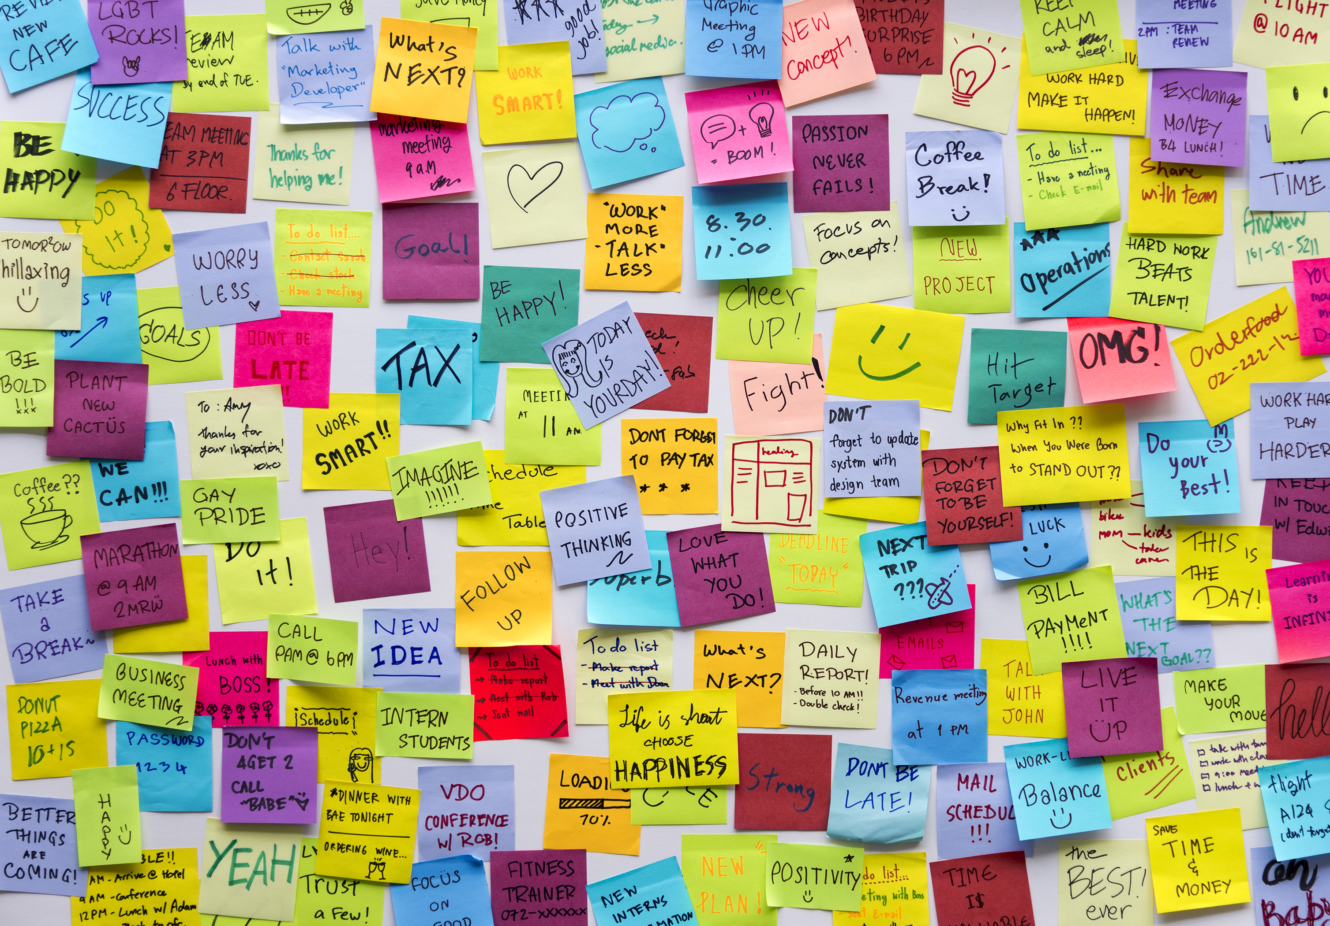
How to start creating your DMP?
Do I need to remember all this when writing a DMP?
DMPs cover many aspects — from data collection to sharing and preservation.
Luckily, you don’t need to memorize everything!
Tools like DMPonline.be and DSW guide you step-by-step.
These platforms use the FOSB template, designed for Belgian funders and institutions.

Slide 27

The FOSB DMP template
A unified approach to DMPs in Flanders
Developed by the Flemish Open Science Board (FOSB) in collaboration with Flemish universities and research organizations.
Aims to standardize DMP requirements across Belgian funders (e.g. FWO, BELSPO, VLAIO).
Based on FAIR principles and aligned with Science Europe guidelines.
https://www.frdn.be/topics/flemish-data-management-plan/
Flemish Data Management Plan (DMP) template: https://zenodo.org/records/17025558
Glossary for the Flemish DMP template: https://zenodo.org/records/16918375

Slide 28
The FOSB DMP template
A unified approach to DMPs in Flanders
Composed of the same sections we just discussed: data description, responsibilities, preservation, etc.
Each section contains specific questions to guide your thinking.
Every question includes detailed guidance: what is expected, examples, and links.
Unsure about terminology? Check the Glossary included with the template.
Available in both DMPonline.be and DSW, with similar structure.
https://www.frdn.be/topics/flemish-data-management-plan/
Flemish Data Management Plan (DMP) template: https://zenodo.org/records/17025558
Glossary for the Flemish DMP template: https://zenodo.org/records/16918375

Slide 29
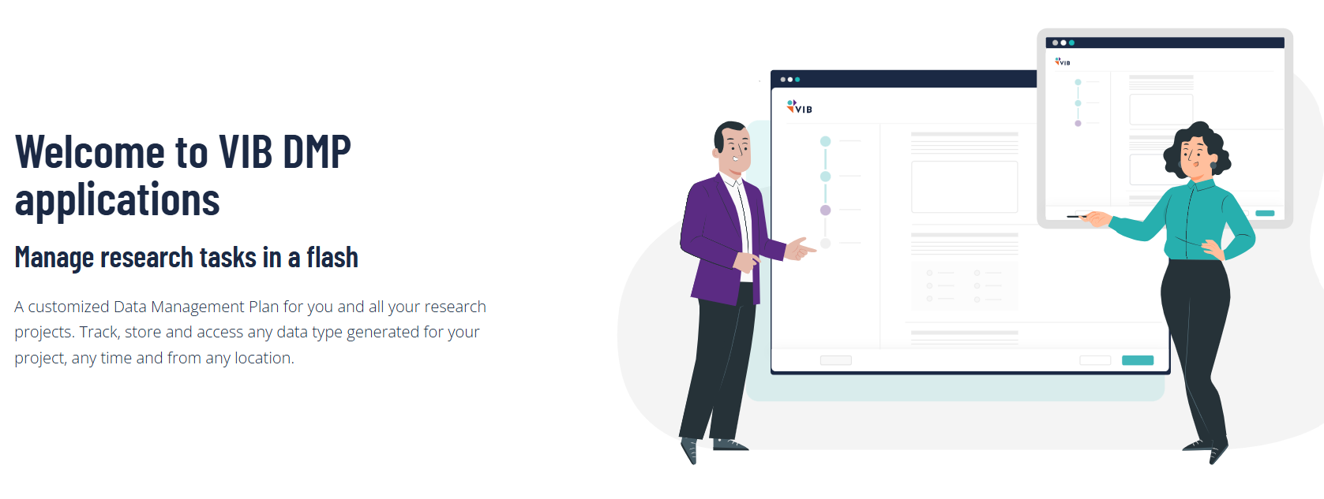
Creating DMPs at VIB
Or rather: DMPs for funders where VIB has reporting duties.
https://dmp.sites.vib.be/en
The Data Management Plan (DMP) - E-Learning@VIB

Slide 30
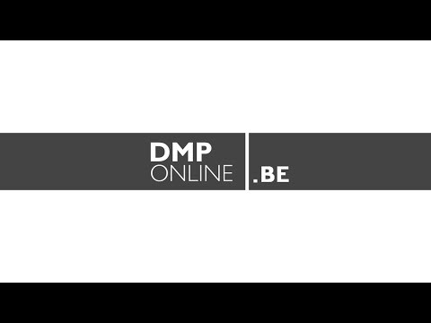
Creating DMPs at Flemish universities
Or rather: DMPs for funders where university has reporting duties.
https://www.youtube.com/watch?v=5U9_DDdBzYk
https://onderzoektips.ugent.be/en/tips/00001281/

Slide 31
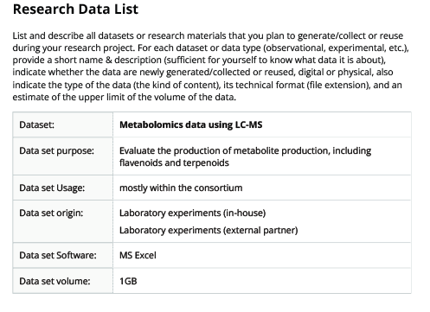
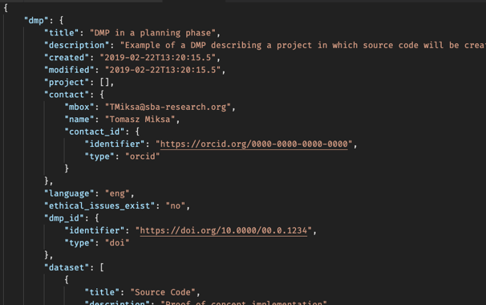
Machine-actionable DMPs?
Machine-Actionability refers to the information that is consistently structured so that machines can be programmed to handle such a structure.
DMP still need a human-readable narrative, but the DMP could have more thematic, machine-actionable information with added value for all stakeholders.
Stakeholder = everyone who is part of the larger ecosystem in which data are produced, transformed, exchanged, and reused.

Slide 32
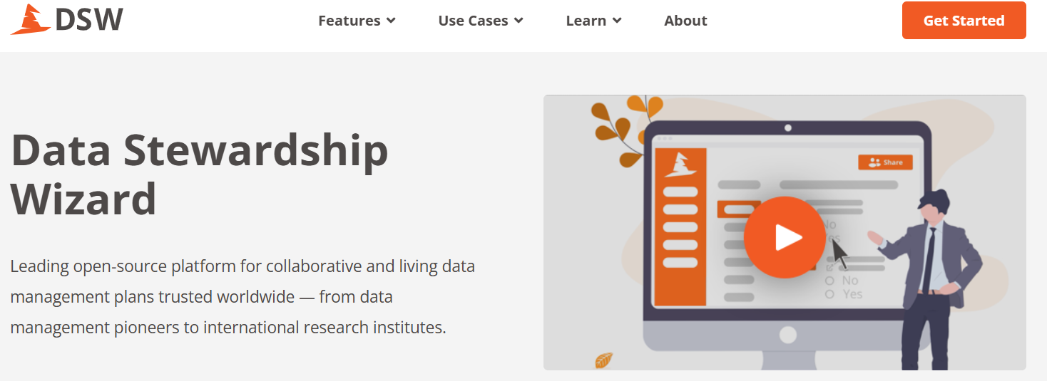
Creating DMPs at VIB ≥ 2026
VIB will change its DMP platform (and make it partly mandatory)
https://elixir-belgium.dsw.elixir-europe.org/

Slide 33
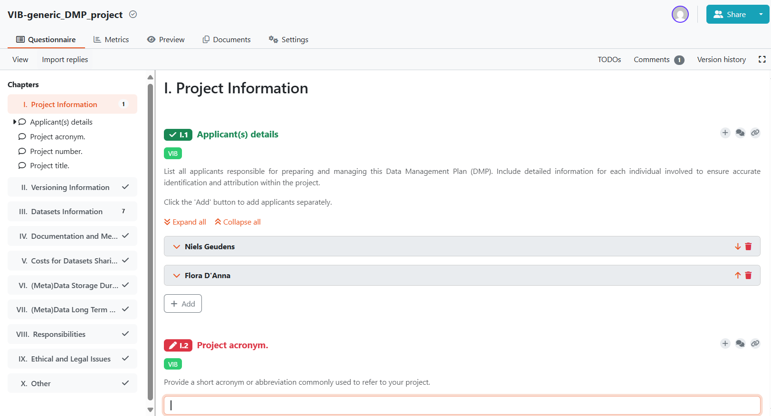
Creating DMPs at VIB ≥ 2026: Data Stewardship Wizard

Slide 34
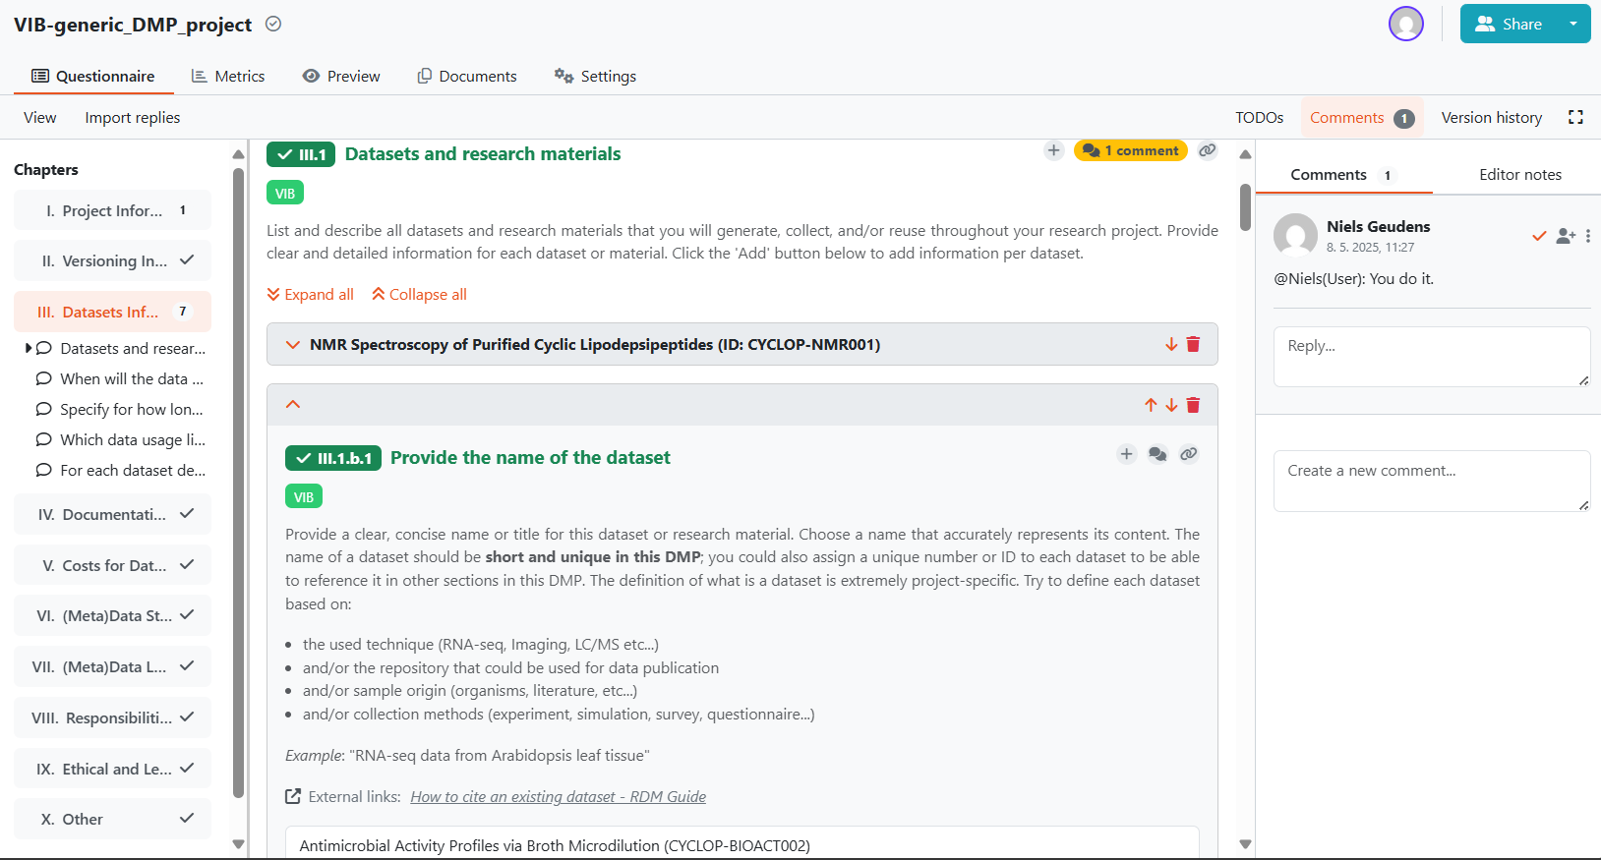

Slide 35
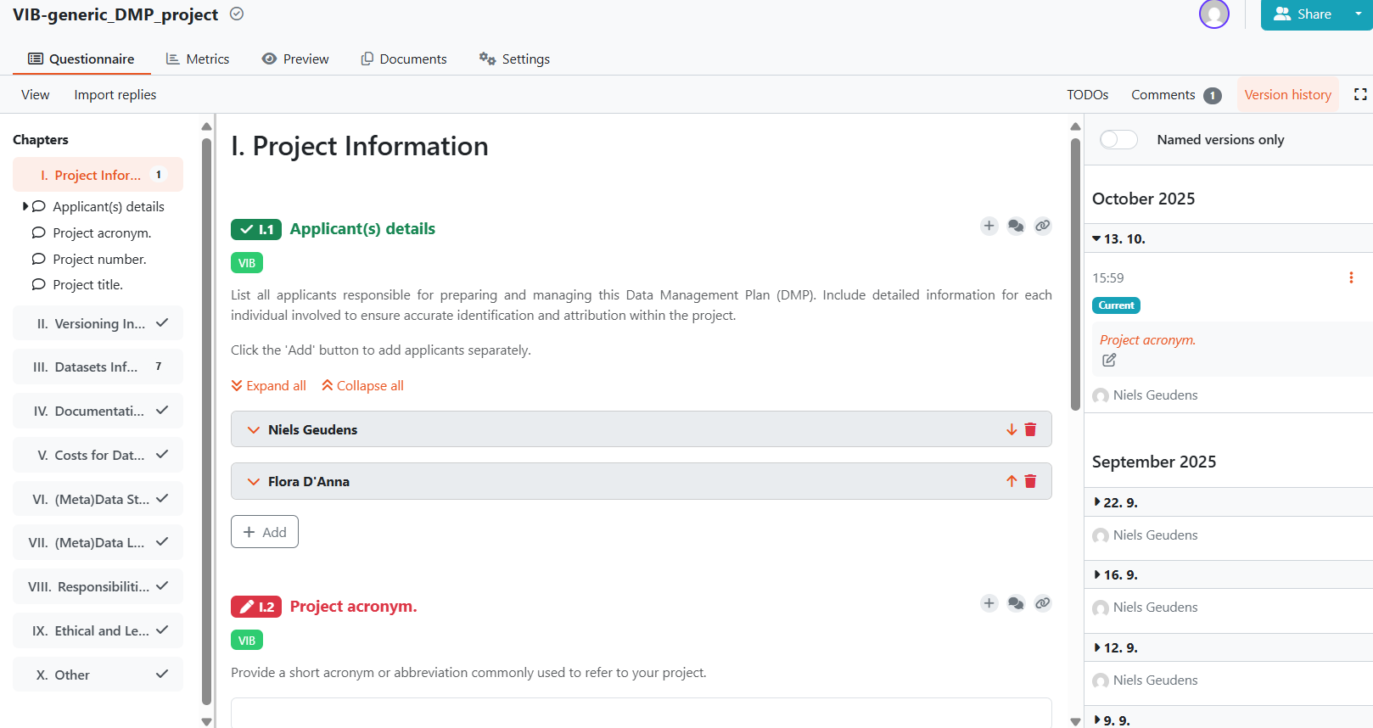
DSW walk-through

Slide 36
DSW walk-through

Slide 37
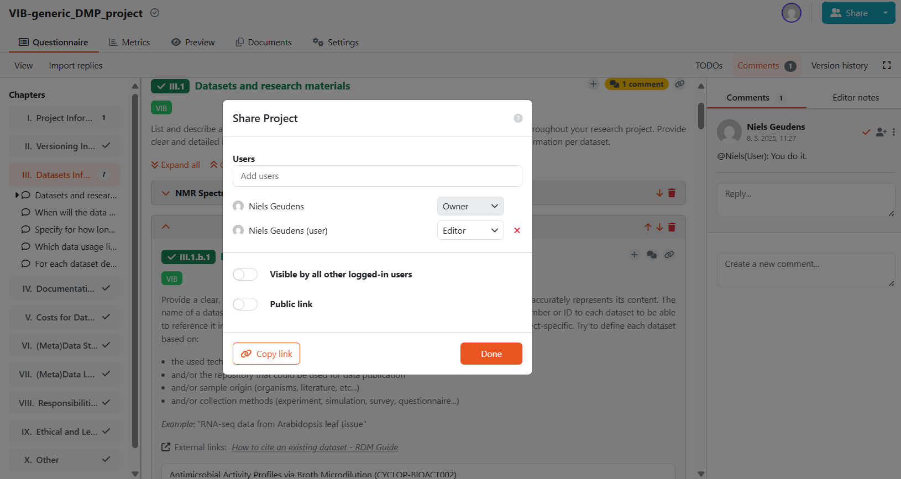

Slide 38
DSW walk-through

Slide 39
DSW walk-through

Slide 40
DSW walk-through

Slide 41
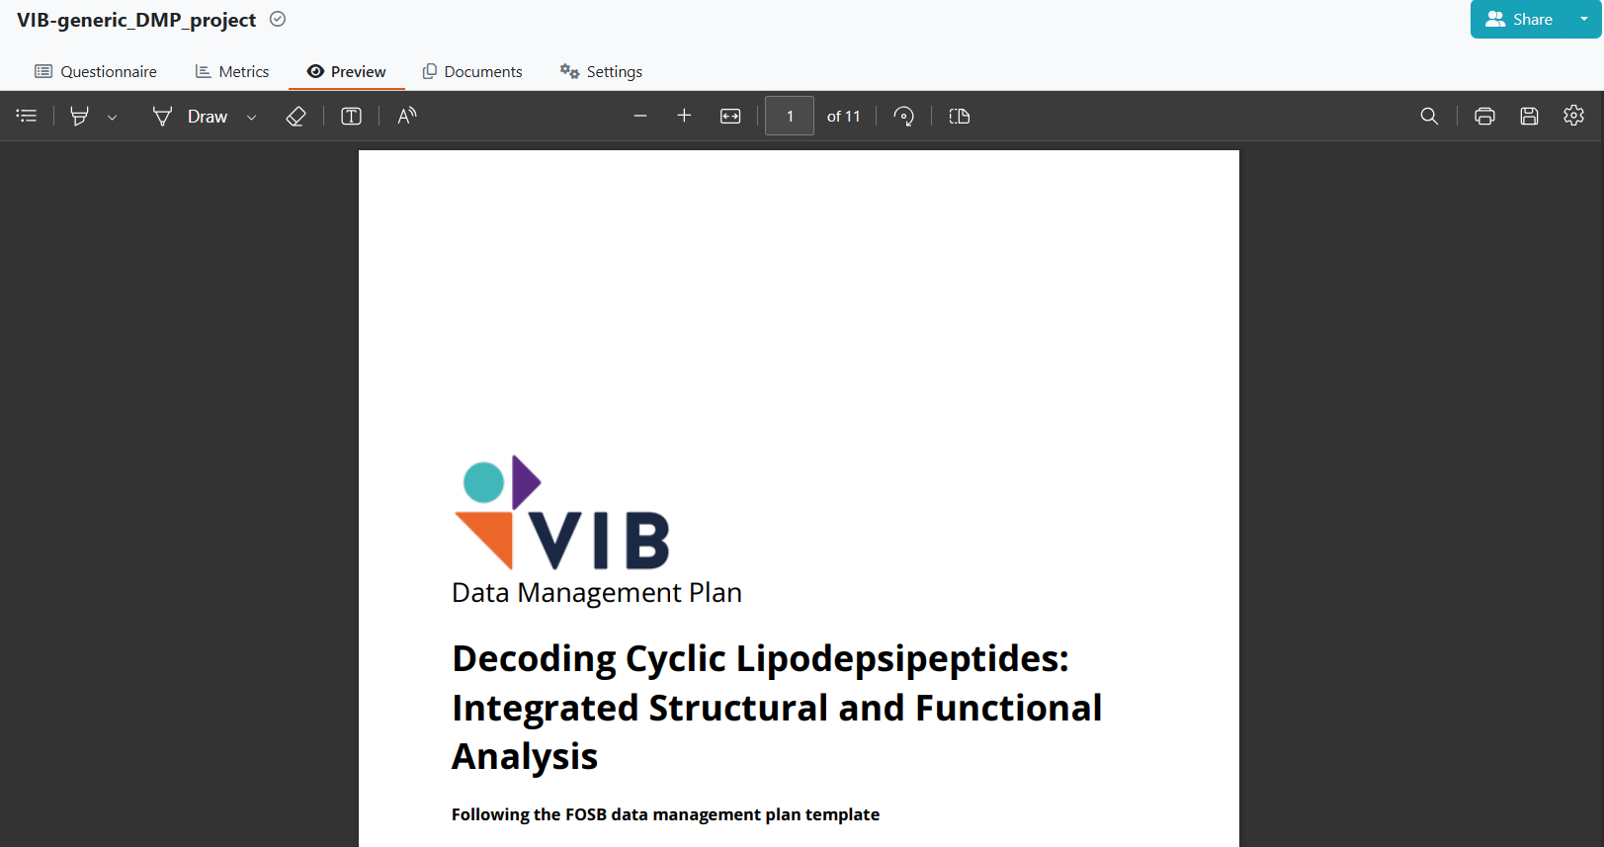
DSW walk-through

Slide 42
Useful links
RDM Guide: https://rdm.elixir-belgium.org/about_DMP
ELIXIR-Belgium: https://www.elixir-belgium.org/research_data_management
FRDN Flemish DMP template: https://www.frdn.be/topics/flemish-data-management-plan/
DMPonline.be: https://www.dmponline.be
Data Stewardship Wizard: https://elixir-belgium.dsw.elixir-europe.org/
VIB E-Learning: https://elearning.vib.be/courses/writing-a-data-management-plan/lessons/the-data-management-plan-dmp/

Slide 43
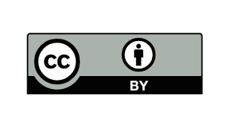
Partly reused slides: “Data management planning for efficient research” by Ghent University Data Stewards, CC BY 4.0
Niels Geudens
Data Steward at VIB Data Core
niels.geudens@vib.be

