Slide 1
describing and Classifying your data

Slide 2








DMP sections
Describe the data that will be used
and/or generated during the research project
Different data types require different management approaches
First step to identify needs and design data management strategy
Data summary & description
Documentation & metadata
Roles &
responsibilities
Purpose, origin, type,
sensitiveness, format & volume
Information to keep data findable, understandable, reusable
Long-term preservation
Costs &
resources
Ethical & legal issues
What to preserve & where,
for how long, access restrictions
Intellectual property, GDPR, etc.
Data storage & security
Data sharing and reuse
Security measures, back-up, data transfers & access control
Data repositories, access conditions, licenses or agreements
Notes:
Confidential data -> shareable / not shareable, security measures
Volume & need for collaboration-> influence the choice of storage platform
Domain and data types -> choice of repositories or archives
Own vs. third-party data -> limitations to share derived work?
File formats -> influence collaboration, long-term reusability
Origin & possibility to reproduce -> what should be preserved

Slide 3




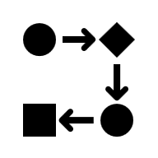


Data Description: different approaches
Write a data description paragraph
Build a project data workflow
Prepare a data summary table
Straightforward project structure
Limited number of data types
Complex project structure, small to medium number of data types.
To visualize data as input & outputs + the different processing and analysis steps.
Can help in other RDM steps: file organization & naming, documentation.
Complex project structure, medium to large number of data types.
Data sets and/or types as rows, with characteristics as columns.
To detect RDM needs: e.g. additional storage space needed, confidential data…

Slide 4
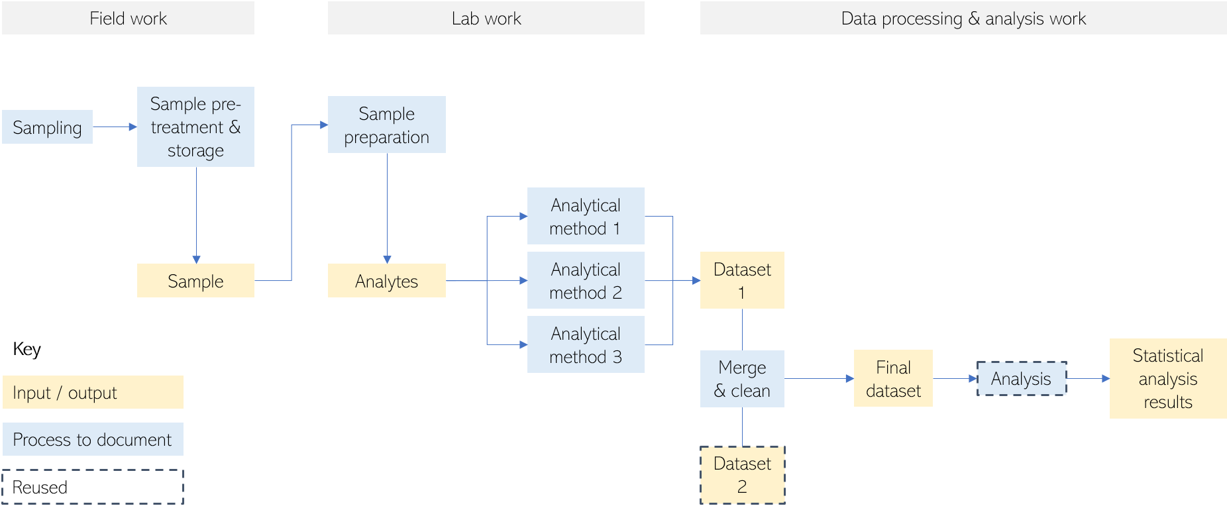
Data workflow: generic example

Slide 5
Data overview table in FWO/cSBO VLAIO DMP
Data overview tables are a useful way to index all the data/outputs in the project and refer to them in other parts of DMP
 |  |  |  | Only for digital data | Only for digital data | Only for physical data
Dataset Reference | Description | New or reused | Data Type | Digital Data format | Digital data volume (MB/GB/TB) | Physical volume
 |  | Please choose from the following options: Generate new data Reuse existing data | Please choose from the following options: Audiovisual Numerical Image Model Software Text Workflow Physical object Other | For example: .csv, .pdf, .txt | Please choose from the following options: < 100MB < 1GB < 2 TB … NA

Slide 6
In practice

Slide 7
Data overview
Rows (i.e. datasets, data types)
Which methods do you use to collect data?
Why are you collecting the data?
What type of data is it? Content? Format? Physical or digital?
Is it raw data or processed data?
Columns (i.e. characteristics of the data)
Is there any pre-existing data that you will be using?
What is the source of the pre-existing data?
Will you be collecting physical materials?
Which methods will you use to collect/generate new data?
Which data is confidential? Personal data? 3rd party data?
What is the expected size of the data?
Which file/data formats will you be using? Are they open and sustainable?

Slide 8





UGent Data Stewards UNIVERSITY SERVICES – RESEARCH TEAM OPen Science
openscience@ugent.be / rdm.support@ugent.be / biblio@ugent.be @ugentopenscience.bsky.social
boekentoren.gent/UGent_OS ugentbe.sharepoint.com/UGent_OS_training
youtube.com/UGent_OS

