Slide 1

Introduction to Research Data Management (RDM) in Life Sciences
Session 3: How to choose a repository
Matheus Lourenço, PhD
Inspired by session 2024 by Bruna Piereck, PhD
October 17, 2025
Notes:
Manage expectations and main objective of the training:
1- This is an introductory course
2- For you to know ahead of time necessary steps and available resources for you to turn policy into action, benefiting your research

Slide 2

Notes:
Ground rules

Slide 3
Disclaimer: I will not tell you which repository to use in your research.
!

Slide 4
How to choose a repository
Basic definitions
Why use a repository
How to find repositories
How to choose a repository
A word on re-usability

Slide 5
01
Basic definitions

Slide 6
Basic definitions
Deposit/depose
The act of submitting research data and associated metadata into a repository.
Repository
A digital platform or infrastructure designed to store, manage, and provide access to research data.
Retention
Mainly policy related, referring to how long data is kept and the reappraisal once the initial retention period expires.
Preservation
Focuses on the act of preserving data. In other words, active care required to ensure continued access to and usability of digital materials for as long as needed.

Slide 7
02
Why

Slide 8
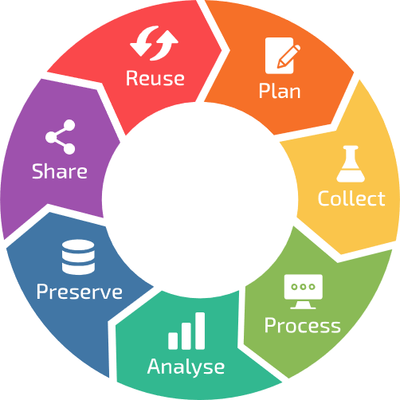
Where to start?

Slide 9
Carrot or stick?

Slide 10
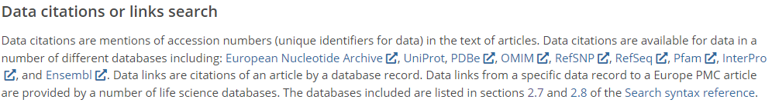
The carrot approach
Future proofing for yourself
Increased citations:
https://europepmc.org/Help#searchdata

Slide 11
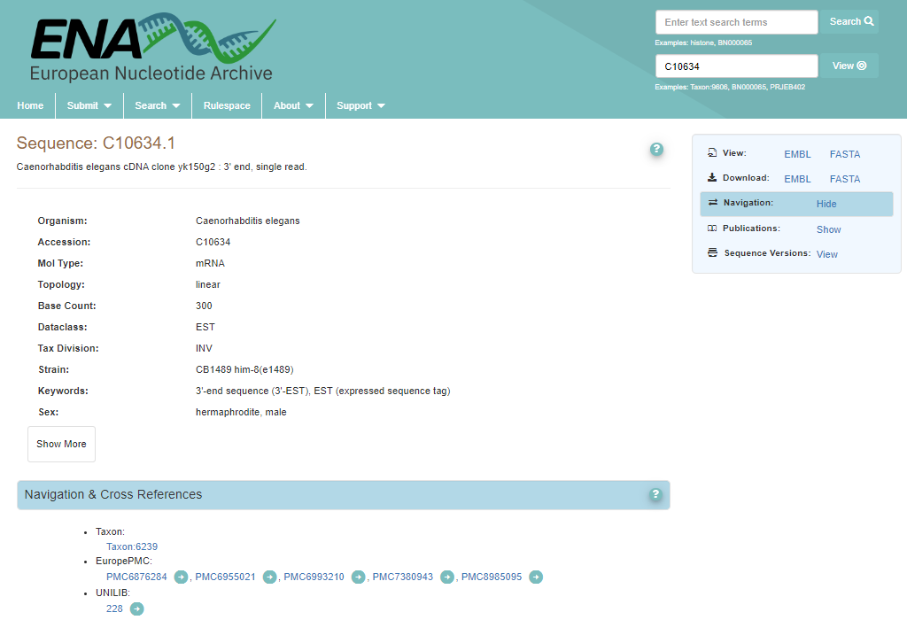
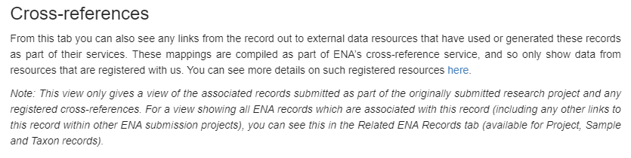
Example:

Slide 12
The carrot approach
Future proofing for yourself
Increased citations:
Visibility and networking possibilities
In other words: You want to do it!
https://europepmc.org/Help#searchdata

Slide 13
03
How to find repositories

Slide 14

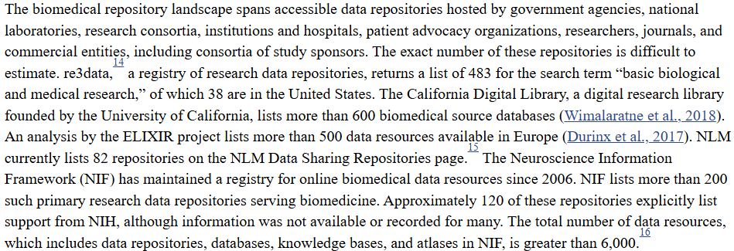
There are hundreds of repositories available
Introduction - Life-Cycle Decisions for Biomedical Data - NCBI Bookshelf (2020)

Slide 15
Tools for finding repositories
Re3data.org
Fairsharing.org
Elixir-Europe.org/platforms/data/elixir-deposition-databases
Ebi.ac.uk/submission/
AI (e.g. co-pilot)
Etc… (check RDMkit for more)

Slide 16
Notes:
Ground rules

Slide 17
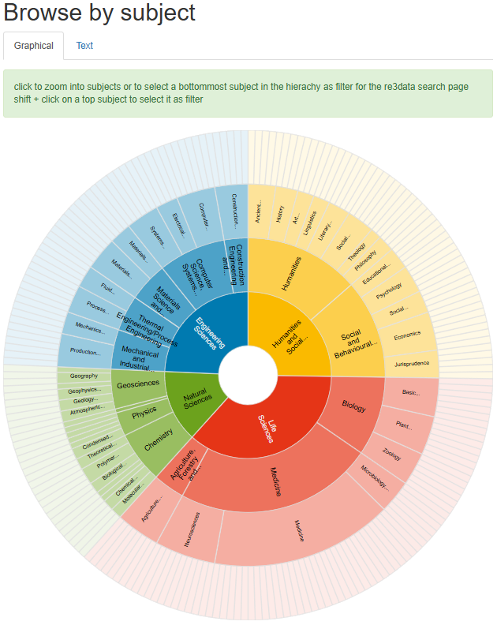

Go to and explore the number of repositories in your field

Slide 18
Notes:
Ground rules

Slide 19
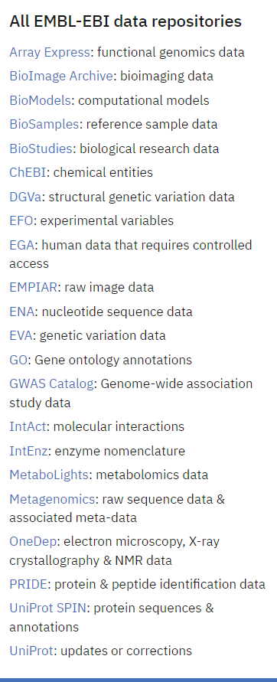

The data wizard:

Slide 20

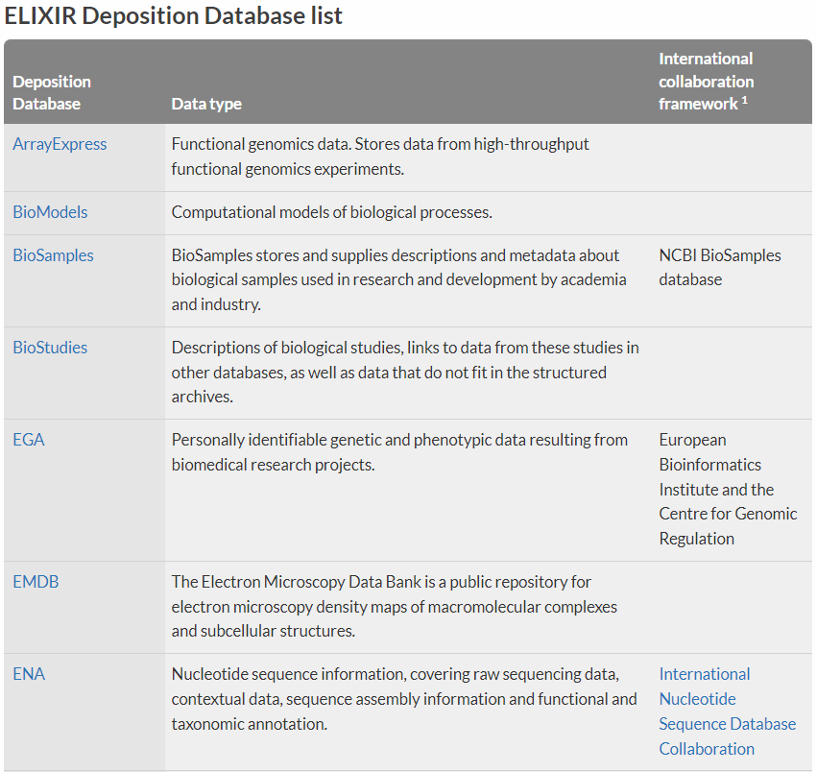
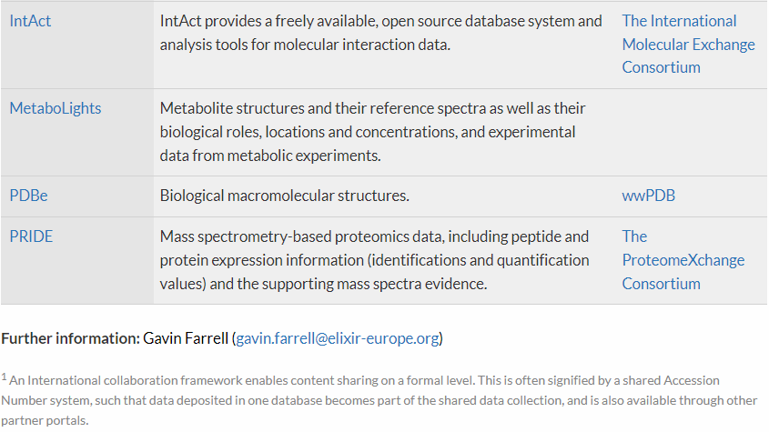
ELIXIR Deposition Database list
ELIXIR Deposition Databases for Biomolecular Data | ELIXIR (2017)

Slide 21
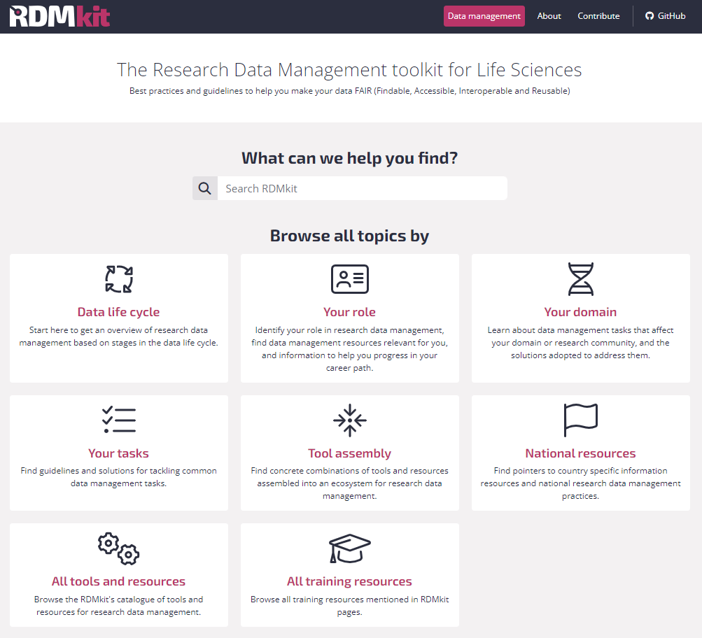

Community driven:

Slide 22
Notes:
Ground rules

Slide 23
Alice
She is a researcher who:
Works with plants
Is generating whole genome sequencing data
Makes use of several public platforms for tools and data
Has the current project funded by a public agency
Aims at publishing work in an open peer reviewed journal
Suggest a couple of repositories based on the RDMkit that are domain specific
Justify your choice
Think about what info you can find about the repository

Slide 24
Notes:
Ground rules

Slide 25
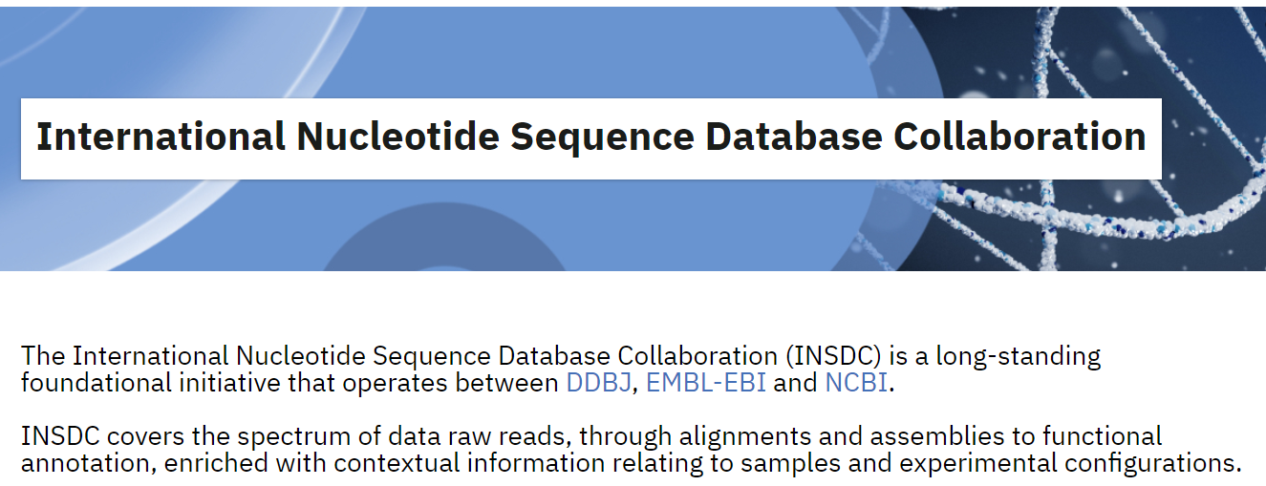
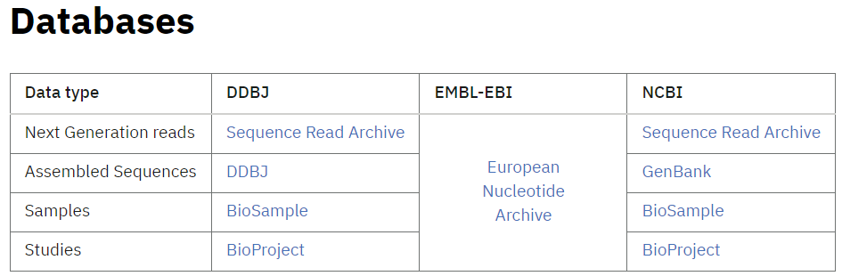
Multiple repositories with similar data type
https://www.insdc.org/

Slide 26



Genomics

Slide 27
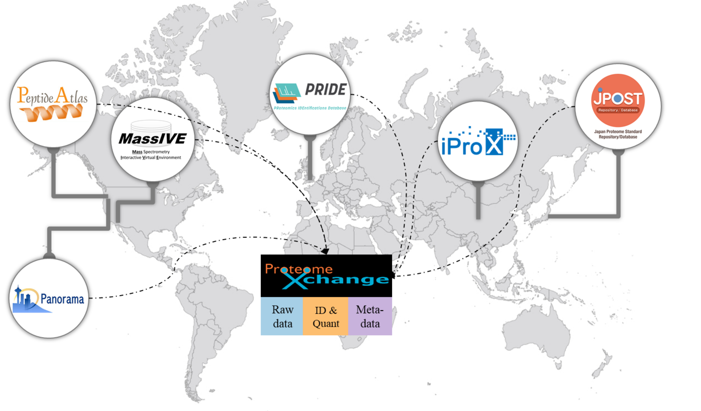
Proteomics
proteomexchange.org

Slide 28

Metabolomics
MetabolomeXchange

Slide 29


The Omics Discovery Index (OmicsDI)
OmicsDI is part of the ELIXIR infrastructure
25 Resources, >3M datasets, 4 Continents

Slide 30
Notes:
Ground rules

Slide 31
Alice is back
Still working with plants
Is generating whole genome sequencing data
Makes use of several public platforms for tools and data
Has the current project funded by a public agency
Aims at publishing work in an open peer reviewed journal
Is also generating proteomics data
Is also generating metabolomics data
Would like that the datasets are recognized as to belonging to the same project
Find suitable domain specific repositories and a way to connect these datasets

Slide 32
Notes:
Ground rules

Slide 33



Multi-omics

Slide 34



Multi-omics
BioSamples
BioSamples
BioSamples
BioSamples

Slide 35

Multi-omics
BioSamples
BioSamples
BioSamples
BioSamples

Slide 36

A side note on human sensitive data
“a service for permanent archiving and sharing of personally identifiable genetic, phenotypic, and clinical data generated for the purposes of biomedical research projects or in the context of research-focused healthcare systems.”
!
Data access defined, including Data Access Committees (DAC). Different datasets may have different DACs. However, VIB members must contact René Custers before submitting data to EGA: rene.custers@vib.be

Slide 37
Access types
Open access: Data is shared publicly. To use open-access researchers need to ensure that the data is anonymized, which is difficult and sometimes impossible in practice.
Registered access: Data is shared with researchers, who have been vouched for by their institution and who agree to abide by data usage policies. Datasets that are shared via registered-access would typically have no restrictions besides the condition that data is to be used for research.
Controlled access: Access is reviewed and approved by a data access committee (DAC). Typically, researchers who were involved in the primary collection of data will form the DAC. There can be a multitude of usage conditions, including allowed research topics, geographical regions, and recipients e.g. non-profit organizations.
At VIB, a DAC may already have been created. Always check with René Custers: rene.custers@vib.be

Slide 38
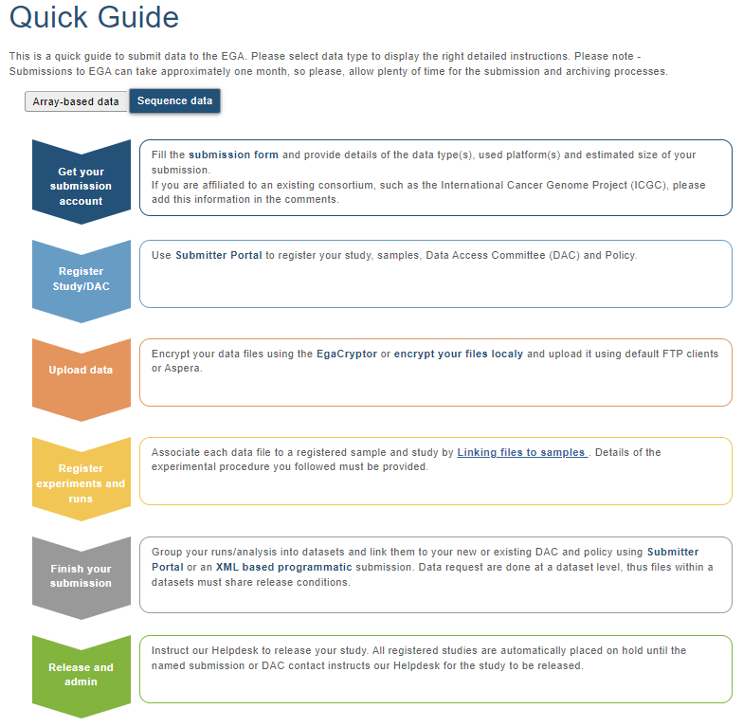
Submitting data to the EGA
https://ega-archive.org/submission/quickguide

Slide 39
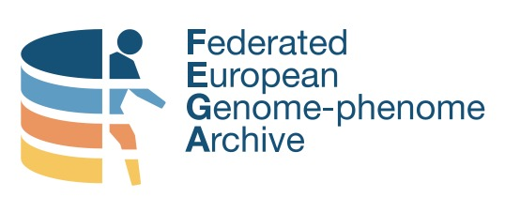
A Federated option
The data does not leave the Local EGA (i.e. your country), while it is still discoverable through the Central EGA

Slide 40
04
How to choose a repository

Slide 41
Do you have to choose?
?
University requirements
Journal requirements
DMP requirements
Funding requirements
Ethical and legal requirements

Slide 42
If you do have to choose
Think strategically
Think about your selected audience
Think about how general vs specific you want to go
Think about your values

Slide 43

Can you trust it?
CoreTrustSeal – Core Trustworthy Data Repositories
In order to provide some guidance to researchers and data stewards, the CoreTrustSeal has 16 requirements which repositories must answer to.
Over 160 repositories are certified.

Slide 44
An example:
A single study has the following topics within it:
Tinnitus treatment
Cognitive Behaviour Therapy
Data on Ecological Momentary Assessment (EMA)
Data on n-of-1 trials
In which journal should you publish the data?
Which repository should you use?

Slide 45
Before you submit!
Different repositories have different rules:
What files are expected?
What metadata is expected?
Can ontologies and controlled vocabularies be used?
Are costs involved?
Is there a license requirement (or is it implicit)?

Slide 46
Before you submit!
Different repositories have different rules:
What files are expected?
What metadata is expected?
Can ontologies and controlled vocabularies be used?
Are costs involved?
Is there a license requirement (or is it implicit)?

Slide 47
05
A word on re-usability

Slide 48
352358 unknown entries in OmicsDI
!

Slide 49
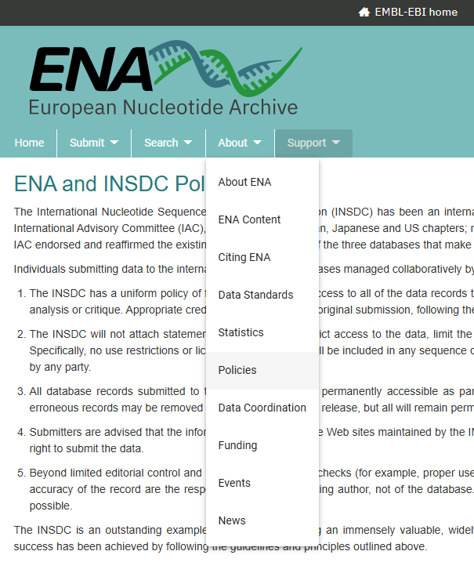
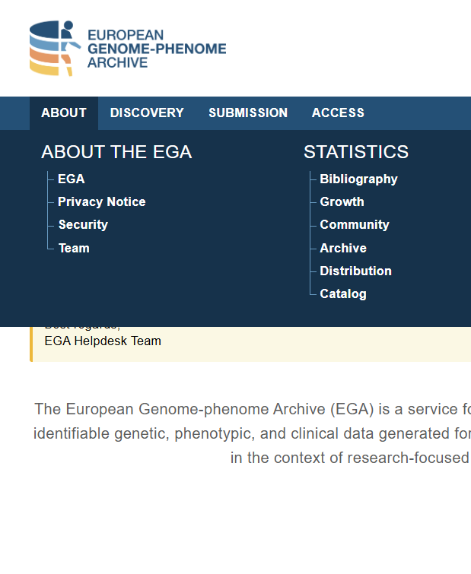
Check licenses for re-use and before submitting

Slide 50
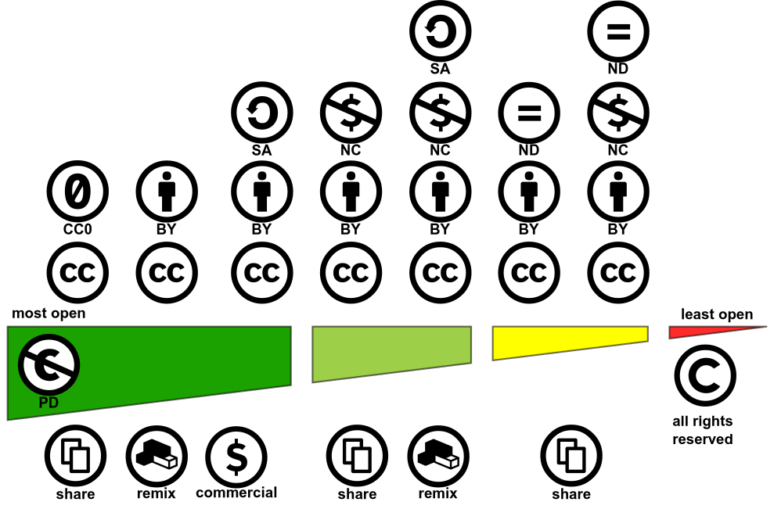

Creative Commons: A license for you
https://creativecommons.org/choose

Slide 51
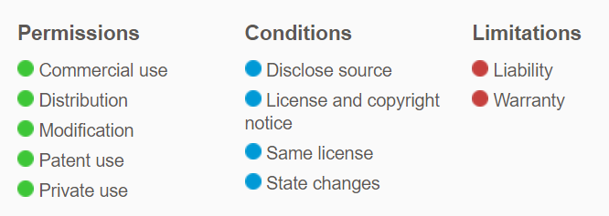

License for other uses: codes
GNU GPLv3:
GNU AGPLv3: Complete source code modifications need to be available
GNU LGPLv3: Large modifications can be distributed under different license.
MIT license: No attribution license
Apache 2.0 ~ GNU PLv3

Slide 52

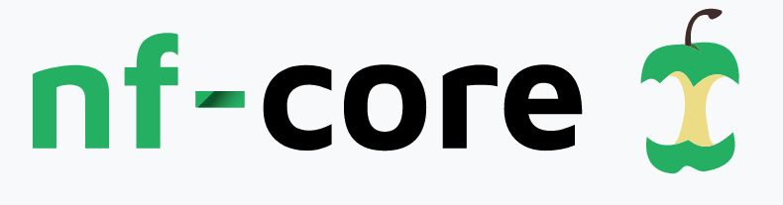




It does not end there…
Computational workflows can also be deposited and shared:
Platform/system specific repositories
Git Based repositories
Generalist repositories

Slide 53
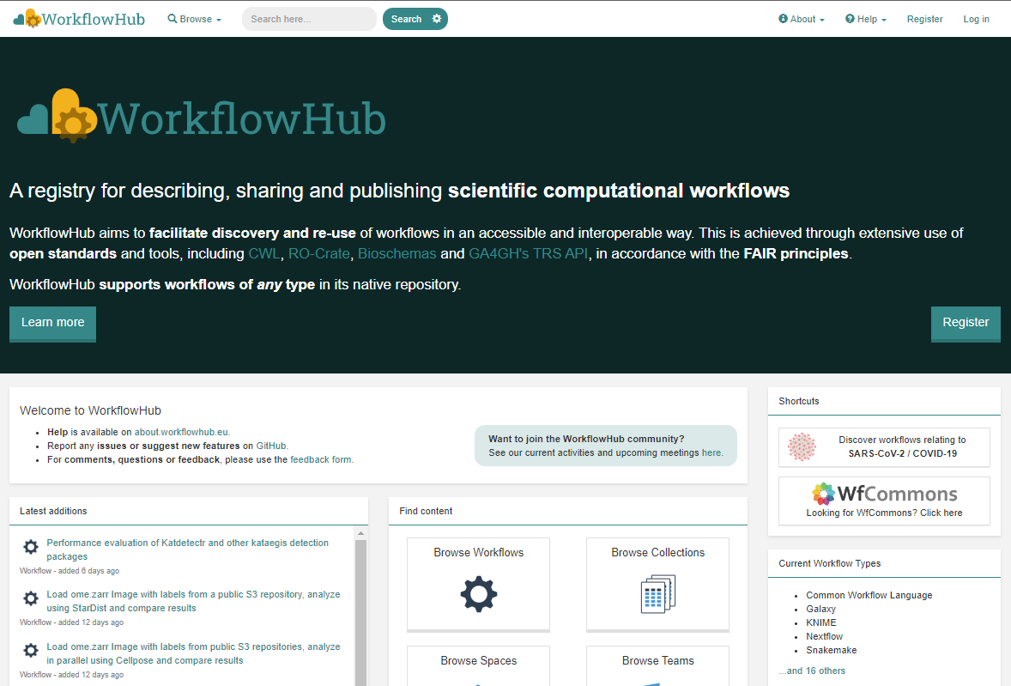
Use a registry to overcome fragmentation
System agnostic
Native repository support
Git integration
Versioning
Links to external files (docs, test and reference data)
Metadata extraction and standards
Integration with Bio.tools
Author credit
Citable
DOI minting

Slide 54
Other relevant repositories:
BCCM Culture Collections

Slide 55


Elixir is here to help!
info@elixir-belgium.org
https://www.elixir-belgium.org

Slide 56
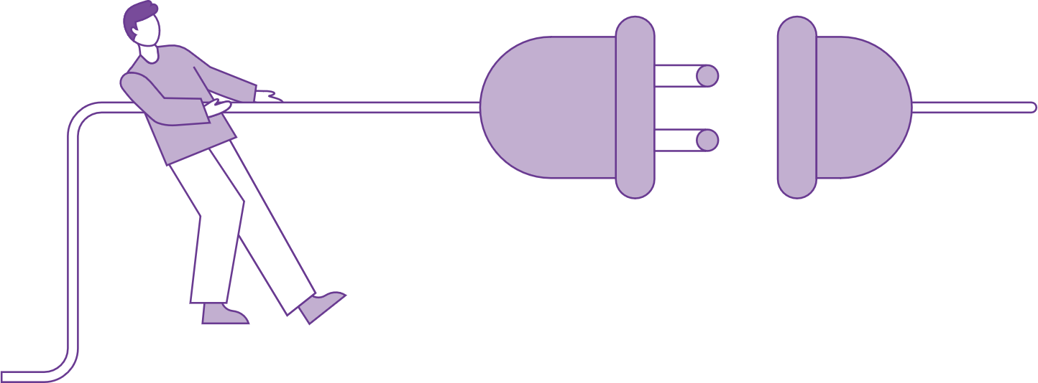
Break
Disconnect for 10 mins

Slide 57
Matheus Lourenço
Matheus.lourenco@vib.be

