Slide 1
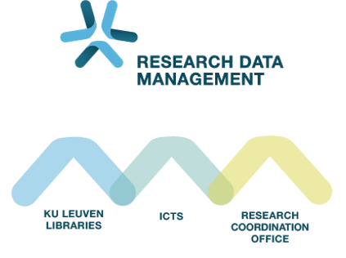
Introduction to RDM in Life Sciences Session 2: Build a plan
Audience: ECR from VIB @ KULeuven
November 25th 2025
Sylvette Vanderstraeten – Willeke de Haan
Inge Mannaerts – Maarten Jackers

Slide 2

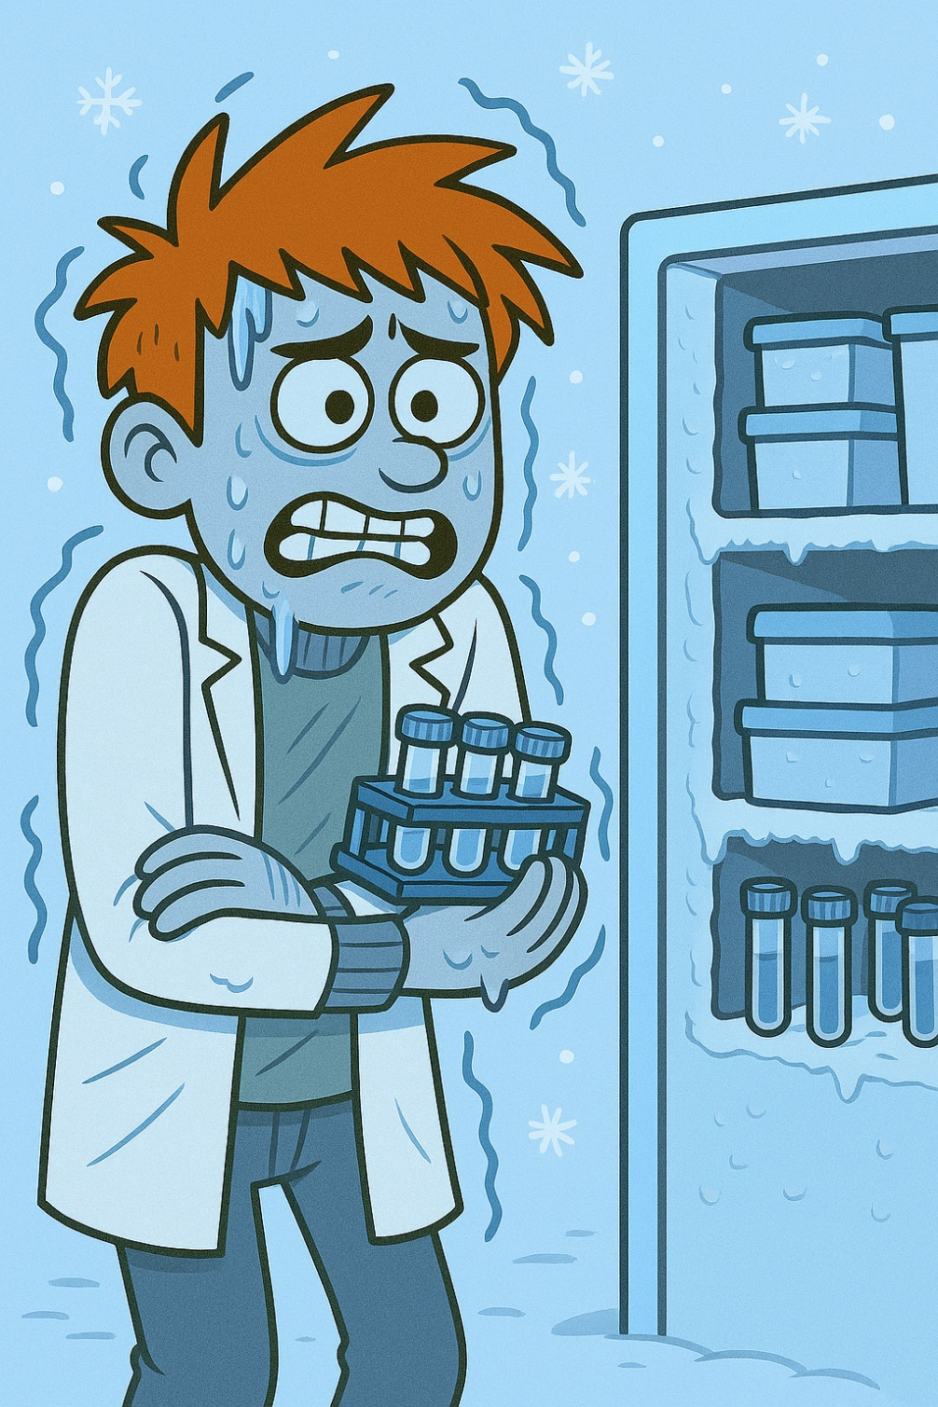


What can go wrong without good RDM

Slide 3
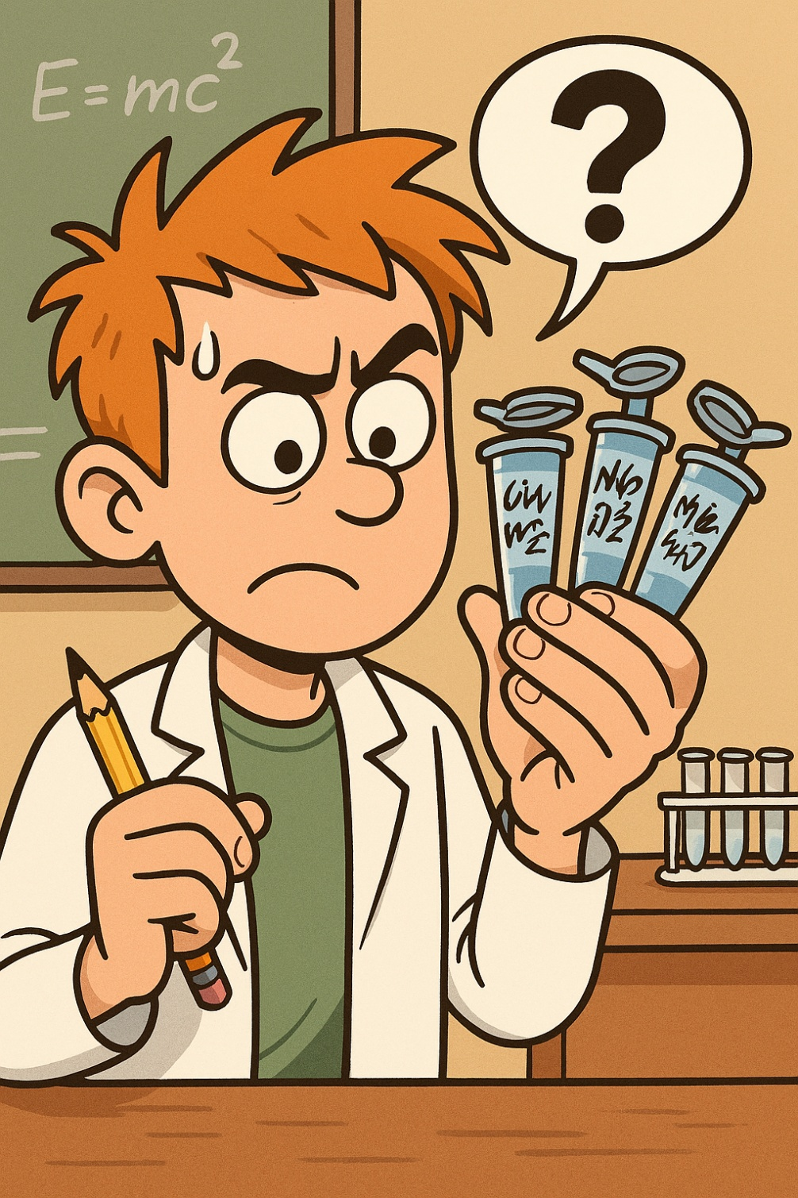
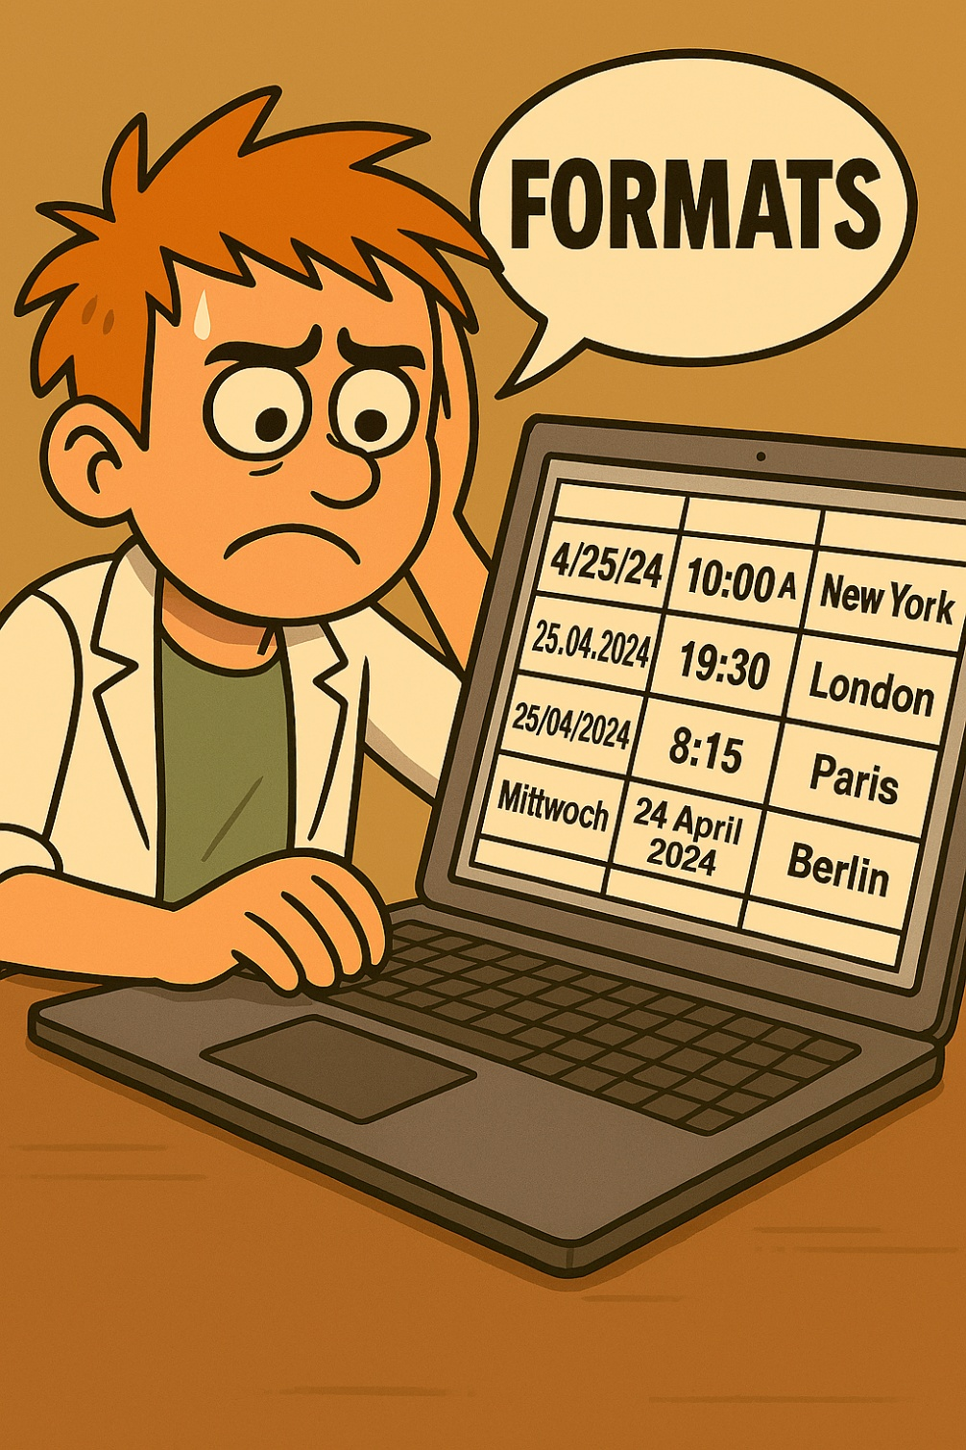
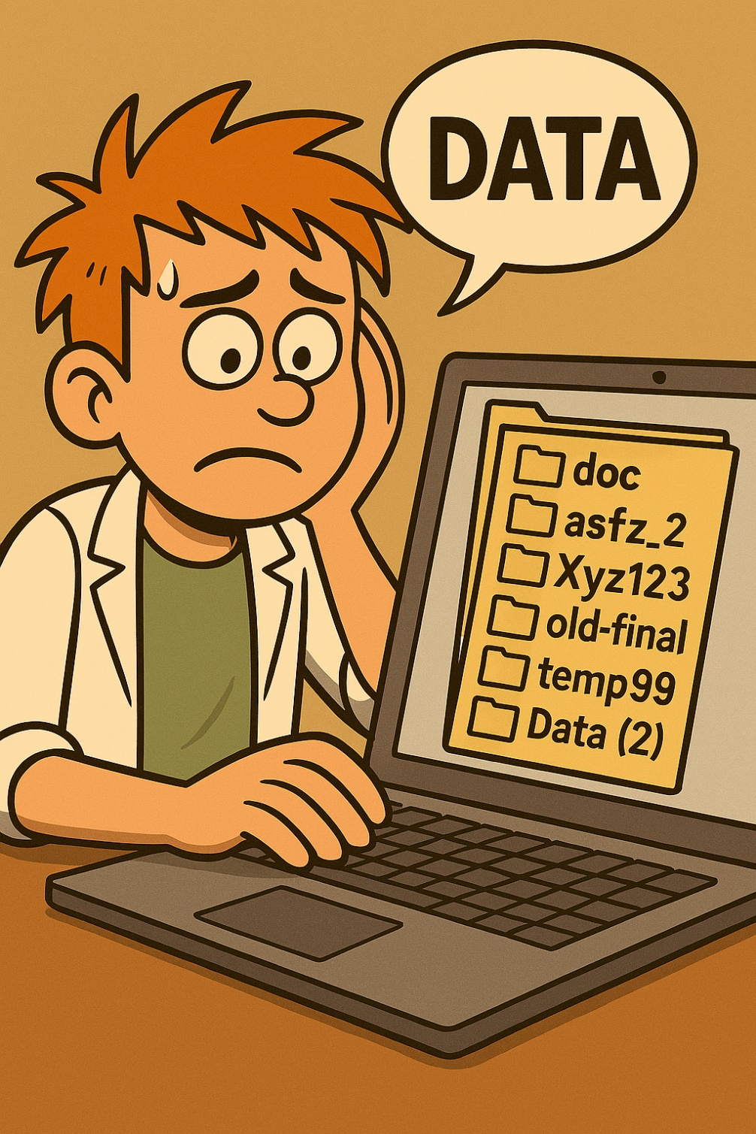
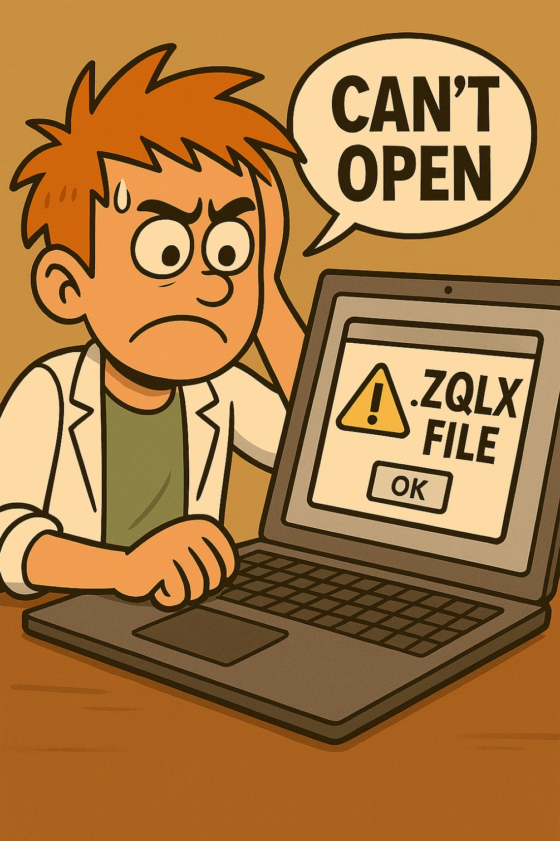
What can go wrong without good RDM

Slide 4
Solution: good RDM
“Prevention is better than cure”
Anticipate issues and, solve them before they occur
Thinking about RDM often starts with a Data Management Plan
Asked by funders
Asked by some doctoral schools
Recommended by KU Leuven RDM support
Do you have to write a DMP for your funder?

Slide 5
Solution: good RDM
“Prevention is better than cure”
Anticipate issues and, solve them before they occur
Thinking about RDM often starts with a Data Management Plan
Asked by funders
Asked by some doctoral schools
Recommended by KU Leuven RDM support
Do you have to write a DMP for your funder?

Slide 6

Flemish funders (FWO BOF, IOF or VLAIO)
A DMP is needed for all projects and mandates
Develop your DMP within 6 months after the start
Use the Flemish DMP template
For KU Leuven:
Submit via the DMP Monitoring Tool
Submit final (updated) DMP to FWO
Part of final report to FWO e-portal
Different template for Horizon Europe funding, focus FAIR data
Not in the scope of today, contact us

Slide 7
Flemish funders (FWO BOF, IOF or VLAIO)
A DMP is needed for all projects and mandates
Develop your DMP within 6 months after the start
Use the Flemish DMP template
For KU Leuven:
Submit via the DMP Monitoring Tool
Submit final (updated) DMP to FWO
Part of final report to FWO e-portal
Different template for Horizon Europe funding, focus FAIR data
Not in the scope of today, contact RDM support

Slide 8
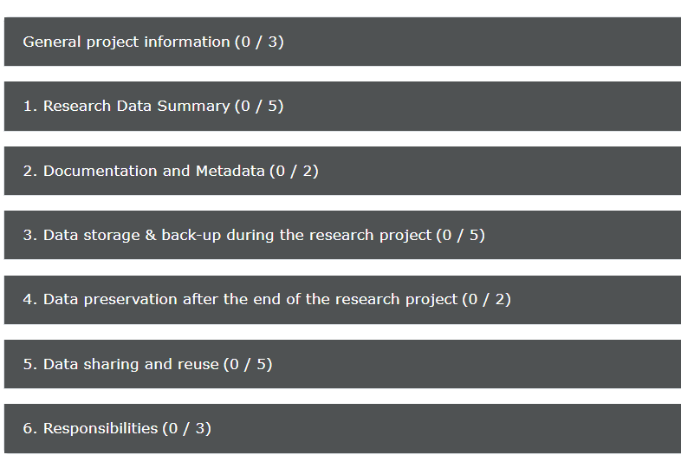
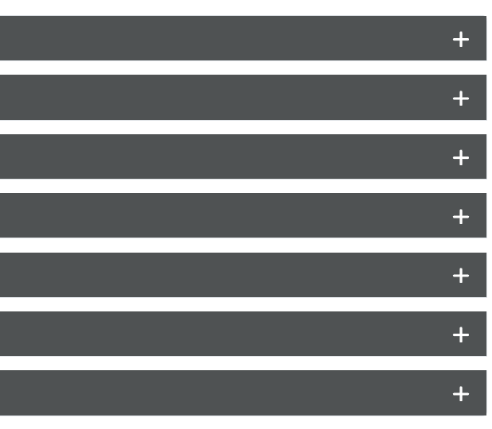
The DMP

Slide 9
Flemish DMP template
The same template for all Flemish funders
https://dmponline.be/
https://zenodo.org/records/17025558

Slide 10
Exercise 1: Start a DMP template in DMP Online Your project
Go to https://dmponline.be
Login with institutional account
“Create Plan”
Select your funder (except if European project → select nothing)
→ DMP template = Flemish data management plan
“Create plan”
Fill in “Project Details”

Slide 11
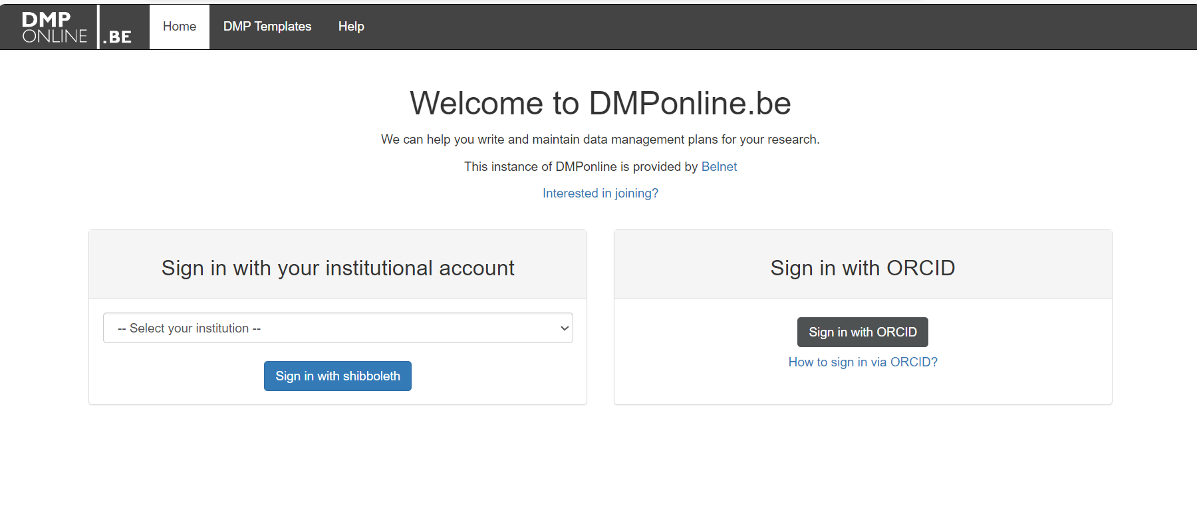
Welcome to DMPonline.be
Notes:
.

Slide 12
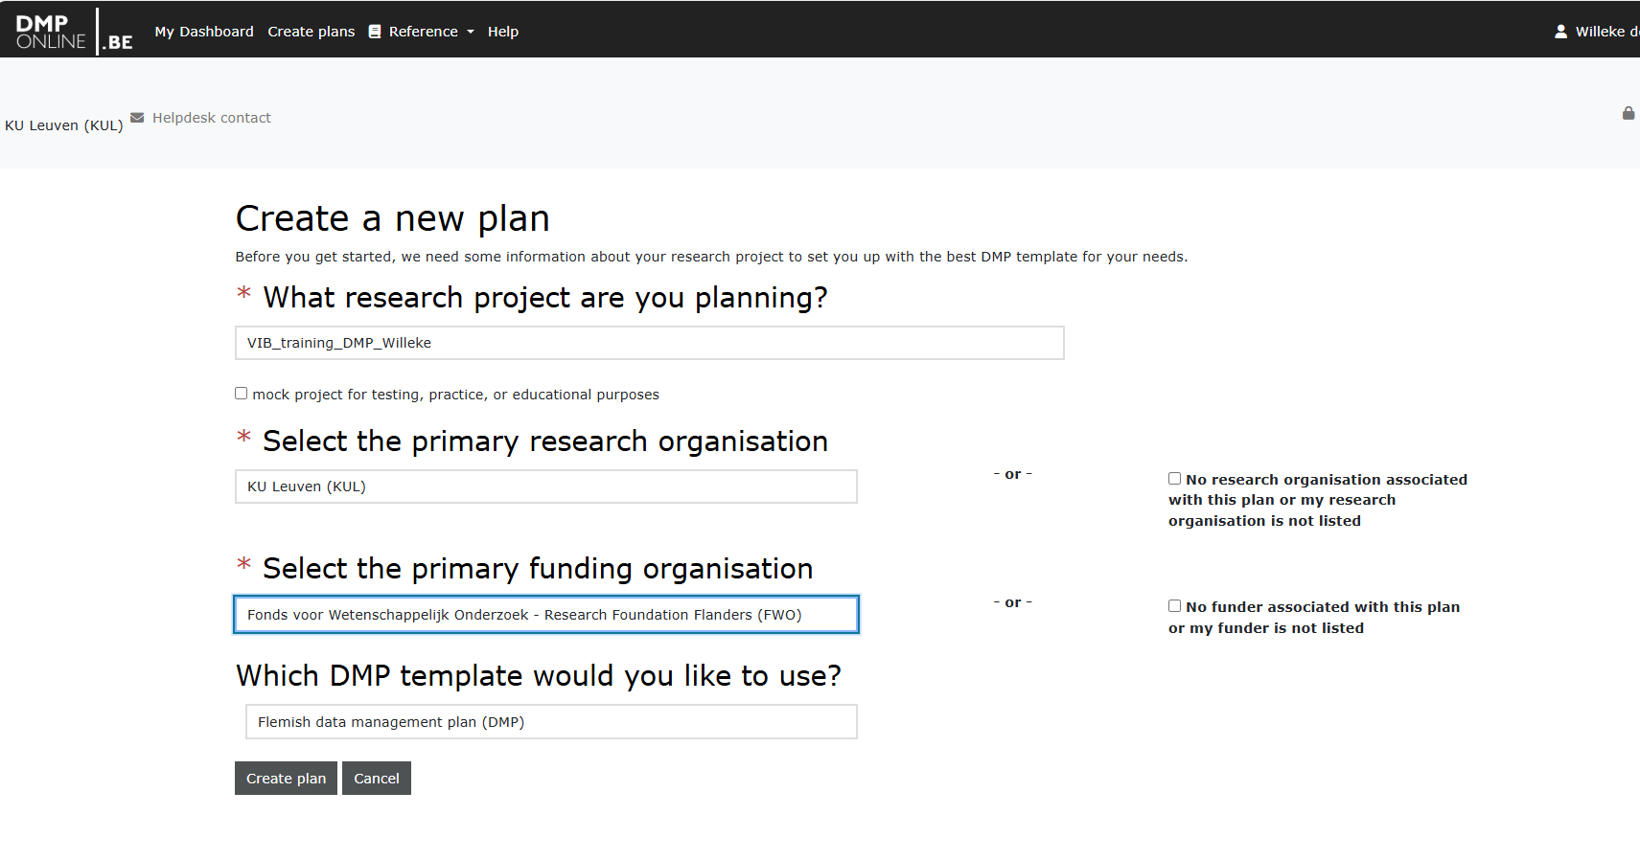
Create a plan

Slide 13
Vanaf hier: 2Bergen

Slide 14
Purpose of the Data Management Plan (DMP)
Plan (Definition):
DMP = summary of intentions about data management
= good summary tool
DMP ≠ complete plan building tool
An organized (…) proposal according to which something is to be done; (…), a method or way of proceeding, an intention or ambition for the future (…). ~ Oxford English Dictionary
Notes:
DMP = very good summary tool
But not a plan building tool (not designed that way)

Slide 15
Reframing RDM: From compliance to craft
DMP = summary of data management for compliance
I think about RDM because I have to
Flip the script: Plan by Design
I get to
design my own data management strategy make my own data management choices build my own data management plan
Notes:
In this session: not only plan for compliance, but building exercise to ensure
Interconnectivity between parts
Completeness – identify the gaps
Agency – it is your choice, you get to build it

Slide 16
What you will build in this course
For a subset of your project:
Visual overview of your data (dataflow)
Documentation and storage plan
File naming convention and folder structure
README - project level
Partly filled in DMP
Notes:
Story:
We are pretty ambitious and want you guys to leave with some tangential – useful outputs that will serve you during your project. This is a pilot so we’ll have to see how it goes, but we are hopeful it will be worth your while
But we only have 1 day, so it will be for a subset of your project. But hopefully you’ll know enough by the end to do all this for the rest of your project as well
A visual overview of your project or dataflow, with a very detailed highlight on one part
With this, a very comprehensive documentation and storage plan
A file naming and folder structure scheme
And a partly filled in Project README file to document the high level stuff
And to make it so you are in line with the RDM requirements, we’ll translate and summarize all of that in a DMP also.

Slide 17


Our example - Jie’s work
ORCID ID: 0000-0001-2345-6789
Project: Iron-Amyloid Interactions in Alzheimer’s disease: From Rodent Models to Human Biomarkers
Researcher role: Starting PhD-student
Data types from rats and humans:
Clinical data (age, sex; disease stage, …)
RNA sequencing on post-mortem brain tissue
Histology & immunohistochemistry for amyloid plaque visualization
Quantitative Susceptibility Mapping (QSM) for Iron mapping
…
Notes:
Alzheimer’s disease is a progressive brain disorder that affects memory and thinking. One of its hallmarks is the buildup of sticky protein clumps called amyloid plaques. Recent research suggests that iron, a metal naturally found in the brain, may interact with these plaques and influence disease progression.
This project explores how iron and amyloid plaques are connected, using both animal models and human brain samples. It combines different types of data: clinical information (like age and disease stage), advanced imaging techniques to map iron in the brain, and molecular analyses such as RNA sequencing and tissue staining to visualize plaques.
By studying these interactions, the goal is to better understand how Alzheimer’s develops and to identify potential biomarkers—measurable signs in the brain or body—that could help diagnose or track the disease earlier and more accurately.

Slide 18
Exercise 2: Dataflow
Build a plan – start with a clear view
End goal = schematic diagram of all research data and steps​
Data points (in/outputs): Blue ​
Steps (methods, analysis, processing,…): Yellow
Start with these questions:
Research question?
Study object/subject?
How? Aka methods?
Notes:
To know what a good plan would be, you need to get a clear view of what it is you are planning for.
During your project you will be handling different data types and formats.
Each data type will be processed following a sequence specific for that data type.
This covers the spectrum from raw-processed data and includes physical data
We like to create a really visual overview, called a dataflow, of how each datapoint flows to the next one. It will be a first for us to do this in a workshop setting, so hopefully it works ☺
This will be our second exercise of the day, and I will illustrate how to do this with our friend Jie.

Slide 19

Exercise 2: Dataflow
Build a plan – start with a clear view
Start with these questions:
Research question?
Study object/subject?
How? Aka methods?
→ Connection between Iron & Amyloid plaques
→ Alzheimer brain in Rats & Humans
→ RNA sequencing, Imaging (histology), …
Notes:
To know what a good plan would be, you need to get a clear view of what it is you are planning for.
During your project you will be handling different data types and formats.
Each data type will be processed following a sequence specific for that data type.
This covers the spectrum from raw-processed data and includes physical data
We like to create a really visual overview, called a dataflow, of how each datapoint flows to the next one. It will be a first for us to do this in a workshop setting, so hopefully it works ☺
This will be our second exercise of the day, and I will illustrate how to do this with our friend Jie.

Slide 20
Exercise 2: Dataflow
Build a plan – start with a clear view
Start with these questions:
Research question?
Study object/subject?
How? Aka methods?
On post-it notes:
Start datapoint = answer to b
Steps (somewhere) = answer to c
End datapoint = publication
→ Connection between Iron & Amyloid plaques
→ Alzheimer brain of Rats & Humans
→ RNA sequencing, Imaging (histology), …
Notes:
To know what a good plan would be, you need to get a clear view of what it is you are planning for.
During your project you will be handling different data types and formats.
Each data type will be processed following a sequence specific for that data type.
This covers the spectrum from raw-processed data and includes physical data
We like to create a really visual overview, called a dataflow, of how each datapoint flows to the next one. It will be a first for us to do this in a workshop setting, so hopefully it works ☺
This will be our second exercise of the day, and I will illustrate how to do this with our friend Jie.

Slide 21






Exercise 2: Build a Dataflow – example Jie’s project
Brain tissues from rats
Sequencing
Publication
Brain tissue from post-mortem Patients
Microscopy
Data points
Steps
Notes:
So, we put the post-its we have on the table. First, we need to select one path, because it would just take too long to do everything today.

Slide 22
Exercise 2: Build a Dataflow – example Jie’s project
Brain tissues from rats
Sequencing
Publication
Brain tissue from post-mortem Patients
Microscopy
Data points
Steps
Notes:
First, we need to select one path, because it would just take too long to do everything today.
We’ll focus on the rats, and the sequencing for example.

Slide 23


Exercise 2: Build a Dataflow – example Jie’s project
Publication
Brain tissues from rats
RNA isolation & quality control
RNA samples
Sequencing
FASTQ files
Data points
Steps
Notes:
We’ll focus on the rats, and the sequencing for example.
Then we start to ask questions:
What is the output from this step? What is the input from this step? How did I get to this datapoint?

Slide 24
Exercise 2: Build a Dataflow – example Jie’s project
Publication
Brain tissues from rats
RNA isolation & quality control
RNA samples
Sequencing
FASTQ files
RNA QC report
Sequencing report
Data points
Steps
Notes:
But then you wonder: is that all I need to do this step? Do I get other datapoints from this step?

Slide 25
Exercise 2: Build a Dataflow – example Jie’s project
TgF344-AD + WT Rats
Euthanasia & brain extraction
Publication
Brain tissues from rats
RNA isolation & quality control
RNA samples
Sequencing
FASTQ files
RNA QC report
Sequencing report
Data points
Steps
Notes:
And then I realize: I actually don’t start with brain tissue. Because I have to collect that myself too.
I actually start with the rats themselves…
Ect ect.

Slide 26
Exercise 2: Build a Dataflow – example Jie’s project
RNA samples
TgF344-AD & WT rat colonies
Euthanasia & brain extraction
Fresh/frozen brain tissue
RNA isolation & Quality Control
RNA QC report
Sample sheet
= simplified
Making Graphs, tables + writing manuscript, …
Bioinformatics Analysis:
Quality control (FastQC)
Alignment (e.g., STAR)
Quantification (e.g., featureCounts)
Differential expression analysis (e.g., DESeq2)
Raw FASTQ-files
QC reports
BAM files
Count matrix
DE results
Library prep & RNA sequencing
Sequencing report
Data types
Processes
Notes:
We could complete the process with something like this.
For sake of space, the analysis part has been simplified. We would still recommend to do this in detail.

Slide 27




A dataflow helps Jie to makes sense of his data
Research data
Images (TIFF-files)
Brain tissue
Microscopy
Data processing, integration & analysis
Study subjects:
Rats
Patients
Sequencing
Sequencing data (FASTQ-files)
Visualizations
Reports
…
Clinical data
Data types
Processes
Notes:
During your project you will be handling different data types and formats.
Each data type will be processed following a sequence specific for that data type.
This can be schematically presented as a data flow. And will be illustrated for 1 of our demo researchers this covers the spectrum from raw-processed data and includes physical data

Slide 28
Exercise 2: Build a Dataflow Your project
Data points (in/outputs): Blue
​Steps (methods, analysis, processing,…): Yellow
Exercise bundle p.1+2
In pairs:
Explain your research using the 3 guiding questions.
Post-its (start, end, steps)
Select one path (max two)
Fill in the gaps
Discuss to refine
Update the dataflow

Slide 29
Exercise 3: Translate Dataflow to DMP Your project
Data points (in/outputs): Blue
​Steps (methods, analysis, processing,…): Yellow
Exercise bundle p.2
Instruction:
Add to your blue post-its (datapoints)
Digital of Physical
New or Reused
Format
Volume (number of samples OR files with expected size)
Translate these to Data table in DMPonline (Section 1. Research Data Summary – Question 1.1)

Slide 30
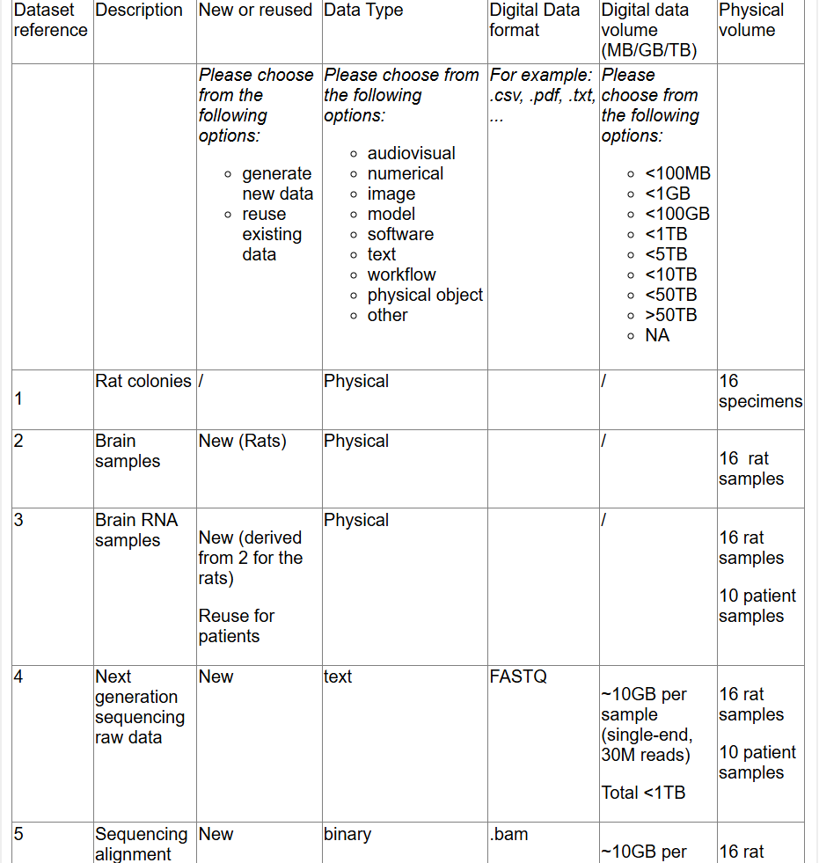
Jie’s data table
Translate to Data table:
Number your rows!
Add number to post-it

Slide 31
Plenary discussion
Share your thoughts about the exercise (1/2 sentences):
How easy was it to make the dataflow?
What insights did you gain from visualizing your dataflow?
Did drawing the dataflow help you to complete the data table in your DMP?

