Slide 1
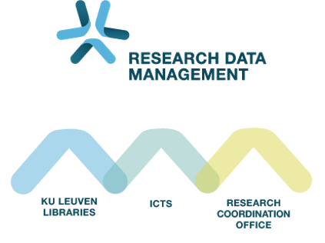
Introduction to RDM in Life Sciences Session 4: Plan for the micro-level
Audience: ECR from VIB @ KULeuven
November 25th 2025
Sylvette Vanderstraeten – Inge Mannaerts – Maarten Jackers

Slide 2
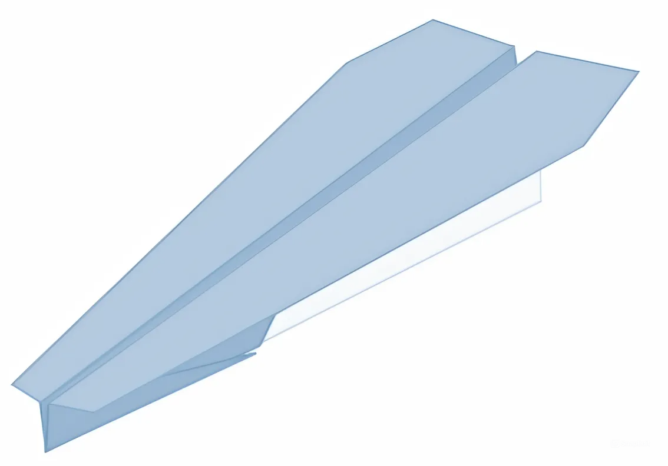
Let’s build a paper airplane!

Slide 3
Let’s build a paper airplane!
Option 2
Dataset: Paper, A4 size
Result: Origami plane
Method: The paper is folded in half, from bottom to top and back again. The points on the left side are folded towards the centerline. After that, the top and bottom are folded in half so that the corners align with the centerline. This point is also the end of the folded left point to the right. The paper is then folded in half towards the back, following the fold line created in the first step. Finally, the wings are formed. Only the top layer is folded in half so that the beveled edge meets the bottom edge. The same thing is done with the other side, but mirrored.

Slide 4
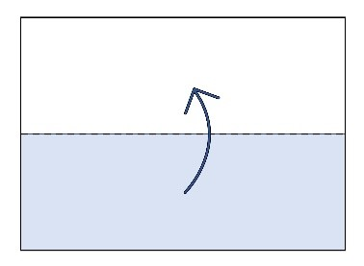
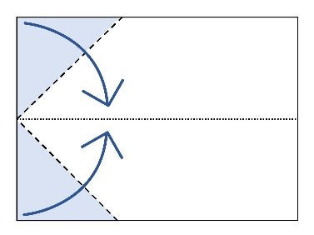
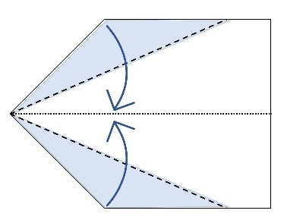
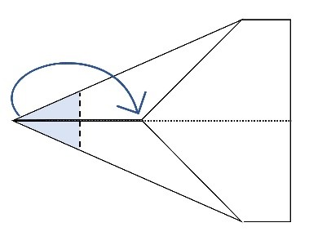
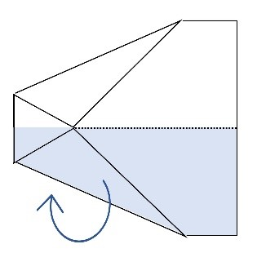
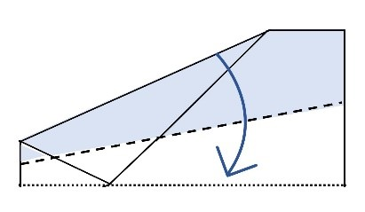
Let’s build a paper airplane!
1 |  | Fold the paper in half, from bottom to top and back again.
2 |  | Fold the points on the left side towards the centerline.
3 |  | Fold top and bottom in half so that the corners align with the centerline.
4 |  | Fold the left point to the right, exactly where the corners of step 3 meet on the centerline.
5 |  | Fold the paper in half towards the back, following the fold line created in step 1.
6 |  | Fold both wings down. Fold only the top layer in half so that the beveled edge meets the bottom edge. Do the same mirrored on the other side for the right wing.
Option 4
Dataset: Paper, A4 size
Result: Origami plane
Preprocessing step: Change the paper’s orientation from portrait to landscape.
Method:

Slide 5

What is documentation?
= information about data
Contextual & descriptive features of data
Understandable & interpretable by any user (humans)
e.g. Research design, data collection methods, protocols, README, …
Documentation

Slide 6
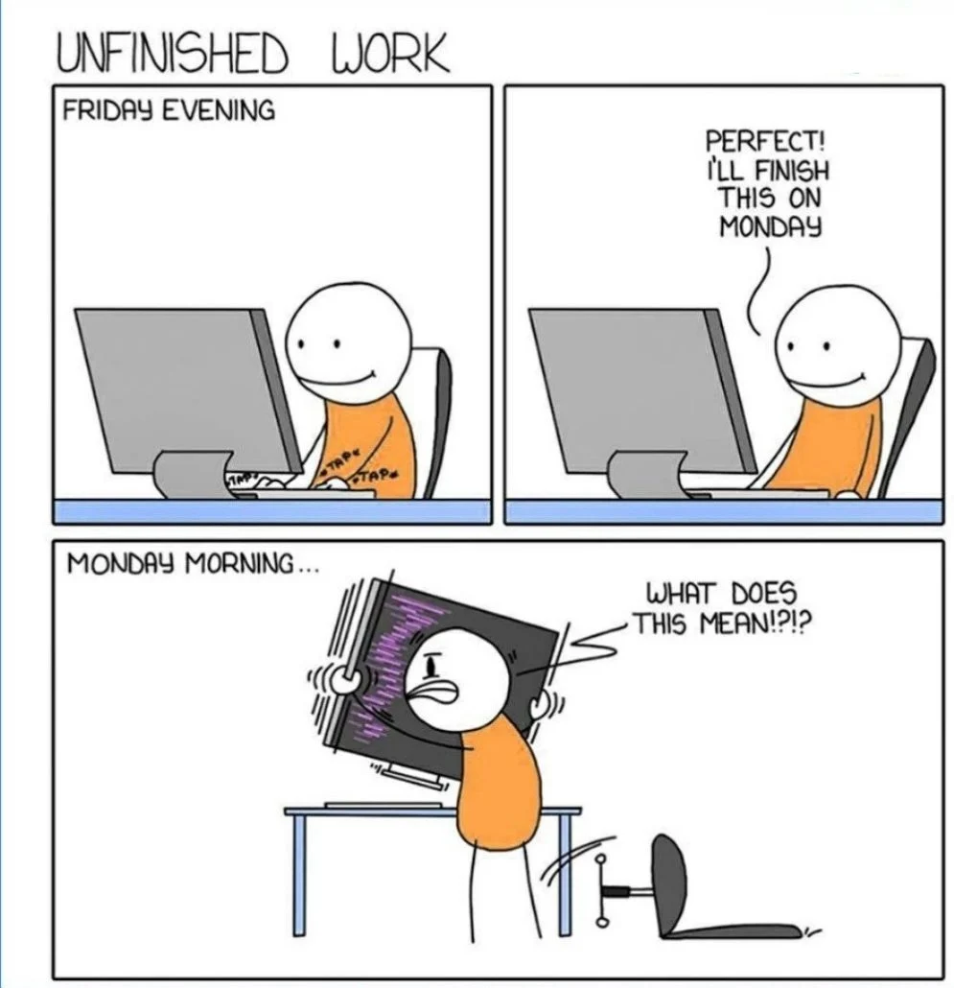
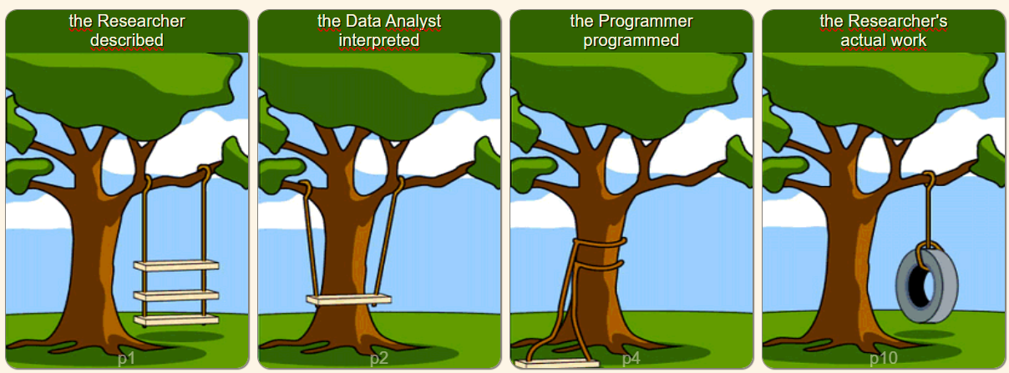
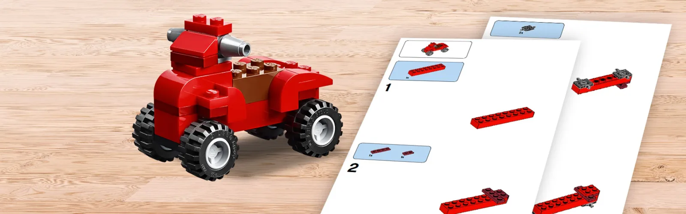
Why does documentation matter?
Starting guide to use Git with R for people with a life-science backround: https://happygitwithr.com/
https://github.com/islambayoumy/Git-Commit-Standards-Handbook
Notes:
1. Others can understand data and you can understand your data in the future (Afbeelding mannetje computer) (https://datasciencedojo.com/blog/data-science-memes/)
2. Make results reproducible/Reuse possible (of data OR methods) (Lego afbeelding) (https://www.lego.com/en-be/themes/classic/building-instructions)
3. Avoid misinterpretation of data (afbeelding met bomen) (https://www.slideshare.net/slideshow/project-cartoon-how-projects-really-work/4941154)

Slide 7
Exercise 4a: What to document?
What elements are needed to document a step (yellow post-it) in your dataflow?
Notes:
Guided group discussion with slides: what elements are needed to document one of the steps in your dataflow. Needs to come to: - Start: aims, objective, experimental design - Materials: -- Ingredients/materials/packages (+versions) -- Input files/samples used -- Tools, instruments, machine, hardware, software, code, … -- Parameters, conditions (experimental/environmental), settings,… —Protocol list/SOP/procedures - Methods: Step by step guide + visual setups etc. - END: conclusion, results, next steps.

Slide 8
Exercise 4a: What to document?
Introduction
Materials
Methods
Conclusions
Aims Objectives
Specimens – Samples Study object – Input files
Step by step Workflow
Results Output files
Ingredients – materials Code – Packages
Conclusions
Instruments – Machines Tools – Hardware - Software
Experimental design
Visual setup
Experimental Conditions Parameters – Settings
Next steps
Procedures – SOP’s – Protocols
Notes:
So, for a complete documentation for methods/steps, we need big blocks:
Introduction = to give context & backround
Materials = that lists everything you need/use for the step
The method itself = that describes the work you did
A conclusion at the end
For the intro: objectives or aims, but also experimental design information
The materials part can host the most categories, but it doesn’t always mean it has to be large.
You usually start with the thing you want the do the step on, whether you call that a specimen, sample, … For computational work that is your input file
Everything else you need to add to be able to do the thing you want to do
The tools you use, whether it is pc or lab
Things like settings, parameters, conditions,…
And then if there is some standardisation of what you’ll do or part of it → procedures, ect.
For the methods, we can think back to the paper airplane. It was useful to have a step by step, and also visual cues
And give a close to the step = results/outputs/… conclusions, next steps.,…

Slide 9
Data re-use
What if you don't collect data yourself?
→ Check & document:
Data provenance: source, author, …
The license/terms of use: This will tell who can do what with the reuse data
Legal & Ethical restrictions
Usability:
Is the documentation complete and understandable?
Do you have the tools/programs to use the data (see also Open / standard data formats)
Notes:
1. Others can understand data and you can understand your data in the future (Afbeelding mannetje computer) (https://datasciencedojo.com/blog/data-science-memes/)
2. Make results reproducible (Lego afbeelding) (https://www.lego.com/en-be/themes/classic/building-instructions)
3. Avoid misinterpretation of data (afbeelding met bomen) (https://www.slideshare.net/slideshow/project-cartoon-how-projects-really-work/4941154)

Slide 10
Exercise 4b: What tools do you use to document each step (yellow post-it) in your dataflow?
Discuss in pairs:
How do you currently document each step (what tool do you use)?
What documentation do you already create, and where are the gaps?
Do you use all elements from the previous exercise? If not, why? Would you change current practice?

Slide 11





Tools to document with
ELN

Slide 12








Originally Dutch (eLabNext merged with SciShield to form SciSure)
SciSure is the world’s first Scientific Management Platform (SMP)
Created by scientists, for scientists (our input is taken by the company to update their services)
Support over 800 organizations with more than 550,000 users globally.
Notes:
Key message: the platform is successful and widely used (social opportunity)
Secondary message: the platform may be called by different names due to mergers and partnerships. Voiceover: The eLabNext is a dedicated platform for scientists by scientists. It is used by some of the largest and most prominent institutions (Sanofi, NIH, Memorial Sloan Kettering, HP, CDC, BMS, etc).

Slide 13

The platform in 3 key modules
Journal
Protocols
Inventory

Slide 14

The journal
Structured platform
Build detailed experiments
Tag, annotate, communicate
Create templates for reproducibility
Export in PDF, HTML, XML or JSON

Slide 15




Tools to document with
Do you write code?
ELN
Moderate to Advanced
Minimal:
Add code comments
Follow code style guide
Valuable:
Use computational notebooks Use Git for version control Use propper Git commit messages Use containers for computational environment
Yes
No
Simple Analysis (xls, SPSS, …)
ELN
Paper notebook
Xls template
…
→ Consider same tool as collection

Slide 16

Tools to document with
Do you write code?
Moderate to Advanced
Minimal:
Add code comments
Follow code style guide
Valuable:
Use computational notebooks Use Git for version control Use propper Git commit messages Use containers for computational environment
Yes
No
Simple Analysis (xls, SPSS, …)
→ Consider same tool as collection
ELN
= information about data
(Semi) structured information on data
Machine readable (preferably)
Standardised: easily combine, compare, map with other data
Metadata

Slide 17
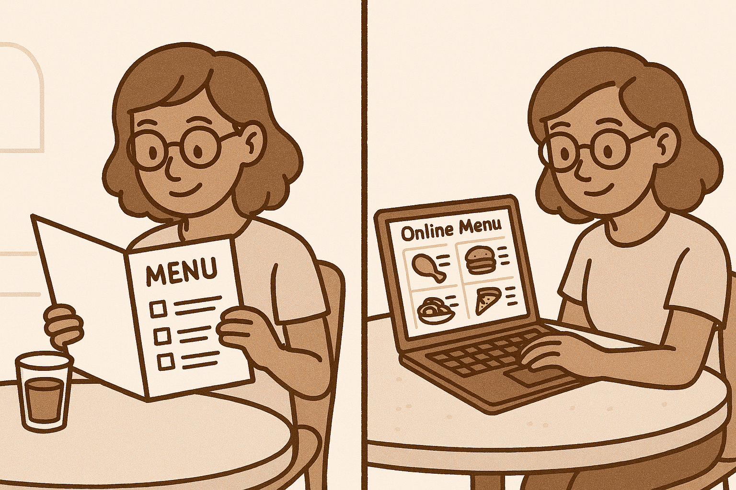
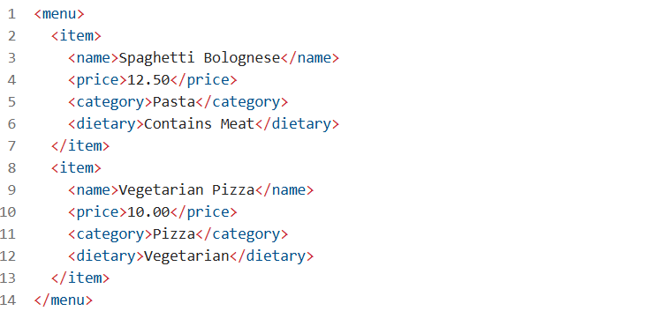
Metadata
What?
Materials & methods
Sample/Patient/Participant ID
Notes:
Uitleg: Het verschil tussen “gewone” documentatie en metadata is dezelfde als tussen een papieren menu in een restaurant, en de online versie van dezelfde menu in een betel-platform als “take away”. Er kan dezelfde informatie instaan, maar de eerste is enkel vlot te lezen door mensen. Het tweede is ook verstaanbaar voor ons, maar er zit ook een heel computersysteem achter, die maakt dat we kunnen filteren, selecteren, categoriseren, ... De makers van het menu kunnen ook gemakkelijker dingen aanpassen, categoriseren, copieren naar andere platformen ect. Zelfde info, meer functionaliteiten en compatible met computers.

Slide 18

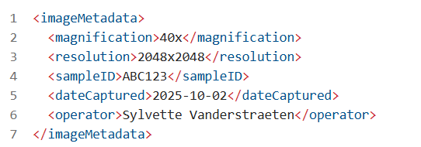

Metadata
Parameters = metadata.xml
For more information about metadata standards

Slide 19
Do you write code?
Tools to document with
Moderate to Advanced
Minimal:
Add code comments
Follow code style guide
Valuable:
Use computational notebooks Use Git for version control Use propper Git commit messages Use containers for computational environment
Yes
No
Simple Analysis (xls, SPSS, …)
→ Consider same tool as collection
ELN
Parameters = metadata.xml

Slide 20






Exercise 4: Documenting each step – Example Jie’s project
M&M = Materials & Methods:
Intro: Objectives, experimental design
Materials: Samples, Ingredients, instruments, parameters, SOP’s
Methods: Visual setup, workflow
Conclusion: Results, link to output, next steps
SciSure ELN
M&M
SciSure ELN
M&M
RNA samples
TgF344-AD & WT rat colonies
Euthanasia & brain extraction
Fresh/frozen brain tissue
RNA isolation & Quality Control
RNA QC report
Sample sheet
= simplified
Making Graphs, tables + writing manuscript, …
Bioinformatics Analysis:
Quality control (FastQC)
Alignment (e.g., STAR)
Quantification (e.g., featureCounts)
Differential expression analysis (e.g., DESeq2)
Raw FASTQ-files
QC reports
BAM files
Count matrix
DE results
Library prep & RNA sequencing
Sequencing report
M&M = Materials & Methods:
Intro: Objectives
Materials: Input files, code source + versions, packages + versions Methods: Data cleaning, Step-by-step (=code itself)
Conclusion: Results, link to output, next steps
SciSure ELN
M&M
Code comments + style guide + GIT commit messages
M&M
Documentation
Data points
Steps/Processes
Notes:
We could complete the process with something like this.
For sake of space, the analysis part has been simplified. We would still recommend to do this in detail.

Slide 21
Exercise 4: Documenting each step of your dataflow
Workbook p.3
Choose tool for “materials & methods” documentation of each step (ELN, …). Write this on a pink post-it note and add it next to the step.
Add M&M (“materials & methods”) template to pink post-it notes Select the correct terminology for you & for each step

Slide 22
Exercise 4: Documenting each step of your dataflow
Pair discussion:
Would you be able to recreate a certain step of the data flow?
Did you include all elements from 4a? If not, why?
Do you use similar words/terminology, or do the terms differ?
Do your documentation practices differ between wet lab and computational work?
Are there already templates available in your research group? Do you see missing elements (from there or here)? Are there templates for both labwork and computerwork?

Slide 23
Plenary discussion
Have you encountered issues related to too little documentation and/or differences in terminology?
Are there templates in your group? Is one person in charge of actively updating/streamlining these templates?
How can we ensure consistency in documentation across team members?
How can we make documentation less burdensome but still effective?
What institutional or community support would help improve documentation?

Slide 24
BREAK

Slide 25
Exercise 5: Beyond the steps – What else to document?
What other documentation do you provide for a project, other than the “materials & methods” style?

Slide 26
Exercise 5: Beyond the steps Documentation for organisation
Sample list
Variable list
Storage inventory
Material inventory
Protocol inventory
Equipment inventory
Codebook
Notes:
Guided group discussion with slides: what other type of documentation do we need to keep things organized? Look back at the Materials section. What needs to be organised?
Materials inventory
Sample list
Instrument inventory
Storage inventory
Protocols inventory
But also: - variable list - ELN organisation -...

Slide 27
The platform in 3 key modules
Journal
Protocols
Inventory

Slide 28



The protocol
Also known as: SOPs, procedures, etc…
Create, share, adapt protocols
Versioning!
Automatic calculations, dynamic fields, minimization of human error

Slide 29
The Inventory
Visualize your lab
Flexible integrated (bulk) sample management
Audit trail
Can be linked to supplies through product catalog to centralize ordering
Equipment booking, maintenance, calibration, sharing, manuals, etc…

Slide 30
Exercise 5: Beyond the steps Documentation for organisation
Workbook p. 4.
Add the missing documentation on your dataflow with pink post-its Add the tool you will use.
Take a global view of all the pink post-its. Go DMPonline – fill in section 2 of your DMP (documentation & metadata).

Slide 31
Storage
Notes:
MIN # slides: 8
MAX # slides: 24

Slide 32
Data storage – secure & reliable
Secure = Protection from hacking and other attempts of theft
Personal data
Confidential data
Trade secrets
Dual use data
Encryption
Controlled access
Password & MFA
Secure transfer

Slide 33

Data storage – secure & reliable
Secure = Protection from hacking and other attempts of theft
Reliable = prevent loss by hardware failure
Backup
Mirroring
Snapshot

Slide 34
Data storage – secure & reliable
Secure = Protection from hacking and other attempts of theft
Reliable = prevent loss by hardware failure
Use storage approved by your institution

Slide 35
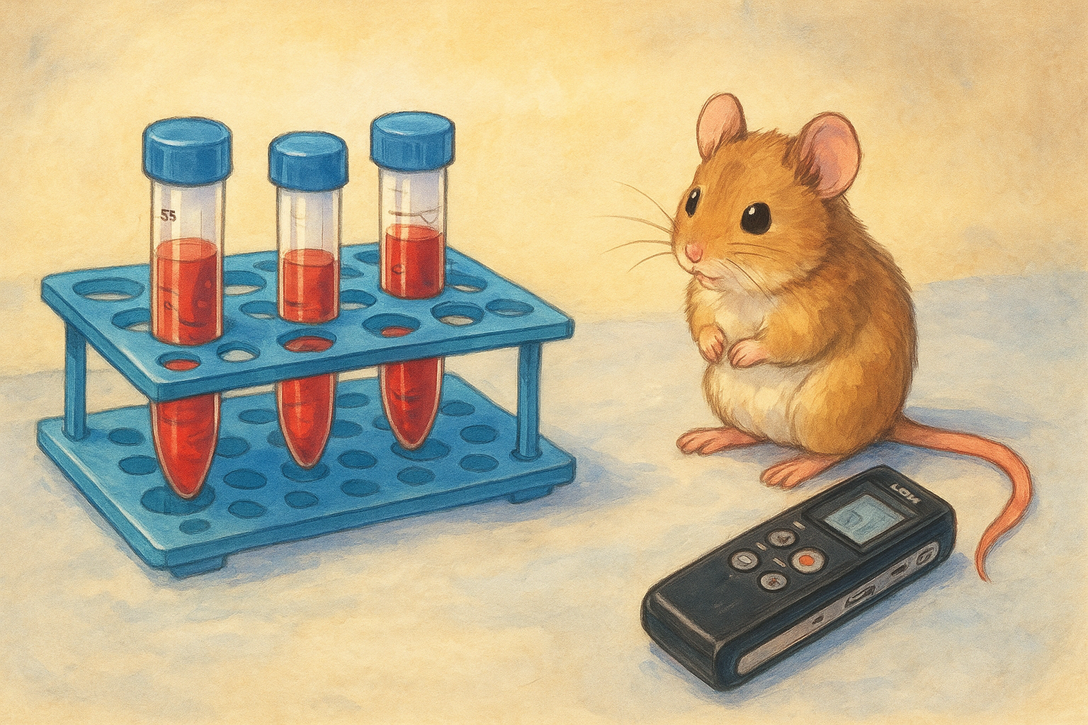
Physical data
Store physical data and documentation appropriately
Tubes, … → freezer, fridge, …
Paper ICF, … → filing cabinet (locked!)
! Check security requirements
! Think about copies

Slide 36
Digital data
Institutional storage!
Use project/group-bound storage locations:​
Primary copy always in secure project/group storage location.​
Avoid personal storage like OneDrive, I: drive, or local drives as primary storage.​
Okay to use local copy for processing
Don’t store sensitive data on portable devices (USB / Hard drives)!

Slide 37
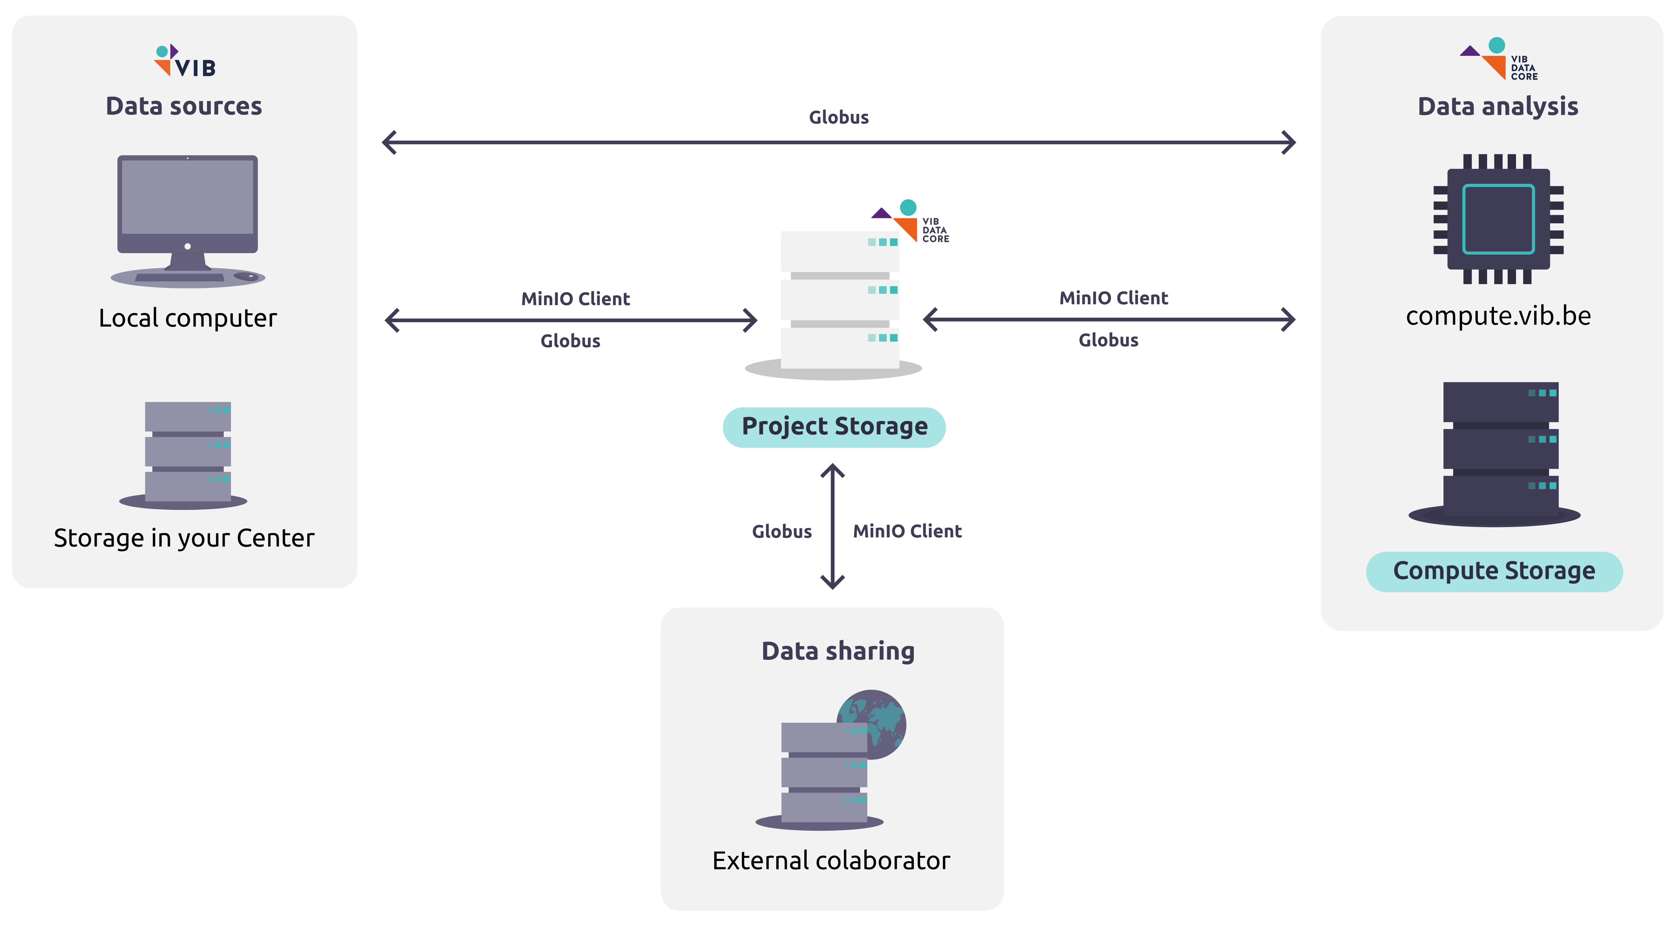


Data Core storage solutions
Ideal for large files
Ideal for collaborations between departments
More info? Data Storage | VIB Data Core Documentation
datacore.help@vib.be
Notes:
Currently there is no cost associated with using Data Core storage. HOWEVER, these will be implemented though more information on when and exact pricing is not known.

Slide 38
Exercise 6: add storage to dataflow
Workbook p.4
For all data points (blue):​
Is the recommended storage place from my research group appropriate for this datapoint?​ (both physical and digital)
If not, where is the best place to store this?​
Do I need additional security measures for this data?​
Do I have enough space available (both physical and digital)?

Slide 39
Exercise 6: add storage to dataflow
For all documentation (pink)​:
Does this documentation fit in the same storage location as my data?​
If not, how will I solve this problem? (documentation is best kept in same location)​
Define proper storage space for all blue and pink post-its
Fill in the questions in section 3 (storage) in your DMP template

