Slide 1
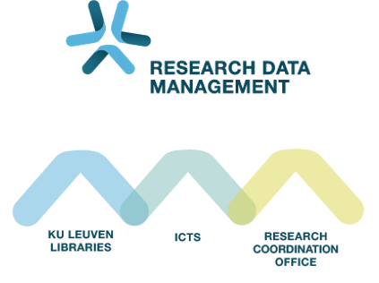
Introduction to RDM in Life Sciences Session 5: Plan for the macro-level
Audience: ECR from VIB @ KULeuven
November 25th 2025
Sylvette Vanderstraeten – Inge Mannaerts – Maarten Jackers

Slide 2
Let’s build with DUPLO

Slide 3




Let’s build with DUPLO

Slide 4




Notes:
Set 30673 duplo

Slide 5



Notes:
Set 30673 duplo

Slide 6
Keep the overview
Organize your project
README file
File naming convention
Folder structure
Metadata
Notes:
We weten nu op het "onderste niveau" hoe we ons werk moeten documenteren en bewaren. Maar het overzicht bewaren van alles in niet simpel, dus documenteren en organiseren op projectniveau is een must.

Slide 7
Keep the overview
Organize your project
README file
Open format (.txt .md)
General information (funder, project description,…)
Document Folder structure & naming
Necessary for repository (see later)
Use template!
File naming convention
Folder structure
Metadata
Notes:
We weten nu op het "onderste niveau" hoe we ons werk moeten documenteren en bewaren. Maar het overzicht bewaren van alles in niet simpel, dus documenteren en organiseren op projectniveau is een must.

Slide 8
Exercise 7: Make a README file for your project
Exercise bundle p.5
Instruction:
Open README_ProjectTemplate.txt
Fill in the General Information about your project
Rename: README_[YourProject].txt and save it in your project folder.

Slide 9
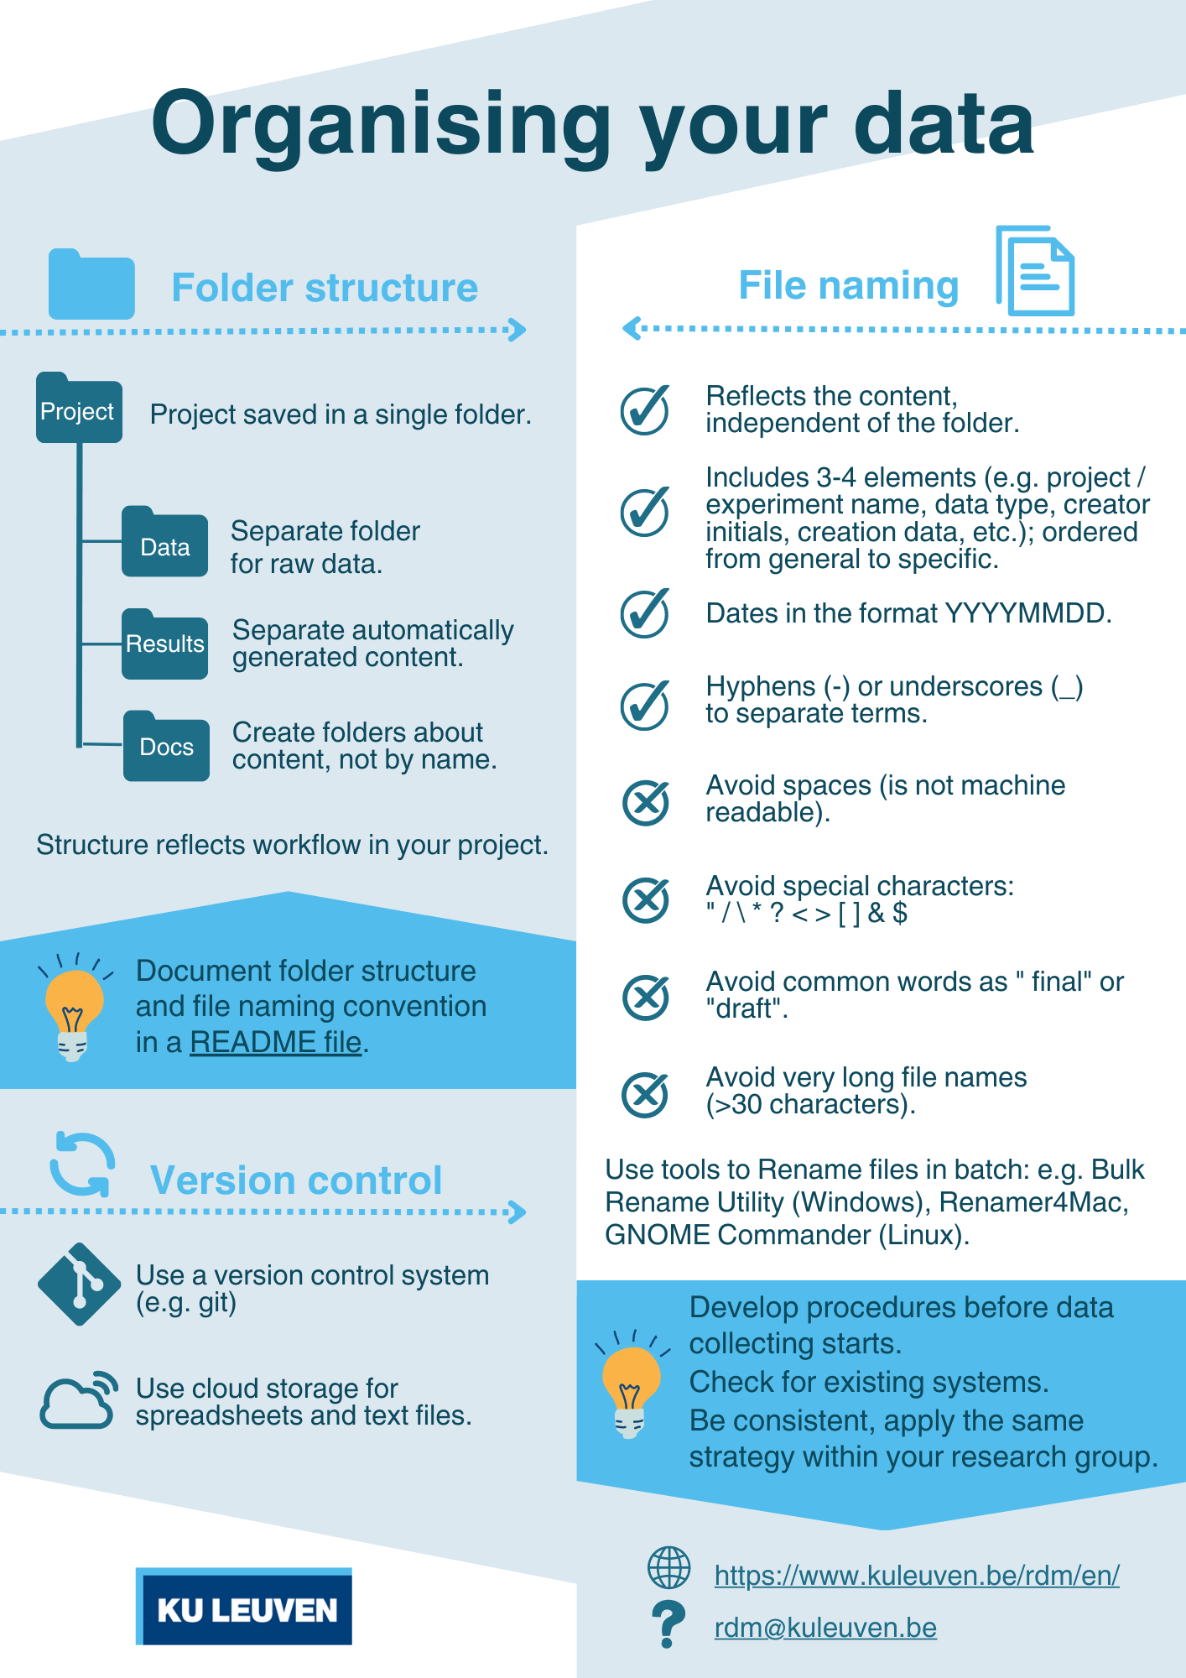
Keep the overview
Organize your project
README file
File naming convention
Folder structure
Metadata
Notes:
We weten nu op het "onderste niveau" hoe we ons werk moeten documenteren en bewaren. Maar het overzicht bewaren van alles in niet simpel, dus documenteren en organiseren op projectniveau is een must.

Slide 10
Exercise 8: Build a file naming convention
Workbook p.5 – 8
From: Briney, K. (2023). The Research Data Management Workbook. Caltech Library. https://doi.org/10.7907/z6czh-7zx60
In pairs:
Follow the 8 questions in your workbook.
Update your README file
Pair discussion:
Would you be able to adapt your convention to the rest of your project?
Could you use a similar method to decide on a naming scheme for your ELN? What are the similarities and differences?

Slide 11
Keep the overview
Processing data
Organize your project
README file
File naming convention
Folder structure
Metadata
Notes:
We weten nu op het "onderste niveau" hoe we ons werk moeten documenteren en bewaren. Maar het overzicht bewaren van alles in niet simpel, dus documenteren en organiseren op projectniveau is een must.

Slide 12
Exercise 9: Build a folder structure
Workbook p.9
In pairs:
In dataflow: find the digital data (blue post-its)
Copy to new blue post-its
Add new post-its from list
Check yellow and pink post-its for data files (code, separate documentation,…) → copy as well
Make folder structure with new post-its
Add to README

Slide 13
Exercise 9: Build a folder structure
Workbook p.9
Pair discussion:
How do you currently organize your project folders?
Would the other parts of your project fit into this folder structure? How would you need to adapt this?
What folder structures have worked well (or not) in past projects?
How do you handle shared folders in collaborative projects?

Slide 14
Jie’s file naming and folder structure

Slide 15
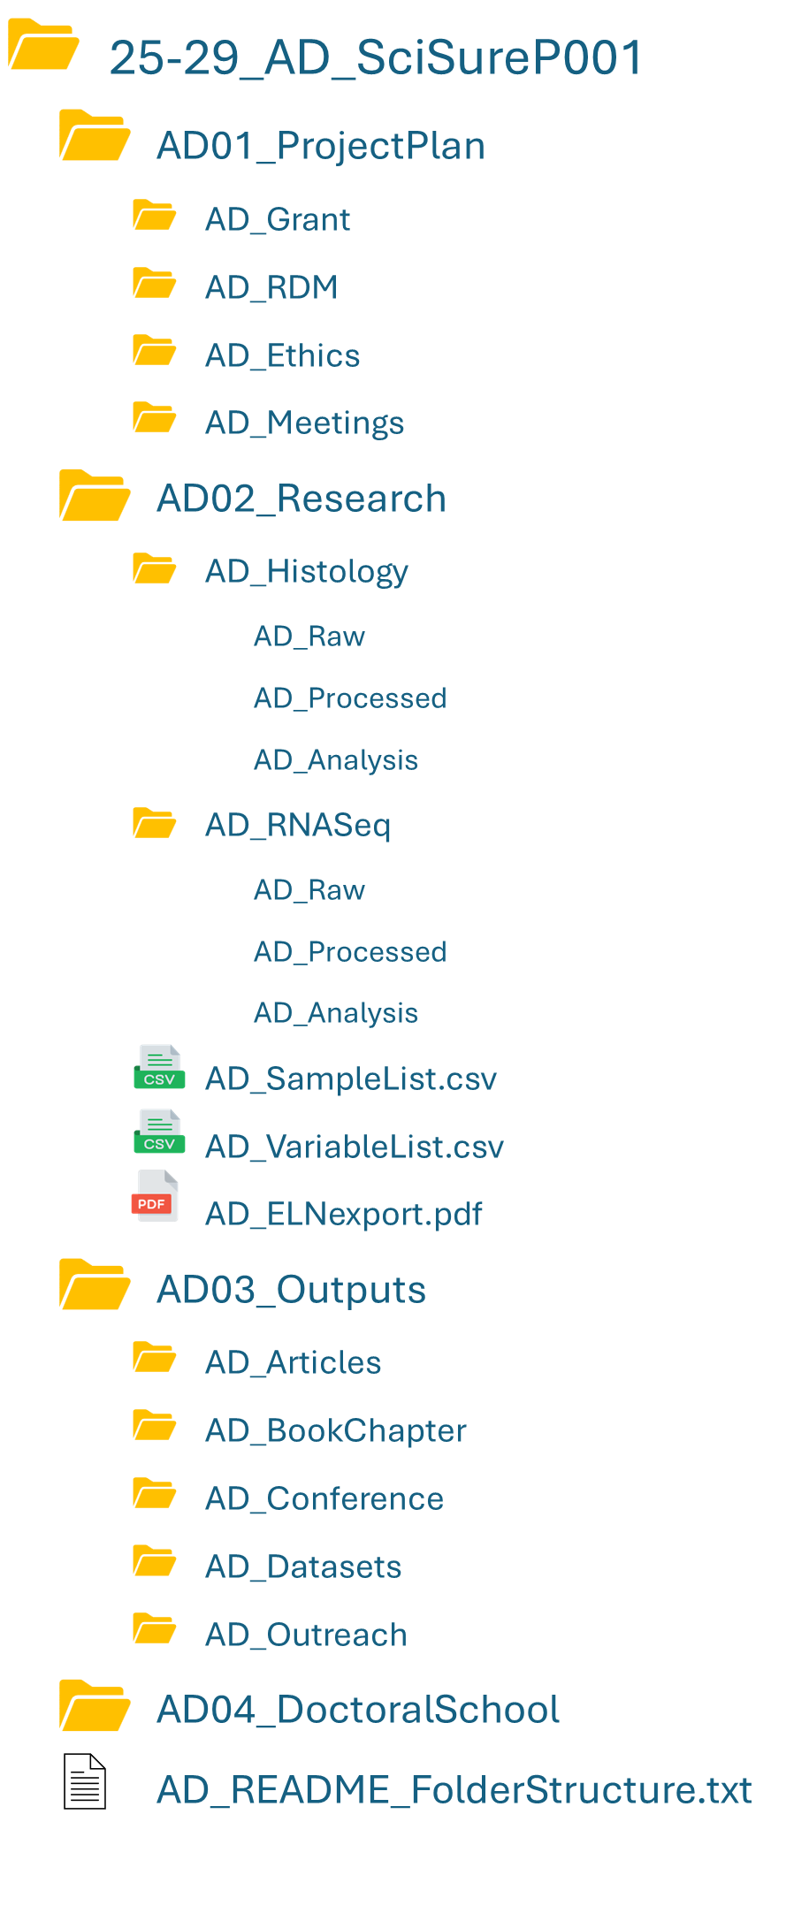
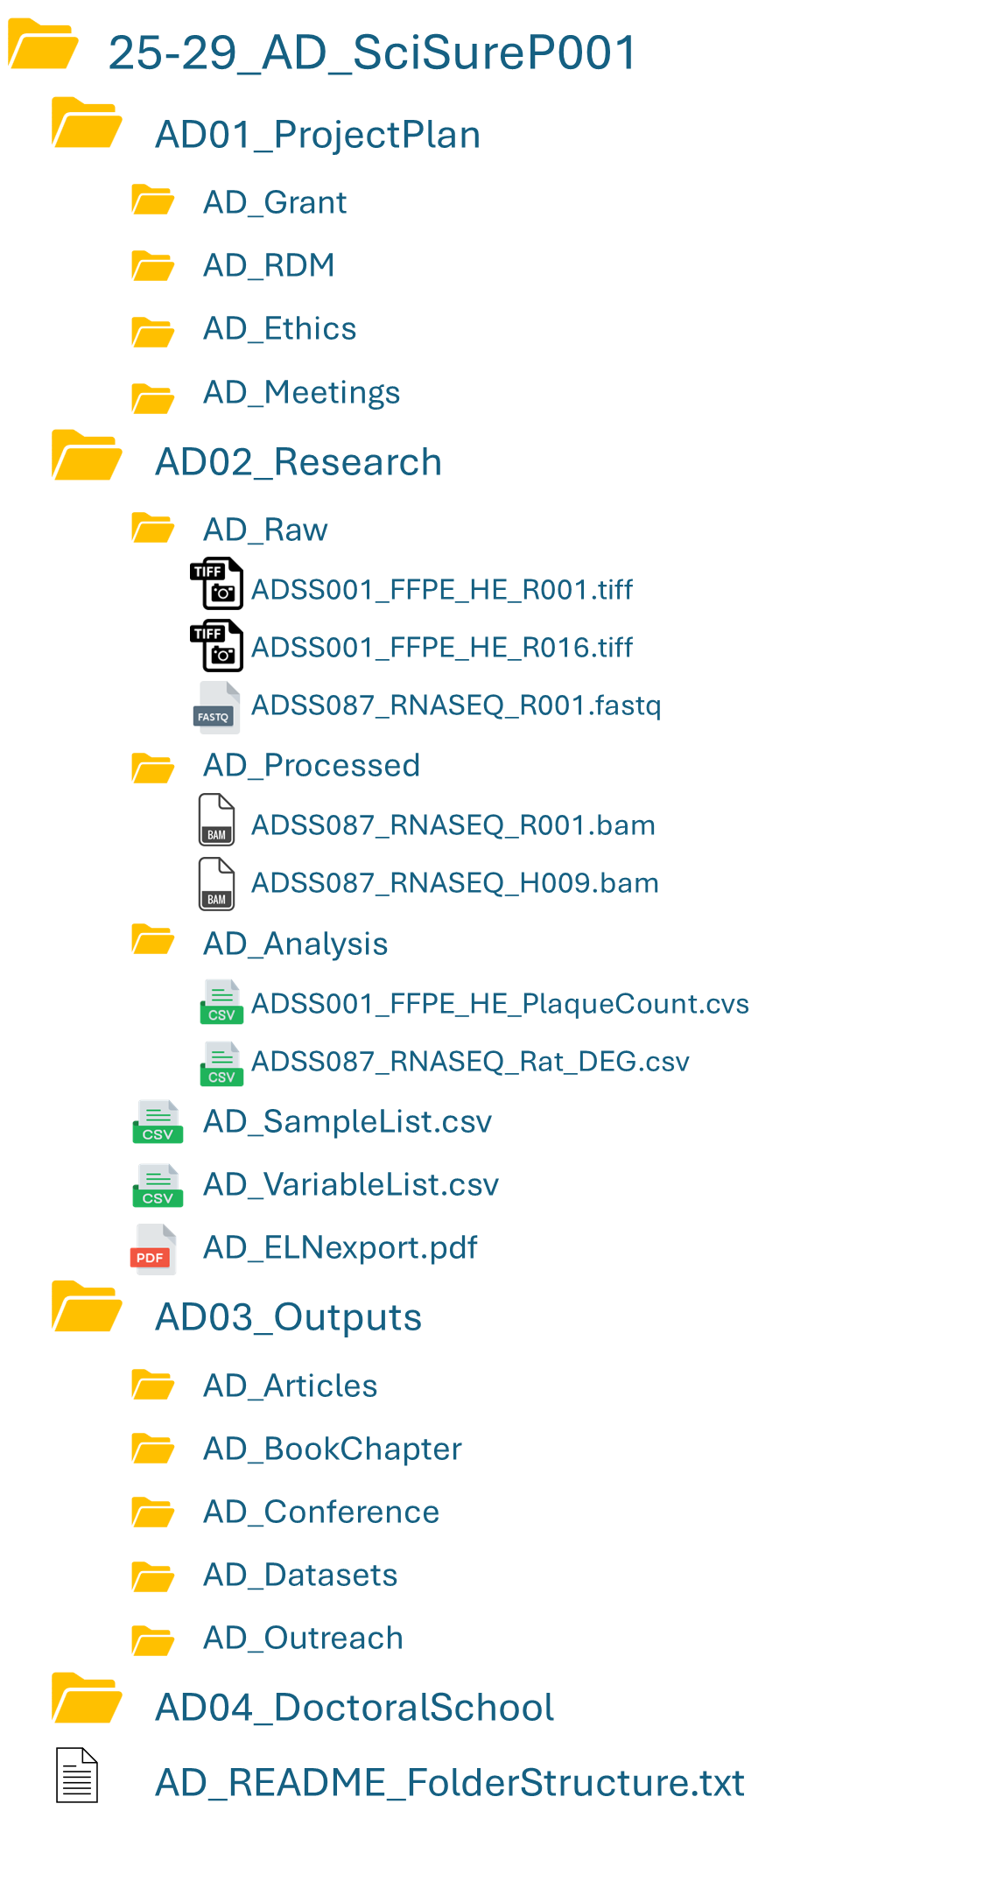
= Data type-based organization
+ Less folder levels (assay folders could be made)
+ Clear file names
Many files in 1 folder
Longer file names
= Assay-based organization
+ Clear
- Many folders = many clicks
= ELN export 1x per year
= ELN export 1x per year
AD = Alzheimer disease
ADSS = Alzheimer disease SciSure

Slide 16
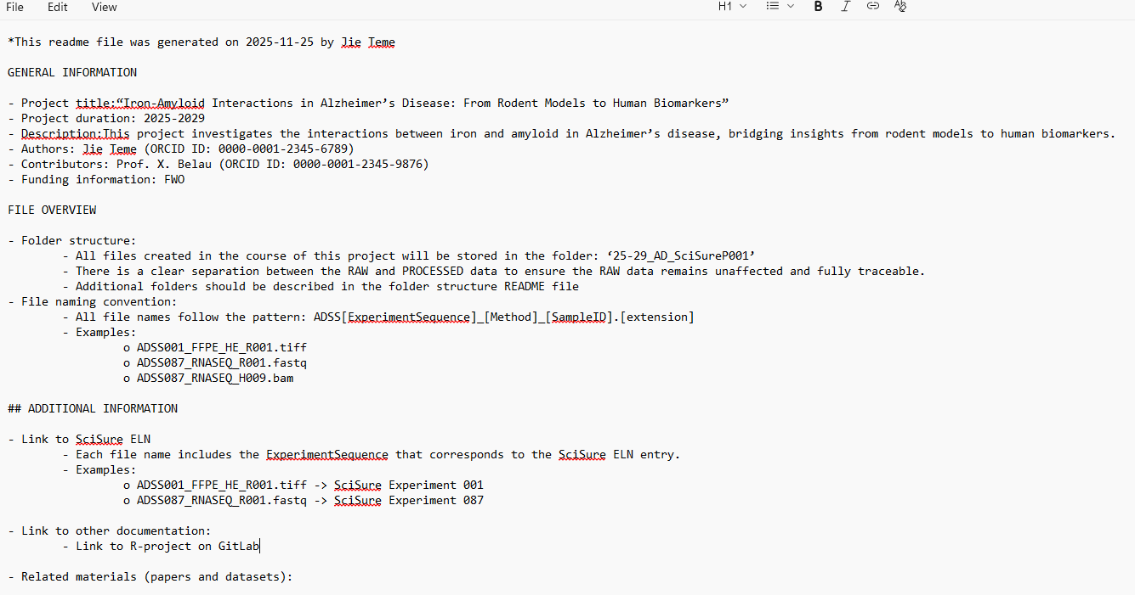
Jie’s project README at project start

Slide 17
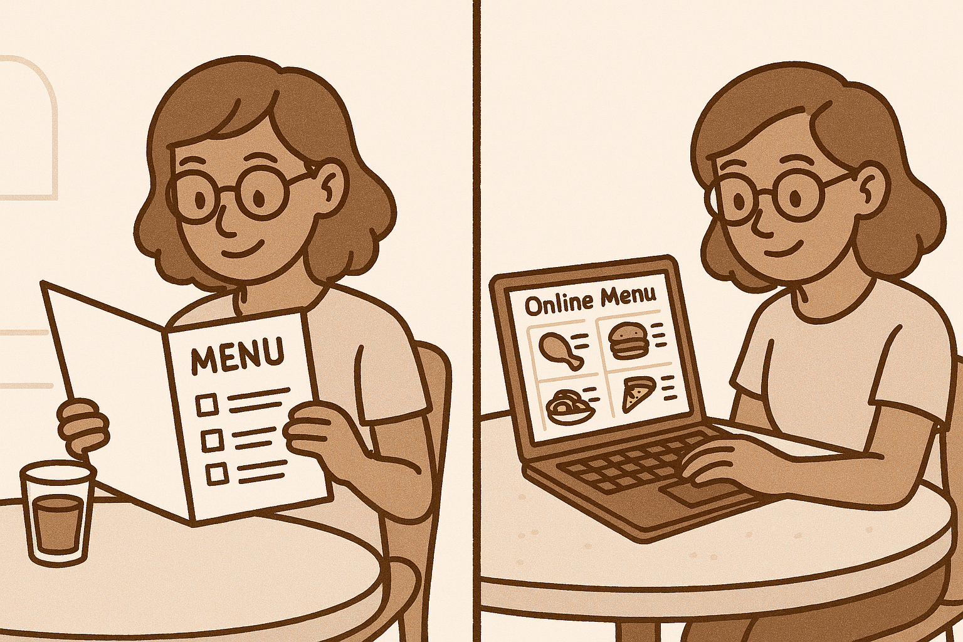
Keep the overview
Organize your project
README file
File naming convention
Folder structure
Metadata
Start with the end in mind
Add metadata by using repositories
Find a trustworthy repository (RDR, …)
Publishers and repositories = requirements for metadata standards
Notes:
We weten nu op het "onderste niveau" hoe we ons werk moeten documenteren en bewaren. Maar het overzicht bewaren van alles in niet simpel, dus documenteren en organiseren op projectniveau is een must.

Slide 18
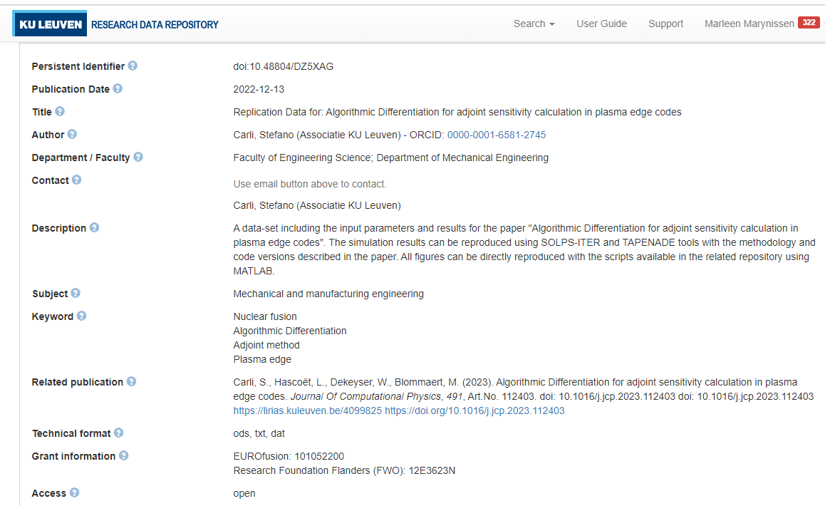
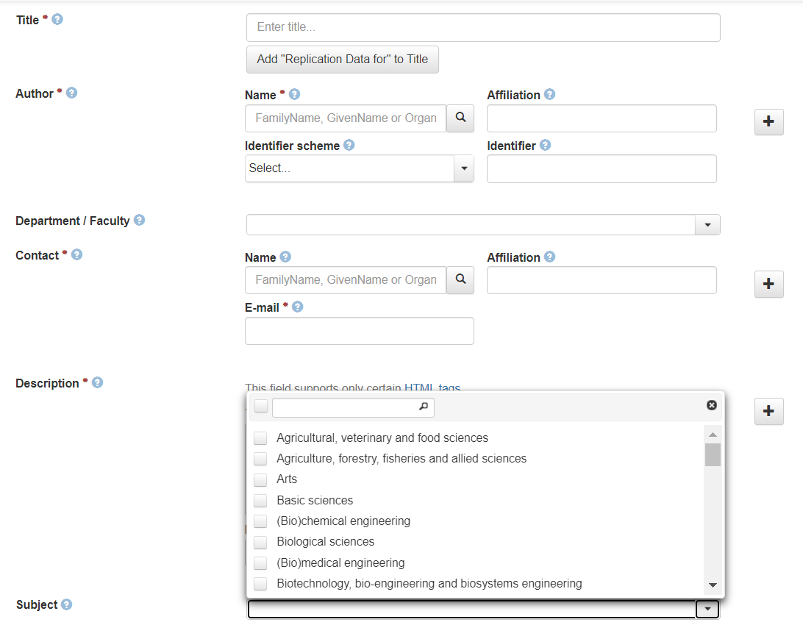
Metadata in Research Data Repository (RDR)
Carli, Stefano, 2022, "Replication Data for: Algorithmic Differentiation for adjoint sensitivity calculation in plasma edge codes", https://doi.org/10.48804/DZ5XAG, KU Leuven RDR, V3
https://www.kuleuven.be/rdm/en/rdr/full-metadata-model
Notes:
Easiest example = metadata fields in repository:
structured, machine readable (format XML, JSON): makes it more exchangeable with other systems & platforms
Standardized fields & terms; controlled vocabularies integrated
DOI included in the metadata

Slide 19
Exercise 10: Back to the DMP
Workbook p.10
Add In DMPonline section 2.1 (documentation):
README
File naming
Folder structure

Slide 20
Plenary discussion
Share your thoughts about this session:
Should naming conventions be flexible or strictly enforced?
How can we make folder structures intuitive for new team members?
How can we deal with changes in the project that affect the naming convention or folder structure?
Can we make a uniform naming scheme across both the files and the ELN?
How can we encourage consistent naming across a team?

Slide 21
What you have build in this course: RDM survival Package
For a subset of your project:
Visual overview of your data (dataflow)
Documentation and storage plan
File naming convention and folder structure
README - project level
Partly filled in DMP
Notes:
Story:
We are pretty ambitious and want you guys to leave with some tangential – useful outputs that will serve you during your project. This is a pilot so we’ll have to see how it goes, but we are hopeful it will be worth your while
But we only have 1 day, so it will be for a subset of your project. But hopefully you’ll know enough by the end to do all this for the rest of your project as well
A visual overview of your project or dataflow, with a very detailed highlight on one part
With this, a very comprehensive documentation and storage plan
A file naming and folder structure scheme
And a partly filled in Project README file to document the high level stuff
And to make it so you are in line with the RDM requirements, we’ll translate and summarize all of that in a DMP also.

Slide 22
Next steps
Build a dataflow for rest of project
Adapt plan to accommodate the rest of your project
Think about ethical & legal considerations
Think about archiving & sharing
Notes:
Story:
We are pretty ambitious and want you guys to leave with some tangential – useful outputs that will serve you during your project. This is a pilot so we’ll have to see how it goes, but we are hopeful it will be worth your while
But we only have 1 day, so it will be for a subset of your project. But hopefully you’ll know enough by the end to do all this for the rest of your project as well
A visual overview of your project or dataflow, with a very detailed highlight on one part
With this, a very comprehensive documentation and storage plan
A file naming and folder structure scheme
And a partly filled in Project README file to document the high level stuff
And to make it so you are in line with the RDM requirements, we’ll translate and summarize all of that in a DMP also.

Slide 23

What will you take home for your own research?

Slide 24

Questions and feedback

