Slide 1
Initiatives for research [sensitive] data sharing
Dilza Campos, PhD
22/10/2024

Slide 2
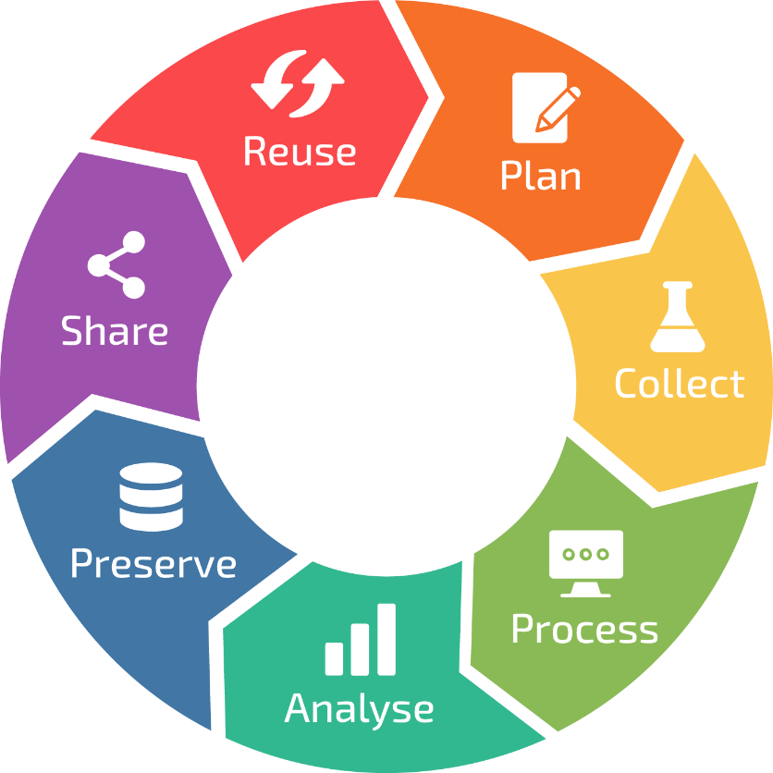
Data sharing
Data management matters at every stage of research
Promotes transparency and reproducibility
Avoids duplication of effort
Accelerates scientific discovery
Maximizes return on investment
Meets funder and journal mandates
Increases your visibility and citations
Contributes to open science and public trust

Slide 3

Data sharing – Plan ahead
Data sharing starts at project design
Define what data will be generated
Choose metadata standards early
Planning ahead will save you from stress

Slide 4
Guidelines on finding a repository
A persistent identifier (PID) should be assigned to each dataset.
Rich and standardized metadata should be present.
License or terms of use information about the reuse of the data is available or can be determined on the dataset level.
The repository provides broad, equitable and ideally open infrastructure to access content on the platform.
The platform ensures the preservation and continued availability and access to the data and metadata entrusted to it by the users.
Information about the mission, scope, preservation policies and plans is available and transparent.
https://www.kuleuven.be/rdm/en/guidance/data-sharing

Slide 5


Finding your repository
Generic versus domain-specific repositories
Disciplinary and domain-specific repositories
  Should be commonly used and endorsed by the research communities.
  Should be recognized internationally.

Slide 6


ELIXIR can help
info@elixir-belgium.org

Slide 7

Sharing sensitive data
Secure sharing of human genomic and phenotypic data
Data access is controlled, not open
Ensures compliance with GDPR and ethics standards
Used by major consortia (e.g., ELIXIR, GA4GH)

Slide 8
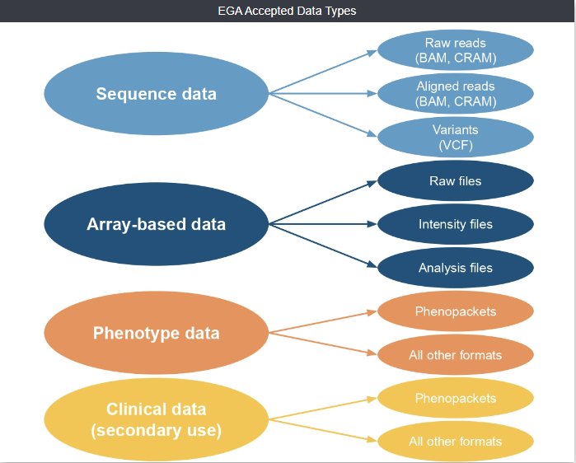
Data types at EGA

Slide 9
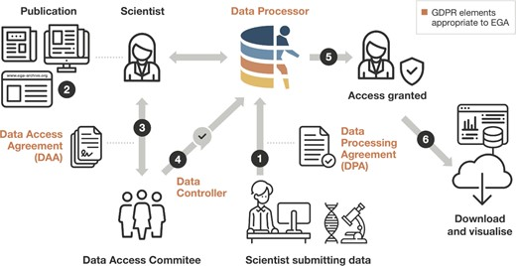
EGA submission process
Submission after a Data Processing Agreement
A scientist discovers the dataset (e.g. through a publication or by navigating the EGA)
The DAC is contacted and a DA is defined
EGA is informed of access permission
Scientist can access the data
Data is downloaded and re-used
VIB: https://kb.vib.be/#/article/1328

Slide 10

Sometimes, data can’t be moved
What to do, then?

Slide 11
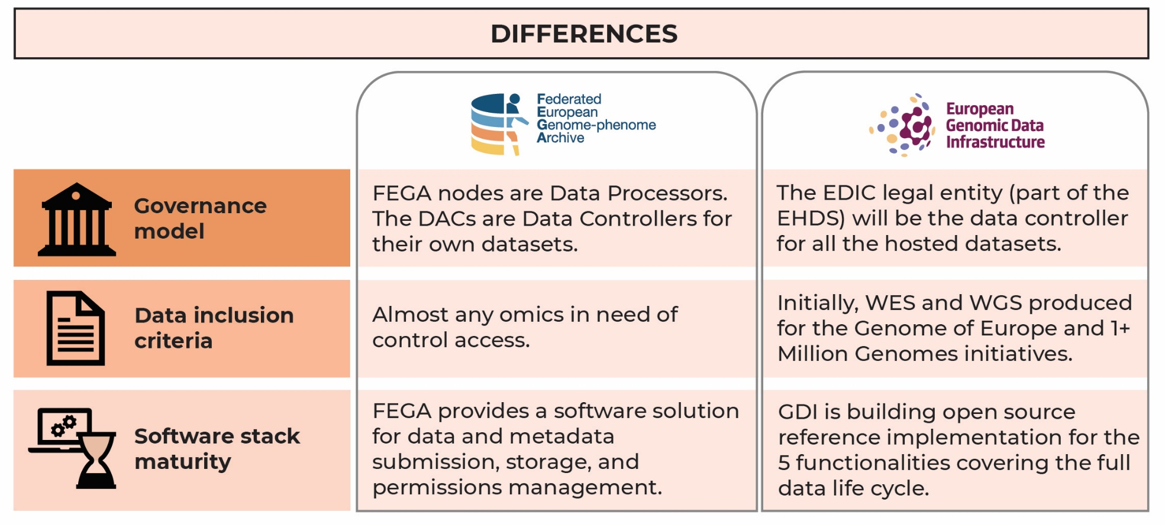
Beyond EGA: FEGA and GDI (2026)

Slide 12
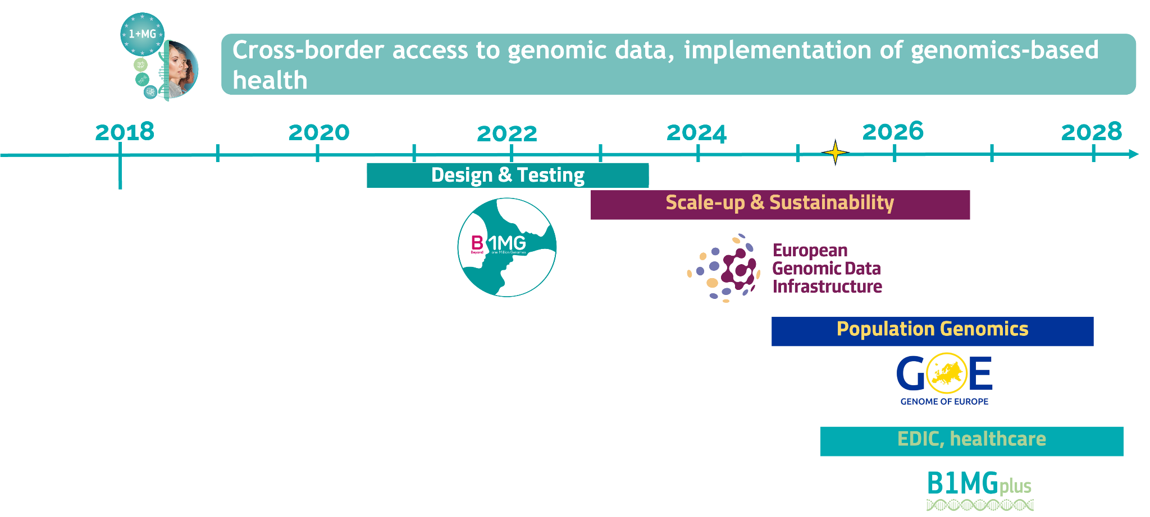


Slide 13
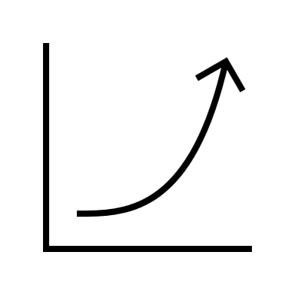
Health data sharing is on the rise
Legislation on reusing health data for research purposes (EHDS) from 2025
Several data sharing and data discovery initiatives (GA4GH, HDA, GDI)
Good moment to think about it

Slide 14
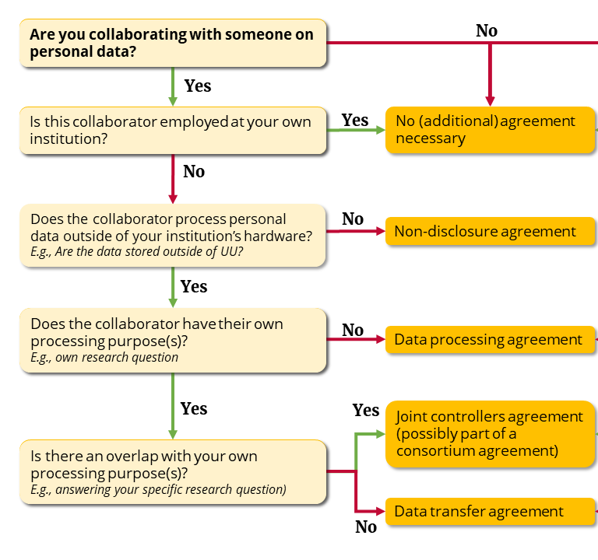
Sharing sensitive data in practice
https://utrechtuniversity.github.io/dataprivacyhandbook/

Slide 15
Thank you

