Slide 1

Ilastik
User-friendly machine-learning-based image analysis
2026
Benjamin PAVIE
Benjamin.pavie@vib.be

Slide 2
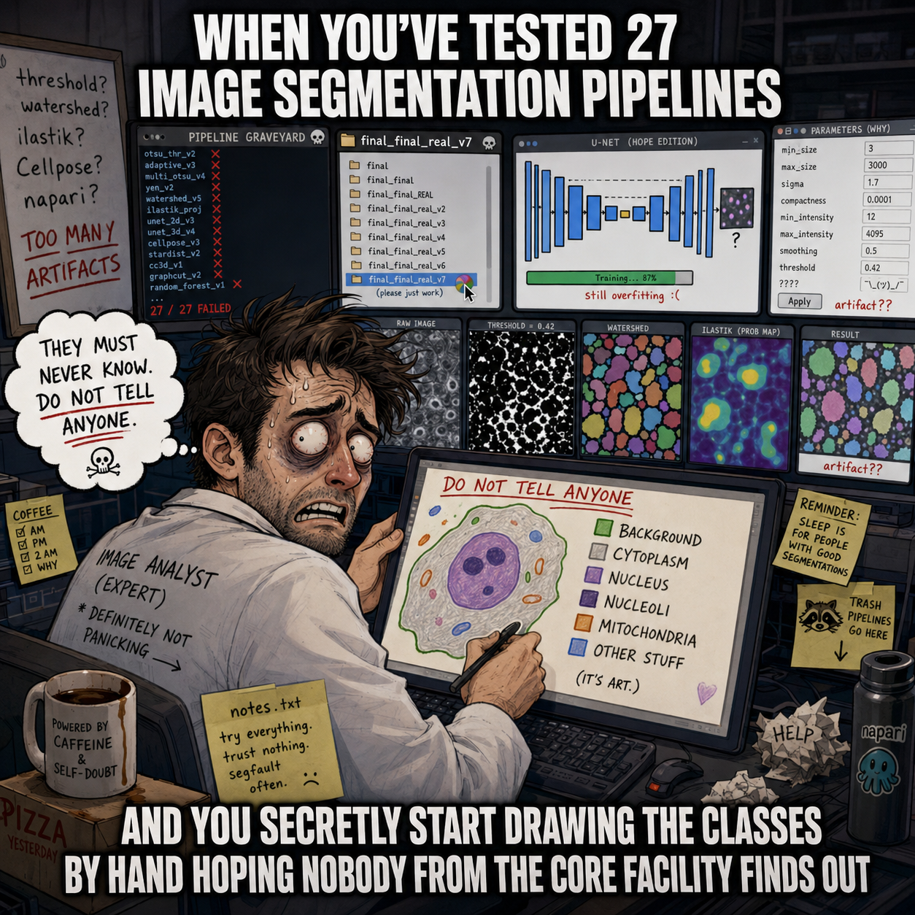
Segmentation is THE bottleneck of image analysis

Slide 3



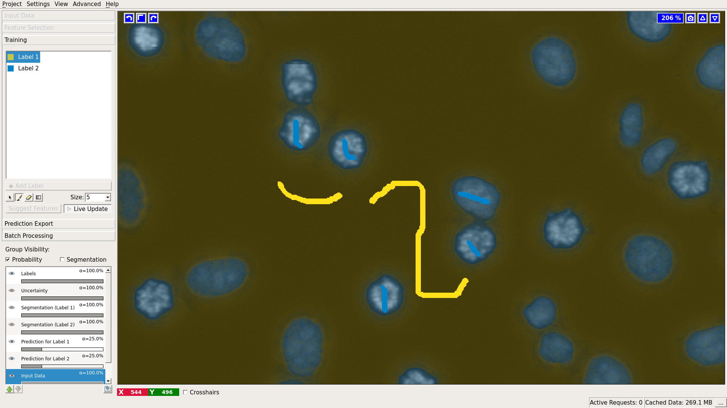
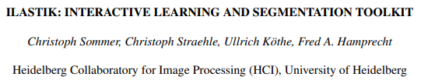
3
Ilastik: Segmentation for the people
Anna Kreshuk
2011 doi: 10.1109/ISBI.2011.5872394

Slide 4
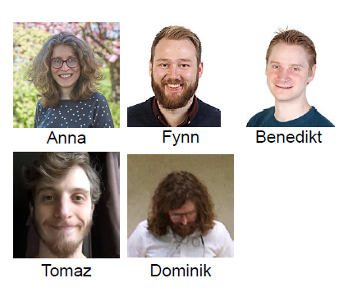



Ilastik
Installation
Installer : https://www.ilastik.org/download
Documentation : https://www.ilastik.org/documentation/
Forum : https://forum.image.sc/tag/ilastik/527

Slide 5
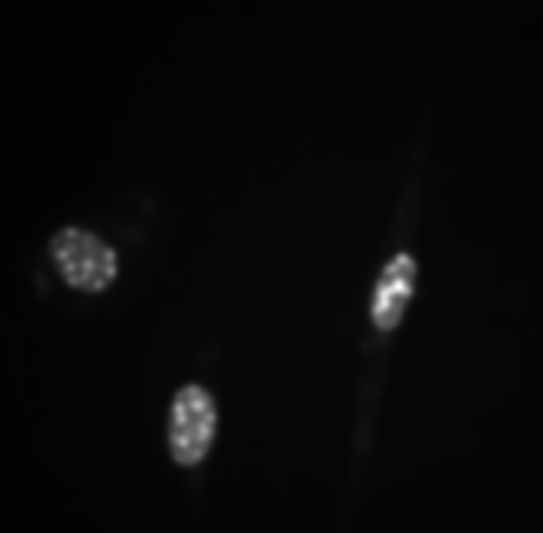
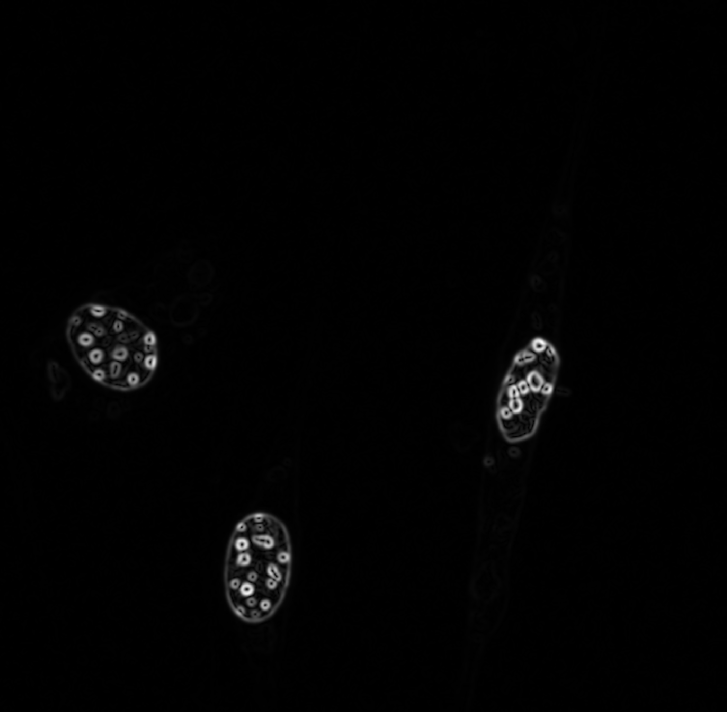
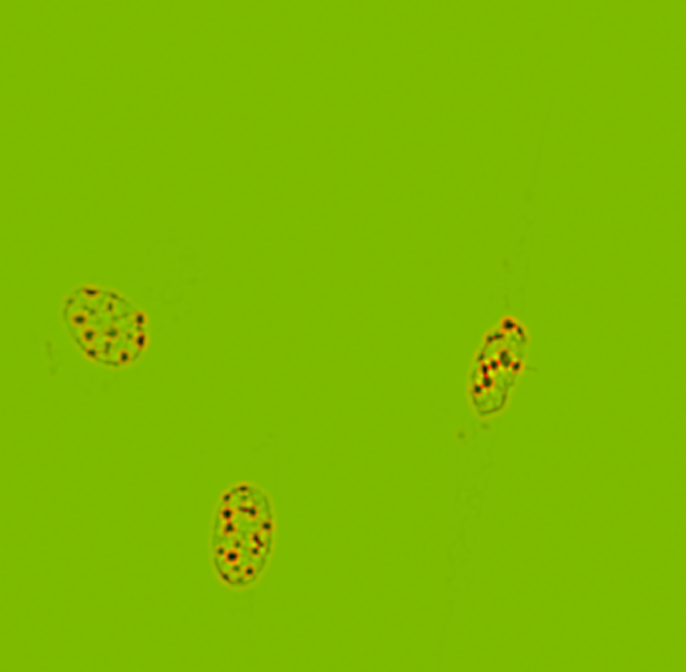

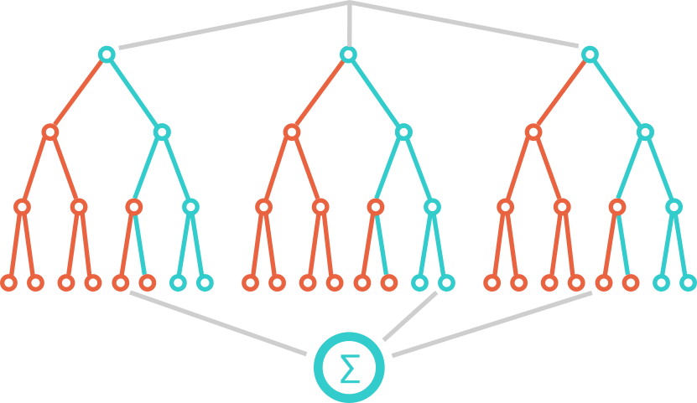
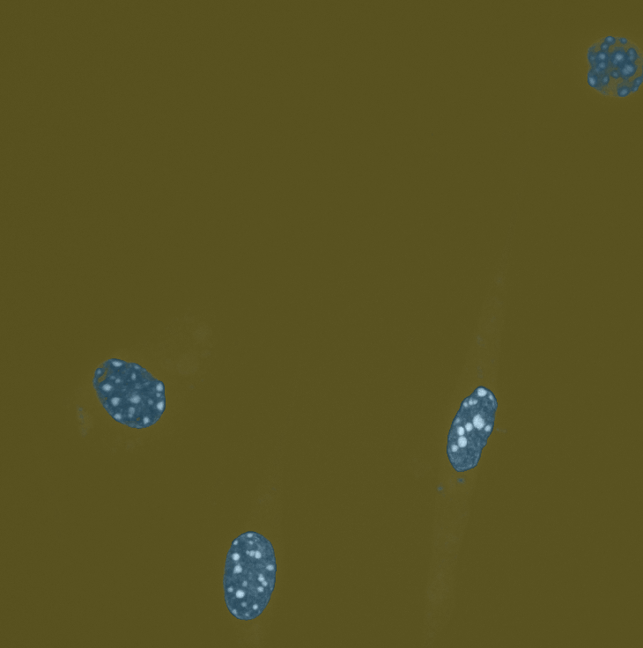
Machine Leaning in Image Analysis
Gaussian Blur
Gaussian Gradient magnitude
Hessian of Gaussian EigenValues
…
Generic
Filters
Raw Image
Machine Learning
Probability Mask

Slide 6
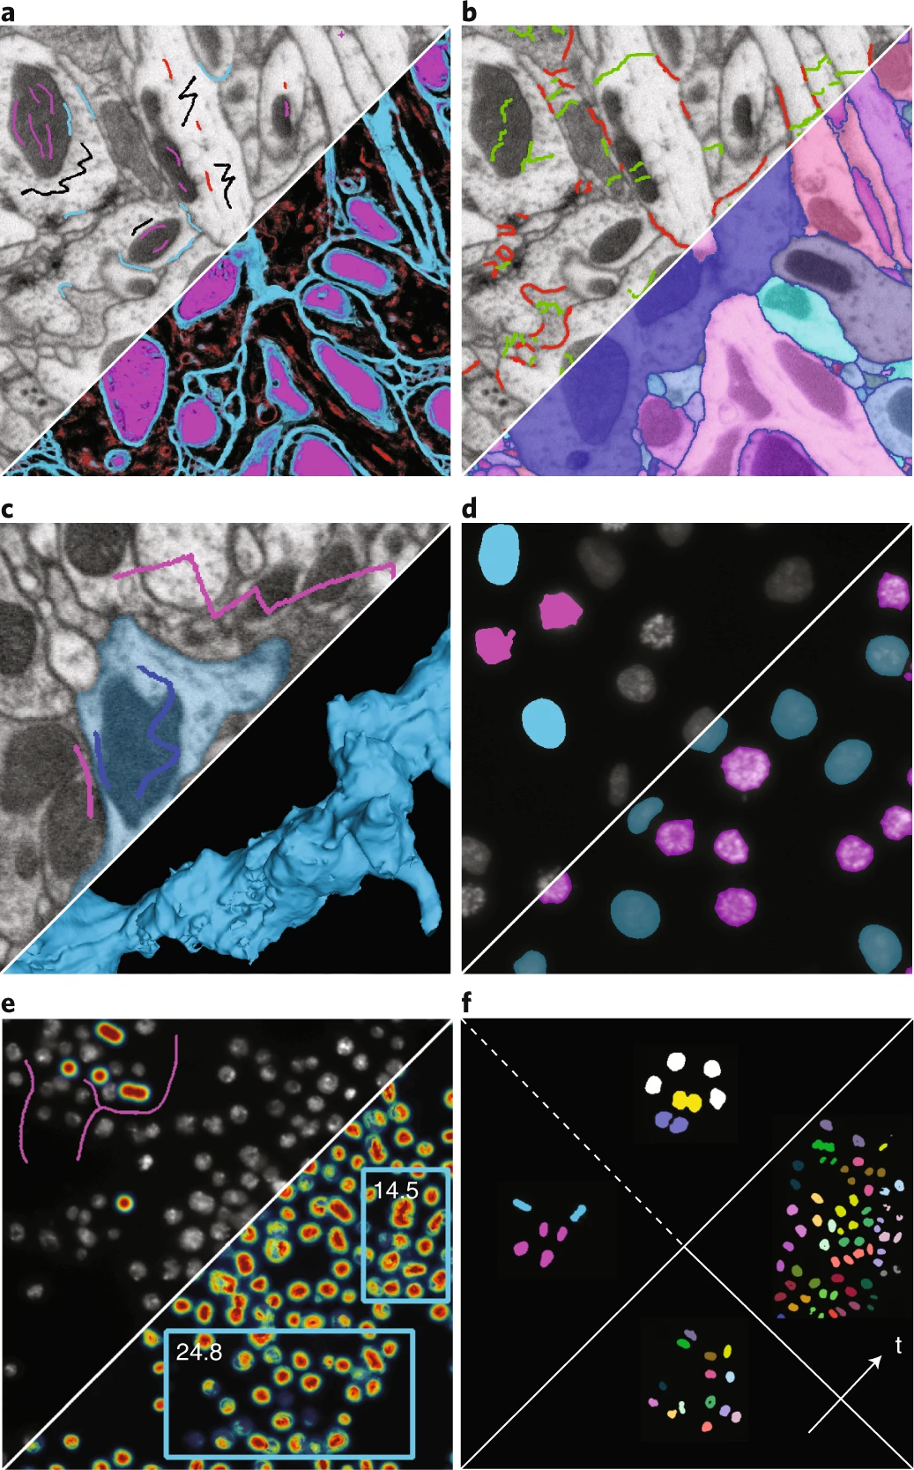
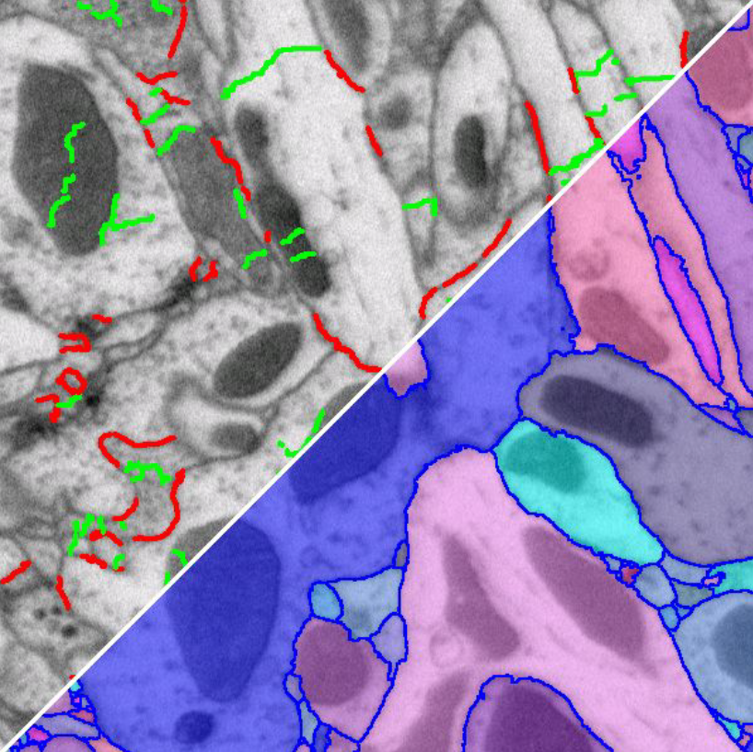
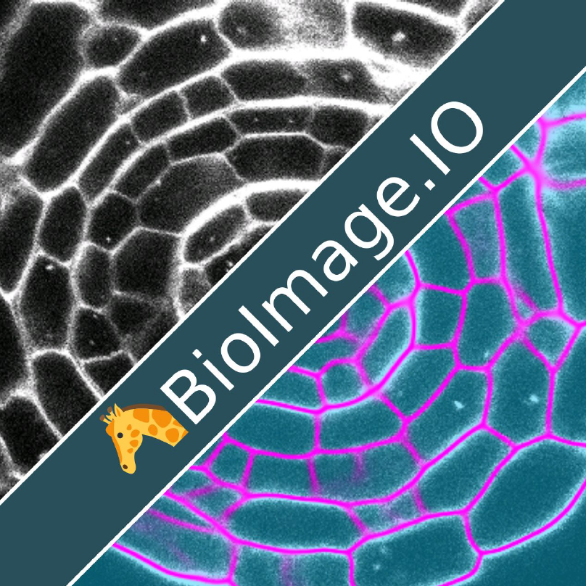
Ilastik Worflows
Boundary-based
Segmentation
Neural Network
segmentaton
Pixel classification
Carving Segmentation
Segmentation
Post-Segmentation
Object classification
Object Tracking

Slide 7
Ilastik Worflows
Boundary-based
Segmentation
Neural Network
segmentaton
Pixel classification
Carving Segmentation
Segmentation
Post-Segmentation
Object classification
Object Tracking

Slide 8
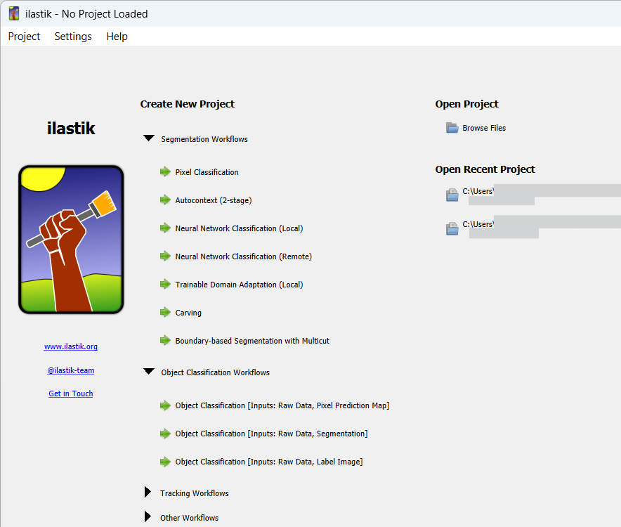
Ilastik Worflows

Slide 9
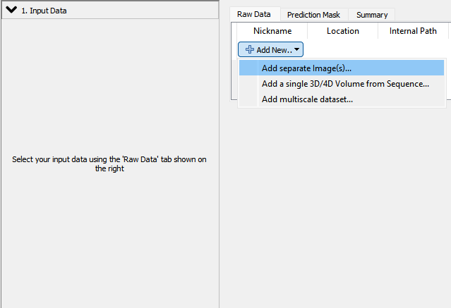


Pixel Classifier
Loading images
Data>00_2d_example>nuclei_D_AlessioSilva.tif
Add training image as separate image(s)
Supported image formats :
Block formats :
HDF5,
Zarr
Generic formats :
TIF/TIFF (2D and stack)
PNG
GIF

Slide 10
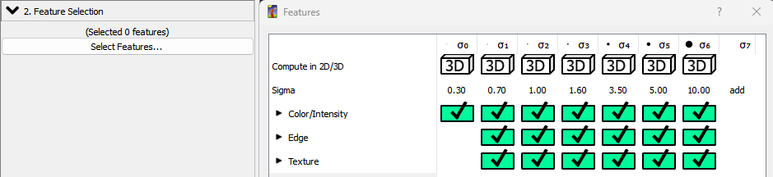
Pixel Classifier
Feature Selection
Features are the eyes of Ilastik:
  Color/intensity
  Edge
  Texture/granularity
  Scale (sigma, 2D/3D)
37 total features by default
adding larger σ is possible

Slide 11

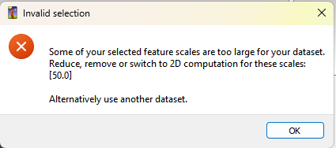
Pixel Classifier
Feature Selection
If you have less that the sigma size number of height/width pixels or Z slices,
it will give you an error that gets solved by ticking off the sigma that is too large for your data.

Slide 12
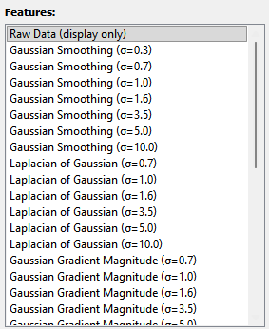
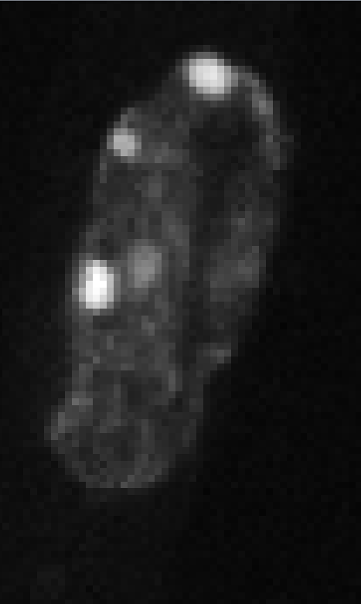
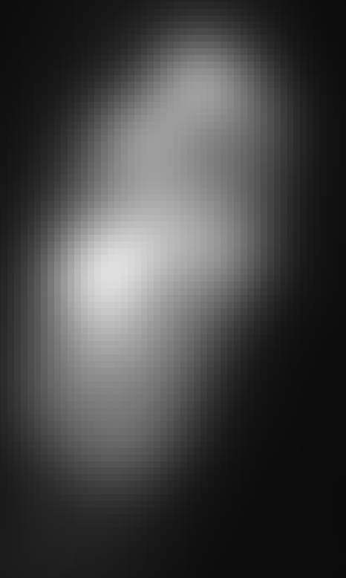
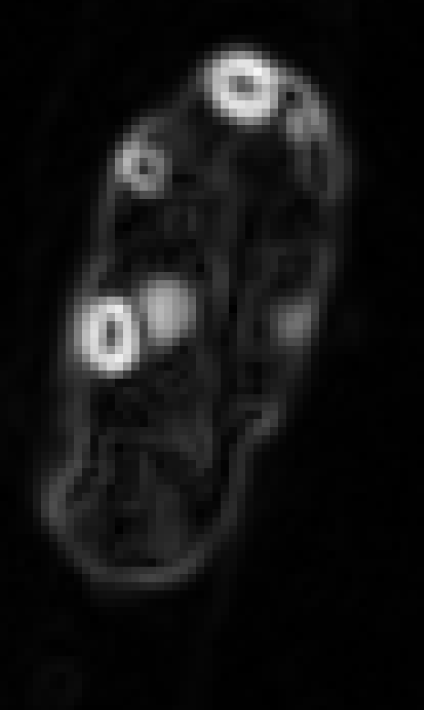
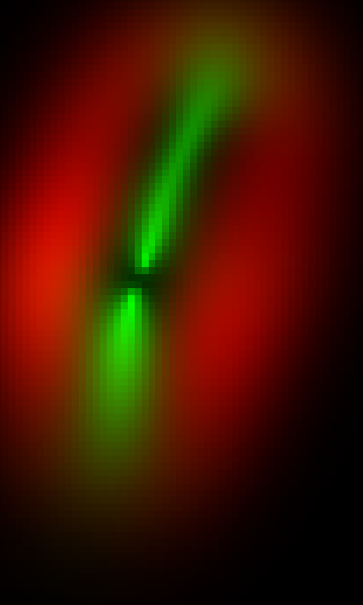
Pixel Classifier
Feature Selection
Features along with their σ are located in the bottom left.
Click on them to visualize the effect of the filter
Raw itensity
Features
Ilastik does not take calibration into account.
Be careful in 3D.

Slide 13
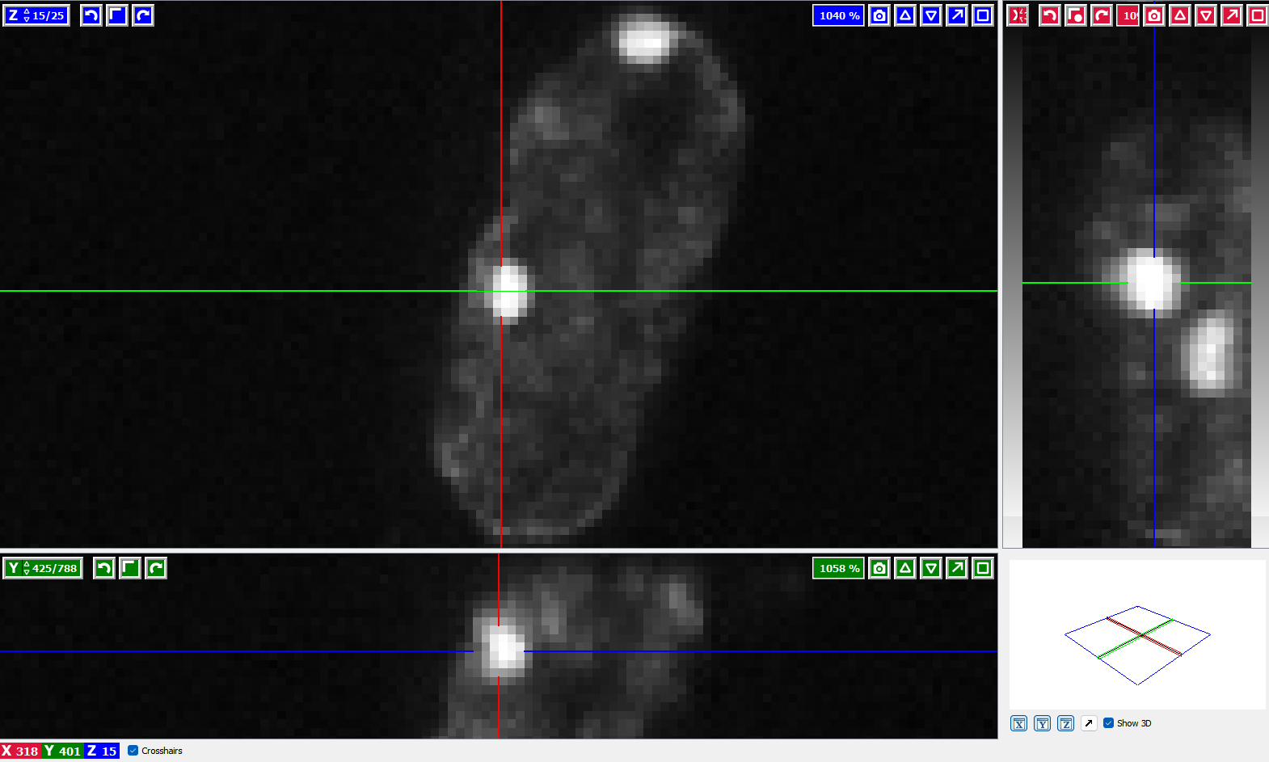
Pixel Classifier
The Ilastik viewer
Useful shortcuts:
Shortcut | Function
Ctrl + mouse wheel | Zoom in and out
Shift + left click drag | Move in XY
Mouse wheel | Move in Z or in T

Slide 14
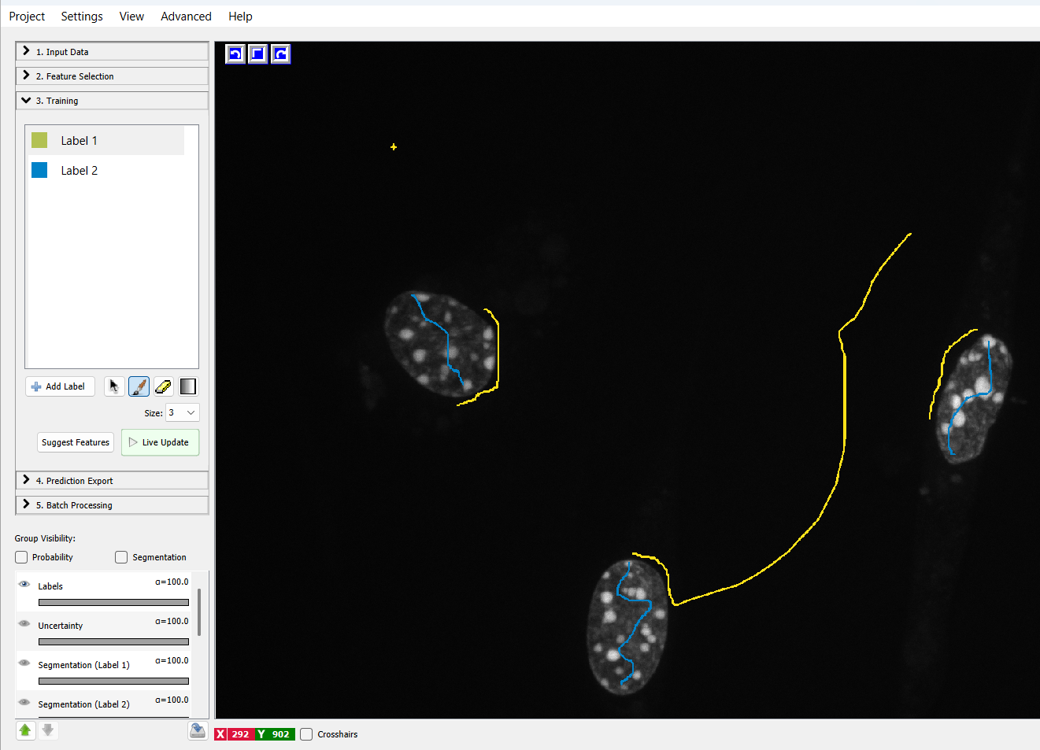
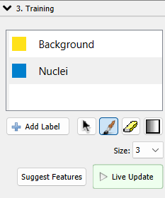
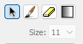
Pixel Classifier
Training
Classes
Tools
brush
B&C
navigation
eraser
Brush size

Slide 15
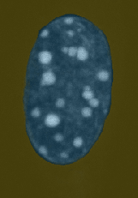

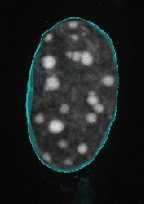
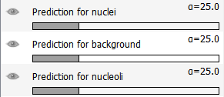
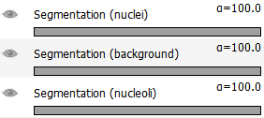

Pixel Classifier
Training Layers
Probability
Segmentation
Uncertainty

Slide 16
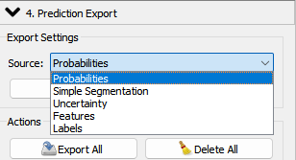
Pixel Classifier
Prediction Export
Multiple Type :
Probabilities
Simple Segmentation
Uncertainty
Features and Labels
Probabilities vs segmentation :
Ilastik outputs a Probability Map -> For each pixel, output a value between 0 and 1 representing the probability to be part of class
  For example: a pixel might be 0.85 Nucleus, 0.03 Background.
To get a segmentation, Ilastik applies a threshold to the probability map (eg 0.4)
Click “Export All” to apply the classifier to all the training data

Slide 17
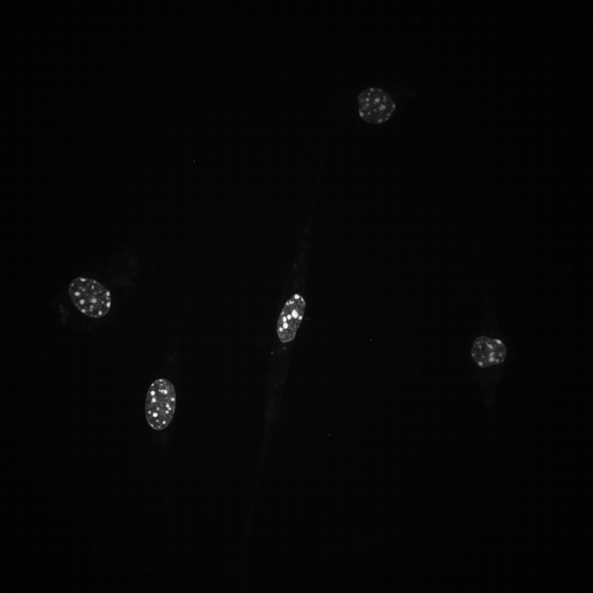

Exercice : Pixel Classifier of a 3D dataset
Data>00_2d_example>nuclei_D_AlessioSilva.tif
Sample from
Alessio Silva

Slide 18
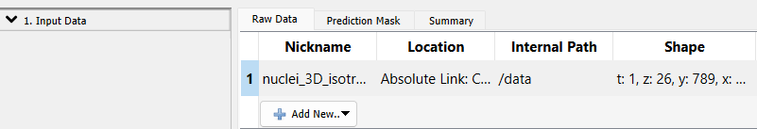
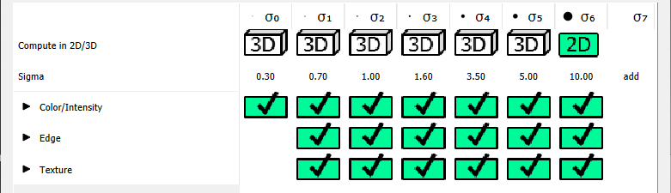
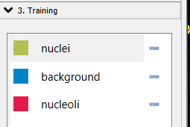
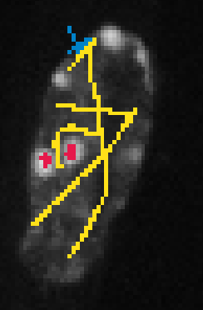
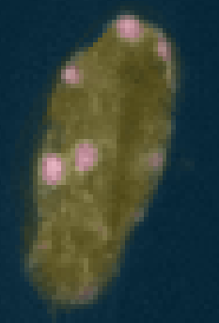
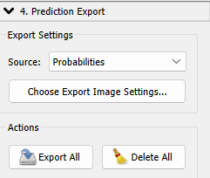

Exercice : Pixel Classifier of a 3D dataset
Data>00_2d_example>nuclei_D_AlessioSilva.tif
1/ Load the data
2/ Select the features
3/ Define the classes
3/ Draw Labels
3/ Preview Segmentation
4/ Export result

Slide 19
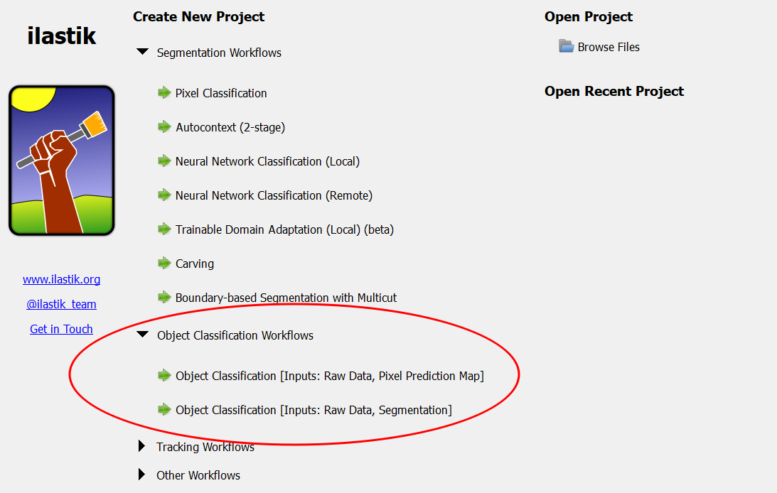
Creating an Ilastik Object Classifier Model
Create new object classification project
There are two pipelines:
  Object creation from probability map + classification
  Objects segmented by the user elsewhere + classification

Slide 20
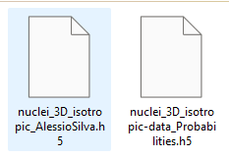
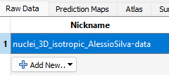
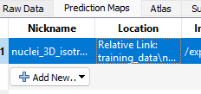
Input data
nuclei_3D_isotropic_AlessioSilva.h5
data\02_demo_ObjClass_3Dnuclei\training_data\
Add the intensity images in the raw data section. (this data can include more channels than the data used for training the pixel classifier)
Add the corresponding probability images in the prediction maps section
nuclei_3D_isotropic_data_Probabilities.h5

Slide 21
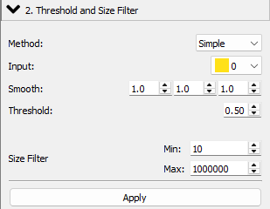
Object Creation: Threshold and Size filter
nuclei_3D_isotropic_AlessioSilva.h5
If you have objects that are not touching. Use the Simple method.
The input should be the class you want to create an object from.
You can smooth the probability map
If you want to see the effects of the size filter and the smoothing check the “Show intermediate results” box.

Slide 22
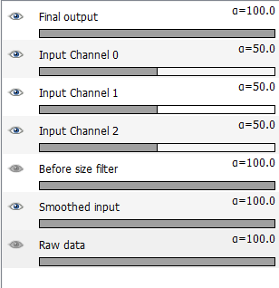
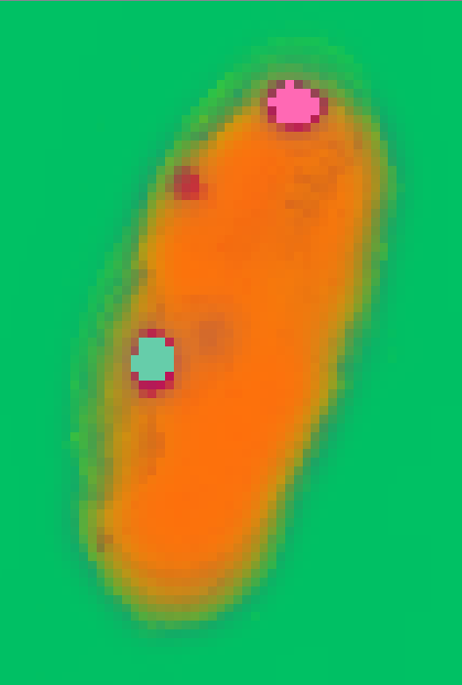
Viewer
Viewer preview when “Show intermediate results is active”
Separated objects have individual labels and hence different colours
Object 1
No object
Object 2

Slide 23
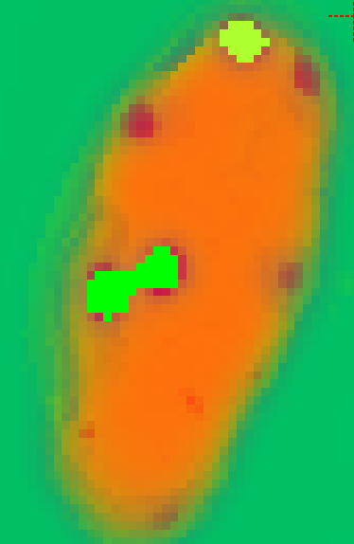
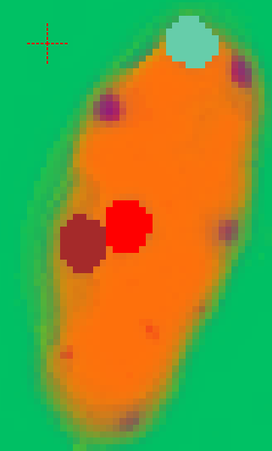
How to separate touching objects
Simple threshold
Hysteresis threshold
To separate touching objects change the Thresholding method to Hysteresis
Hysteresis uses a higher threshold to create seeds and then grows them until reaching the second threshold. This method is known as marker seeded watershed (a.k.a. seeded region growing).

Slide 24
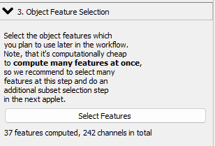
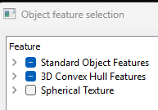


Object feature selection
Compute features to be to train a classifier
As before, define what would be the best features to differentiate your classes
Default selection recommended
For neighbourhood features, size can be changed

Slide 25
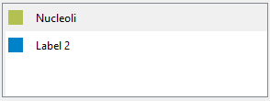


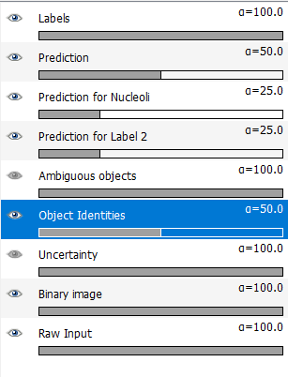
Object classification – Training the classifier
Training is done like the pixel classifier but here you click on objects instead of pixels.
Visualize objects as Binary image or with a random colour (Object Identity)
Use the uncertainty to guide your annotations.
If no need of the classification, only annotate your class and export the object measurements
Prediction binary
Object identity

Slide 26



Object information export
Export predictions or probabilities and also export the object identities to do further measurements elsewhere.
Ilastik can export the feature table containing all of the selected features. ( select them in “Configure Feature Table Export”)
This configuration can be used for the batch processing tab too

Slide 27


Blockwise object classification
Standard object classification in Ilastik is limited by RAM. For large dataset, select the “Blockwise Object Classification” method.
Blocksize should be small to fit memory but large enough not to miss-segment objects.
Be sure to select blockwise in the object information export tab.
https://www.ilastik.org/documentation/objects/objects

Slide 28






Further learning
EM boundary based segmentation in 3D
Other classifiers
https://www.ilastik.org/documentation/carving/carving
https://imagej.net/plugins/tws/
https://github.com/ilastik/ilastik-napari
https://qupath.github.io/
Tracking
https://www.youtube.com/watch?v=F6KbJ487iiU
https://www.ilastik.org/documentation/
https://www.ilastik.org/documentation/tracking/tracking

Slide 29





Benjamin.Pavie@vib.be

