Slide 1
Data management
Making Data Fair
With Many thanks to Ayebuke Kupcu Yoldas

Slide 2
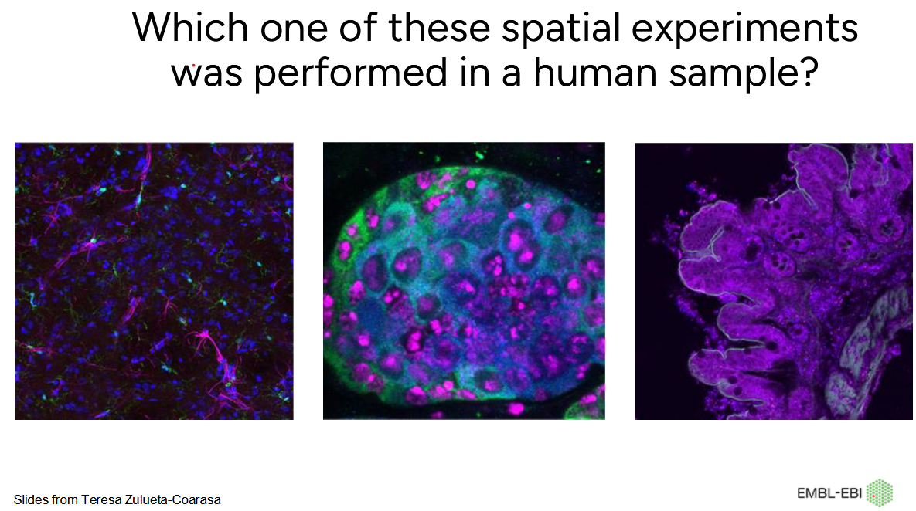
Why Bother

Slide 3
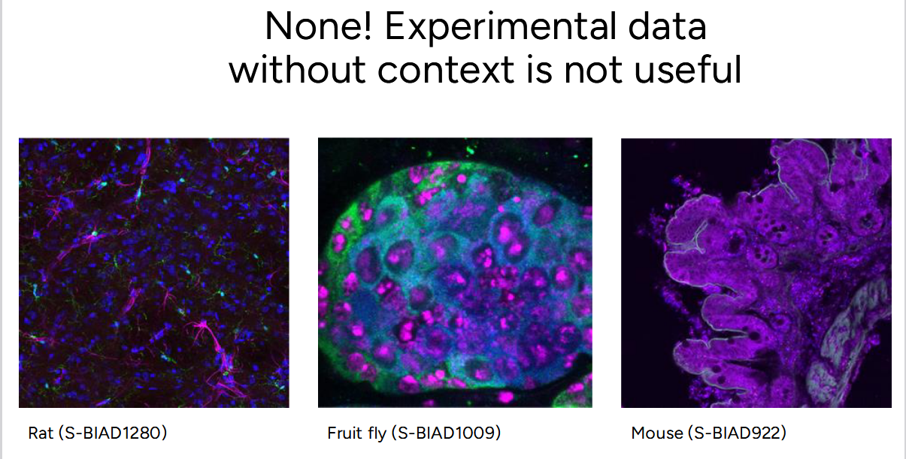

Slide 4
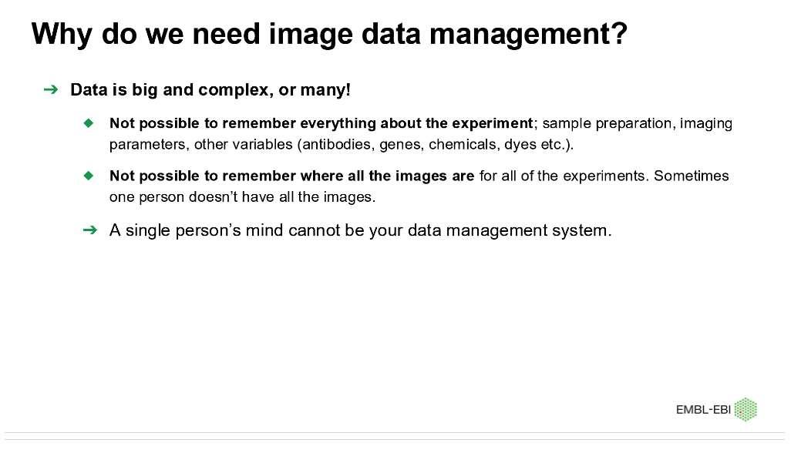
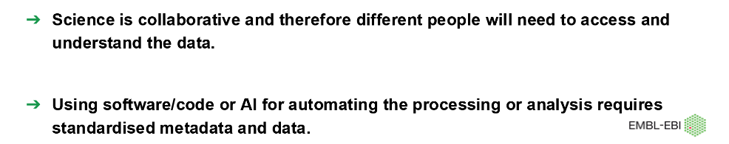

Slide 5
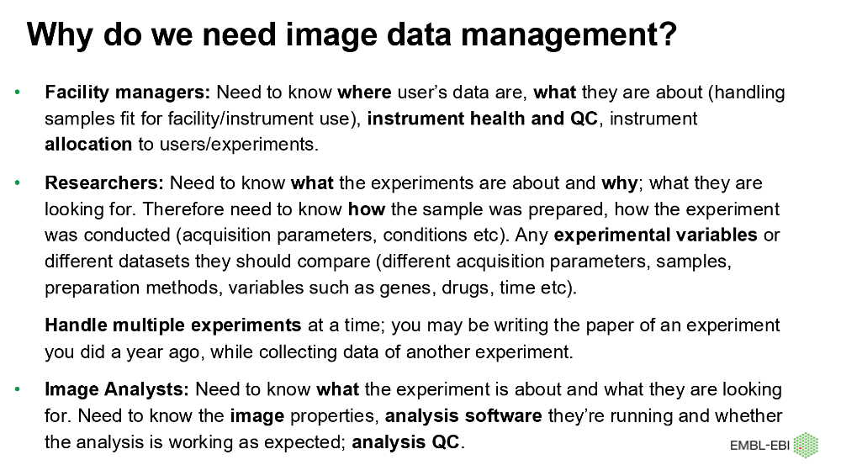

Slide 6
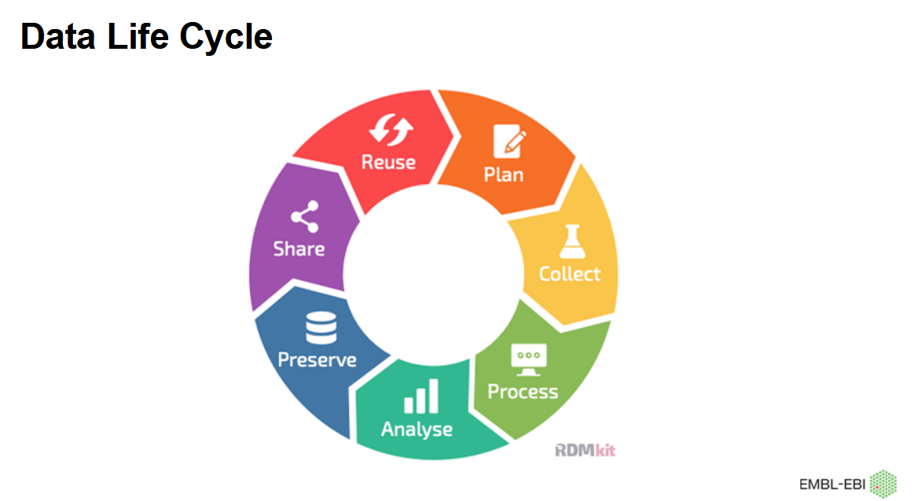

Slide 7
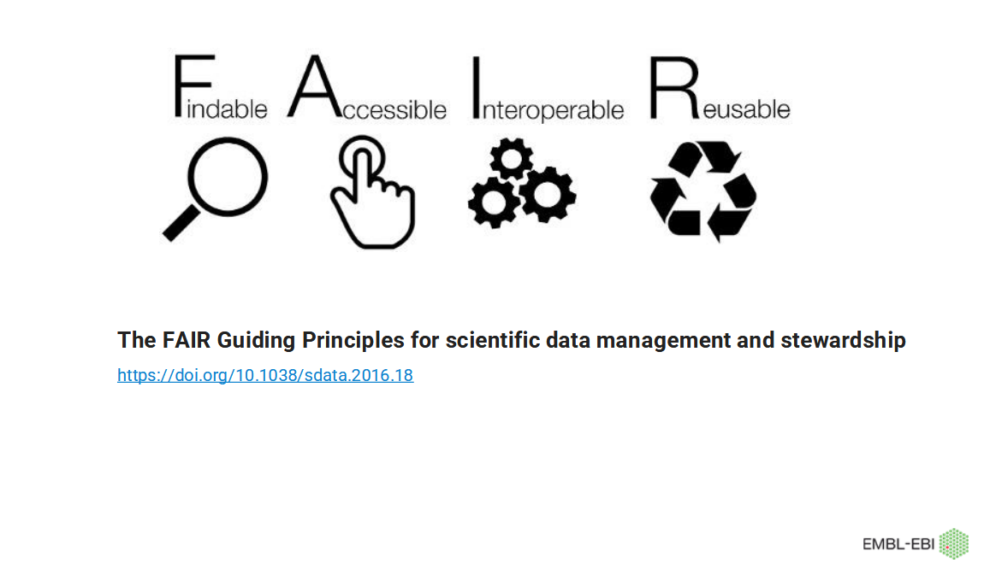

Slide 8
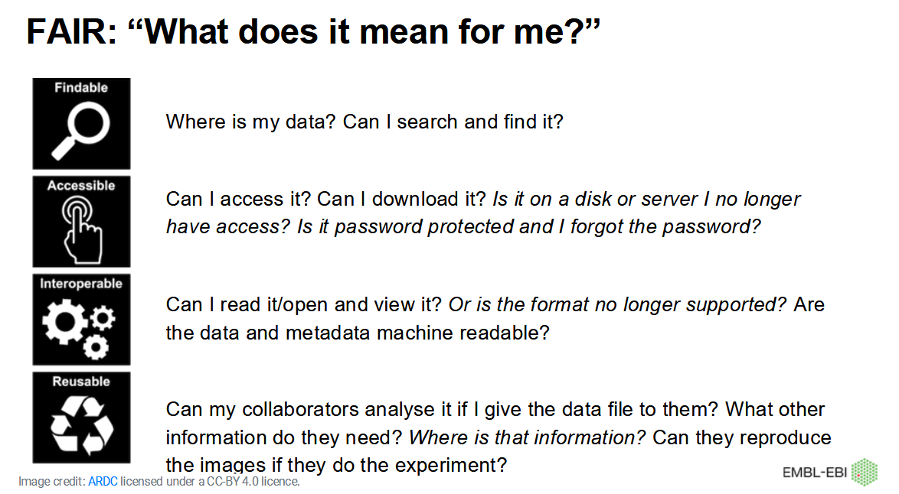

Slide 9
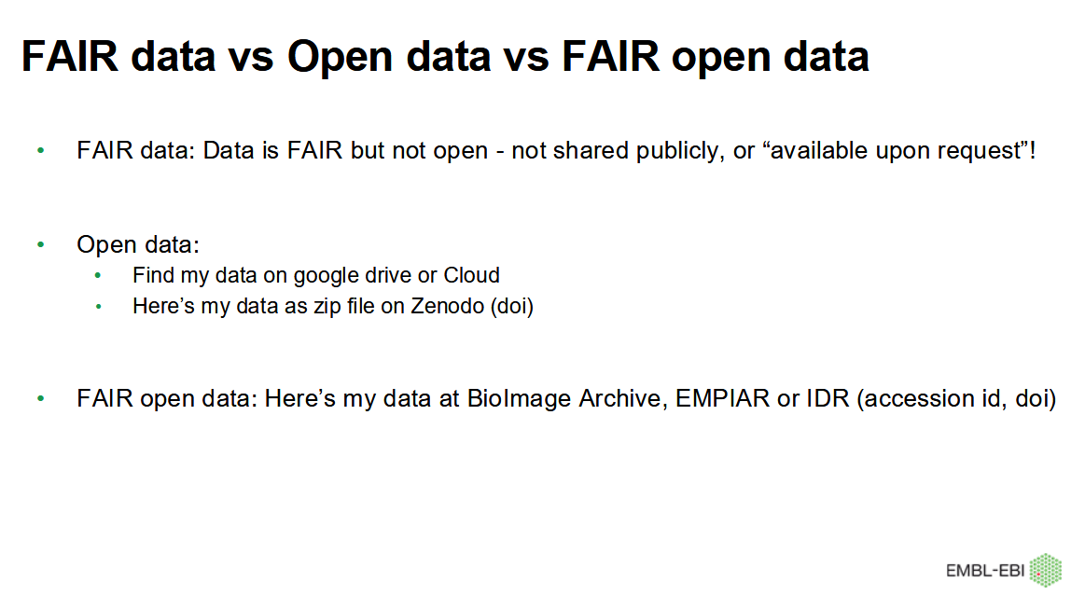

Slide 10
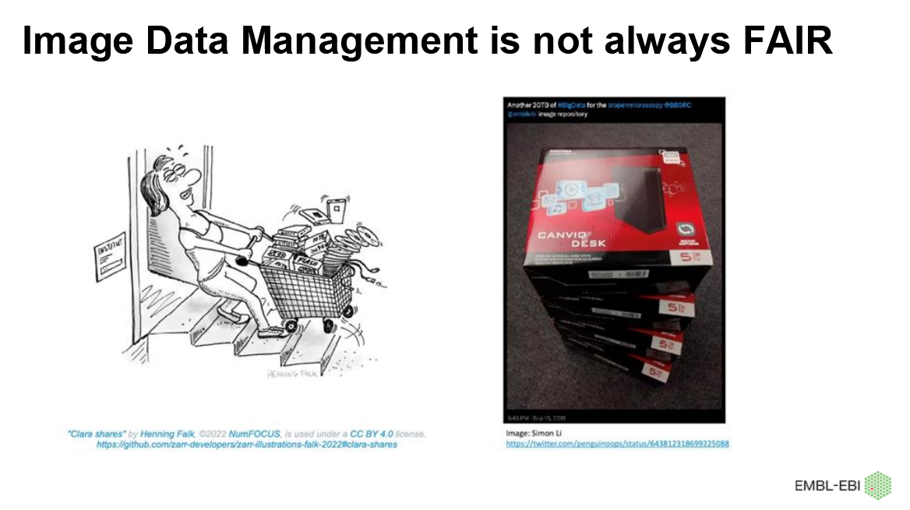

Slide 11
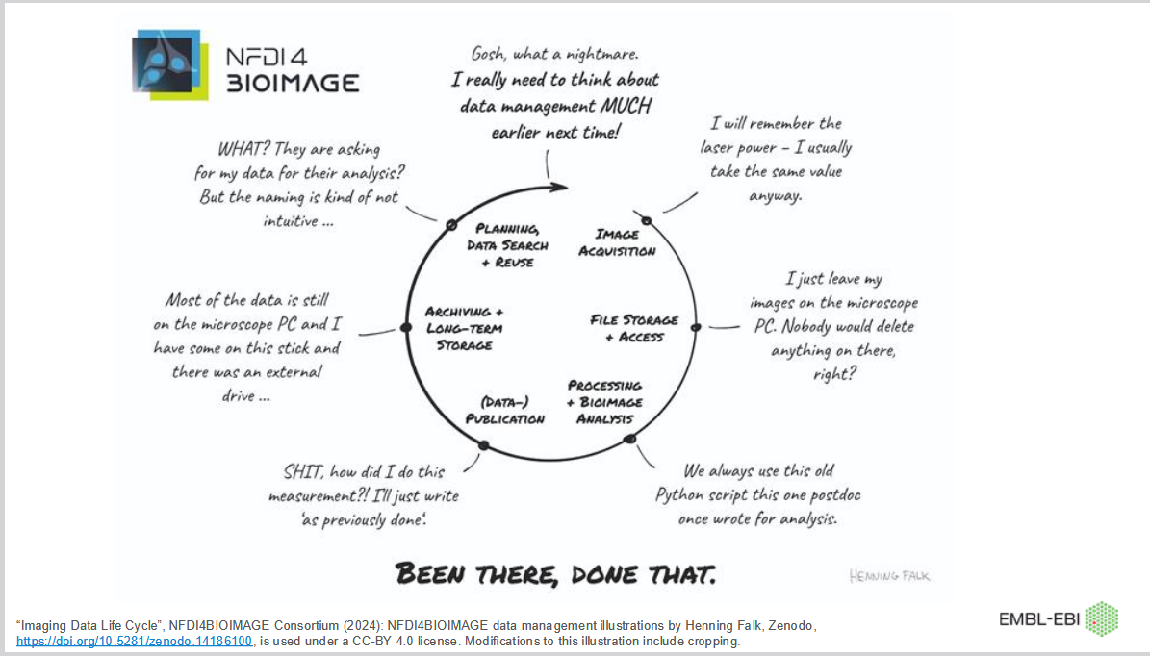

Slide 12
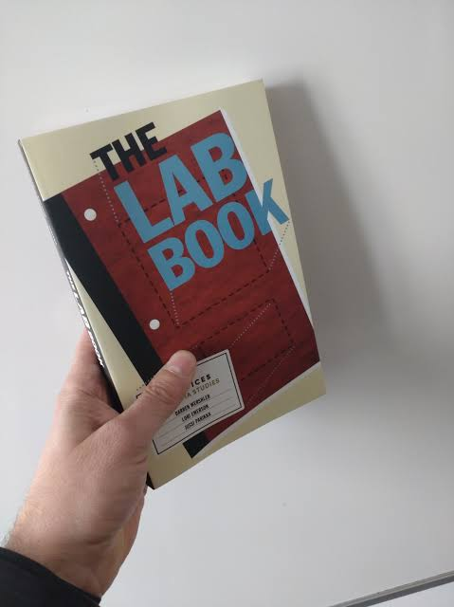
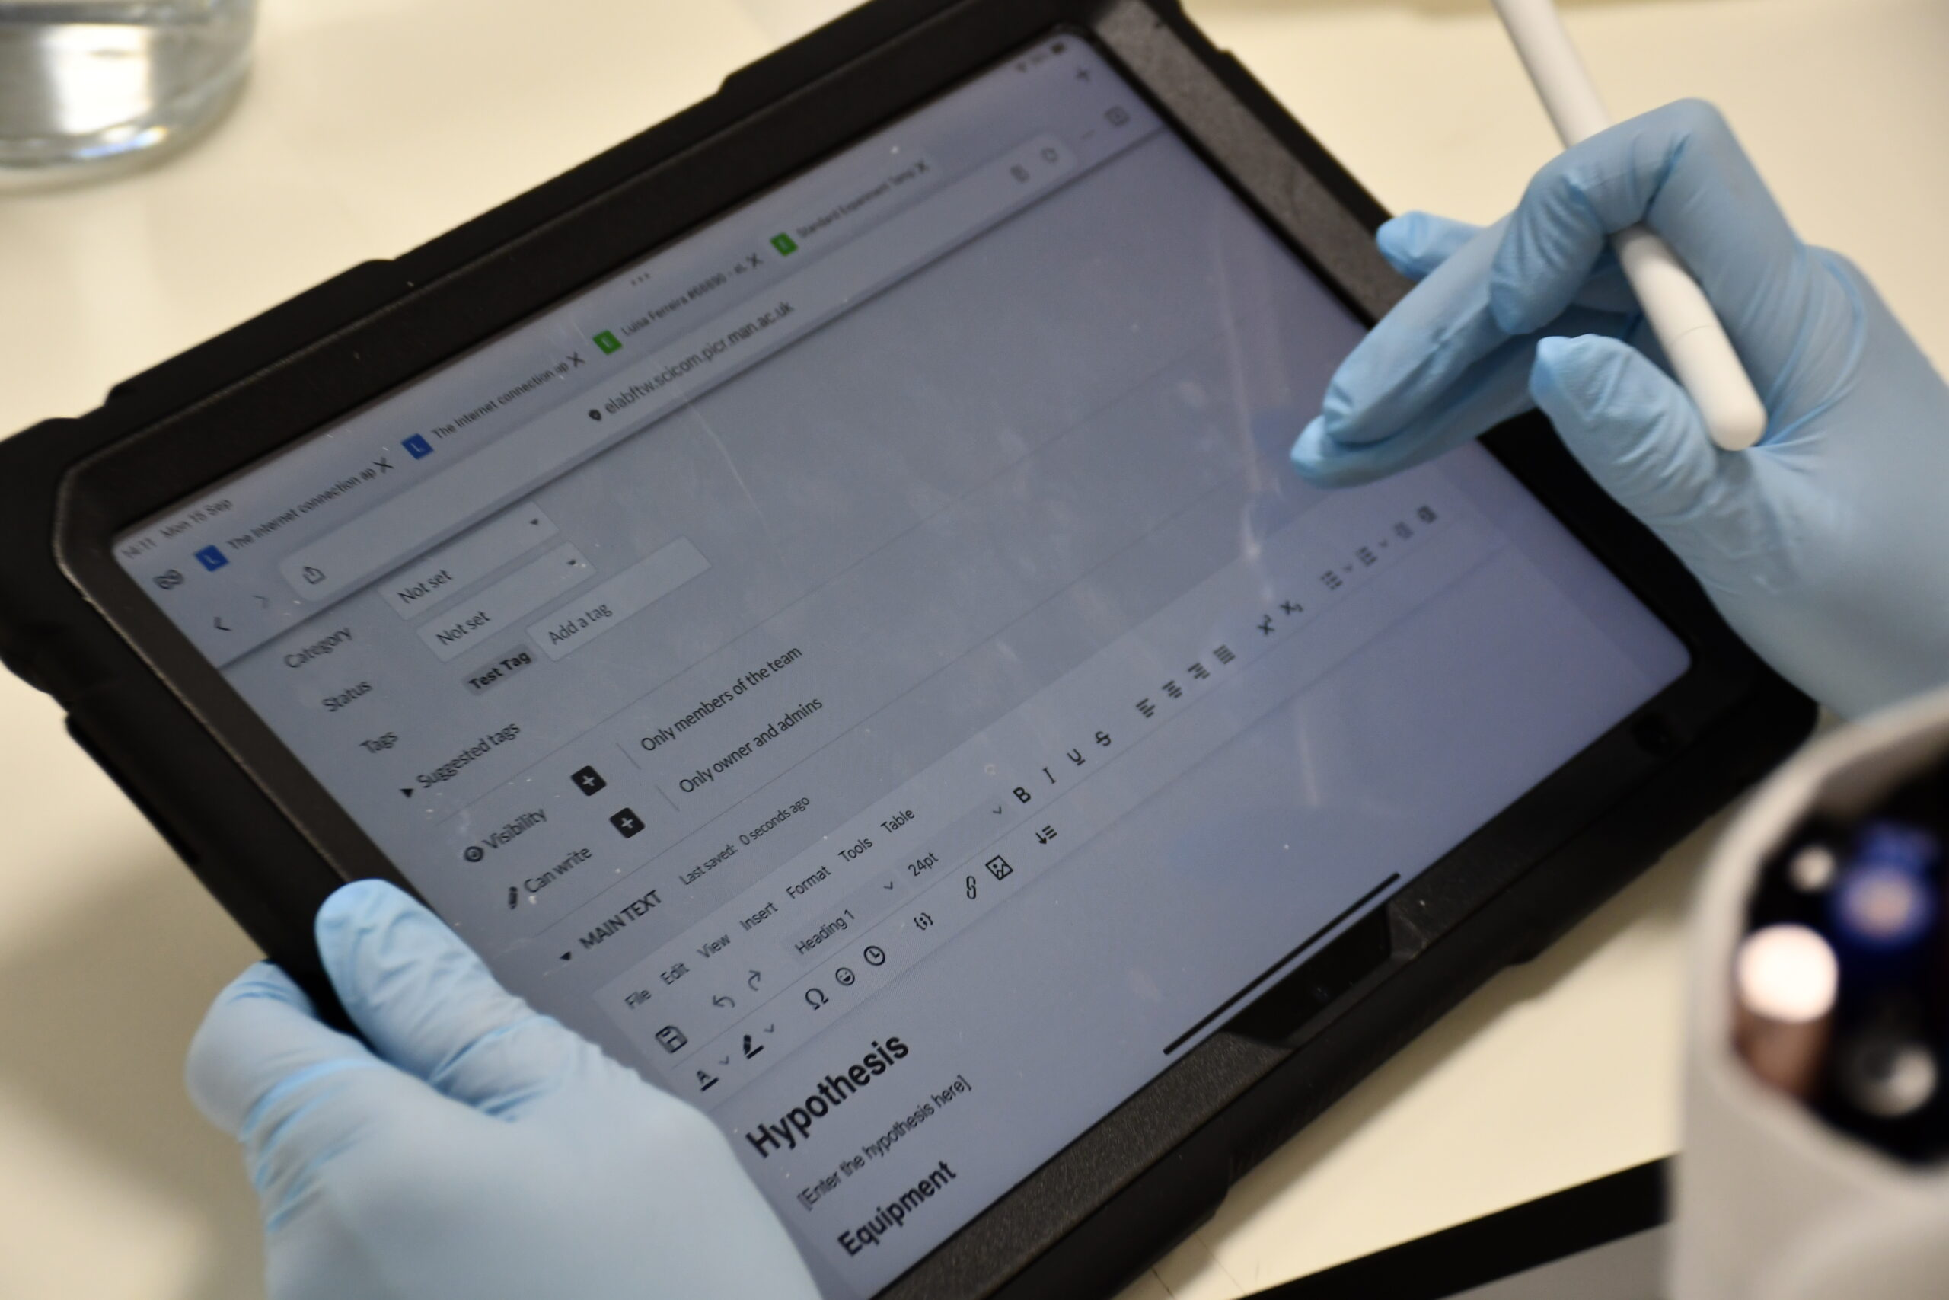
Where to start with FAIR Data

Slide 13
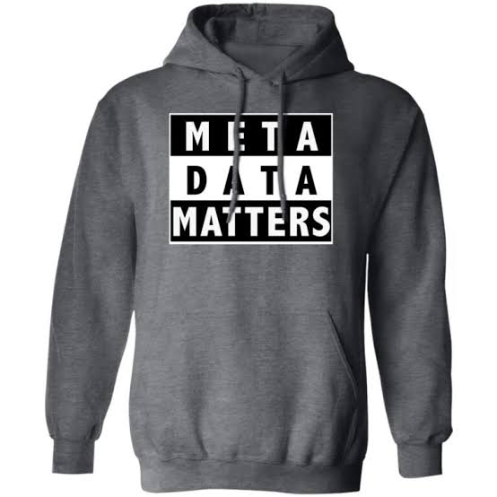
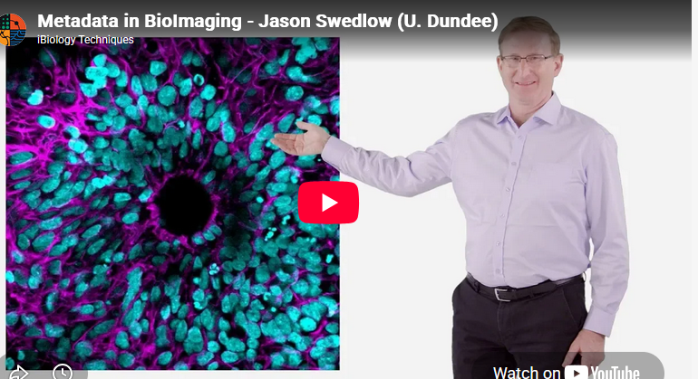
Metadata matters
Meta data gives context to the data
What metadata should be there for you to be able to do your responsibilities?
What metadata should be there if one needs to repeat the experiment?
What metadata should be there if it was someone else’s data you’d like to re-use?
https://www.ibiology.org/techniques/metadata/

Slide 14
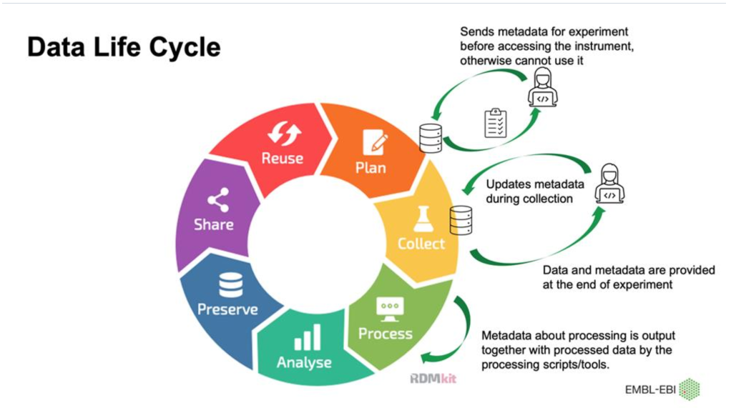
REMBI- REMBI: Recommended Metadata for Biological Images—enabling reuse of microscopy data in biology
https://www.nature.com/articles/s41592-021-01166-8

Slide 15
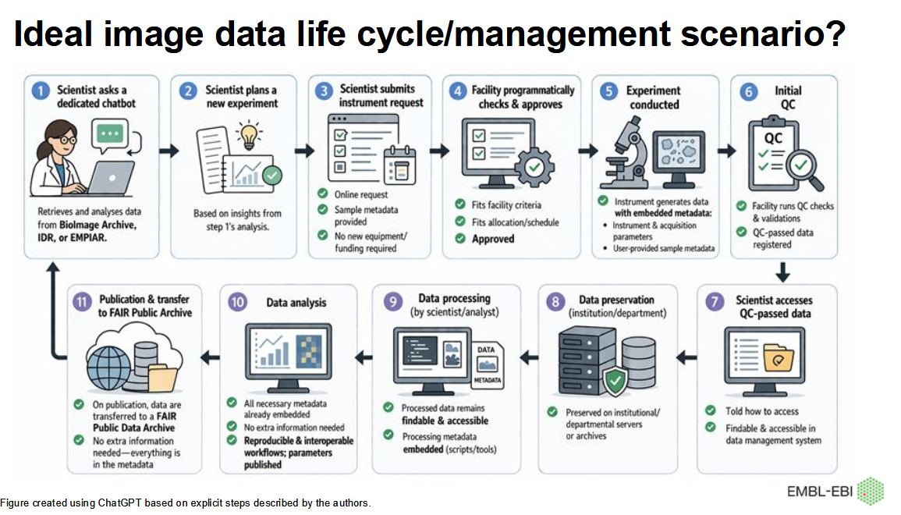

Slide 16
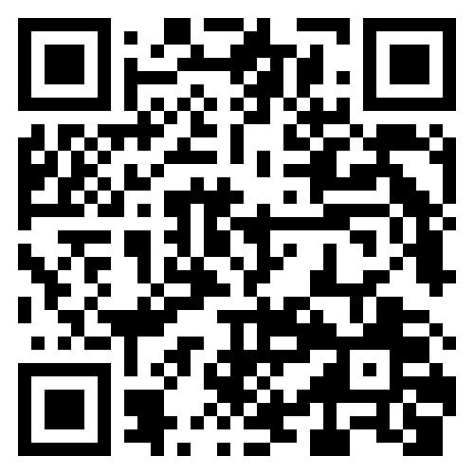
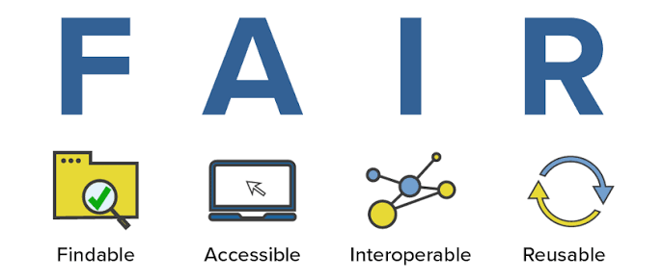
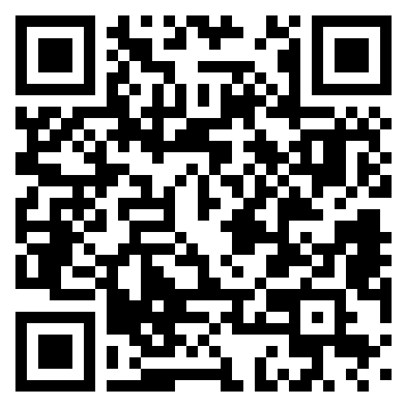
Exercise (5 minutes)
Group 1
Can you re-use this or replicate this experiment?
What information is missing?
https://zenodo.org/records/16618585
https://zenodo.org/records/5140334
Group 2

Slide 17
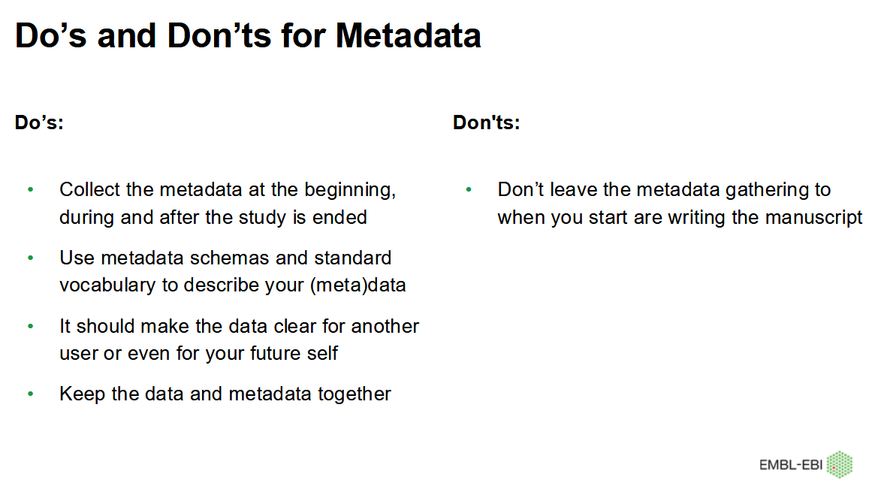

Slide 18
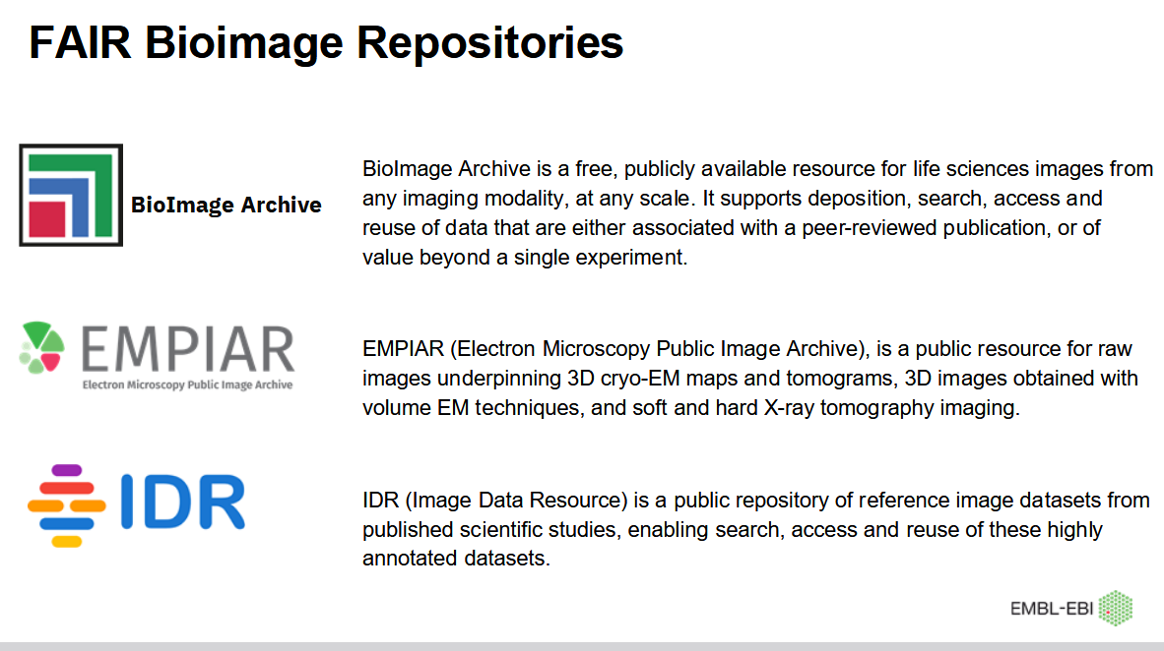

Slide 19
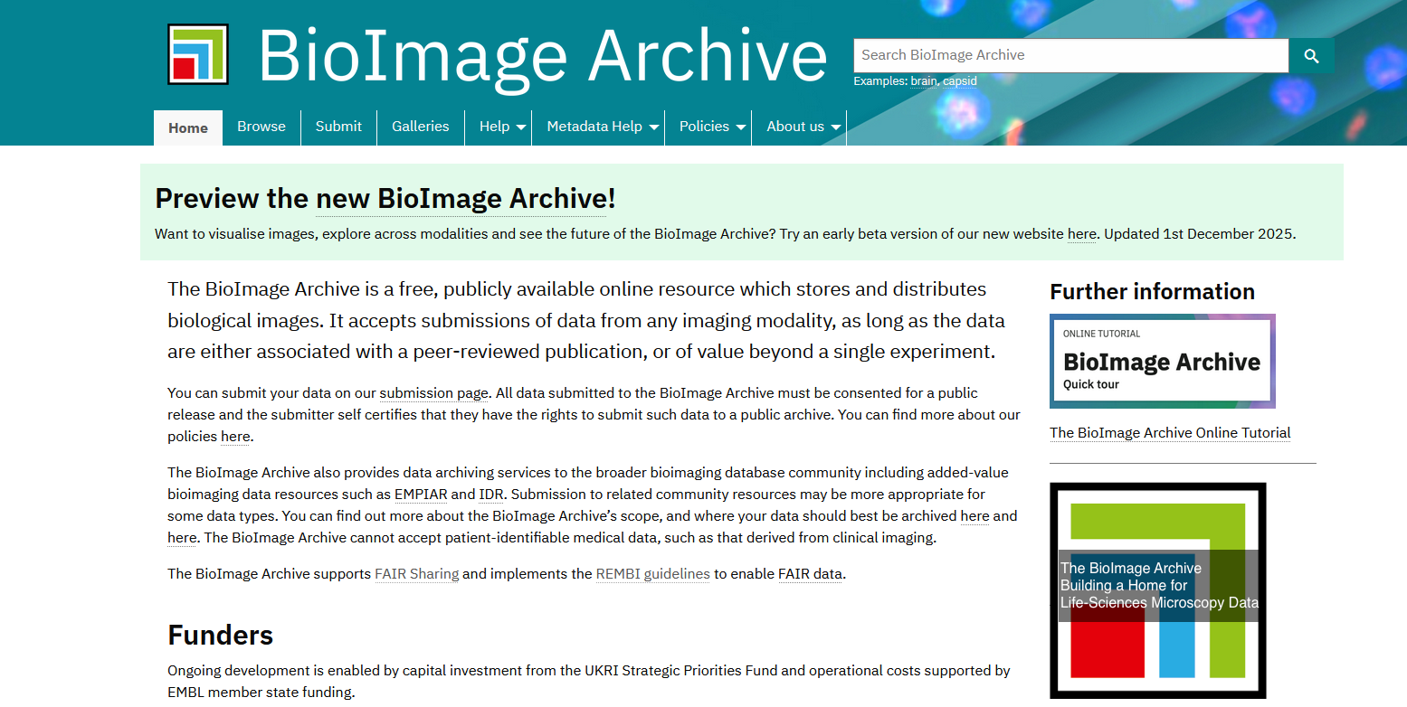
https://www.ebi.ac.uk/bioimage-archive/

Slide 20
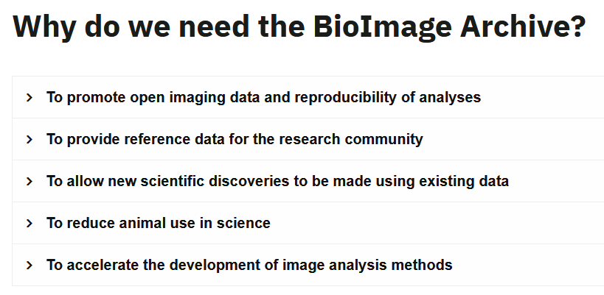
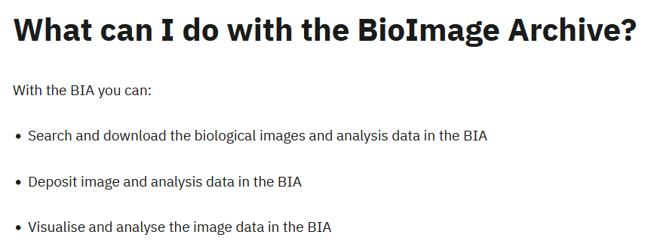
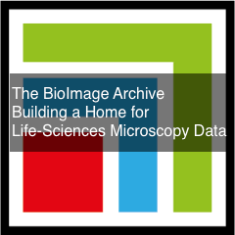
The BioImage Archive
The output is a DOI which is very useful when submitting a paper

Slide 21
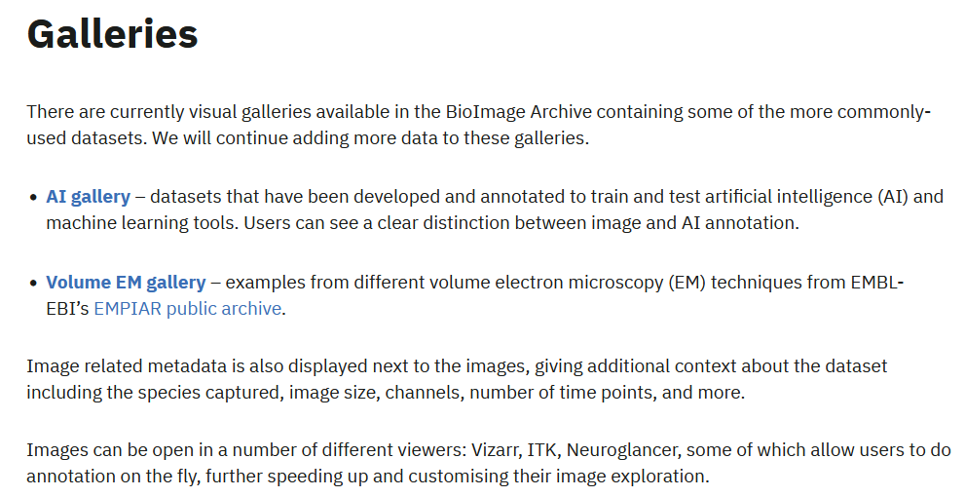
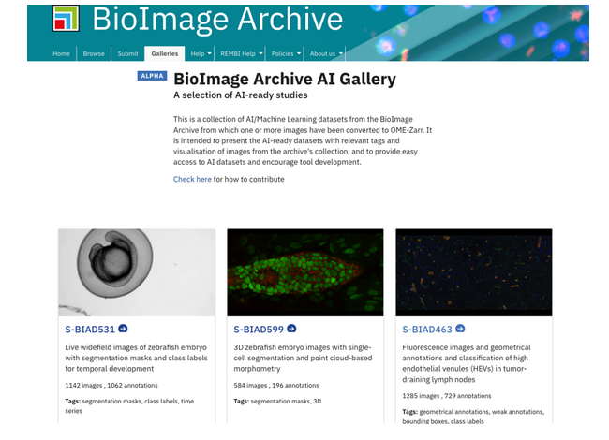
Bioimage Archive and AI models

Slide 22
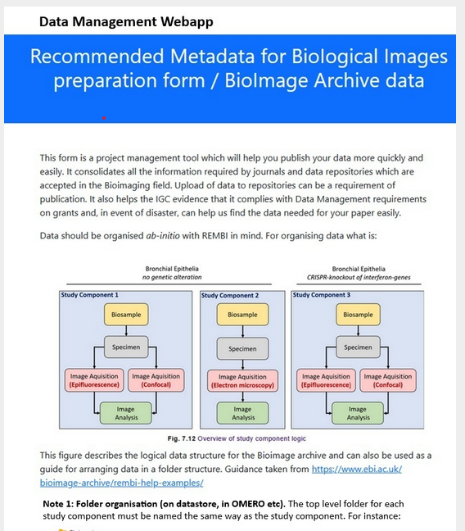
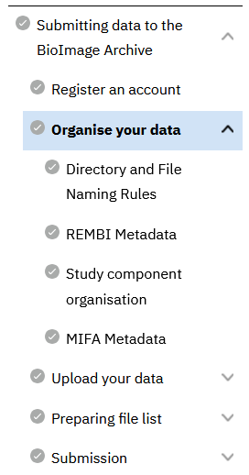
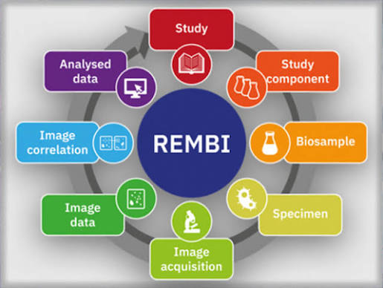
Bioimage Archive and data submission
The output is a DOI which is very useful when submitting a paper

Slide 23
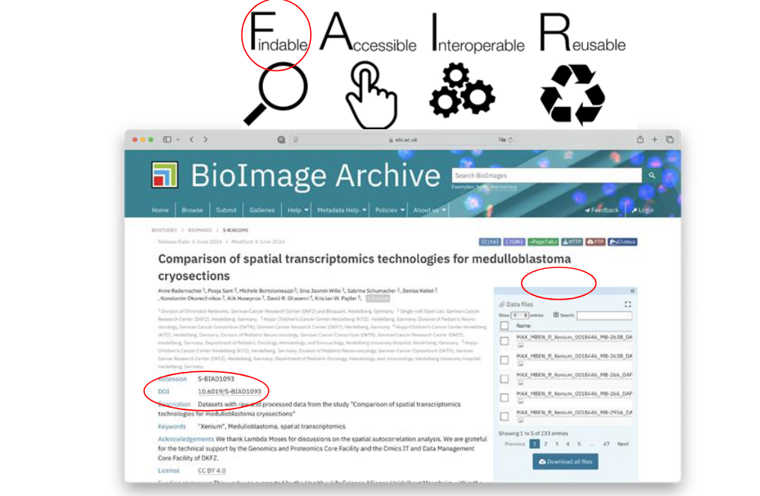

Slide 24
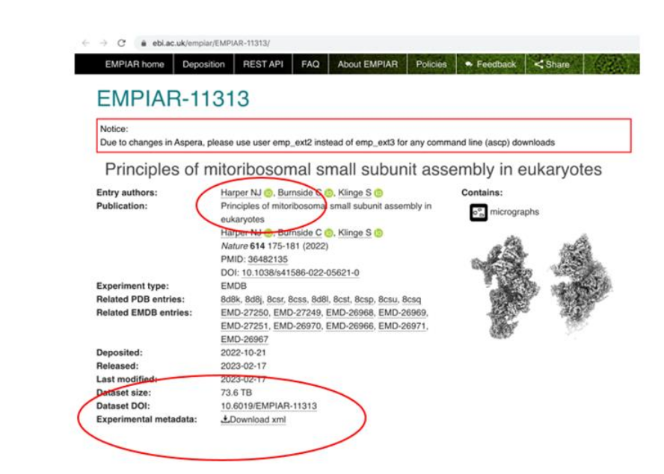

Slide 25
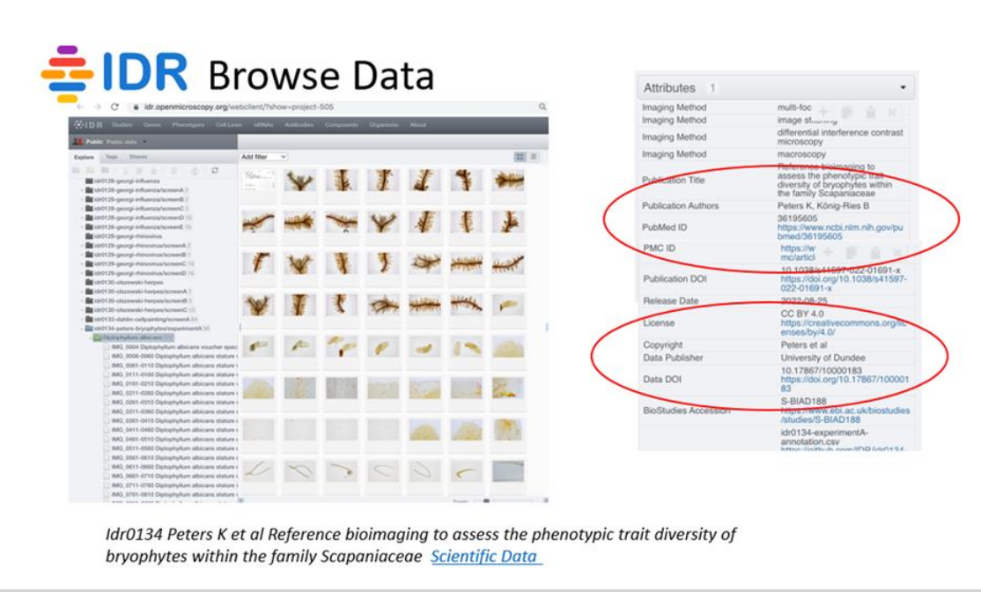

Slide 26
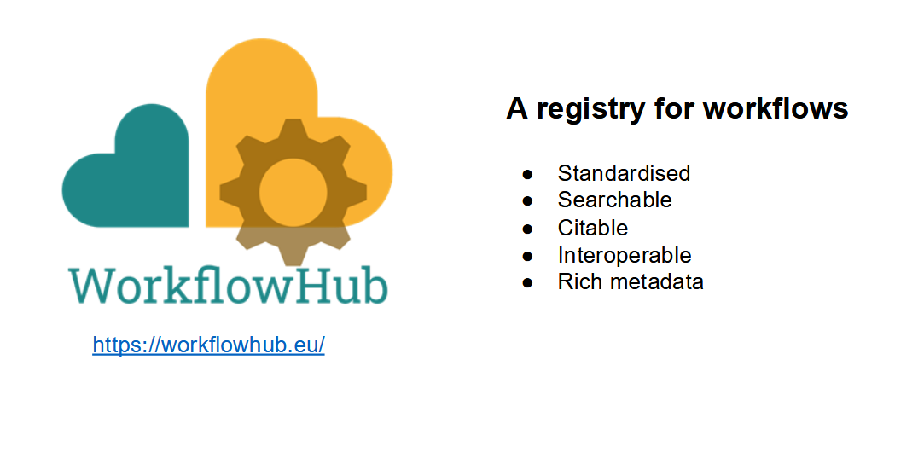
What about analysis workflows?

Slide 27
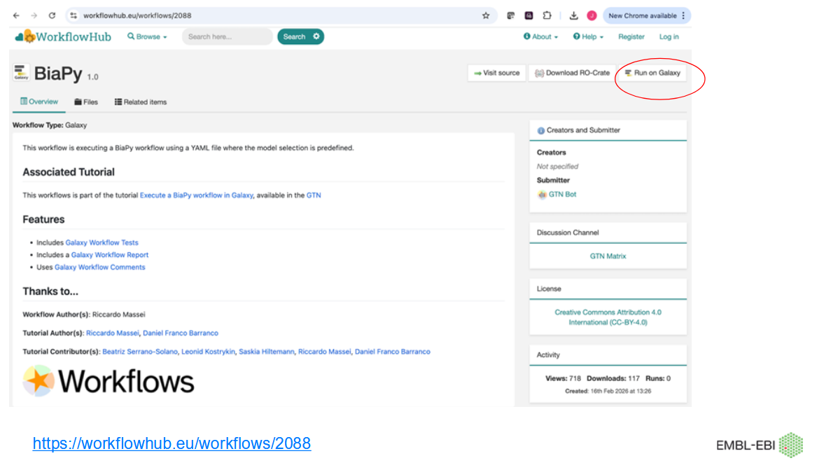

Slide 28

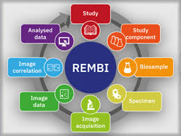
So how can I manage my data?
Provide resource for data management even for data on NAS boxes as USB Drives (The reality)
Which scales to when more robust systems can be used
That can be used by Pis, Postdocs and Students anytime in the data lifecycle (including reanalysis of old data)
Is compatible with the Bioimage Archive (right information)

Slide 29
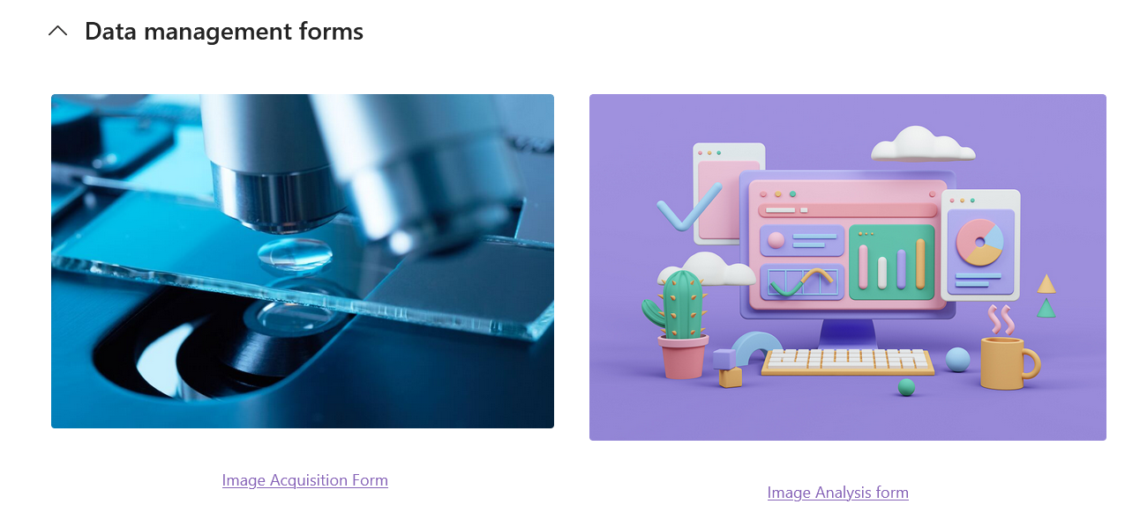
The Solution (high Tech)
Emails
Submitter
Data owner
Data manager

Slide 30
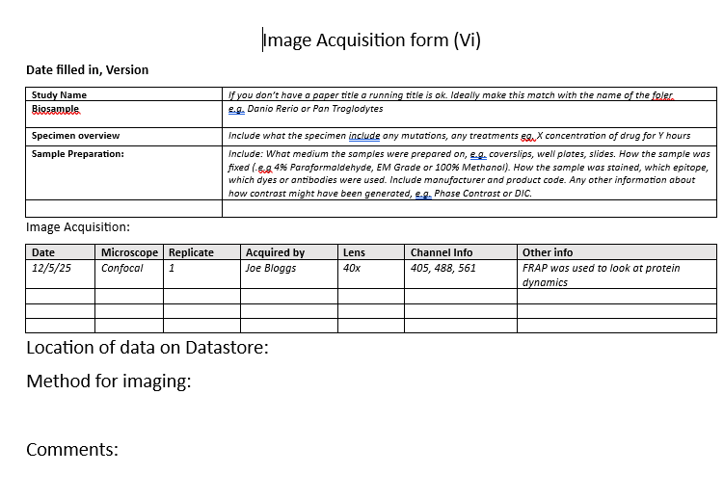
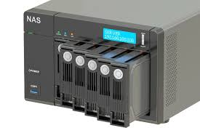
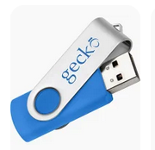
The Solution (Low Tech i)

Slide 31
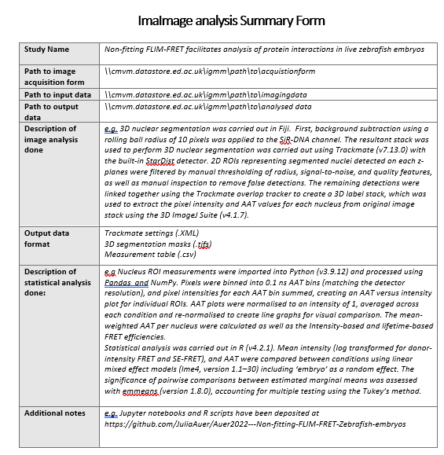
The Solution (Low Tech ii)

Slide 32
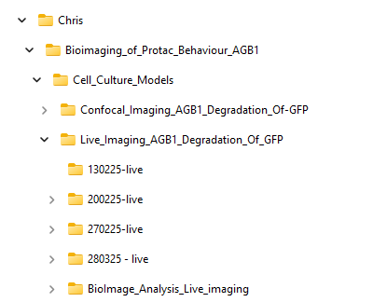
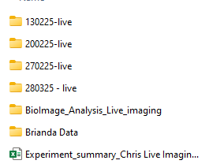

BIA compatible data organisation
Study:
  Bioimaging Protac Behaviour
Study Component:
  Cell Culture models
Biosample / Specimen:
  Hela Cells
Image acquisition:
  Live epifluorescence imaging
  Confocal Imaging
Image analysis

Slide 33
Advantages
All of the metadata are stored together
REMBI and FAIR compatible
Not dependant on having excellent infrastructure or highly skilled and available IT team
Can be used when importing data into BIA
Easily updated, the form can be added to or resubmitted,
A separate analysis form acknowledges image data can and are often reused
No last minute publication panics

Slide 34
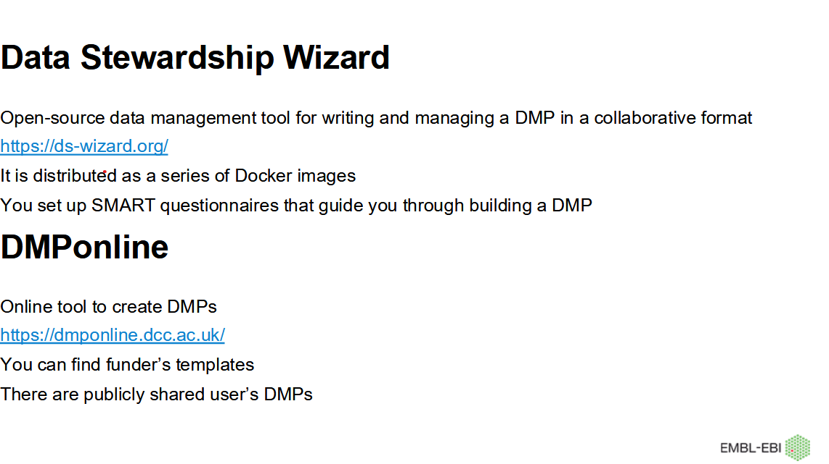

Slide 35
Day-to-day data management
Guidance on practical dos and don’ts
https://www.ebi.ac.uk/training/events/data-management-bioimage-informatics-data-flow/
https://www.ebi.ac.uk/training/events/principles-research-data-management
https://gerbi-gmb.de/i3dbio/i3dbio-rdm/data-management-platforms/

Slide 36

Acknowledgements + Thanks
Steve Fox
Laura Murphy
Moni Choudhury
Ewan MacDowell
John Ireland
Andy Law
Anna Raper
Jon Moss
Edinburgh Bioimaging team
Ayebuke Kupcu Yoldas
Matthew Hartley
OME Team
EuroBioimaging Fair Data team

Slide 37
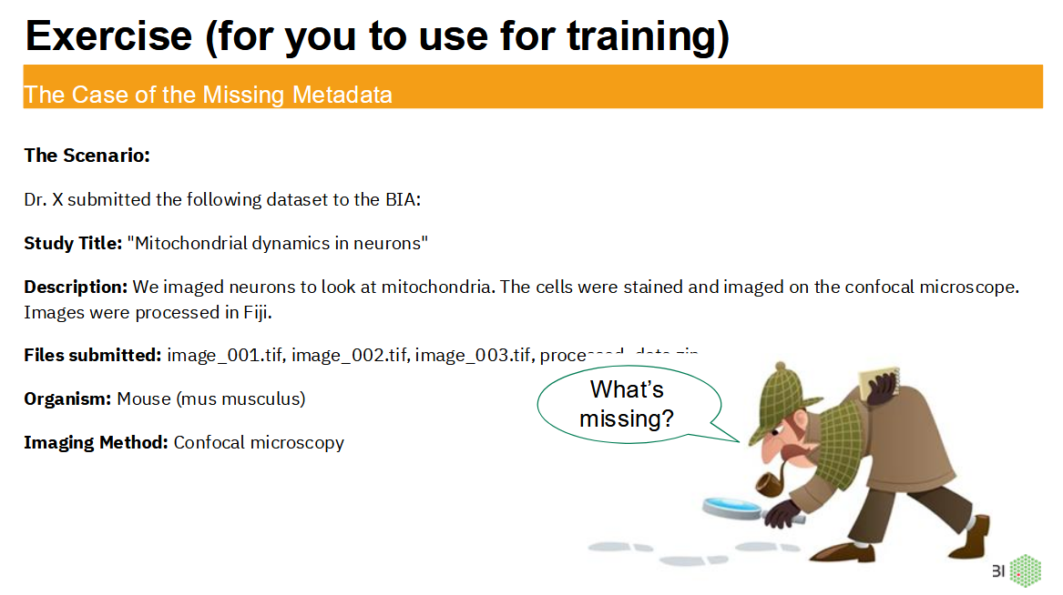

Slide 38
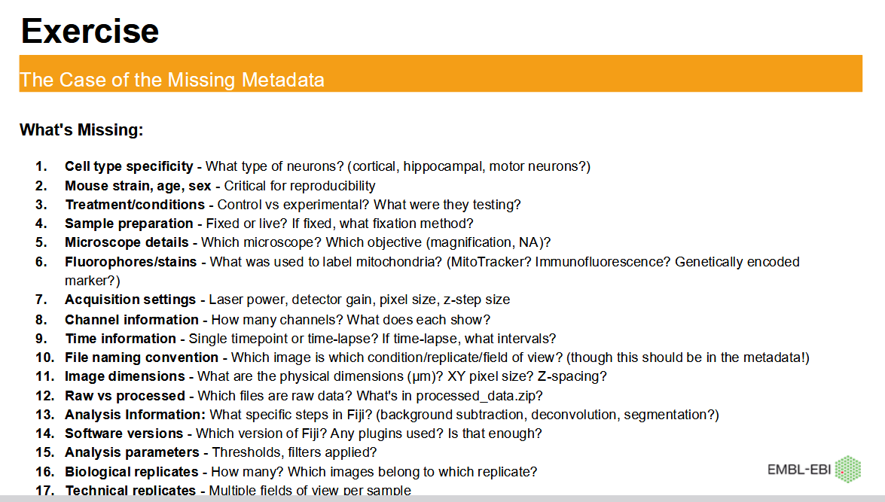

Slide 39
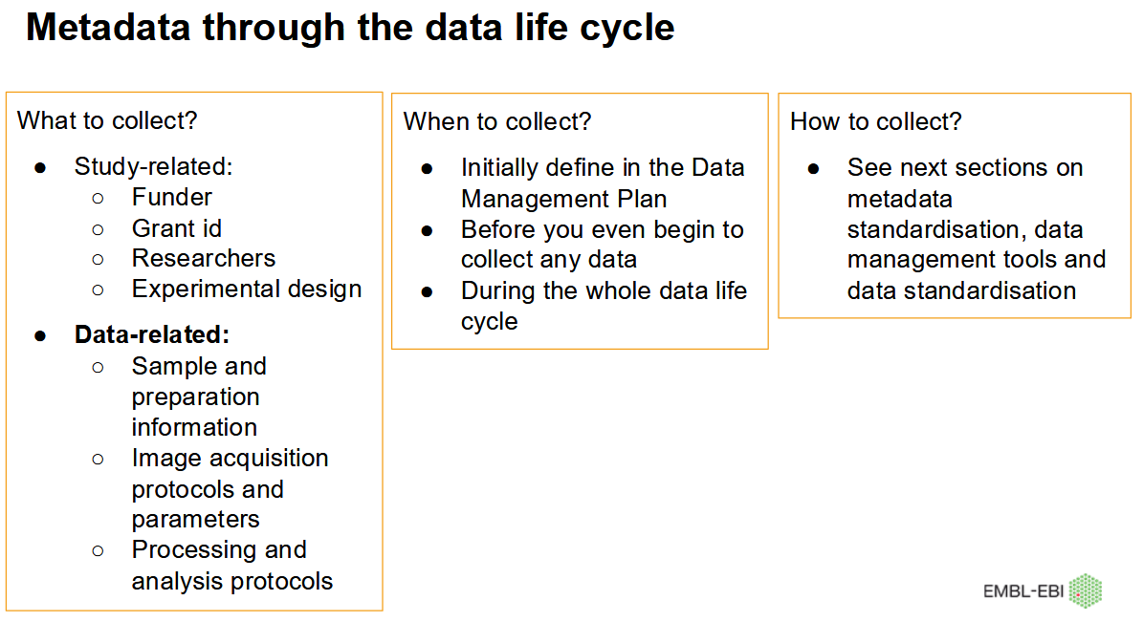

Slide 40
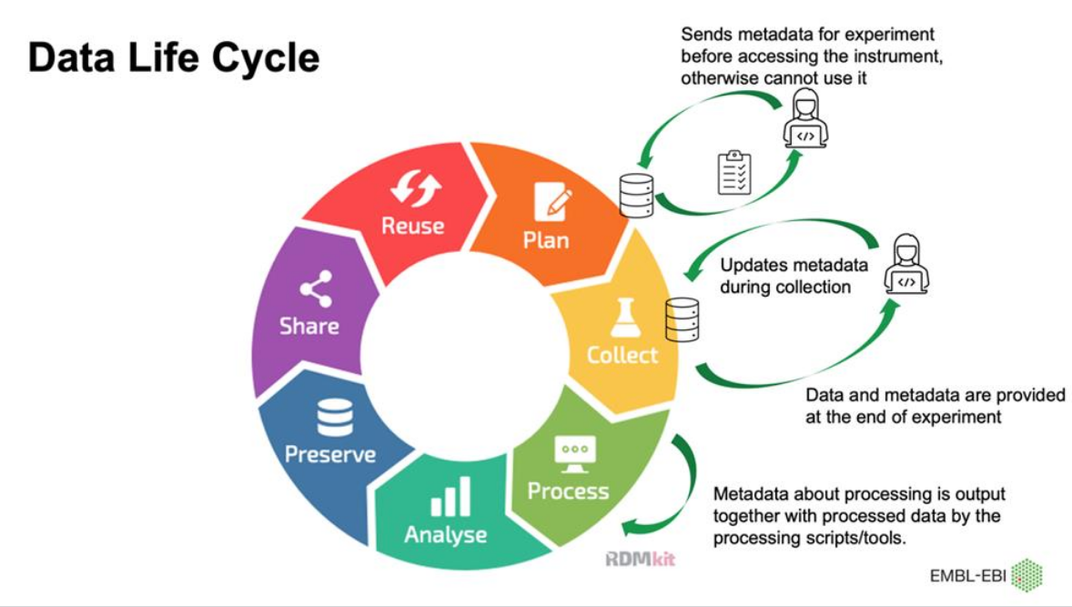
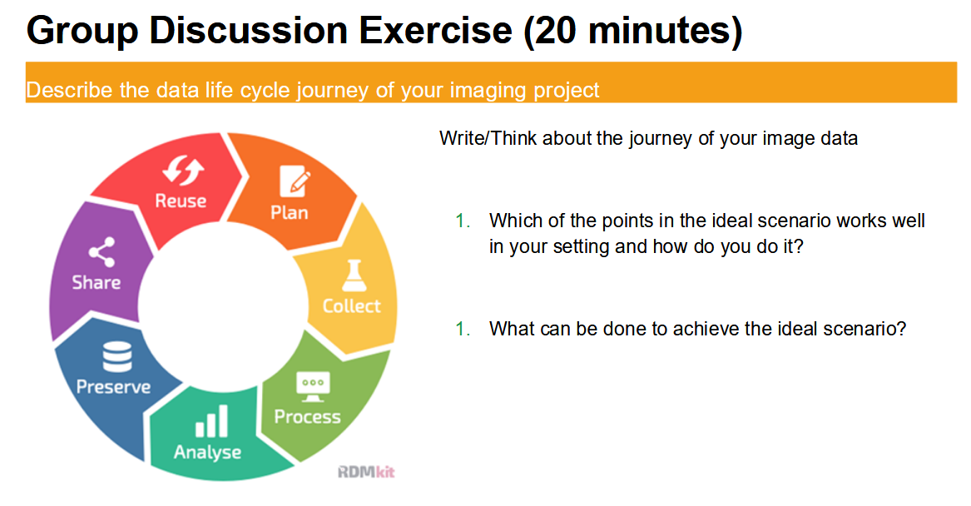

Slide 42

What we want to avoid: companies-are-selling-antibodies-using-faked-validation-data

