Slide 1
What can Machine Learning do for me
Notes:
Thank Sebastian for his input

Slide 2


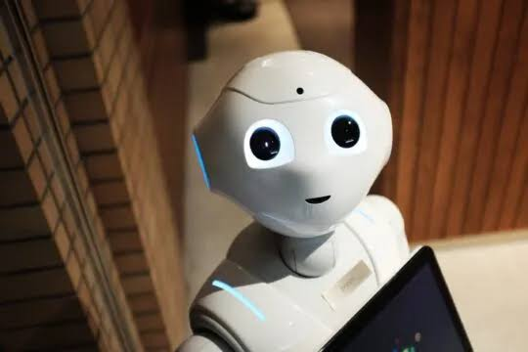
Do we already use Machine Learning ‘stuff’ 1?
https://machinelearningmastery.com

Slide 3

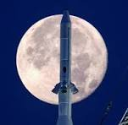
Why bother with machine learning
We have Data (x), we want to know how this data can allow us to infer what that data means (Y). The inference is an unknown function F
Since its biological data there is very likely to be some error involved.
F(x) + error = Y
We could spend a very long time trying to establish F. Or …….

Slide 4
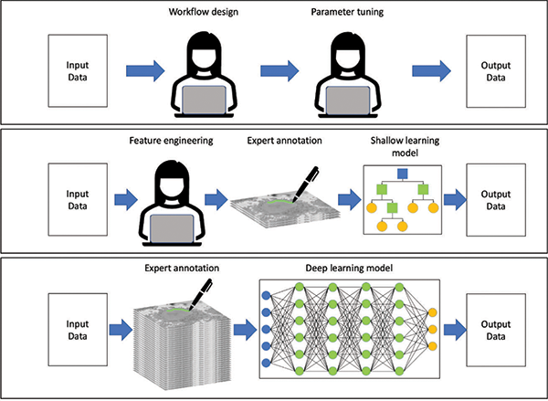
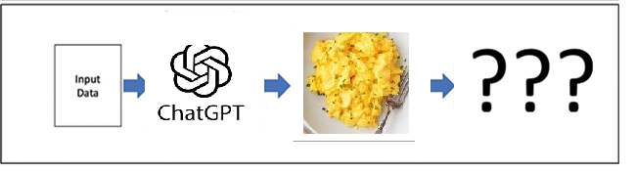
How Image analysis can be done
Old skool (human learning)
Covered in this course
New for 2026 (no thankyou)

Slide 5
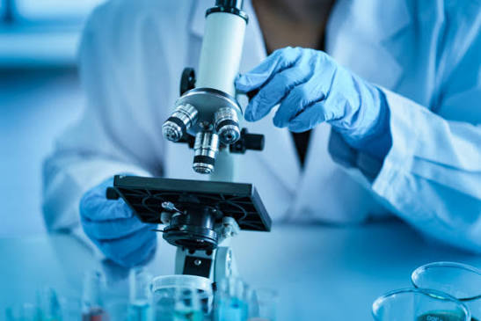
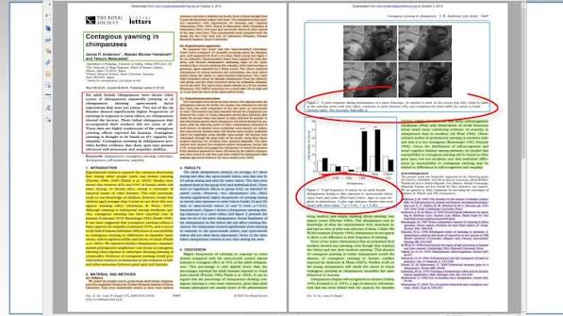
What goes into Machine learning?
Is it simply a black box?

Slide 6
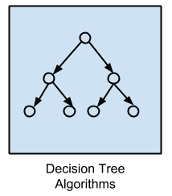
We are familiar with some of the methods used
Regression / regularisation Algorithms (Linear regression, least squares)
Instance-based Algorithms - requires training data. (SVM, K nearest neighbour)
Decision Tree Algorithms
Bayesian Algorithms
Clustering Algorithms (K means, Hierarchical)
Dimensionality Reduction Algorithms (PCA, etc)
Association Rule learning Algorithms (If, then type)
Pattern Matching
Artificial Neural Networks (ANNs)
Deep Learning – Larger and complex ANNs which require more computation

Slide 7
How It fits together
Artificial Intelligence
Machine Learning
Computer learns patterns and relationships from data
Deep Learning:
Uses Artificial neural networks (ANNs) with multiple layers to process data
May require a LOT of compute power
Shallow learning
Uses a ANN with one or two layers (faster and quicker)
E.g. Ilastik, Fiji’s trainable Weka,
Kmeans clustering, DB Scan

Slide 8
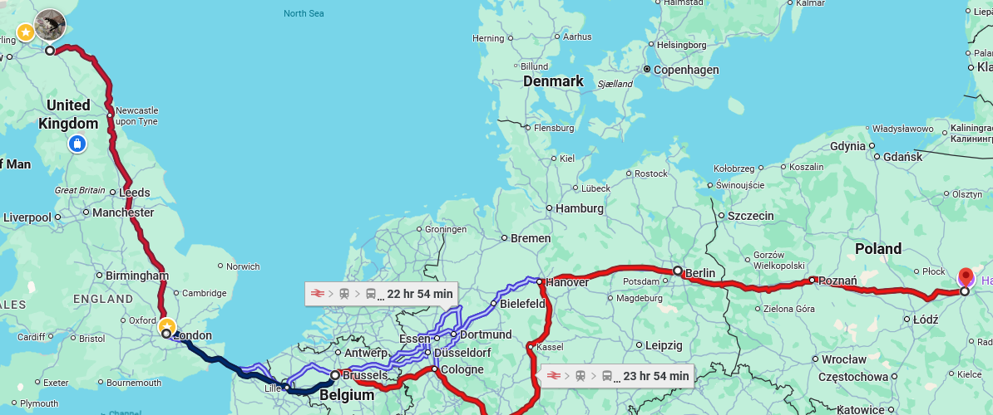
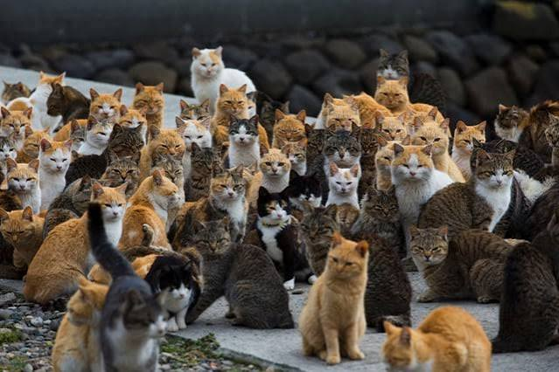
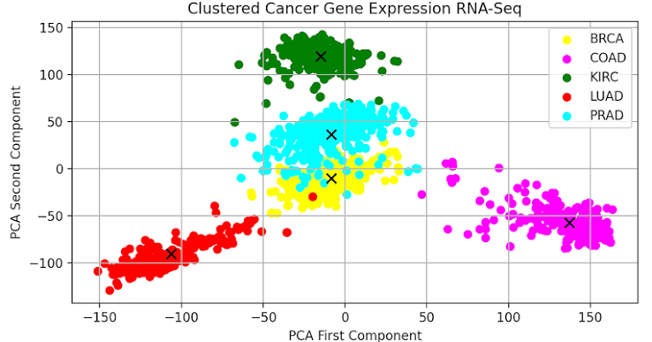
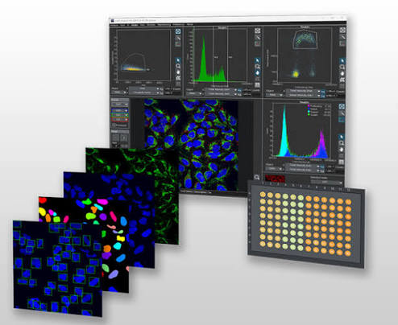
Supervised, Unsupervised and semi supervised Learning
Supervised learning.
  We know the data and the output but not the connection
Unsupervised learning
  We have the data but not the output or connection (clustering, association)
Semi supervised learning
  We have annotated some of the data but not all of it. We need the machine to extrapolate

Slide 9
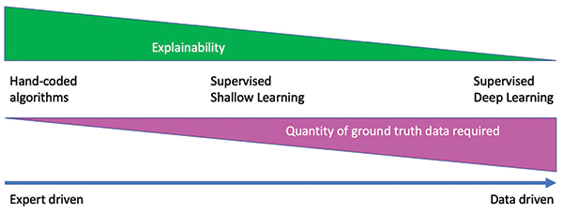
To supervise or not to supervise that is the question
Supervised Machine learning –Annotated ‘ground truth’ data is provided, either by you or a corporate entity (Nikon and Zeiss’s AI tools) so the machine has something to refer to and you can see how ‘good a job’ the machine has done
Works in Deep and Shallow learning
Jones and Strange, 2023 https://analyticalscience.wiley.com/content/article-do/artificial-intelligence-image-analysis-microscopy

Slide 10
But there is too much data to annotate - Transfer learning
Your image analysis problem is new.
Training data = not much
Recycle –
Priors, e.g. Stardist (assumes everything is a convex polygon) / Cell Pose
Take similar data from else where
  Bioimage model Zoo - A centralized community library for sharing and discovering pre-trained deep learning models for microscope

Slide 11
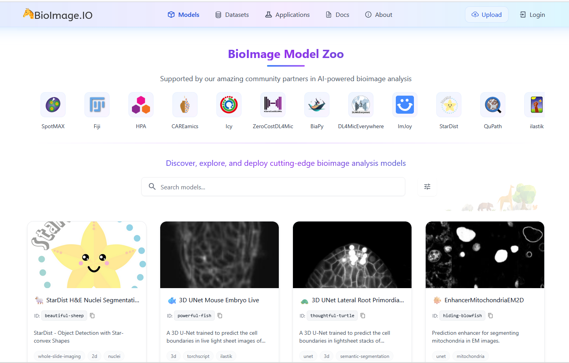

The Bioimage Model Zoo
https://bioimage.io/#/models

Slide 12
Machine Learning methods in BIA
CellPose: A popular generalist, deep learning-based segmentation tool that uses a gradient-based flow-field representation https://doi.org/10.1038/s41592-025-02595-5
U-Net: A neural network designed for fast biomedical image segmentation, works via data augmentation. Can be applied in Fiji/ ImageJ
Ilastik – supports interactive pixel and object classification, segmentation and machine learning (and can use U-net for this). Uses Random Forest and other classifiers
Care – Restores / enhances fluorescent microscopy data
SAM/SAM2 – Supported by Meta, Segments anything, if you have time…
https://focalplane.biologists.com/2024/12/10/sam-for-bioimage-analysis-a-comprehensive-guide/

Slide 13
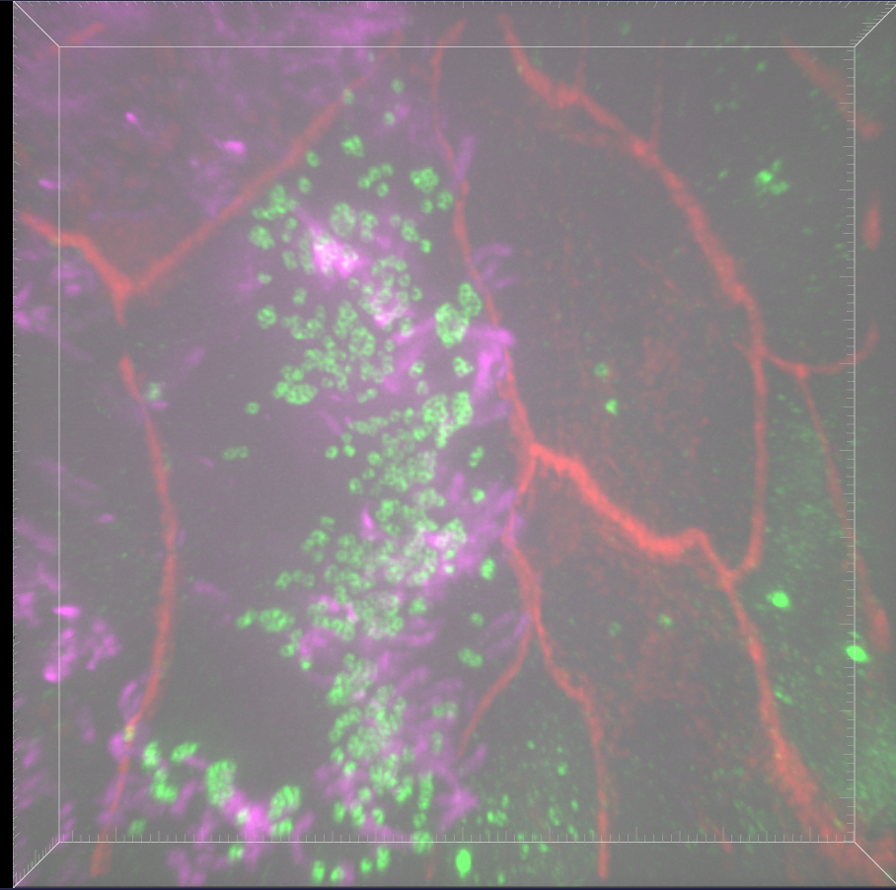
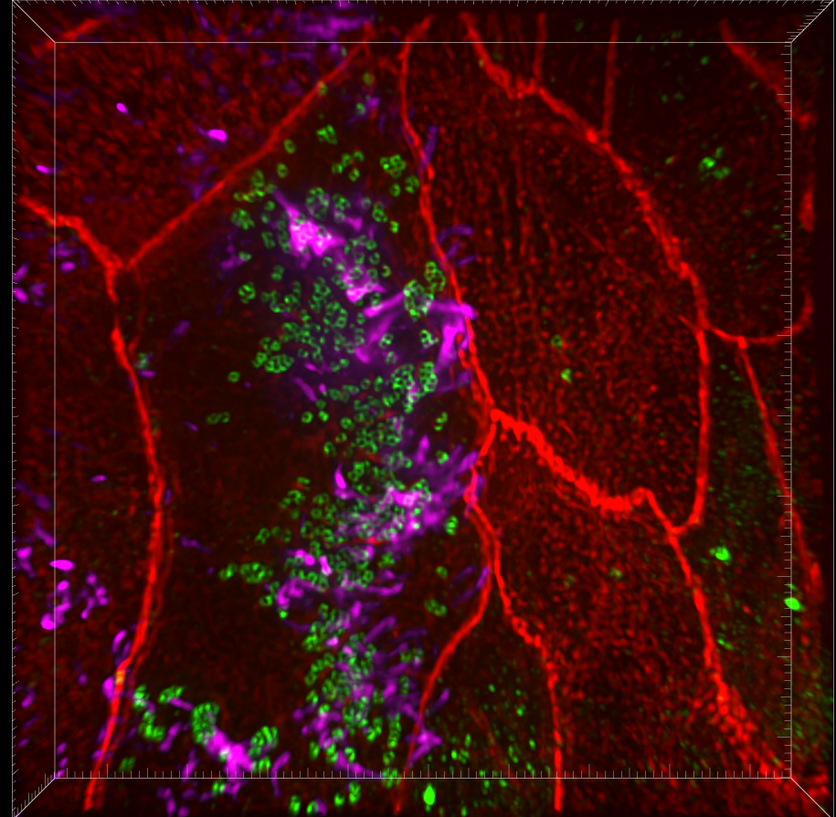
IGC exemplars when AI / Machine learning is impemented
Simplistic improvement by background removal (NIS) Super-resolution imaging
Removes Shot noise and fixed pattern noise from sCMOS camera

Slide 14
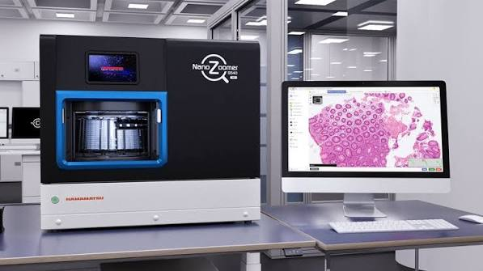
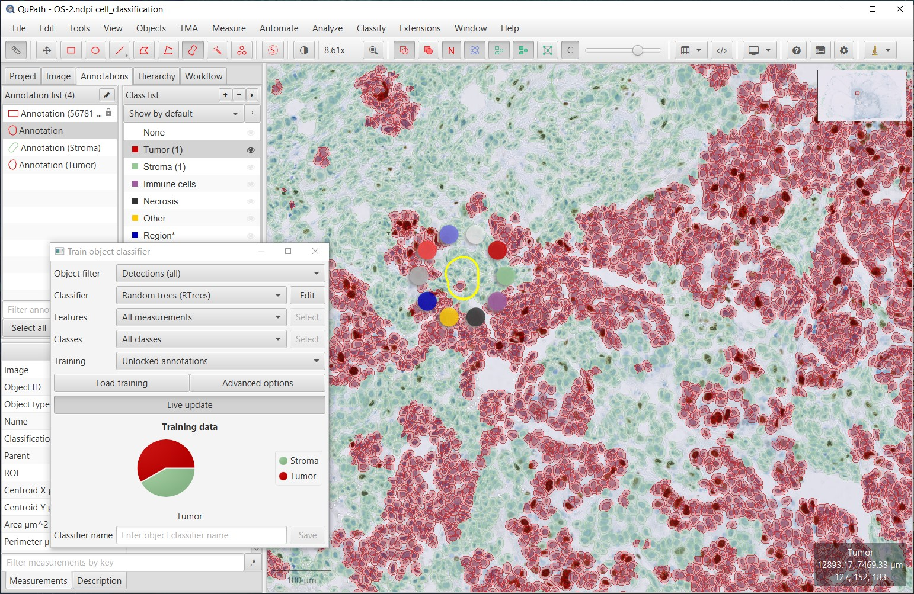
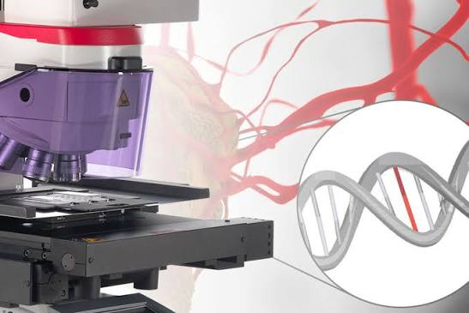
QuPath and Deep learning – Qupath to LMD
Exports coordinate
Of tissue areas
+ 3 fiducial markers

Slide 15
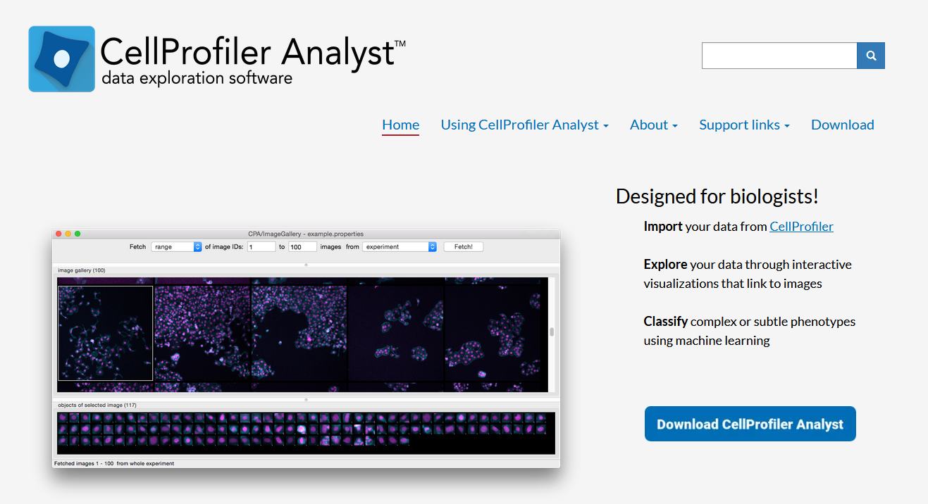
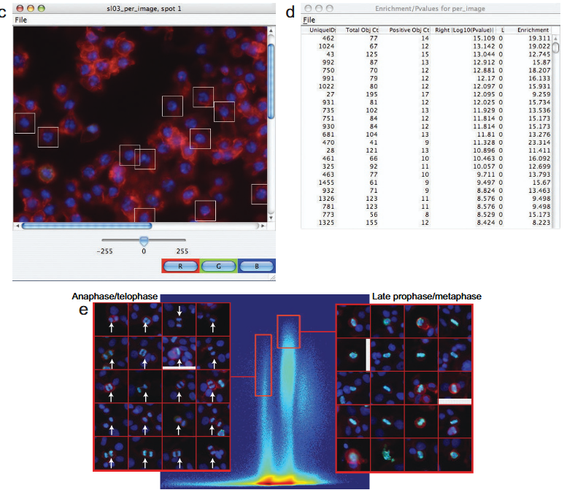
High through-put semi supervised learning.

Slide 16
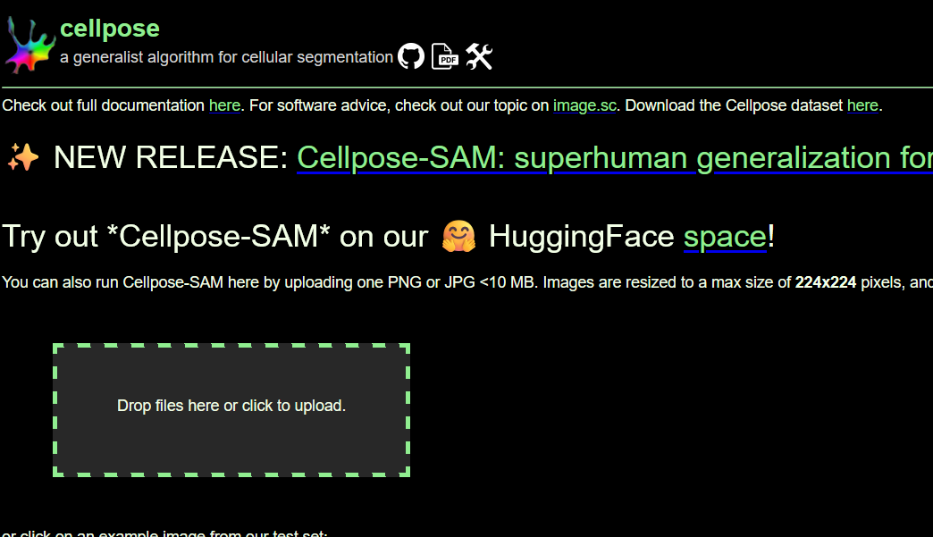
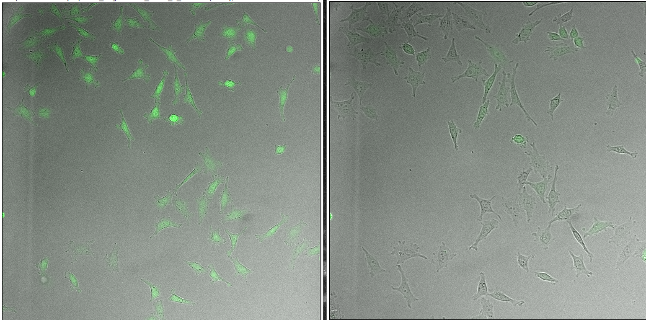
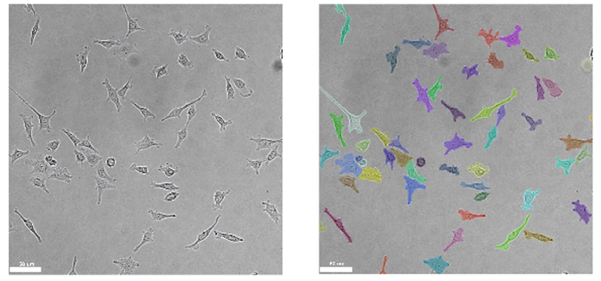
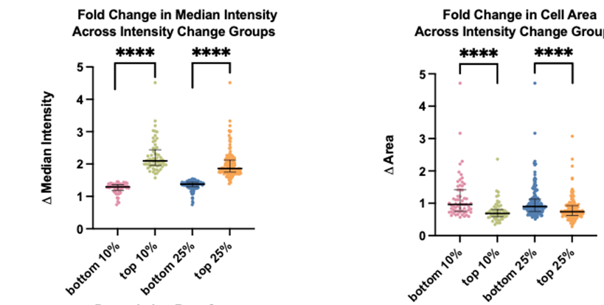
CellPose segmentation finds cells expressing GFP and tracks their expression over time
Time 0
Time 3hr +Protac
CellPose segmented the Brightfield
James Iremonger and Chris Callahagn

Slide 17
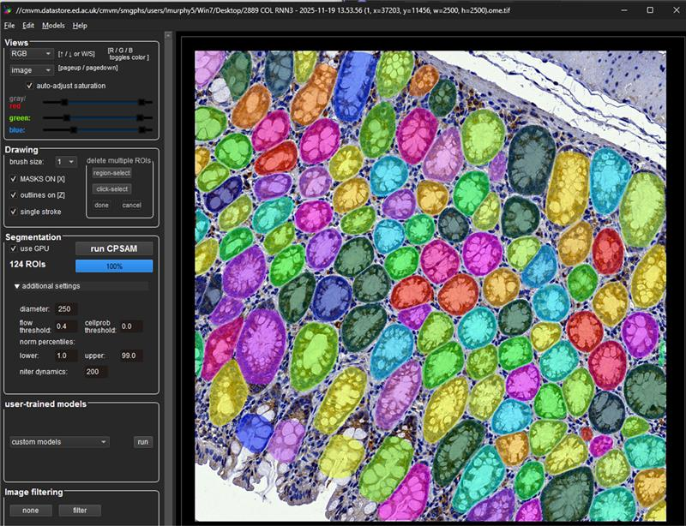
CellPose Classifiers:
Training ML Classifiers
For finding Crypts in liver Tissue
Scanned in from Brightfield images from the slide scanner
Segment anything (SAM) then used to identify crypts

Slide 18
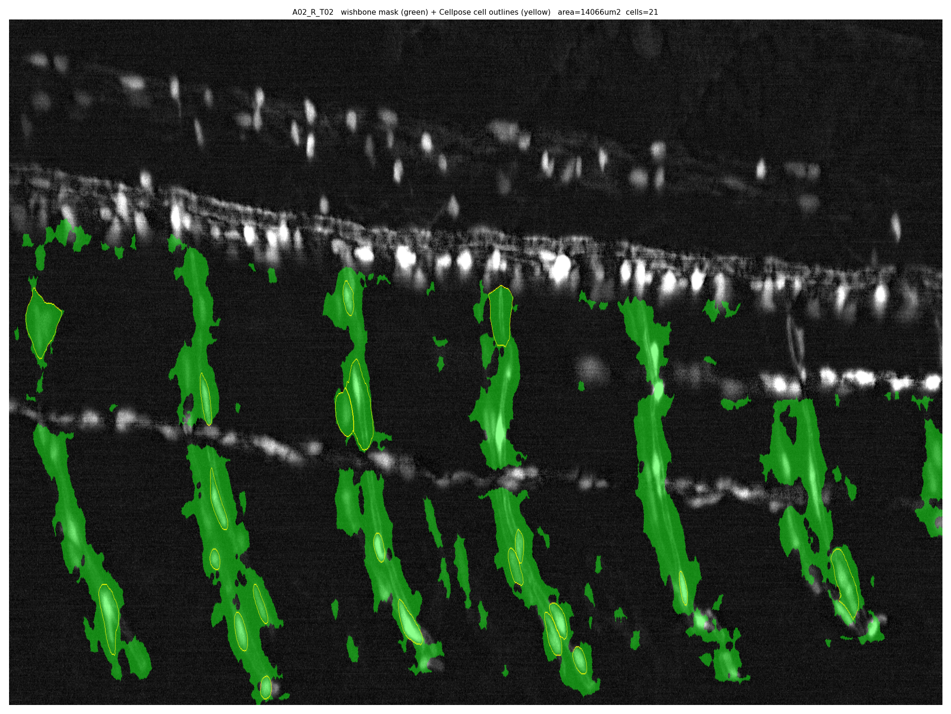
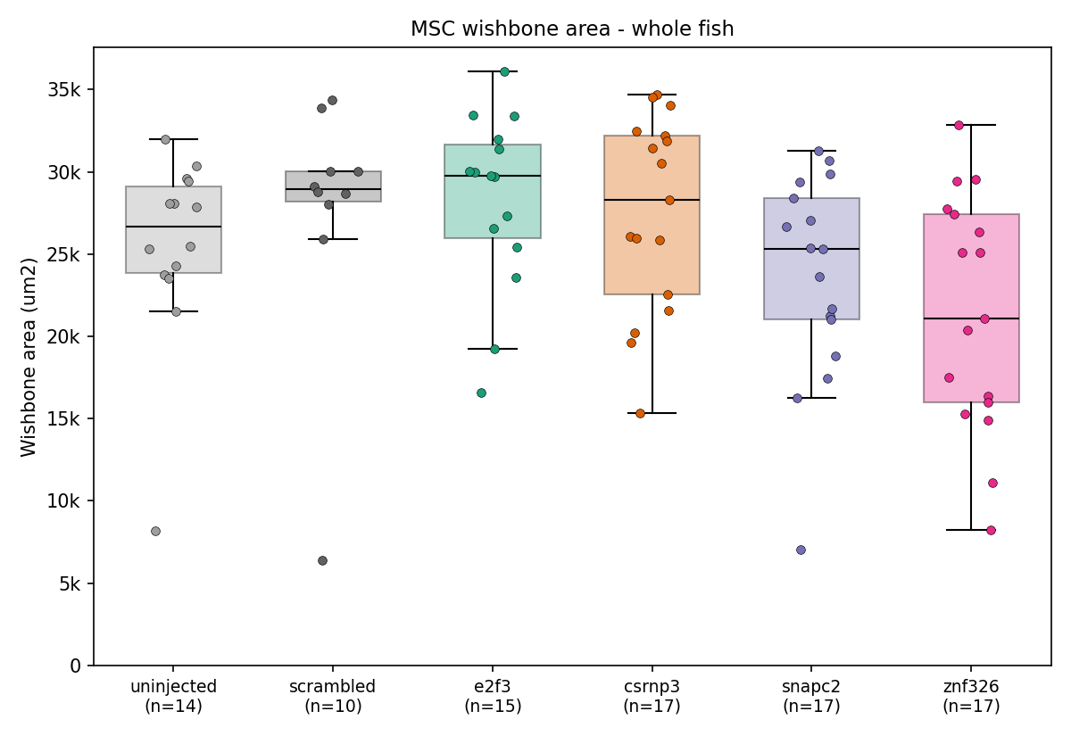
3D analysis of melanocyte-stem-cells in Zebrafish
This U-Net measures the melanocyte-stem-cell "wishbone" structures — their area, fluorescence intensity, and cell number — and compares the treatment groups. Over 90 fish measured

Slide 19
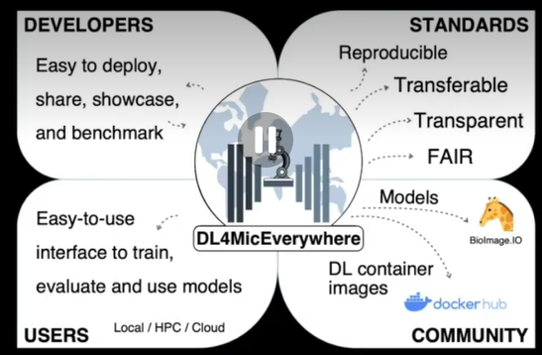
DL4Mic Everywhere

Slide 20
DL4MicEverywhere:
Uses Docker desktop (which it installs itself)
Makes no assumptions about coding expertise.
Gui interface which enables training and evaluation of models:
Including: segmentation, object detection, denoising, super-resolution microscopy and image-to-image translation
https://doi.org/10.1038/s41592-024-02295-6
https://github.com/HenriquesLab/DL4MicEverywhere

Slide 21
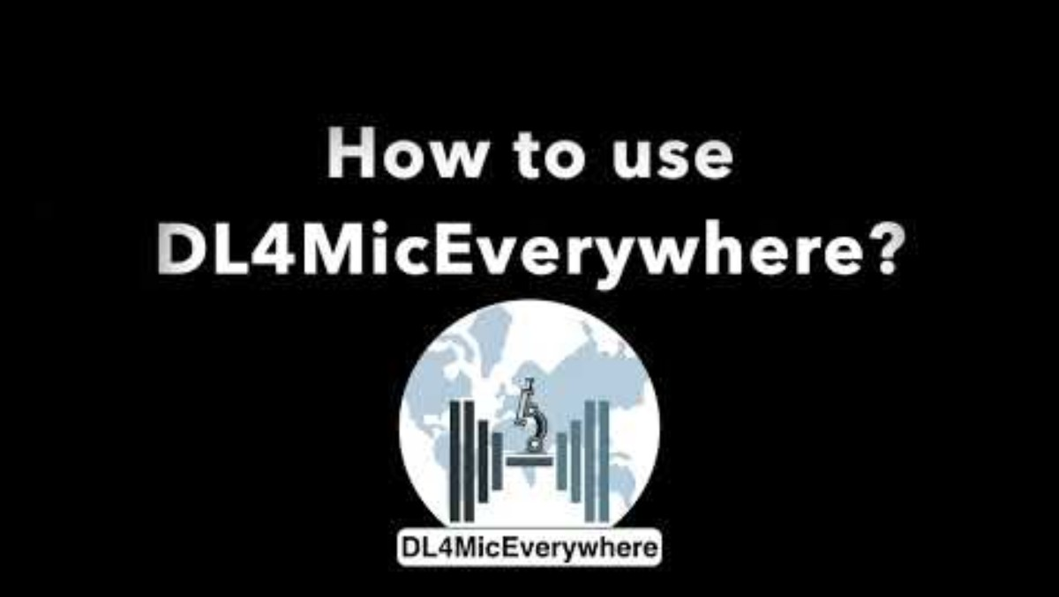

Slide 22
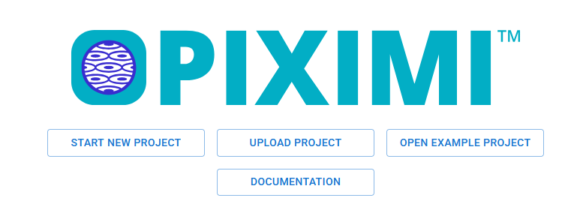
Piximi - https://piximi.app/
no-programming image analysis tool
Uses deep learning
Interoperable
DOI: 10.1101/2024.06.03.597232

Slide 23
Piximi functionality
Classifier: allowing researchers to easily label images or objects within images, such as cells, and train a classifier to recognize them.
Annotator: providing multiple flexible tools for creating object bounding boxes and segmentation outlines to allow researchers to annotate images directly in Piximi for use in downstream tasks.
Segmenter: allowing researchers to find object within images using pre-trained instance segmentation and object detection networks
Measurements: capturing various properties of images or entities identified therein, such as size, shape, and intensity. Measurements can then be plotted to examine distributions or between-group differences.

Slide 24
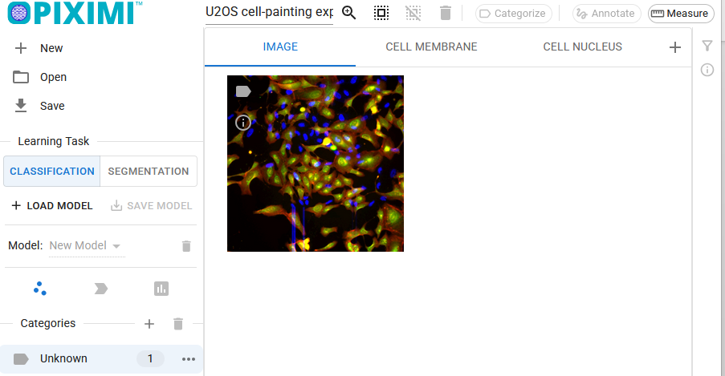
Using Piximi

Slide 25
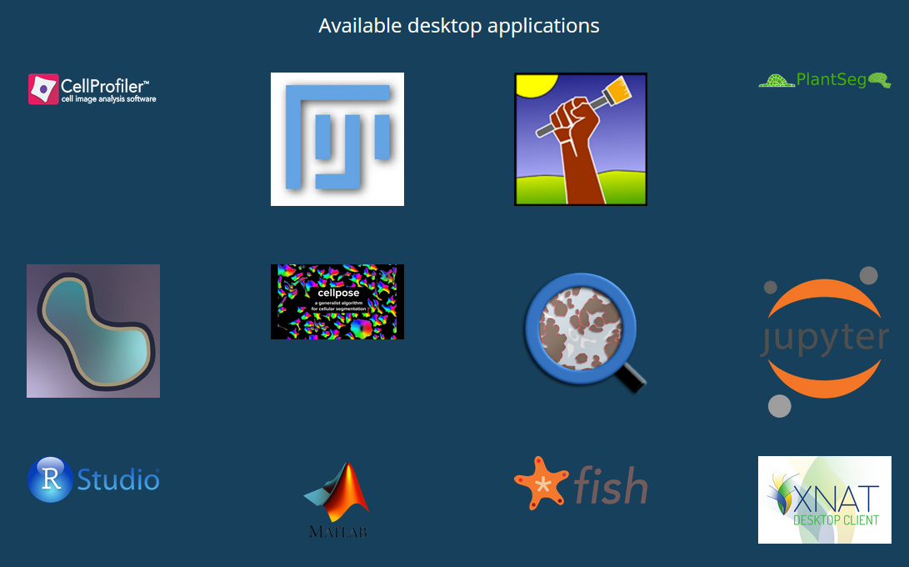
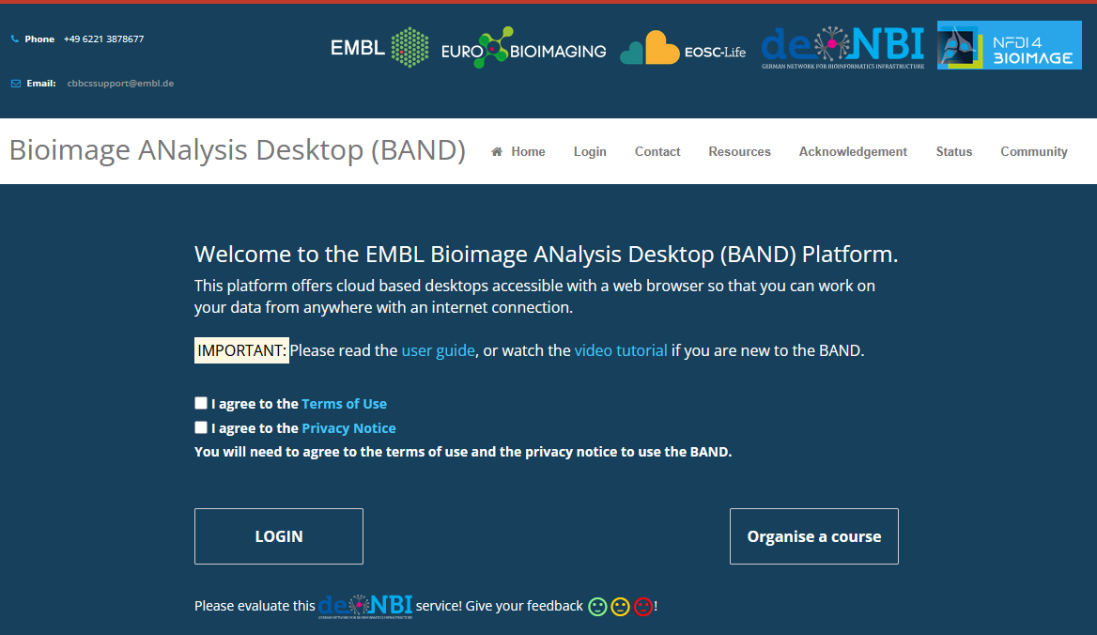
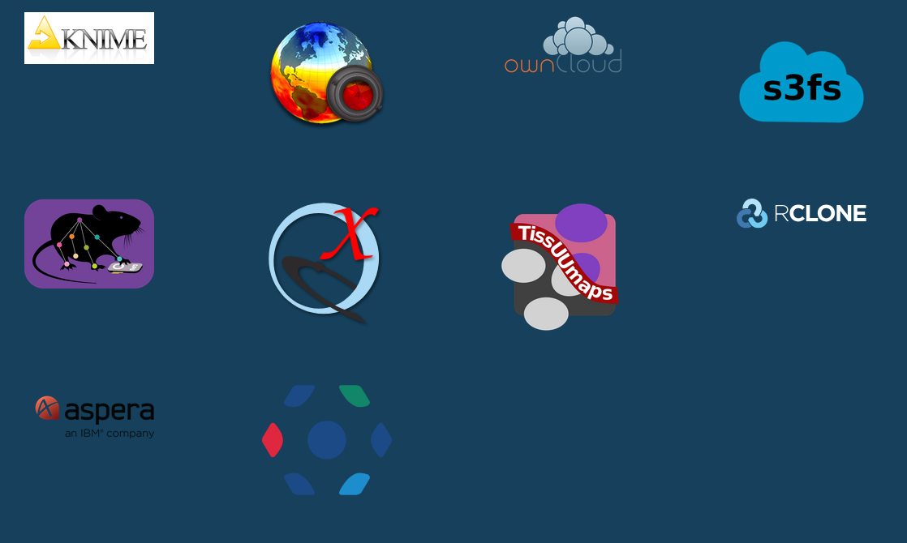
What is BAND and how can it help
https://bandv1.denbi.uni-tuebingen.de/#/eosc-landingpage

Slide 26
Summary
Machine learning is a branch of AI
It uses classifers to learn from data
Deep learning uses layers of classifiers in an Artificial Neural network
Can use a lot of processing power
Tools such as CellPose, QuPath, Ilastik include Machine learning algorithms
Tools such as DL4MicEverywhere and Piximi enable equality of access to Deep learning for machine learning.

Slide 27
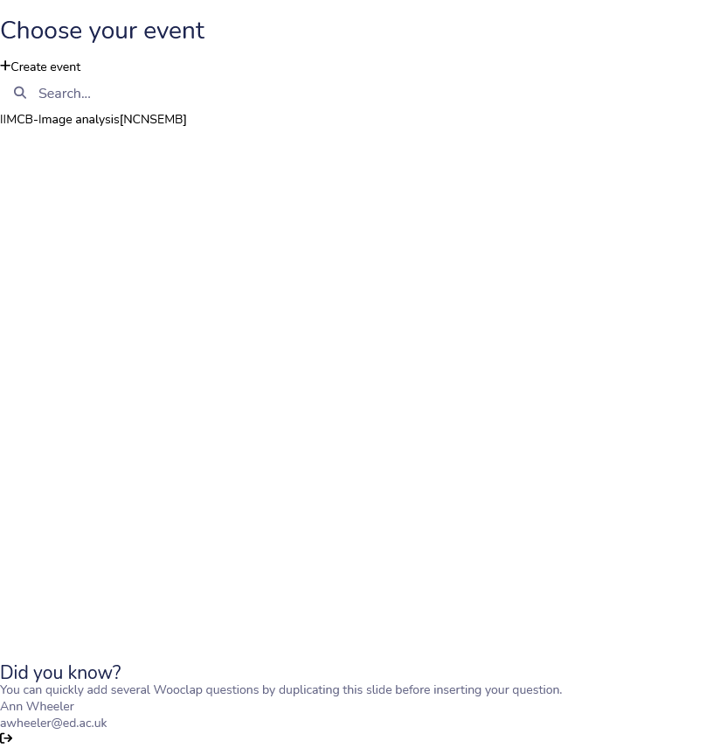
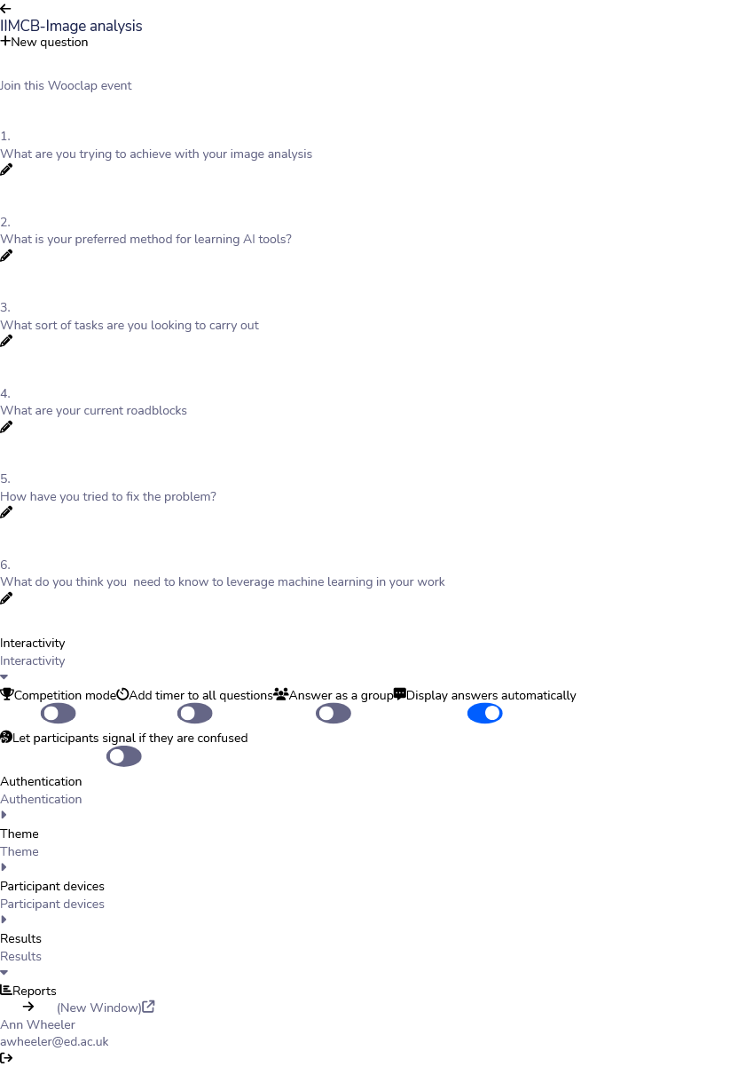
Over to you

Slide 28

Session Two – Over to you

Slide 29
Menti - what are you trying to do
Word cloud of what people want to do

Slide 30
Where does your project sit
Segmentation of cells
Feature identification in tissues
3D analysis of organoids / model organism
High content analysis
Analysis of Electron microscopy data
Restoring weak images

Slide 31
What are the current challenges / Roadblocks
Don’t know how to use Python for programming
No idea where to start
I took some code from a paper / Github but it doesn’t work for my data
Don’t have time to annotate images
When I try to analyse my images the Computer runs out of memory / trys to take a very long time

Slide 32
What have you tried so far to fix this
Vibe coding?
Borrowing other peoples data
How to use Github
Asked a friend

Slide 33
What do you think you need to know to leverage machine learning
Menti:

