Slide 1

Intro to HPC
Bruna Piereck
March 2025
This material is extended and adapted from
“How to start with spatial omics” module “Data Analysis” by Janick Mathys
Notes:
https://www.freepik.com/free-photo/data-center-with-server-racks-corridor-room-3d-render-digital-data-cloud-technology_20668653.htm#fromView=search&page=1&position=2&uuid=a9b2d649-42d2-4466-848d-a7f1f1c30340&query=servers

Slide 2
HPC
High-performance computing

Slide 3



High-performance computing
Computer
Different resources available
Nodes → parallel file system
CPU with
Multi-processor interconnect
High memory
GPU
Specialized processor
Fast interconnection
Server
HPC
Illustrations 1, 2 and 3 by @storyset at Freepik.com

Slide 4
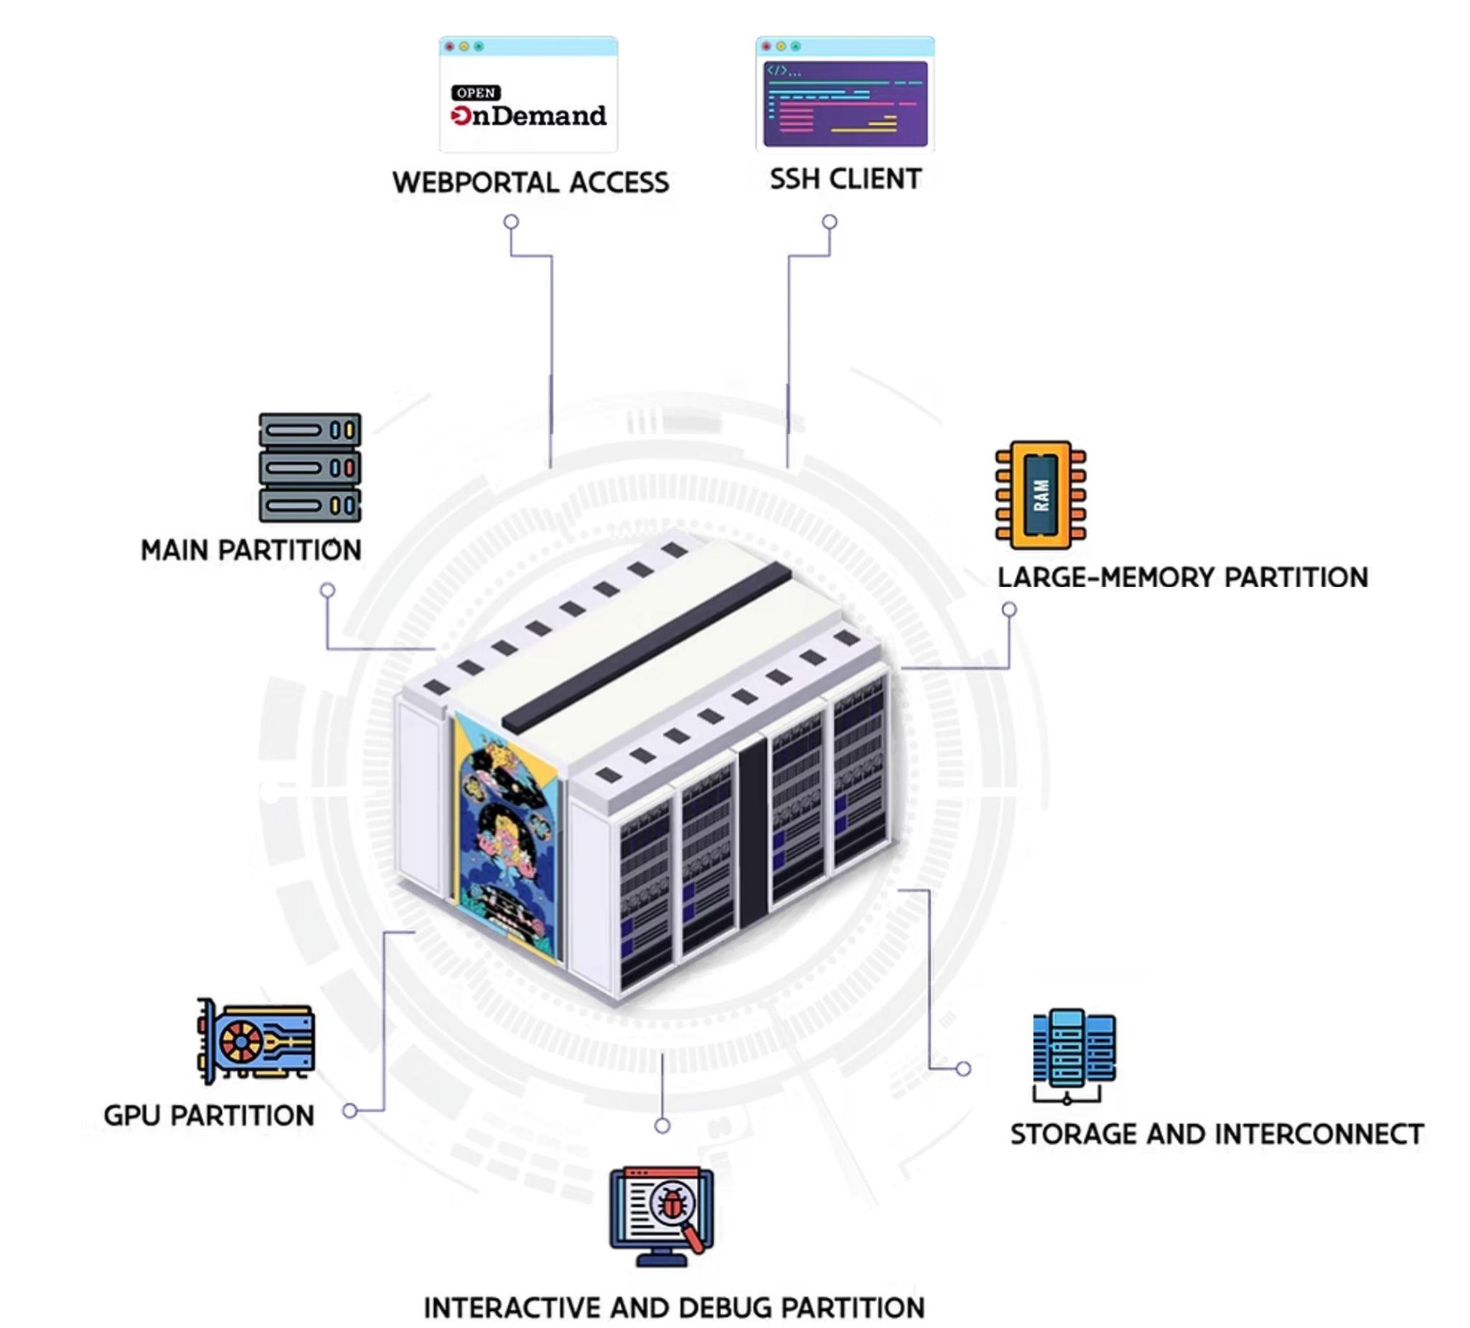
Notes:
https://www.vscentrum.be/compute

Slide 5
Tiers & Resources
HPC

Slide 6
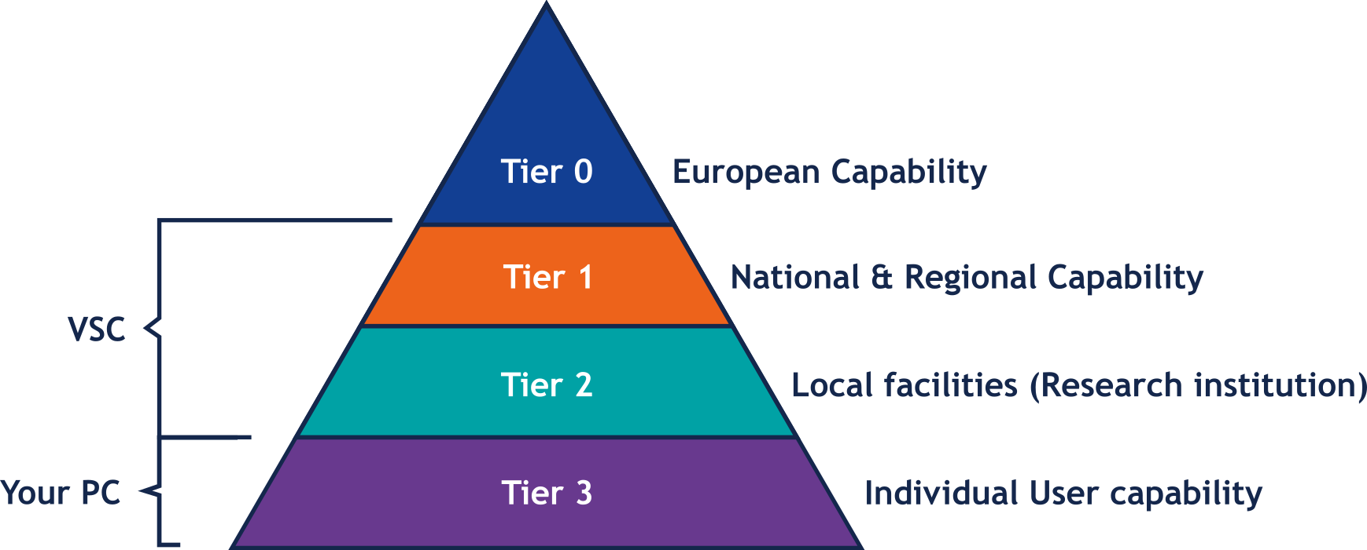

EU model: Infrastructure
Tier-0
6 in EU
Collaboration
Tier-1
Hortense (UGent)
Tier-2
Stevin (UGent)
Genius (KULeuven)
wICE (KULeuven)

Slide 7

VIB Data Core Compute Cluster
A centralized Compute solution for VIB users
Similar infrastructure
Only for VIB employees
Not using the Tier system classification

Slide 8
File System
HPC

Slide 9



File System
Purpose & Maintenance
Capacity (GB)
Home:
Data
Scratch
Notes:
https://www.freepik.com/icon/home_738822#fromView=search&page=1&position=2&uuid=2cf5ecab-7b68-4be4-8b58-ade72f18b7ff
https://www.freepik.com/icon/database_2351573#fromView=search&page=2&position=43&uuid=3967281a-e595-4993-a1a1-5a96b8931281
https://www.freepik.com/icon/schedule_16921098#fromView=search&page=1&position=64&uuid=772ccc1f-4dd5-468b-9e80-e5ad162ba517

Slide 10
File System
Purpose & Maintenance
Capacity (GB) | Performance
Home:
Data
Scratch
Notes:
https://www.freepik.com/icon/home_738822#fromView=search&page=1&position=2&uuid=2cf5ecab-7b68-4be4-8b58-ade72f18b7ff
https://www.freepik.com/icon/database_2351573#fromView=search&page=2&position=43&uuid=3967281a-e595-4993-a1a1-5a96b8931281
https://www.freepik.com/icon/schedule_16921098#fromView=search&page=1&position=64&uuid=772ccc1f-4dd5-468b-9e80-e5ad162ba517

Slide 11
File System
Purpose & Maintenance
Capacity (GB) | Performance | Purpose
Home:
Data
Scratch
Config and user preferences
No job execution
No data
Notes:
https://www.freepik.com/icon/home_738822#fromView=search&page=1&position=2&uuid=2cf5ecab-7b68-4be4-8b58-ade72f18b7ff
https://www.freepik.com/icon/database_2351573#fromView=search&page=2&position=43&uuid=3967281a-e595-4993-a1a1-5a96b8931281
https://www.freepik.com/icon/schedule_16921098#fromView=search&page=1&position=64&uuid=772ccc1f-4dd5-468b-9e80-e5ad162ba517

Slide 12
File System
Purpose & Maintenance
Capacity (GB) | Performance | Purpose
Home:
Data
Scratch
Config and user preferences
No job execution
No data
Long-term storage
No job execution
Notes:
https://www.freepik.com/icon/home_738822#fromView=search&page=1&position=2&uuid=2cf5ecab-7b68-4be4-8b58-ade72f18b7ff
https://www.freepik.com/icon/database_2351573#fromView=search&page=2&position=43&uuid=3967281a-e595-4993-a1a1-5a96b8931281
https://www.freepik.com/icon/schedule_16921098#fromView=search&page=1&position=64&uuid=772ccc1f-4dd5-468b-9e80-e5ad162ba517

Slide 13
File System
Purpose & Maintenance
Capacity (GB) | Performance | Purpose
Home:
Data
Scratch
Config and user preferences
No job execution
No data
Long-term storage
No job execution
Short-term storage
Job executed
Not accessible in other VSCs
Notes:
https://www.freepik.com/icon/home_738822#fromView=search&page=1&position=2&uuid=2cf5ecab-7b68-4be4-8b58-ade72f18b7ff
https://www.freepik.com/icon/database_2351573#fromView=search&page=2&position=43&uuid=3967281a-e595-4993-a1a1-5a96b8931281
https://www.freepik.com/icon/schedule_16921098#fromView=search&page=1&position=64&uuid=772ccc1f-4dd5-468b-9e80-e5ad162ba517

Slide 14
File System
Purpose & Maintenance
Capacity (GB) | Performance | Purpose
Home:
Data
Scratch
Config and user preferences
No job execution
No data
Long-term storage
No job execution
Copy
before run
Short-term storage
Job executed
Not accessible in other VSCs
Notes:
https://www.freepik.com/icon/home_738822#fromView=search&page=1&position=2&uuid=2cf5ecab-7b68-4be4-8b58-ade72f18b7ff
https://www.freepik.com/icon/database_2351573#fromView=search&page=2&position=43&uuid=3967281a-e595-4993-a1a1-5a96b8931281
https://www.freepik.com/icon/schedule_16921098#fromView=search&page=1&position=64&uuid=772ccc1f-4dd5-468b-9e80-e5ad162ba517

Slide 15
File System
Different systems
$VSC_HOME
$VSC_DATA
$VSC_SCRATCH
Other Scratch
Notes:
https://www.freepik.com/icon/home_738822#fromView=search&page=1&position=2&uuid=2cf5ecab-7b68-4be4-8b58-ade72f18b7ff
https://www.freepik.com/icon/database_2351573#fromView=search&page=2&position=43&uuid=3967281a-e595-4993-a1a1-5a96b8931281
https://www.freepik.com/icon/schedule_16921098#fromView=search&page=1&position=64&uuid=772ccc1f-4dd5-468b-9e80-e5ad162ba517

Slide 16


File System
* $HOME = $VCS_SCRATCH
** Project based
Different systems
Tier1 | Tier2 | Tier 2
**
**
$VSC_HOME * $HOME 3 GB 3 GB
$VSC_DATA Variable 25 GB 75 GB
$VSC_SCRATCH 3 GB 25 GB 500 GB
Other Scratch Variable X up to 600 GB
$VSC_SCRATCH_PROJECTS_BASE $VSC_SCRATCH_NODE
Notes:
https://www.freepik.com/icon/home_738822#fromView=search&page=1&position=2&uuid=2cf5ecab-7b68-4be4-8b58-ade72f18b7ff
https://www.freepik.com/icon/database_2351573#fromView=search&page=2&position=43&uuid=3967281a-e595-4993-a1a1-5a96b8931281
https://www.freepik.com/icon/schedule_16921098#fromView=search&page=1&position=64&uuid=772ccc1f-4dd5-468b-9e80-e5ad162ba517

Slide 17
File System
Comment by Boris:
Users can have storage and computational credits (in the future) based on a project OR their center / group. So not sure if their should be a triple asterisks saying ‘project or goup based’?
** Project based
If it is based on project or group it fits in the asterisks case … no?!
Different systems
Tier1 | Tier2 | Tier 2 | Data Core compute
Comment by Maria:
the official naming is “Data Core Compute” instead of “compute” so if it fits there, it can be changed?
**
**
**
$VSC_HOME * $HOME 3 GB 3 GB $HOME 10 GB
$VSC_DATA Variable 25 GB 75 GB path/to/ Variable
Comment by Maria:
I am wondering if providing the exact path will make it clearer to the cluster users. So replace “path/to” with “/data/groups/<your_center>/<your_group>/”
$VSC_SCRATCH 3 GB 25 GB 500 GB X X
The idea here to make it short and self explanatory, the whole path will be difficult to read and it is a variable path to each person/group. So the idea is to explain and point them the documentation.
Other Scratch Variable X up to 600 GB $SCRATCHDIR Variable
$VSC_SCRATCH_PROJECTS_BASE $VSC_SCRATCH_NODE Local to Node
Notes:
https://www.freepik.com/icon/home_738822#fromView=search&page=1&position=2&uuid=2cf5ecab-7b68-4be4-8b58-ade72f18b7ff
https://www.freepik.com/icon/database_2351573#fromView=search&page=2&position=43&uuid=3967281a-e595-4993-a1a1-5a96b8931281
https://www.freepik.com/icon/schedule_16921098#fromView=search&page=1&position=64&uuid=772ccc1f-4dd5-468b-9e80-e5ad162ba517

Slide 18


Accessible from:
Tier 1
$VSC_HOME
Tier 2
Tier 2
Access in any VSC instance
Any VSC instance

Slide 19
Accessible from:
Tier 1
$VSC_DATA
Tier 2
Tier 2
Access in any VSC instance
Any VSC instance

Slide 20
Accessible from:
Tier 1
$VSC_SCRATCH
Tier 2
$VSC_SCRATCH
Exclusive access in “your” instance
Tier 2
$VSC_SCRATCH
$VSC_SCRATCH
Any VSC instance

Slide 21
Accessible from:
$VSC_SCRATCH_NODE
$VSC_SCRATCH_NODE
$VSC_SCRATCH_NODE
Tier 1
$VSC_SCRATCH_NODE
$VSC_SCRATCH_NODE
$VSC_SCRATCH_NODE
Tier 2
Exclusive of each node
Tier 2
$VSC_SCRATCH_NODE
$VSC_SCRATCH_NODE
$VSC_SCRATCH_NODE
$VSC_SCRATCH_NODE
$VSC_SCRATCH_NODE
$VSC_SCRATCH_NODE
Any VSC instance
Similar for Data Core compute

Slide 22
Node offer
HPC

Slide 23
Nodes in HPC
Variable resources
CPUs
GPUs
Memory
Debug interactive node
Each node has a name

Slide 24
Nodes in HPC
Variable resources
CPUs
GPUs
Memory
Debug interactive node
Each node has a name
More resources == Less priority

Slide 25
Nodes in HPC
Variable resources
CPUs
GPUs
Memory
Debug interactive node
Each node has a name
More resources == Less priority
Optimization!!!

Slide 26

Nodes in HPC
Variable resources
CPUs
GPUs
Memory
Look into log file jobname.logID
Optimization!!!
Notes:
https://www.freepik.com/icon/hosting_8712787
https://www.freepik.com/icon/folder_13194314#fromView=search&page=1&position=2&uuid=6b74e9e2-e694-4572-9582-4b97ba9ff542

Slide 27



Nodes and names
Comment by Boris:
Changed link to point directly to #hardware section.
debug_28C_56T_750GB donphan debug_rome interactive
gpu_a100_debug
VIB Tier 2 UGent Tier 1 UGent Tier 2 KULeuven
Notes:
https://meta.wikimedia.org/wiki/File:Pokebola-pokeball-png-0.png
https://www.freepik.com/icon/body_16487673#fromView=search&page=1&position=37&uuid=7a41290c-42dd-49f9-879a-52e1b7929e55
https://www.freepik.com/icon/map_15940462#fromView=search&page=1&position=19&uuid=9f4f097d-77b4-47ac-826d-d798be6b573d

Slide 28
Nodes and names
debug_28C_56T_750GB donphan debug_rome interactive
gpu_a100_debug
VIB Tier 2 UGent Tier 1 UGent Tier 2 KULeuven
Notes:
https://meta.wikimedia.org/wiki/File:Pokebola-pokeball-png-0.png
https://www.freepik.com/icon/body_16487673#fromView=search&page=1&position=37&uuid=7a41290c-42dd-49f9-879a-52e1b7929e55
https://www.freepik.com/icon/map_15940462#fromView=search&page=1&position=19&uuid=9f4f097d-77b4-47ac-826d-d798be6b573d

Slide 29
Connect to OnDemand
HPC

Slide 30

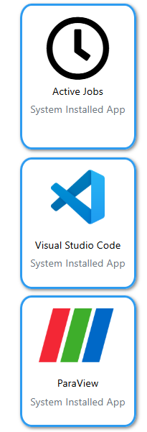
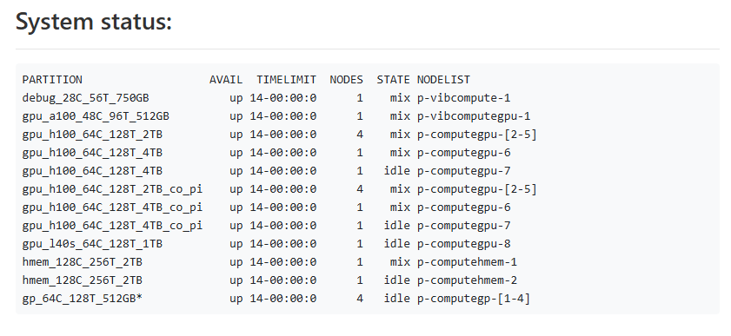
OnDemand: Friendly interface
https://website.be
VIB
https://compute.vib.be
UGent Tier-2
https://login.hpc.ugent.be
UGent Tier-1
https://tier1.hpc.ugent.be/
KULeuven Tier-2
https://ondemand.hpc.kuleuven.be/
Files
Jobs
Clusters
Interactive Apps
…
Open OnDemand provides an integrated, single access point for all your HPC resources.

Slide 31




Where can you connect ?
account
Tier 1
Tier 2
OnDemand
Tier 2
Any of their partners
Any VSC instance

Slide 32
Where can you connect ?
account
Tier 1
Tier 2
OnDemand
Tier 2
Any of their partners
Any VSC instance

Slide 33
Where can you connect ?
account
Tier 1
Tier 2
OnDemand
Tier 2
Any of their partners
Any VSC instance
OnDemand
account

Slide 34
Where can you connect ?
account
Tier 1
Tier 2
OnDemand
Tier 2
Any of their partners
Any VSC instance
OnDemand
account

Slide 35
Let’s connect
Chose one or both:
VIB
UGent Tier-2
Steps to follow:

Slide 36
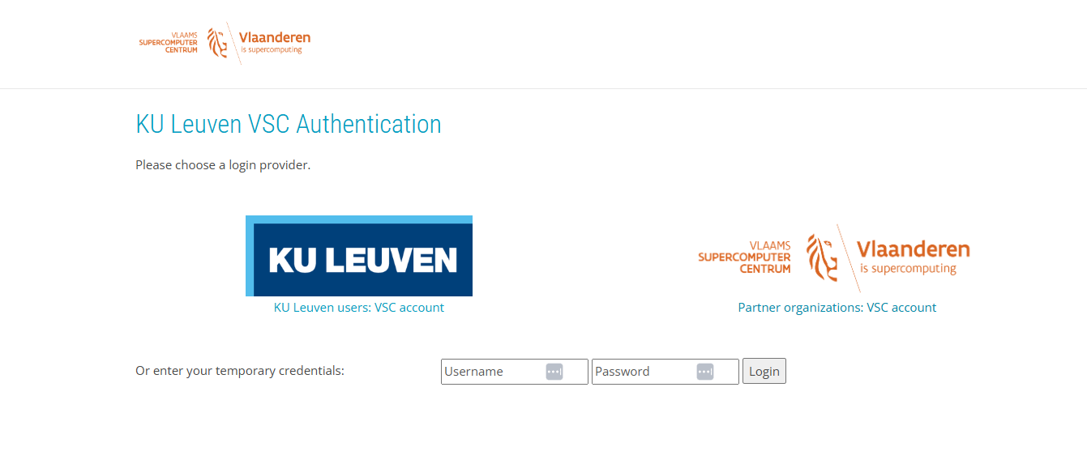
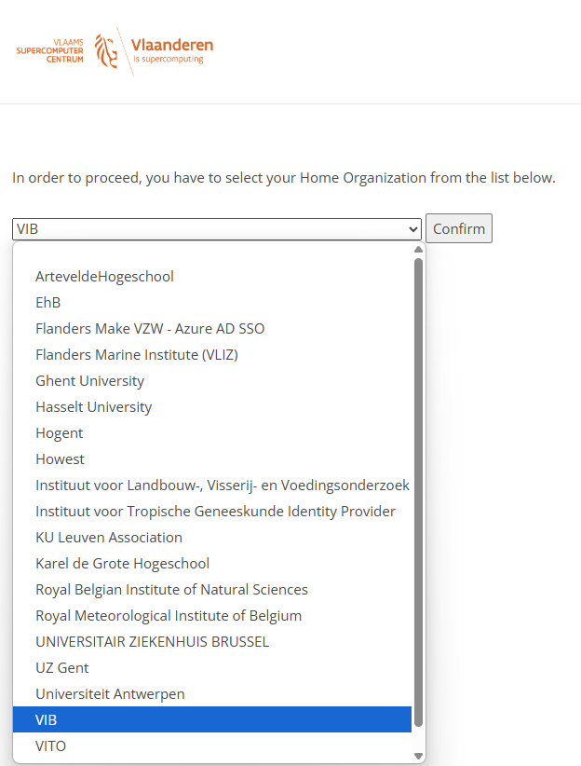

Let’s connect
Chose one or both:
VIB
UGent Tier-2
Steps to follow:
Choose your institutions

Slide 37

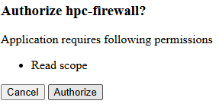
Let’s connect
Chose one or both:
VIB
UGent Tier-2
Steps to follow:
Choose your institutions
Authorize access

Slide 38
Connect cmd-line
HPC

Slide 39
Create an SSH key
ssh vsc47776@login.hpc.ugent.be
Check existing keys ls ~/.ssh
Generate a new key just for VSC ssh-keygen -t ed25519 -C "your_email@example.com" -f ~/.ssh/ed25519_vsc P.S.: Choose a strong password
Check your new key ls ~/.ssh

Slide 40


Inform the key to VSC
Access your account https://account.vscentrum.be/django//
https://account.vscentrum.be/django//
It can take some time to be active

Slide 41

Authentication for VIB Data Core Compute Cluster
Guide on docs.datacore.vib.be/entrypoints/command-line-access/
Smallstep CLI leverages VIB SSO for a secure connection
=
=
Generates certificate that is valid for 16 hours
Notes:
https://smallstep.com/cli/index.html

Slide 42
Access from WSL/LINUX terminal
Log in
VSC
ssh vsc00000@login.hpc.kuleuven.be
ssh vsc00000@login.hpc.ugent.be
VIB
ssh -p 2022 firstname.lastname@compute.vib.be
https://account.vscentrum.be/django//
We will try later
We need to wait the key to be authorized

Slide 43
Working & checking resources
Ondemand

Slide 44
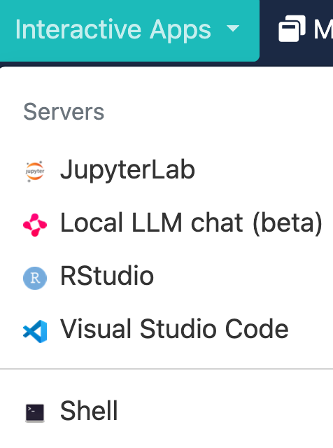
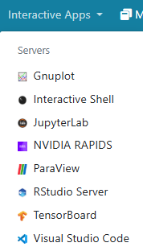
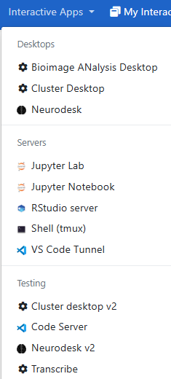
Let’s connect
Chose one or both:
VIB
UGent Tier-2
Steps to follow:
Choose your institutions
Authorize access
Choose the APP

Slide 45
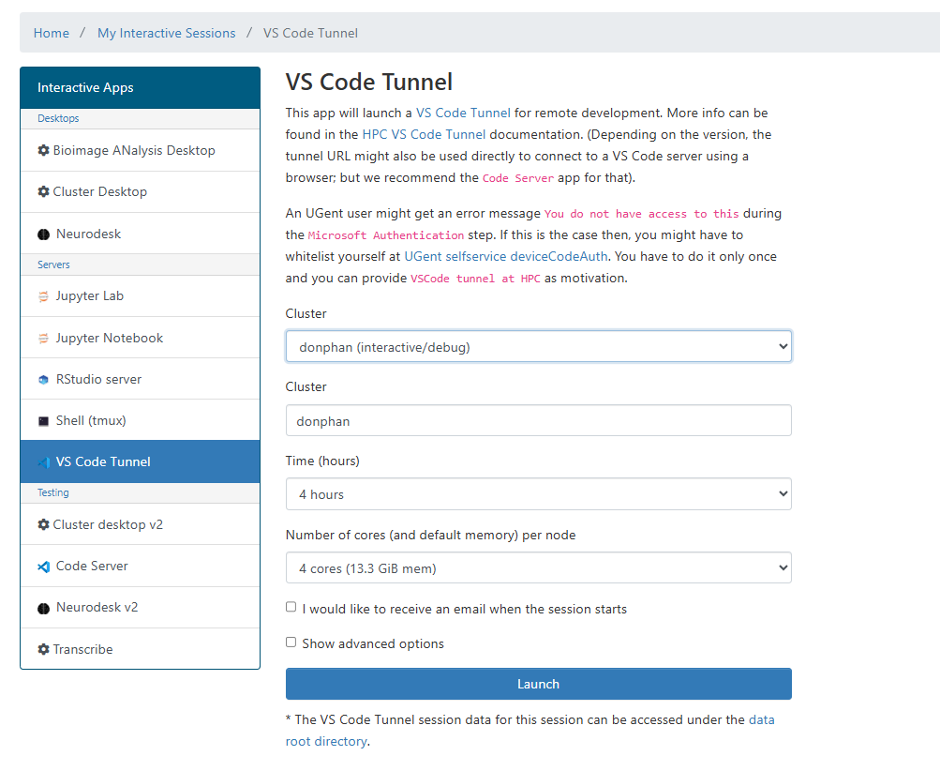
Let’s connect
Chose one or both:
VIB
UGent Tier-2
Steps to follow:
Choose your institutions
Authorize access
Choose the APP
Define resources

Slide 46
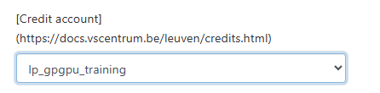

Let’s connect
Chose one or both:
VIB
UGent Tier-2
Steps to follow:
Choose your institutions
Authorize access
Choose the APP
Define resources
zx_accont_project
local_training

Slide 47
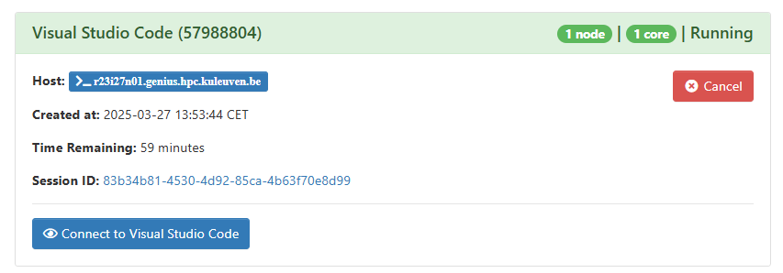
Let’s connect
Chose one or both:
VIB
UGent Tier-2
Steps to follow:
Choose your institutions
Authorize access
Choose the APP
Define resources
Launch → wait …

Slide 48
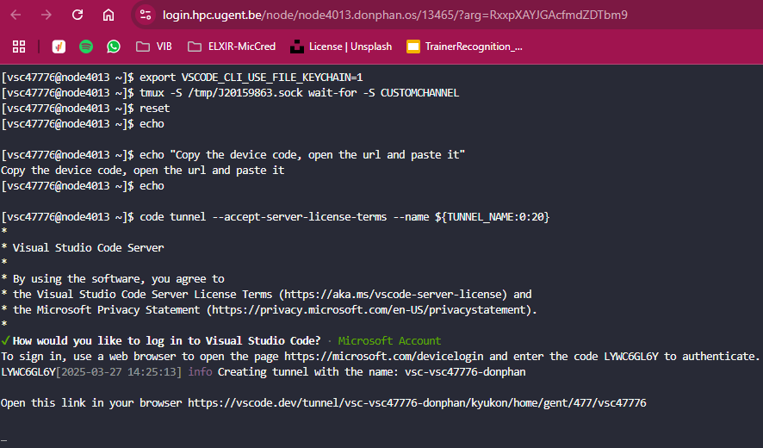

Let’s connect
Notes:
https://www.freepik.com/icon/key_15849555#fromView=search&page=1&position=39&uuid=aac9eae4-b934-40d8-bbb7-78877baeb5cc

Slide 49
Let’s connect

Slide 50
Let’s connect

Slide 51




Let’s connect
------------------------- Connects in $HOME -------------------------
Chose one or both:
VIB
UGent Tier-2
Steps to follow:
Choose your institutions
Authorize access
Choose the APP
Define resources
Choose the Shell
Start in $HOME

Slide 52
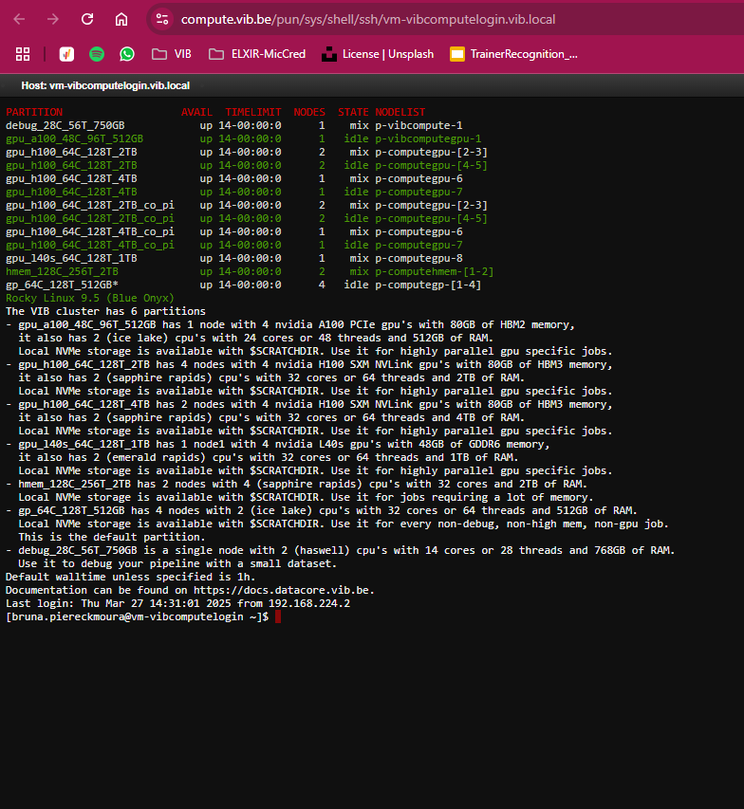
Let’s connect
Chose one or both:
VIB
UGent Tier-2
Steps to follow:
Choose your institutions
Authorize access
Choose the APP
Define resources
Choose the Shell
Start in $HOME
Move to cluster
Module swap <cluster>

Slide 53
Tools available
HPC

Slide 54
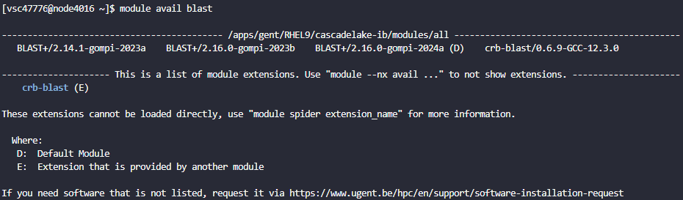
Terminal Tools
Search for tools:
$ module avail <name>
$ module av <name>
$ module spider <name>
D = default
E = extension

Slide 55

Terminal Tools
Search for tools:
$ module avail <name>
$ module av <name>
$ module spider <name>
D = default
E = extension
Load and use
$ module load <name>

Slide 56

Terminal Tools
Check loaded modules:
$ module list <name>
Modules will be available
in the node
during time requested
Unload modules
$ module unload <name>
$ module purge
Notes:
https://www.freepik.com/free-vector/code-review-concept-illustration_10733828.htm#fromView=search&page=1&position=39&uuid=159caae4-0f4e-41b2-bfe1-70e8f133ae86&query=inspecting

Slide 57
Terminal Tools
Some resources are promptly available
Check loaded modules:
$ module list <name>
Modules will be available
in the node
during time requested
Unload modules
$ module unload <name>
$ module purge
If you want to do a request, check if a module exists to facilitate: https://docs.easybuild.io/api/easybuild/tools/modules/
Notes:
https://www.freepik.com/free-vector/code-review-concept-illustration_10733828.htm#fromView=search&page=1&position=39&uuid=159caae4-0f4e-41b2-bfe1-70e8f133ae86&query=inspecting

Slide 58
Terminal Tools
Automatically available:
Example:
python
singularity
apptainer
perls
sqlite
git
Notes:
https://www.freepik.com/free-vector/code-review-concept-illustration_10733828.htm#fromView=search&page=1&position=39&uuid=159caae4-0f4e-41b2-bfe1-70e8f133ae86&query=inspecting

Slide 59
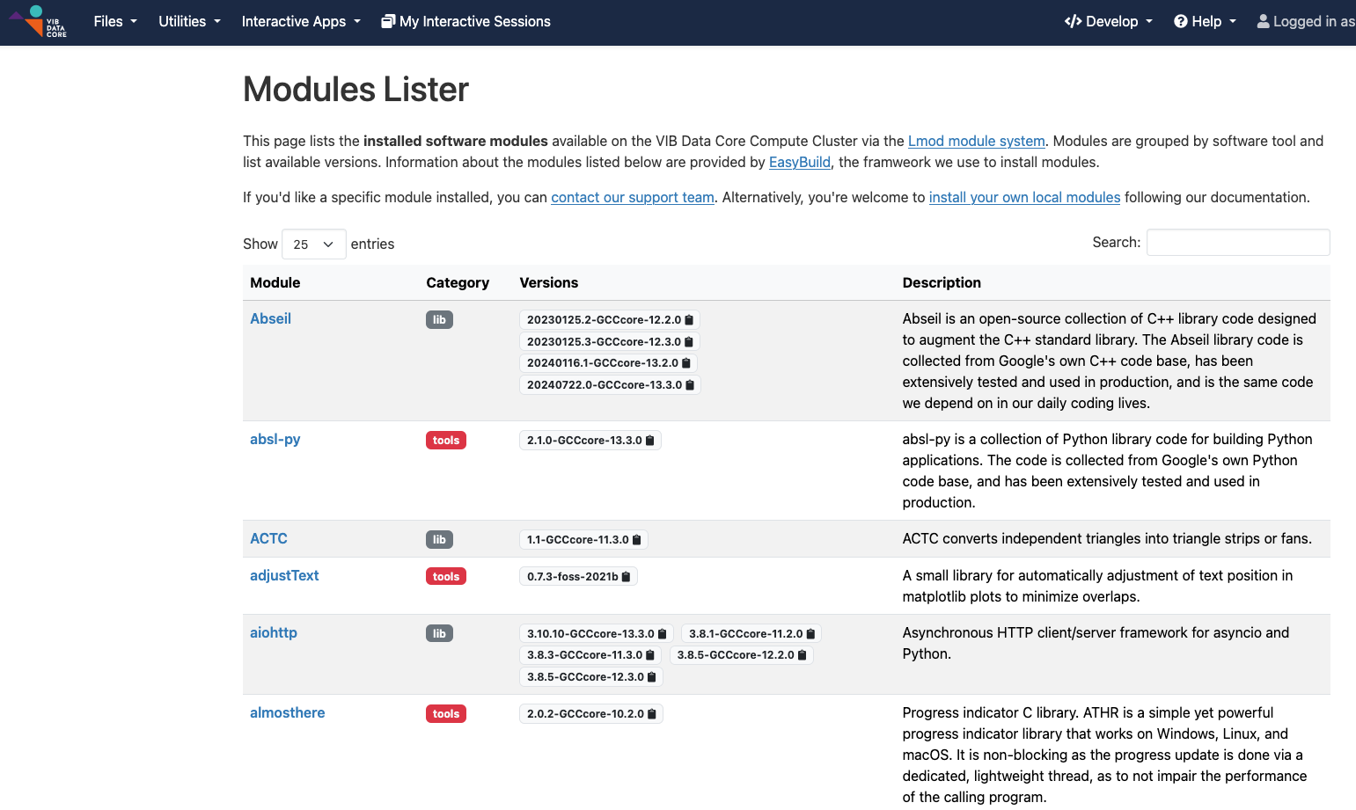
Terminal Tools
VIB Data Core Compute Cluster
Module lister
Notes:
https://compute.vib.be/pun/sys/dashboard/custom/modules
https://www.freepik.com/free-vector/code-review-concept-illustration_10733828.htm#fromView=search&page=1&position=39&uuid=159caae4-0f4e-41b2-bfe1-70e8f133ae86&query=inspecting

Slide 60
Submitting Jobs
HPC
Shell approach

Slide 61
Resource managers
PD (PENDING), R (RUNNING), S (SUSPENDED), CG (COMPLETING), and CD (COMPLETED).
Slurm vs Torque
#SBATCH
#PBS
Steps to follow:
Arguments
Different names
Same functionality

Slide 62
Resource managers
Define resources
same-same, not the same !
--partition = <cluster_name>
--mem = <number>
--time = hh:mm:ss
--ntasks = <number_cores>
Scripting = Reproducibility

Slide 63
Resource managers
PD (PENDING), R (RUNNING), S (SUSPENDED), CG (COMPLETING), and CD (COMPLETED).
Slurm
Torque
Slurm vs Torque
#SBATCH
#PBS
Steps to follow:
Arguments
Different names
Same functionality
Submit a job
sbatch script.sh
Submit a job
qsub script.pbs
Define resources

Slide 64
Resource managers
PD (PENDING), R (RUNNING), S (SUSPENDED), CG (COMPLETING), and CD (COMPLETED).
Slurm
Torque
Slurm vs Torque
#SBATCH
#PBS
Steps to follow:
Arguments
Different names
Same functionality
Submit a job
sbatch script.sh
Define resources
--job-name = <name>
--output = <name.out>
Submit a job
qsub script.pbs
Define Resources
--N <job_name>
-o stdout.$PBS_JOBID

Slide 65
Resource managers
PD (PENDING), R (RUNNING), S (SUSPENDED), CG (COMPLETING), and CD (COMPLETED).
Slurm
Torque
Slurm vs Torque
#SBATCH
#PBS
Steps to follow:
Arguments
Different names
Same functionality
Submit a job
sbatch script.sh
Define resources
--job-name = <name>
--output = <name.out>
--time = hh:mm:ss
–-mem = <n>G
Submit a job
qsub script.pbs
Define Resources
--N <job_name>
-o stdout.$PBS_JOBID
-l walltime = hh:mm:ss
memory
-l mem = <n> [MB]
-l pmem = <n> [GB]

Slide 66
Resource managers
PD (PENDING), R (RUNNING), S (SUSPENDED), CG (COMPLETING), and CD (COMPLETED).
Slurm
Torque
Slurm vs Torque
#SBATCH
#PBS
Steps to follow:
Arguments
Different names
Same functionality
Submit a job
sbatch script.sh
Submit a job
qsub script.pbs
Define resources

Slide 67
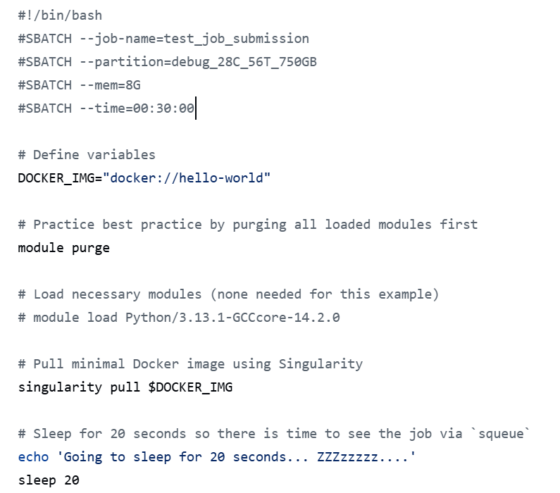
Our first job
Define resources
Define variables
Think of modules
Commands
Run in Slurm and PBS
UGent
VIB (if possible)
github copy-paste
Notes:
https://github.com/vib-tcp/introduction_2_HPC/blob/main/code/example_slurm/slurm_vib.sh

Slide 68
Resource managers
Slurm
Torque
Slurm vs Torque
#SBATCH
#PBS
Common tasks:
Cancel a job
Scancel <id>
qdel <id>
List Jobs
qstat
squeue
Submit a job
sbatch script.sh
Cancel a job
scancel <id>
List jobs
squeue
Submit a job
qsub script.pbs
Cancel a job
qdel
ist jobs
qstat

Slide 69
Resource managers
Slurm
Torque
Slurm vs Torque
#SBATCH
#PBS
Common tasks:
Cancel a job
Scancel <id>
qdel <id>
List Jobs
qstat
squeue
Submit a job
sbatch script.sh
Cancel a job
scancel <id>
List jobs
squeue
Status possible:
R: running
CD: completed
S: suspended PD: pending
CG: completing
Submit a job
qsub script.pbs
Cancel a job
qdel
ist jobs
qstat
Status possible:
R: running
C: completed
S: suspended Q: queued
E: exiting
seff <jobID>
Slurm_jobinfo <jobID>
Notes:
https://docs.vscentrum.be/jobs/slurm_pbs_comparison.html

Slide 70
Connect cmd-line
HPC

Slide 71
Access from WSL/LINUX terminal
Log in
ssh vsc00000@login.hpc.kuleuven.be
ssh vsc47776@login.hpc.ugent.be
ssh -p 2022 firstname.lastname@compute.vib.be
https://account.vscentrum.be/django//
It can take some time to be active

Slide 72
Bruna Piereck
bruna.piereckmoura@vib.be

Slide 73
Aqua
HEX #02A2A7
RBG 2, 162, 167
Orange
HEX #EC6523
RBG 236, 101, 35
Purple
HEX #693A91
RBG 105, 58, 145
Navy
HEX #14274C
RBG 20, 39, 76
Blue
HEX #1F448F
RBG 31, 68, 143
Cherry
HEX #E83050
RBG 232, 48, 80
Green
HEX #00A14A
RBG 0, 161, 74
Yellow
HEX #F9B418
RBG 249, 180, 24
Tint 01
HEX #29B3B8
RBG 41, 179, 184
Tint 01
HEX #EF7739
RBG 239, 119, 57
Tint 01
HEX #784B9A
RBG 120, 75, 154
Tint 01
HEX #24539F
RBG 36, 83, 159
Tint 01
HEX #EC4D6A
RBG 236, 77, 106
Tint 01
HEX #1AAF5E
RBG 26, 175, 94
Tint 01
HEX #FCC747
RBG 252, 199, 71
Tint 02
HEX #99D7D6
RBG 153, 215, 214
Tint 02
HEX #F7C1A3
RBG 247, 193, 163
Tint 02
HEX #C2AFD0
RBG 194, 175, 208
Tint 02
HEX #A1B2D5
RBG 161, 178, 213
Tint 02
HEX #F6AAB9
RBG 246, 170, 185
Tint 02
HEX #9BD3B3
RBG 155, 211, 179
Tint 02
HEX #FCE39B
RBG 252, 227, 155
Tint 03
HEX #CBEAEC
RBG 203, 234, 236
Tint 03
HEX #FBE8DF
RBG 251, 232, 223
Tint 03
HEX #E3DCEA
RBG 227, 220, 234
Tint 03
HEX #D5DBEC
RBG 213, 219, 236
Tint 03
HEX #FCE3E6
RBG 252, 227, 230
Tint 03
HEX #D1EAD9
RBG 209, 234, 217
Tint 03
HEX #FEF4CF
RBG 252, 244, 207

