Slide 1
05
Model Selection

Slide 2
Section contents
Cross-validation
Hyperparameter tuning
Model comparison and selection criteria

Slide 3
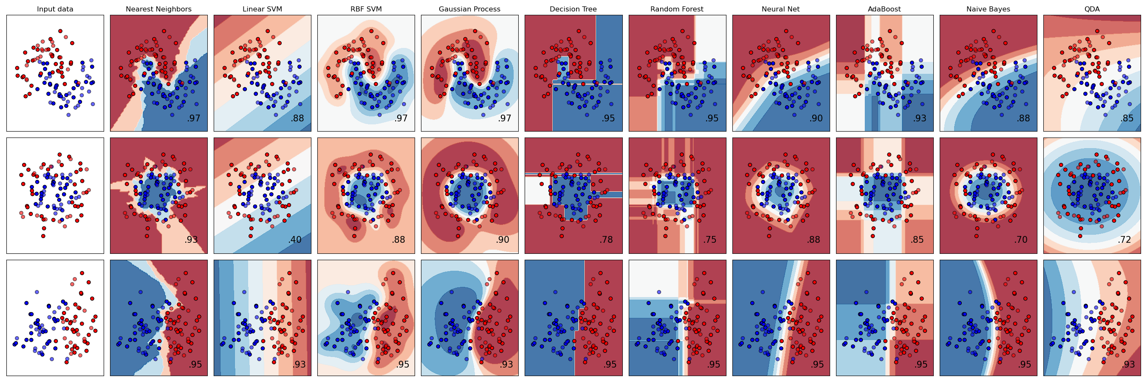
Classifiers
Which model is the best fit to my dataset/prediction problem?
How do I choose the optimal parameters?

Slide 4
Model selection
The goal of machine learning is generalization, not memorization
Different models might perform differently depending on
Data size
Data noise
Feature dimensionality
(non-)Linearity
Model selection = choosing the best model + hyperparameters that yield the best expected performance on unseen data

Slide 5
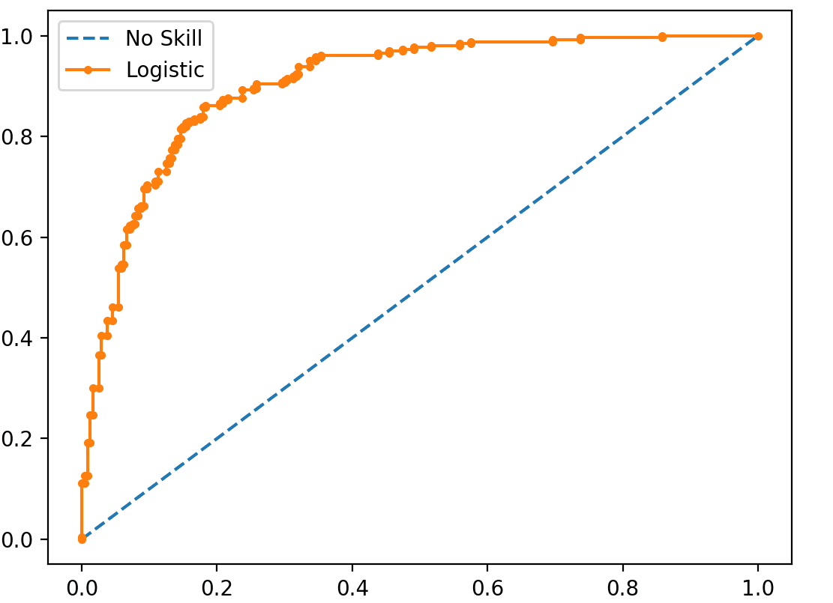
Evaluation metrics (classification)
Accuracy – only useful for balanced datasets
Precision, Recall, F1-score – useful for imbalanced data
ROC-AUC – threshold-independent metric
Confusion matrix – interpretable breakdown (not a metric on its own)
The ”optimal” model will depend on your choice of the evaluation metric
sensitivity
Area Under the Curve (AUC)
1-specificity
Classified as …
positive
negative
TP
FN
positive
Really is …
FP
TN
negative

Slide 6
Train-test splitting
Best fit
underfitting
overfitting
Test set = independent dataset to measure model performance
Model learns on training data
Evaluated on (unseen) test data
→ Good generalization to new inputs
Test error
Error
Training error
Model complexity

Slide 7
How do we compare the performance of different models without consuming the test data?

Slide 8
Train-test splitting
samples
train
validate
test
Train a model
xN
Validate the intermediate model
x1
test the final model

Slide 9
Train-test splitting
Best fit
underfitting
overfitting
Test set can only be used once!
The validation data models the aspect of “unseen data”
Model selection involves optimization on the validation error
Test error
Error
Validation error
Training error
Model complexity

Slide 10
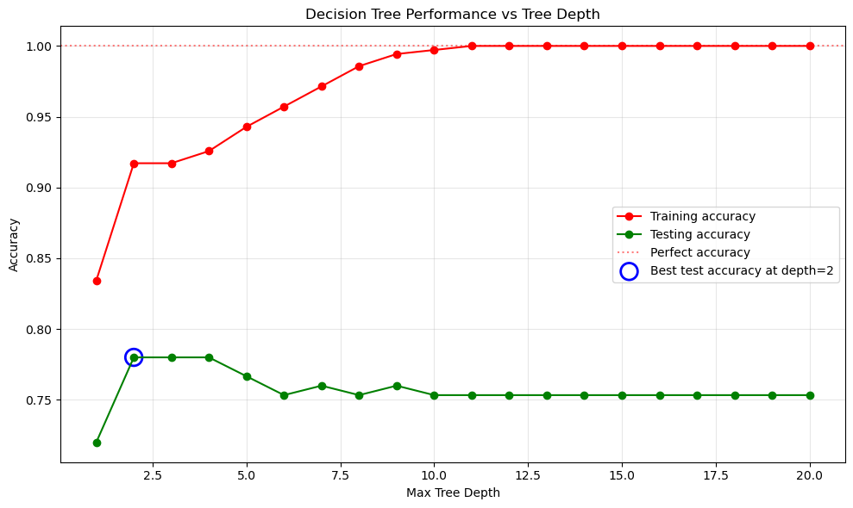
Hyperparameter tuning
Training accuracy
Validation accuracy
Perfect accuracy
Best validation accuracy

Slide 11
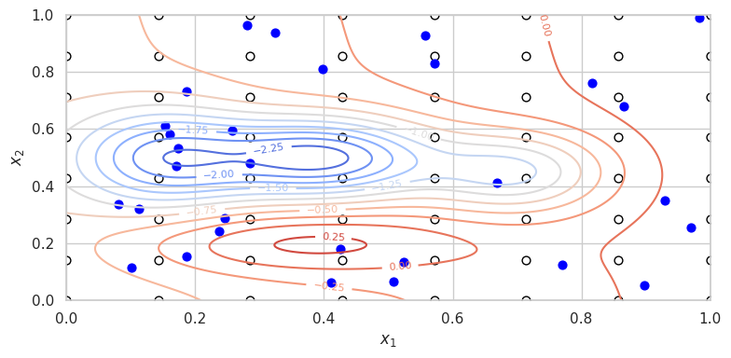
Hyperparameter tuning
Optimization on the validation error (similar to loss optimization during training, but now across hyperparameters)
Grid Search
Systematic but expensive
Best for low-dimensional hyperparameter spaces
Random search
Surprisingly effective
Much more efficient for large spaces

Slide 12
Cross-validation
samples
train
validate
test
With extensive optimization, the model might overfit on the validation set
Cross-validation
Iterative optimization on separate train/validation splits
Reduces variance in the performance estimation
…

Slide 13
Machine Learning Pipeline
MODEL SELECTION
Cross-validation
GridSearch/ RandomSearch
Learning algorithm
Dataset
Model
Predictions
Pre-processing
ML model
TUNABLE PARAMETERS
Scaling/imputation strategy
Dimensionality reduction
Model
Regularization
Hyperparameters

