Slide 1
02
Data Preprocessing

Slide 2
Section contents
Handle missing values
Scaling & normalization
Train/test split

Slide 3
DATA
MODEL
Learns patterns & decision rules
PREDICTION
Notes:
Since machine learning models learn patterns from the data that we give to it, it is evident that the quality of the output of your model will heavily depend on the quality of the data that it was trained on
GARBAGE IN = GARBAGE OUT
No matter how sophisticated your model, if the data quality is low, you will never get good and reproducible results

Slide 4

https://medium.com/nyc-design/gigo-garbage-in-garbage-out-concept-for-ux-research-7e3f50695b82
Notes:
Since machine learning models learn patterns from the data that we give to it, it is evident that the quality of the output of your model will heavily depend on the quality of the data that it was trained on
GARBAGE IN = GARBAGE OUT
No matter how sophisticated your model, if the data quality is low, you will never get good and reproducible results

Slide 5

CLEAN DATA
Data pre-processing
Missing data
Different scales
Non-numerical values
Wrong values
Notes:
Data preprocessing can help to reduce the impact of impurities in your dataset

Slide 6
Missing data
Eccentricity | Diameter (mm) | Color | Border
0.1 | 4 | No | NaN
0.3 | 3 | No | Yes
0.9 | 6 | Yes | NaN
0.3 | 2 | Yes | NaN
NaN | 3 | No | NaN
0.6 | NaN | No | NaN

Slide 7
Missing data
Eccentricity | Diameter (mm) | Color | Border
0.1 | 4 | No | NaN
0.3 | 3 | No | Yes
0.9 | 6 | Yes | NaN
0.3 | 2 | No | NaN
NaN | 3 | No | NaN
0.6 | NaN | No | NaN
Remove rows/columns with many missing values

Slide 8
Missing data
Eccentricity | Diameter (mm) | Color | Border
0.1 | 4 | No | NaN
0.3 | 3 | No | Yes
0.9 | 6 | Yes | NaN
0.3 | 2 | No | NaN
NaN | 3 | No | NaN
0.6 | NaN | No | NaN
Remove rows/columns with many missing values
Remove rows with important missing values

Slide 9
Missing data
Eccentricity | Diameter (mm) | Color | Border
0.1 | 4 | No | NaN
0.3 | 3 | No | Yes
0.9 | 6 | Yes | NaN
0.3 | 2 | No | NaN
0.3 | 3 | No | NaN
0.6 | NaN | No | NaN
Remove rows/columns with many missing values
Remove rows with important missing values
Imputation
Numeric → mean/median
Categorical → most frequent value
K-nearest neighbors
Model-based (e.g. regression)
clean data vs sample size Imputations are also ”impure”

Slide 10

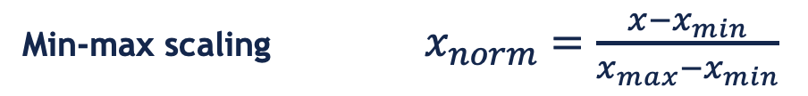
Data normalization
Eccentricity | Diameter (mm) | Color
0.1 | 4 | No
0.3 | 3 | No
0.9 | 6 | Yes
0.3 | 2 | No
0.3 | 3 | No
Features with large ranges can dominate model training
→ biased weight updates → slow or unstable learning
Min-max scaling $x_{norm}=\frac{x−x_{min}}{x_{max}−x_{min}}$
Standardization $x_{norm}=\frac{x−μ}{σ}$

Slide 11
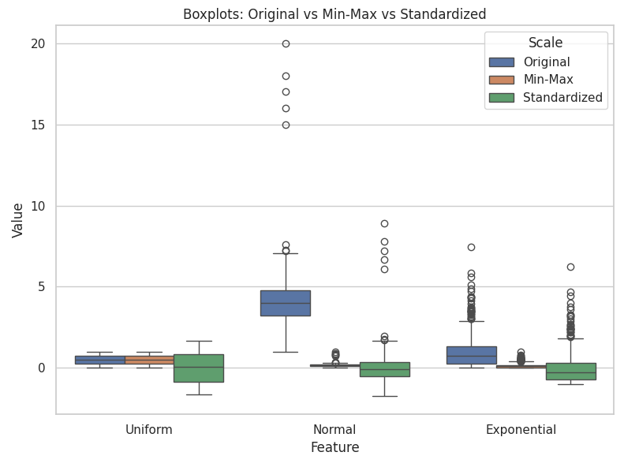
Data normalization
Bringing everything on the same scale → fair comparison

Slide 12
Categorical features
Ordinal encoding
Each category label is mapped to an integer
Implicit meaning of order
Small, medium, large → 0, 1, 2
Dog, cat, cow → 0, 1, 2
One-hot encoding
Categorical feature is transformed to n_categories binary features
1 = yes; 0 = no
Red, yellow, blue →
Eccentricity | Diameter | Color
0.1 | 0.66 | No
0.3 | 0.5 | No
0.9 | 1 | Yes
0.3 | 0.33 | No
0.3 | 0.5 | No
Red | Yellow | Blue
1 | 0 | 0
0 | 1 | 0
0 | 0 | 1

Slide 13
Categorical features
Ordinal encoding
Each category label is mapped to an integer
Implicit meaning of order
Small, medium, large → 0, 1, 2
Dog, cat, cow → 0, 1, 2
One-hot encoding
Categorical feature is transformed to n_categories binary features
1 = yes; 0 = no
Red, yellow, blue →
Eccentricity | Diameter | Color
0.1 | 0.66 | 0
0.3 | 0.5 | 0
0.9 | 1 | 1
0.3 | 0.33 | 0
0.3 | 0.5 | 0
No = 0
Yes = 1
Red | Yellow | Blue
1 | 0 | 0
0 | 1 | 0
0 | 0 | 1

Slide 14
How complex should our model be?
DATA
MODEL
Learns patterns & decision rules
PREDICTION
Notes:
Since machine learning models learn patterns from the data that we give to it, it is evident that the quality of the output of your model will heavily depend on the quality of the data that it was trained on
GARBAGE IN = GARBAGE OUT
No matter how sophisticated your model, if the data quality is low, you will never get good and reproducible results

Slide 15
What is the goal of machine learning? (vs. statistics)
Notes:
Artificial intelligence is a cluster term for any technology where a machine shows “human intelligence”

Slide 16
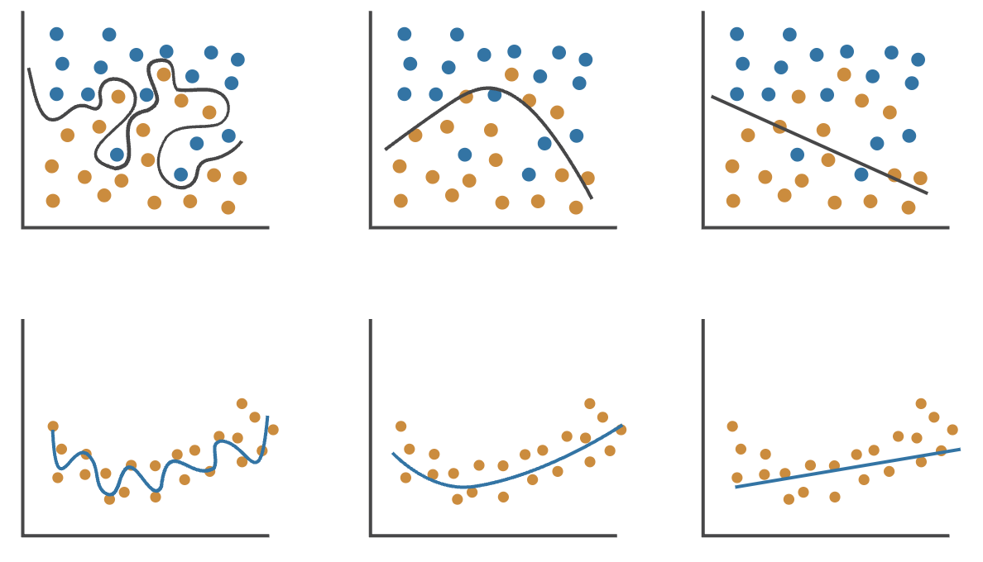
Train-test splitting
Underfitting
Good fit
Overfitting
Classification
Regression

Slide 17
Train-test splitting
Underfitting
Good fit
Overfitting
Classification
Regression

Slide 18
Train-test splitting
Best fit
underfitting
overfitting
Test set = independent dataset to measure model performance
Model learns on training data
Evaluated on (unseen) test data
→ Good generalization to new inputs
Test error
Error
Training error
Model complexity

Slide 19
Train-test splitting
Training data
Test data
Train-test split
Single split (e.g. 80%/20%)
Requires more data
Cross-validation
K splits
More data efficient
Reduced bias

Slide 20
All data
Training data
Test data
Which dataset do we use if we want to …
… train our model
… select the best features (e.g. based on a T-test)
… fit our feature scaler (i.e. compute μ and σ)

Slide 21
Data leakage
When information from the test set influences the model during training
Violates the principle of evaluation on unseen data
Test data ”doesn’t exist yet”
→ All fitting should happen only on the training data
Training data
Test data
Data preprocessing
Feature selection
Model optimization

