Slide 1
03
Regression

Slide 2
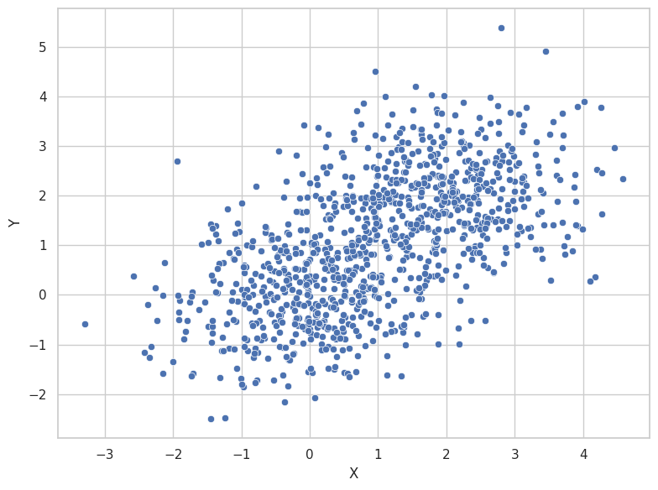
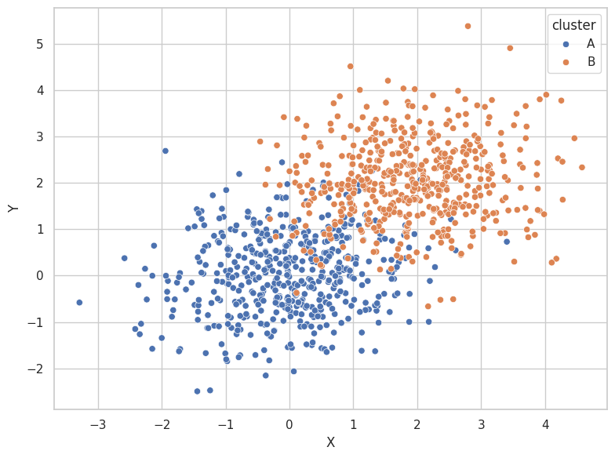
Regression vs classification
REGRESSION
Output = continuous
Based on X, predict the value of Y
CLASSIFICATION
Output = discrete
Based on X and Y, predict the class

Slide 3
Linear regression
Linear relationship
We need to make assumptions about the model that generated the data
Linear model

Slide 4
Linear regression
Linear equation: Y = w*X + b
Model parameters
w = weight (slope)
b = intercept (bias)

Slide 5
How do we optimize/evaluate our model?

Slide 6
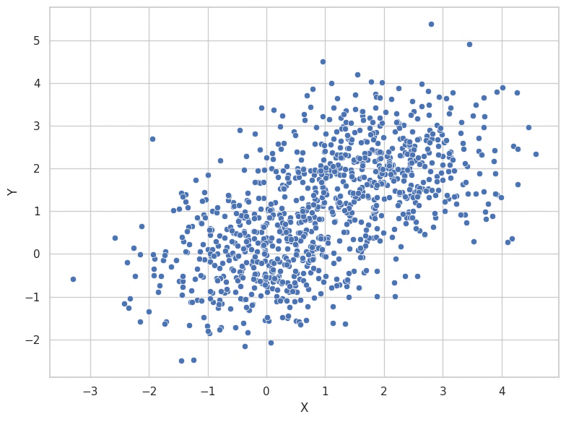
Linear regression
STATISTICS
“What is the relationship between X and Y? Can we explain it?”
→ goodness-of-fit (R²)
MACHINE LEARNING
“Given X, can we predict Y accurately?”
→ Predictive performance on test data

Slide 7
Linear regression - prediction
Y = 0.8*X + 0.5
Linear equation: Y = w*X + b
Model parameters
w = weight (slope)
b = intercept (bias)
Predictions (generalization!)

Slide 8
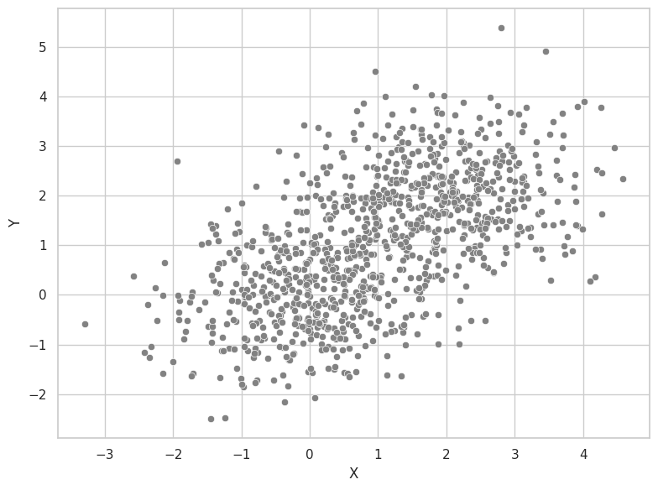
Linear regression - prediction
Linear equation: Y = w*X + b
Model parameters
w = weight (slope)
b = intercept (bias)
Predictions (generalization!)
Mismatch between train/test data → poor generalization

Slide 9
Linear regression - fitting
What values for w and b are optimal and give the best fit to the model?

Slide 10
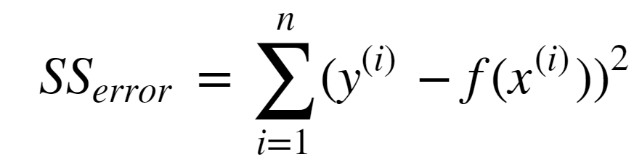
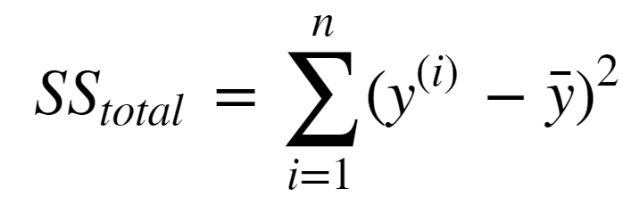
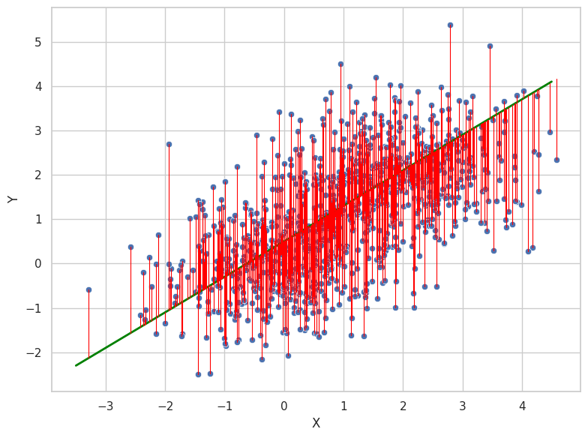
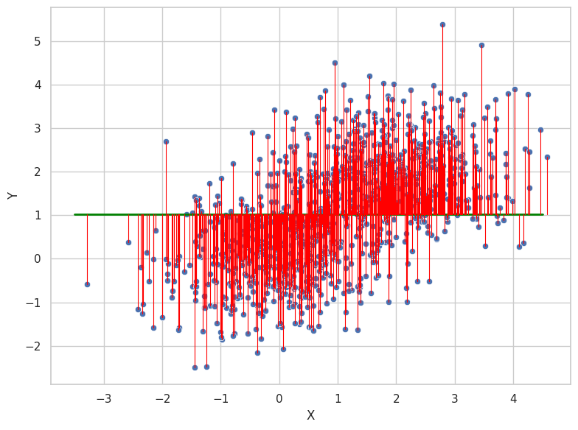

Linear regression - fitting

Slide 11
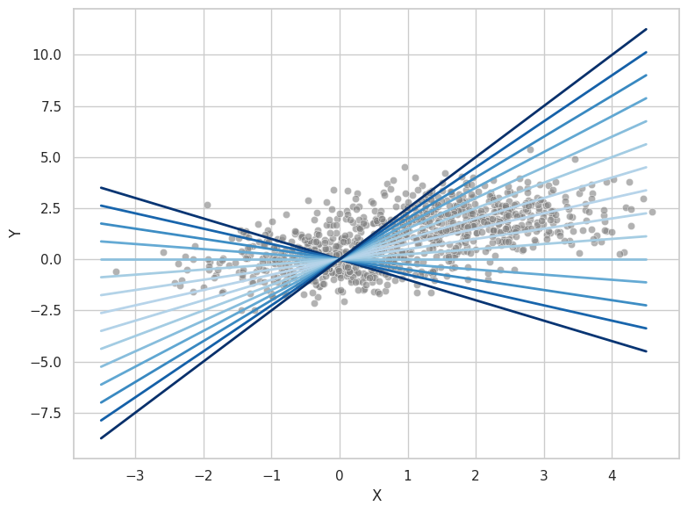
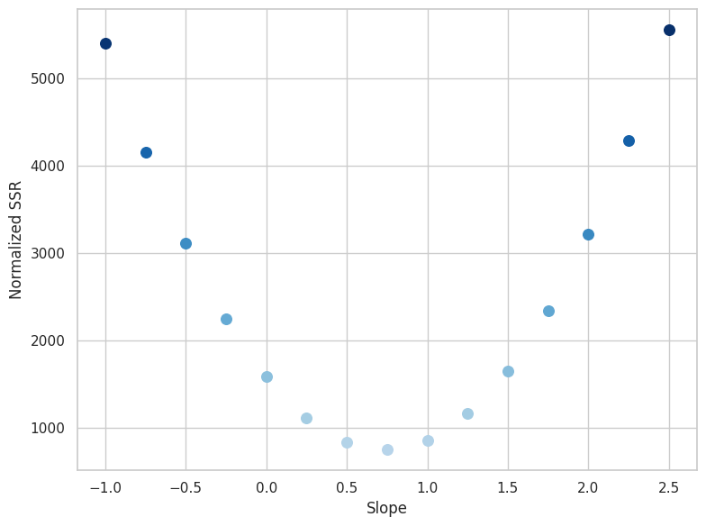
Linear regression - fitting
→ Finding the “best” slope

Slide 12
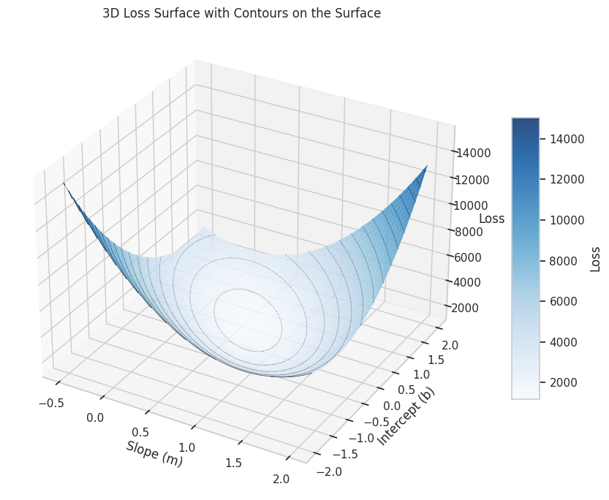
Linear regression - fitting
→ Finding the “best” combination of slope and intercept

Slide 13
Linear regression - fitting
Fit a linear model
$$f\left(x,θ\right)= θ_{0}x_{0}+θ_{1}x_{1}+θ_{2}x_{2}+…+θ_{m}x_{m}+b$$

Slide 14
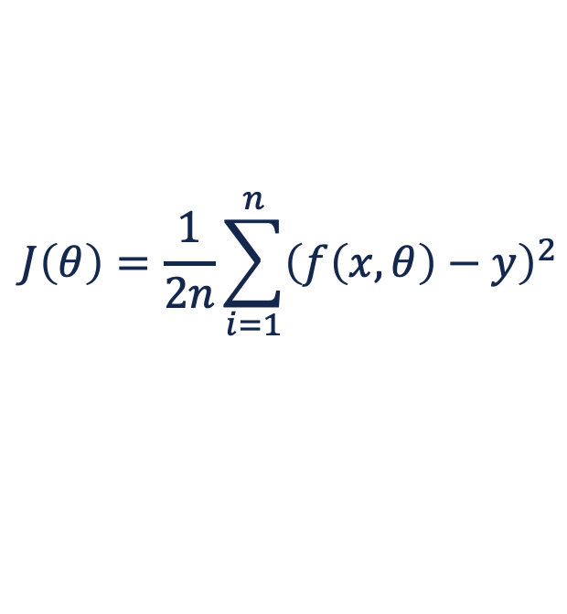
Linear regression - fitting
Fit a linear model
$$f\left(x,θ\right)= θ_{0}x_{0}+θ_{1}x_{1}+θ_{2}x_{2}+…+θ_{m}x_{m}+b$$
to the dataset such that the cost function
$$J\left(θ\right)=\frac{1}{2n}\sum_{i=1}^{n}{{\left(f\left(x,θ\right)−y\right)}^{2}}$$
is minimal

Slide 15
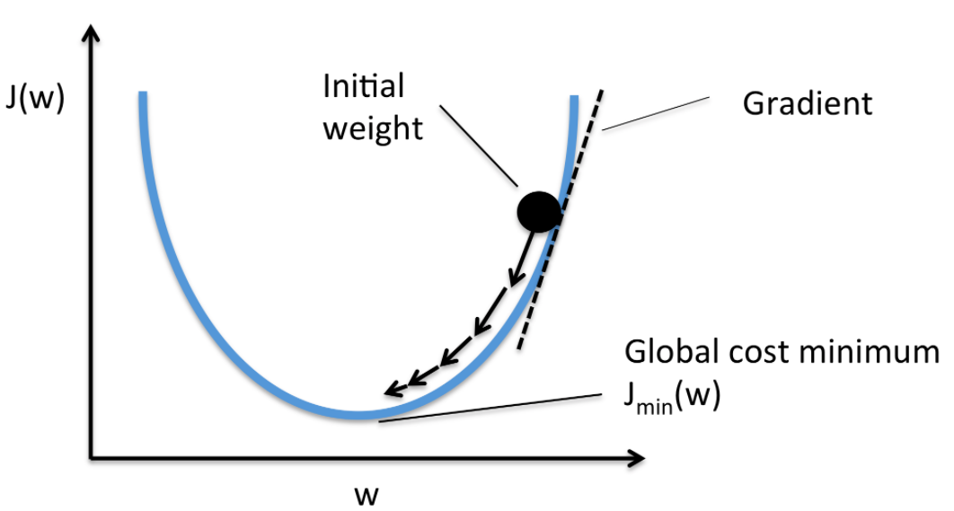
Gradient descent
optimization algorithm
minimize a loss function
iteratively updating model parameters
direction of the weight change → the steepest descent = negative gradient
The learning rate (⍺) controls the step size of updates

Slide 16
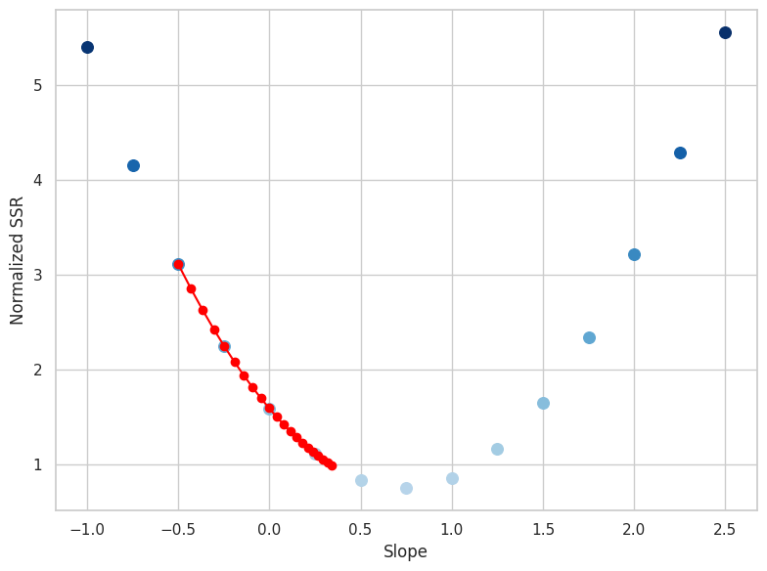
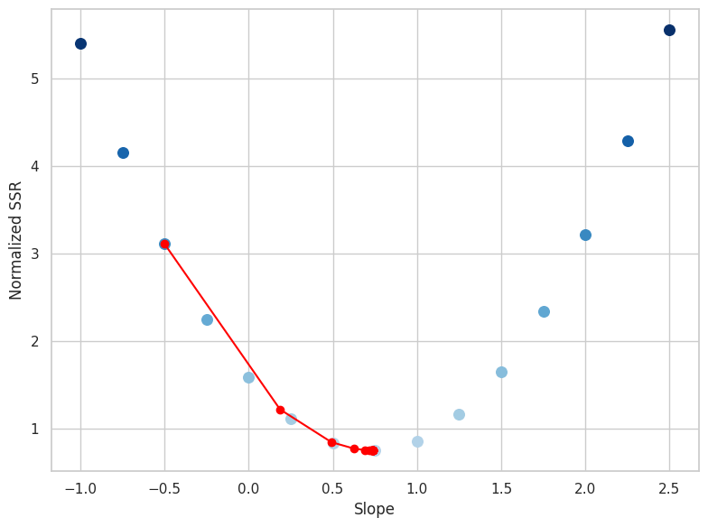
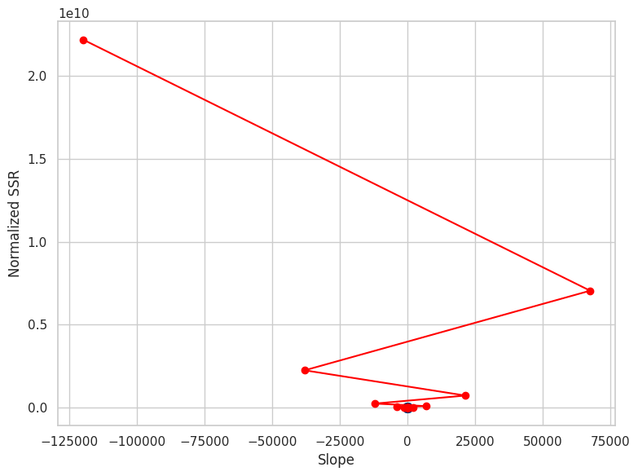
Gradient descent
⍺=0.00001
⍺=0.0001
⍺=0.0005

Slide 17
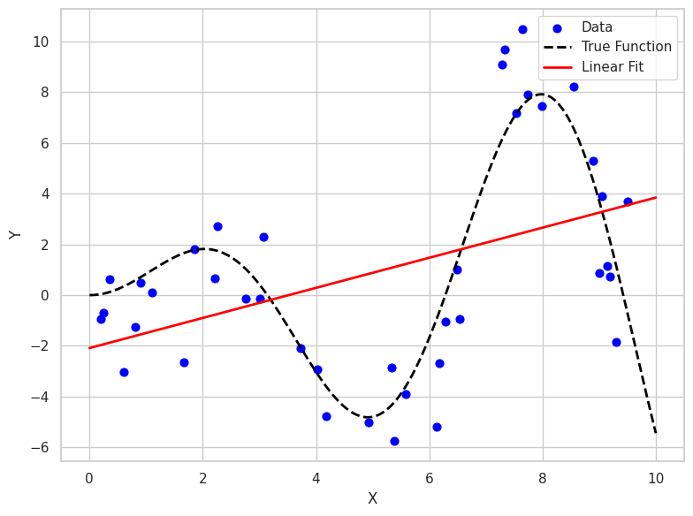

Slide 18
Non-linear regression
Non-linear relationship
We need to make assumptions about the model that generated the data
Non-linear model

Slide 19
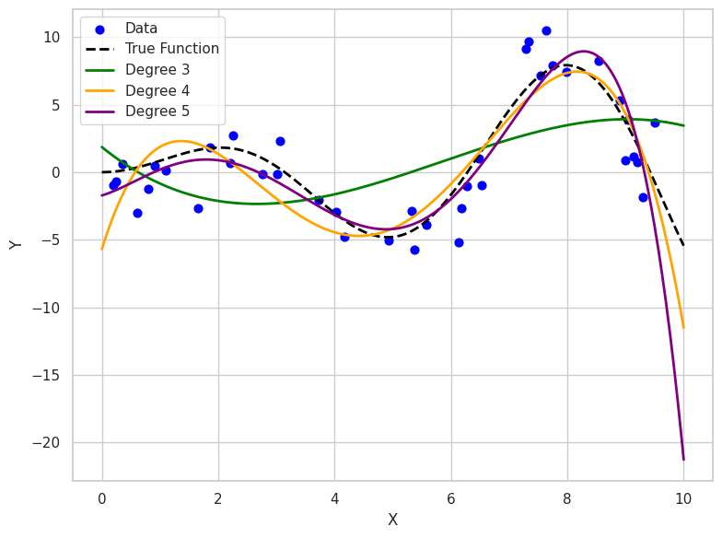
Non-linear regression
Polynomial transformation
Include higher-order features
Allows to fit a linear model to non-linear relationships in the data
$$f\left(x,θ\right)=θ_{0}x_{0}+θ_{1}x_{1}+θ_{2}x_{1}^{2}+θ_{3}x_{1}^{3}+…$$
Increasing the polynomial degree
→ allows to fit more complex relationships
But …
Requires more data (more model parameters)
Can lead to poor generalization (overfitting)

Slide 20
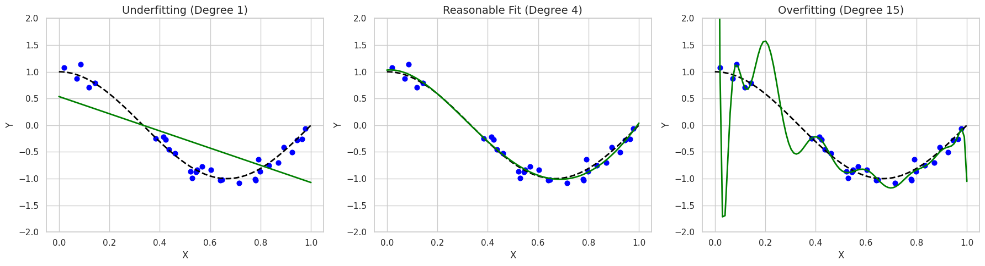
Underfitting & overfitting

Slide 21
Train-test splitting
Best fit
underfitting
overfitting
Test error
Error
Training error
Model complexity
How can we limit the model complexity?

Slide 22
Model regularization
Label noise
Every dataset contains noise
Feature noise
Don’t try to fit the data perfectly!
Limit the model complexity
Skip irrelevant/correlated features (feature selection)
Choose a simple model (linear vs non-linear)
Put a constraint on the model complexity (regularization)
Check the generalizability with a validation/test set

Slide 23
Model regularization
Prevents overfitting by adding a penalty term to the loss function, discouraging overly complex models
L1 regularization (Lasso)
Penalty term = sum of the absolute values of the model weights
Promotes sparsity (weights are set to zero)
L2 regularization (Ridge)
Penalty term = sum of the squared values of the model weights
Prevents large weights and ensures smooth generalization
Elastic Net
Combination of L1 and L2 penalties
Balances feature selection and weight shrinkage
Useful for high-dimensional datasets with correlated features

Slide 24
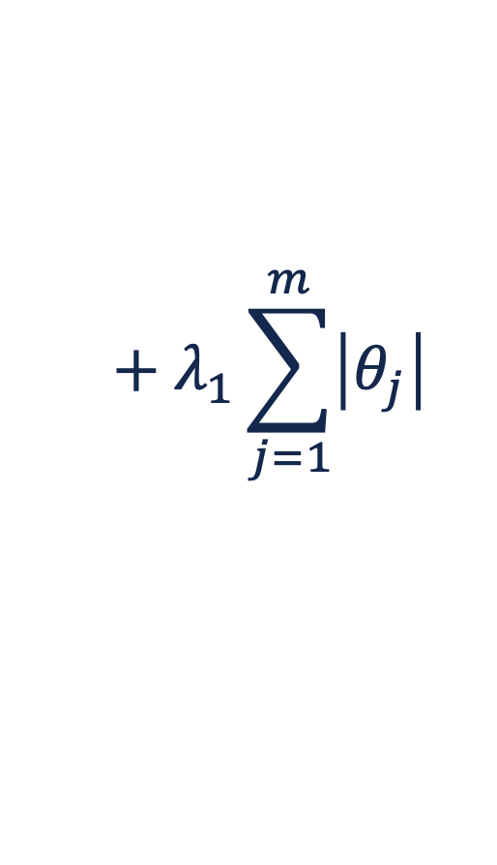
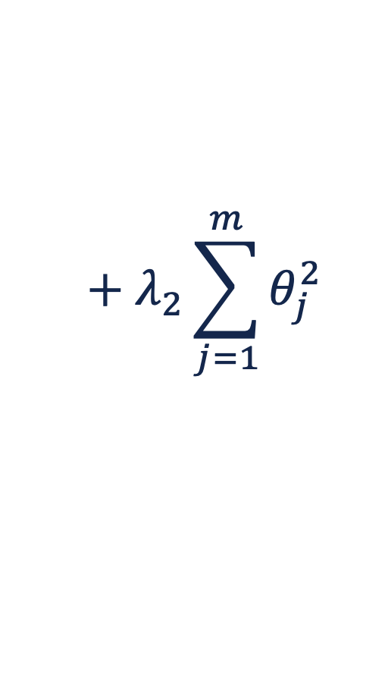
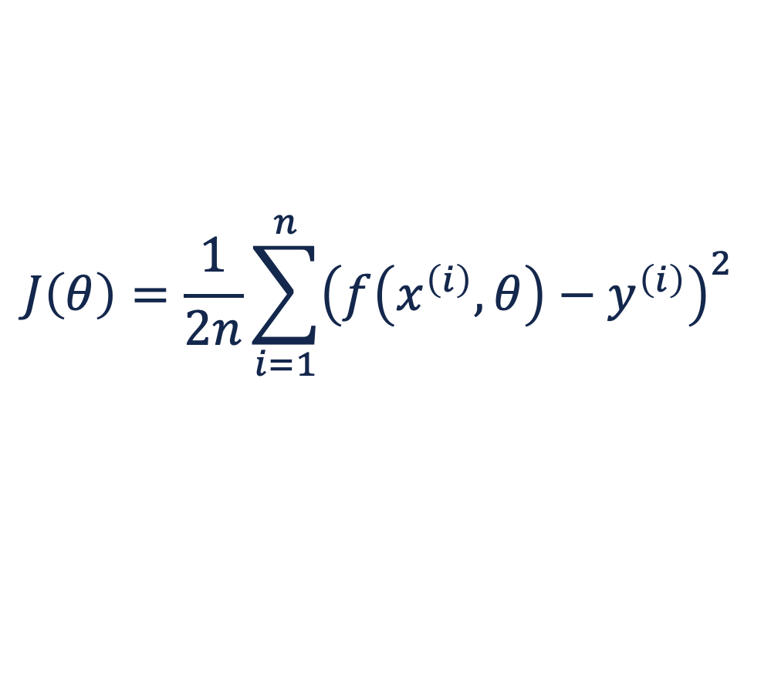
Regularized linear regression
linear model
$$f\left(x,θ\right)=θ_{0}x_{0}+θ_{1}x_{1}+θ_{2}x_{2}+…+θ_{m}x_{m}$$
$$J\left(θ\right)=\frac{1}{2n}\sum_{i=1}^{n}{{\left(f\left(x^{\left(i\right)},θ\right)−y^{\left(i\right)}\right)}^{2} }$$
$$+ λ_{1}\sum_{j=1}^{m}{\left|θ_{j}\right|}$$
$$+ λ_{2}\sum_{j=1}^{m}{θ_{j}^{2}}$$
Cost function
L1
L2

Slide 25
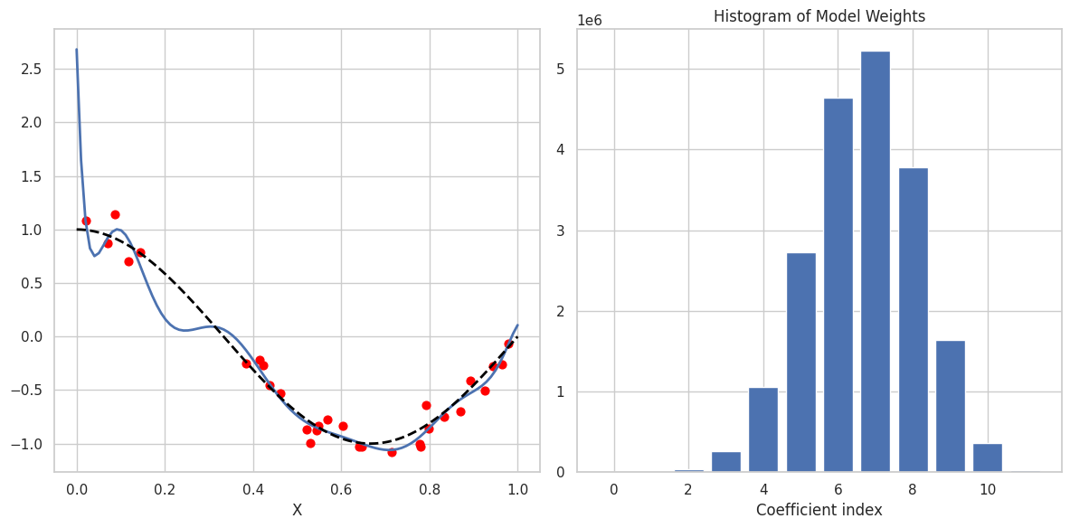
Non-regularized linear regression

Slide 26
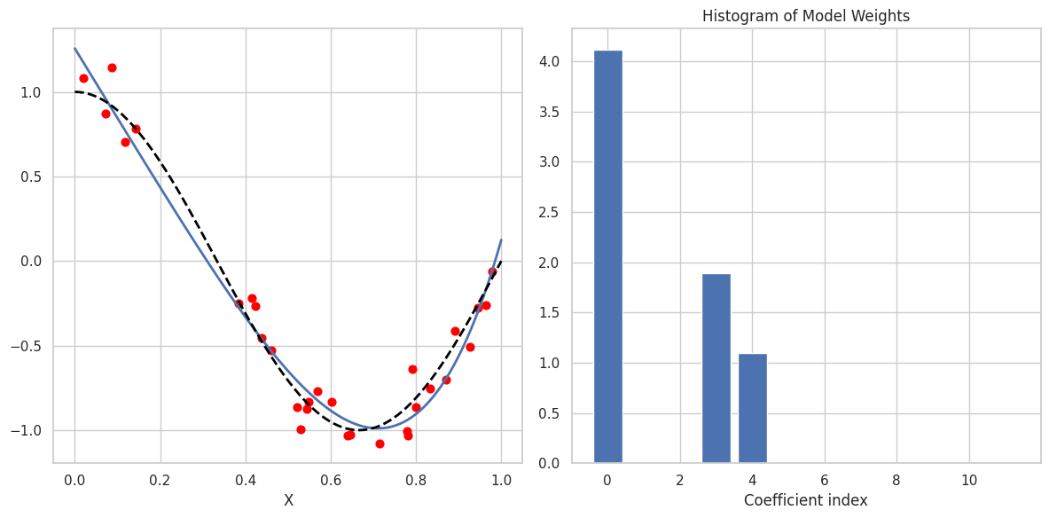
Regularized linear regression (Lasso)

Slide 27
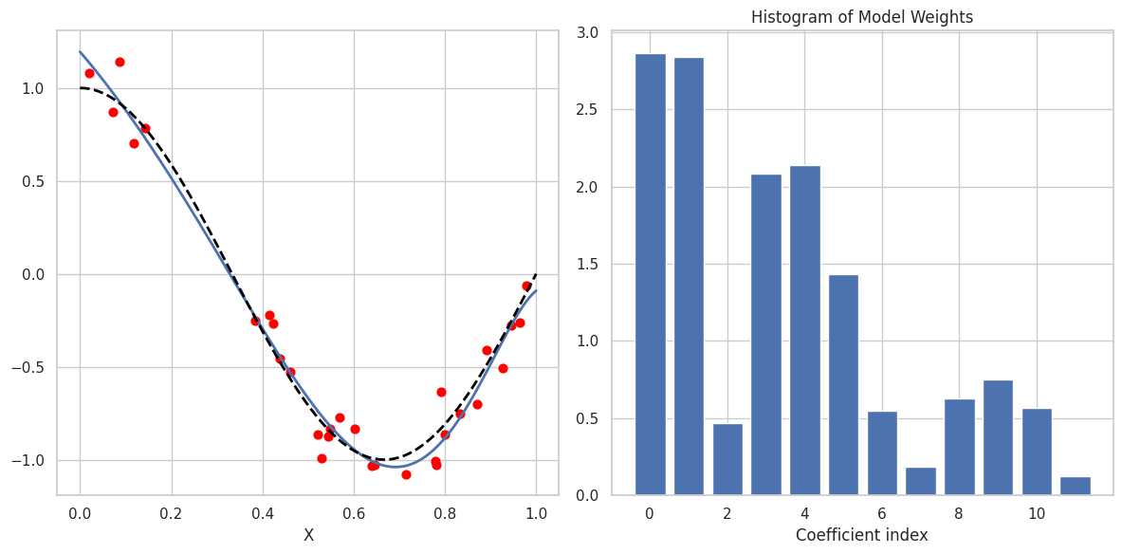
Regularized linear regression (Ridge)

Slide 28
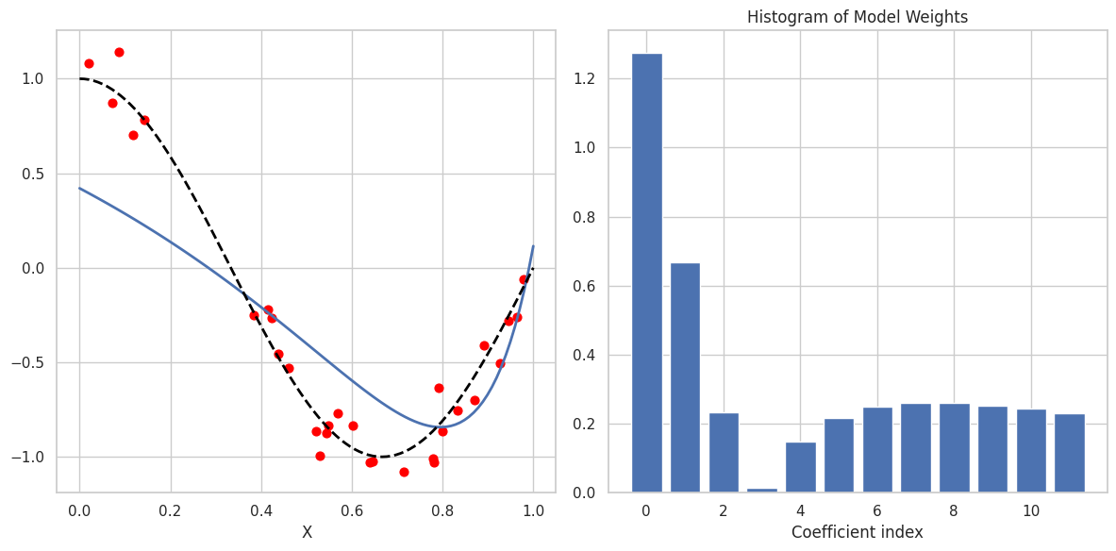
Regularized linear regression (Ridge)
Stronger regularization (λ₂)

Slide 29
Linear regression - recap
Loss function (R²)
+
Optimization strategy (gradient descent)
+
regularization
Learning algorithm
Dataset
Model
Predictions
(non-)Linear Regression
(ASSUMPTIONS!)
Generalization → evaluate on test set
TRAINING
TESTING

