Slide 1
Could you
install it all ?
WSL (windows only)
Get GitHub account
Git / GitBash
VScode / other editor

Slide 2

Versioning with
Git & GitHub
For code and documentation
Bruna Piereck
November 2026

Slide 3
Uses case
Covered in the course
  Single user
  Collaborating
Not to be covered
  Contribute to open-source project
Back up
History
Recover previous state
Working remotely
Publication

Slide 4
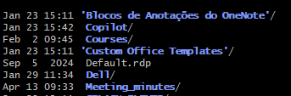
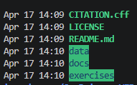
Folder structure
It is hierarchical
  Folder appear bold/highlighted
  Files not
This_PC
Documents
Project_1
Data
Code
Docs
Results
Project_2
Pictures
Downloads

Slide 5
UNIX basics review
How to?
  Find the path to directory Data?
  P.S.: Use <tab> to auto-complete
This_PC
Documents
Project_1
Data
Code
Docs
Results
Project_2
Pictures
Downloads

Slide 6
UNIX basics review
How to?
  List all content from
  directory Project_1?
  Move from directory Project_1 to directory Results ?
  Move from directory Results to directory Pictures ?
This_PC
Documents
Project_1
Data
Code
Docs
Results
Project_2
Pictures
Downloads

Slide 7
UNIX basics review
Why ?
  Why are the directories named
  Project_1 | Project_2
  Instead of:
  - Project one | Project two
  - Project 1 | Project 2
This_PC
Documents
Project_1
Data
Code
Docs
Results
Project_2
Pictures
Downloads

Slide 8
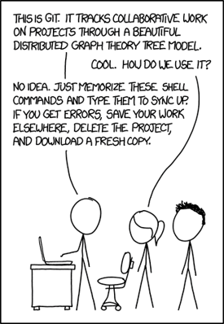
Have you been in this situation?

Slide 9
Class Project
Goal
  Create and update a DICTIONARY of concepts
  Create and update a CHEATSHEET with all the commands
  Make it all available in GitHub with version control

Slide 10

Class Project
Starting the project
  Create a folder where your project is going to be developed
    Make sure is not inside a git project
    (If you ever used git before)
  Only files in text format should be created
    MarkDown is preferable

Slide 11
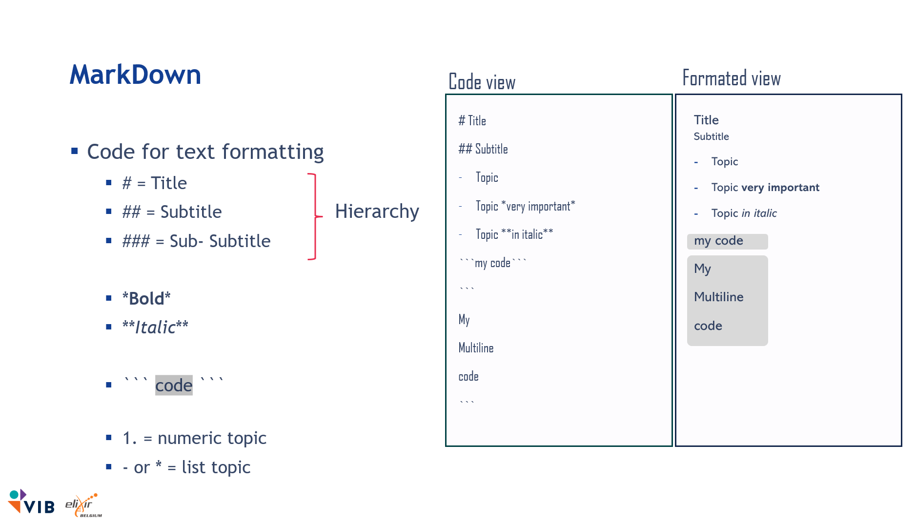
MarkDown
Code view
Formated view
# Title
## Subtitle
Topic
Topic *very important*
Topic **in italic**
```my code```
```
My
Multiline
code
```
Title
Subtitle
Topic
Topic very important
Topic in italic
my code
My
Multiline
code
Code for text formatting
  # = Title
  ## = Subtitle
  ### = Sub- Subtitle
  *Bold*
  **Italic**
  ``` code ```
  1. = numeric topic
  - or * = list topic
Hierarchy
https://github.com/vib-training-conferences/versioning-code-and-documentation-with-Git-GitHub/blob/master/docs/markdown_cheatsheet.txt

Slide 12
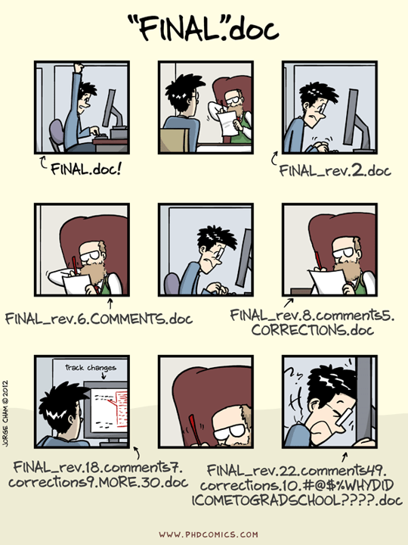
What is happening?

Slide 13

How would you solve?

Slide 14

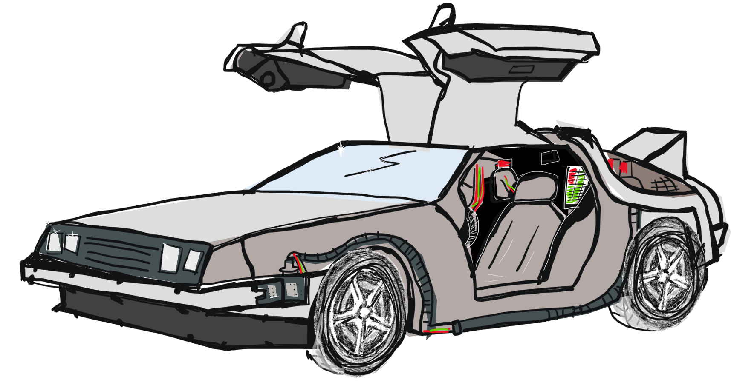
Think of a time machine
(like in Back to the Future)

Slide 15
differences
git vs GitHub

Slide 16

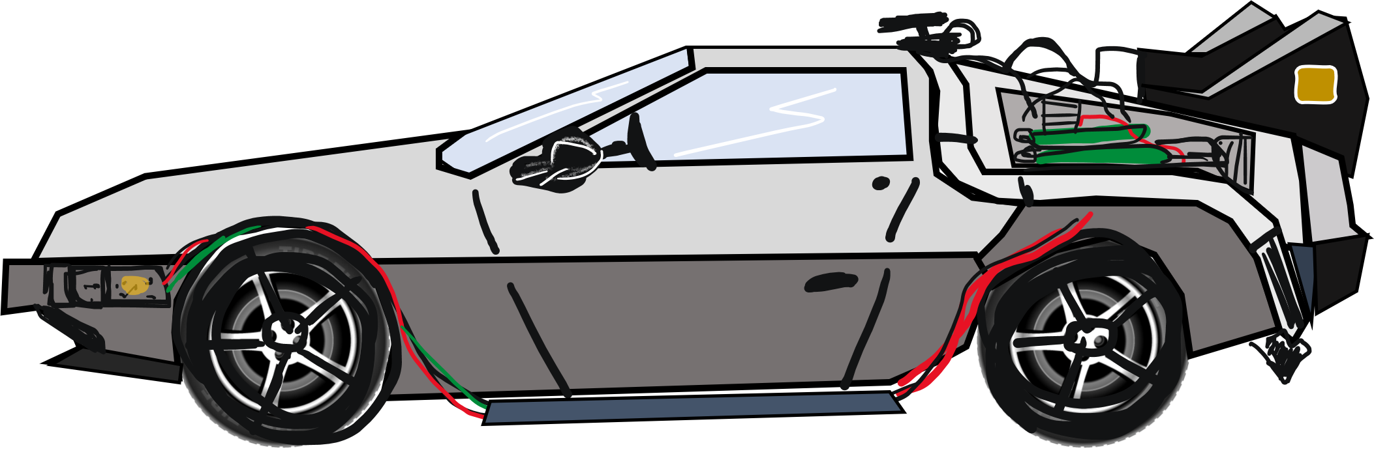
Git repository = Timeline
Commit
V 0.2
Commit
V 1.1
…
Commit
V 0.1
Commit
V 1.0
Commit
V 1.2

Slide 17

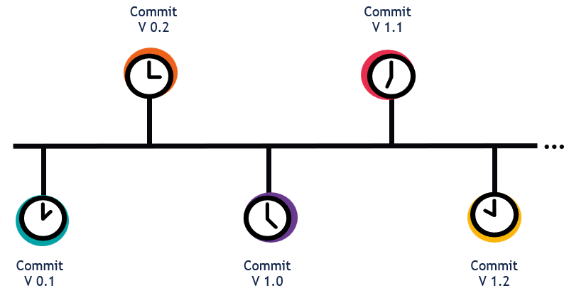
GitHub= Timeline Backup
Project 1
Project 2
Project 3

Slide 18
Activity
Create a concepts_dictionary.md file
  Write your first concepts
    What is a git repository?
    What is GitHub?
vs

Slide 19

Starting a timeline
user$ git init
…
Empty timeline
= empty git repository
Necessary to start versioning
Next step: “define” versions in the timeline

Slide 20
Defining one version
Save changes ≠ Saving a commit (version)
10:00h
13:00h
V_1.0
11:00h
Routine to save/define a version
My computer
git
13:00h
$ git add file_name
$ git commit –m “message”
Developing Area
Staging Area
Local repository

Slide 21
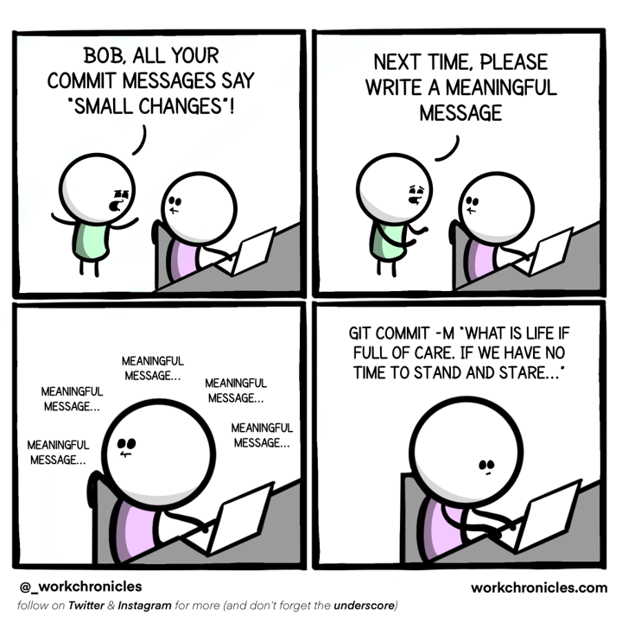
Commit message
user$ git commit –m “meaningful message”
What is meaningful?
  Why was changed
  How this addresses the issue
  Effects due the change
  Limitations of the change
  Be descriptive !!!

Slide 22
QUIZ
Which message better suits a commit to update a
hypothetical project description ?
  Update TUTORIAL.md file
  Added ‘This tutorial is for beginners’ to TUTORIAL.md
  Disambiguate this project from Project X by stating the audience
x
What is meaningful?
  Why was changed
  How this addresses the issue
  Effects due the change
  Limitations of the change

Slide 23
Before we start
git configurations
Check if git has your information in the config file
user$ git config --global --list
Add or change your information
user$ git config --global user.name “Your Name”
user$ git config --global user.email “your_email@domain.com”

Slide 24
Save a point in time: one version
Routine to save/define a version
My computer
git
$ git add file_name
$ git commit –m “message”
Developing Area
Staging Area
Local repository

Slide 25
QUIZ
What if we create a subfolder of the main project. Is this folder under git version control?
Do we need to initialize git again inside of the subfolder?
  No. We need to “git init” again.
  No. We need to work in one folder only.
  Yes. The software will track it all.
  Yes. But we need to do “git init again”
x

Slide 26
Explaining
This_PC
Documents
Project_1
.git
Data
Code
Docs
Results
dir
dir
Project_2
Pictures
Downloads

Slide 27
Conceptual areas
Where is the file?

Slide 28
Where is GitHub ?
Where is git ?

Slide 29
1. Development Area
Project folder
  Where files & sub-directories are managed
My computer
Development Area
1

Slide 30
Activity
Go to your development area and add this new concept in your dictionary.
  Once ready git add file > git commit –m “meaningful message”

Slide 31
3. Saving the TIMELINE (version history)
git local repository
  Keep your version-points
  “points in the timeline”
$ git commit –m “message”
My computer
git
Developing Area
Local repository
1
3

Slide 32
QUIZ
Why do we write a commit message?
This message will help our collaborators and ourselves in the future to understand why changes were made. How the issue was addresses and if this the solution had any impacts or limitations.

Slide 33
QUIZ
What happened if we forget about the “-m” when committing a file?
  git commit
It opens an editor and allows you to write longer, and more detailed messages organized in paragraphs.
Choose your editor
  VSCode: user$ git config --global core.editor “code --wait”
  Nano: user$ git config --global core.editor "nano“
  Set default (vi): user$ git config --global --unset-all core.editor

Slide 34
Activity
Go to your development area and add this new concept in your dictionary.
  Once ready git add file > git commit
  Commit with a long message

Slide 35
staging
before saving
2nd area

Slide 36
2. Organize before moving to a permanent location
A storehouse
  Organize the snapshot
  Useful with multiple files
$ git add file_name.md
My computer
git
Developing Area
Staging Area
Local repository
1
2
3

Slide 37




Why it is useful to stage files?
Several files and folders
Organize of your timeline in clear units
Think critically of your commit messages

Slide 38
Staging before saving
My computer
git
$ git add File_C
$ git commit –m “independent change file C”
$ git add File_A File_B
$ git commit –m “change A + related change B”
Developing Area
Staging Area
Local repository
File_A
File_B
File_C
File_A
File_B
File_C
File_A
File_B
File_C
0001 Commit - “File A created”
0003 Commit - “File C created”
0005 Commit - “independent change file C”
0002 Commit - “File B created”
0004 Commit - “change A + related change B”

Slide 39
Activity
Go to your development area and
  Add the concept of using the Staging area to your dictionary
  Create another file: commands-git.md
  Add the basic routine to define/save a version of your project
Do not commit anything YET
My computer
git
$ git add file_name
$ git commit –m “message”
Developing Area
Staging Area
Local repository

Slide 40

Activity
White on a paper
  A commit message if each file was independently committed
  A commit message if files were committed together
  Discussion time
  Committing time
Do not commit anything YET

Slide 41
How does staging helps organizing the timeline?
Staging all documents at once
  Creates insufficient versions
  Confuse and unclear history
Staging only one document at a time or
Staging every few lines
  Repetitive very long history
  Difficult to navigate
  Using it thoughtfully creates a logical history, easier to navigate. Like an organized library.

Slide 42

Activity
Add an image to the developing area
  The image will be shared in GitHub later
  It will be se by your collaborator and maybe others
CHOOSE WISELY

Slide 43
Coffee time

Slide 44
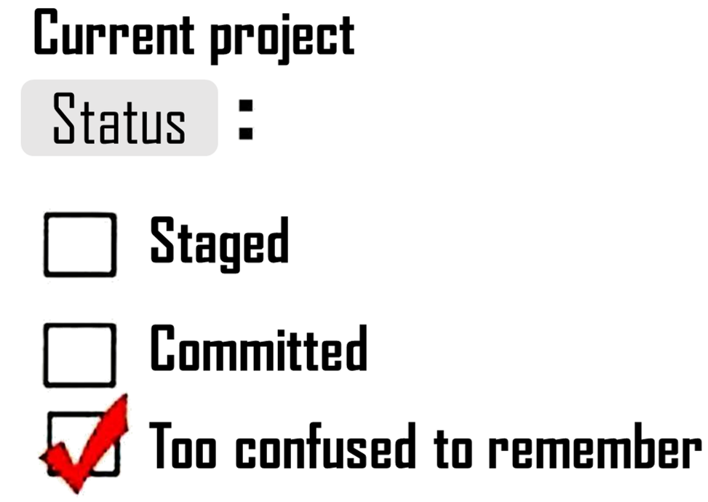
Where is the image?
Which conceptual area?
user$ git status
Checks the status of each file
  To be committed:
  New version in the staging area
  Not staged:
  New version in the developing area
  Untracked:
  Never managed by git

Slide 45

Always check: it will save you trouble
NEW Routine to save/define a version
Not staged: File A
To be committed: File B
Untracked: File C
$ git status
My computer
git
Developing Area
Staging Area
Local repository
File_A
File_B
File_C
File_B
File_A
File_B

Slide 46
Always check: it will save you trouble
NEW Routine to save/define a version
$ git status
My computer
$ git commit –m “change file A & C”
git
$ git add File_A File_C
$ git commit –m “change file B”
Developing Area
Staging Area
Local repository
File_A
File_B
File_C
File_B
File_A
File_C
File_A
File_B
File_C
0001 Commit - “change file B”
0002 Commit - “change file A and C”

Slide 47
Always check: it will save you trouble
NEW Routine to save/define a version
Summary
$ git status
My computer
git
$ git add File
$ git commit –m message”
Developing Area
Staging Area
Local repository
File_A
File_B
File_C
File_A
File_A

Slide 48
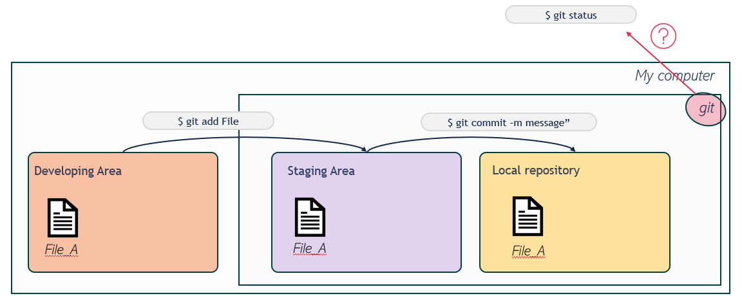
Activity
Update the commands-git.md
  Update the advised commands routine
  If necessary, add information about this in the dictionary.
  Check status at every step
  Check until you see “working tree clean” when asking for status
P.s. MAC computers:
don’t commit the “.ms” file

Slide 49

Travel in time
How?

Slide 50
Activity
In pairs
  Solve it together
    It might have more than one possible solution
    A new complementary task comes after
  Actions
    In the commands.md file annotate the new command
    In the dictionary.md annotate when and for what it is useful
How can I see the history of the timeline?
Notes:
Change the phrasing: how can I see all the previous versions I’ve committed.

Slide 51
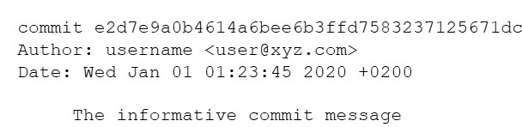
Challenge 1
How can I see the history of the timeline?
user$ git log
-- help
--oneline
-n <nº>
--name-only
--abbrev-commit
Your timeline
Summary of all versions
Chronological order
top = most recent
bottom = oldest

Slide 52
Activity
In pairs
  Solve it together
    It might have more than one possible solution
    Use the knowledge of the previous activity
  Actions
    In the commands.md file annotate the new command
    In the dictionary.md annotate when and for what it is useful
How can I see differences between current and past versions?

Slide 53
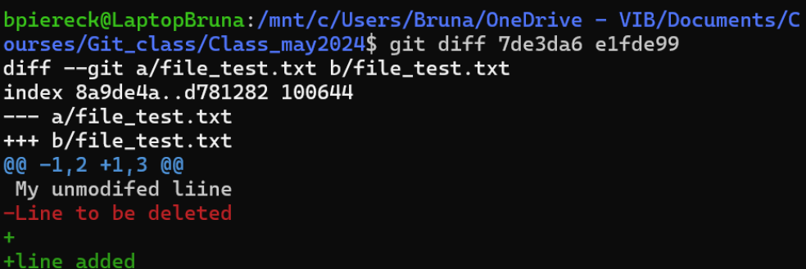
Challenge 2
How can I see differences between current and past versions?
user$ git diff <old> <new>
Prints a combined version
+ add lines
- deleted or edited lines
[ ] no changes

Slide 54
Challenge 2
How can I see differences between current and past versions?
user$ git diff <old> <new>
user$ git show <old> <new>
Prints separate versions + info
1st older file
  Commit
  Text
2nd more recent file
  Commit
  Text

Slide 55
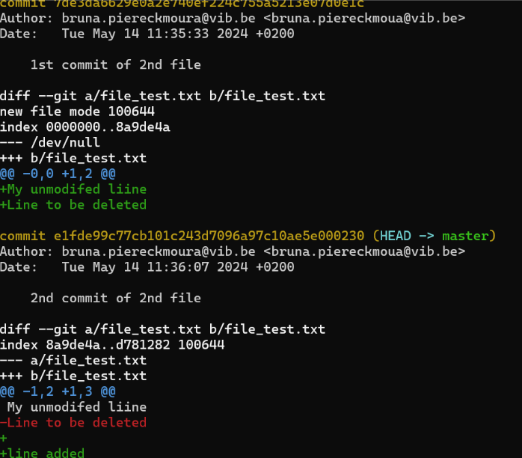
Challenge 2
Prints separate versions + info
1st older file
  Commit
  Text
2nd more recent file
  Commit
  Text

Slide 56
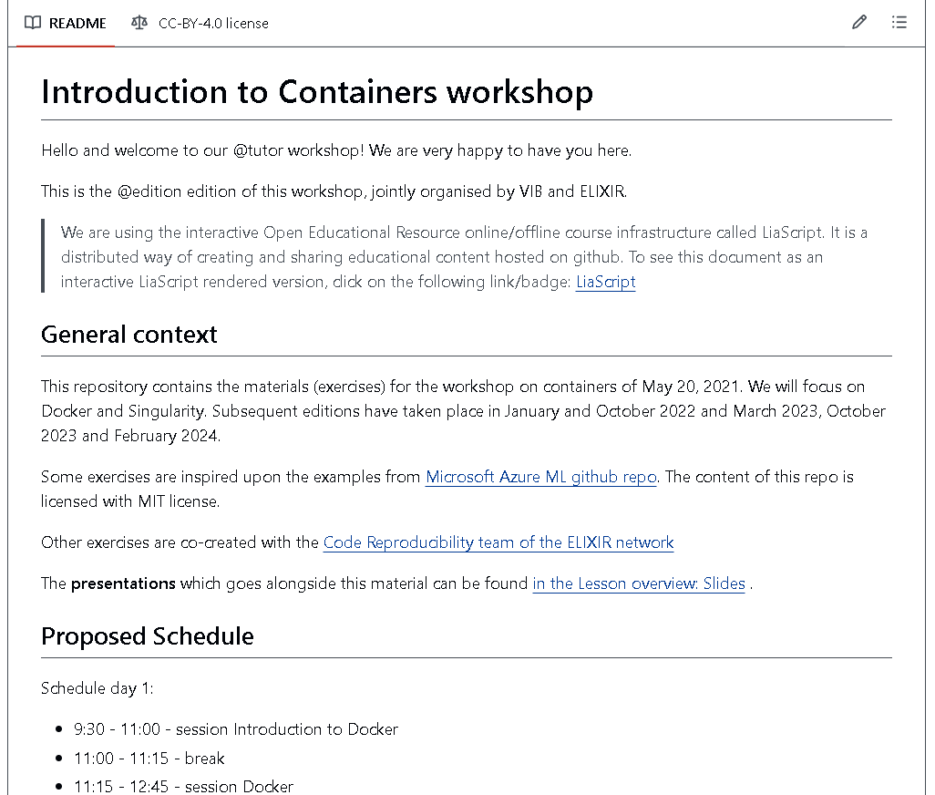
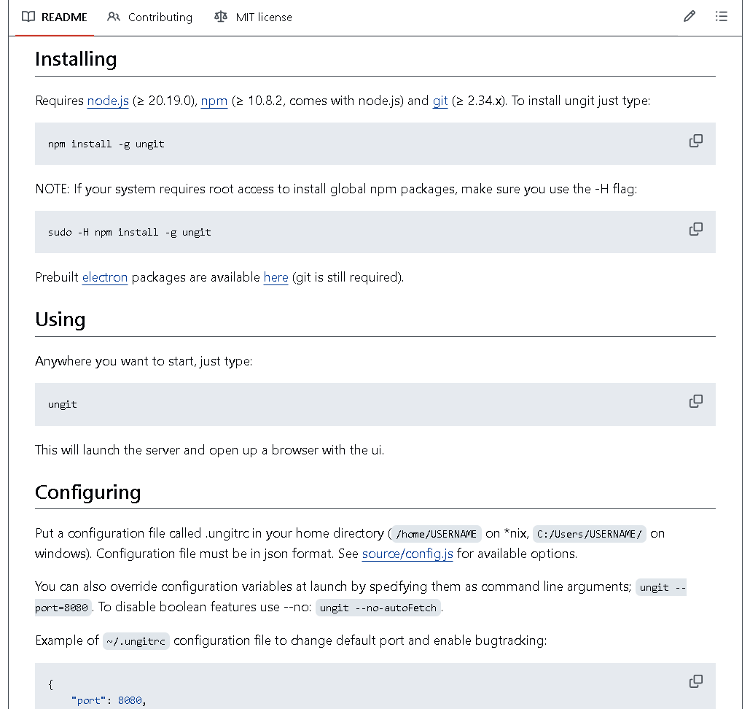
Special files
Important
README.md file
  Detailed description
    Project
    Usage
    Installations

Slide 57
Special files
Important
Documentation
README.md file
  Detailed description
    Project
    Usage
    Installations
.gitignore file
  List of files to be ignored
    Data
    Backup
    Intermediate files
    Confidential files
Scripts
Sample data
README
Git & GitHub
Others
Confidential
Results data
Raw data
Intermediary files

Slide 58
Special files
Important
README.md file
  Detailed description
    Project
    Usage
    Installations
.gitignore file
  List of files to be ignored
    Data
    Backup
    Intermediate files
    Confidential files
Ignore
  Files
  Folders
Using REGEX
  *.csv = all CSV files
  !datasample.csv = except this file
  # text = make comments

Slide 59
Activity
Create 2 new files README.md and .gitignore
Describe the aim of this project in the README.md (the one we have being developing)
Add the explanation of each file in dictionary.md .
  Add a PDF or image in your folder
  Create a .gitignore (name exactly as it is here)
  Check the status, it should be untracked
  Include the file in the .gitignore , check the status (should not be mentioned)
  For MAC computers, also ignore the *.ms file
  You can ignore the .gitignore file
  Commit the changes, think if you will commit all together or separately.

Slide 60
4 conceptual areas
WHAT IS MISSING?
Developing
area
Staging
area
Local
repository
Remote
repository

Slide 61
Local to Remote
Connecting
with GitHub

Slide 62
Allowing communication local >>> remote
SSH key
  An authenticator
  Connects PC and Remote location
    Gives access to your computer
  Strong “memorizable” password
  Requested at each connection

Slide 63


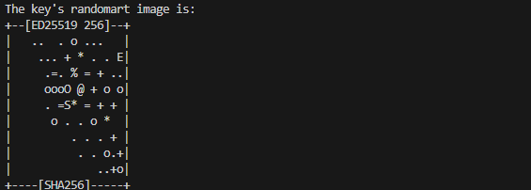
Allowing communication local >>> remote
SSH key
  One per computer
  An authenticator
  Connects PC and Remote location
    Gives access to your computer
  Strong “memorizable” password
  Requested at each connection
ssh-keygen -t ed25519 -C "your_email@example.com"
Checks:
Is the key in your folder (it shouldn‘t)
Is the key in the ~/.ssh folder (the write place)

Slide 64
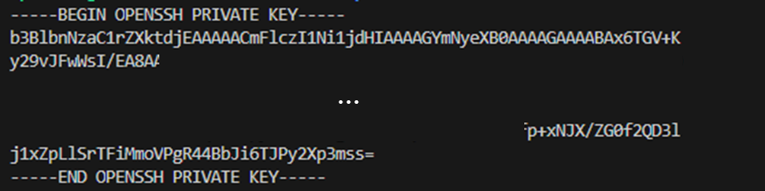
Allowing communication local >>> remote
SSH key
  One per computer
  An authenticator
  Connects PC and Remote location
    Gives access to your computer
  Strong “memorizable” password
  Requested at each connection
private
public
cat ~/.ssh/id_ed25519.pub
ssh-ed25519 AAAAC3Nza ……. ……. ……. ……. ……. ……. ……. ……. ……. TXQ bruna.piereckmorua@vib.be

Slide 65
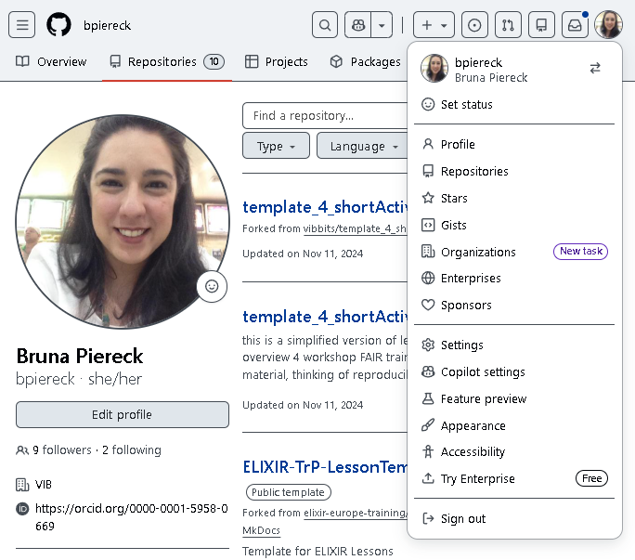
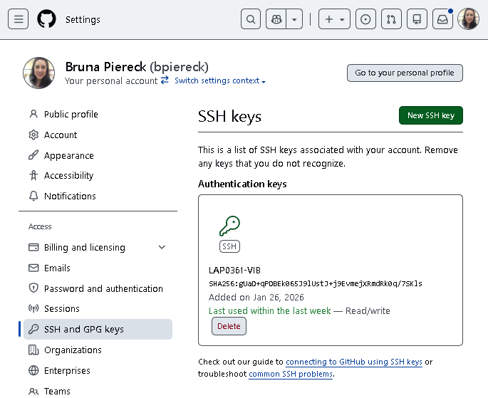
Allowing communication local >>> remote

Slide 66
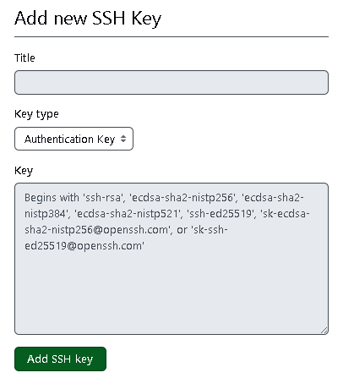
Allowing communication local >>> remote
Names you can use
Names you should not use
Work computer
VIB computer
Personal computer
LAP0361-VIB-computer
GitHub course
Training key
Bruna key
GitHub
Working computer
Personal computer
My collaborator’s

Slide 67
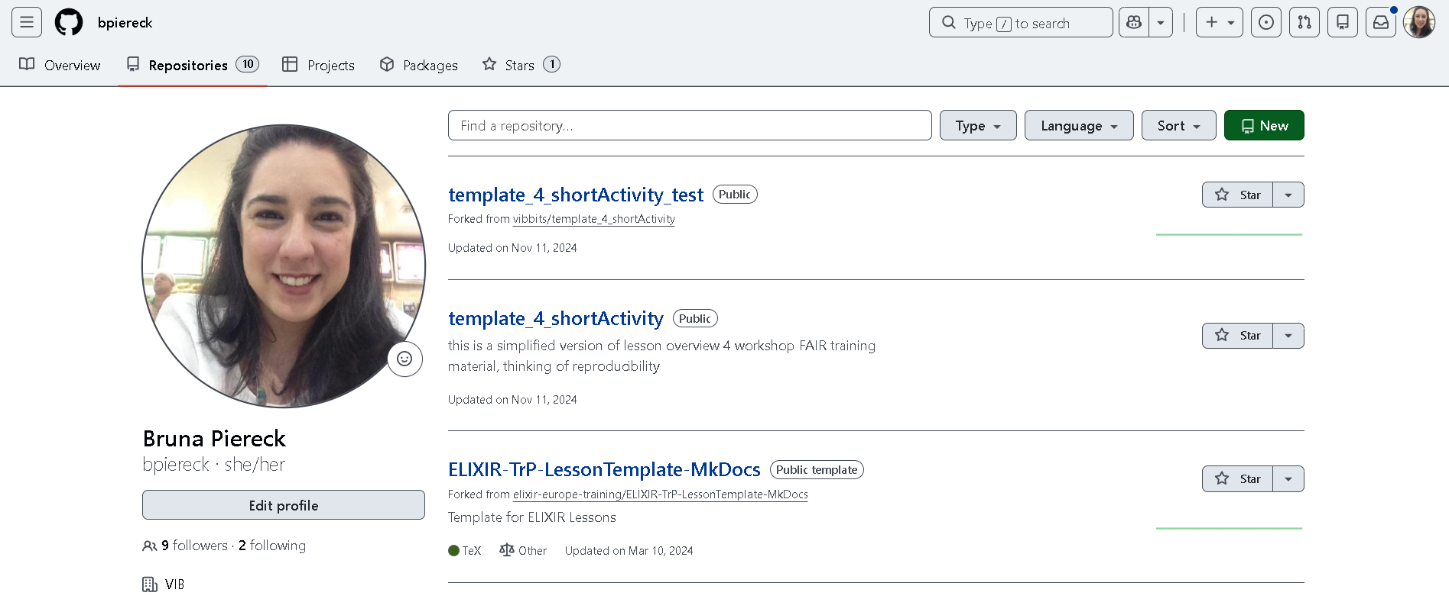
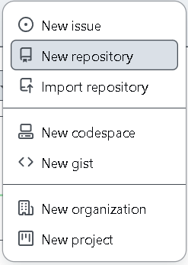
Create a remote repository
Situation 1: Backup a local repo in a remote repo
Dedicated space for backup of your timeline
One for each git project

Slide 68
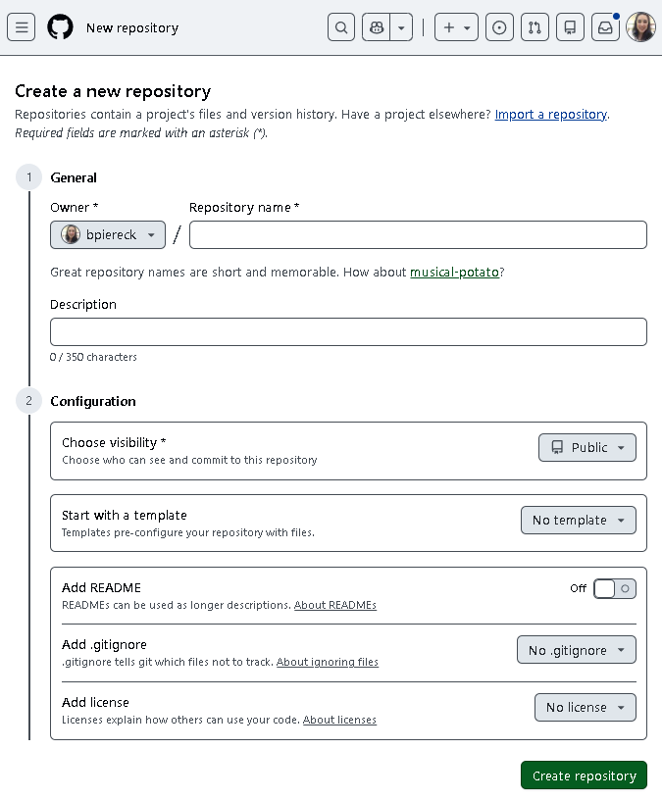
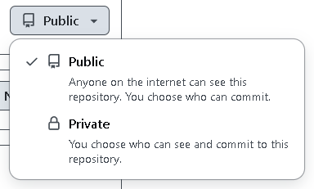
Don’t add ANY files in this step !
You need an
empty repo.
my_project_name
This project is about …..

Slide 69
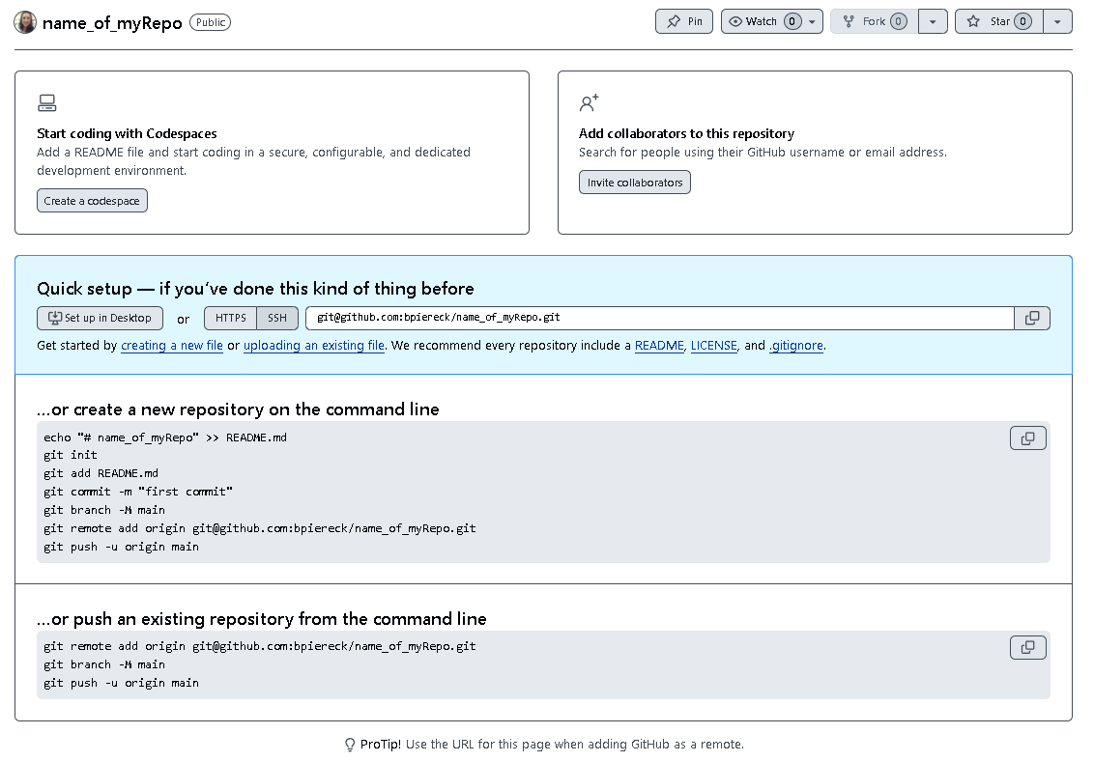

Slide 70
We have …
Remote repository
Local repository

Slide 71

We need …
Remote repository
Local repository

Slide 72
Connecting repositories
user$ git remote add origin <ssh address>
Creates a “bridge” between two points
Data is NOT automatically shared
Back up ONLY for committed changes
Just need to do it once
  If access denied: https://github.com/settings/tokens

Slide 73
Connecting repositories
user$ git remote add origin <ssh address>
Different repos = independent connections
Same key
ssh key: authentication
<ssh address> : location_project1
Project 1
Project 1
<ssh address> : location_project2
Project 2
Project 2

Slide 74
Activity
Connect your local repository to your remote repository
user$ git remote add origin <ssh address>
!!! Important
Follow the instructions git will print in the screen
Annotate in your files
  How to create a “bridge”
  When to create it

Slide 75
Activity
Annotate in your files
  About the ssh key
    How to
    Importance
  About how to create an empty repository
    How to
    When to do it
    When can you create a non-empty repository

Slide 76
HOW DO WE
TRANFER DATA
TO REMOTE REPOSITORY?

Slide 77
Sync changes from local to remote
$ git push
My computer
git
Developing Area
Staging Area
Local repository
Remote repository
$ git add File
$ git commit –m message”

Slide 78
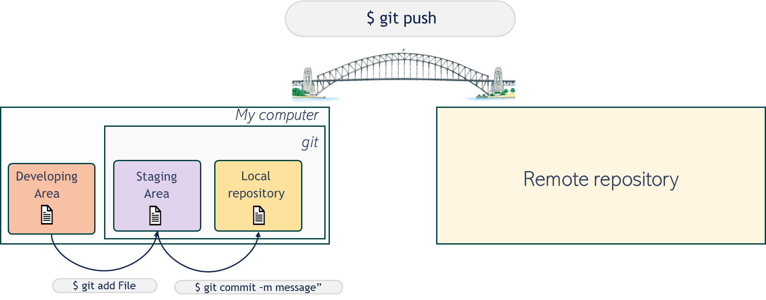
Activity
Push all your content to GitHub

Slide 79
A “bridge” works two ways
$ git push
Local repository
Remote repository
$ git pull

Slide 80
QUIZ
When are PUSH and PULL useful?
1. We push
  To create a back up of the versions in GitHub
  To share the changes with collaborators
2. We pull
  To see locally the changes made by collaborators
  To see locally changes that were done online (GitHub)

Slide 81
Activity
Annotate in the dictionary.md
  Why do we need a ssh key
  How to connect local and remote repositories
  When do we need to connect repositories
  When Push and Pull are useful
Check status
Add and commit
user$ git remote add origin <ssh address>
$ git push
Local repo
Remote repo
$ git pull

Slide 82

Activity
Check your files (part 1)
  Check the status
  Make sure your work tree is clean

Slide 83
REVIEW

Slide 84
How I create a git repository? An empty timeline?
$ git init
My computer
git
Developing Area
Staging Area
Local repository

Slide 85
If I want to know in which conceptual area is the file?
$ git status
$ git init
My computer
git
Developing Area
Staging Area
Local repository

Slide 86
If I want to see all commits that I’ve done ?
$ git log
07b
$ git status
$ git init
My computer
git
03a
Developing Area
Staging Area
Local repository
Unique_ID
Author
Date & Time
File
Message

Slide 87
If I want to compare commits?
$ git log
07b
$ git diff 03a 07b
$ git show 03a 07b
$ git status
$ git init
My computer
git
03a
Developing Area
Staging Area
Local repository
Unique_ID
Author
Date & Time
File
Message

Slide 88
If I want to authorize connecting with GitHub, I need ?
$ git log
$ git log
07b
$ git diff 03a 07b
$ git show 03a 07b
$ git status
$ git init
My computer
GitHub
git
ssh key
03a
Developing Area
Staging Area
Local repository
Unique_ID
Author
Date & Time
File
Message

Slide 89
Before transferring data to GitHub I need to create a channel. How do I do?
$ git log
$ git log
07b
$ git diff 03a 07b
$ git show 03a 07b
$ git remote add origin <ssh address>
$ git status
$ git init
My computer
GitHub
git
ssh key
03a
Developing Area
Staging Area
Local repository
Unique_ID
Author
Date & Time
File
Message

Slide 90
The basic routine to have a version in the local repository is?
$ git log
$ git log
07b
$ git diff 03a 07b
$ git show 03a 07b
$ git remote add origin <ssh address>
$ git status
$ git init
My computer
GitHub
git
ssh key
03a
Developing Area
Staging Area
Local repository
Unique_ID
Author
Date & Time
File
Message
$ git add File
$ git commit –m “meaningful message”

Slide 91
To update my GitHub backup
$ git log
$ git log
07b
$ git diff 03a 07b
$ git show 03a 07b
$ git remote add origin <ssh address>
$ git status
$ git init
My computer
GitHub
git
ssh key
$ git push
03a
Developing Area
Staging Area
Local repository
Unique_ID
Author
Date & Time
File
Message
$ git add File
$ git commit –m “meaningful message”

Slide 92
To sync changes from remote to local
$ git log
$ git log
07b
$ git diff 03a 07b
$ git show 03a 07b
$ git remote add origin <ssh address>
$ git status
$ git init
My computer
GitHub
git
ssh key
$ git push
03a
Developing Area
Staging Area
Local repository
$ git pull
Unique_ID
Author
Date & Time
File
Message
$ git add File
$ git commit –m “meaningful message”

Slide 93
To check my git config
$ git log
$ git config --global --list
$ git log
07b
$ git diff 03a 07b
$ git show 03a 07b
$ git remote add origin <ssh address>
$ git status
$ git init
My computer
GitHub
git
ssh key
$ git push
03a
Developing Area
Staging Area
Local repository
$ git pull
Unique_ID
Author
Date & Time
File
Message
$ git add File
$ git commit –m “meaningful message”

Slide 94
To change my info in the config file
$ git log
$ git config --global --list
$ git log
$ git config --global user.name “Your Name”
$ git config --global user.email “your_email@domain.com”
07b
$ git diff 03a 07b
$ git show 03a 07b
$ git remote add origin <ssh address>
$ git status
$ git init
My computer
GitHub
git
ssh key
$ git push
03a
Developing Area
Staging Area
Local repository
$ git pull
Unique_ID
Author
Date & Time
File
Message
$ git add File
$ git commit –m “meaningful message”

Slide 95
Coffee time

Slide 96

Catastrophe!

Slide 97
Catastrophe!
Each person will have a different challenge. You are working in pairs; you should help each other to solve the problem.
First, I need access to your computers !

Slide 98
Catastrophe!
Each person will have a different challenge.
You can help each other.
First, I need access to your computers !

Slide 99
Catastrophe!
Each person will have a different challenge.
You can help each other.
First, I need access to your computers !
Challenge A: You messed up!
  You had a freak commit-accident. Now you need to recover your version to a
  previous good state.
Challenge B: You messed up big time!
  You lost your local repository in a freak deletion accident. You need to recover
  a full functional version of your local repository. Including your files back.

Slide 100
Challenge A: You had a freak commit-accident

Slide 101
Challenge A: You had a freak commit-accident
My text
09d
09d
Copy back the “good” commit
Keeps in the history
  committed
  Reverted
Dangerous!!
Discard a commit
“Unstage” file
$ git revert <ID>
Accident
08c
copy
08c
My text
07b
My text
07b
$ git reset HEAD~1

Slide 102
Challenge B: You had a freak deletion accident

Slide 103
Challenge B: You had a freak deletion accident
GitHub
My computer
ssh key
git
Developing Area
Staging Area
Local repository
$ git clone <ssh address>
Downloads repository content (creates dev. area)
Adds the bridge immediately
Creates a local repository automatically
Only works if you have set a ssh key

Slide 104
Activity
Annotate the new commands and concepts I your project.
  git revert
  git clone

Slide 105
QUIZ
What is the difference between git clone and git pull ?
git clone
  Copies the repo bringing along all the git functionality
    Local repo
    Staging area
    Bridge for sync
git pull
  Updates (sync) the changes from remote to local repositories
  Can only be used if a local >>> remote repository are connected

Slide 106
QUIZ
When else is git clone useful?
git clone
  Recover a lost local repo
  Collaborating
  Using available tools
  Create a local repo from a brain new GitHub project

Slide 107
QUESTIONS?

Slide 108
Collaborating
GitHub brings
you together

Slide 109
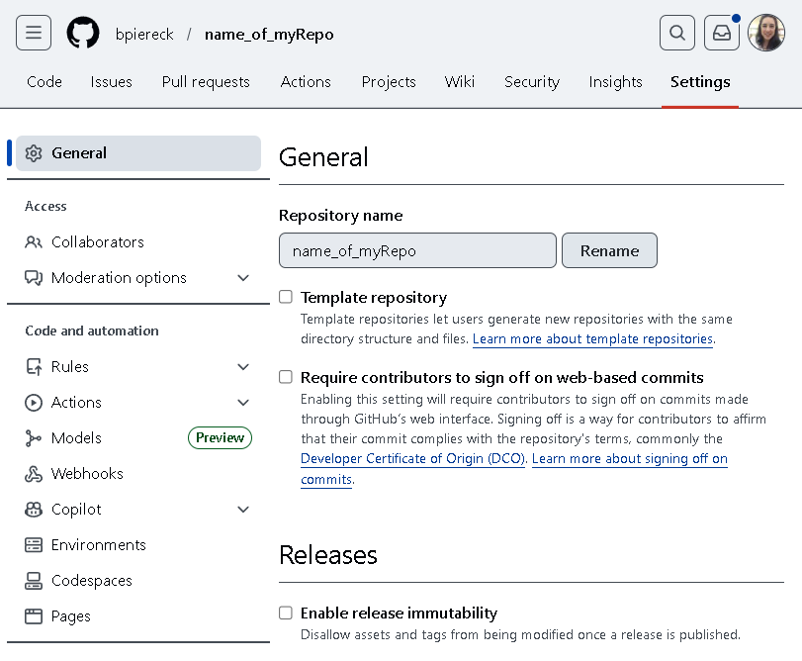
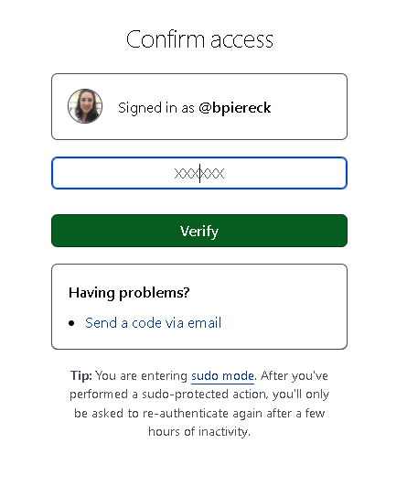
Collaborate to specific repositories
Chose what repository you want
Find the repository settings
In access management click Collaborators
GitHub will ask some
kind of authentication

Slide 110
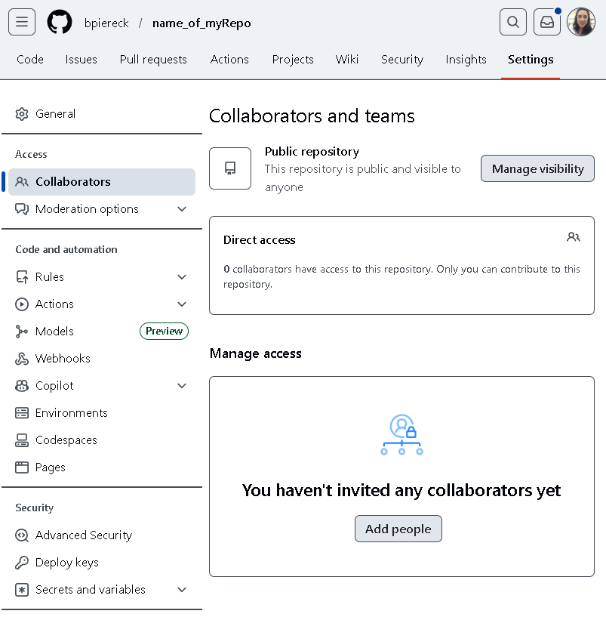

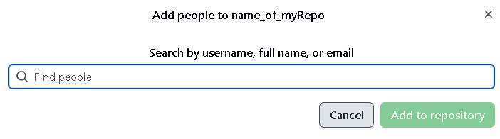
Collaborate to specific repositories
3
Check your mailbox
& accept the collaboration
bpiereck
Bruna Piereck Moura
Bruna.piereckmoura@vib.be
1
2

Slide 111
What step is missing?

Slide 112
How this will work
GitHub
Person Y
Person Z
Person Y
Person Z
Notes:
Use this slides to explain the interaction of the collaboration.
Draw the lines of the interaction direction during the class instead of adding animation. You can use power point resources or other.

Slide 113
Activity
We will work together
  Before starting
    Check the status, add >>> commit >>> push
    Is your working three clean?
    AVOID CONFLICTS FOR NOW!
      Solving conflicts Is the next topic.

Slide 114
Activity
GitHub
We will work together
  Help your partner
    Clone their repository
      Be careful to do outside your own project
    Create a branch (start using your names’ initials, e.g BP_branchName)
      In theirs dictionary file:
        Write what they need to do to start a collaboration
        Write about how to use branches to support a smooth collaboration
    Commit and push
$ git clone
My computer

Slide 115
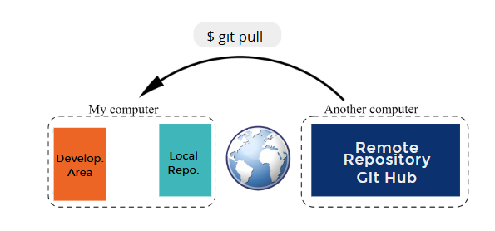
Activity
Bring the changes of your project to your local repo

Slide 116
New branches and collaborations
Check ALL branches
  Local
  Remote
user$ git branch –a
user$ git branch –-all

Slide 117
Activity
Go back to your project
  Sync the content
  Check the updates in the new branch your collaborator has created
user$ git branch - a
user$ git checkout <name>

Slide 118
Solving
conflicts

Slide 119

Activity
Creating conflicts to solve them later
  Choose one project, work in the same file
  Write a message in the same line of the file
    Commit and push
THE LAST ONE WILL BE IN TROBLE
conflict to solve

Slide 120

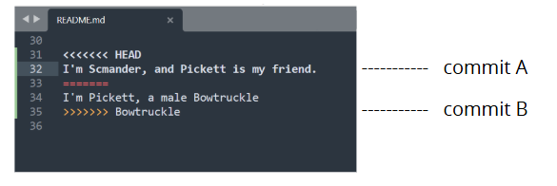
Fixing the conflict
With great power, comes great responsibility
Open the file where the conflict is found
<<<<<< HEAD
Text 1
=========
Text 2
>>>>>>>> 587SD574

Slide 121
Fixing the conflict
With great power, comes great responsibility
Open the file where the conflict is found
You can change the text
  Chose the best solution
  Merge both solution
  Create a completely new solution
<<<<<< HEAD
Text 1
=========
Text 2
>>>>>>>> 587SD574
Text 1
Text 2
Save
add
Commit
Push
Text 1
Text 2
NEW TEXT

Slide 122
Activity
Create a new conflict, your partner now has the chance to solve it
  Choose one project, work in the same file
  Write a message in the same line of the file
    Commit and push
conflict to solve

Slide 123
QUESTIONS?

Slide 124

Other considerations
Colourblindness: in order to ensure that most of your audience can see differences in colour, use teal vs orange. For more information on how colours look for those with colourblindness, click here!
Trebuchet is the recommended font for VIB presentations. Trebuchet is also easier for those who have dyslexia to read.

Slide 125
02
Resources

Slide 126
Aqua
HEX #02A2A7
RBG 2, 162, 167
Orange
HEX #EC6523
RBG 236, 101, 35
Purple
HEX #693A91
RBG 105, 58, 145
Navy
HEX #14274C
RBG 20, 39, 76
Blue
HEX #1F448F
RBG 31, 68, 143
Cherry
HEX #E83050
RBG 232, 48, 80
Green
HEX #00A14A
RBG 0, 161, 74
Yellow
HEX #F9B418
RBG 249, 180, 24
Tint 01
HEX #29B3B8
RBG 41, 179, 184
Tint 01
HEX #EF7739
RBG 239, 119, 57
Tint 01
HEX #784B9A
RBG 120, 75, 154
Tint 01
HEX #24539F
RBG 36, 83, 159
Tint 01
HEX #EC4D6A
RBG 236, 77, 106
Tint 01
HEX #1AAF5E
RBG 26, 175, 94
Tint 01
HEX #FCC747
RBG 252, 199, 71
Tint 02
HEX #99D7D6
RBG 153, 215, 214
Tint 02
HEX #F7C1A3
RBG 247, 193, 163
Tint 02
HEX #C2AFD0
RBG 194, 175, 208
Tint 02
HEX #A1B2D5
RBG 161, 178, 213
Tint 02
HEX #F6AAB9
RBG 246, 170, 185
Tint 02
HEX #9BD3B3
RBG 155, 211, 179
Tint 02
HEX #FCE39B
RBG 252, 227, 155
Tint 03
HEX #CBEAEC
RBG 203, 234, 236
Tint 03
HEX #FBE8DF
RBG 251, 232, 223
Tint 03
HEX #E3DCEA
RBG 227, 220, 234
Tint 03
HEX #D5DBEC
RBG 213, 219, 236
Tint 03
HEX #FCE3E6
RBG 252, 227, 230
Tint 03
HEX #D1EAD9
RBG 209, 234, 217
Tint 03
HEX #FEF4CF
RBG 252, 244, 207

Slide 131
Matheus Lourenço & Bruna Piereck

Slide 132
Create a remote repository
Situation 2: Start from a remote repo

