Slide 1

Versioning with
Git & GitHub
For code and documentation – Day 2
Bruna Piereck
Nov 2026

Slide 2
Review QUIZ
Notes:
https://play.kahoot.it/v2/?quizId=0c611126-e0a0-4537-aed6-b07a238f79ba&hostId=cca14541-11b4-4508-8ad0-66ab86decb32

Slide 3
Experimenting
Risk Free
Branching
an alternative timeline

Slide 4
Alternative history
user$ git branch <name>
New_branch
Branch
Has a specific name
Alternative history of commits
  Independent timeline
Shared commit between timelines
Main
History Main
History
New_branch
Shared commit

Slide 5
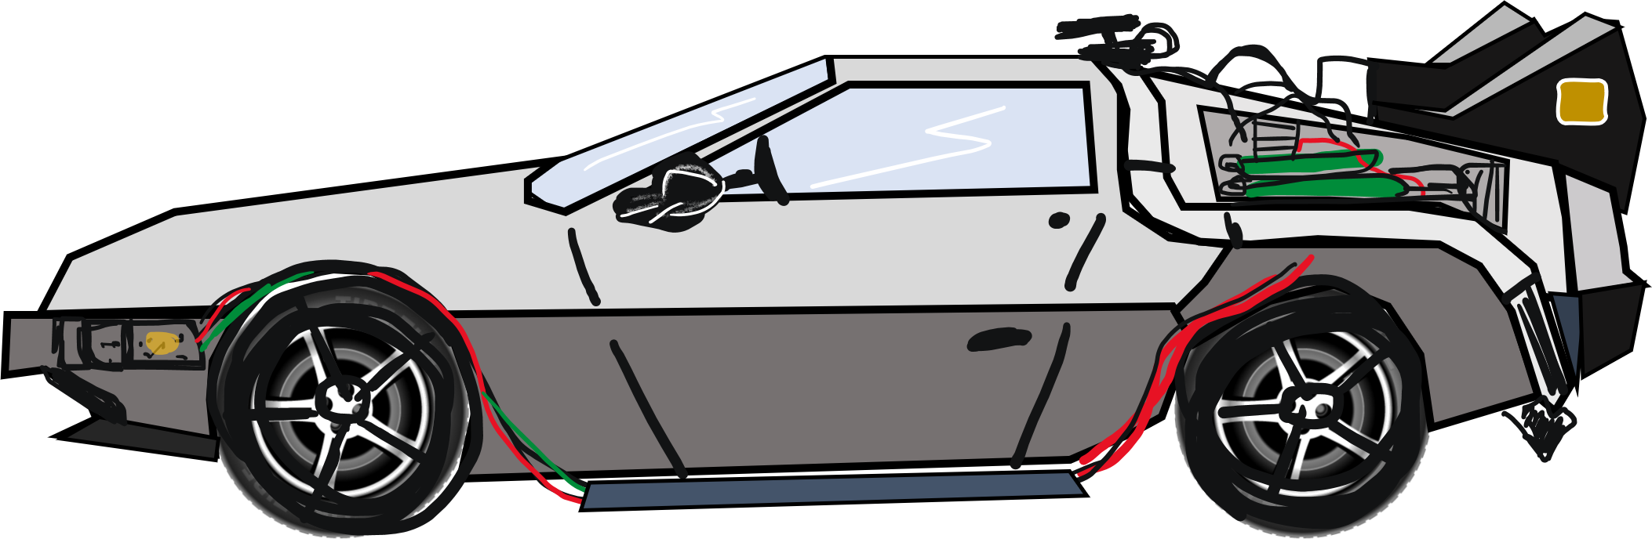
Alternative history
user$ git branch <name>
Utility
Experiment risk free
Collaborating in a project
Work in different tasks
Testing different possible solutions
P.s.: Creating ≠ Working on
New_branch
Main
Shared commit

Slide 6
Moving between branches
(parallel timelines)
user$ git checkout <branch_name>
user$ git checkout -b <name>
Move between branches
Move between commits
(!! Dangerous)
New_branch
Main
Shared commit

Slide 7
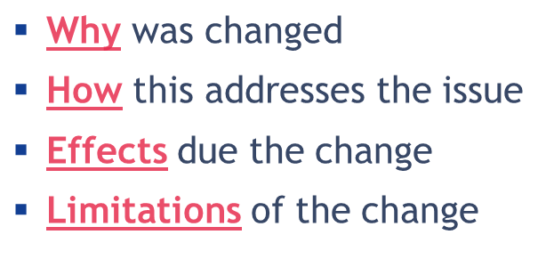
Activity
Making use of branches
  Go to your project
    Sync all the content
    Create your branch name b_concept
    Checkout to your new branch
    Write the concepts of Branching & Checkout
    Write when and why branching can be useful
    Commit and Push
    (think of your commit message)
    P.S.: don’t fill the commands file
$ git branch <branch_name>
$ git checkout <branch_name>
$ git checkout -b <name>

Slide 8
Activity
Making use of branches (Part 2)
  Checkout back to Main/Master
    Create a new branch name b_command
    Checkout to your new branch
    Write the commands
      How to create a branch
      How to move between branches
    Commit and Push
    (think of your commit message)
$ git branch <branch_name>
$ git checkout <branch_name>
$ git checkout -b <name>

Slide 9
Check branch names
Check local branches
user$ git branch -- list
user$ git branch -l
user$ git branch
All the same

Slide 10
Branches review
user$ git branch -- list List the local branches
--all List all branches, local & remote
<name> Create a new branch
user$ git checkout <name / ID > Go to branch
-b <name> Create and go to new branch
user$ git switch –c <name_new_branch> Transform a detached HEAD in a branch

Slide 11


The “Mirror”
effect..
Dynamic
Dev. area

Slide 12




Branches: The “mirror” effect
Dev. Area

Slide 13
Branches: The “mirror” effect
Git checkout vib_green
Dev. Area
README.txt
.gitignore
Chapter01.md
README.txt
.gitignore
Chapter01.md
README.txt
.gitignore
Chapter02.md
README.txt
.gitignore
Chapter01.md
Illustrations

Slide 14
Branches: The “mirror” effect
Git checkout vib_green
Dev. Area
README.txt
.gitignore
Chapter01.md
README.txt
.gitignore
Chapter02.md
README.txt
.gitignore
Chapter02.md
README.txt
.gitignore
Chapter01.md
Illustrations

Slide 15
Branches: The “mirror” effect
Git checkout vib_green
Dev. Area
README.txt
.gitignore
Chapter01.md
README.txt
.gitignore
Chapter01.md
Illustrations
README.txt
.gitignore
Chapter02.md
README.txt
.gitignore
Chapter01.md
Illustrations

Slide 16
One possible reality
README.txt
.gitignore
Chapter01.md
Dev. Area
README.txt
.gitignore
Chapter01.md
Illustrations
README.txt
.gitignore
Chapter02.md
README.txt
.gitignore

Slide 17
Activity
Compare content in both timelines (b_command and b_command)
  Steps
    Check your branch history and list of files/folders
    Close all files
    Checkout to the main branch
    Check the history and list of files
    Are there any differences?
  Open the files
    Are there any information missing?
    Why?

Slide 18
Activity
Working with branches
  Create a new_branch named b_mirror_effect
  Write about the “mirror” effect in your file
  Commit & Push

Slide 19
Activity
Comparing
  Close all files
  Move back to main
    Is the content there?
    Why?
  Can you see all branches in GitHub?

Slide 20
QUIZ
Notes:
https://play.kahoot.it/v2/?quizId=0c611126-e0a0-4537-aed6-b07a238f79ba&hostId=cca14541-11b4-4508-8ad0-66ab86decb32

Slide 21
Merging
Branches come together

Slide 22
Merging Branches
user$ git merge <branch_name>
Use cases
  Experiment worked out
  Finished collaboration
  Problem solved
Too many branches
  Clean up
user$ git branch –d <branch_name>
History Main
History
New_branch

Slide 23
Activity
Create a new branch
  Write about merging

Slide 24
Merging Branches
user$ git merge <branch_name>
Use cases
  Experiment worked out
  Finished collaboration
  Problem solved
Challenge !!!
Solving conflicts

Slide 25
Activity
Merge one-by-one
  Merge all your branches with main
  Use conflict solving to keep only relevant information
  Think carefully of your commit messages
  Push your changes to GitHub

Slide 26

Change the past at
your own risk
Checkout to an
old commit

Slide 27
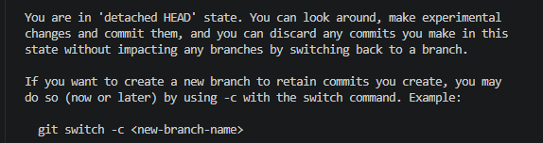
Detached head
HEAD
user$ git checkout <commit_ID>
You can’t change the past
You CAN create “an alternative future”
  Be careful !!
HEAD
Detached HEAD
user$ git switch –c <name_new_branch>

Slide 28
Activity
Changing the past
  Move to an old commit
  Add some text (2 steps)
    Commit without switching
      Check in the list of branches
    Commit and do switch – c
      Check the list of branches
  What happens?
user$ git checkout <commit_ID>
user$ git switch –c <name_new_branch>

Slide 29
REVIEW

Slide 30
Review
user$ git branch <branch_name>
Creates an alternative timeline
user$ git checkout <branch_name>
Moves in the alternative timeline or old commit
History Main
History
New_branch
user$ git checkout –b <branch_name>
Creates and moves in the alternative timeline
user$ git merge <branch_name>
Merges two timelines in a shared commit point

Slide 31
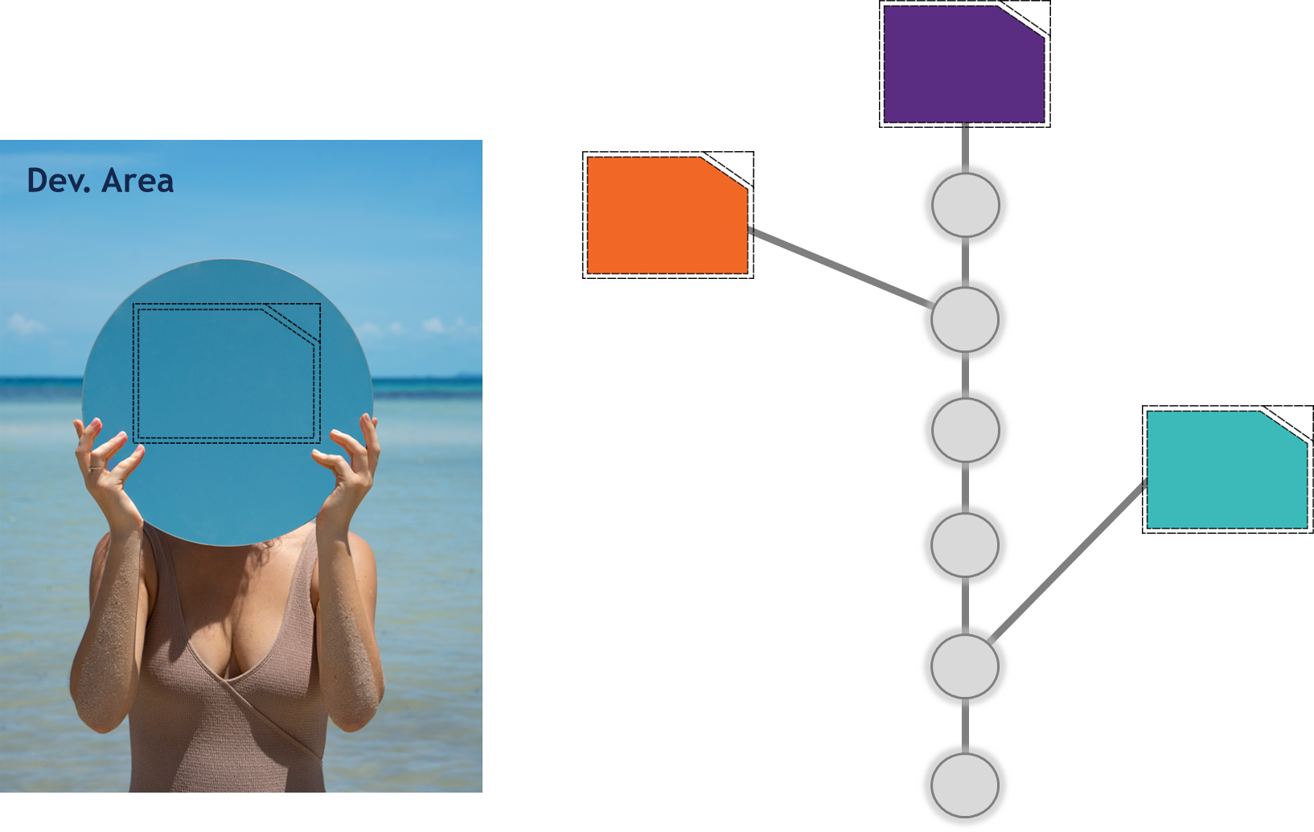
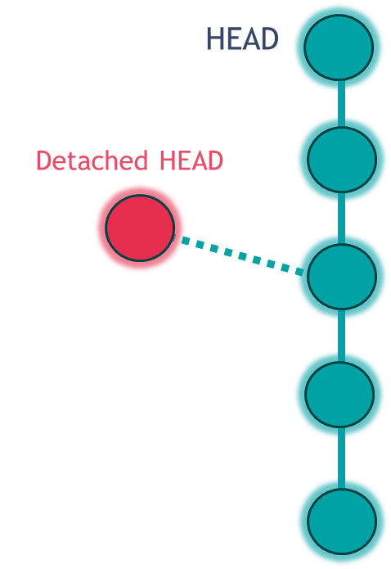
Review
The “mirror” effect
  Folder Content == Branch you are working on
Detached HEAD
  Checking to old commit
  A “floating” branch
  Need to be connected
user$ git switch -c <branch_name>

Slide 32
3 topics
Where do we start?
Working on GitHub
Tagging & Releases
Forking

Slide 33
Tagging
Highlight
good versions

Slide 34
Tagging the commit
user$ git tag <name>
Tag an important commit
  A good version
  A version for release
  A specific feature
  Experiment risk free
  Etc ..

Slide 35
Tagging the commit
user$ git tag <name>
Tag an important commit
  A good version
  A version for release
  A specific feature
  Experiment risk free
  Etc ..
Listing existing tags
  user$ git tag
  user$ git tag –l
  user$ git tag --list

Slide 36
Tagging the commit
user$ git tag <name>
Tag an important commit
  A good version
  A version for release
  A specific feature
  Experiment risk free
  Etc ..
Listing existing tags
  user$ git tag
  user$ git tag –l
  user$ git tag --list
Tag an old commit
  user$ git tag <name> <commit_ID>

Slide 37
Activity
Annotating
  Annotate in your documents about what is the tag used for
  What are the commands
  Commit
Creating tags
  Tag the last commit as “info_tag”
  Choose an old commit and create a tag for it
  List your tags
Challenge: Push your tags to GitHub
  user$ git push --tags

Slide 38
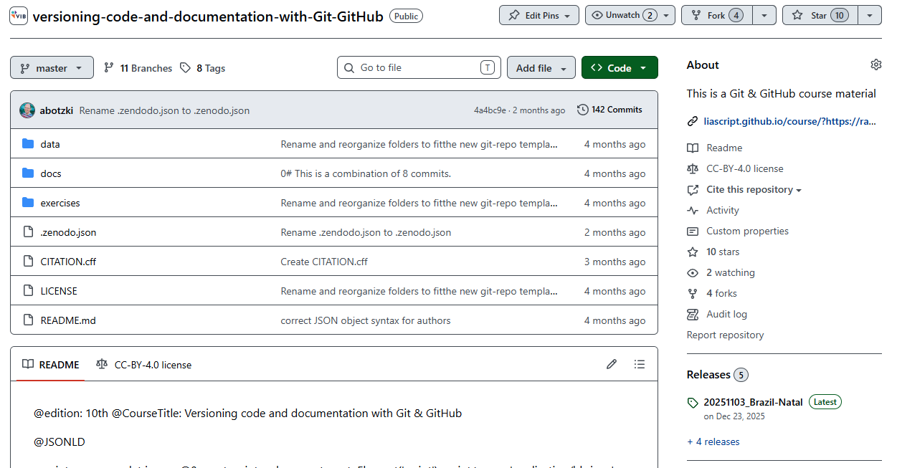
Tags and GitHub releases
Tag == commit “name”
GitHub release

Slide 39
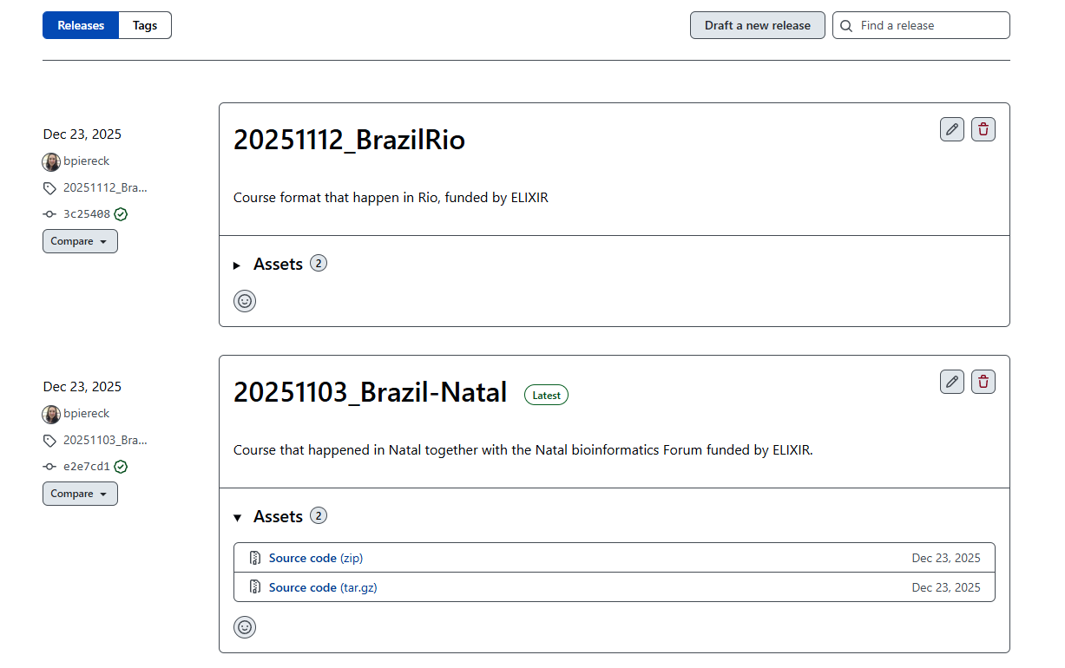
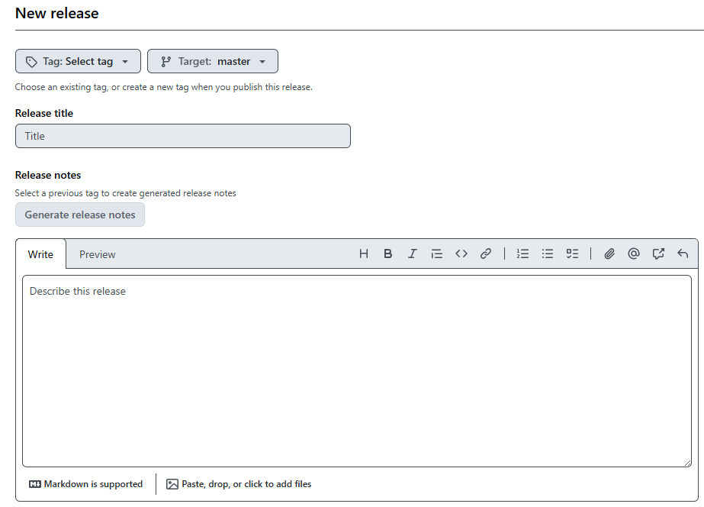
Tags and GitHub releases
Tag == commit “name”
GitHub release
  Are based on tags
  Allow for notes explanations
  Can be sync to Zenodo for DOI

Slide 40
Activity
Create a Release o GitHub

Slide 41
GitHub
Working
Online

Slide 42
Basics on GitHub
Check all branches
Check all commits
Editing
  One-by-one
  Several files
Creating Issues
  List of TODOs
  List of bugs
Tags and Releases

Slide 43
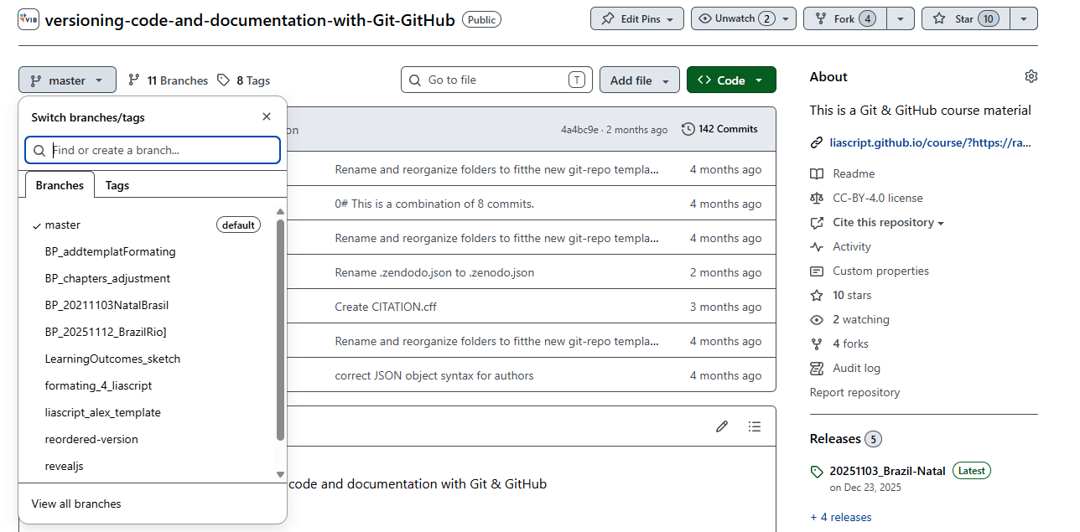
Basics on GitHub
Check all branches
Check all commits
Editing
  One-by-one
  Several files
Creating Issues
  List of TODOs
  List of bugs
Tags and Releases

Slide 44
Basics on GitHub
Check all branches
Check all commits
Editing
  One-by-one
  Several files
Creating Issues
  List of TODOs
  List of bugs
Tags and Releases

Slide 45
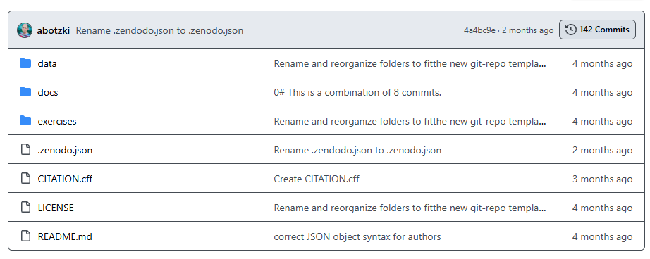
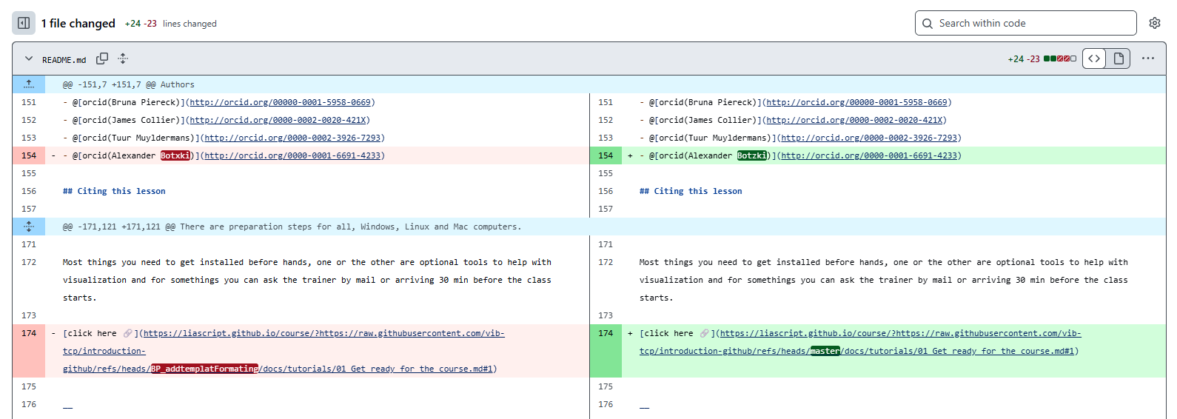
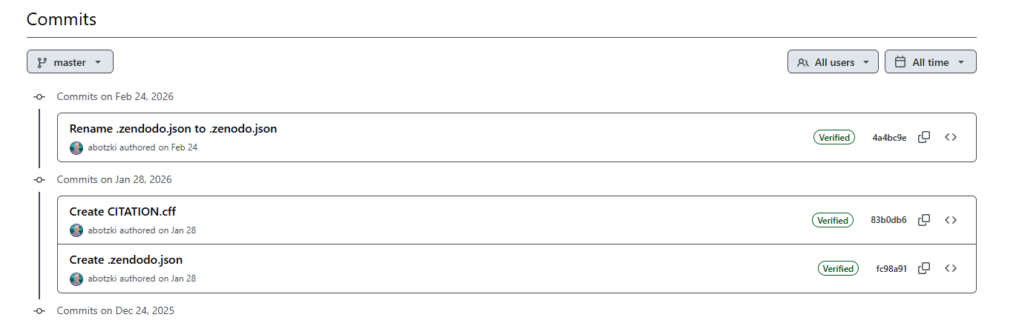
Basics on GitHub
Check all branches
Check all commits
Editing
  One-by-one
  Several files
Creating Issues
  List of TODOs
  List of bugs
Tags and Releases

Slide 46
Basics on GitHub
Check all branches
Check all commits
Editing
  One-by-one
  Several files
Creating Issues
  List of TODOs
  List of bugs
Tags and Releases

Slide 47
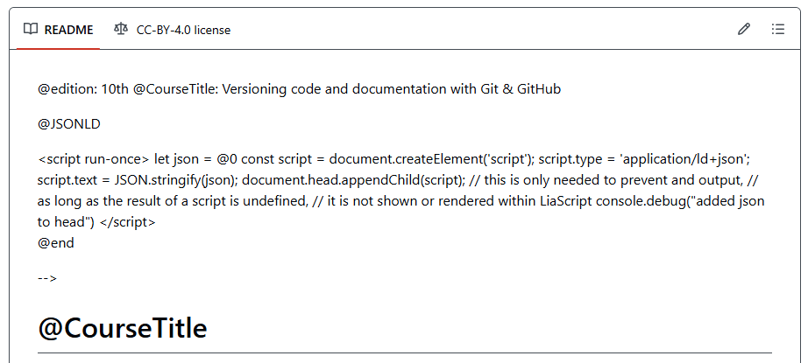
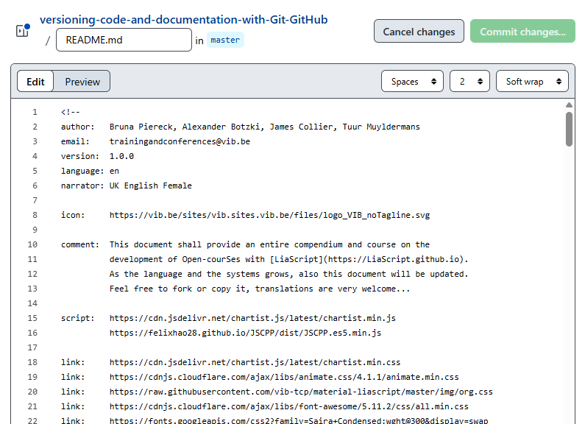
Basics on GitHub
Check all branches
Check all commits
Editing
  One-by-one
  Several files
Creating Issues
  List of TODOs
  List of bugs
Tags and Releases

Slide 48
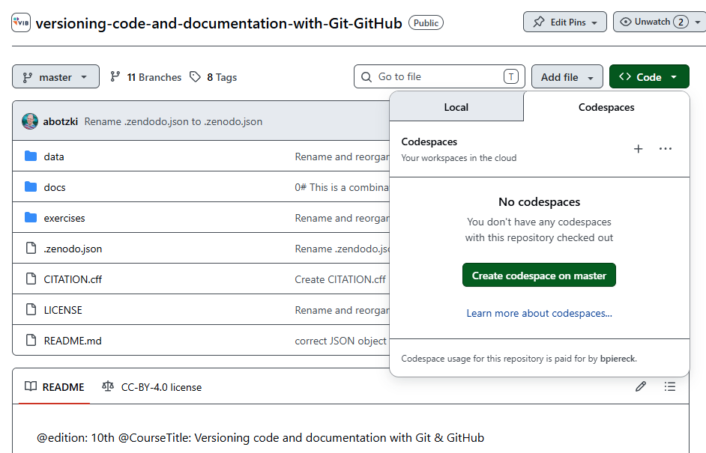
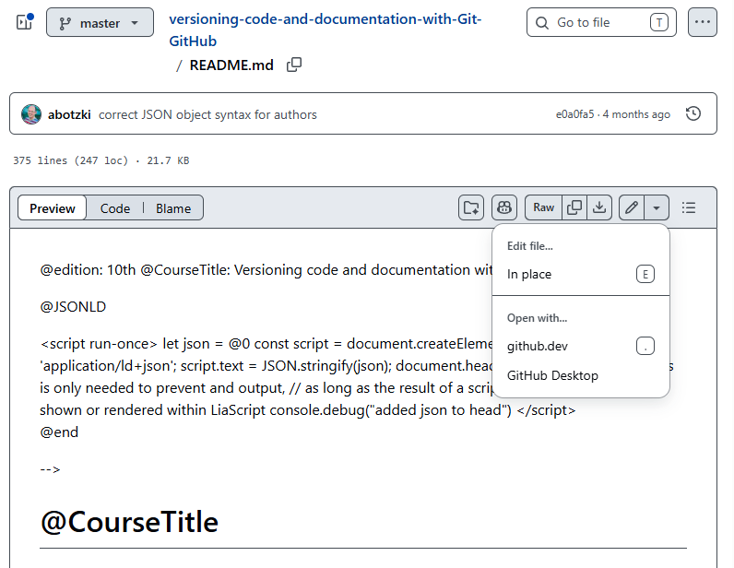

Basics on GitHub
Check all branches
Check all commits
Editing
  One-by-one
  Several files
Creating Issues
  List of TODOs
  List of bugs
Tags and Releases

Slide 49
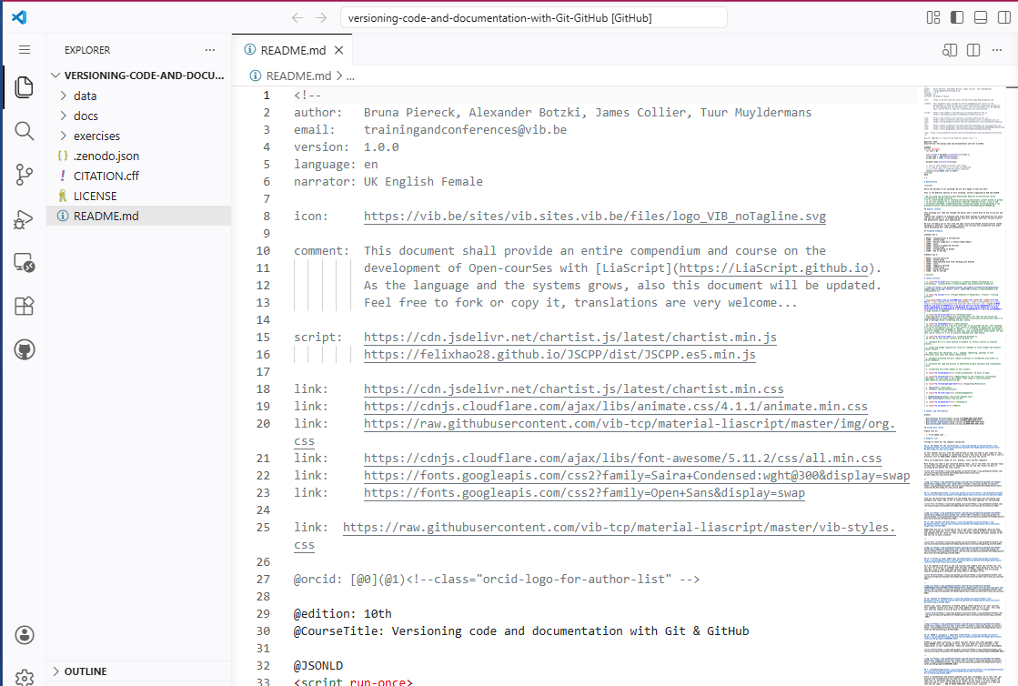
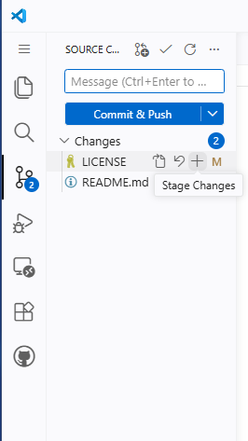
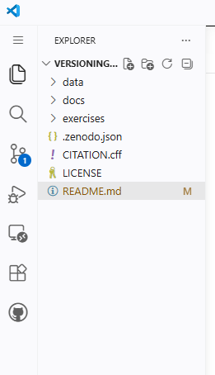
Basics on GitHub
Check all branches
Check all commits
Editing
  One-by-one
  Several files
Creating Issues
  List of TODOs
  List of bugs
Tags and Releases

Slide 50
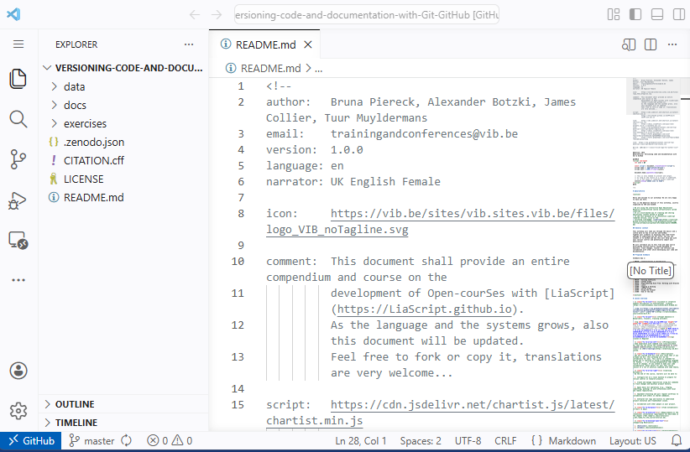
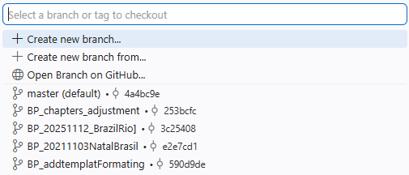
Basics on GitHub
Check all branches
Check all commits
Editing
  One-by-one
  Several files
Creating Issues
  List of TODOs
  List of bugs
Tags and Releases
Branches

Slide 51
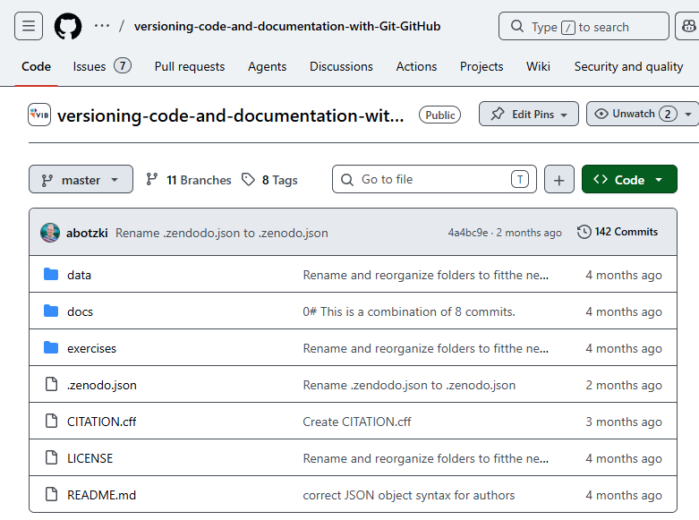
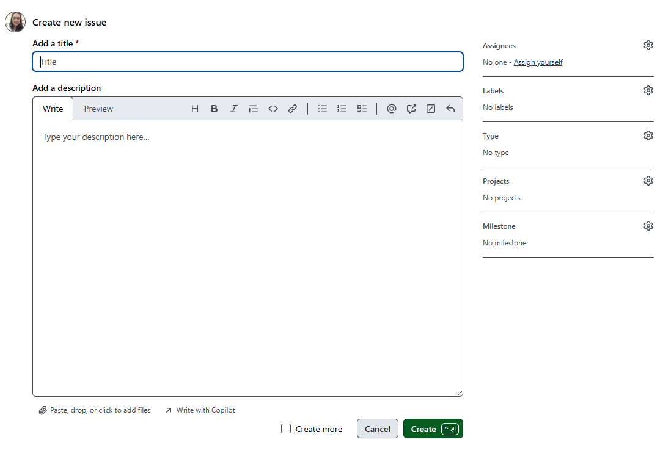
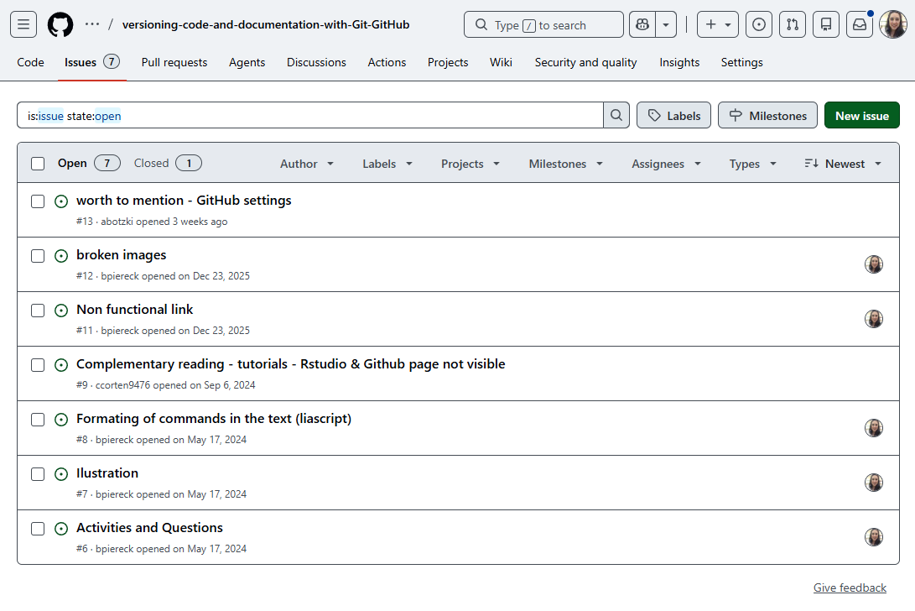
Basics on GitHub
Check all branches
Check all commits
Editing
  One-by-one
  Several files
Creating Issues
  List of TODOs
  List of bugs
Tags and Releases

Slide 52
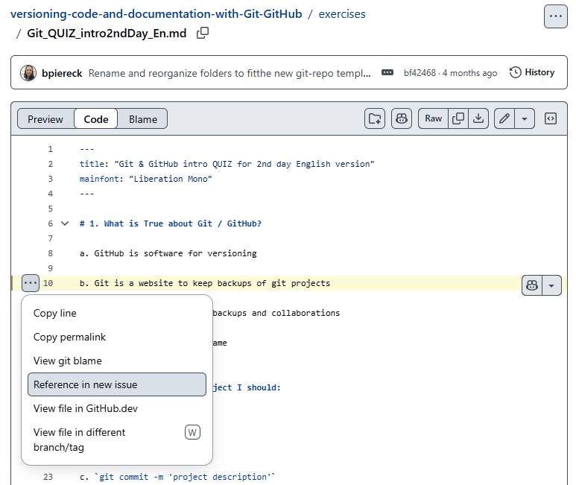
Basics on GitHub
Check all branches
Check all commits
Editing
  One-by-one
  Several files
Creating Issues
  List of TODOs
  List of bugs
Tags and Releases

Slide 53
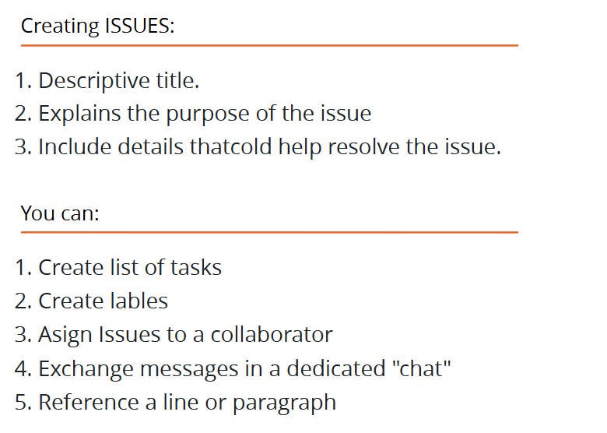
Basics on GitHub
Check all branches
Check all commits
Editing
  One-by-one
  Several files
Creating Issues
  List of TODOs
  List of bugs
Tags and Releases

Slide 54
Basics on GitHub
Check all branches
Check all commits
Editing
  One-by-one
  Several files
Creating Issues
  List of TODOs
  List of bugs
Tags and Releases

Slide 55
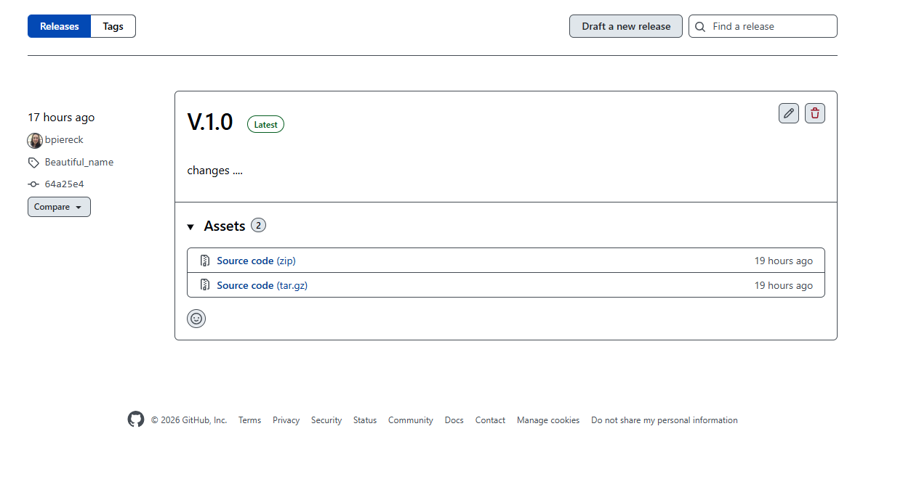
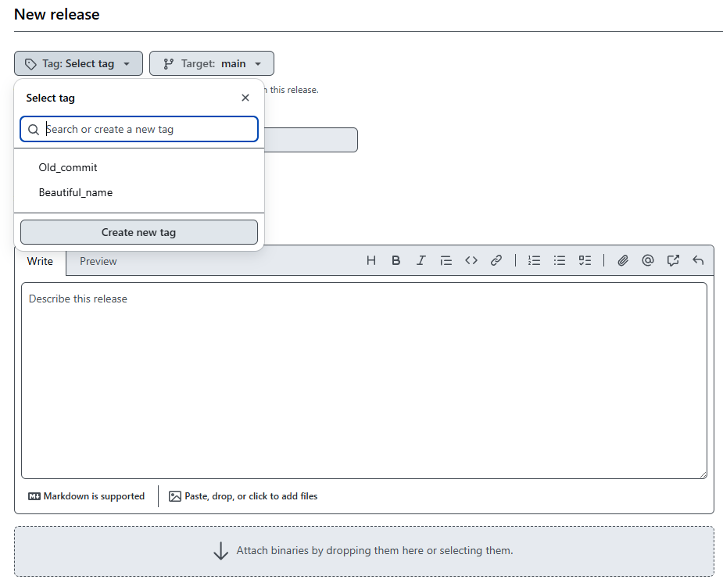
Releases
Se tags from any branch and describe
changes in the new release.

Slide 56

Forking
Copping
repositories

Slide 57
Fork vs Clone
GitHub
Bruna
Alex
Repo 1Br
Repo 2Br
Repo BR_own
Repo 1Al
Repo 2Al
Repo 3Al
Git fork
Bruna Owns
Git clone
Git clone
Bruna Owns
Push & Pull possible
Alex Owns
Push & Pull possible if collaborating
Bruna’s
Computer
Repo 2Br
Repo 3Al

Slide 58
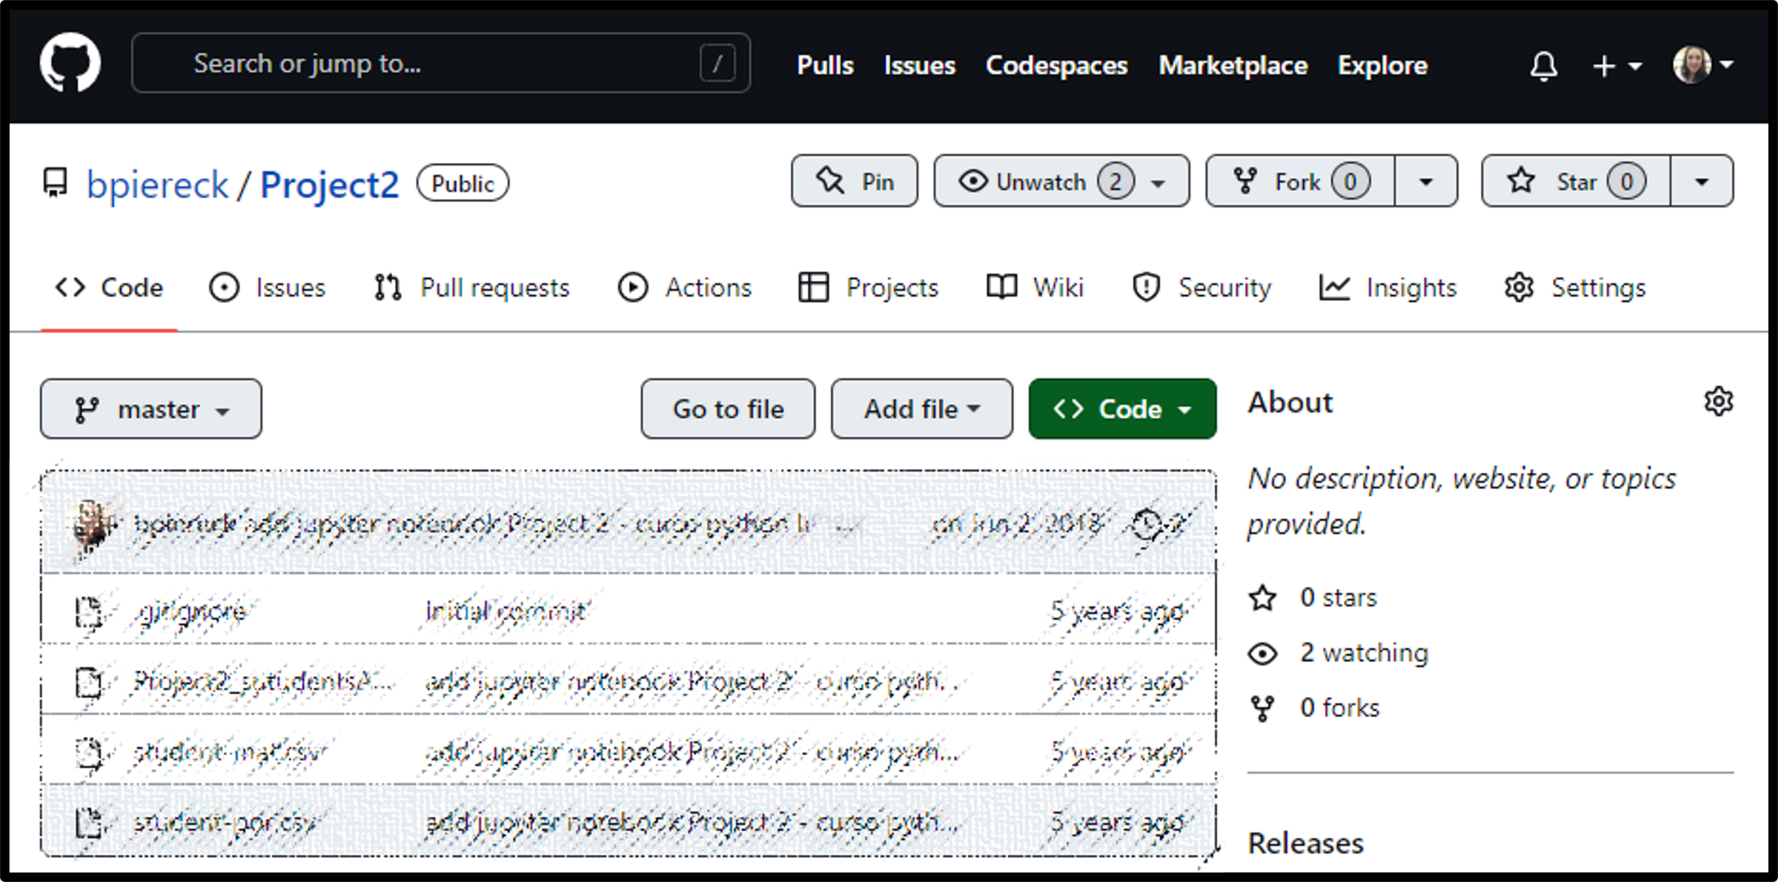
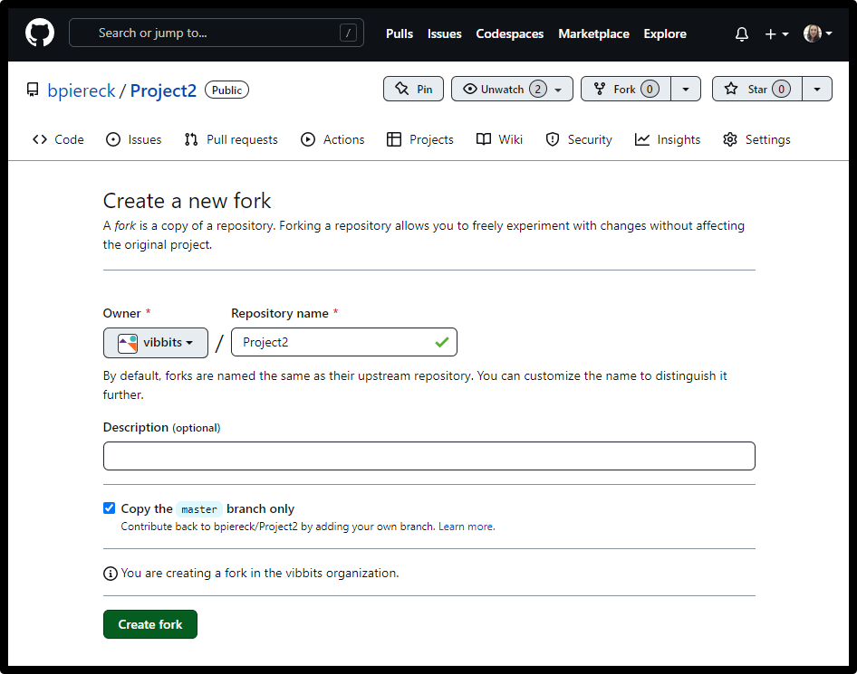

Slide 59
Fork vs Clone
GitHub
Bruna
Alex
Repo 1Br
Repo 2Br
Repo BR_own
Repo 1Al
Repo 2Al
Repo 3Al
Git fork
Bruna Owns
Owner can see
Still connected
Original creator can see it
Changes can be incorporated
  Both directions
    Pull request

Slide 60
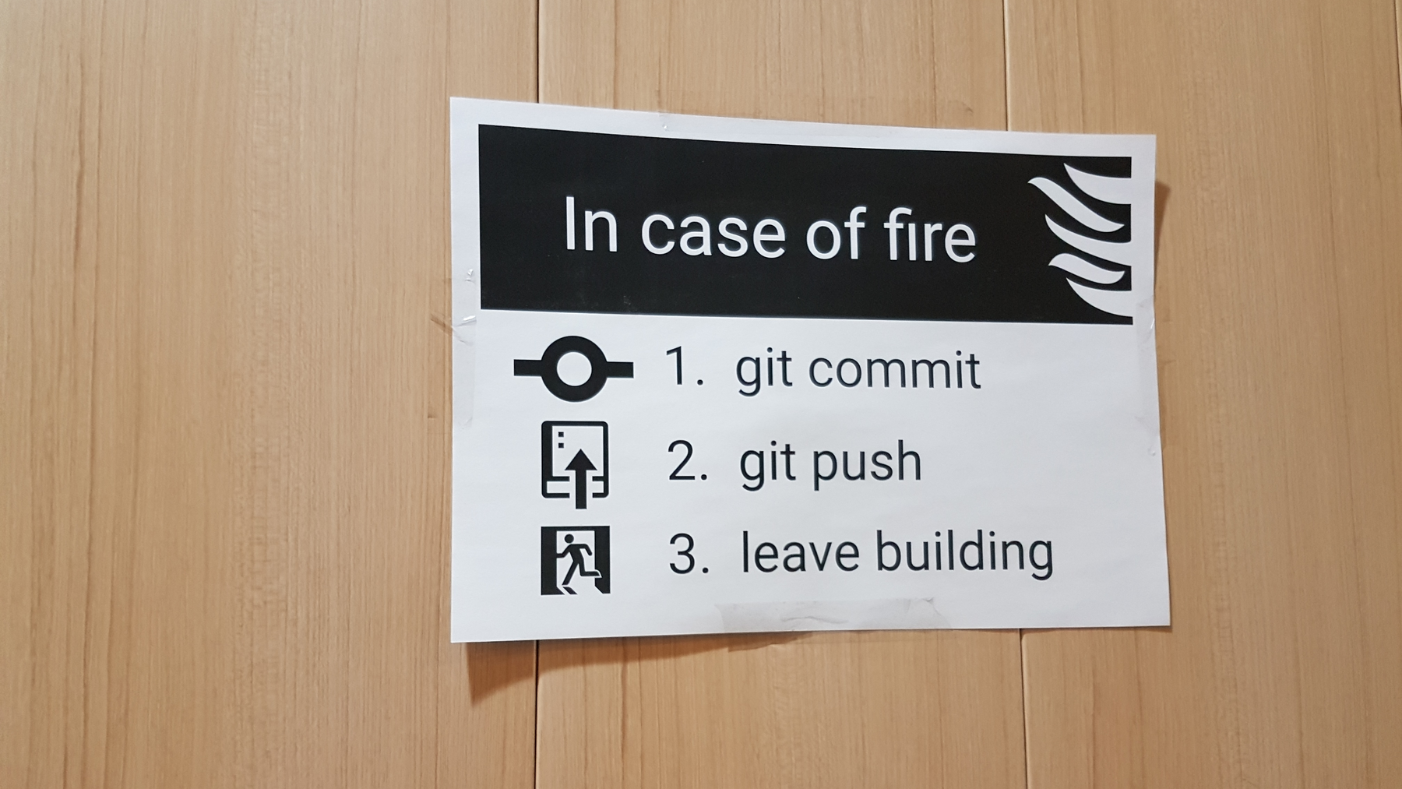
You are ready

Slide 61
Activity
Fork race
  Wait for instructions to be a fair race!
  Add your name to the last line of the README file
  Commit (and wait)
  When instructed ask for a pull requested
    A pull request must be evaluated and accepted

Slide 62
Bruna Piereck
Bruna.piereckmoura@vib.be

Slide 63

Other considerations
Colourblindness: in order to ensure that most of your audience can see differences in colour, use teal vs orange. For more information on how colours look for those with colourblindness, click here!
Trebuchet is the recommended font for VIB presentations. Trebuchet is also easier for those who have dyslexia to read.

Slide 64
02
Resources

Slide 65
Aqua
HEX #02A2A7
RBG 2, 162, 167
Orange
HEX #EC6523
RBG 236, 101, 35
Purple
HEX #693A91
RBG 105, 58, 145
Navy
HEX #14274C
RBG 20, 39, 76
Blue
HEX #1F448F
RBG 31, 68, 143
Cherry
HEX #E83050
RBG 232, 48, 80
Green
HEX #00A14A
RBG 0, 161, 74
Yellow
HEX #F9B418
RBG 249, 180, 24
Tint 01
HEX #29B3B8
RBG 41, 179, 184
Tint 01
HEX #EF7739
RBG 239, 119, 57
Tint 01
HEX #784B9A
RBG 120, 75, 154
Tint 01
HEX #24539F
RBG 36, 83, 159
Tint 01
HEX #EC4D6A
RBG 236, 77, 106
Tint 01
HEX #1AAF5E
RBG 26, 175, 94
Tint 01
HEX #FCC747
RBG 252, 199, 71
Tint 02
HEX #99D7D6
RBG 153, 215, 214
Tint 02
HEX #F7C1A3
RBG 247, 193, 163
Tint 02
HEX #C2AFD0
RBG 194, 175, 208
Tint 02
HEX #A1B2D5
RBG 161, 178, 213
Tint 02
HEX #F6AAB9
RBG 246, 170, 185
Tint 02
HEX #9BD3B3
RBG 155, 211, 179
Tint 02
HEX #FCE39B
RBG 252, 227, 155
Tint 03
HEX #CBEAEC
RBG 203, 234, 236
Tint 03
HEX #FBE8DF
RBG 251, 232, 223
Tint 03
HEX #E3DCEA
RBG 227, 220, 234
Tint 03
HEX #D5DBEC
RBG 213, 219, 236
Tint 03
HEX #FCE3E6
RBG 252, 227, 230
Tint 03
HEX #D1EAD9
RBG 209, 234, 217
Tint 03
HEX #FEF4CF
RBG 252, 244, 207

