Slide 1

Versioning with
Git & GitHub
For code and documentation – Day 2
Bruna Piereck
Nov 2026

Slide 2

Review
Notes:
https://play.kahoot.it/v2/?quizId=0c611126-e0a0-4537-aed6-b07a238f79ba&hostId=cca14541-11b4-4508-8ad0-66ab86decb32

Slide 3
Restore a previous good state
My text
09d
09d
Copy back the “good” commit
Keeps in the history
  committed
  Reverted
Dangerous!!
Discard a commit
“Unstage” file
$ git revert
Accident
08c
copy
08c
My text
07b
My text
07b
$ git reset

Slide 4



From remote to local
GitHub
My computer
ssh key
git
Developing Area
Staging Area
Local repository
$ git clone <ssh address>
Downloads repository content (creates dev. area)
Adds the bridge immediately
Creates a local repository automatically
Only works if you have set a ssh key

Slide 5
Activity
Check if your notes have all you need
  Concepts:
    Git vs GitHub
    Conceptual areas
    Meaningful message git commit (Why, How, Effects, limitations)
    Staging area (Why and how to use)
    README files usage
    .gitignore file usage

Slide 6
Activity
Check if your notes have all you need
  Commands:
    Basic routine
      git status, git add, git commit, git push
    Sync remote to local
      git pull
    From local to remote
      git remote add origin <ssh address>
    From remote to local
      git clone
    Comparing commits
      git diff & git show
    Check the history
      git log
    Recover to a previous state
      git reset, git revert
    Rewrite the last commit message
      git commit –amend
    Delete the “bridge”
      git remote (to list the name - origin)
      git remote remove <name>

Slide 7

Review QUIZ
Notes:
https://play.kahoot.it/v2/?quizId=0c611126-e0a0-4537-aed6-b07a238f79ba&hostId=cca14541-11b4-4508-8ad0-66ab86decb32

Slide 8
Experimenting
Risk Free
Branching
an alternative timeline

Slide 9
Alternative history
user$ git branch <name>
New_branch
Branch
Has a specific name
Alternative history of commits
  Independent timeline
Shared commit between timelines
Main
History Main
History
New_branch
Shared commit

Slide 10
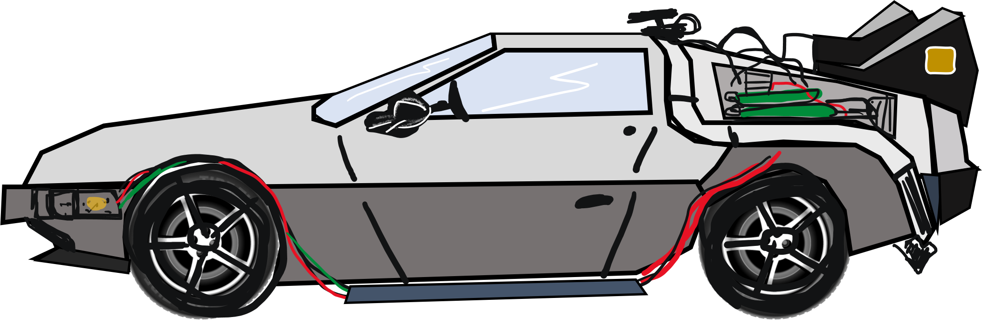
Alternative history
user$ git branch <name>
Utility
Experiment risk free
Collaborating in a project
Work in different tasks
Testing different possible solutions
P.s.: Creating ≠ Working on
New_branch
Main
Shared commit

Slide 11
Moving between branches
(parallel timelines)
user$ git checkout <branch_name>
user$ git checkout -b <name>
Move between branches
Move between commits
(!! Dangerous)
New_branch
Main
Shared commit

Slide 12
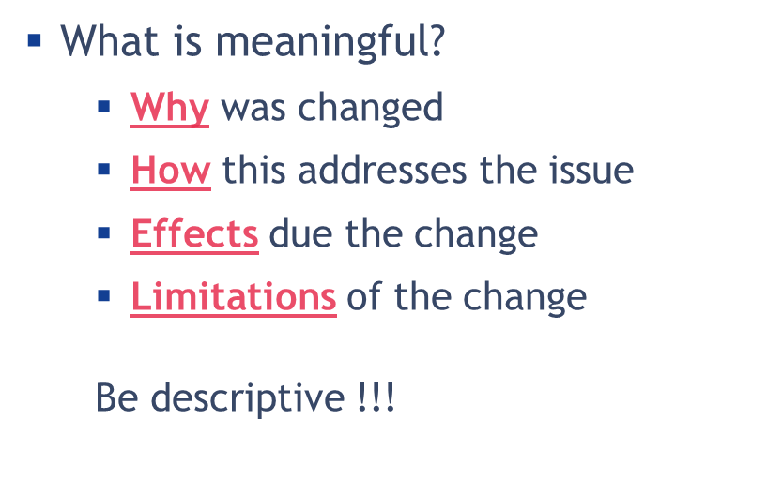
Activity
Making use of branches
  Go to your project
    Sync all the content
    Create your branch name b_concept
    Checkout to your new branch
    Write the concepts of Branching & Checkout
    Write when and why branching can be useful
    Commit and Push
    (think of your commit message)
    P.S.: don’t fill the commands file
$ git branch <branch_name>
$ git checkout <branch_name>
$ git checkout -b <name>

Slide 13
Activity
Making use of branches (Part 2)
  Checkout back to Main/Master
    Create a new branch name b_command
    Checkout to your new branch
    Write the commands
      How to create a branch
      How to move between branches
    Commit and Push
    (think of your commit message)
$ git branch <branch_name>
$ git checkout <branch_name>
$ git checkout -b <name>

Slide 14
Check branch names
Check local branches
user$ git branch -- list
user$ git branch -l
user$ git branch
All the same

Slide 15


The “Mirror”
effect..
Dynamic
Dev. area

Slide 16




Branches: The “mirror” effect
Dev. Area

Slide 17
Branches: The “mirror” effect
Git checkout vib_green
Dev. Area
README.txt
.gitignore
Chapter01.md
README.txt
.gitignore
Chapter01.md
README.txt
.gitignore
Chapter02.md
README.txt
.gitignore
Chapter01.md
Illustrations

Slide 18
Branches: The “mirror” effect
Git checkout vib_green
Dev. Area
README.txt
.gitignore
Chapter01.md
README.txt
.gitignore
Chapter02.md
README.txt
.gitignore
Chapter02.md
README.txt
.gitignore
Chapter01.md
Illustrations

Slide 19
Branches: The “mirror” effect
Git checkout vib_green
Dev. Area
README.txt
.gitignore
Chapter01.md
README.txt
.gitignore
Chapter01.md
Illustrations
README.txt
.gitignore
Chapter02.md
README.txt
.gitignore
Chapter01.md
Illustrations

Slide 20
One possible reality
README.txt
.gitignore
Chapter01.md
Dev. Area
README.txt
.gitignore
Chapter01.md
Illustrations
README.txt
.gitignore
Chapter02.md
README.txt
.gitignore

Slide 21
Activity
Compare content in both timelines (b_command and b_command)
  Steps
    Check your branch history and list of files/folders
    Close all files
    Checkout to the main branch
    Check the history and list of files
    Are there any differences?
  Open the files
    Are there any information missing?
    Why?

Slide 22
Activity
Working with branches
  Create a new_branch named b_mirror_effect
  Write about the “mirror” effect in your file
  Commit & Push

Slide 23
Activity
Comparing
  Close all files
  Move back to main
    Is the content there?
    Why?
  Can you see all branches in GitHub?

Slide 24
Collaborating
GitHub brings
you together

Slide 25
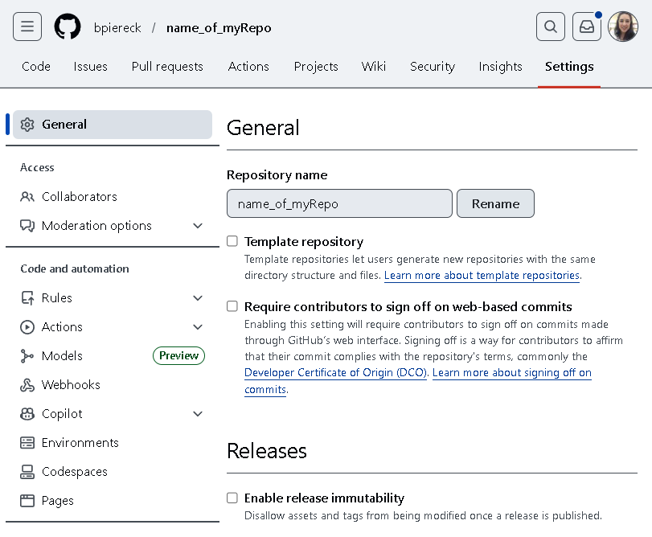
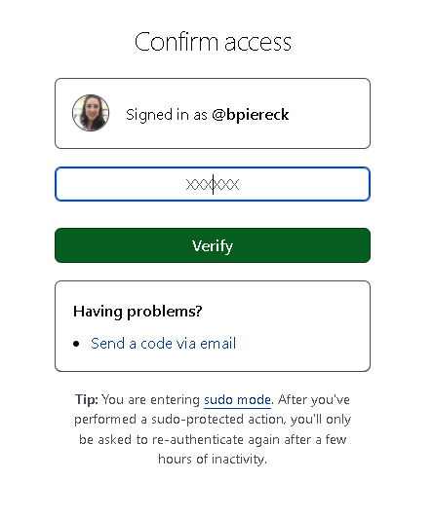
Collaborate to specific repositories
Chose what repository you want
Find the repository settings
In access management click Collaborators
GitHub will ask some
kind of authentication

Slide 26
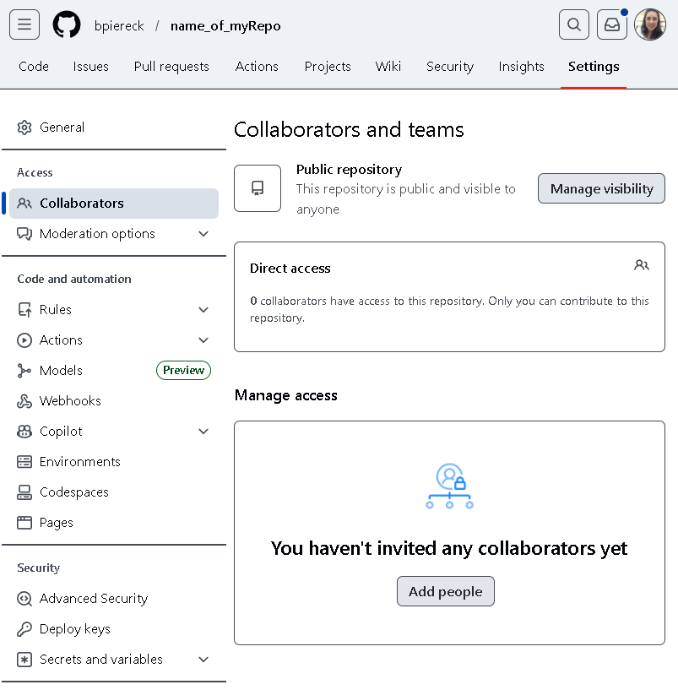

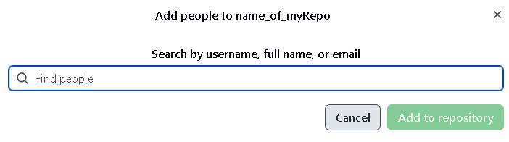
Collaborate to specific repositories
3
Check your mailbox
& accept the collaboration
bpiereck
Bruna Piereck Moura
Bruna.piereckmoura@vib.be
1
2

Slide 27
What step is missing?

Slide 28
How this will work
GitHub
Person Y
Person Z
Person Y
Person Z
Notes:
Use this slides to explain the interaction of the collaboration.
Draw the lines of the interaction direction during the class instead of adding animation. You can use power point resources or other.

Slide 29
Activity
We will work together
  Before starting
    Check the status, add >>> commit >>> push
    Is your working three clean?
    AVOID CONFLICTS FOR NOW!
      Solving conflicts Is the next topic.

Slide 30
Activity
GitHub
We will work together
  Help your partner
    Clone their repository
      Be careful to do outside your own project
    Create a branch (start using your names’ initials, e.g BP_branchName)
      In theirs dictionary file:
        Write what they need to do to start a collaboration
        Write about how to use branches to support a smooth collaboration
    Commit and push
$ git clone
My computer

Slide 31
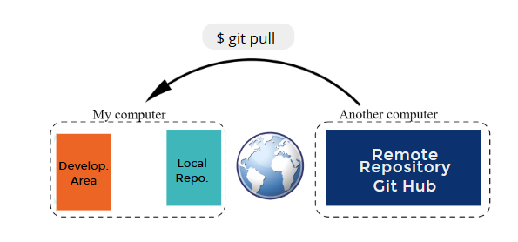
Activity
Bring the changes of your project to your local repo

Slide 32
New branches and collaborations
Check ALL branches
  Local
  Remote
user$ git branch –a
user$ git branch –-all

Slide 33
Activity
Go back to your project
  Sync the content
  Check the updates in the new branch your collaborator has created
user$ git branch - a
user$ git checkout <name>

Slide 34
QUIZ
Notes:
https://play.kahoot.it/v2/?quizId=0c611126-e0a0-4537-aed6-b07a238f79ba&hostId=cca14541-11b4-4508-8ad0-66ab86decb32

Slide 35
QUIZ
Why I can’t see the changes in the file present in the Main Branch?
  I lost what I just did?
  It can only be found in the branch where I edited it
  Git reloads my files based in the branch I am in
  B and C are correct
  I have no idea
x

Slide 36
QUIZ
How many copies of each file I have in the Dev. Area?
x
  Only 1.
  I have 2, one for each branch
  As many as branches I have
  As many as versions I have
Where are the other versions?
  In another folder
  I GitHub only
  In the .git folder
x

Slide 37
QUIZ
Where can I create a branch?
  Only projects I own
  Projects I own or collaborate
  Any repository
  B and C are correct
x

Slide 38
QUIZ
Can you see all branches your collaborators have created?
x
  Only the ones pushed to GitHub
  Yes, I can see all
  No, I can’t see them unless invited for collaboration
  I can see them on GitHub always

Slide 39
QUIZ
Can you see the history of changes your collaborator made?
  No, I can’t. It is only theirs
  I can see only on GitHub
  I can see locally and remotely, but with restrictions
  I have full access locally and remotely
x

Slide 40
QUIZ
As a collaborator I …
  Co-Own the repository
  I can edit freely, but I don’t own the repository
  I can edit the content upon authorization
x

Slide 41
Solving
conflicts

Slide 42

Activity
Creating conflicts to solve them later
  Choose one project, work in the same file
  Write a message in the same line of the file
    Commit and push
THE LAST ONE WILL BE IN TROBLE
conflict to solve

Slide 43

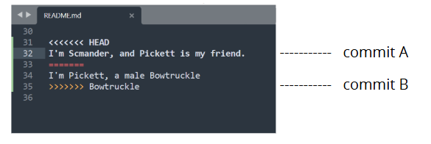
Fixing the conflict
With great power, comes great responsibility
Open the file where the conflict is found
<<<<<< HEAD
Text 1
=========
Text 2
>>>>>>>> 587SD574

Slide 44
Fixing the conflict
With great power, comes great responsibility
Open the file where the conflict is found
You can change the text
  Chose the best solution
  Merge both solution
  Create a completely new solution
<<<<<< HEAD
Text 1
=========
Text 2
>>>>>>>> 587SD574
Text 1
Text 2
Save
Commit
Push
Text 1
Text 2
NEW TEXT

Slide 45
Activity
Create a new conflict, your partner now has the chance to solve it
  Choose one project, work in the same file
  Write a message in the same line of the file
    Commit and push
conflict to solve

Slide 46
QUESTIONS?

Slide 47
Merging
Branches come together

Slide 48
Merging Branches
user$ git merge <branch_name>
Use cases
  Experiment worked out
  Finished collaboration
  Problem solved
Too many branches
  Clean up
user$ git branch –d <branch_name>
History Main
History
New_branch

Slide 49
Activity
Create a new branch
  Write about merging

Slide 50
Merging Branches
user$ git merge <branch_name>
Use cases
  Experiment worked out
  Finished collaboration
  Problem solved
Challenge !!!
Solving conflicts

Slide 51
Activity
Merge one-by-one
  Merge all your branches with main
  Use conflict solving to keep only relevant information
  Think carefully of your commit messages
  Push your changes to GitHub

Slide 52

Change the past at
your own risk
Checkout to an
old commit

Slide 53
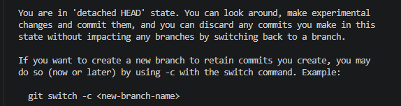
Detached head
HEAD
user$ git checkout <commit_ID>
You can’t change the past
You CAN create “an alternative future”
  Be careful !!
HEAD
Detached HEAD
user$ git switch –c <name_new_branch>

Slide 54
Activity
Changing the past
  Move to an old commit
  Add some text (2 steps)
    Commit without switching
      Check in the list of branches
    Commit and do switch – c
      Check the list of branches
  What happens?
user$ git checkout <commit_ID>
user$ git switch –c <name_new_branch>

Slide 55
Branches review
user$ git branch -- list List the local branches
-a List all branches, local & remote
<name> Create a new branch
user$ git checkout <name / ID > Go to branch
-b <name> Create and go to new branch
user$ git switch –c <name_new_branch> Transform a detached HEAD in a branch

Slide 56
REVIEW

Slide 57
Review
user$ git branch <branch_name>
Creates an alternative timeline
user$ git checkout <branch_name>
Moves in the alternative timeline or old commit
History Main
History
New_branch
user$ git checkout –b <branch_name>
Creates and moves in the alternative timeline
user$ git merge <branch_name>
Merges two timelines in a shared commit point

Slide 58
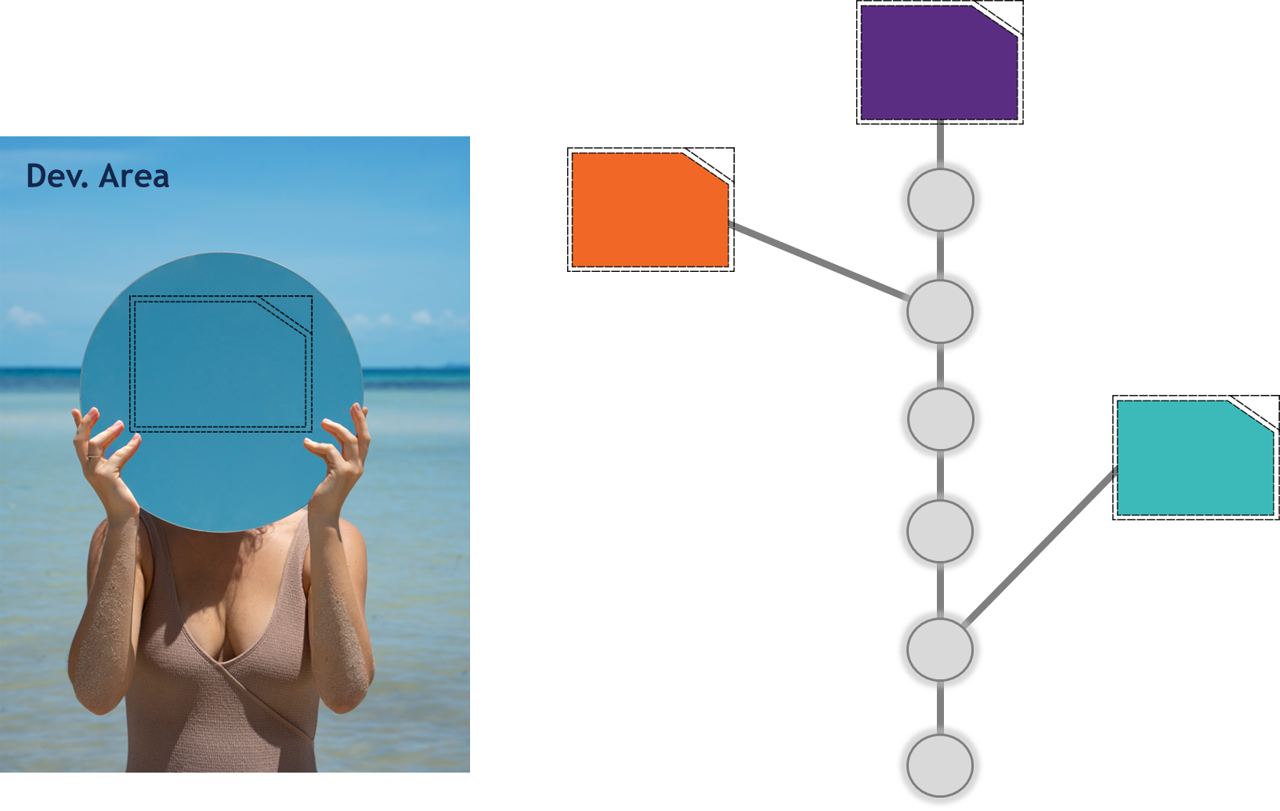
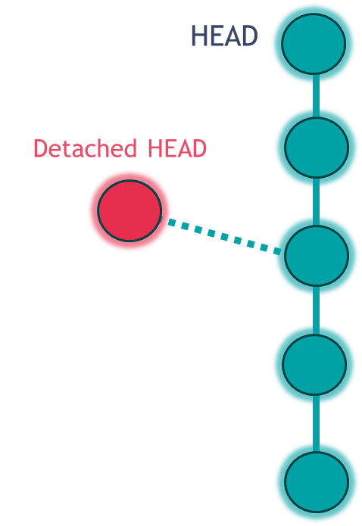
Review
The “mirror” effect
  Folder Content == Branch you are working on
Detached HEAD
  Checking to old commit
  A “floating” branch
  Need to be connected
user$ git switch -c <branch_name>

Slide 59
3 topics
Where do we start?
Working on GitHub
Tagging & Releases
Forking

Slide 60
Tagging
Highlight
good versions

Slide 61
Tagging the commit
user$ git tag <name>
Tag an important commit
  A good version
  A version for release
  A specific feature
  Experiment risk free
  Etc ..

Slide 62
Tagging the commit
user$ git tag <name>
Tag an important commit
  A good version
  A version for release
  A specific feature
  Experiment risk free
  Etc ..
Listing existing tags
  user$ git tag
  user$ git tag –l
  user$ git tag --list

Slide 63
Tagging the commit
user$ git tag <name>
Tag an important commit
  A good version
  A version for release
  A specific feature
  Experiment risk free
  Etc ..
Listing existing tags
  user$ git tag
  user$ git tag –l
  user$ git tag --list
Tag an old commit
  user$ git tag <name> <commit_ID>

Slide 64
Activity
Annotating
  Annotate in your documents about what is the tag used for
  What are the commands
  Commit
Creating tags
  Tag the last commit as “info_tag”
  Choose an old commit and create a tag for it
  List your tags
Challenge: Push your tags to GitHub
  user$ git push --tags

Slide 65
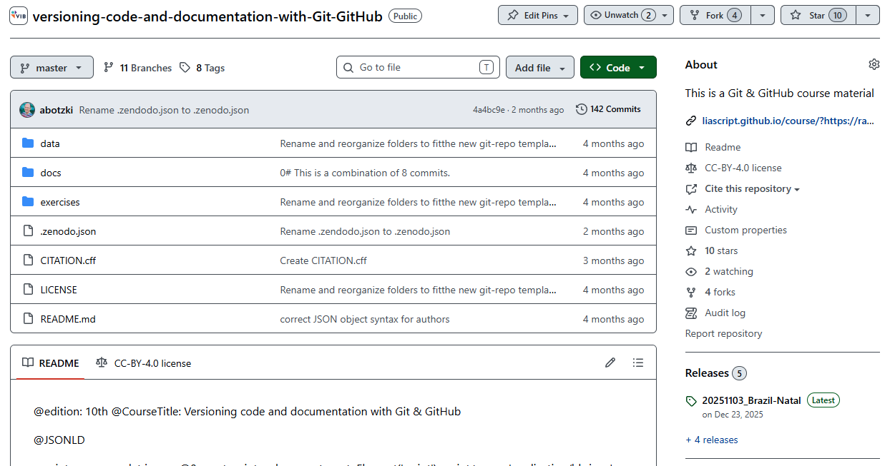
Tags and GitHub releases
Tag == commit “name”
GitHub release

Slide 66
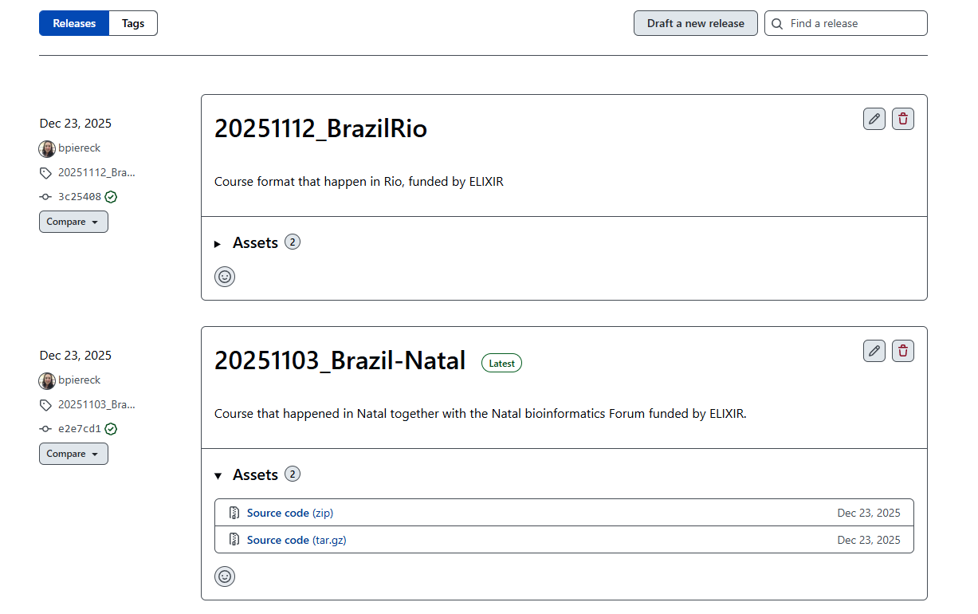
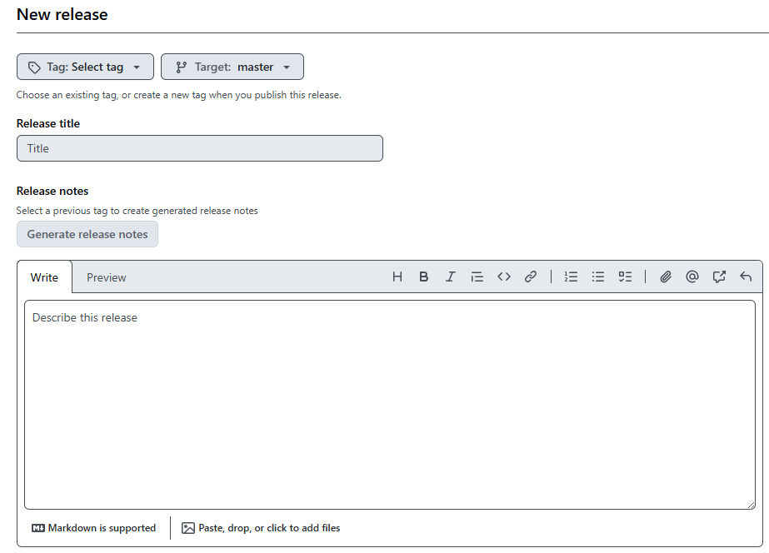
Tags and GitHub releases
Tag == commit “name”
GitHub release
  Are based on tags
  Allow for notes explanations
  Can be sync to Zenodo for DOI

Slide 67
Activity
Create a Release o GitHub

Slide 68
GitHub
Working
Online

Slide 69
Basics on GitHub
Check all branches
Check all commits
Editing
  One-by-one
  Several files
Creating Issues
  List of TODOs
  List of bugs
Tags and Releases

Slide 70
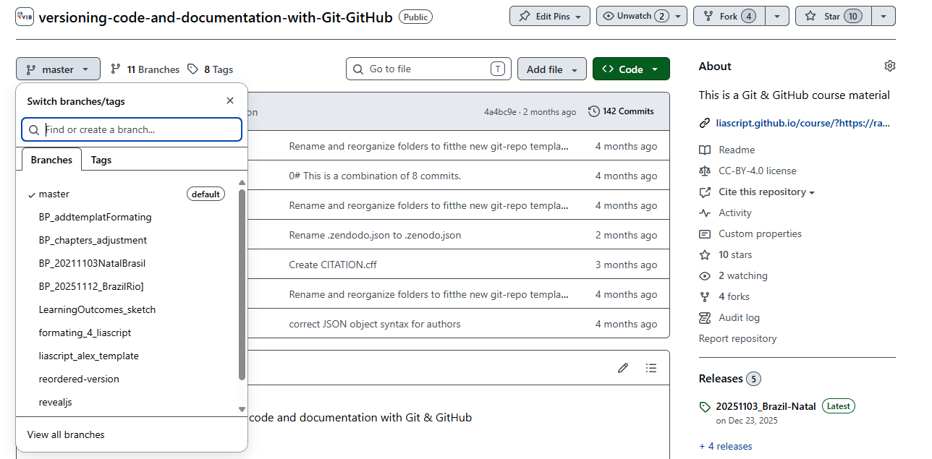
Basics on GitHub
Check all branches
Check all commits
Editing
  One-by-one
  Several files
Creating Issues
  List of TODOs
  List of bugs
Tags and Releases

Slide 71
Basics on GitHub
Check all branches
Check all commits
Editing
  One-by-one
  Several files
Creating Issues
  List of TODOs
  List of bugs
Tags and Releases

Slide 72
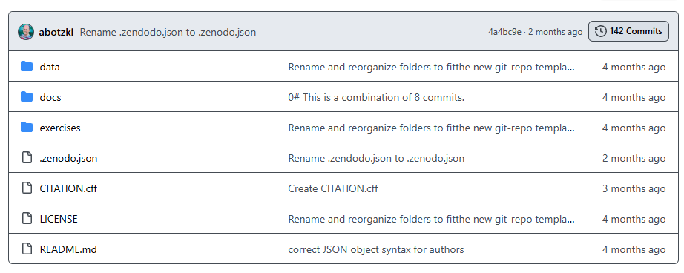
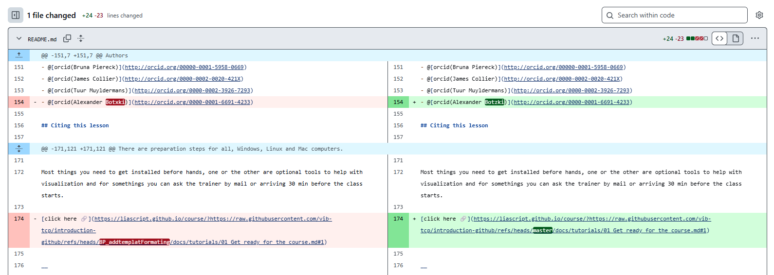
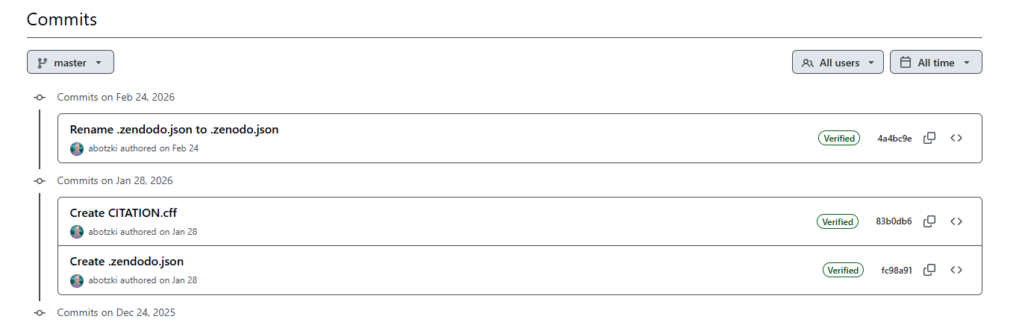
Basics on GitHub
Check all branches
Check all commits
Editing
  One-by-one
  Several files
Creating Issues
  List of TODOs
  List of bugs
Tags and Releases

Slide 73
Basics on GitHub
Check all branches
Check all commits
Editing
  One-by-one
  Several files
Creating Issues
  List of TODOs
  List of bugs
Tags and Releases

Slide 74
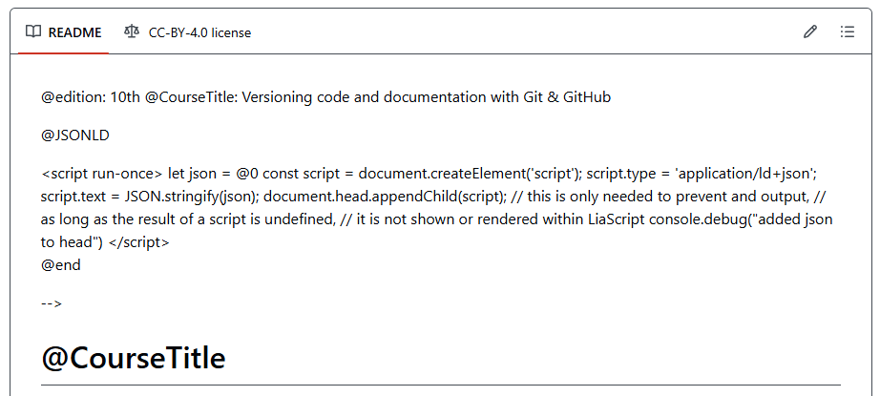
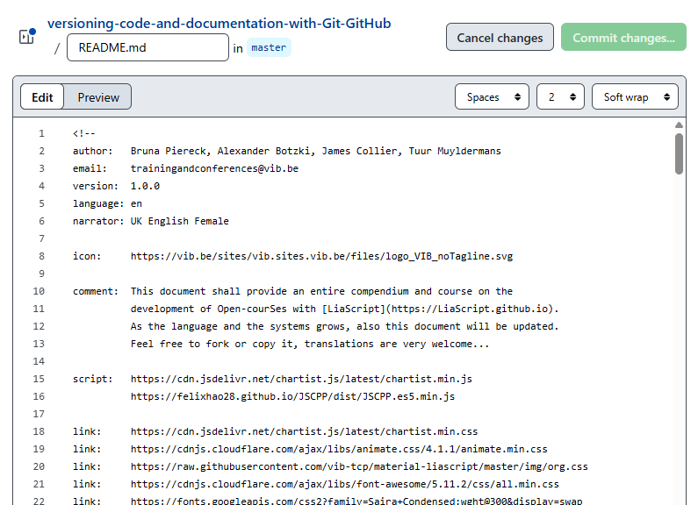
Basics on GitHub
Check all branches
Check all commits
Editing
  One-by-one
  Several files
Creating Issues
  List of TODOs
  List of bugs
Tags and Releases

Slide 75
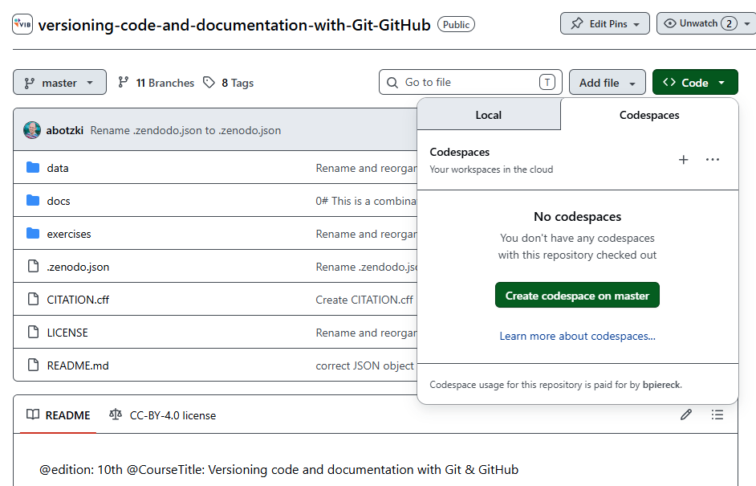
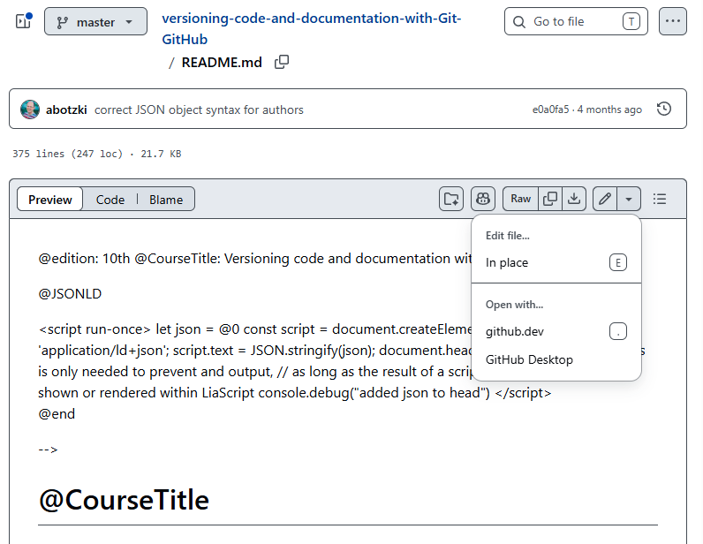

Basics on GitHub
Check all branches
Check all commits
Editing
  One-by-one
  Several files
Creating Issues
  List of TODOs
  List of bugs
Tags and Releases

Slide 76
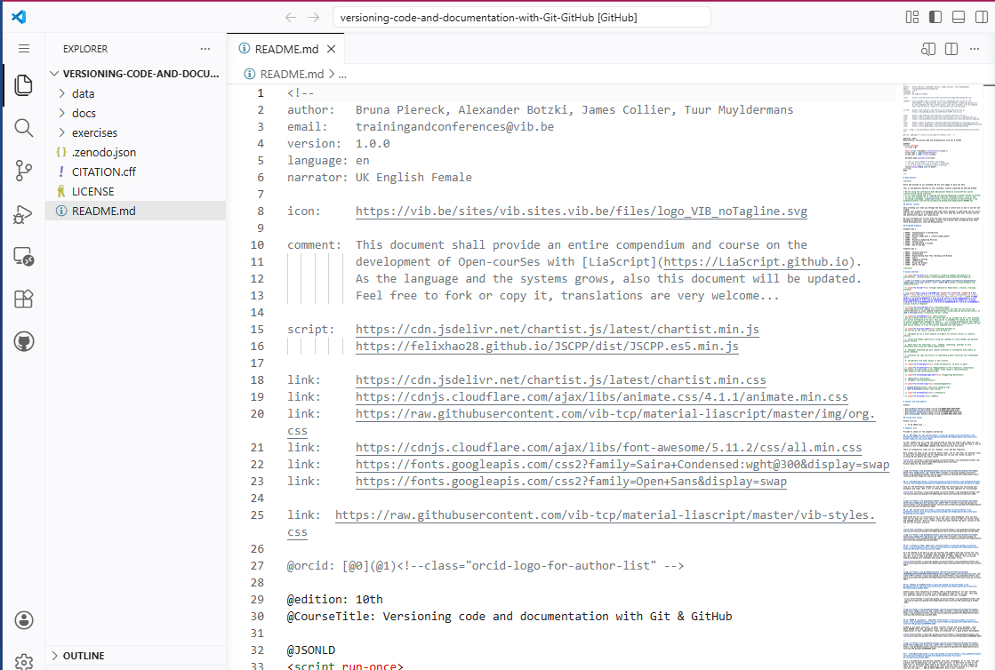
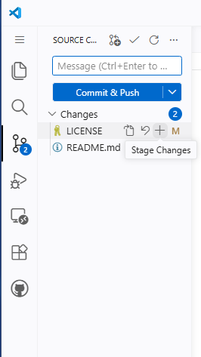
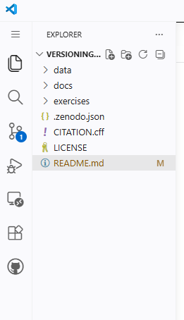
Basics on GitHub
Check all branches
Check all commits
Editing
  One-by-one
  Several files
Creating Issues
  List of TODOs
  List of bugs
Tags and Releases

Slide 77
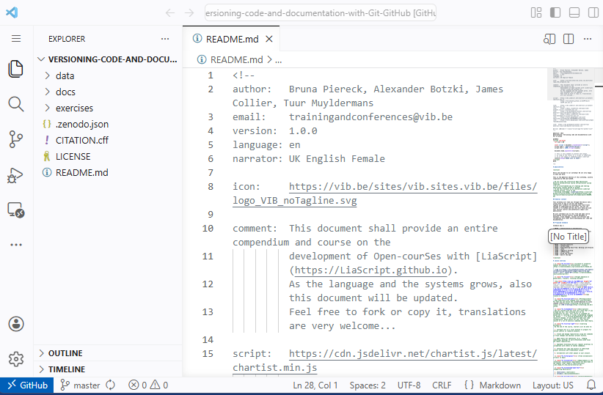
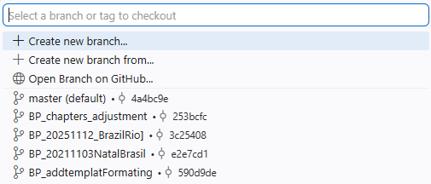
Basics on GitHub
Check all branches
Check all commits
Editing
  One-by-one
  Several files
Creating Issues
  List of TODOs
  List of bugs
Tags and Releases
Branches

Slide 78
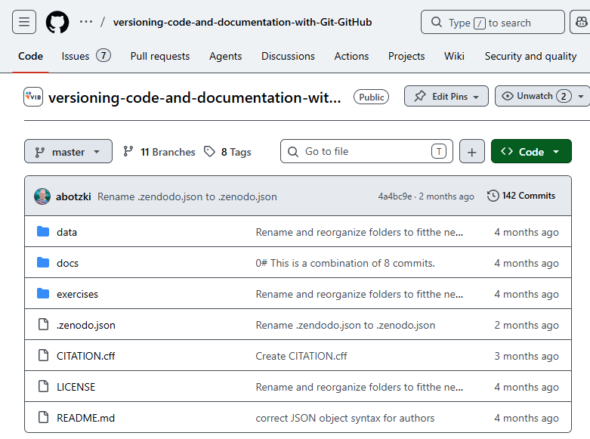
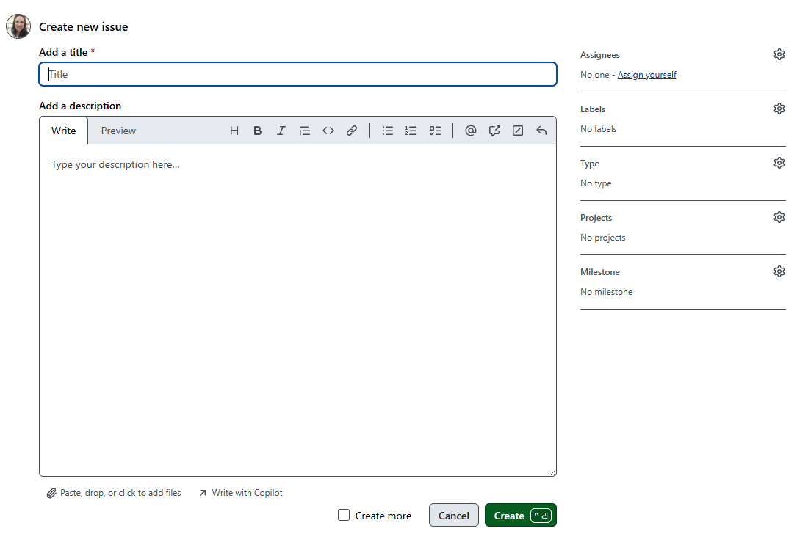
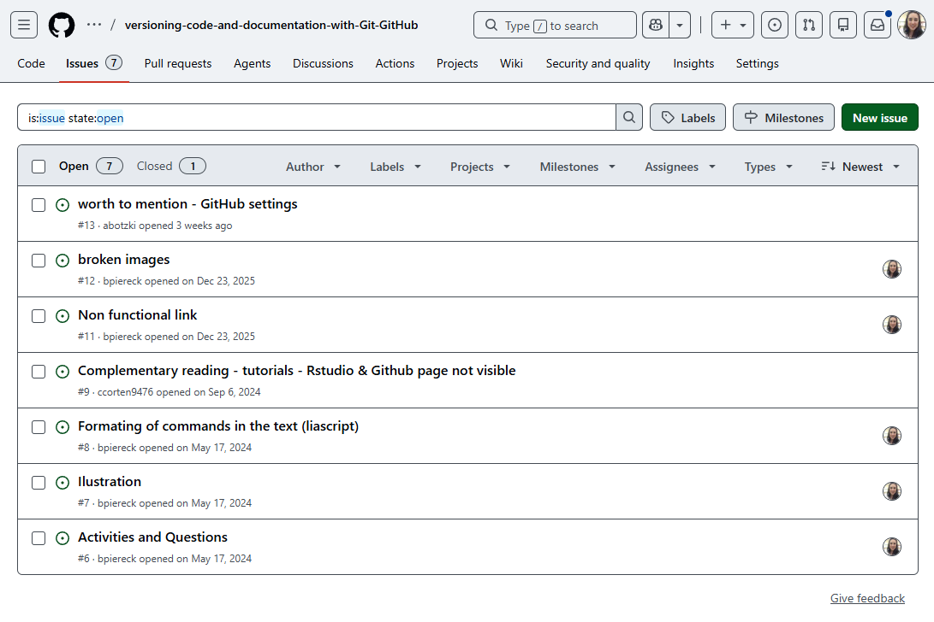
Basics on GitHub
Check all branches
Check all commits
Editing
  One-by-one
  Several files
Creating Issues
  List of TODOs
  List of bugs
Tags and Releases

Slide 79
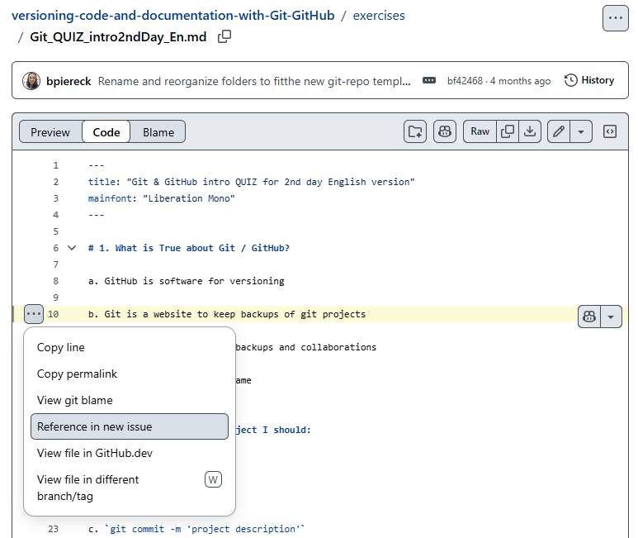
Basics on GitHub
Check all branches
Check all commits
Editing
  One-by-one
  Several files
Creating Issues
  List of TODOs
  List of bugs
Tags and Releases

Slide 80
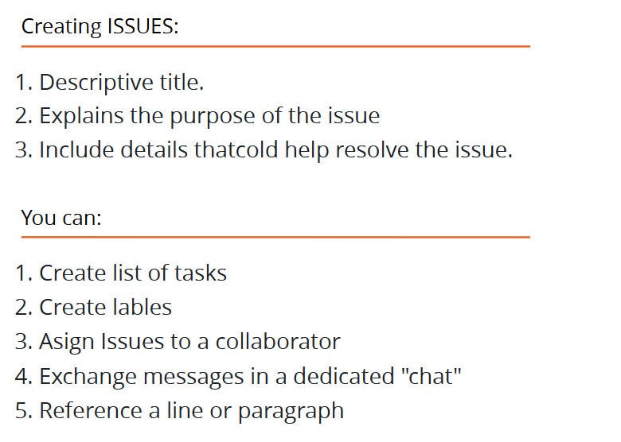
Basics on GitHub
Check all branches
Check all commits
Editing
  One-by-one
  Several files
Creating Issues
  List of TODOs
  List of bugs
Tags and Releases

Slide 81
Basics on GitHub
Check all branches
Check all commits
Editing
  One-by-one
  Several files
Creating Issues
  List of TODOs
  List of bugs
Tags and Releases

Slide 82
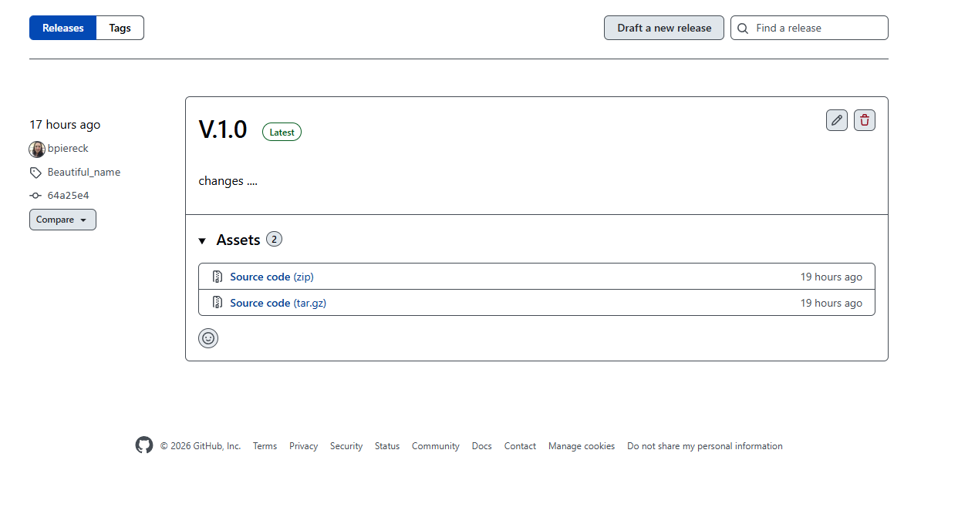
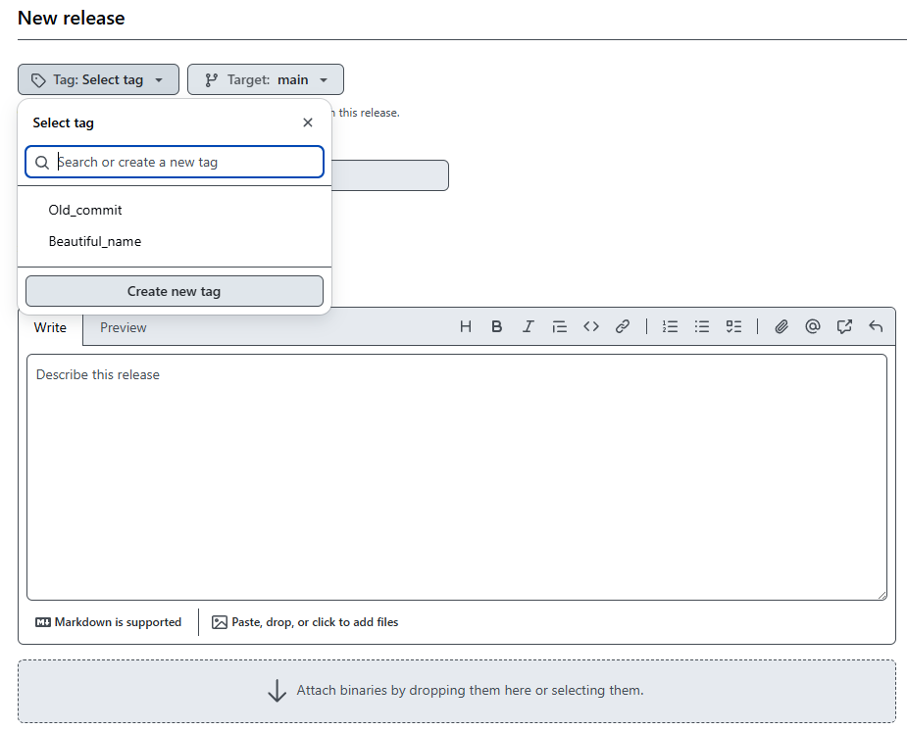
Releases
Se tags from any branch and describe
changes in the new release.

Slide 83

Forking
Copping
repositories

Slide 84
Fork vs Clone
GitHub
Bruna
Alex
Repo 1Br
Repo 2Br
Repo BR_own
Repo 1Al
Repo 2Al
Repo 3Al
Git fork
Bruna Owns
Git clone
Git clone
Bruna Owns
Push & Pull possible
Alex Owns
Push & Pull possible if collaborating
Bruna’s
Computer
Repo 2Br
Repo 3Al

Slide 85
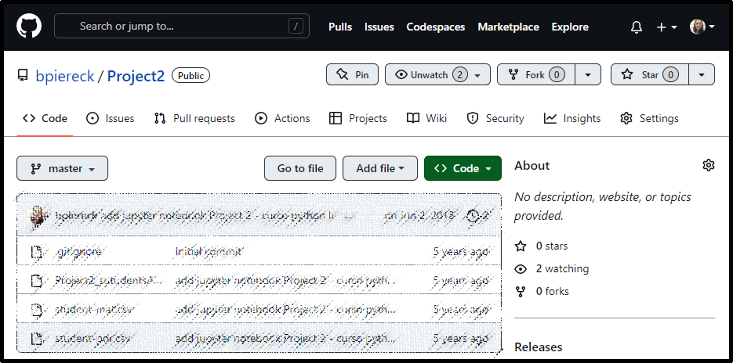
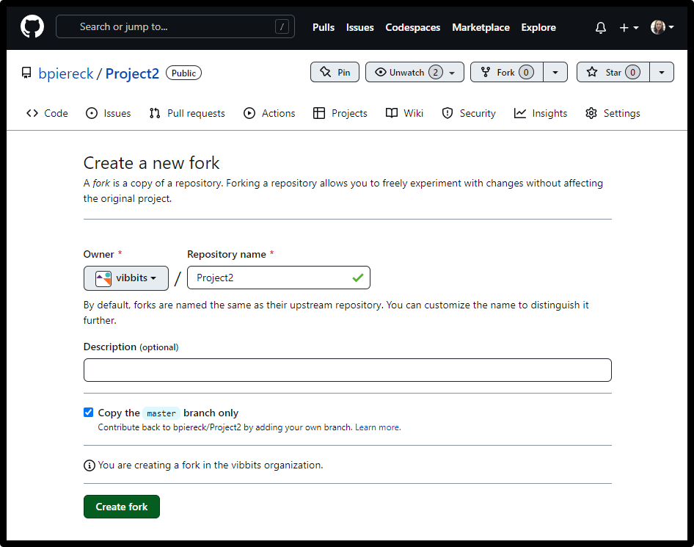

Slide 86
Fork vs Clone
GitHub
Bruna
Alex
Repo 1Br
Repo 2Br
Repo BR_own
Repo 1Al
Repo 2Al
Repo 3Al
Git fork
Bruna Owns
Owner can see
Still connected
Original creator can see it
Changes can be incorporated
  Both directions
    Pull request

Slide 87
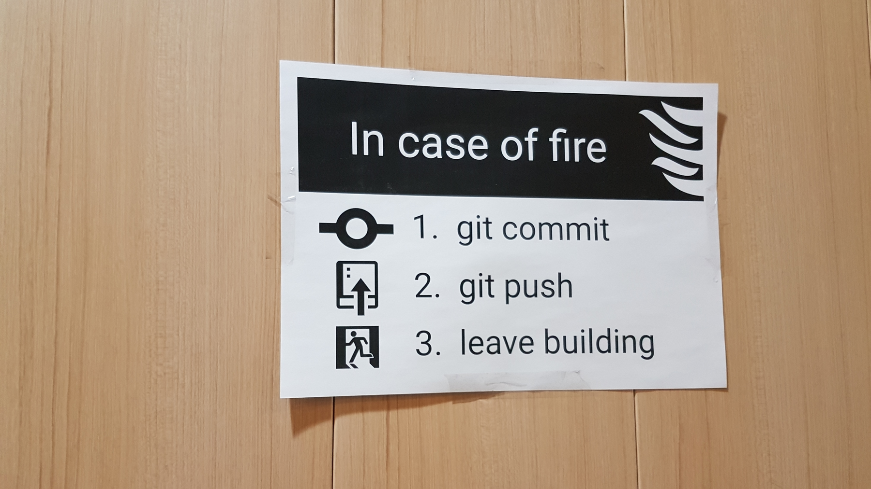
You are ready

Slide 88
Activity
Fork race
  Wait for instructions to be a fair race!
  Add your name to the last line of the README file
  Commit (and wait)
  When instructed ask for a pull requested
    A pull request must be evaluated and accepted

Slide 89
Bruna Piereck
Bruna.piereckmoura@vib.be

Slide 90

Other considerations
Colourblindness: in order to ensure that most of your audience can see differences in colour, use teal vs orange. For more information on how colours look for those with colourblindness, click here!
Trebuchet is the recommended font for VIB presentations. Trebuchet is also easier for those who have dyslexia to read.

Slide 91
02
Resources

Slide 92
Aqua
HEX #02A2A7
RBG 2, 162, 167
Orange
HEX #EC6523
RBG 236, 101, 35
Purple
HEX #693A91
RBG 105, 58, 145
Navy
HEX #14274C
RBG 20, 39, 76
Blue
HEX #1F448F
RBG 31, 68, 143
Cherry
HEX #E83050
RBG 232, 48, 80
Green
HEX #00A14A
RBG 0, 161, 74
Yellow
HEX #F9B418
RBG 249, 180, 24
Tint 01
HEX #29B3B8
RBG 41, 179, 184
Tint 01
HEX #EF7739
RBG 239, 119, 57
Tint 01
HEX #784B9A
RBG 120, 75, 154
Tint 01
HEX #24539F
RBG 36, 83, 159
Tint 01
HEX #EC4D6A
RBG 236, 77, 106
Tint 01
HEX #1AAF5E
RBG 26, 175, 94
Tint 01
HEX #FCC747
RBG 252, 199, 71
Tint 02
HEX #99D7D6
RBG 153, 215, 214
Tint 02
HEX #F7C1A3
RBG 247, 193, 163
Tint 02
HEX #C2AFD0
RBG 194, 175, 208
Tint 02
HEX #A1B2D5
RBG 161, 178, 213
Tint 02
HEX #F6AAB9
RBG 246, 170, 185
Tint 02
HEX #9BD3B3
RBG 155, 211, 179
Tint 02
HEX #FCE39B
RBG 252, 227, 155
Tint 03
HEX #CBEAEC
RBG 203, 234, 236
Tint 03
HEX #FBE8DF
RBG 251, 232, 223
Tint 03
HEX #E3DCEA
RBG 227, 220, 234
Tint 03
HEX #D5DBEC
RBG 213, 219, 236
Tint 03
HEX #FCE3E6
RBG 252, 227, 230
Tint 03
HEX #D1EAD9
RBG 209, 234, 217
Tint 03
HEX #FEF4CF
RBG 252, 244, 207

