Slide 1
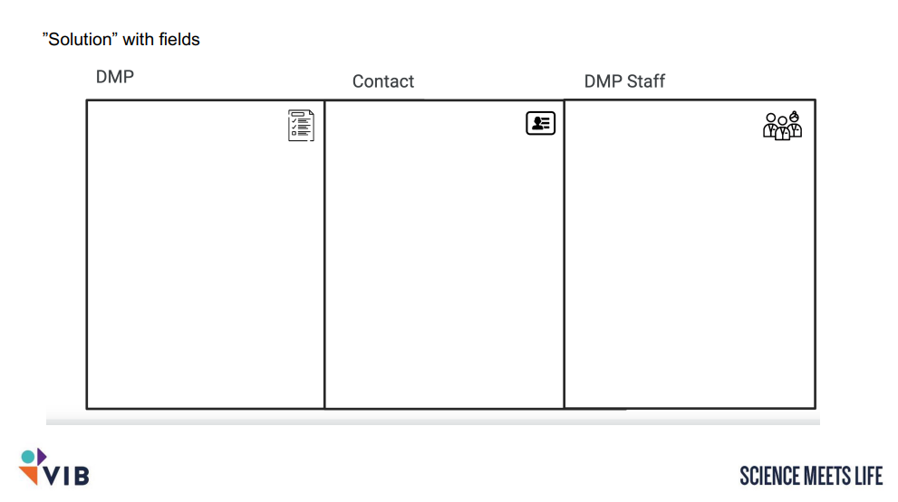
Keywords
Funder
Authors
Contributors
Ethical commit
Data types
Versions
English
E-mails for contact of people involved in the project
Data resp.

