Slide 1
Legal aspects of research data sharing
Dilza Campos, PhD
22/10/2024

Slide 2

Sharing sensitive data in practice
Bob is a researcher working with genomic data in Ugent, he does a
collaboration with Alice, also from UGent
Conditions
Sufficient technical and organisational measures such as pseudonymisation, limitation of access to the data, encryption, ...
Data minimisation must be respected (do not collect more personal data than necessary and do not transmit more personal data than necessary).
If the data was originally collected on the basis of consent, consent must also be requested for reuse.
Document and justify this transfer of data in UGent GDPR register

Slide 3
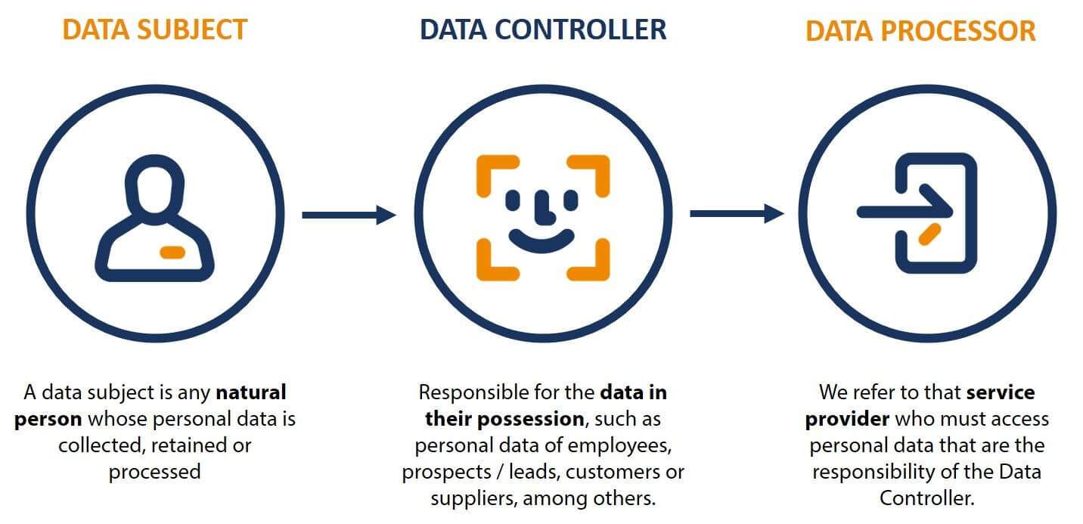
Sharing sensitive data in practice
Alice is a researcher working with genomic data in Ugent, she does a
collaboration with Maria, from another institute in EEA
FURTHER LEGAL REQUIREMENTS

Slide 4
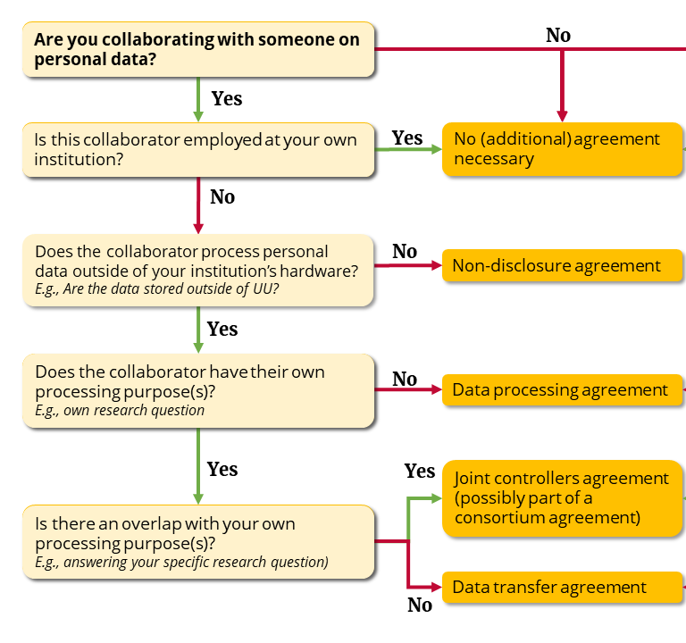
Sharing sensitive data in practice
https://utrechtuniversity.github.io/dataprivacyhandbook/

Slide 5
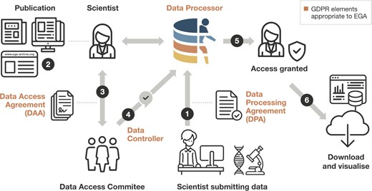
EGA submission process
Submission after a Data Processing Agreement
A scientist discovers the dataset (e.g. through a publication or by navigating the EGA)
The DAC is contacted and a DA is defined
EGA is informed of access permission
Scientist can access the data
Data is downloaded and re-used

Slide 6
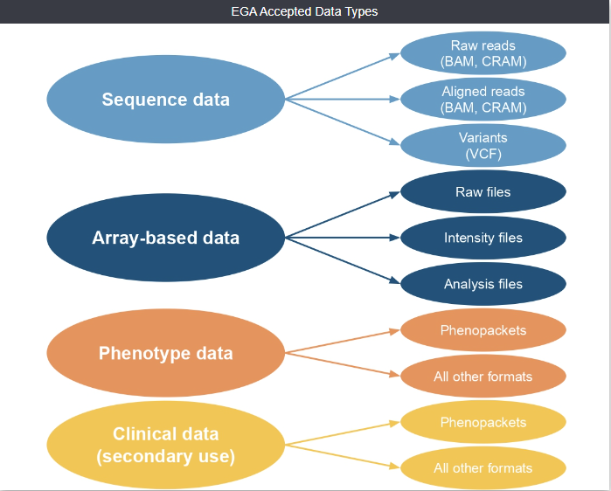
Data types at EGA

Slide 7
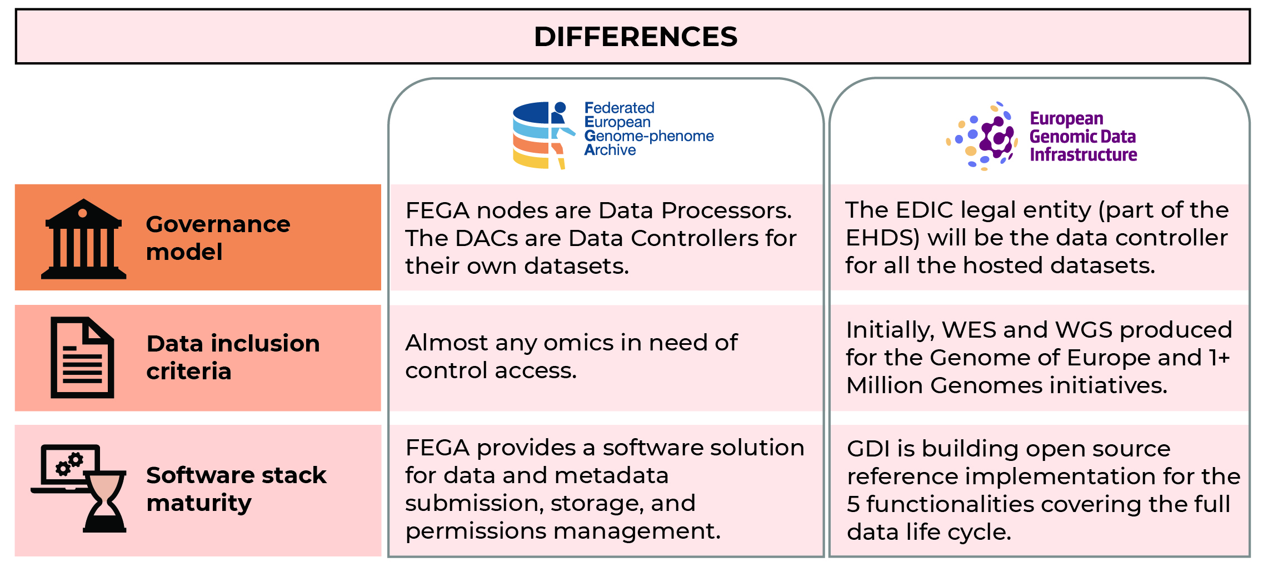
Beyond EGA: FEGA and GDI (2026)

Slide 8


EGA is not the only repository
Generic versus domain-specific repositories
Disciplinary and domain-specific repositories
Should be commonly used and endorsed by the research communities.
Should be recognized internationally.

Slide 9
Guidelines on finding a repository
A persistent identifier (PID) should be assigned to each dataset.
Rich and standardized metadata should be present.
License or terms of use information about the reuse of the data is available or can be determined on the dataset level.
The repository provides broad, equitable and ideally open infrastructure to access content on the platform.
The platform ensures the preservation and continued availability and access to the data and metadata entrusted to it by the users.
Information about the mission, scope, preservation policies and plans is available and transparent.
https://www.kuleuven.be/rdm/en/guidance/data-sharing

Slide 10
Sharing sensitive data in practice
Maria is a researcher working with genomic data in Ugent, she does a
Collaboration with Stewart, from the US

Slide 11
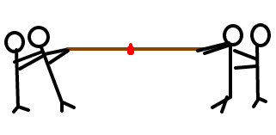
Cross-border data transfer
Movement of personal data to a country outside the European Economic Area (EEA)
Protection X Free movement

Slide 12
Non-EEA
Only allowed if the country or organisation can guarantee an “adequate level of protection” for the processing of personal data.
Who decides on adequacy levels? European Commision
Andorra, Argentina, Canada (commercial organisations), Faroe Islands, Guernsey, Israel, Isle of Man, Japan, Jersey, New Zealand, Republic of Korea, Switzerland , the United Kingdom under the GDPR and the LED, the United States (commercial organisations participating in the EU-US Data Privacy Framework) and Uruguay
https://commission.europa.eu/law/law-topic/data-protection/international-dimension-data-protection/adequacy-decisions_en
Ask help from your institution: DPO, TechTransfer, Legal team to assist and draw the legal documents

Slide 13
Thank you

