Slide 1



Reusing existing data
Thanks to : Korbinian Bösl. (2020, March). DMP-writing-workshop: 2020_03_11_Aas. Zenodo. http://doi.org/10.5281/zenodo.3996086
Alexander Botzki & Bruna Piereck
ELIXIR Belgium Training Coordinator
June 2023

Slide 2

Where do you look for your data?

Slide 3













Where do you look for your data?
Generic sources
Dedicated sources
Publications
OmicsDI

Slide 4
Where do you look for your data?
Is there any other pages you look into?

Slide 5



How do I know that I can reuse the data? Licenses to your rescue!
How do I know that I can reuse the data?
Allows deposition/mirroring in 2nd databases (Findability)
Legal security for users (Accessibility)
Increase of willingness to reuse outputs (Reusability)

Slide 6
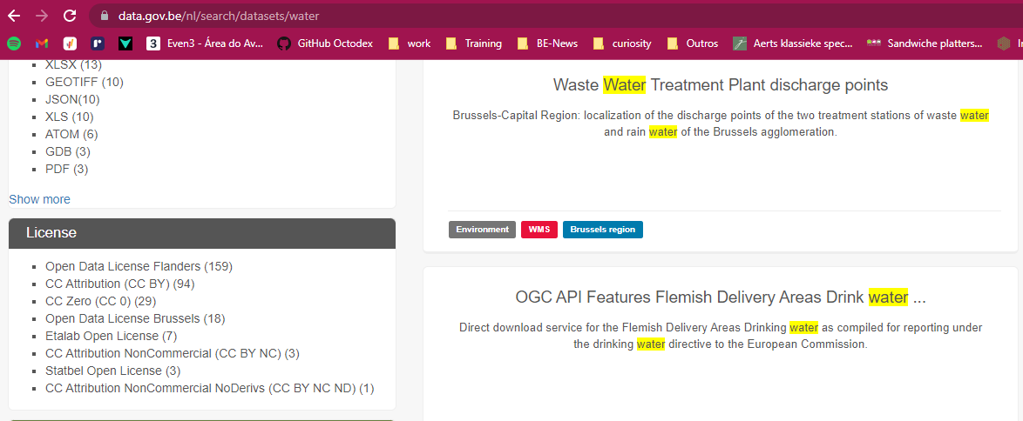
When (re)using data, it is important:
License/Policies
Acknowledge source
Metadata
Data quality

Slide 7
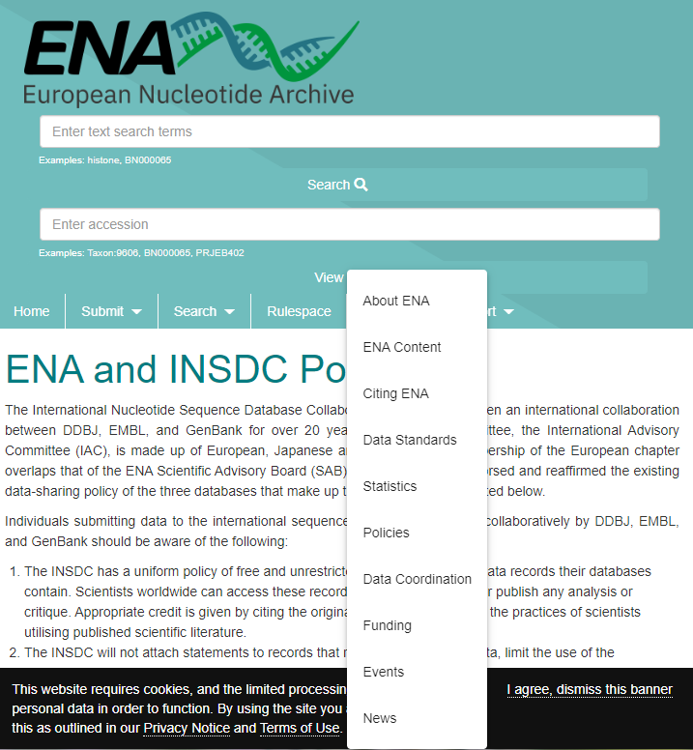
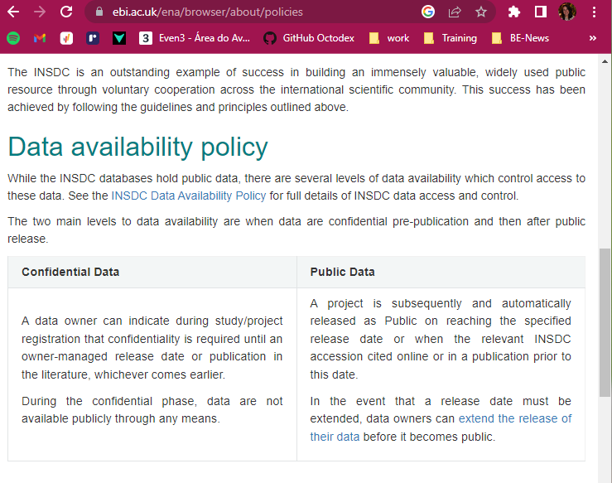
When (re)using data, it is important:
License/Policies
Acknowledge source
Metadata
Data quality

Slide 8
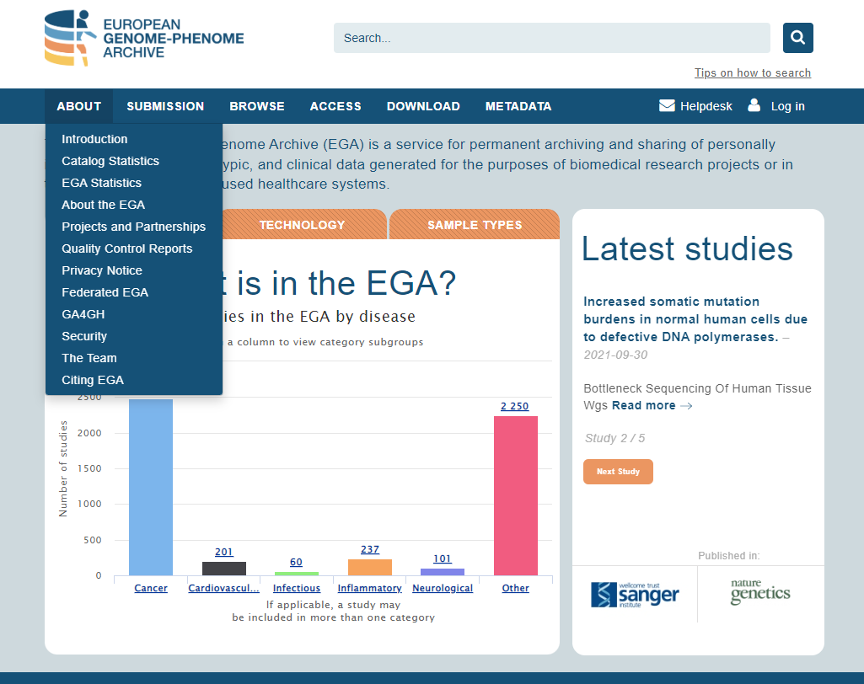
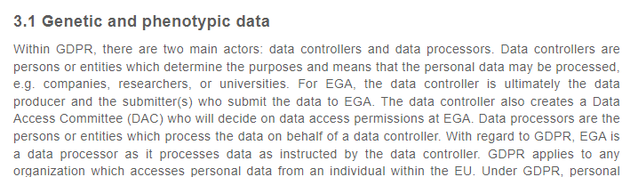
When (re)using data, it is important:
License/Policies
Acknowledge source
Metadata
Data quality

Slide 9
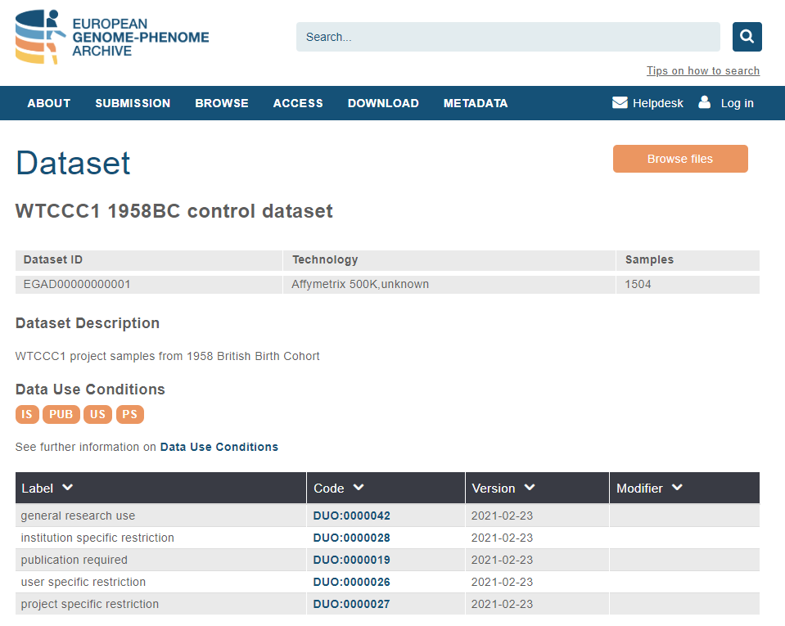
When (re)using data, it is important:
Use of data is limited to approval for:
IS: Institution
US: Users
PS: Projects
PUB: Results MUST be public for large scientific community
Notes:
https://ega-archive.org/datasets/EGAD00000000001

Slide 10





Concepts in open licenses
No conditions stated! Most open.
Credit for the original creators
New creations must be shared under the same therms
Only non-commercial use
Non derivatives or adaptations are allowed, only re-use in original form
Icons CC-BY 4.0 https://creativecommons.org/

Slide 11
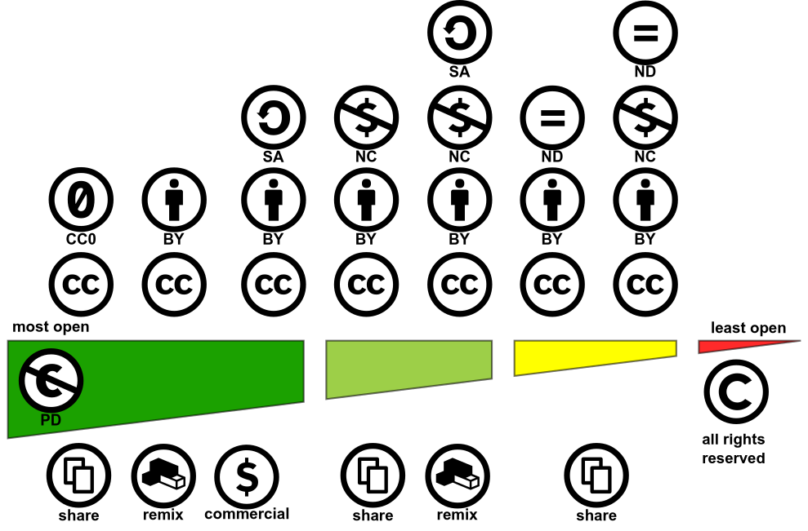

https://creativecommons.org/share-your-work/cclicenses/
CC-BY 4.0 Shaddim; original CC license symbols by https://creativecommons.org/
https://creativecommons.org/choose

Slide 12
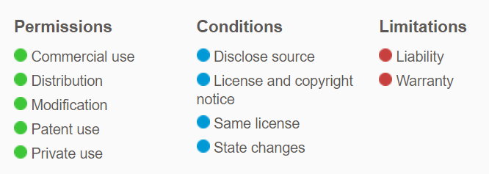


Open Source Software Licenses
GNU GPLv3:
GNU AGPLv3: Complete source code modifications need to be available
GNU LGPLv3: Large modifications can be distributed under different license.
MIT license: No attribution license
Apache 2.0 ~ GNU PLv3
https://opensource.org/licenses
https://choosealicense.com/
BSD licenses
Notes:
SPEX = overview of license type
Recommend some in the list
Organisations policy with recommendations (TUDelft)

Slide 13
When (re)using data, it is important:
License/Policies
Acknowledge source
Metadata
Data quality
Paper citation
Database citation
Unique ID
Collaborators
Clear link for dataset
Dataset version

Slide 14
When (re)using data, it is important:
License/Policies
Acknowledge source
Metadata
Data quality
Study
Samples
Experiments
Analysis
Notes:
Activity with examples to search or all this information and copy somewhere

Slide 15
Where do you look for your data?
Generic sources
Dedicated sources
Publications
OmicsDI

Slide 16
Now, try to look for info in
your favorite DBs
What does the License/Policies says?
How can you acknowledge the source ?
Is the metadata linked? Do you have directions to find it?
Notes:
Activity with examples to search or all this information and copy somewhere

Slide 17
A good example to reflect on

Slide 18
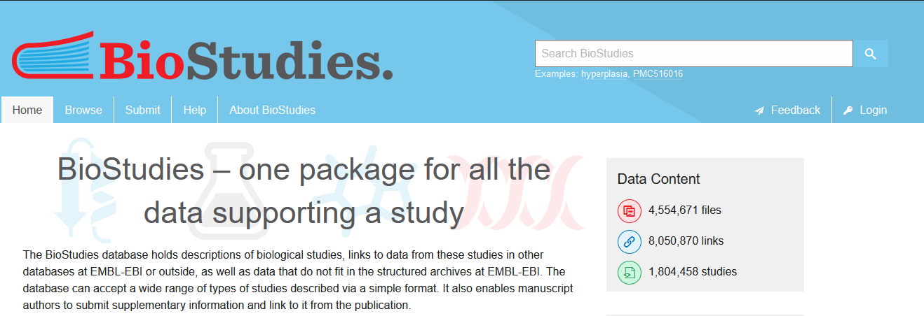

Slide 19
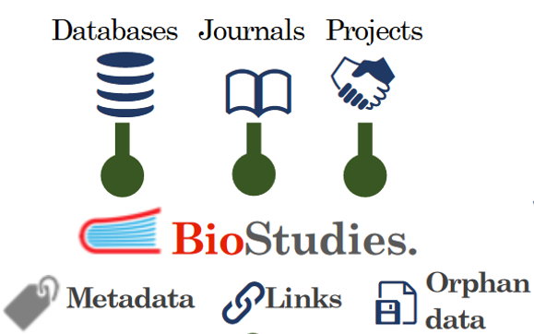
Biostudies
ingest
(
)
package
integrate

Slide 20


Example
Let’s look at this paper
What data are associated to this paper?
DOI: 10.1128/AEM.00675-10 https://aem.asm.org/content/76/22/7373
what data are in various community databases?
are all associations of the same nature?
what other data are attached to this paper?

Slide 21
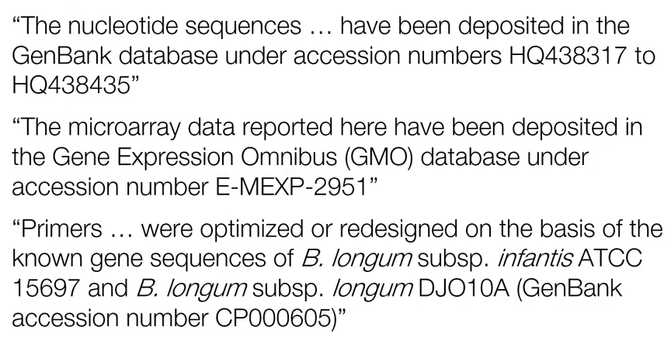
Example – what did we find out?
Notes:
Biostudies - example extraction problem ….

Slide 22
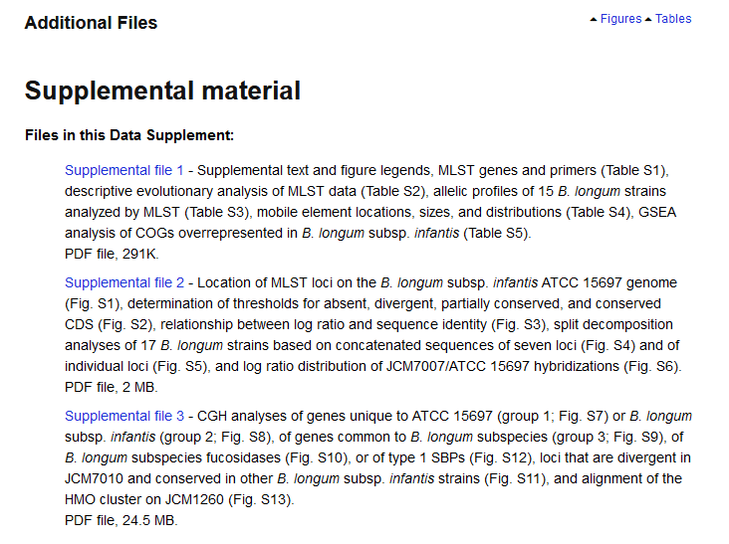
Example – and the supplementary material
Notes:
Biostudies - supl. material clicable

Slide 23
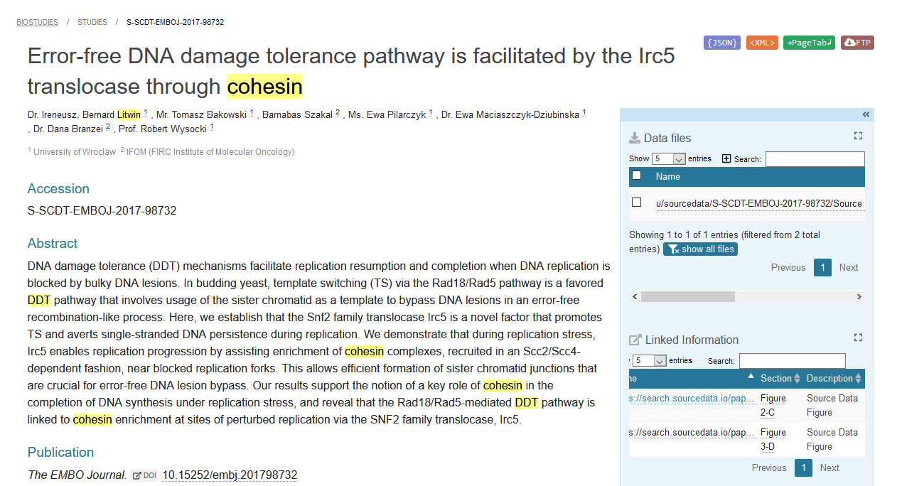
The overview of another article with source data
S-SCDT-EMBOJ-2017-98732
Notes:
https://www.ebi.ac.uk/biostudies/sourcedata/studies/S-SCDT-EMBOJ-2017-98732

Slide 24
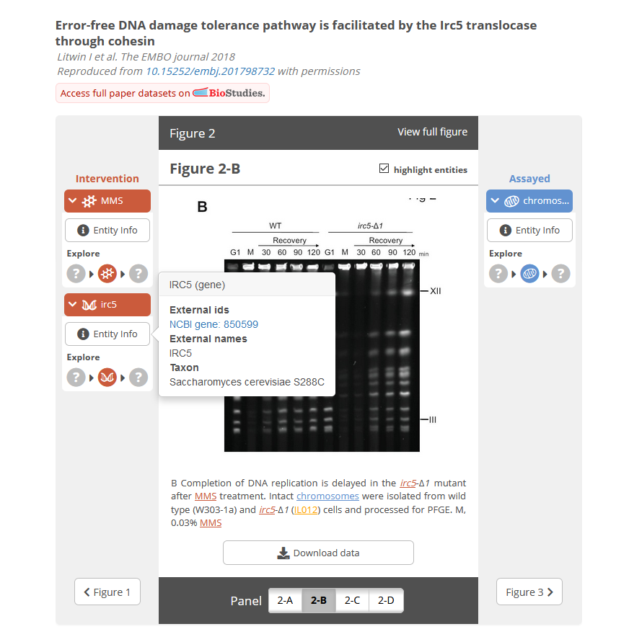
A lot of additional work but a dream to browse through

Slide 25
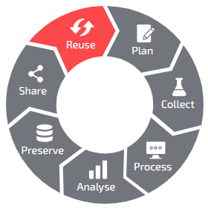
Thank you
Bruna Piereck VIB & ELIXIR- BE Training Coordinator
June 2023
bruna.piereckmoura@vib.be
Image data_life_cycle: https://rdmkit.elixir-europe.org

