Slide 1
Documentation and Metadata
12-12-2022
Alexander Botzki

Slide 2
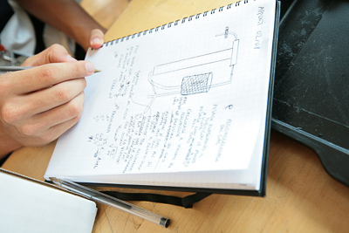
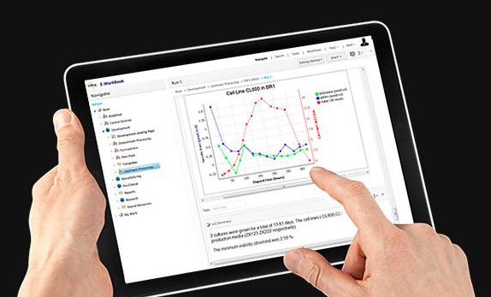
Why would I use an ELN for documentation?
Paper replacement
Project-based system
Share data
Experiments, protocols, ...
Standardization of experiments
Templates
Intellectual property protection
Data stored in central database
Eventually Office integration
MS Office: Word, Excel, PowerPoint
Search function
Advanced search

Slide 3










Project-based system
Project
Notebook Subproject
Experiment
Section
User
User Configuration
Templates, View Folder, …
VIB Research Center
Lab/User group
Group Project
Group Configuration
Templates, Reagents Folder, …
Notes:
What type of information would you document on the various levels?
What is missing on this slide?

Slide 4
General consideration with the publishing in mind
Write the documentation in such a way that someone else who is known to the field can not mis-interpret any of the data, even if they tried.
Documentation at two levels
Project/Study level: title, summary, aims, authors, funds, methods, license and id for data sets, folder structure, file naming
Data-level documentation
Both the study- and data-level documentation must be generated as early as possible in the research process and also maintained, in order to be accurate and complete
https://rdmkit.elixir-europe.org/metadata_management

Slide 5
Our guide for today’s session
HyDrop-RNA single-cell library preparation
https://pubmed.ncbi.nlm.nih.gov/35195064/
Exercise 1 Documentation at project level

Slide 6
How to write useful documentation?
Exercise 2 wet lab protocols
The resulting emulsion was collected in aliquots of 50 μL total volume and thermocycled according to the RT program (42°C for 90 min, 11 cycles of [50°C for 2 min, 42°C for 2 min], 85°C for 5 min, followed by a final hold on 4°C). 125 μL of recovery agent (20% PFO in HFE), 55 μL of GITC Buffer (5 M GITC, 25 mM EDTA, 50 mM Tris-HCl pH 7.4) and 5 μL of 1 M DTT was added to each separate aliquot of 50 μL thermocycled emulsion and incubated on ice for 5 min.

Slide 7
Annex exercise 2
https://www.protocols.io/view/hydrop-rna-v1-0-dm6gpwqjjlzp/v2?step=5 While RT is on, you can prepare GITC buffer and other components necessary in the later steps. Droplet Breaking and Purification
Now, we will break all the droplets and purify the cDNA, which is the result of our in-droplet reverse transcription reaction.
https://www.protocols.io/view/hydrop-rna-v1-0-dm6gpwqjjlzp/v2?step=6.1

Slide 8
How to document scripts and code
Exercise 2 part 2 data analysis scripts Barcode reads were trimmed to exclude the intersub-barcode linear amplification adapters using a mawk script. Reads were then mapped and cell-demultiplexed using STARsolo (Kaminow et al., 2021) in CB_UMI_Complex mode. The resulting STARsolo-filtered count matrices were further analyzed using Scanpy (Wolf et al., 2018). In short, cells were filtered on expression of a maximum of 4000 genes, and a maximum of 1% UMIs from mitochondrial genes. Genes were filtered on expression in a minimum of three cells. Potential cell doublets were filtered out using a Scrublet (Wolock et al., 2019) threshold of 0.25.

Slide 9
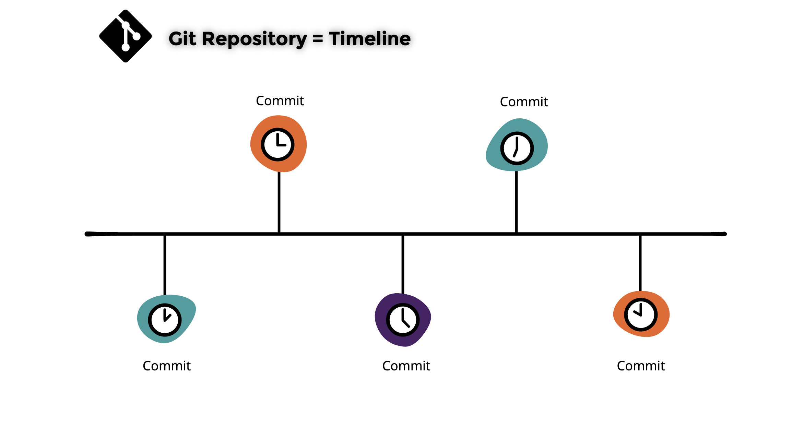
Data analysis scripts under version control
The best possible way of documenting scripts and code for software is using git and github (or alternative online ‘backup’ solution to github).

Slide 10
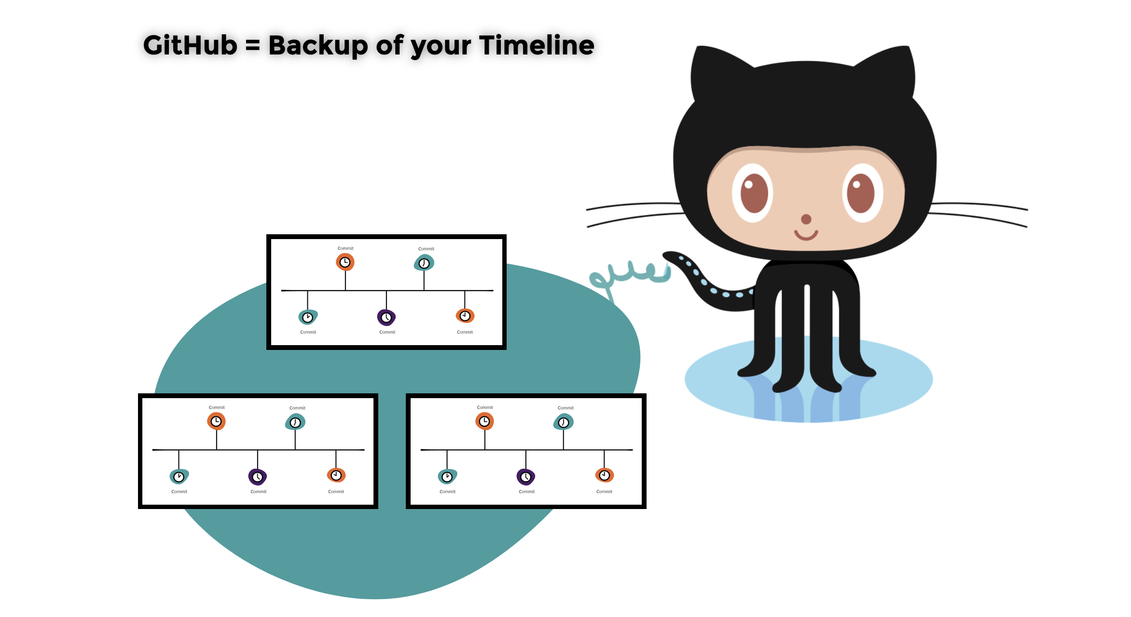
Data analysis scripts under version control
The best possible way of documenting scripts and code for software is using git and github (or alternative online backup solution to github).
Notes:
git clone https://github.com/aertslab/hydrop_data_analysis.git
Launch ungit in the folder /Users/albot/hydrop_data_analysis

Slide 11
What’s in the paper? Zoom in on metadata
Data availability The data discussed in this publication have been deposited in NCBI's Gene Expression Omnibus and are accessible through GEO Series accession number GSE175684
A copy is available in the European Nucleotide Archive at PRJNA733185

Slide 12
What do you know about metadata?

Slide 13
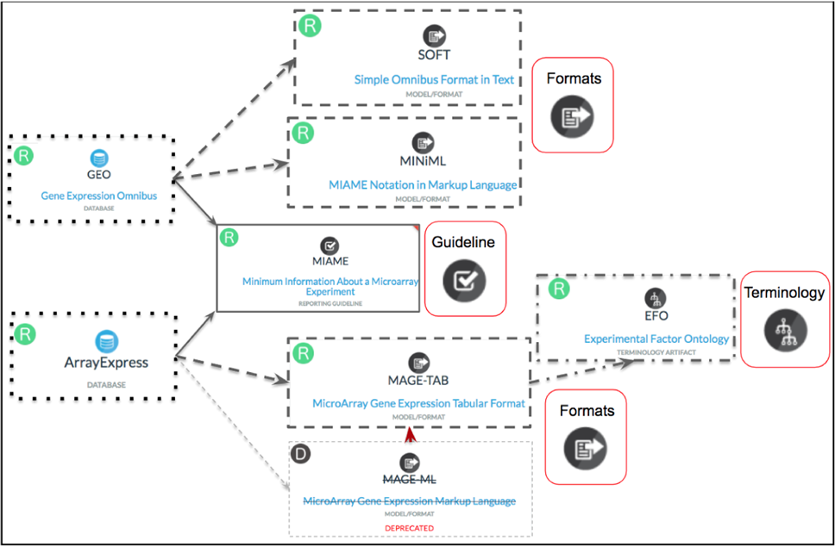
First a short excursion to nomenclature
Metadata model
Metadata checklist
https://doi.org/10.1038/s41597-022-01707-6

Slide 14
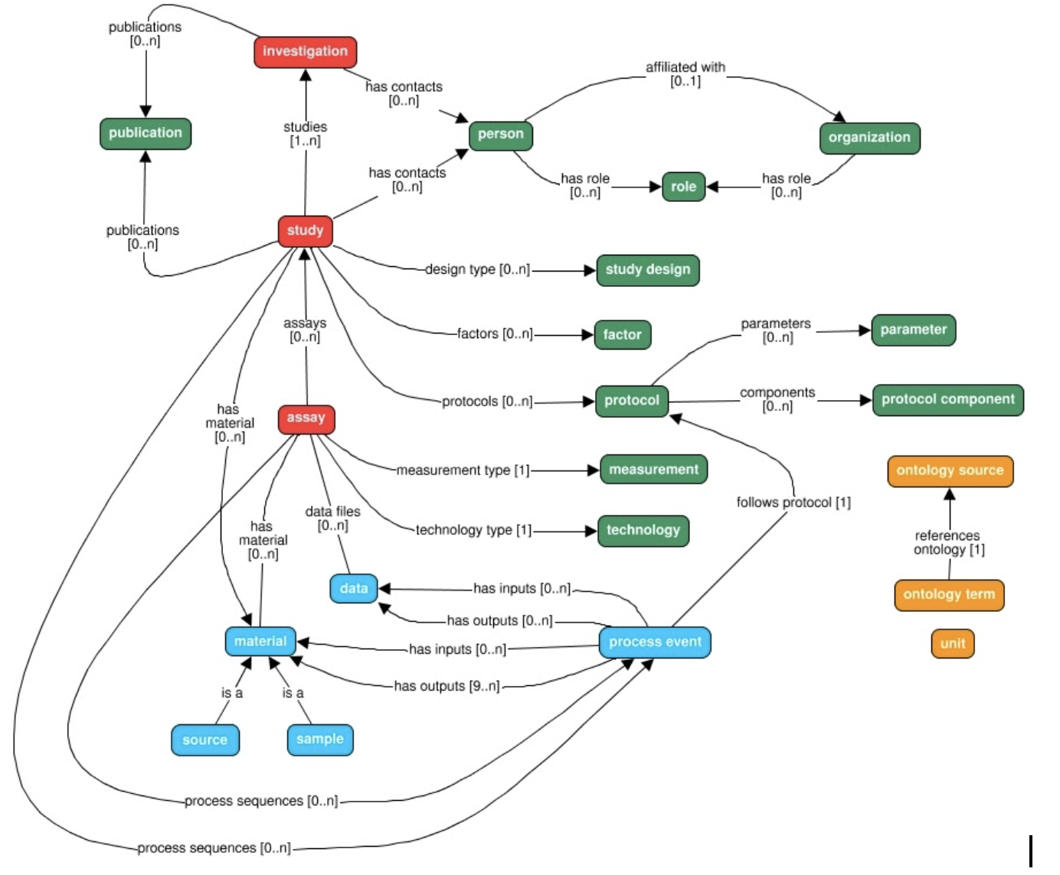
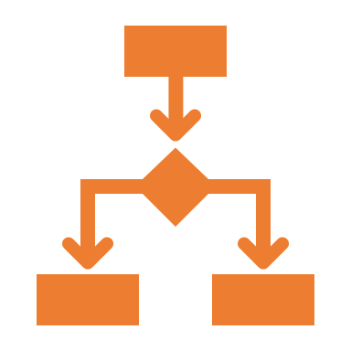
There are many metadata models
https://isa-tools.org/isa-api/_images/isa-model.png

Slide 15
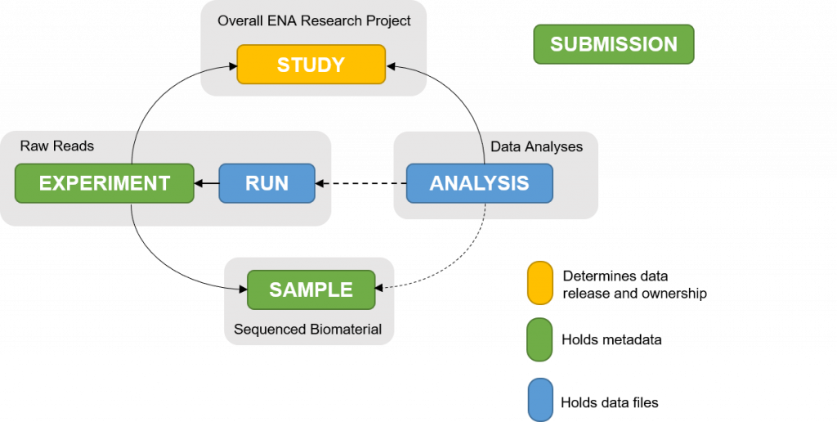
ENA’s metadata model

Slide 16

Let’s focus on the metadata checklists
From ENA
ELIXIR's Fair Cookbook for transcriptomics data
Exercise 3 Let’s fill in the metadata based on the paper

Slide 17
External references
Harvard Comparison Grid: https://datamanagement.hms.harvard.edu/electronic-lab-notebooks
NKI: LabGuru for Wetlab and Castor for Clinical Data Capature
MDC and BIH – LIMS is available, RDM SODAR (Omics data)

Slide 18
Documentation and support
VIB & ELIXIR Support
bits@vib.be
Research Data Service Facility will be set up in 2023
ELIXIR services - usegalaxy.eu More information at: https://www.elixir-belgium.org/services

Slide 19





What did we cover today.
implement SOP type of approach for your daily documentation of experiments
describe the impact of documentation on the publication preparation
make versioning more persistent by using protocols.io and/or your Electronic Lab Notebook
use github for scripts and code
apply at least minimal metadata standards for domain-specific data

