Slide 1


A closer look at the repositories’ world
Alexander Botzki
ELIXIR Belgium Training Coordinator
December 2022
Thanks to Korbinian Bösl. (2020, March). DMP-writing-workshop: 2020_03_11_Aas. Zenodo. http://doi.org/10.5281/zenodo.3996086 @UGentRDM

Slide 2

Where should I deposit my data?
molecular biology
~1650 databases
Rigden, D. J. & Fernández, X. M.
The 27th annual Nucleic Acids Research database issue and molecular biology database collection. Nucleic Acids Res 48, D1–D8 (2020).

Slide 3


Where should I deposit my data?
fairsharing.org
re3data.org

Slide 4


Where should I deposit my data?
Free of charge
Quick upload (Aspera)
Not operated by single university/government
Guided submission process
Generous embargo regulation (2yrs → )
API access (upload to ENA via Galaxy)
elixir-europe.org/platforms/data/core-data-resources
elixir-europe.org/platforms/data/elixir-deposition-databases

Slide 5











Where should I deposit my data?
...
elixir-europe.org/platforms/data/core-data-resources
elixir-europe.org/platforms/data/elixir-deposition-databases

Slide 6



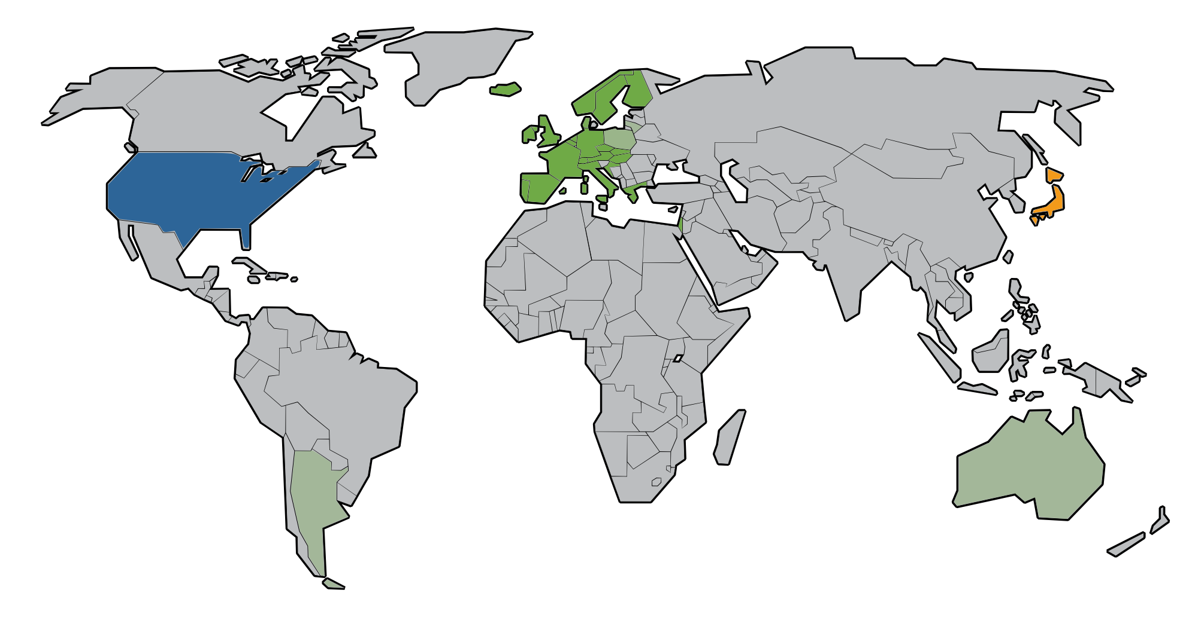


2017
SRA
Multiple Repositories – similar datatypes

Slide 7

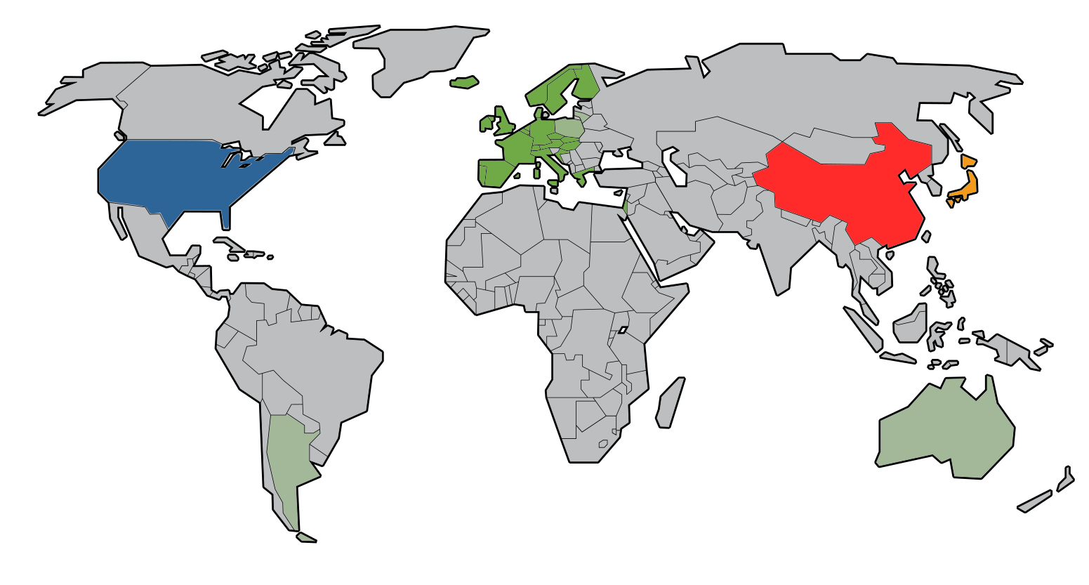





https://doi.org/10.1093/nar/gkz984

Slide 8


Meta data standards
MINSEQE
MIAME
...
’SRA-XML’
HUPO-PSI TraML
MIAPE
...

Slide 9
Data format standards
FASTQ
MAGE-ML
...
FASTA
FASTQ
...
mzML
mzQuantML
...
Support from VIB Core facilities and VIB Center Bioinformatics services and Research Data Service Facility
https://www.ebi.ac.uk/training/online/

Slide 10
Exercise
- Upload one sample with the metadata to ENA test server
- Use metadata from yesterday’s session ‘Documentation’

Slide 11
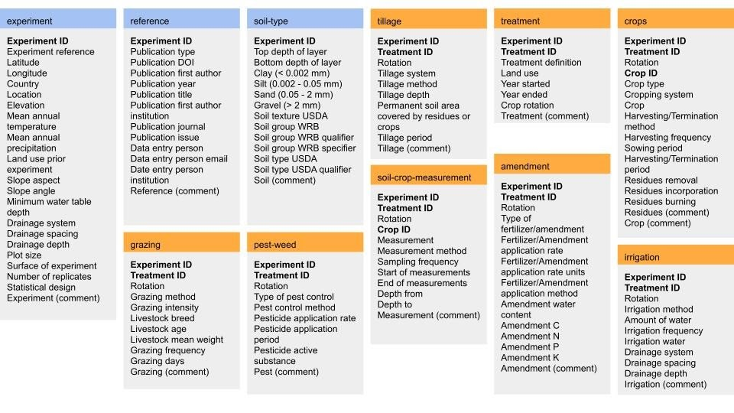
Other data specialised repositories
Provision of Metadata of European Agricultural Long-Term Experiments through BonaRes and EJP SOIL Collaboration

Slide 12

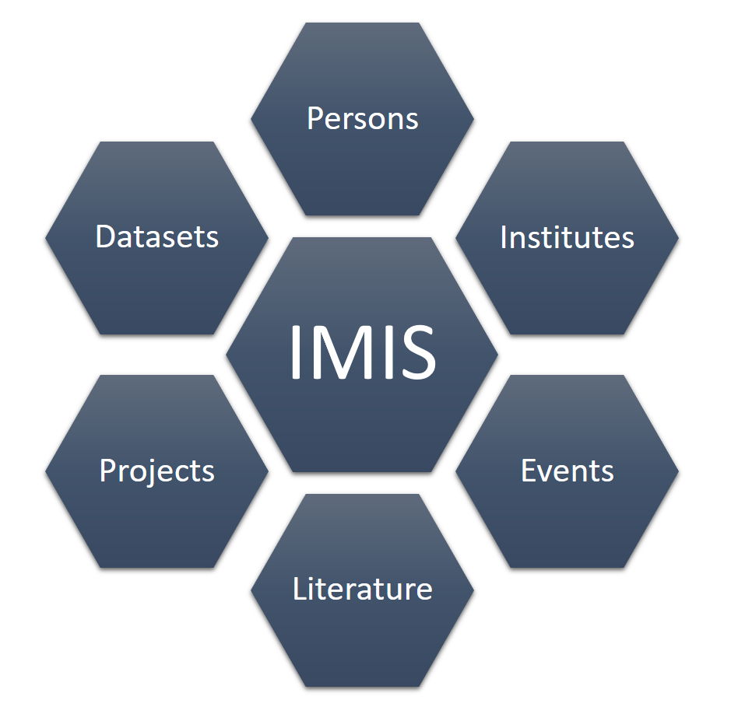

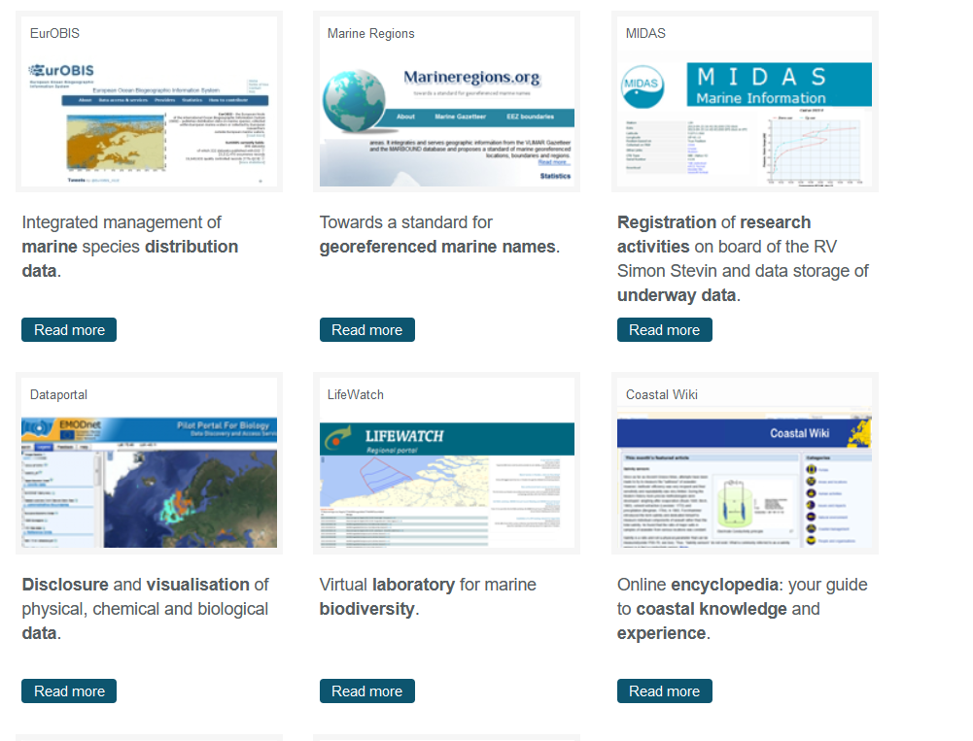
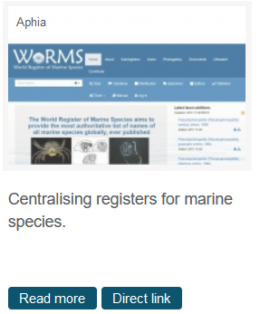
VLIZ data submission
DOI service for datasets
http://www.vliz.be/en/data-submission
VLIZ services for data: http://www.vliz.be/en/datasystems
Questions: data@vliz.be
data@vliz.be
DOI

Slide 13








Repository | Link | Data type | DOI or other PID | Certification or assessment | Federation/integration | Embargo? | Restricted access?
 | https://www.pangaea.de/ | Georeferenced data from earth system research | DOI | Core Trust Seal | No | Yes | No
 | https://portal.edirepository.org/ | Environmental Data Initiative Data Portal. Data from studies of ecological processes | DOI | No | No | Yes | Yes
 | https://data.4tu.nl/portal | Data from all fields and subjects in science, engineering and design. Atmospheric and environmental research overrepresented. | DOI | Data Seal of Approval | No | Yes | Yes (i)
 | https://nomad-lab.eu/services/repo-arch | Material science data | DOI | No | No | Yes | No, CC-BY 4.0
 | https://ieee-dataport.org | Communications, Computational Intelligence, Computer Vision, Geoscience and Remote Sensing, Image Processing, etc. | DOI | No | No | No | Yes
 | https://www.hydroshare.org | Data, models and tools for hydrologic science | DOI | No | No | No | Yes
 | Data Observation Network for Earth, https://www.dataone.org | A network of data repositories for environmental science data. | DOI | No | Yes | NA | NA
 | Global Biodiversity Information Facility https://www.gbif.org | International network and data infrastructure for open access to data about all types of life on Earth. | DOI | World Data System | Yes | NA | NA
 | https://jupyter.org/ https://codeocean.com/ https://github.com | Software, scripts, data analysis workflows and pipelines, notebooks | DOI (when github repo is deposited in Zenodo) | No | No | NA | NA
https://www.re3data.org/

Slide 14


What about sensitive data?
Central metadata accessibility
Secure storage
Implemented data access committees
Local EGA in development
ega-archive.org

Slide 15
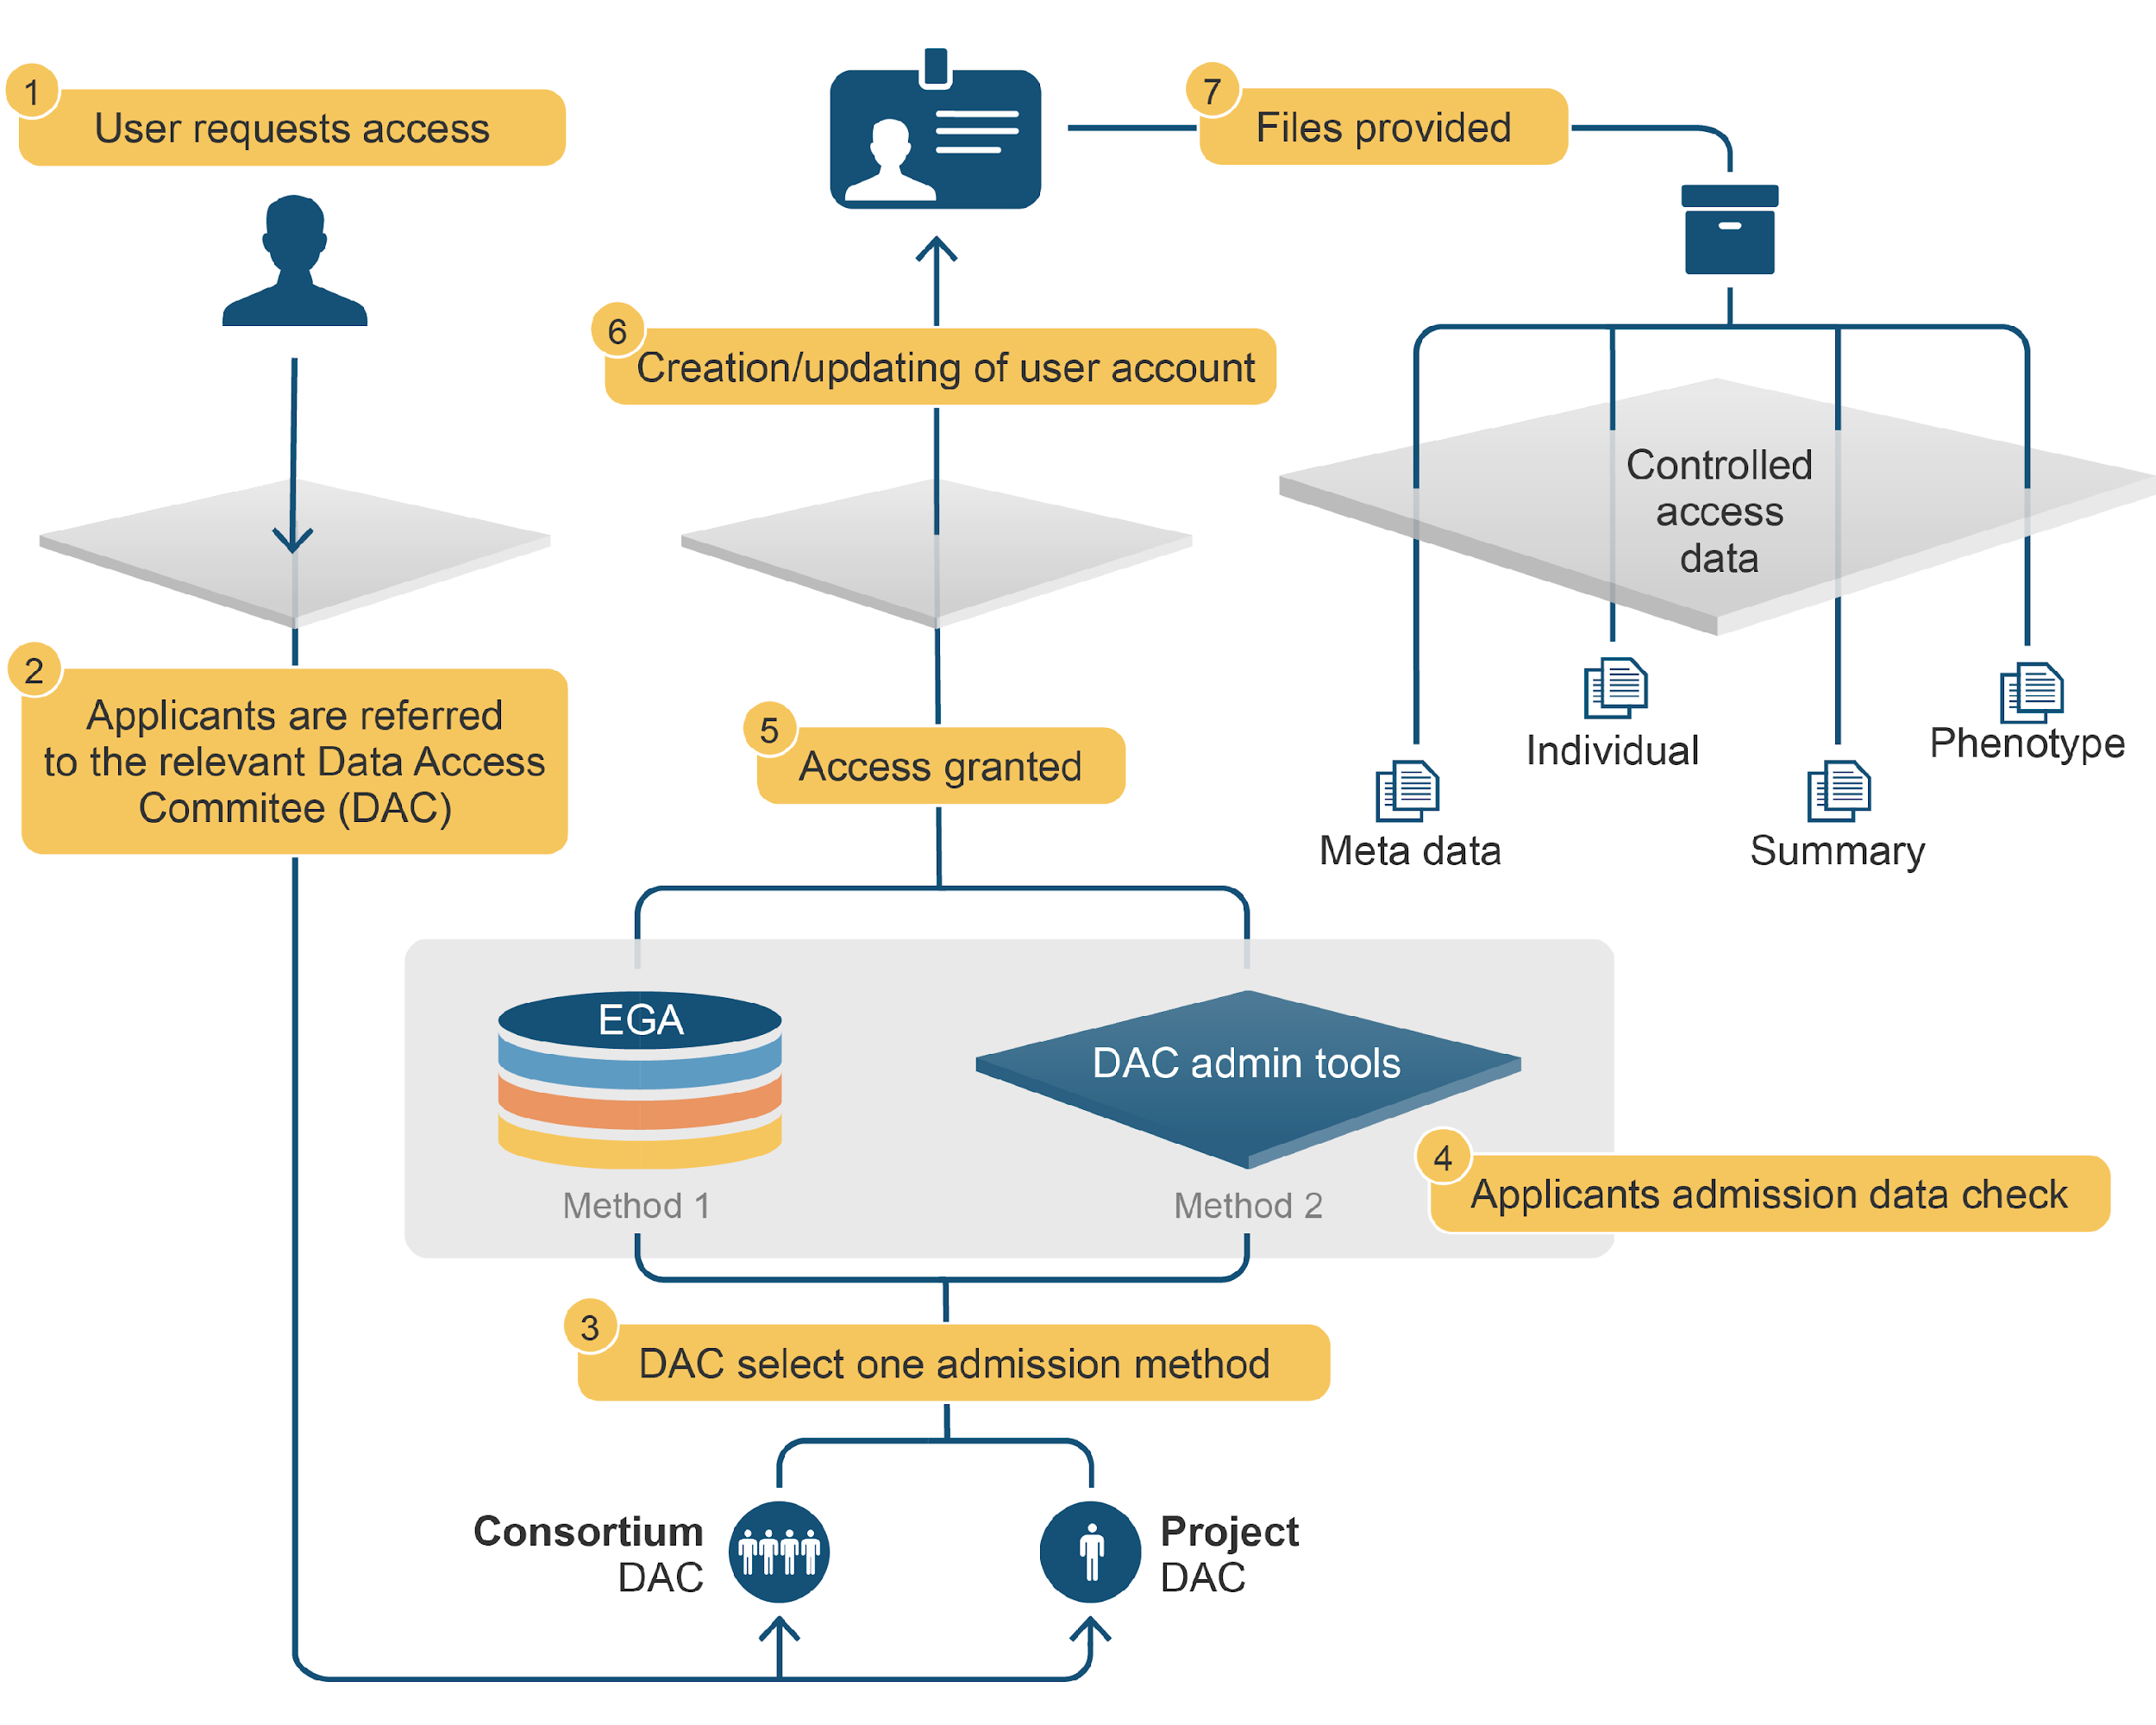
How access to data is controlled?

Slide 16
Exercise 2
What type of datasets are deposited and why the selected repository has been used?
Reporting of EU project VIROPLANT
table of viruses https://zenodo.org/record/6054494#.Y5d6n7LMI2M
interviews, surveys https://zenodo.org/record/6054397#.Y5d6IrLMKeM

Slide 17
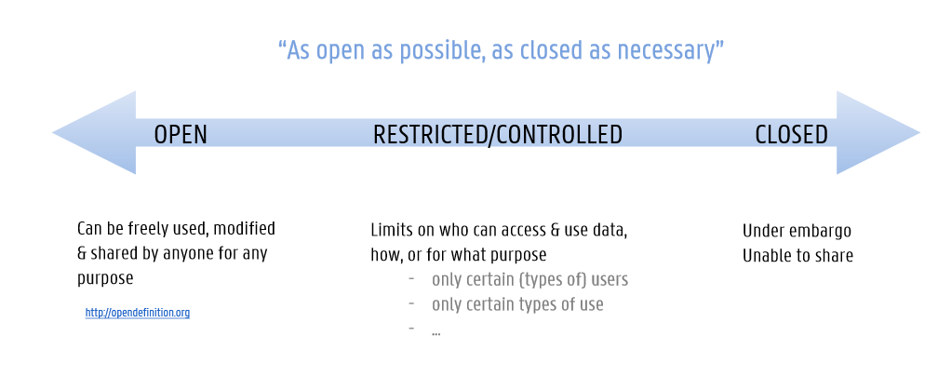
Our key principle for sharing data
from https://osf.io/kdypa/
adapted from ‘Managing and sharing research data’ by S. Jones, CC-BY, FOSTER

Slide 18
Good reasons to close or restrict access to your datasets
Ethical issues
Personal data
Sensitive data that could potentially cause harm (e.g. to endangered species, vulnerable sites or groups, public health, national security…) if made public. Some personal data are considered sensitive personal data.
Legal or contractual issues:
Confidential data (you have a duty or agreed to keep the data confidential).
Third-party data (data are not generated in the course of your own research project, but are supplied to you by another party).
Copyright and/or database right data.
Data with potential economic/commercial value.
from https://osf.io/kdypa/
Notes:
If you want to close or restrict access to your datasets, you must explain your ethical and/or legal issues in the Data Management Plan. You can ask help to the Legal Team, Tech Transfer Office or Data Protection Officer of your institute.

