Slide 1


Reusing existing data
Alexander Botzki
ELIXIR Belgium Training Coordinator
December 2022
Thanks to Korbinian Bösl. (2020, March). DMP-writing-workshop: 2020_03_11_Aas. Zenodo. http://doi.org/10.5281/zenodo.3996086

Slide 2
Where do you look for your data?

Slide 3
Seven ways to discover existing data
1 Google Dataset search
2 OmicsDI
3 Mendeley Data search
4 Publications and Data journals
5 https://www.kcgg.ugent.be/zoeken/databanken/
6 Biostudies https://www.ebi.ac.uk/biostudies/
7 Data portal of your organisation
8 Web of Science Data Search

Slide 4
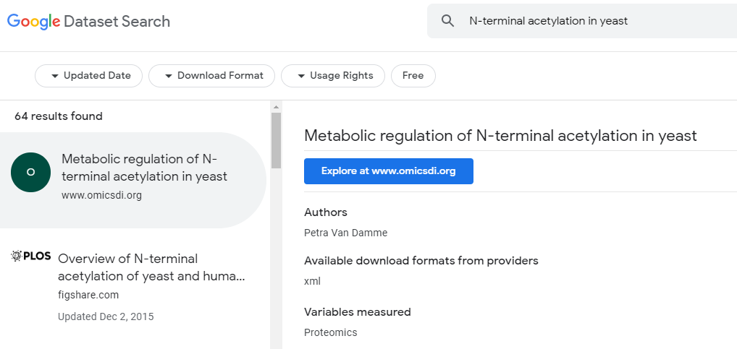
From Google Dataset search to OmicsDI.org
https://datasetsearch.research.google.com/

Slide 5
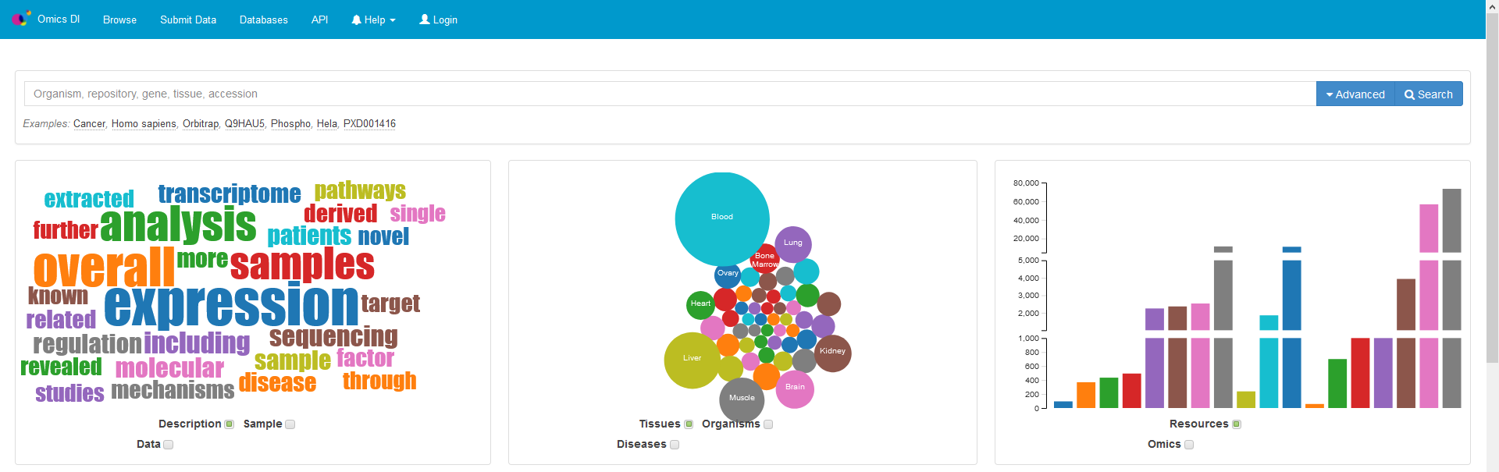
Omics Directory Index
https://www.omicsdi.org/

Slide 6
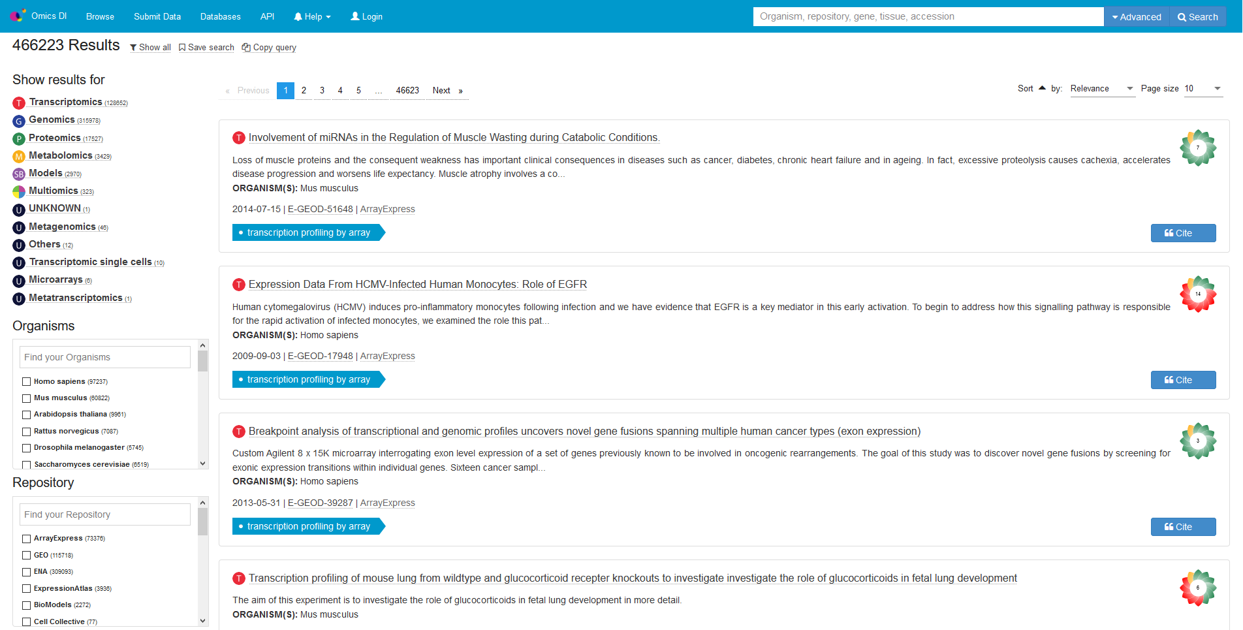
Omics Directory Index

Slide 7
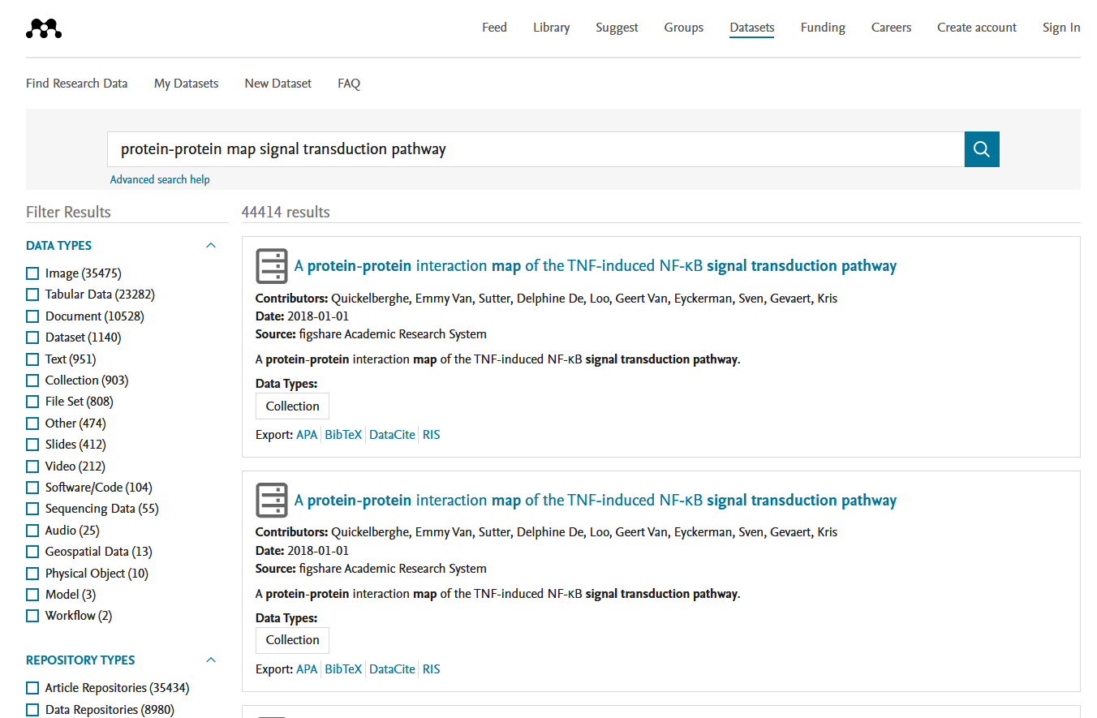
From Mendeley Dataset search (by Elsevier)
https://data.mendeley.com/research-data

Slide 8
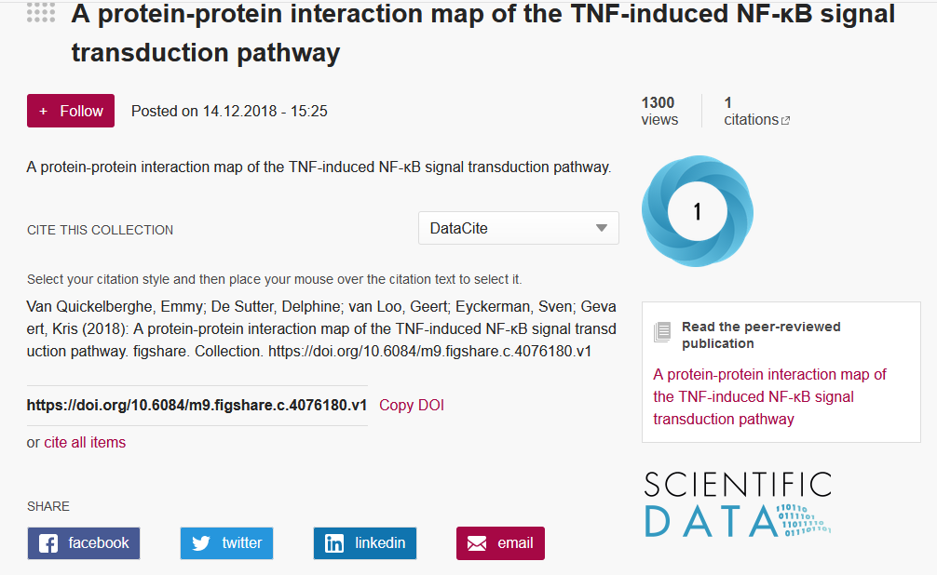

Slide 9
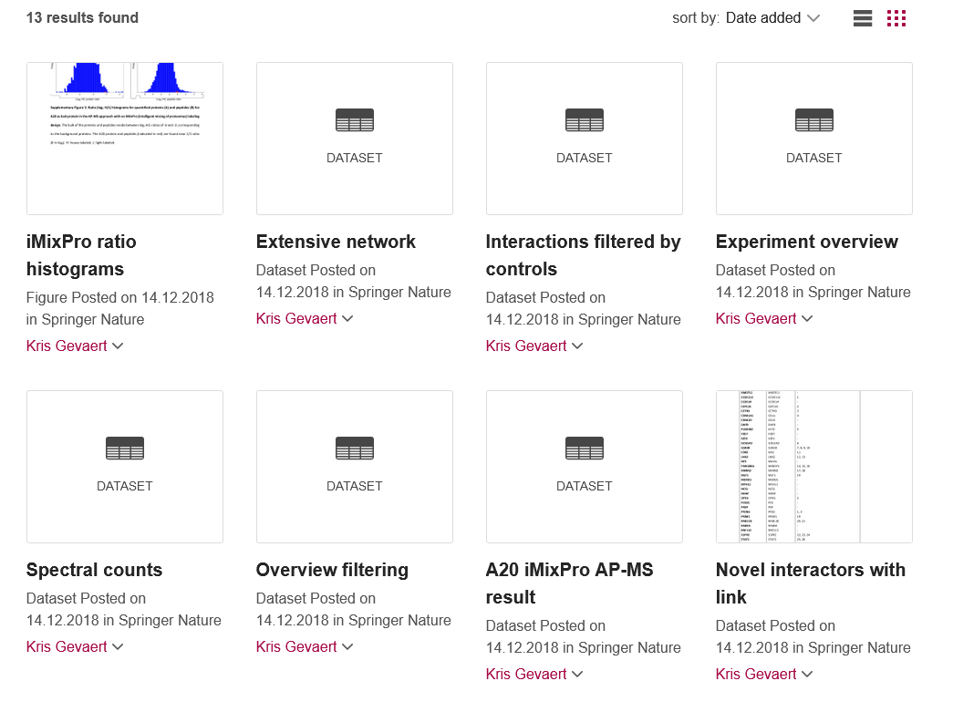

Slide 10
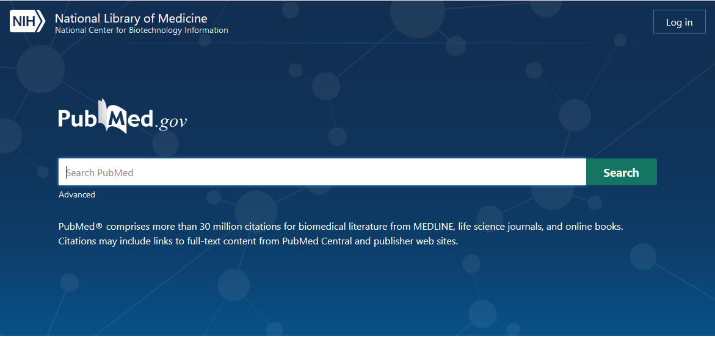
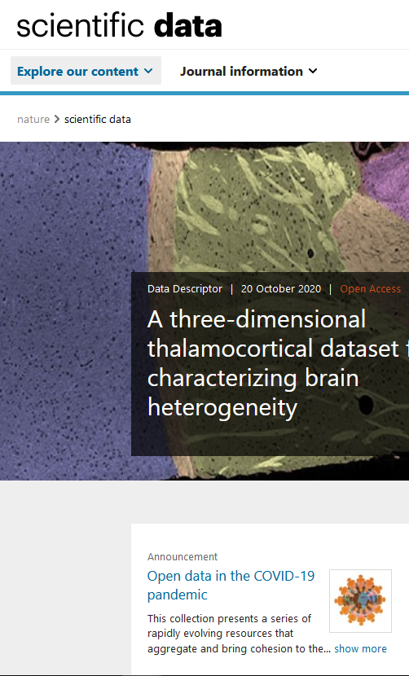
Publications and Data Journals
Scientific Data
Data
Data Science
BMCR

Slide 11
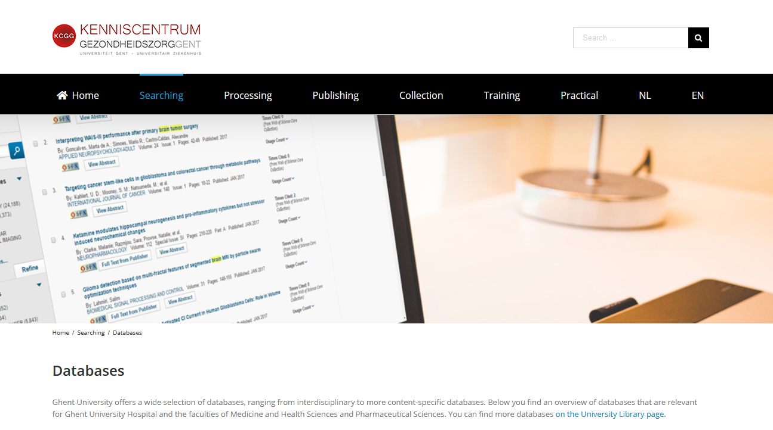

Slide 12
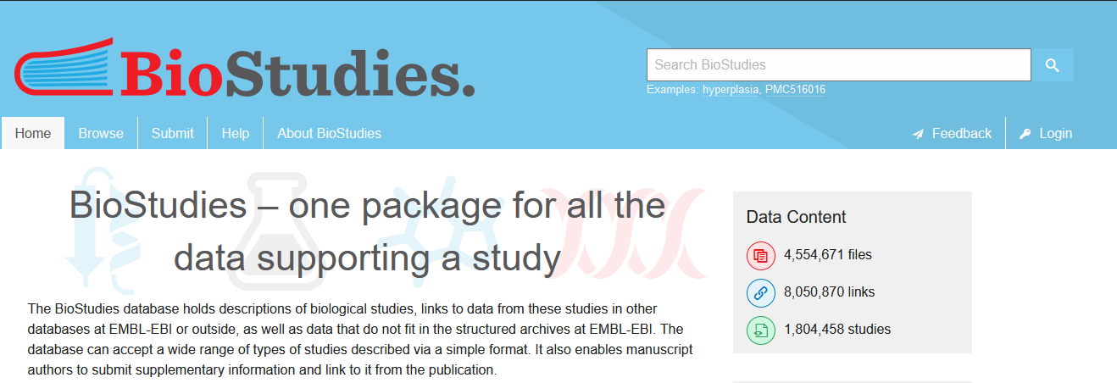

Slide 13
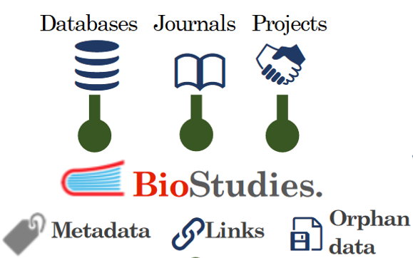
Biostudies
ingest
(
)
package
integrate

Slide 14

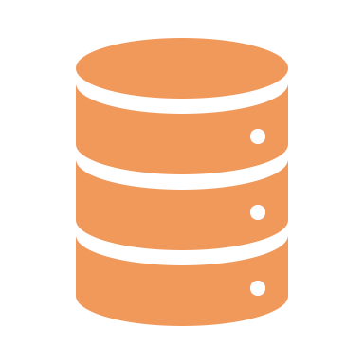
Example
Let’s look at this paper
What data are associated to this paper?
DOI: 10.1128/AEM.00675-10 https://aem.asm.org/content/76/22/7373
what data are in various community databases?
are all associations of the same nature?
what other data are attached to this paper?

Slide 15
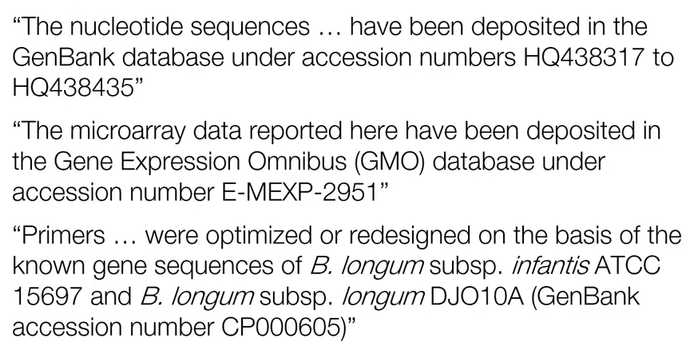
Example – what did we find out?

Slide 16
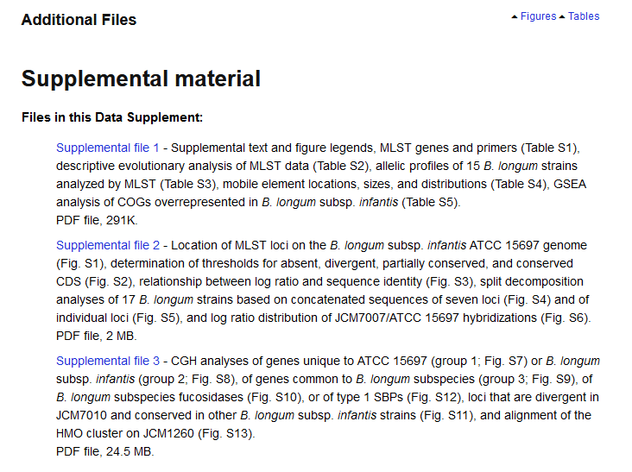
Example – and the supplementary material

Slide 17
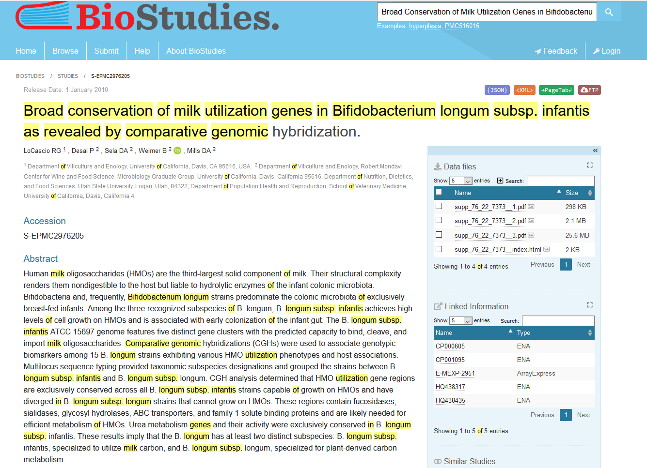
The overview of this article in Biostudies

Slide 18
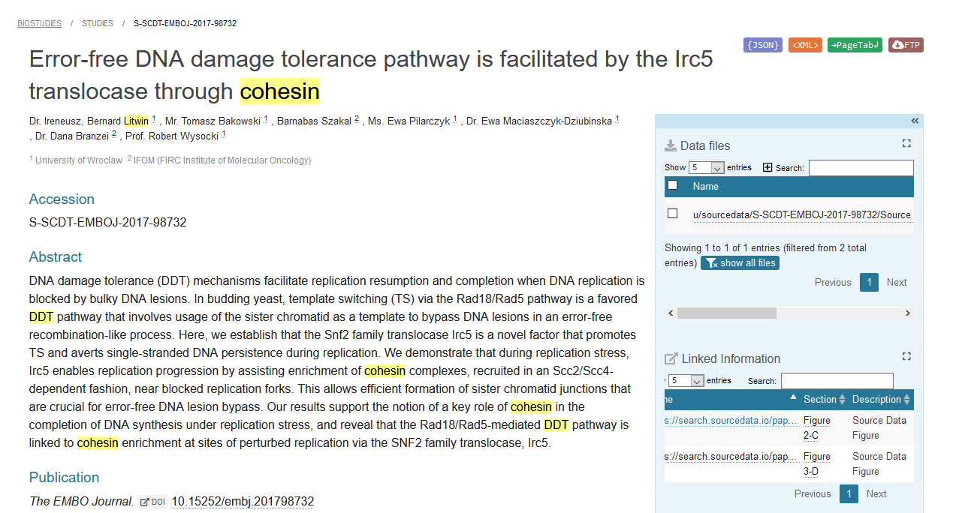
The overview of another article with source data

Slide 19
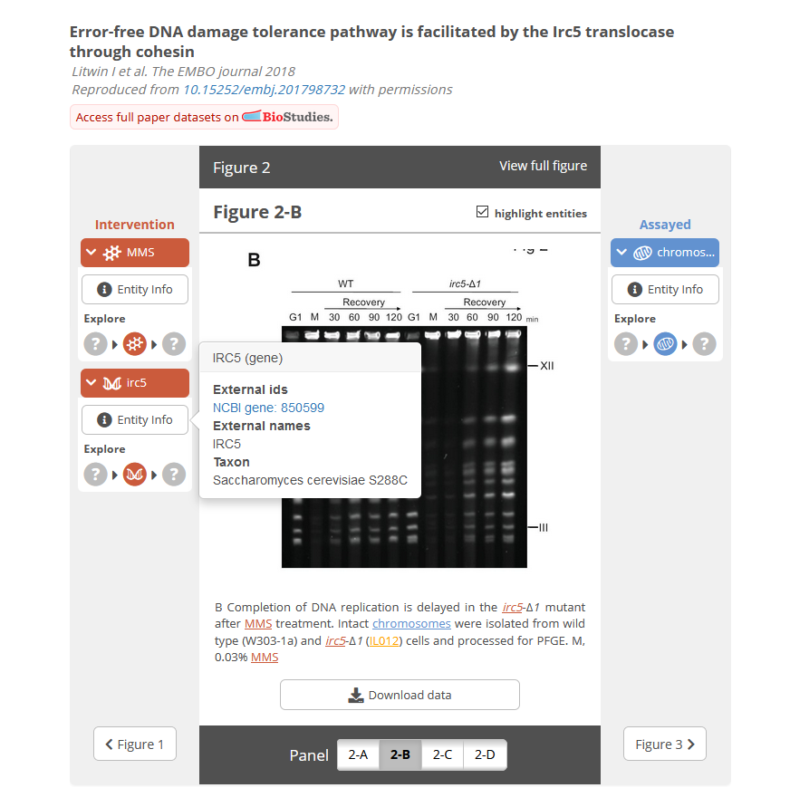
A lot of additional work but a dream to browse through

Slide 20
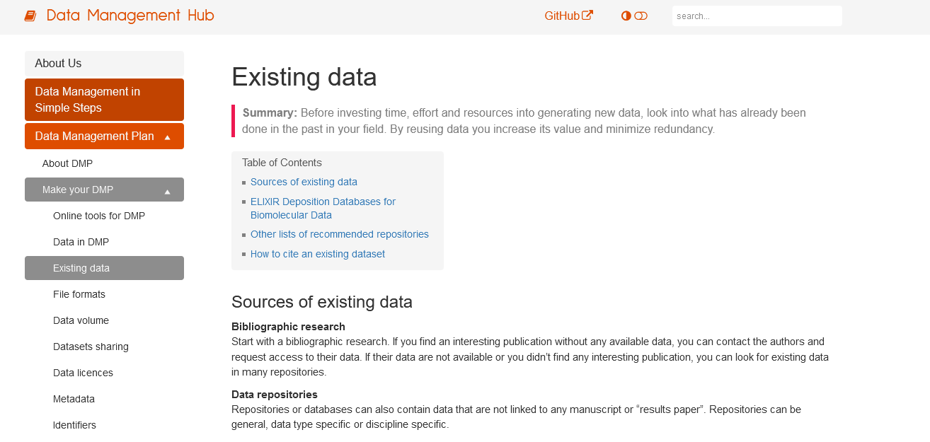
https://rdm.elixir-belgium.org

Slide 21
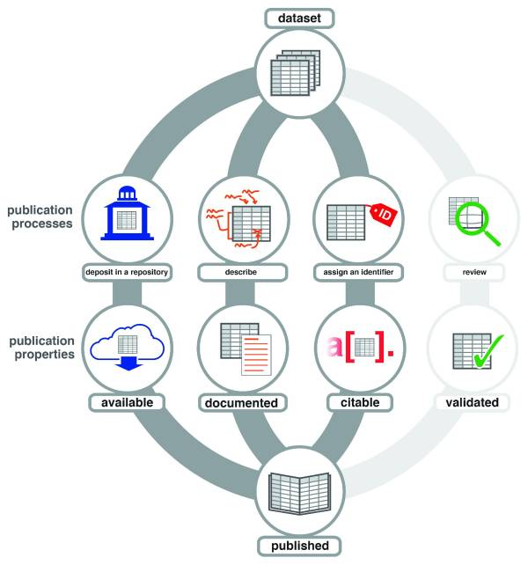
Acknowledge data creators: datasets as first-class research products
https://dx.doi.org/10.12688%2Ff1000research.3979.3

Slide 22
Use Data Citations to acknowledge the creators of the data sets
1. Van Quickelberghe, E. PRIDE PXD009366 (2018)
2. Van Quickelberghe, E., De Sutter, D., van Loo, G., Eyckerman, S., & Gevaert, K. figshare https://doi.org/10.6084/m9.figshare.c.4076180 (2018)
3. Van Quickelberghe, E. IntAct IM-26500 (2018)
4. De Rop, F. , 2022, aertslab/hydrop_data_analysis, 10.5281/zenodo.6415968, Zenodo

Slide 23



How do I know that I can reuse the data? Licenses to your rescue!
Legal security for users (Accessibility)
Increase of willingness to reuse outputs (Reusability)
Allows deposition/mirroring in 2nd databases (Findability)

Slide 24





Concepts in open licenses
Waive all your interests that may exist in your work
Copy left (protective licenses) Credit for the original creation
License new creations under identical terms
Non-commercial
Cannot be shared with others in adapted form
Icons CC-BY 4.0 https://creativecommons.org/

Slide 25
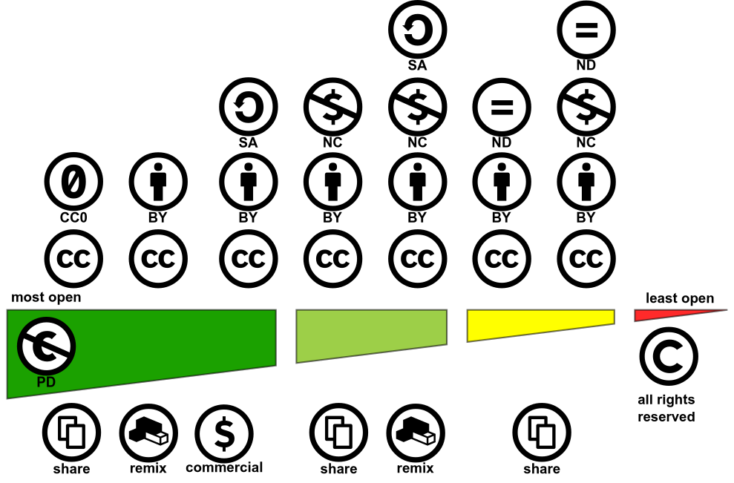

CC-BY 4.0 Shaddim; original CC license symbols by https://creativecommons.org/
https://creativecommons.org/choose

Slide 26
Research Software is also first-class research product
Special considerations for Software
Liability
Warranty
Modifications
Network use = Distribution?

Slide 27




Open Source Software licenses
BSD licenses
GNU AGPLv3
GNU GPLv3
MIT license
GNU LGPLv3
Apache 2.0
https://opensource.org/licenses
https://choosealicense.com/
Icons CC-BY 4.0
https://creativecommons.org/

Slide 28
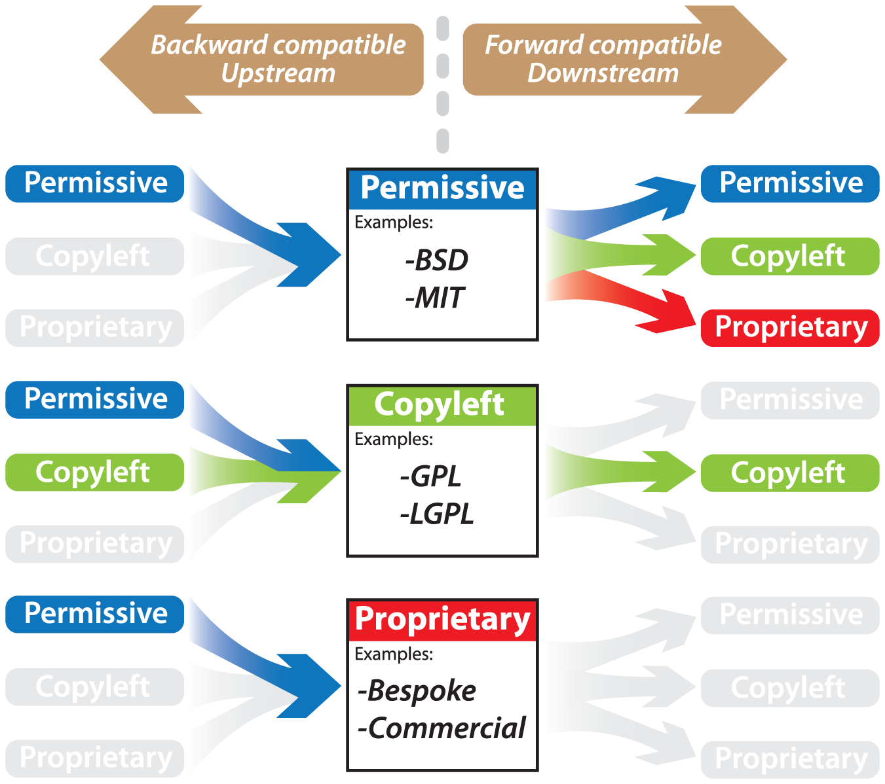
Open Source Software licenses
CC-BY 4.0
http://software-carpentry.org/
Icons CC-BY 4.0
https://creativecommons.org/

Slide 29
Licenses of commonly used data resources
ChEMBL | SQLite database download (Version 25) | CC BY-SA 3.0
DrugEBIlity | File from ftp://ftp.ebi.ac.uk/pub/databases/chembl/DrugEBIlity/ | ?
BindingDB | Files from https://www.bindingdb.org/bind/chemsearch/marvin/SDFdownload.jsp | CC BY 3.0 US
TCRD | SQL database download from http://juniper.health.unm.edu/tcrd/download/ | TCRD is made available under the CC-BY-SA 4.0 license. For details, see https://creativecommons.org/licenses/by/4.0/ Please note that TCRD incorporates many data sources with a variety of associated licenses. Details of the TCRD source data are located here: http://juniper.health.unm.edu/tcrd/download/TCRD_DataSourceLicenses.xslx
PDB | Files downloaded from http://files.rcsb.org/download/ | From https://www.rcsb.org/pages/policies "free of all copyright restrictions and made fully and freely available for both non-commercial and commercial use. Users of the data should attribute the original authors of that structural data"
PDBBind | File download from http://www.pdbbind.org.cn/download.asp | License agreement available there: http://www.pdbbind.org.cn/enroll.asp
Humanmine | Python API | LGPL license
OpenTargets | Python API | Open source and open access
Human Protein Atlas | Files downloaded | CC BY-SA 3.0
HGNC | Files from https://www.genenames.org/download/statistics-and-files/ | Publicly available data
PubMed | Via Eutils API | ?
UniProt | Web API at http://www.uniprot.org/uniprot/ | CC BY-ND 3.0

