Slide 1
Ethical and legal constraints on the sharing of personal data
13 December 2022
René Custers

Slide 2
Information security: categories of data
Public
Internal
Confidential
Restricted (‘highly confidential’)

Slide 3
Research data in terms of information security
Public
Internal
Confidential
Restricted (‘highly confidential’)
?
RESEARCH DATA

Slide 4
Research data in terms of information security
Public
Internal
Confidential
Restricted (‘highly confidential’)
General rule
RESEARCH DATA

Slide 5
Research data in terms of information security
Public
Internal
Confidential
Restricted (‘highly confidential’)
After the deliberate decision that it is OK to publish
RESEARCH DATA

Slide 6
Research data in terms of information security
Public
Internal
Confidential
Restricted (‘highly confidential’)
GENETIC DATA
Because they are sensitive personal data

Slide 7
The ethics of personal data
The basic right to decide on the collection and processing of your personal data (autonomy)
The sharing/disclosure of personal data can lead to harm (non malificence)

Slide 8
Personal data
‘personal data’ means any information relating to an identified or identifiable natural person (‘data subject’);
an identifiable natural person is one who can be identified, directly or indirectly, in particular by reference to an identifier such as a name, an identification number, location data, an online identifier or to one or more factors specific to the physical, physiological, genetic, mental, economic, cultural or social identity of that natural person;
Data of deceased persons are not considered personal data

Slide 9
Sensitive personal data
Data revealing racial or ethnic origin, political opinions, religious or philosophical beliefs, trade union membership, genetic data, biometric data, health data, data on sex life or sexual orientation

Slide 10
The legislation
Regulation (EU) 2016/679: the ‘General Data Protection Regulation’
Belgian law of 30 July 2018 on the protection of natural persons concerning the processing of personal data

Slide 11
General principles
Lawfulness, fairness and transparency
Purpose limitation
Data minization
Accuracy
Storage limitations
Confidentiality and integrity

Slide 12
Lawfulness
6 possible legal grounds
The data subject has given consent
Necessary for the performance of a contract
Legal obligation of the data controller
Protection of vital interest of the data subject or another person
Necessary for a task of public interest
Necessary for purposes of the legitimate interest of the controller or a third party

Slide 13
Purpose limitation
Only process personal data for your particular research purpose
Processing of data should be reasonable and proportionate for achieving the research goals
Data minimization
Only use data that are necessary to achieve the objective

Slide 14
Storage limitations
Personal data may not be kept longer than necessary for your current research and for possible further analyses of data
-> but principle of Open Data resulting in uploading of datasets onto repositories for future use

Slide 15
Rights of the data subject
Transparent information on exercise of rights
Right to information and access to personal data
Right to rectification
Right to erasure
Right to restriction of processing
Right to data portability
Right to object

Slide 16
Limits to the right of erasure
Right of erasure in the context of scientific research is limited, to the extent that the exercise of the right would render impossible or seriously impair the scientific research
-> Data that have already been generated can still be used.

Slide 17
Obligations of the controller
Implement appropriate technical and organisational measures
Ensure security of personal data
Keep records of processing activities -> GDPR processing log
Notification of personal data breach
Perform data protection impact assessments where necessary
Ensure agreements with processors and recipient third parties

Slide 18
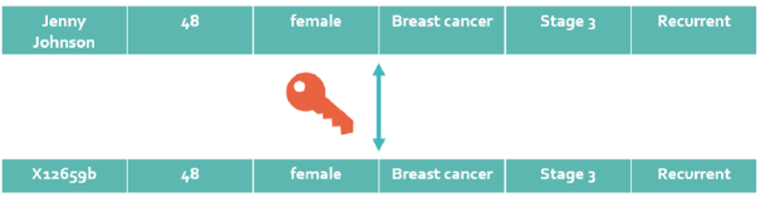
Pseudonymous data
Personal data that has been processed in such a manner that the personal data can no longer be attributed to a specific data subject without the use of additional information
The additional information is kept separately and is subject to measures to ensure that this information can only be accessed by priviledged persons
Pseudonymization is regarded an important security measure

Slide 19
Pseudonymous data
Not being in the possession of the decoding key does not make a dataset anonymous!

Slide 20
Anonymous data
information which does not relate to an identified or identifiable natural person or to personal data rendered anonymous in such a manner that the data subject is not or no longer identifiable
Anonymization must be irreversible
Methods of anonymization:
Removal of information that would allow to identify a person
Randomization
Aggregation

Slide 21
Identifiability
To determine whether a natural person is identifiable, account should be taken of all the means reasonably likely to be used, such as singling out, either by the controller or by another person to identify the natural person directly or indirectly. To ascertain whether means are reasonably likely to be used to identify the natural person, account should be taken of all objective factors, such as the costs of and the amount of time required for identification, taking into consideration the available technology at the time of the processing and technological developments

Slide 22
Generate research data
Process research data
Store research data
Share research data
Manage research data that constitute personal data in a way that is lawful, and enables you to do what you need and want to do with these data

Slide 23
Consequences of the GDPR for the way you manage your research data
List up possible consequences

Slide 24
……
……
……
……
……
……
……

Slide 25
Transparency
Data subjects must be informed correctly on the collection of data and how their data will be processed
They also need to know where they can turn to for questions on the data processing
-> include information in the ICF
Management of personal data includes informing people on what you are going to do with their data

Slide 26
You want to inform participants correctly on how their data will be processed
Which information elements would you then take up in your informed consent form?

Slide 27
……
……
……
……
……
……
……

Slide 28
The type of data that will be collected
That data will be coded, researcher will not know the identity
That processing will be done in a GDPR compliant manner with full protection of privacy
That coded data may be uploaded into a repository
That coded data may be shared with third parties (mention recipient if already known)
……

Slide 29
Processing of personal data in scientific research – which legal ground?
The data subject has given consent
Necessary for the performance of a contract
Legal obligation of the data controller
Protection of vital interest of the data subject or another person
Necessary for a task of public interest
Necessary for purposes of the legitimate interest of the controller or a third party

Slide 30
Processing of personal data in scientific research – which legal ground?
The data subject has given consent
Necessary for the performance of a contract
Legal obligation of the data controller
Protection of vital interest of the data subject or another person
Necessary for a task of public interest
Necessary for purposes of the legitimate interest of the controller or a third party

Slide 31
ICFs in (biomedical) research
The participant needs to give explicit consent to participation to the study
But the collection and processing of personal data can be done on the legal ground of public interest

Slide 32
Entering your project in the GDPR processing log

Slide 33
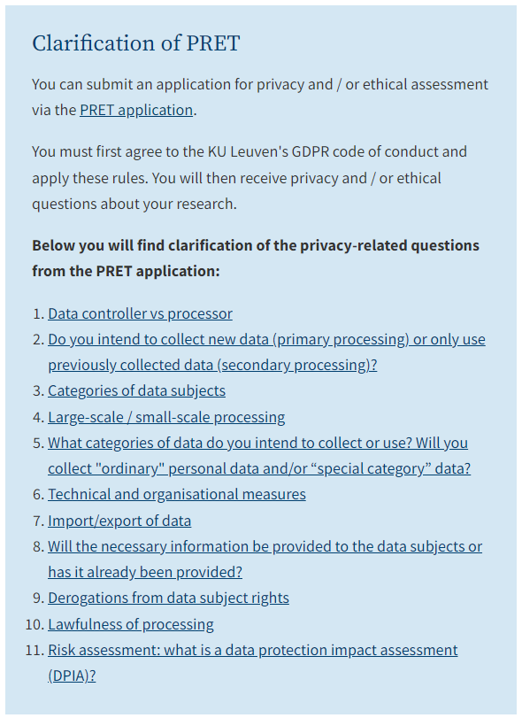
In Leuven
Privacy & Ethics questionnaire

Slide 34
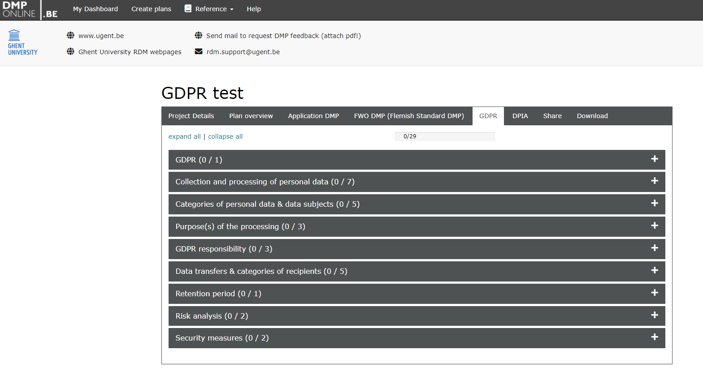
In Gent

Slide 35
Management of personal datasets in the research life cycle

Slide 36
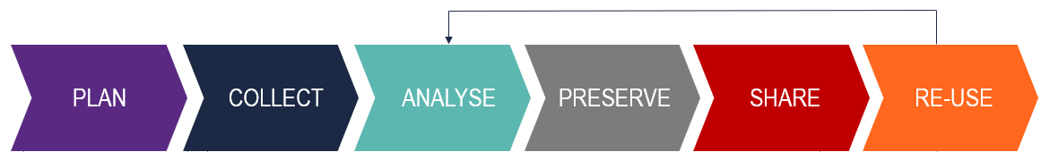

Slide 37
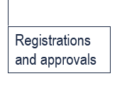
Step 1. The necessary registrations and approvals to enable you to collect personal data
ICF
Ethics approval
GDPR log

Slide 38
Step 2: ensure that the researchers only work with pseudonymous data
Ensure that you only receive pseudonymous data
Or pseudonymize the data yourself (this requires proper organisation!)

Slide 39
Step 3: Store relevant project-related metadata
Store project-related metadata: create label
Relevant info from the ICF or the ICF template
Scope of research allowed
Ethical approval
GDPR processing log √
Link to DTA, if applicable
Link to DPIA, if applicable
Third party sharing allowed Y/N

Slide 40
Step 4: ensure that GDPR compliant security is applied during the whole cycle
Apply security measures
Ensure traceability

Slide 41
Step 4: Check metadata and share in a GDPR compliant manner; pseudonymize or anonymize where possible
PLAN
COLLECT
ANALYSE
PRESERVE
SHARE
RE-USE
Check label
Check status of data in manuscript
Instructions and checklist on pseudonymization / anonymization
Instruction on sharing of pseudonymous data
MDTA template for sharing of data
Data Access Committee procedure for sharing of data containing personal data
Publish manuscript
Upload data in repository
Share data with third parties

Slide 42
Uploading of genetic data onto a public restricted access repository – only metadata are publicly visible
EGA
dbGAP
JGA
But also:
RDR
…

Slide 43
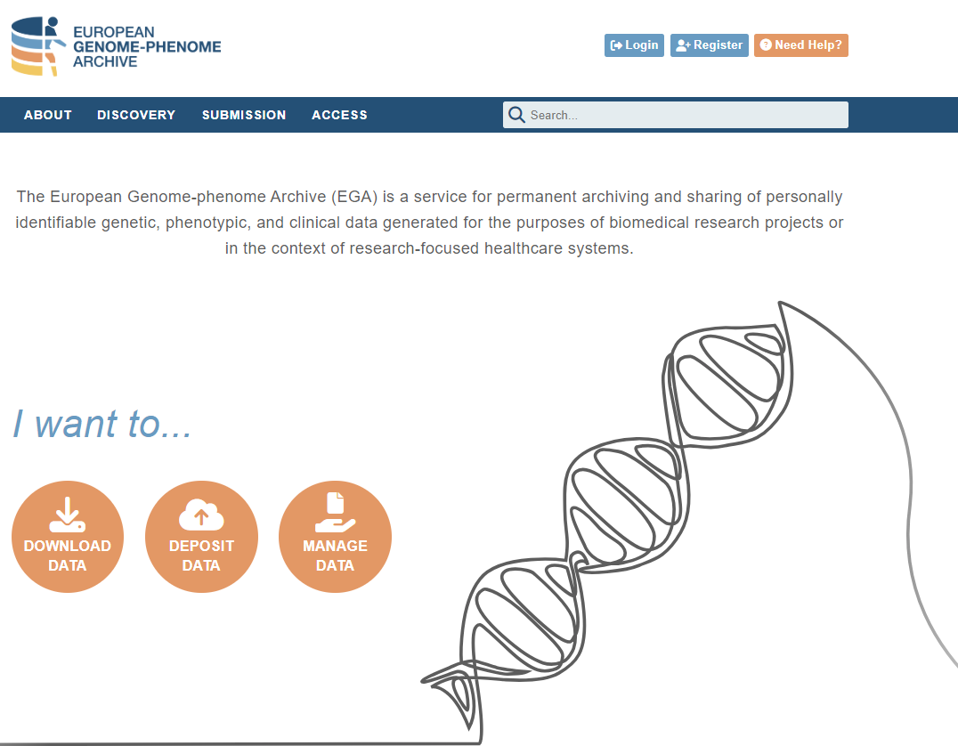
Uploading a dataset onto EGA

Slide 44
Check that the ICF, and where applicable the MTA, that are at the basis of the dataset allow data to be shared with third parties. Uploading a dataset onto EGA means that the dataset is available for third parties and datasets that are not allowed to be shared with third parties should not be uploaded.
Prepare the dataset(s) that you wish to upload. Delete columns with information that would not be relevant to share and critically consider whether certain information can be made less specific. For instance you can replace a specific age by an age range.
Initiate the submission process at ega-archive.org. If you are not a registered user yet, first create an EGA user account. After validation of the account you should request to obtain the submitter role. Navigate to the submitter portal: I want to be a Submitter - EGA European Genome-Phenome Archive (ega-archive.org)
As part of the process to become a submitter you have to upload the signed DPA. Request a copy of the signed DPA with goedele.dedeurwaerder@vib.be. Upload this signed DPA and request the submitter role.
Do not navigate to the DAC Portal, and certainly do not create a new DAC. There already is a VIB DAC in the EGA portal, with a connected data access policy
Follow the steps of the submitter portal. You can find detailed guidance on the EGA website: Submitter Portal - EGA European Genome-Phenome Archive (ega-archive.org).
When adding a dataset, EGA will ask for a policy. This is the VIB data policy (provided in annex) with reference number EGAP00001003327, linked to the VIB DAC (dac@vib.be ) with reference number EGAC00001003263.
Perform the actual upload of the dataset following the EGA instructions. The files must be encrypted.

Slide 45
In summary
Inform data subjects
On what type of data you will collect and what you are going to do with them
On how their privacy is guaranteed
Where they can turn to if they have questions or wish to exert their rights
Enter your project in the institution’s GDPR log
Ensure that you do not receive direct identification information
Only give access to the data to those that need access
Respect TOM and security measures
Do not openly share personal data
Paper should only contain anonymous information
Personal data sets should only be uploaded onto a restricted access repository / database
Sharing of data with third parties is subject to DAC procedure and DTA

Slide 46
When is a dataset anonymous, when is it pseudonymous?

Slide 47
The consequence of pseudonymity
Pseudonymous data | Anonymous data
Subject to the GDPR | NOT subject to the GDPR
Data not allowed to be openly available | Data open (unless contractual agreements or IP analysis determines otherwise)
Data access by third parties subject to Data Access Committee procedure | Unrestricted third party access to open data
Data transfer/access agreement necessary

Slide 48
Is this dataset anonymous?

Slide 49
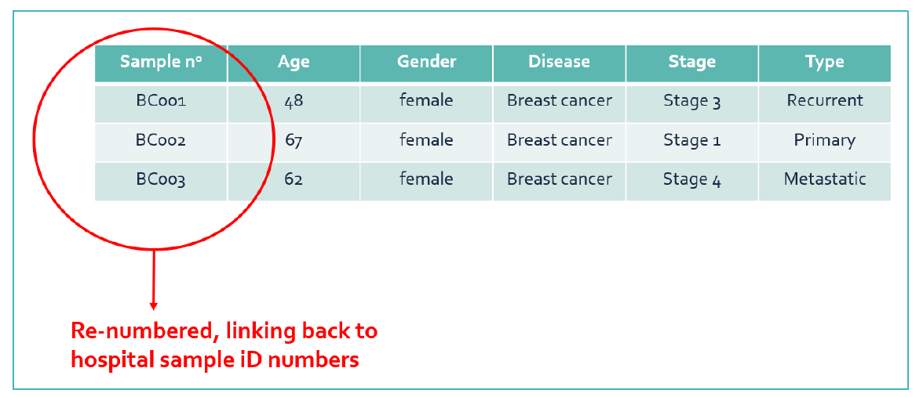

Slide 50
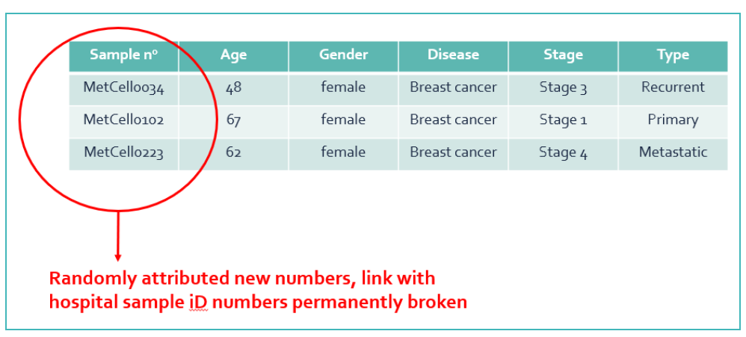

Slide 51
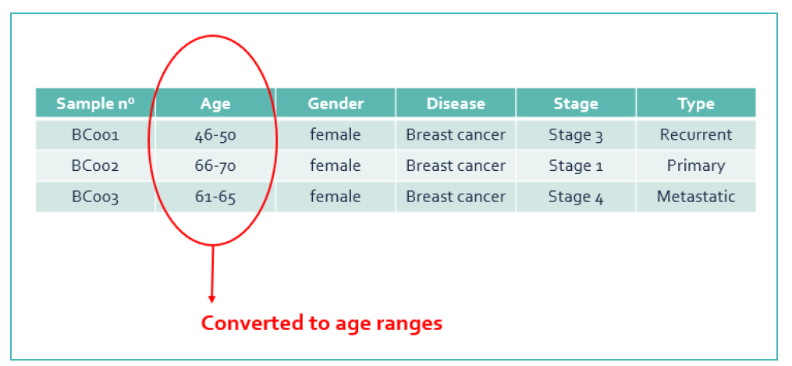

Slide 52
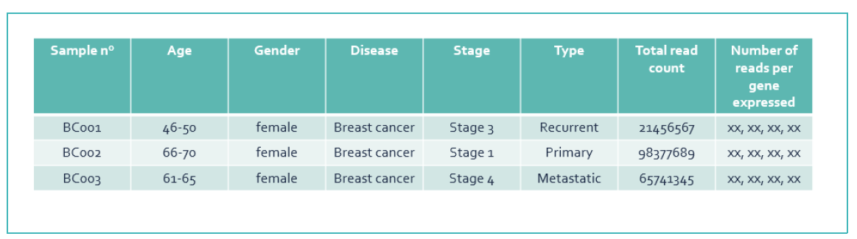

Slide 53
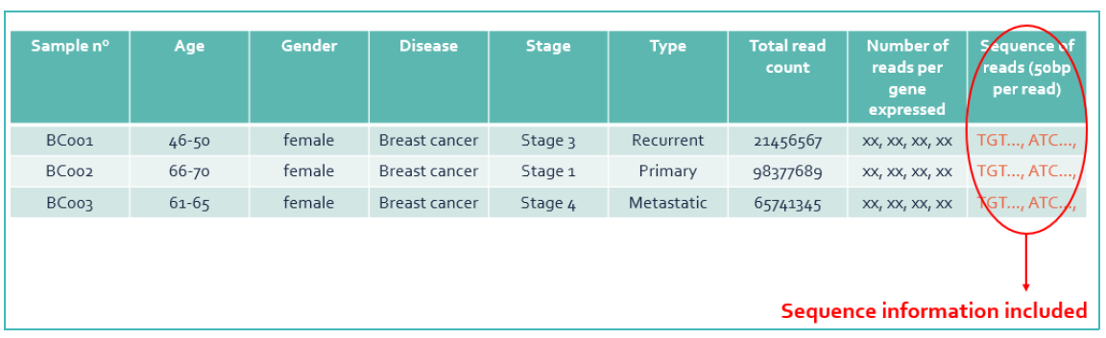

Slide 54
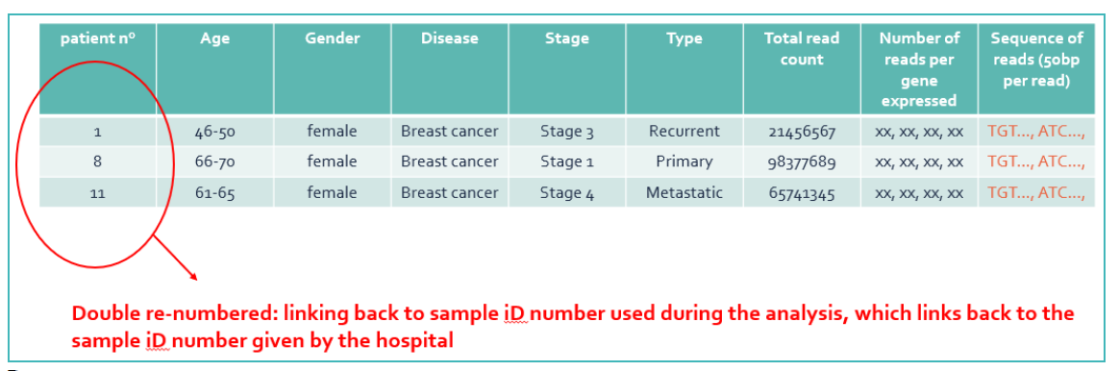

Slide 55
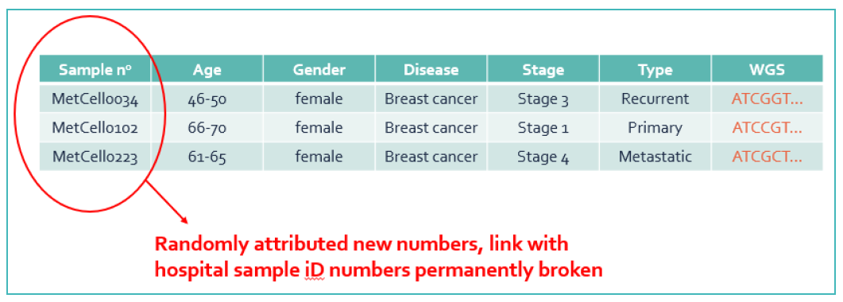

Slide 56
When the link with the direct identification information has been permanently broken, one still has to consider the uniqueness of the data!

Slide 57
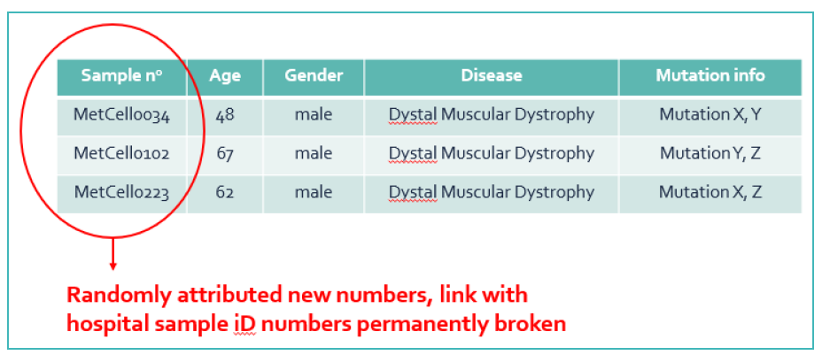

Slide 58
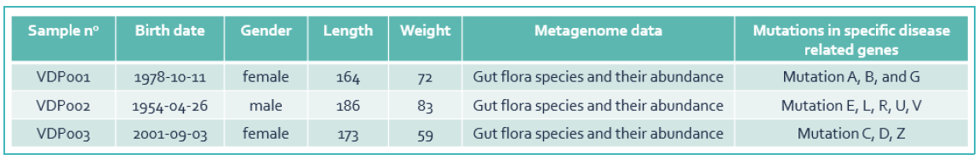

Slide 59
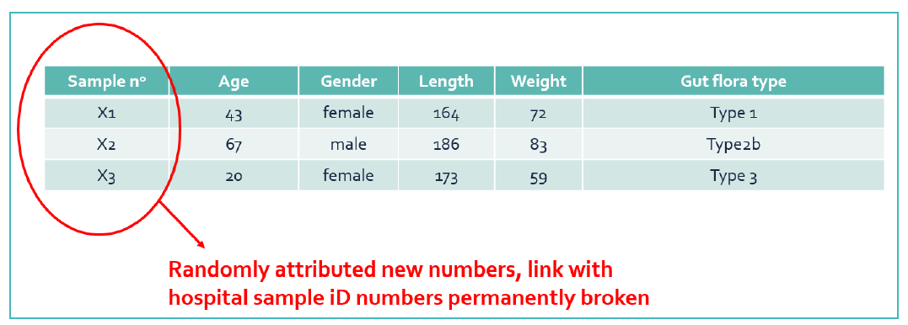

Slide 60
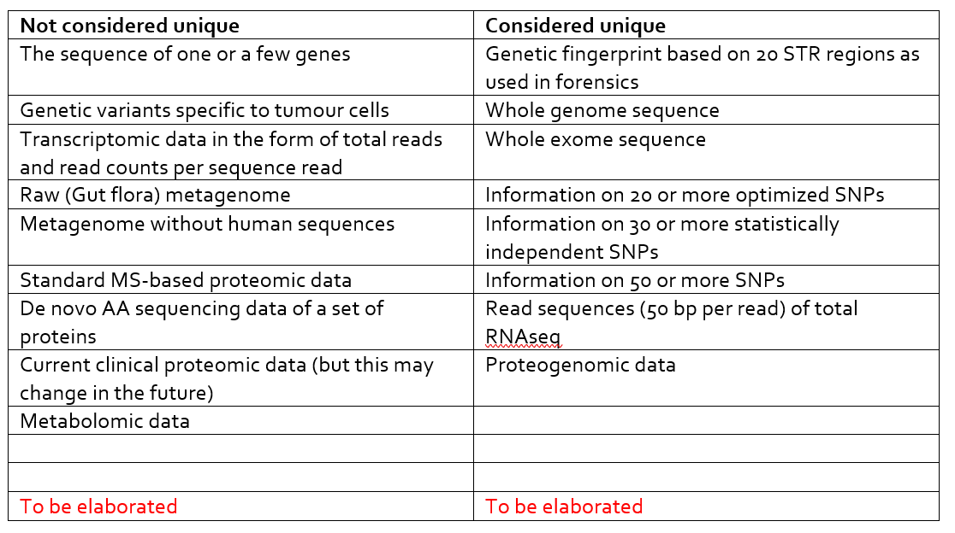
Highly unique data are in themselves considered subject to the GDPR

Slide 61
Data not subject to the GDPR, so everything OK?
There may still be ethical reasons not to share certain data openly

Slide 62
Is proteomic data personal data?

Slide 63
Is metabolomic data personal data?

