Slide 1



Relationships between Mode Choice and Independence for the Journey to School
Carole Turley Voulgaris
Gregory S. Macfarlane
Anders Fjendbo Jensen

Slide 2
Motivation
Change between 2009 (and previous years?) and 2017 in
Active travel
Accompanied travel
HARVARD UNIVERSITY GRADUATE SCHOOL OF DESIGN Brigham Young University Technical University of Denmark
2

Slide 3
Questions
What is the relationship between choice of mode and choice of independence?
What explains the shift towards more parents walking their kids to school?
HARVARD UNIVERSITY GRADUATE SCHOOL OF DESIGN Brigham Young University Technical University of Denmark
3

Slide 4
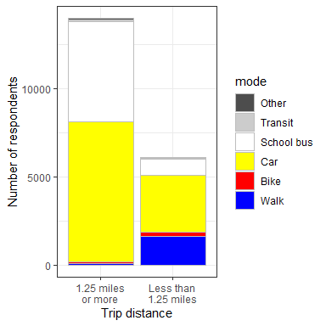
Data: Sample
National Household Travel Survey
2009: 2834 trips
2017: 2076 trips
Criteria for inclusion
Trip begins at home and ends at school
First such trip by the traveler that day
Arrival at school before 10am
Traveler is between the ages of 7 and 14
Trip is shorter then 1.25 miles (about 2 kilometers)
Trip is by car, walking, or bicycle
HARVARD UNIVERSITY GRADUATE SCHOOL OF DESIGN Brigham Young University Technical University of Denmark
4

Slide 5
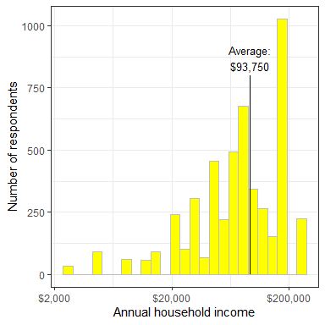
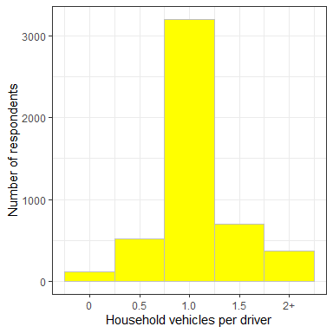
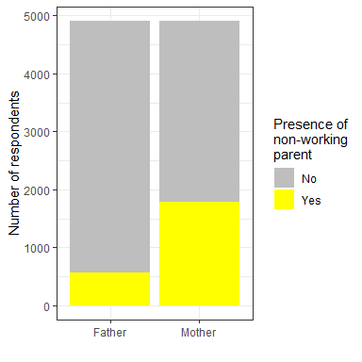
Predictors:
Household Characteristics
37%
11%
HARVARD UNIVERSITY GRADUATE SCHOOL OF DESIGN Brigham Young University Technical University of Denmark
5

Slide 6
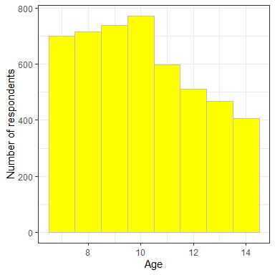
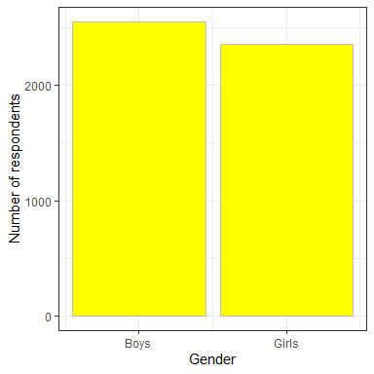
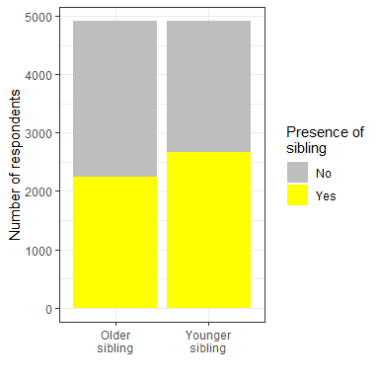
Predictors:
Individual characteristics
HARVARD UNIVERSITY GRADUATE SCHOOL OF DESIGN Brigham Young University Technical University of Denmark
6

Slide 7
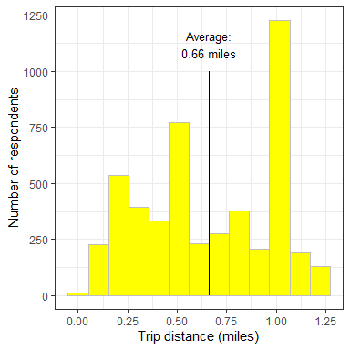
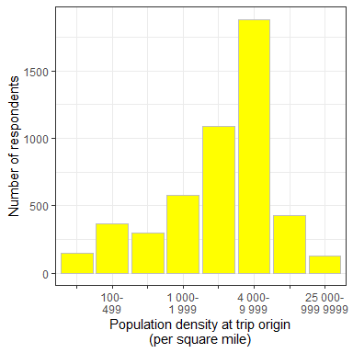
Predictors:
Location characteristics
HARVARD UNIVERSITY GRADUATE SCHOOL OF DESIGN Brigham Young University Technical University of Denmark
7

Slide 8
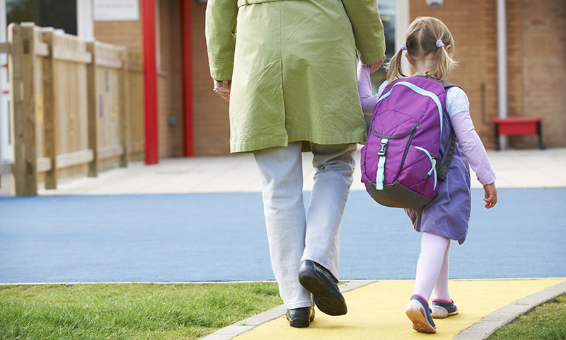



Three Alternatives
Accompanied by a parent:
Not accompanied by a parent:
1%
(2009)
13%
(2017)
36%
(2009)
23%
(2017)
By an active mode:
Includes travel with other children or non-household adults.
All household adults are classified as parents.
By car:
63%
(2009)
64%
(2017)
Anyone old enough to drive is classified as a parent (even if they are from outside the household).
Children can’t drive cars.
HARVARD UNIVERSITY GRADUATE SCHOOL OF DESIGN Brigham Young University Technical University of Denmark
8

Slide 9
Alternative Choice Structures
Unnested
Car
Cross-nested
Active with parent
Active without parent
Active with parent
Active without parent
Car
Accompanied
Active
Nests based on escorting
Nests based on mode
Active without parent
Car
Without parent
Active
Car
Car
With parent
Accompanied
Unaccompanied
Car
Active
HARVARD UNIVERSITY GRADUATE SCHOOL OF DESIGN Brigham Young University Technical University of Denmark
9

Slide 10
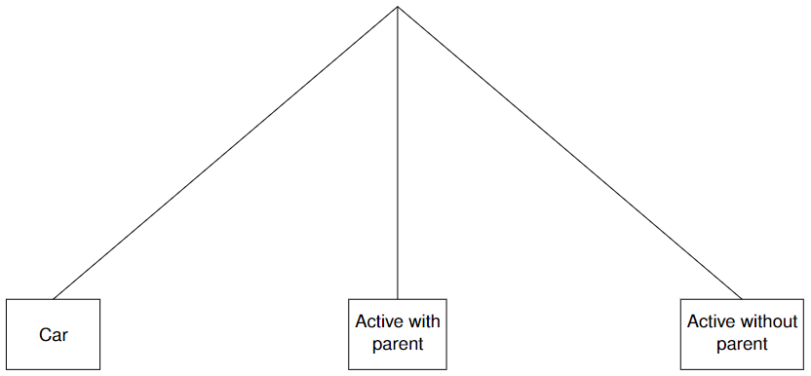
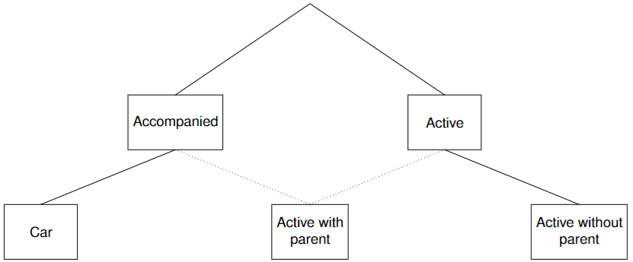
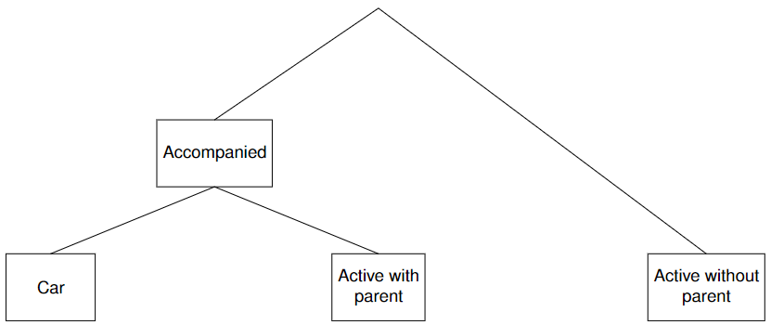
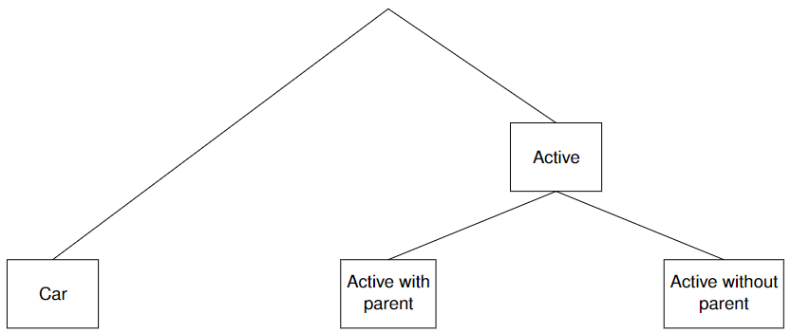
Alternative Choice Structures
Must be significantly greater than one (less than one indicates greater substitution between nests than within nests).
Unnested
Cross-nested
μ
μ
1− α
α
Constrained to be between zero and one. Indicates the degree to which the alternative belongs in each nest.
Nests based on escorting
Nests based on mode
μ
μ
HARVARD UNIVERSITY GRADUATE SCHOOL OF DESIGN Brigham Young University Technical University of Denmark
10

Slide 11
Results: Model fit and Validity
Unnested
Cross-nested
μ = 1.78 (95% conf. 1.04 to 2.52)
μ = 3.41 (95% conf. 2.11 to 4.70)
1 - α = 0.45
α = 0.55
Nests based on escorting
Nests based on mode
μ = 1.01 (95% conf. 0.56 to 1.46)
μ = 4.45 (95% conf. -2.84 to 11.74)
HARVARD UNIVERSITY GRADUATE SCHOOL OF DESIGN Brigham Young University Technical University of Denmark
11

Slide 12
Results: Model fit and Validity
Unnested
Cross-nested
μ = 1.78 (95% conf. 1.04 to 2.52)
μ = 3.41 (95% conf. 2.11 to 4.70)
1 - α = 0.45
α = 0.55
Log likelihood: -3177
AIC: 6401
BIC: 6557
Log likelihood: -3164
AIC: 6383
BIC: 6558
HARVARD UNIVERSITY GRADUATE SCHOOL OF DESIGN Brigham Young University Technical University of Denmark
12

Slide 13
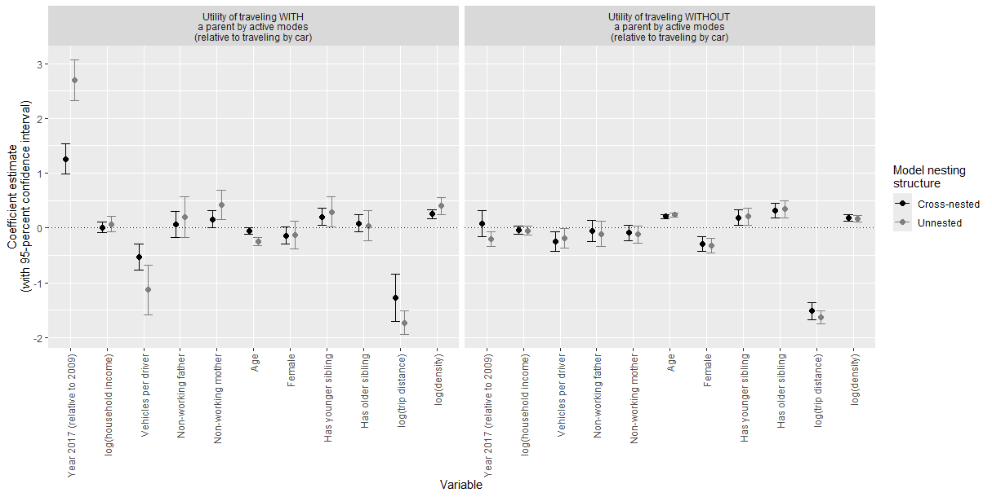
Results: Model Coefficients
Significant coefficients (both models)
HARVARD UNIVERSITY GRADUATE SCHOOL OF DESIGN Brigham Young University Technical University of Denmark
13

Slide 14
Results: Model Coefficients
Difference in significance between the two models
HARVARD UNIVERSITY GRADUATE SCHOOL OF DESIGN Brigham Young University Technical University of Denmark
14

Slide 15
Results: Model Coefficients
Results that are significantly different between the two models
HARVARD UNIVERSITY GRADUATE SCHOOL OF DESIGN Brigham Young University Technical University of Denmark
15

Slide 16
Conclusions: Modeling
More substitution
More substitution
Failure to account for the structure of these alternatives may lead to an overestimation of the effects of some predictors on the joint choice of mode and independence.
Less substitution
HARVARD UNIVERSITY GRADUATE SCHOOL OF DESIGN Brigham Young University Technical University of Denmark
16

Slide 17
Conclusions: Policy and Planning
More substitution
More substitution
Escorted active travel represents a point on a continuum between motorized and independent active travel:
Children who walk or bike to school with parents may be more likely to switch from active to motorized modes than those who walk or bike independently.
Policies that focus on parents walking or biking their children to school might be more effective in reducing car dependence than those focusing on independent travel.
HARVARD UNIVERSITY GRADUATE SCHOOL OF DESIGN Brigham Young University Technical University of Denmark
17

Slide 18
Future Research Questions
Are these relationships consistent:
Across trip purposes?
Is a greater propensity for independent travel associate with more trip-making?
Across national contexts?
Other countries have
Better infrastructure for pedestrians and cyclists
Different policies and cultural norms with regards to caregiving
HARVARD UNIVERSITY GRADUATE SCHOOL OF DESIGN Brigham Young University Technical University of Denmark
18

Slide 19
Thank You
Carole Turley Voulgaris cvoulgaris@gsd.harvard.edu
Gregory S. Macfarlane gregmacfarlane@byu.edu
Anders Fjendbo Jensen afjje@dtu.dk

