Slide 1
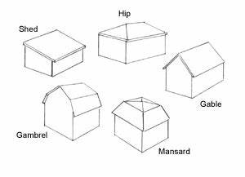
height_top
height_deck
height_top
PLACEHOLDER
height_top
height_eave
height_eave
roof_type: flat
roof_type: skillion
roof_type: mansard
height_top
height_top
height_top
height_eave
height_eave
height_eave
roof_type: hip
roof_type: gable
roof_type: gambrel

