Slide 1



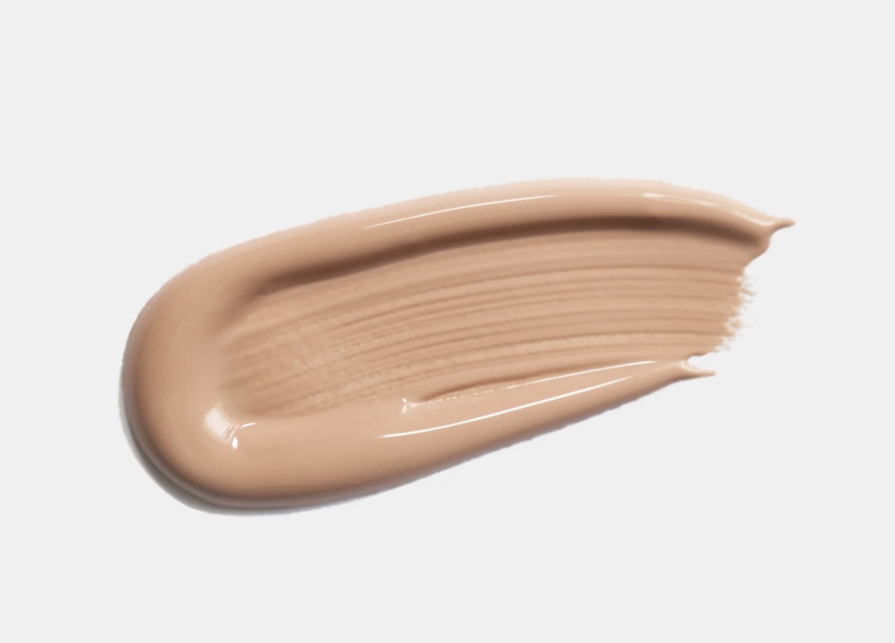
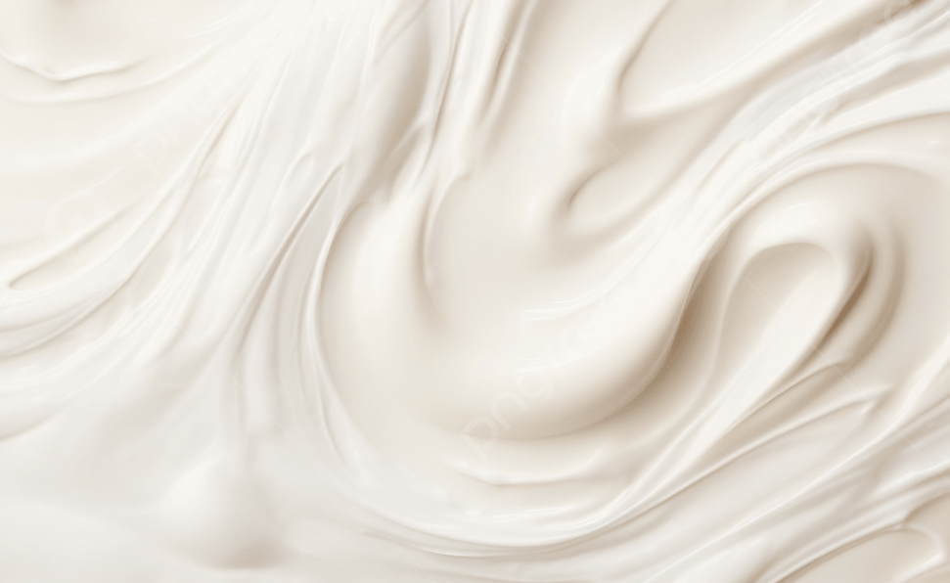
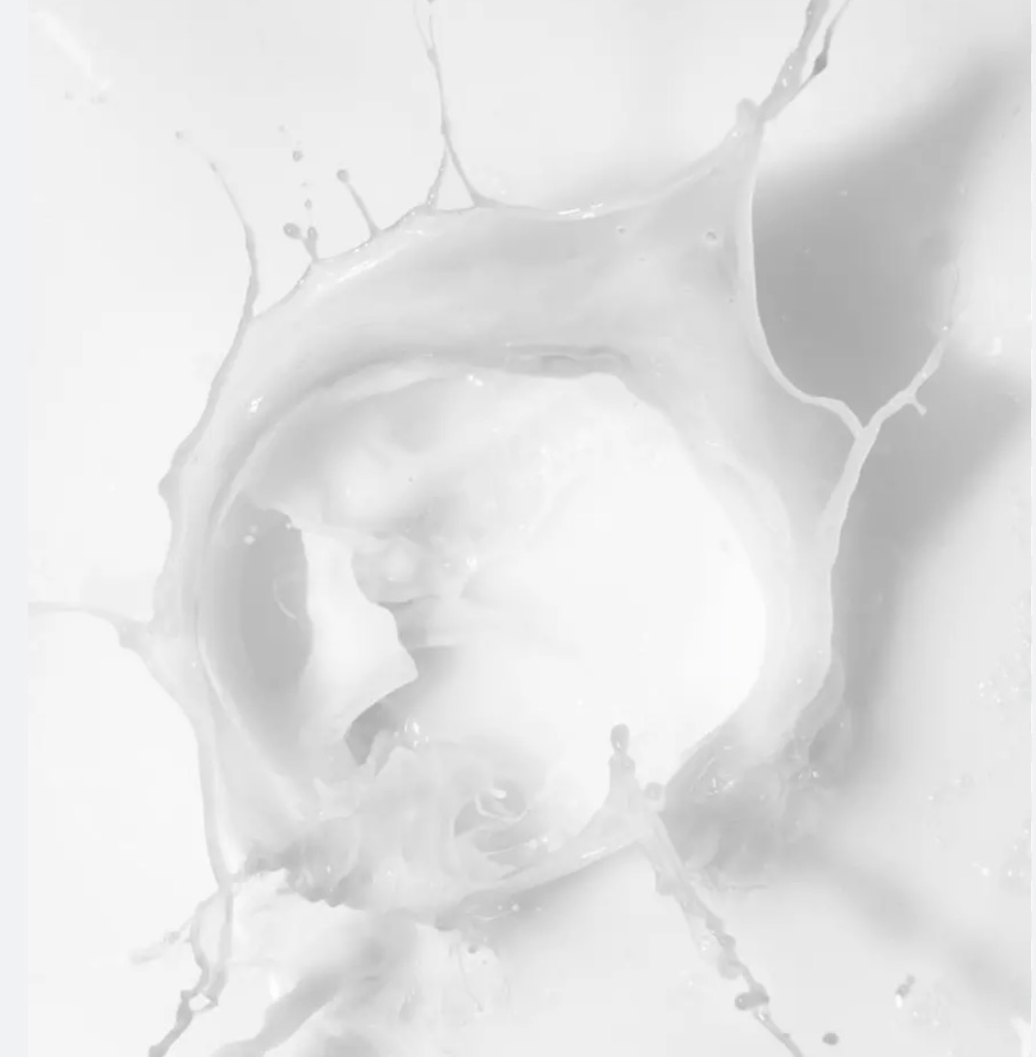
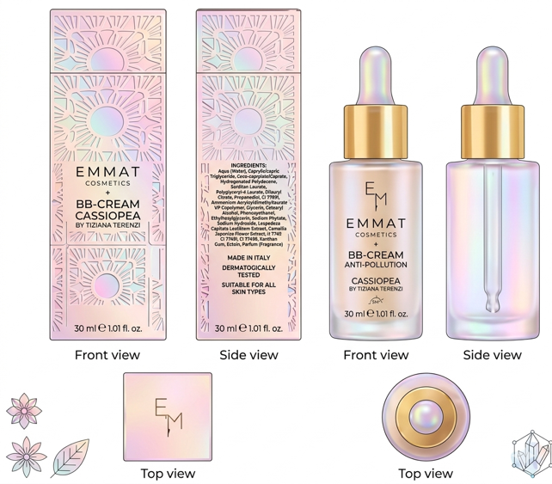
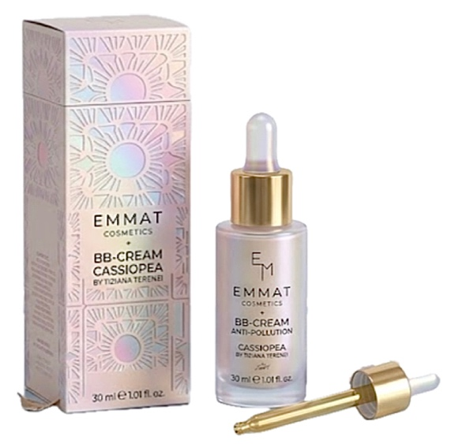
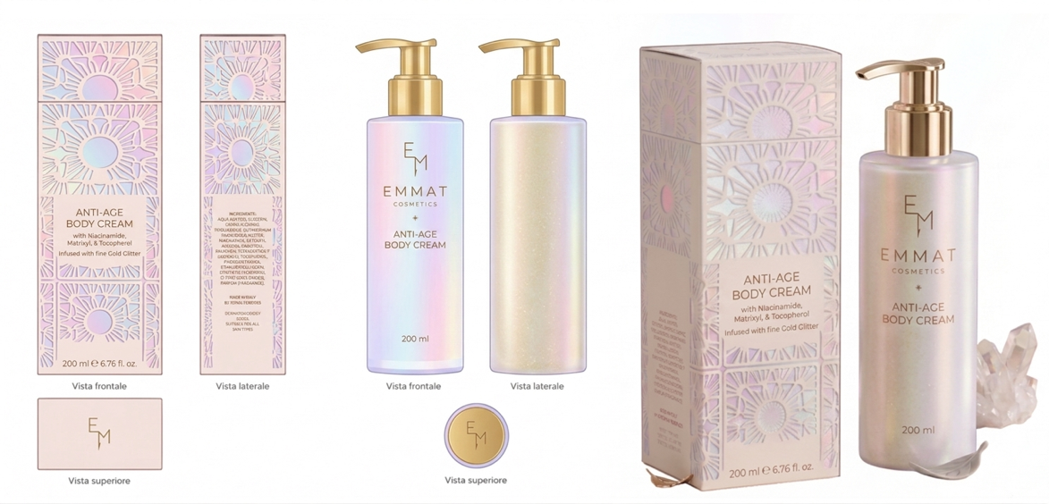
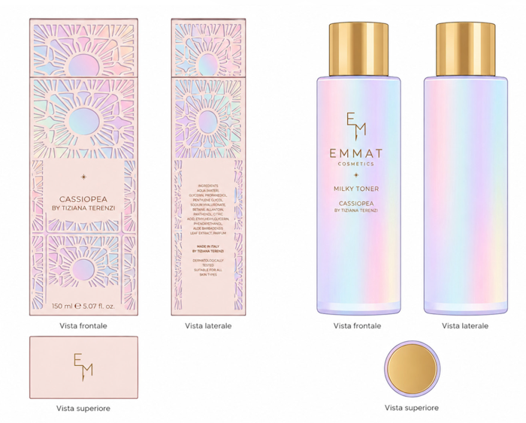
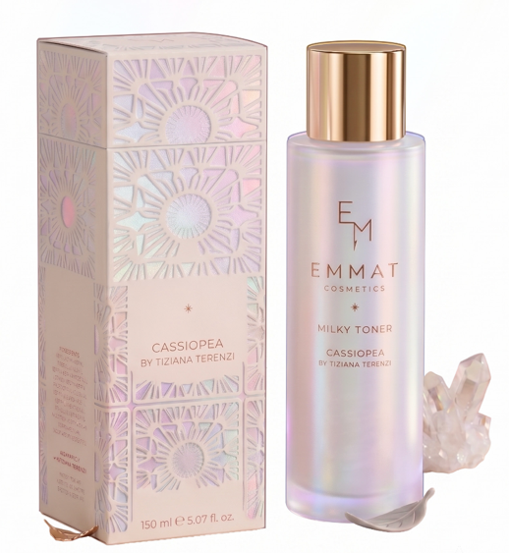
Candidate: Emma Terenzi
Academic Tutor: Prof. Antonella Casiraghi
Company Tutor: Dr. Nicola Lionetti
Cosmetic Industrial Science
Background and Aim of the thesis:
Natural O/W emulsifiers are increasingly replacing synthetic surfactants, driven by clean-beauty demand and by sustainability standards. At the same time, the skinification and K-beauty trends are raising the performance bar for lightness, absorption and multifunctionality, while formulating natural emulsions that remain stable across different oil phases, actives and pigments continues to be a genuine technical challenge.
This thesis carries out a systematic comparative screening of three natural O/W emulsifiers across seven experimental series, combining full physicochemical characterisation (pH, viscosity, centrifuge stability, optical microscopy) with sensory evaluation. The resulting dataset is then translated into three finished Cosmetics prototypes: a BB Cream, a Body Cream and a Milky Toner.
Methodology and Results:
S1
Mixed Oil Phase ± Stabilisers
S2
Oil Phase Load (10-30%)
S3
Oil Functional Groups
S4
Emulsifier Concentration
S5
Polymer Compatibility
S6
Emulsification Method
S7
Inorganic Pigments
Ester Blend
Sorbitan Laurate / PGL-4 Laurate / Dilauryl Citrate. .
This system only becomes stable once Xanthan Gum and Cetearyl Alcohol are combined, and it reaches its best performance at a 4% concentration. Coco-Caprylate/Caprate proved the most compatible oil, with an optimal load of 10-20%, giving a light, fluid, highly spreadable texture with the lowest soaping effect of the three systems.
It also showed excellent compatibility with inorganic pigments, reaching a colour homogeneity score of 7.3/10 and a blendability of 7.6/10, although at the 2% level it underwent delayed but complete phase separation after two months.
Alkyl Glucoside
C14-22 Alcohols / C12-20 Alkyl Glucoside. .,
This emulsifier builds lamellar liquid-crystal networks that provide intrinsic structuring even without added stabilisers, and it tolerates high oil loads of up to 30%, performing best at a 4% concentration. Its rich, occlusive texture leaves the highest shine and residual film of the three systems.
It proved incompatible with inorganic pigments, separating immediately once they were added, but over the three-month stability study it showed the best long-term behaviour of the three emulsifiers.
Modified Starch
Sodium Starch Octenylsuccinate .
This emulsifier stabilises through a Pickering mechanism, remaining stable even without any added stabilisers at 5%, and it tolerates a broad range of oils while reaching very high viscosities even at low oil fractions. On skin it is the fastest-absorbing of the three, leaving the lowest residual amount and a distinctive powdery after-feel.
The pigmented version stayed stable under centrifugation but showed oil migration on storage, and although the emulsion remained visually stable over three months, it lost around 59% of its initial viscosity.
Conclusion and Future Perspectives:
BB Cream Anti-Pollution
Built on a 4% Sorbitan Laurate/PGL-4 Laurate/Dilauryl Citrate system, this cream combines Ectoin, Lespedeza Capitata extract and Camellia Japonica extract in a triple anti-pollution mechanism that stabilises cell membranes, protects the skin’s circadian clock and scavenges free radicals.
The emulsion carries a fine, uniform pigment dispersion of 2-8 µm and is packaged in a glass dropper bottle.
Anti-Age Body Cream
This cream uses the C14-22 Alcohols/C12-20 Alkyl Glucoside system at 4%, enriched with Palmitoyl Tripeptide-38, Niacinamide, Sodium Hyaluronate and Allantoin. Its high-lipid lamellar structure, built on roughly 32% oil phase, delivers an occlusive, barrier-supportive texture.
It reaches perfect centrifuge stability at 20-30% oil and is dispensed from a pump bottle.
Milky Toner
The toner relies on Sodium Starch Octenylsuccinate at 2.5%, combined with Centella Asiatica triterpenoids, a postbiotic ferment and a multi-ceramide complex. Its low oil phase, around 8%, gives it the fast-absorbing, K-beauty-inspired texture of a hybrid toner-emulsion.
Droplets are fine, at 2-10 µm, and the product is packaged in a glass bottle fitted with an orifice-reducer cap.
Key Conclusions
Across the seven experimental series, each emulsifier revealed a distinct and consistent technical identity: interfacial-film mechanics for the ester blend, lamellar liquid-crystal co-assembly for the alkyl glucoside, and Pickering-type particle adsorption for the modified starch. The assignment of each system to its finished product was evidence-based, driven by pigment compatibility, oil-phase tolerance and sensory profile, and all three finished formulations achieved satisfactory pH and centrifuge stability at both t₀ and t_{24h}, confirming a successful transfer from screening to finished product.
Future Perspectives
Future work should extend the three-month ambient stability study to six to twelve months and to accelerated conditions at 40°C and explore secondary thickener systems to counter the viscosity loss observed for the starch-based platform.
Consumer and clinical testing of the three finished prototypes would help substantiate their sensory and efficacy claims, and the seven-series screening methodology developed here could be extended to other natural emulsifier classes as the portfolio of bio-derived ingredients continues to grow.

