Slide 1
Which of the sub reasons are causing the highest dispersion (distortion).
https://chatgpt.com/share/6a29bfec-53c0-83e8-92e7-08513fd9ccd1 https://chatgpt.com/share/6a29bffd-5524-83e8-9fa6-ef4205aea166 https://chatgpt.com/share/6a29c01b-9e18-83e8-bcdc-207cdd371cf1 https://chatgpt.com/share/6a29c031-0ee0-83e8-9772-4602fb4511ba https://chatgpt.com/share/6a29c14b-5564-83e8-9452-cec185a7cce7 https://chatgpt.com/share/6a29c177-17f0-83e8-8274-4b41218d9562 https://chatgpt.com/c/699fb4b9-2f38-8332-8292-2026d6cb5dee https://chatgpt.com/c/699fad70-050c-832d-852a-7319318c5c75
MAD in Data Distortion
Measuring Distortion in Data

Slide 2
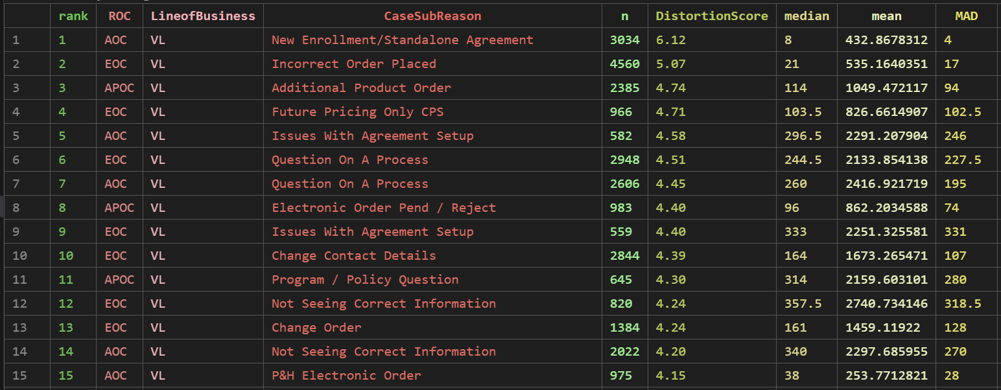
These are the top 15 combinations ranked based on a robust distortion score derived from relative dispersion (MAD/Median) and tail heaviness (log(P95/Median)).
The ranking is derived by evaluating how much each combination’s case times vary around their typical value (median) and how extreme the upper-end delays are compared to other combinations.

Slide 3
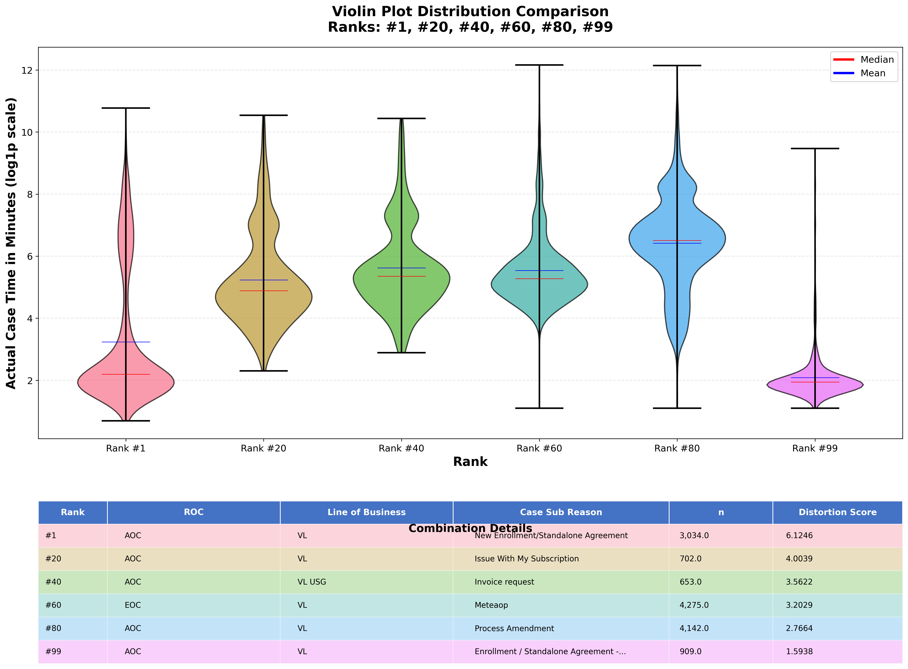
Comparison plot and their distribution for some ranks from 1 to 99.
Rank#1 high distortion and Rank#99 low distortion)
Characteristics of ideal violin plot
Symmetric distribution : Mean & Median close
Centrally concentrated : Highest peak at mean
Low skewness: Short tails
Single dominant peak : Less number of peaks

Slide 4
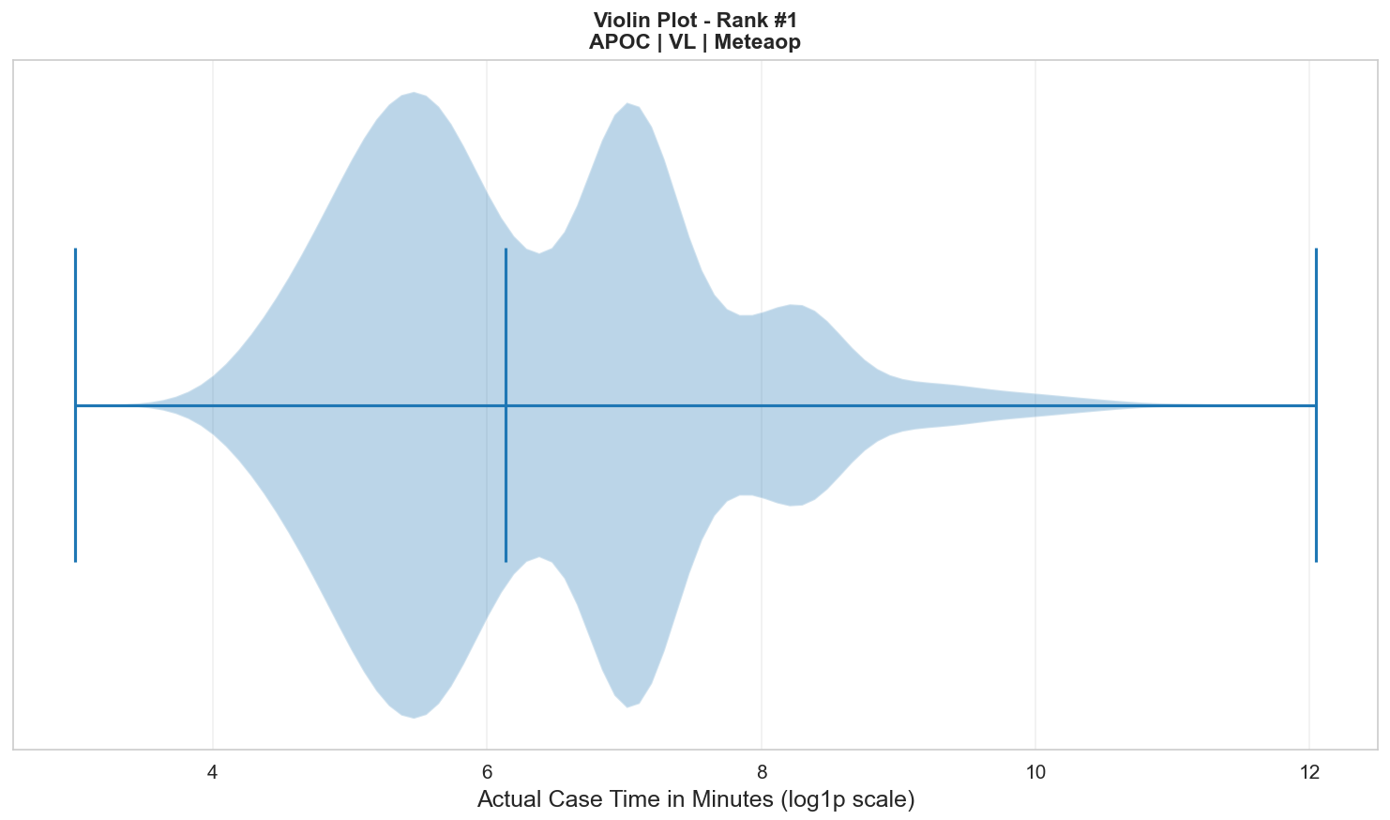
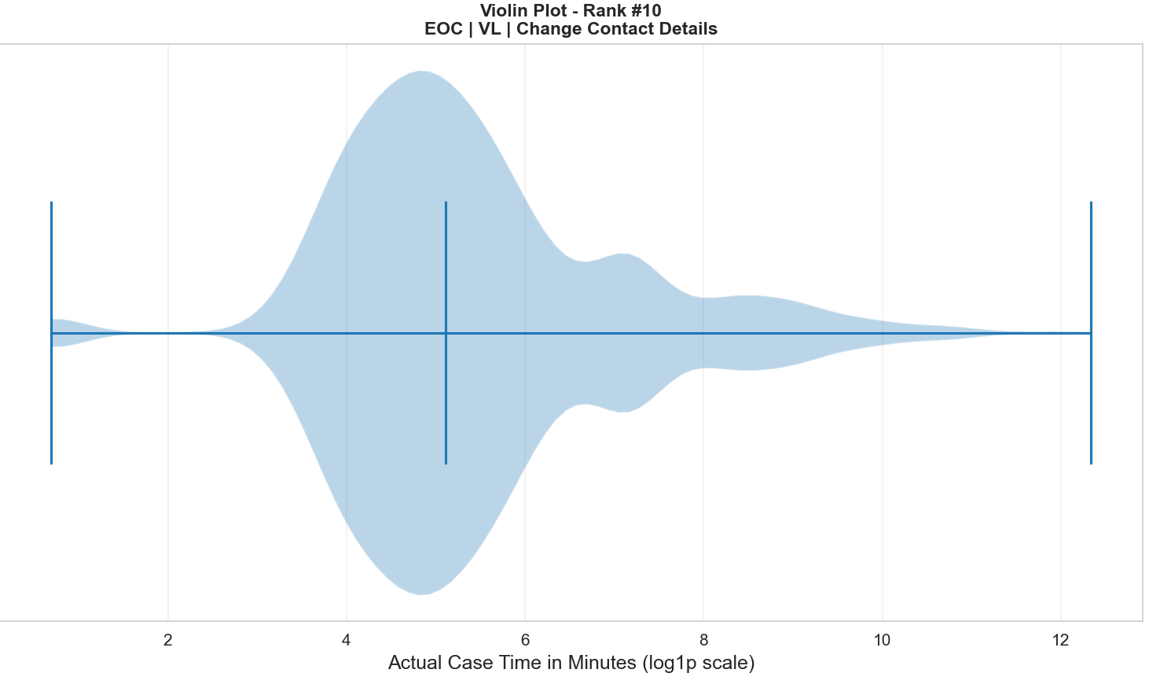

Slide 5
Metric | What It Shows
Median (P50) | The central value of the data. 50% of values are below it. Robust to outliers.
MAD (Mean Absolute Deviation) | Average absolute distance from the mean. Shows overall spread of data. Lower MAD = tighter clustering.
IQR (Interquartile Range) | Spread of the middle 50% of data (Q3 − Q1). Measures variability without influence from extreme values.
P95 (95th Percentile) | Value below which 95% of observations fall. Shows upper-tail behavior and extreme high values.
P50 (50th Percentile) | Same as median. Represents the typical/central value.
MAD / Median | Relative dispersion. Normalizes spread against central value. Higher ratio = more variability relative to scale.
P95 / P50 | Tail heaviness indicator. Shows how extreme the upper tail is compared to typical value. Higher ratio = skewed or heavy-tailed distribution.

Slide 6
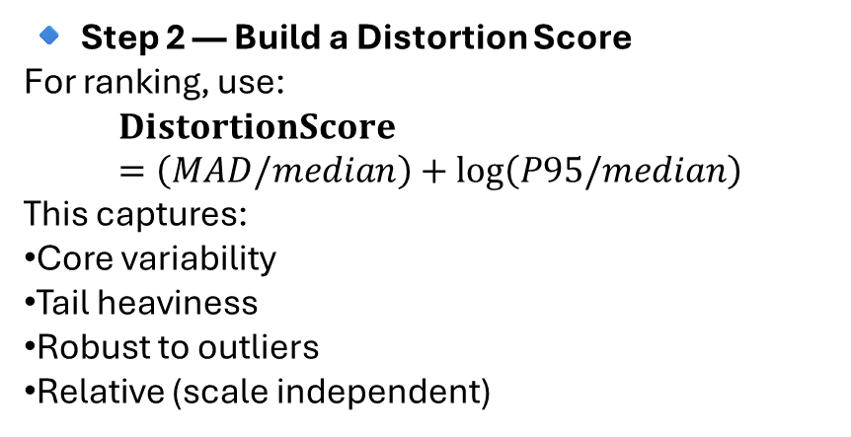
robust dispersion measures.
We compute dispersion per combination.
n → record count
median
MAD
Low – Tight clustering otherwise dispersed
IQR
P95
P50
MAD/median
P95/P50
🔹 Step 2 — Build a Distortion Score
For ranking, use:
$$\text{DistortionScore}=\left(MAD/median\right)+log⁡\left(P95/median\right)$$
This captures:
Core variability
Tail heaviness
Robust to outliers
Relative (scale independent)

Slide 7
DistortionScore=(MAD/median)+log(P95/median)
This captures:
Core variability
Tail heaviness
Robust to outliers
Relative (scale independent)
Higher distortion is not good distribution.
Lower distortion represents better distribution
n ≥ 500 to 800
Rank them from top distortion to lowest distortion

Slide 8
Plot | Why
Box Plot | Quickly shows spread, median, IQR, and outliers. Best first diagnostic.
Histogram (or KDE) | Shows distribution shape and skewness. Reveals tail stretch.
Violin Plot | Combines density + boxplot. Good for comparing multiple groups visually.
ECDF Plot | Clearly shows tail behavior (how fast values accumulate).

