Slide 1

COSMIC CASE SLA Prediction Catboost Machine Learning Algorithm
Date : 2-9-2026

Slide 2
Cosmic Case SLA Prediction
The COSMIC Case SLA Prediction project focuses on building a supervised regression model to predict case closure time at the point of case creation for license ticket requests. Each case is represented using structured categorical features including region, business function, line of business, case type, case reason, and country submitter. The modeling dataset comprises approximately 500,000 historical records, framing the problem as a large‑scale regression task with categorical feature dominance.
Model development was carried out using CatBoost and LightBoost gradient‑boosted decision tree algorithms, selected for their effectiveness on structured, categorical‑heavy datasets. The end‑to‑end machine learning pipeline included exploratory data analysis, feature engineering, model training, performance evaluation, hyperparameter tuning, and inferencing, resulting in a robust predictive framework capable of generating SLA estimates for newly created cases.

Slide 3
Activities done
ML Algorithm Comparative Analysis — Systematically evaluated XGBoost, LightGBM, and CatBoost for SLA prediction across five dimensions: categorical feature handling, high-cardinality performance, speed on ~1M rows, accuracy on mixed data, and suitability for 1M-level cardinality. CatBoost selected for native categorical handling and ordered boosting. Researched outlier handling strategies (IQR, Z-Score, Log Transform, Box Plot, Capping at 95th percentile, MAE vs MSE tradeoffs).
Log Transformation for Skewness — Applied log1p(target_minutes) transformation (y = ln(1+x)) to handle long-tail skewness in duration distribution; trained the regression model on the log-transformed target to normalize the heavily right-skewed SLA duration data.
Feature Engineering & Derivation — Derived four engineered features beyond the raw dataset: Daily_volume (case count per received date capturing team workload), hour_of_day (submission time-of-day effects), day_of_week (weekday/weekend patterns), and reason_median_speed (target encoding — median target_minutes per case reason, embedding historical resolution speed). Combined with 10 original dataset features including ROC, Line of Business, Program, Case Type/Subtype/Reason/Subreason, and Country.
Hold Time Feature Engineering — Studied overlapping hold record patterns across 170K records; researched interval merging algorithms to derive non-overlapping timelines; built compressed intelligence features (TotalHoldMinutes, MaxConsecutiveHoldDuration, AvgHoldDuration, NumberOfHoldSegments, EntropyOfReasons, %TimeInTopReason, DominantReason, FirstHoldReason, LastHoldReason, MostFrequentReason, NumberOfReasonSwitches) and validated their predictive significance for SLA outcomes.
High-Cardinality Categorical Feature Handling — Researched strategies for managing up to 140 categorical features: label encoding with ENABLE_CATEGORY=TRUE, grouping low-occurrence categories (fewer than 100 cases), truncation strategies, and exploratory data analysis on category distribution across features.
Exploratory Data Analysis & Visualization — Published category distribution charts across all features, skewness distribution plots with long-tail analysis, box plots for outlier identification, violin plots for distortion comparison across Line of Business × Case Subreason combinations. EDA drove decisions on truncation thresholds, feature selection, and outlier capping.
Hyperparameter Tuning — Compared GridSearchCV vs Optuna Bayesian optimization. GridSearchCV yielded final parameters: iterations=3000, learning_rate=0.015, depth=10, l2_leaf_reg=12, bagging_temperature=0.2, loss_function=MAE, eval_metric=R2, od_type=Iter, od_wait=200. Optuna-Bayesian did not yield better R² or MAE and took ~26 hours vs GridSearchCV's ~3 hours.

Slide 4
Activities done
Multi-Model Inference with Threshold-Based Routing — Built combined Regressor + Classifier inference pipeline. Regressor predicts SLA duration; Classifier categorizes risk. Integrated both models with threshold-based routing, tested with different quartile thresholds (0.75, 0.8) for truncation. Frontend developed to compare predicted vs actual values side by side.
Inference Pipeline for Live Cases — Developed inference code deployed to Azure Function App that accepts new case payloads via POST endpoint, runs prediction, and stores both the input payload and prediction output in Blob Storage. Frontend built to upload actual case values, invoke the prediction endpoint, and generate a comparison table of predicted vs actual SLA duration.
Performance Metrics & Score Progression — Tracked R² progression through iterative improvements: 0.49 → 0.51 → 0.59 → final 0.6014 with MAE of 102.89 minutes, truncated at 75th percentile. Performance metrics used: R² (variance explained by independent variables) and MAE (mean absolute error from derived equation). Identified root causes for remaining variance: cases reopened multiple times, tasks completed but not closed, human agent back-and-forth, and cases solved in under 5–30 minutes.
Dataset Refinement & Segmentation Strategy — Filtered extreme duration outliers (360 days → ≤31 days with SL and Signature-to-Invoice scoping), built exclusive models on category subsets (METEAOP subreason), scaled from curated subsets to 1,048,468 records (2025 data) with quartile-based filtering at 0.8. Identified audit history as source for new features explaining completion time variance.
Feature Selection from High-Dimensional Data — Researched key column identification and dependency mapping out of hundreds of columns in the Synapse dataset; studied feature importance, identified unimportant columns, and analyzed the impact of feature variance and data skew on model performance degradation.
Initial Algorithm Scoping: ML vs LLMs — Before converging on gradient-boosted trees, evaluated whether LLM-based approaches or classical ML were the right fit for SLA duration prediction on structured tabular data. Classical ML chosen for tabular numeric+categorical mix.
Prediction Clustering Root Cause Analysis — Investigated why all model predictions collapsed into a narrow 4–6 minute range; traced to feature variance issues and data skew; resolved through successive dataset refinement and feature engineering corrections.

Slide 5
SCOPE
Predict the duration required to close a newly opened case for Cosmic Case SLA, using Machine Learning Algorithm

Slide 6
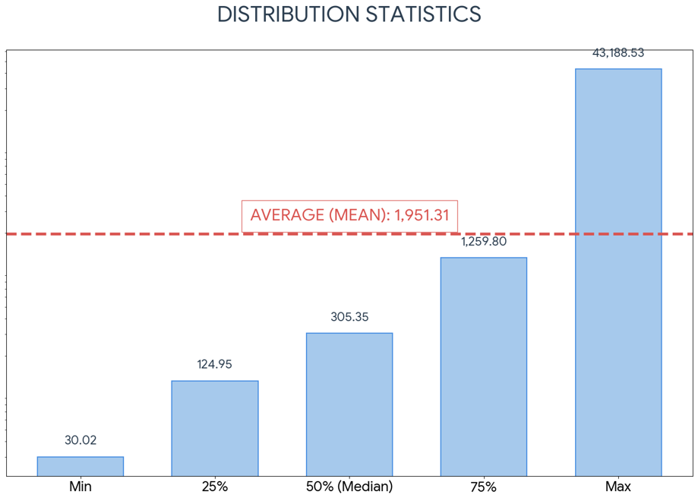

INPUT DATASET
405107
Number of records
Data from 2025 through Feb26
Features Considered for Model Training
Features from Dataset
Createdon
Resolvedon
msdyn_caserocname
msdyn_businessfunctionidname
msdyn_lineofbusinessidname
msdyn_programidname
msdyn_casetypeidname
msdyn_casesubtypeidname
msdyn_casereasonidname
msdyn_casesubreasonidname
msdyn_countrysubmitteridname
Derived Features
Duration
Day of the week
Volume per day
Reason_median_speed
Records considered for training = 338087 (less than 30day)
Longest closure time was up to 250+ days

Slide 7
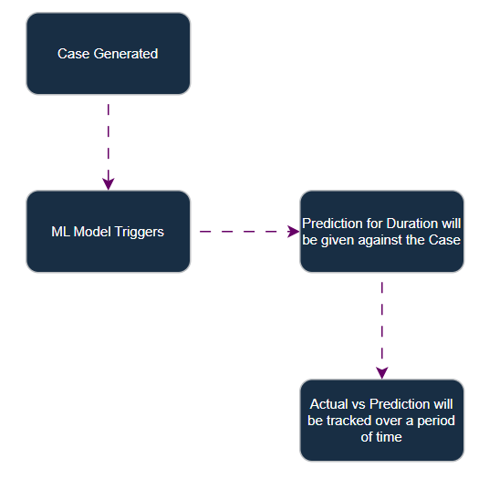
Machine Learning Process
Dataset Preparation
Exploratory data analysis
Feature Engineering
Model Selection
Model training
Model Evaluation
Hyper parameter Tuning
Model Deployment
Inference and Predictions
1. Date range, capping 30days, handling null values, missing values | 3. log function, new features, capping 0.75, 1100 minutes

Slide 8
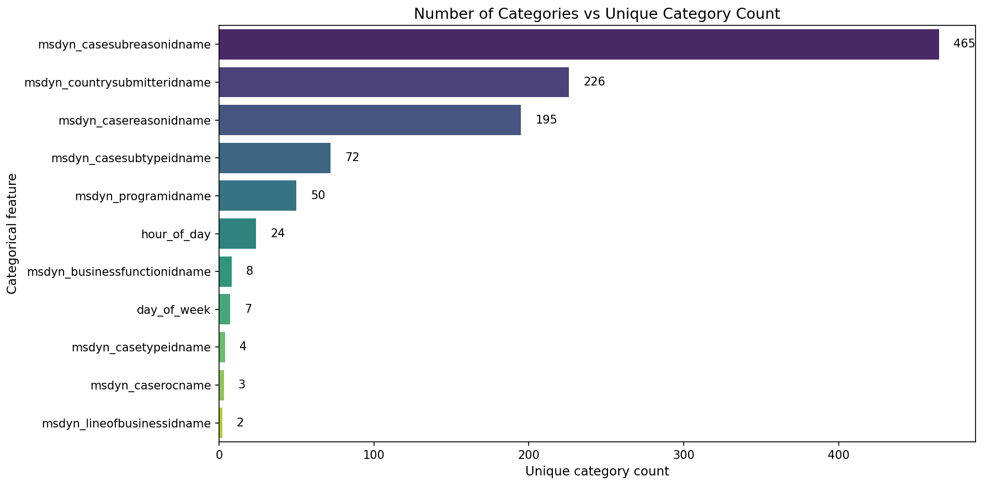
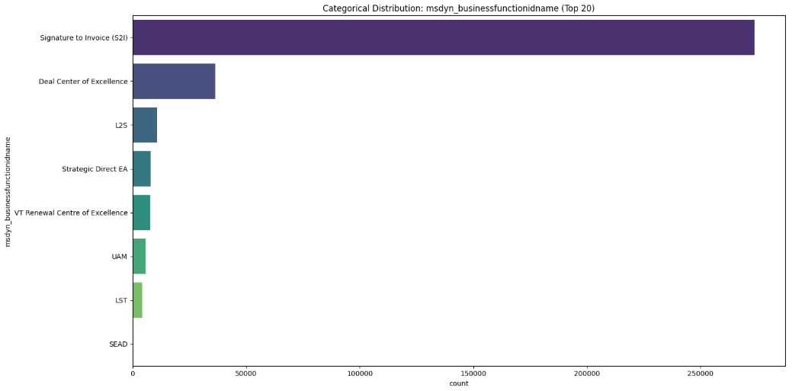
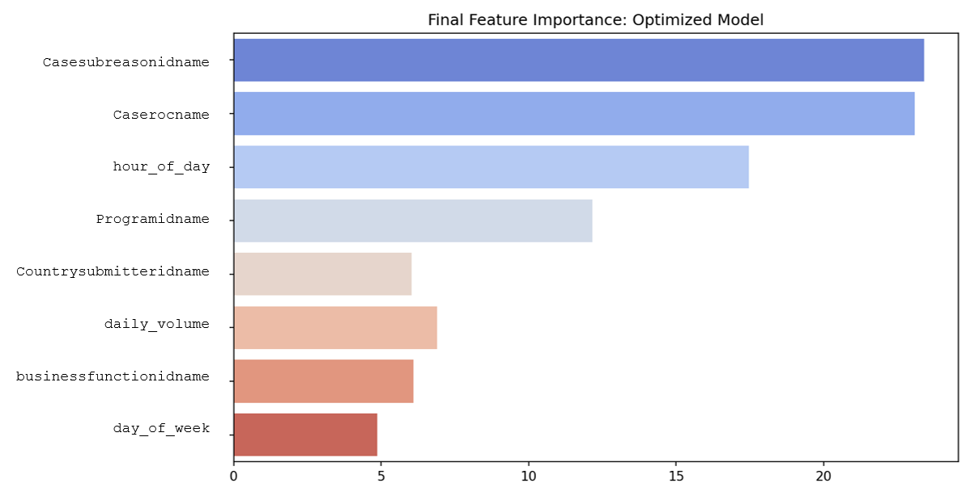
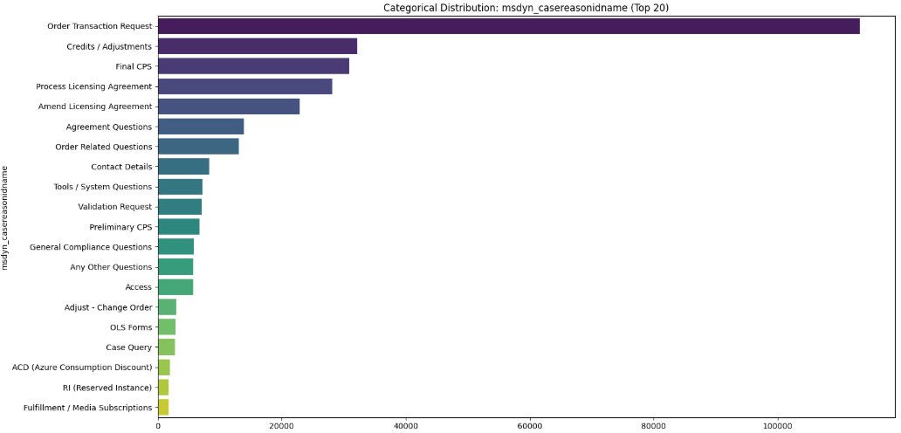
Exploratory Data Analysis
Categories in each Feature
Value Count against BusinessFunction
Features Importance
Value Count against CaseReason

Slide 9
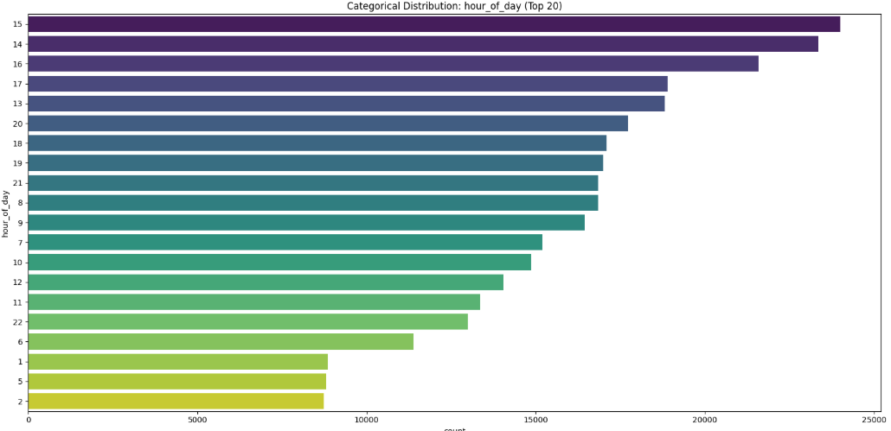
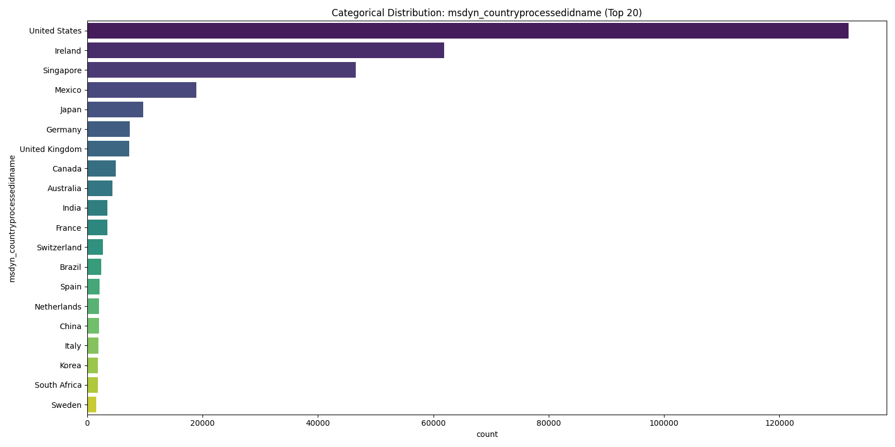
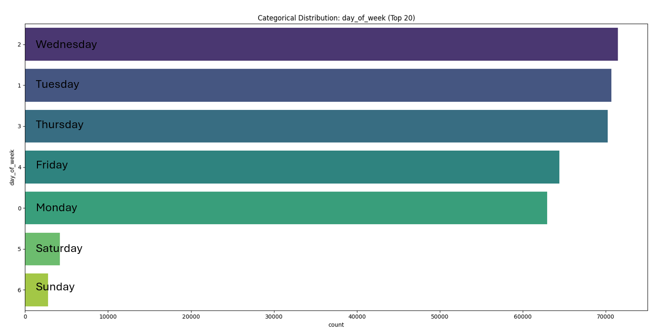
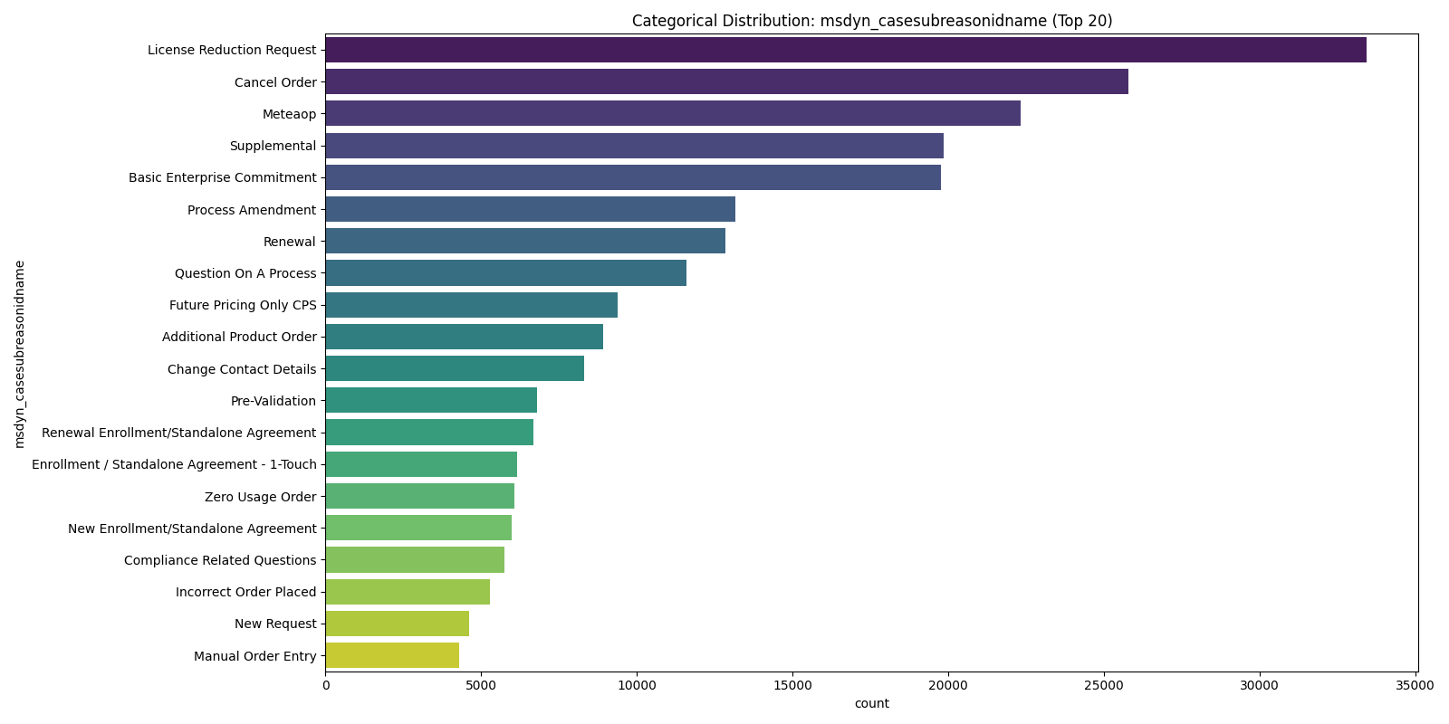
Exploratory Data Analysis
Value counts each hour (received date)
Value Counts against Country Processed
Value counts against day of the week (received date)
Value Counts against SubReason

Slide 10
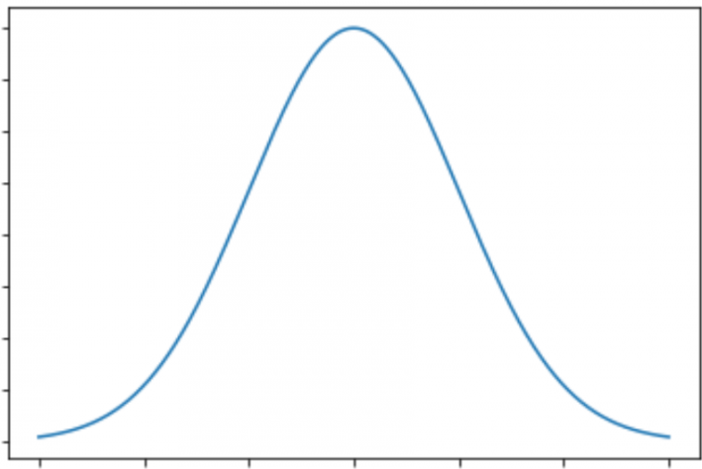
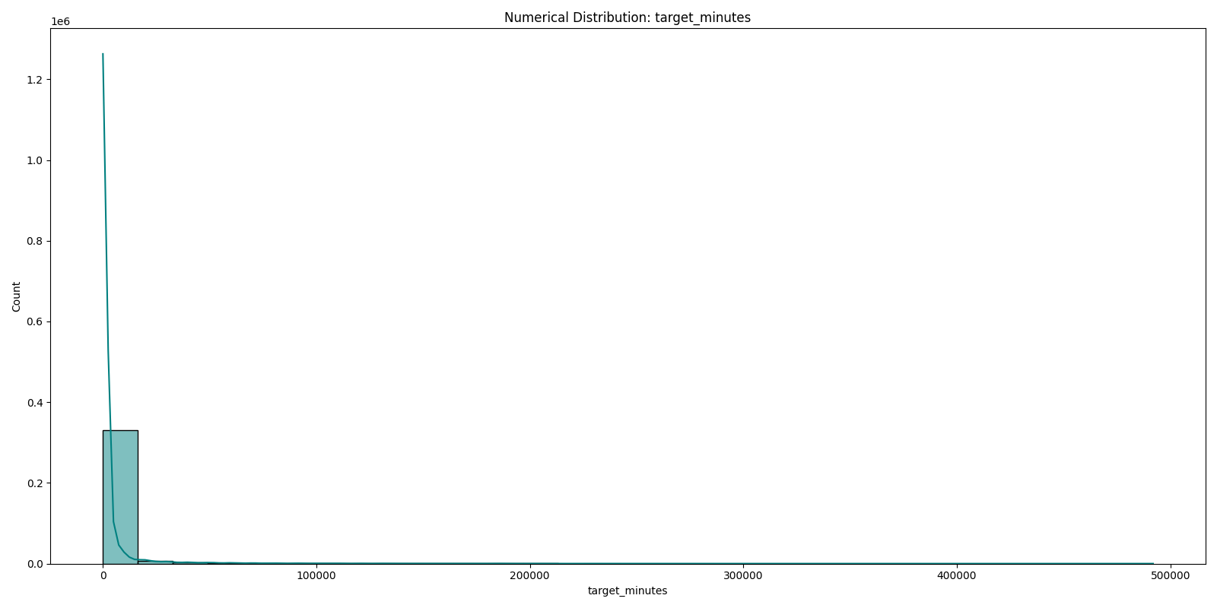
Skewness in the Distribution
With Longtail

Slide 11
Discoveries & Feature Engineering
Discoveries
Handle the Skewness of the data
Regression Algorithm
Hyper Parameter Tuning
Feature Engineering (Derived features)
Daily_volume: Count of cases per received date; captures team workload on that day.
hour_of_day : Hour extracted from received_dt; represents submission time-of-day effects.
day_of_week : Day index (0–6) from received_dt; captures weekday/weekend patterns.
reason_median_speed: Target encoding—median of target_minutes for a particular category
backlog_24h : how many cases were opened in last 24 hours
backlog_4h : how many cases were opened in last 44 hours

Slide 12
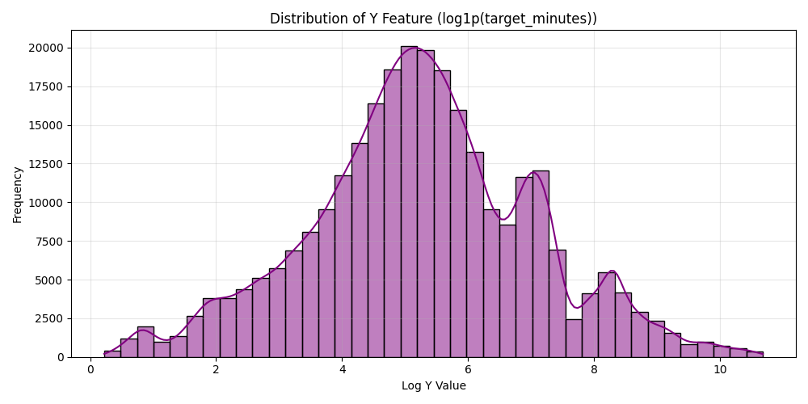
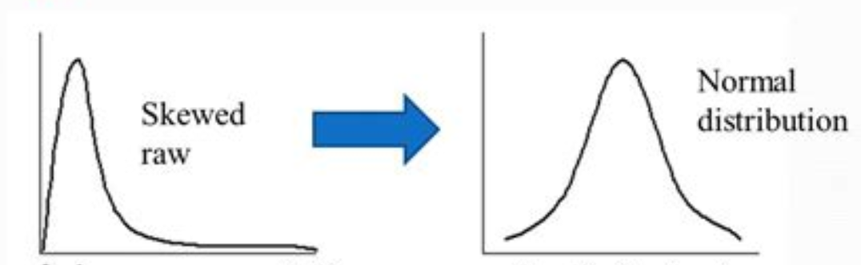
Data Transformation
Log transform: Train on log1p(target_minutes).
All the values are transformed to be in between 3 to 11
Large values lose their overpowering effect. Small and medium cases get balanced importance
y= ln(1 + x)
y= exp(x)-1

Slide 13
Model Selection Criterion
High Cardinality 250 + categories
1 Million records
Combination of Numerical and categorical features
y​=w1​x1​+w2​x2​+w3​x3​+b
While training the model lot of information is available but not while inferencing – Prediction shift
Dimension | CatBoost | XGBoost | Random Forest
Ordered Boosting | Can see the target value of the current record. Uses residuals computed from previous records to calc the weights. Cannot use future target values → prevents leakage. Prevents prediction shift | Can see the target values of the all the records. Uses standard Boosting | Uses standard Boosting
Handling Categorical Features | Exclusively designed to handle High cardinality (One‑hot, label, target encoding – Not Required) | Requires manual encoding (one‑hot, label, target encoding). High cardinality becomes expensive. | No native support; requires encoding. One‑hot encoding becomes impractical with high cardinality.
Dimensionality Explosion | Excellent — optimizes categorical statistics, less preprocessing bias. Best in class. No issue of dimensionality explosion (Dramatical increase of the columns | Poorer performance when encoding introduces noise or dimensionality explosion. | Moderate. Many independent trees suffer when categorical expansion degrades split quality.
Speed & Stability with 1Million Records dataset | Faster and stable prediction | Can slow down with high‑cardinality. Encoding is mandatory | Training is parallel and relatively fast, but performance stability degrades as cardinality.
Accuracy on Mixed Data (Cat + Numeric) | High — designed for mixed data (Cat + Numeric) ; reduces target leakage with ordered boosting. | Sensitive to encoding quality on categorical features. | Moderate–High, but usually lower than boosting methods on complex patterns.

Slide 14
Hyper Parameter Tuning
GridSearchCV vs Optuna-Bayesian optimization
Tuning Method : GridSearchCV
iterations = 3000
learning_rate = 0.015
depth = 10
l2_leaf_reg = 12
bagging_temperature = 0.2
loss_function = 'MAE'
eval_metric = 'R2'
cat_features = final_cat_features
R2 & MAE Value Improved after the fine tuning with GridSearch CV
Optuna - Bayesian which didn’t yield good results with R2 Score and MAE. Took a longer time up to 26 Hours, where as GSCV took about 3 hours

Slide 15
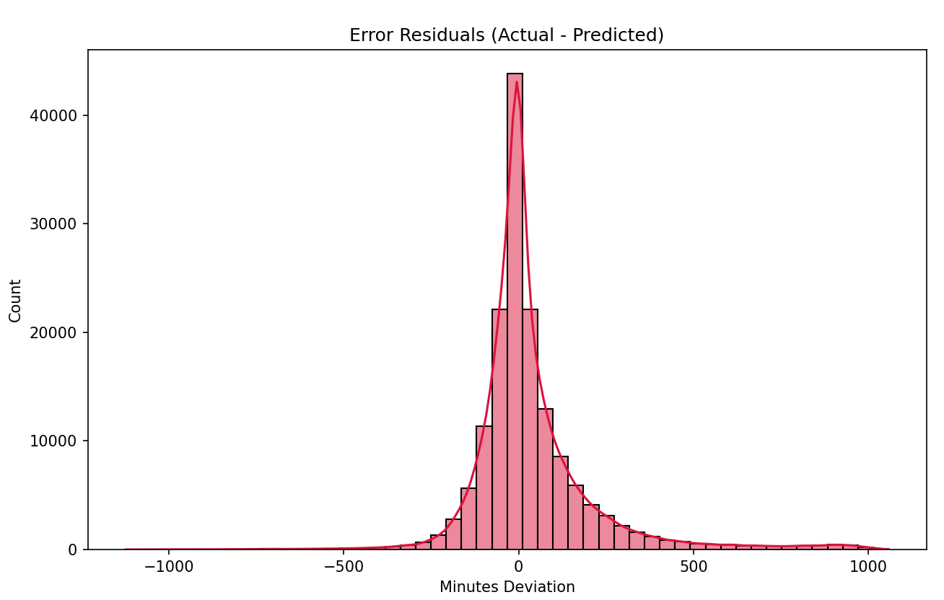
Model Evaluation & Performance Metrics
Final R2 Score: 0.6014
Final MAE: 102.89 minutes
Minutes : 1075.5 (18 Hours)
0.75
R2 : How well the regression Models fits the data. The Independent variables explain the variance. What % it is learnt and clear
MAE : Mean Absolute error. From the derived equation what is the error
Truncated to 75%. It is working well. There are several other things happened after that

Slide 16
Observations and Further Investigation :
Some cases are opened and closed serval times before it is getting completed.
Task completed but not closed.
Human element involved. Possible feature for skill level
The tickets being flowing among many Human agents back and forth.
Some cases are solved in less than 5 to 30 minutes
Analysis on Audit History
Deriving some new features from the Audit History. Deep dive into different scenarios. Finding the attributes which are contributing to Skewness in duration

Slide 17
Thank you

