Slide 1
Addressing in the TCP/IP model
IN2140: Introduction to Operating Systems and Data Communication
Layer 3 Addressing: IPv6 addresses
Notes:
Vi snakket om L3 adresser, altså IP adresser, allerede i den forrige forelesningen.
Men da begrenset vi oss til IPv4 adresser, som verden egentlig har gått tomt for. Vi rakk ikke å snakke om IPv6, og dette skal vi ta nå.
Egentlig er IPv6 bare enklere strukturert enn IPv4, og derfor tar det ikke så veldig lang tid.
Men må går først tilbake til sentrale IPv4-ideer som også gjelder i IPv6.

Slide 2
CIDR: Classless InterDomain Routing
Idea
local decision for subdividing host share into network portion and end system portion
20
16
B
10
e.g. address
129.8.7.2:
1
0
Network
Host
To write down subnet address with netmask use either
129.8.4.0/255.255.252.0
or
129.8.4.0/22
1
&
0
0
0
0
0
0
1
0
0
0
0
1
0
0
0
0
0
0
0
0
1
1
&
1
0
0
0
0
0
0
1
0
netmask:
1
1
1
1
1
1
1
1
1
1
1
1
1
1
1
1
1
1
1
1
1
1
0
0
0
0
0
0
0
0
0
0
net address:
1
0
0
0
0
0
0
1
0
0
0
0
1
0
0
0
0
0
0
0
0
1
0
0
0
0
0
0
0
0
0
0
Use “netmask” to distinguish network part from host part
Routing with 3 levels of hierarchy
end system: compute “dst addr & netmask == subnet addr”
TRUE: packet to local end system (perhaps ARP, then deliver packet)
FALSE: packet to another network (send to this network’s router)
router: compute “dst addr & netmask == subnet addr”
TRUE: packet to local end system (perhaps ARP, then deliver packet)
FALSE: packet to another network (look up in routing table, send to other router)
Notes:
Først kommer nettmaskene. Det finnes bare et stort navnerom for L3 addresse (vel, et rom for IPv4 og et from for IPv6).
Siden vi har gått tomt for IPv4 adresser bruker vi tricks som NAT – network address translation – for å leve uten IPv6 i noen år til, men prinsipielt skal man kunne finne maskiner entydig med bare deres IP adresse.

Slide 3
CIDR: Classless InterDomain Routing
Rule of the longest match
if several entries with different subnet mask length may match then use the one with the longest mask
000010xx
11111100
00000xxx
11111000
194.24.0.0/21
Router B
194.24.8.0/22
Router C
194.24.0.0/19
Router A
Unassigned 194.24.12.0/22
1100001000011000
000xxxxx
11100000
xxxxxxxx
194.24.16.0/20
Router D
1111111111111111
00000000
0001xxxx
11110000
000011xx
11111100
Notes:
19: de siste 13 bittene er reservert for adresser som kan ligge innenfor nettet

Slide 4
CIDR: Classless InterDomain Routing
Rule of the longest match
if several entries with different subnet mask length may match then use the one with the longest mask
000010xx
11111100
00000xxx
11111000
194.24.0.0/21
Router B
194.24.8.0/22
Router C
194.24.0.0/19
Router A
Unassigned 194.24.12.0/22
1100001000011000
000xxxxx
11100000
xxxxxxxx
194.24.16.0/20
Router D
1111111111111111
00000000
&: fit
0001xxxx
11110000
000011xx
11111100
&: fail
Route this address:
194.24.6.12
&: fail
&: fit
&: fail
00000110
Notes:
de første 16 bittene må være identiske – alle 5 masker har flere enn 16 bit i starten satt til 1
de siste 8 bittene spiller ikke noen rolle for rutingen – ingen av de 5 maskene har mindre enn 24 bit I starten satt til 1
dette gjør eksempelet vårt enkel: vi må bare se på byte 3 og de bittene i byte 3 som gjelder

Slide 5
CIDR: Classless InterDomain Routing
Rule of the longest match
if several entries with different subnet mask length may match then use the one with the longest mask
000010xx
11111100
00000xxx
11111000
194.24.0.0/21
Router B
194.24.8.0/22
Router C
194.24.0.0/19
Router A
Unassigned 194.24.12.0/22
1100001000011000
000xxxxx
11100000
xxxxxxxx
194.24.16.0/20
Router D
1111111111111111
00000000
&: fail
0001xxxx
11110000
000011xx
11111100
&: fit
Route this address:
194.24.10.12
&: fail
&: fit
&: fail
00001010

Slide 6
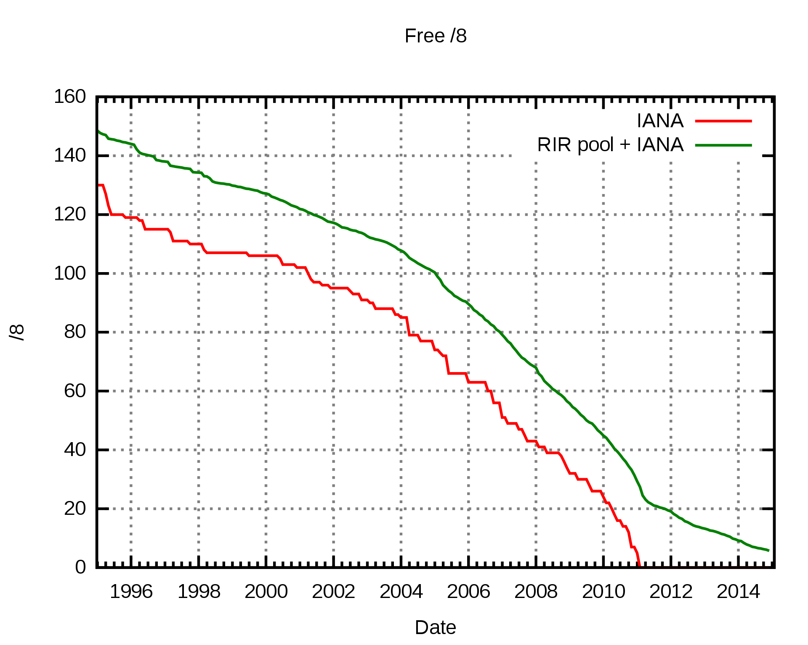
IP Version 6 (IPv6)
Motivation for IPv6: problems with IPv4
Too few addresses
Bad support for QoS
Bad support for mobility
Many other shortcomings …
IANA: Internet assigned numbers authority
RIR: regional Internet registry
Example consequences:
no IP addresses for individuals
large-scale sharing of Internet addresses in local networks using NAT
Microsoft using addresses from RIR LACNIC (Latin America & Caribbean NIC) for Cloud nodes in North America
[by Mro, CC BY-SA 4.0, https://commons.wikimedia.org/w/index.php?curid=10593349]
Notes:
By Mro - Own work, CC BY-SA 4.0, https://commons.wikimedia.org/w/index.php?curid=10593349
LACNIC: Latin America and Caribbean Network Information Centre

Slide 7
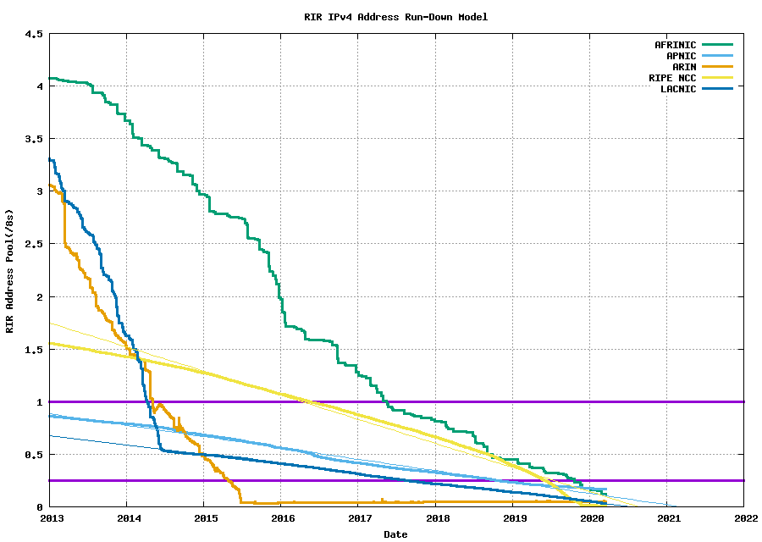
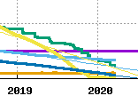
IP Version 6 (IPv6)
Motivation for IPv6: problems with IPv4
Too few addresses
Bad support for QoS
Bad support for mobility
Many other shortcomings …
Latin America & Caribia
Africa
Asia-Pacific
North America
Europe
from the Blog potaroo.net by Geoff Huston, Chief Scientist at APNIC
Notes:
From the blog of Geoff Huston, Chief Scientist at APNIC
Data from APNIC

Slide 8
IPv6 Objectives
To support billions of end systems
longer addresses
To reduce routing tables
To simplify protocol processing
simplified header
To increase security
security integrated
To support real-time data traffic
flow label, traffic class
To provide multicasting
To support mobility (roaming)
To be open for change (future)
extension headers
To coexist with existing protocols
Scalability
Addressing IPv4
limitations
Coexistance

Slide 9
IPv4 and IPv6
shown as 32 bits per line
Version
IHL
DSCP
Type of service
Total length
ECN
Identification
D
M
Fragment offset
Time to live
Protocol
Header checksum
Source address (32 bit)
IPv4 Header
Destination Address (32 bit)
Options (0 or more)
L4 Data
shown as 32 bits per line
New IPv6 header
is larger but simpler
Version
DSCP
ECN
Flow label
Payload length
Next header
Hop Limit
Source address
(128 bit)
IPv6 Header
packet can never be fragmented, now an L4 task
options are now payload (data)
checksum is now an L2/L4 task
Destination Address
(128 bit)
L4 Data
Notes:
IPv6 header: 40 bytes, IPv4 header: from 20 bytes up to 60 bytes
total length in bytes: 16 bit -> 1 opphøyd i 16, 65536, much bigger than packets today
større pakker er mulig (jumbograms) – mulig ved bruk av en extension header – sett payload len til 0 og bruk opsjonen
Header checksum
L2 and L4 have sufficient mechanisms
Communication channels better nowadays, at the expense of the performance

Slide 10
IPv6 addresses
example of the IPv6 address spaces
shown as 64 bits per line
network prefix
subnet identifier
interface identifier
a typical routed address
00101010000000000001010001010000010000000000111100001000000010100000000000000000000000000000000000000000000000000010000000000100
a bit more compact: 2a00:1450:400f:080a:0000:0000:0000:2004
This is an address for www.google.com
2
a
0
0
:
1
4
5
0
:
4
0
0
f
:
0
8
0
a
:
:
:
:
0
0
0
0
0
0
0
0
0
0
0
0
2
0
0
4
Notes:
QUESTION: It is forbidden to write the address with 2 or more sets of compressed zeroes. Why?

Slide 11
IPv6 addresses
example of the IPv6 address spaces
shown as 64 bits per line
network prefix
subnet identifier
interface identifier
a typical routed address
IPv6 addresses are written in sets of 2 bytes in hexadecimal notation
2a00:1450:400f:080a:0000:0000:0000:2004
sets of zero can be compressed:
2a00:1450:400f:80a::2004
this address is part of the network 2a00:1450:400f::/48 which is known to be used by Google since 12/2018
So, its netmask has 48 1-bits followed by 80 0-bits
Notes:
QUESTION: It is forbidden to write the address with 2 or more sets of compressed zeroes. Why?
1 208 925 819 614 629 174 706 176 approx 10^24

Slide 12
IPv6 addresses
example of the IPv6 address spaces
shown as 64 bits per line
network prefix
subnet identifier
interface identifier
a typical routed address
Acquiring IPv6 addresses for mobile computers
getting a non-routable IPv6 address using auto-configuration
self-assigns an IPv6 address consisting of prefix FE80::0 followed by the interface identifier (RFC4291), which is created from the MAC address (RFC 8064)
before using the address, “Neighbour Solicitation” ICMP message must be sent to ensure the address is not in use yet (RFC4443) – variation of ARP Probe
DHCPv6 to ask for a routable address
requires auto-configured local address first
Mobile IPv6 to transfer routable home address to visited network
requires auto-configured local address first

Slide 13
IPv6 addresses
example of the IPv6 address spaces
shown as 64 bits per line
1
1
1
1
1
1
1
0
1
0
all zeroes
interface identifier
a link-local address
Acquiring IPv6 addresses for mobile computers
example IPv6 address of jordin.ifi.uio.no: fe80::250:56ff:fe80:3f82
which is an abbreviation for fe80:0000:0000:0000:0250:56ff:fe80:3f82
for us, so far mostly worthless because UiO does not route IPv6 anyway

Slide 14
Addressing in the TCP/IP model
IN2140: Introduction to Operating Systems and Data Communication
Layer 4 Address Resolution: Ports and more

Slide 15
Transport Layer Function
Transport layer tasks
5
Application
Application
Layer
Application
5
1. Addressing
Transport
Layer
Transport
Layer
Transport
Layer
4
Application
Layer
4
Network
Layer
Network
Layer
Network
Layer
3
Transport
Layer
3
1-2
Network
Layer
1-2
Notes:
Tanenbaum 6.0+6.1

Slide 16
Transport Layer Function
Transport layer tasks
5
Application
Application
5
1. Addressing
Transport
Layer
Transport
Layer
4
4
2. End-to-end connection management
Network
Layer
Network
Layer
3
3
1-2
3. Transparent data transfer between processes
1-2
4. Quality of service options
Error recovery
Reliability
Flow control
Congestion control
Notes:
Addressing: machines + processes
Transparent data transfer between endpoints: hide topology, hide network peculiarities, de-/multiplexing
QoS: error recovery, reliability, flow control (hide speed diff), congestion control (adapt to network capabilities)
Next year: symbolize transfer with packets and find animation for QoS and its problems

Slide 17
Transport Layer Addressing
Transport
Protocol
Port
Service Interface
Application
Layer
Application
Layer
Addresses
TCP/IP 1. Port
2. IP address !!
ISO TSAP
(transport service access point)
5
Transport
Entity
Transport
Entity
4
Network
Layer
Network
Layer
3
1-2
TCP: Message, UDP: Datagram, ISO: TPDU
Notes:
Historically in Unix: socket = TSAP

Slide 18
Transport Layer Function
UDP
TCP
int main()
{
…
if((sock = socket(AF_INET, SOCK_DGRAM, 0)) < 0)
{ … }
memset(&addr, 0, sizeof(addr));
addr.sin_family = AF_INET;
addr.sin_addr.s_addr = INADDR_ANY;
addr.sin_port = htons(PORT);
if(bind(sock,(struct sockaddr *)&addr,
sizeof(addr))<0)
{ … }
len = sizeof(struct sockaddr_in);
n = recvfrom(sock,(char*)buffer,buflen,0,
(struct sockaddr*)&addr,&len);
…
sendto(sock,(char*)msg, strlen(msg),
0,(struct sockaddr*)&addr,len);
…
}
int main()
{
…
if((sock = socket(AF_INET, SOCK_STREAM, 0))<0)
{ … }
…
memset(&servaddr, sizeof(addr));
addr.sin_family = AF_INET;
addr.sin_addr.s_addr = INADDR_ANY;
addr.sin_port = htons(PORT);
…
if((bind(sock,(struct sockaddr*)&addr, sizeof(addr)))<0)
{ … }
if((listen(sock,10))<0)
{ … }
len = sizeof(struct sockaddr_in);
conn = accept(sock,(struct sockaddr*)&addr,&len);
if(conn < 0) { … }
len = sizeof(buf); i=0;
while(len>0 && n=read(conn,&buf|i],len))
{ i+=n; len-=n; }
if(n<=0) { … }
…
write(conn,buf,1);
…
}
Connectionless
No error recovery
No reliability
No flow control
No congestion control
Connection-oriented
Error recovery
Reliability
Flow control
Congestion control

Slide 19
Transport Layer Function
UDP
TCP
int main()
{
…
if((sock = socket(AF_INET, SOCK_DGRAM, 0)) < 0)
{ … }
memset(&addr, 0, sizeof(addr));
addr.sin_family = AF_INET;
addr.sin_addr.s_addr = INADDR_ANY;
addr.sin_port = htons(PORT);
if(bind(sock,(struct sockaddr *)&addr,
sizeof(addr))<0)
{ … }
len = sizeof(struct sockaddr_in);
n = recvfrom(sock,(char*)buffer,buflen,0,
(struct sockaddr*)&addr,&len);
…
sendto(sock,(char*)msg, strlen(msg),
0,(struct sockaddr*)&addr,len);
…
}
int main()
{
…
if((sock = socket(AF_INET, SOCK_STREAM, 0))<0)
{ … }
…
memset(&servaddr, sizeof(addr));
addr.sin_family = AF_INET;
addr.sin_addr.s_addr = INADDR_ANY;
addr.sin_port = htons(PORT);
…
if((bind(sock,(struct sockaddr*)&addr, sizeof(addr)))<0)
{ … }
if((listen(sock,10))<0)
{ … }
len = sizeof(struct sockaddr_in);
conn = accept(sock,(struct sockaddr*)&addr,&len);
if(conn < 0) { … }
len = sizeof(buf); i=0;
while(len>0 && n=read(conn,&buf|i],len))
{ i+=n; len-=n; }
if(n<=0) { … }
…
write(conn,buf,1);
…
}
Bind the port PORT to the socket
Bind the port PORT to the socket
But how to inform the other side about this port number?

Slide 20
Addressing at the Transport Layer
What are their ports?
SSH
client
SSH
server
DNS
client
DNS
server
HTTP
client
HTTP
server
Transport
Network
Data link
Physical
“Simple” answer for servers
Notes:
SSH – 22
DNS – 53
HTTP - 80

Slide 21
Addressing at the Transport Layer
There is a list maintained by IANA – Internet Assigned Numbers Authority
TCP and UDP have separate assignments
same port number – different service
The table shows some examples for TCP (read /etc/services for more)
Port Number | Service | Service name
22 | SSH | Secure Shell
25 | SMTP | Simple Mail Transfer Protocol
53 | DOMAIN | Domain Name Systems
80 | HTTP | Hypertext Transport Protocol
110 | POP3 | Post Office Protocol, version 3
123 | NTP | Network Time Protocol
143 | IMAP | Internet Message Access Protocol

Slide 22
Multiplexing task of the Transport Layer
Multiplexing and demultiplexing task of the transport layer
Example: accessing a web page with video element
Three protocols used (minor simplification)
HTTP for web page
RTSP for video control
RTP for video data
port 80
Web server
Video
server
Video
plugin
Web
browser
port 554
5
TCP
UDP
UDP
TCP
4
ports
dynamically
chosen
Network
Layer
Network
Layer
3
1-2

Slide 23
Multiplexing task of the Transport Layer
Multiplexing and demultiplexing task of the transport layer
Example: accessing a web page with video element
Three protocols used (minor simplification)
HTTP for web page
RTSP for video control
RTP for video data
Web server
Video
server
Video
plugin
Web
browser
5
TCP
UDP
multiplexing
UDP
TCP
4
demultiplexing
IP addr 1
IP addr 2
3
same IP address for
all services
1-2

Slide 24
Connection – Addressing
TCP service obtained via service endpoints on sender and receiver
Typically socket
Socket number consists of a 3-tuple
IP address of host and
16-bit local number (port)
TCP protocol identifier
Transport Service Access Point
Port
TCP connection is clearly defined by a 5-tuple consisting of
IP address of sender and receiver
Port address of sender and receiver
TCP protocol identifier
Applications can use the same local ports for several TCP connections
if the remote side is different
Server offers (IP addr/port/TCPid)
(80.80.1.1/80/6)
80.80.1.1
80
(IP addr sender/port sender/
IP addr recv/port recv/TCPid)
(129.3.3.3/4000/80.80.1.1/80/6)
4000
(241.240.2.2/3210/
80.80.1.1/80/6)
129.3.3.3
4000
3210
(241.240.2.2/4000/ 80.80.1.1/80/6)
241.240.2.2
Notes:
Mention passive open and active open
Highlight on: mention “quadruple”

Slide 25
Addressing in the TCP/IP model
IN2140: Introduction to Operating Systems and Data Communication
Layer 5 Address Resolution: DNS -- Domain Name System

Slide 26
How to connect to a remote computer?
Connect to <hostname,port>
e.g. telnet 127.0.0.1 23 or telnet ::1 23 talking to my own machine special addresses
or wget http://173.194.39.31:80/ talking to one of Google’s machines possible to remember
or ssh 9.228.93.3 trying to talk to my desktop that had this address in 1995 impossible to remember unless you’ve typed it 100 times a day
If you want short names, write them into /etc/hosts
originally globally maintained by SRI, changes re-distributed by email and ftp (no more, ancient history)
Notes:
SRI / SRI International - Stanford Research Institute

Slide 27
How to connect to a remote computer?
Use “reasonable” names
e.g. ssh login.ifi.uio.no wget www.google.com
not only easier to remember
reflects also organisation structures
although the hierarchical structure may not fulfill all purposes
somewhat related to physical network structure, at least locally
Domain Name System (DNS)

Slide 28
DNS at a High-Level
Domain Name System
Hierarchical namespace
As opposed to original, flat namespace
e.g. .com → google.com → mail.google.com
Distributed database
Simple client/server architecture
UDP or TCP port 53
servers must use TCP nowadays
clients using TCP are mostly rejected
reduces server load
is a security problem
Notes:
UDP: connectionless transport, unordered and errors possible
TCP: connection-oriented transport, ordered and error-free

Slide 29
Naming Hierarchy
root servers
TLDs – top level domains
Root
net
edu
com
gov
mil
org
uk
no
etc.
uio
hioa
Each Domain Name is a subtree
.no → uio.no → ifi.uio.no → www.ifi.uio.no
Other regions could have other “uio”s
ifi
smtp
imap
www
login

Slide 30
Naming Hierarchy
Root
net
edu
com
gov
mil
org
uk
no
etc.
nodes in this tree tend to have lots of children
tree is not very deep
uio
hioa
names should be memorable
ifi
smtp
imap
old: diku.dk new: di.ku.dk
7 characters + \0
informatics at Copenhagen University
a classic name in computer science history
not obvious but memorable
www
login
Notes:
diku.dk is one of the oldest DNS names in Denmark, among the oldest still resolved

Slide 31
Naming Hierarchy
Root
net
edu
com
gov
mil
org
uk
no
etc.
nodes in this tree tend to have lots of children
tree is not very deep
uio
hioa
names should be memorable
ifi
smtp
imap
chalumeaux.kom.e-technik.tu-darmstadt.de
40 characters + \0
login from Mac & BSD still failed in the 2000s: name was cut after 32 characters
www
login

Slide 32
Hierarchical Administration
ICANN
Root
UNINETT
net
edu
com
gov
mil
org
uk
no
etc.
UIO
uio
hioa
ifi
smtp
imap
Tree is divided into zones
Each zone has an administrator
Responsible for the part of the hierarchy
Can delegate sub-trees to others
www
login
Notes:
ICANN – US dept commerce has decided !!!!!

Slide 33
Server Hierarchy
Functions of each DNS server
Authority over a portion of the hierarchy
No need to store all DNS names
Store all the records for hosts/domains in its zone
Must be replicated for robustness (at least 2 servers)
Know the addresses of the root servers
Resolve queries for unknown names
Root servers know about all TLDs

Slide 34
Root Name Servers
Responsible for the Root Zone File
Lists the TLDs and who controls them
com. 172800 IN NS a.gtld-servers.net.
com. 172800 IN NS b.gtld-servers.net.
com. 172800 IN NS c.gtld-servers.net.
Administered by ICANN
13 root servers, labeled A→M
6 are anycasted, i.e. they are globally replicated
Contacted when names cannot be resolved
In practice, most systems cache this information
DDoS attacks designed to reach root (30.11 & 1.12. 2015: 5 mio queries per seccond)
infrastructure bugs (e.g. old Telenor modems converted IPv6 lookup into broken IPv4 lookup)

Slide 35
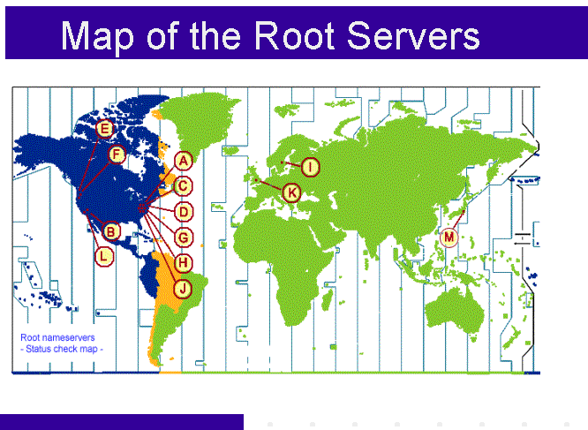
ICANN
from: http://www.icann.org/en/news/correspondence/roberts-testimony-14feb01-en.htm

Slide 36
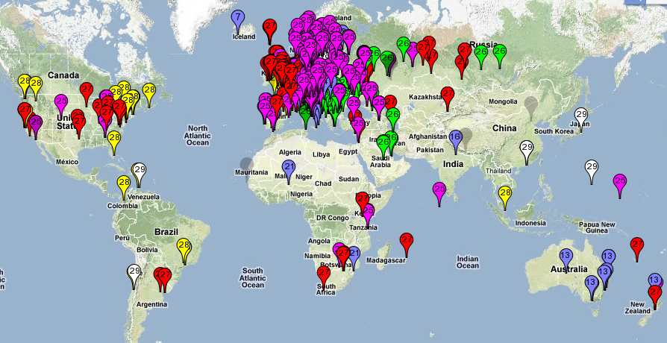
Map of the Roots
k-root (Europe) is an anycast root node
This is RIPE’s map of probing which of the 6 k-root copies get accessed
from https://labs.ripe.net/Members/kistel/dns-measurements-with-ripe-atlas-data

Slide 37
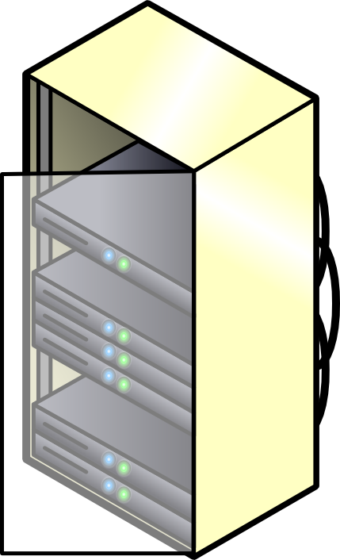


Recursive DNS Query
Classical approach
Must keep state for every request in a server until answered
Allows every node along the path to cache results
Concentrates the data flow at the central servers
Keeps a lot of state on central servers
k.root-server.net
com
huldra.uio.no
ns1.google.com
get www.google.com
www.google.com

Slide 38
Iterated DNS Query
Newer approach
Redirects request
Keep state only at local server (or some servers) until answered
Allows few nodes to cache results
Halves number of requests at central servers
Avoids state on central servers entirely
k.root-server.net
com
huldra.uio.no
ns1.google.com
get www.google.com
www.google.com

Slide 39
Caching vs. Freshness
Caching reduces DNS resolution latency
Caching reduces server load
Caching delays updates
lookup mpg.ndlab.net
Cached Root Zone File
Cached .com Zone File
Cached .net Zone File
Etc.
ns.ifi.uio.no
Root
net
Information is cached between 5 minutes and 72 hours
update
mpg.ndlab.net
domainnameshop.com
Notes:
CORRECT THIS !!!!!!

Slide 40
DNS as Indirection Service
DNS gives us very powerful capabilities
Not only easier for humans to reference machines!
Changing the IPs of machines becomes trivial
e.g. you want to move your web server to a new host
Just change the DNS record!
Dynamic DNS
Zoned DNS

Slide 41
Aliasing and Load Balancing
One machine can have many aliases
mpg.ndlab.net
drammen.ndlab.net
records.sigmm.org
simula080.simula.no
One name can map to multiple machines
www.google.com
That includes k.root-server.net
and
login.ifi.uio.no

Slide 42



Content Delivery Networks
DNS allows zoning
e.g. Netflix (and Google) addresses depend
on the origin of your connection
geography, ISP, ...
addresses can also depend on server load
minimal 5-minutes allows Netflix
to direct people to other servers every 5 minutes

Slide 43
Content Delivery Networks
DNS allows zoning
e.g. Netflix (and Google) addresses depend
on the origin of your connection
geography, ISP, ...
“Small problem” with this technique
modern to use external resolvers
e.g. ALL Chrome DNS lookups seem to originate from 8.8.8.8 (an address owned by Google)
Consequences
user stays more anonymous
Netflix and others make wrong decisions
addresses can also depend on server load
minimal 5-minutes allows Netflix
to direct people to other servers every 5 minutes

Slide 44
DNS Record
hostname
admin email
record serial number
refresh time
retry time
expiry time
min TTL
start of authority record
@ IN SOA rh7login.ifi.uio.no. hostmaster.ifi.uio.no. 201703291 1800 900 960000 86400
@ NS nn.uninett.no.
@ NS ns1.uio.no.
@ NS ifi.uio.no.
@ A 129.240.65.60
@ A 129.240.65.61
@ A 129.240.65.62
@ A 129.240.65.63
@ MX 50 smtp.uio.no.
login.ifi.uio.no CNAME rh7login.ifi.uio.no
CNAME: an alias (another name)
A: an IPv4 address, several means the name has multiple interfaces, perhaps hosts, AAAA for IPv6
NS: a responsible
name server
MX: mail server’s name
Notes:
2017030312 – serial number by date
refresh time – when to refresh this zone file – 1800sec = 30min
retry time (time to wait after zone file fetch failure) – 1800sec = 15min
expiration time – when does this zone file expire (many failures) – 960 000sec = 11.11 days
min TTL (lifetime of the records in this zone file) – 86 400sec = 24 hours
CNAME: canonical name (an alias)

Slide 45
mDNS
A way of discovering services by announcing them with IP multicast
RFC 6762 (2013): multicast DNS
records announce services (as well as link-local hostnames that are invisible outside the current multicast domain, like mymac.local)
records are never authoritative and mDNS can never redirect or recurse
name of the service
domain where the service is located
priority
port
name of the server
protocol
weight
_service._protocol.example.com SRV 10 0 5060 service.example.com
Example from my machine:
_ssh._tcp.example.com SRV 10 0 22 1x-193-157-212-9.uio.no

