Slide 1



The Effect of Network Topology on Credit Network Throughput
Vibhaalakshmi Sivaraman, Weizhao Tang,
Shaileshh Bojja Venkatakrishnan, Giulia Fanti, Mohammad Alizadeh
Notes:
Thanks
It’s great to be here and I am going to be talking about how we can increase transaction throughput on payment channels in today’s blockchains using ideas from computer networks.
This is joint work with my collaborators at MIT, CMU and Ohio State.

Slide 2


Credit Networks
Networks enabling transfer of money, goods, or services through trust lines
$5
$5
Bidirectional Trust
Alice
Bob
$5M
$5M
Bob
Bidirectional Trust
Bidirectional Trust
Bidirectional Trust
Bank 1
Bank 2
Alice
Charlie
Bidirectional Trust
Alice
Shanu
Notes:
Bidirectional trust establishing a maximum amount of money or goods one is willing to accept and as you send more and more money, the stash depletes and you run out of available trust/capacity at some point
Alice is willing to lend Bob upto $5, withbanks this might be a much larger amount
between people, between institutions
modern day version of this is payment channels
network of these trust relationships - which is useful
one more example is pcn
You can chain these trust relationships to now make multi-hop payments

Slide 3
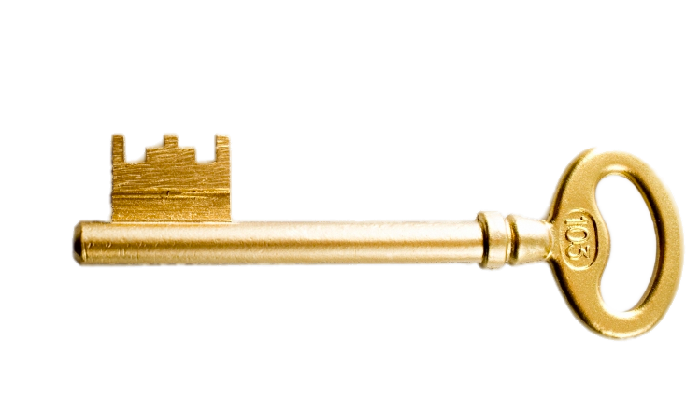
Payment Channel Networks
Alice wants to send
3 coins to Bob
Alice
6
Charlie
7
Bob
3
3
4
4
1
Alice can no longer pay Bob
Notes:
Notice that as more and more transactions complete in the same direction, the more imbalanced channels start becoming and the harder it is to complete future transactions in the same direction.
How does money actually flow on these networks
Alice and charlie have escrowed or set aside some money or limit that they are willing to transfer to each other Charlie and Bob also do this,
First each party sets aside the necessary tokens on each PCN. Once the receiver knows there’s sufficient funds on the path, they release the secret key which propagates back to the sender claiming tokens on each channel and completing the transactions. This ensures that no intermediary can hold up or run away with the funds.
and this is how money transfers over from over person to another
Clearly once this flow of money happens, it transforms the configuration of this PCN and the precise tokens on each of the channels. Now, Alice can no longer send money to Bob.
Does the configuration matter?
in some topologies, it does matter quite a lot. Point of this work is to understand when does it matter and when doesn't it matter

Slide 4
How does the configuration affect credit network throughput?
Notes:
Notice that as more and more transactions complete in the same direction, the more imbalanced channels start becoming and the harder it is to complete future transactions in the same direction.
How does money actually flow on these networks
Alice and charlie have escrowed or set aside some money or limit that they are willing to transfer to each other Charlie and Bob also do this,
First each party sets aside the necessary tokens on each PCN. Once the receiver knows there’s sufficient funds on the path, they release the secret key which propagates back to the sender claiming tokens on each channel and completing the transactions. This ensures that no intermediary can hold up or run away with the funds.
and this is how money transfers over from over person to another
Clearly once this flow of money happens, it transforms the configuration of this PCN and the precise tokens on each of the channels. Now, Alice can no longer send money to Bob.
Does the configuration matter?
in some topologies, it does matter quite a lot. Point of this work is to understand when does it matter and when doesn't it matter

Slide 5
Comparing Configurations
Alice → Bob
Bob → Alice
Alice
Charlie
Bob
3
3
3
3
Alice and Bob can pay each other
Alice
Charlie
Bob
6
6
0
Deadlock!
0
Alice and Bob can no longer make payments
Notes:
Basically what we have here is two states for the same network topology, same set of demands, and same amount of collateral. One where they can pay each other and the other where no payments can be made
Why can’t you make payments in the second situation

Slide 6
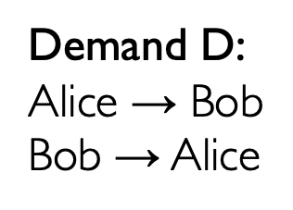

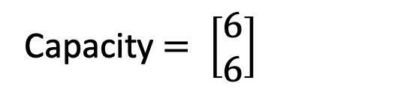

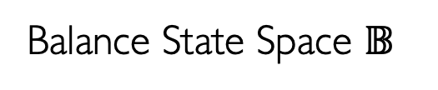

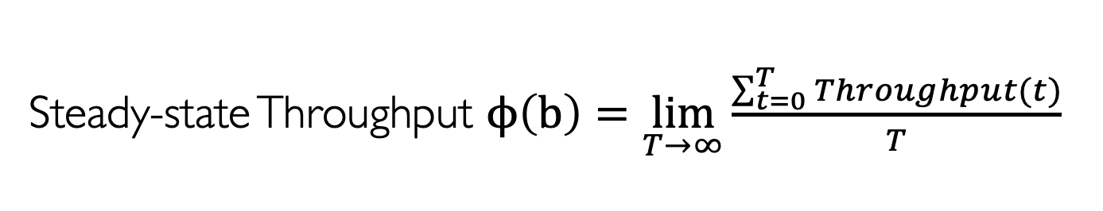
Simplified Model
Capacity $= \left[\begin{matrix}6 \\ 6\end{matrix}\right]$
$$G(E,V)$$
Alice
3
3
Charlie
3
Bob
3
$$b= \left[\begin{matrix}3 \\ 3\end{matrix}\right]$$
Balance State Space $𝔹$
6
6
$$b= \left[\begin{matrix}6 \\ 0\end{matrix}\right]$$
Demand D:
Alice → Bob
Bob → Alice
0
0
Steady-state Throughput $ϕ\left(b\right)=\lim_{T→∞}{\frac{\sum_{t=0}^{T}{Throughput(t)}}{T}}$
(Subject to Demand D and topology)
Notes:
Given this notion of throughput, now what we realize is that the minimum tpt and the maximum tpt for the same topology, same amount of collateral is very different based on the starting state. This is tpt sensitivity. We’re interested in understanding when is a topology insensitive or in other words when is the max tpt equal to min tpt.
However, this seems hard to do in practice – the state space is huge, the balances can literally be any real valued number between 0 and the capacity. How do we evaluate the min/max tpt at each point to check for this sensitivity.
This is a topology and a set of balance states wheret the state that matters
Write out the max and min in math
and in fact the max throughput is always at perfect balance
phi min
TODO:
For a graph with a capacity vector
Define round at least briefly. Throughput needs to be maximized given a state b using some strategy of sending transactions over each round.

Slide 7

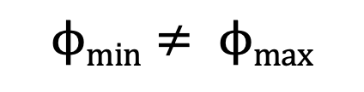
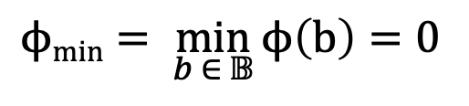
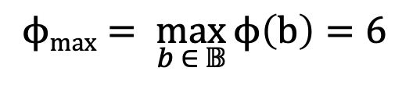
Throughput Sensitivity
Alice
3
3
Charlie
3
Bob
3
$$ϕmax= \underset{b ∈ 𝔹}{\text{max}}{ϕ\left(b\right)}=6$$
Throughput Sensitivity
6
6
0
0
$$ϕmin= \min_{b ∈ 𝔹}{ϕ\left(b\right)}=0$$
$$ϕmin≠ ϕmax$$
Throughput Insensitivity:
When is $ϕmin≈ ϕmax$?
Notes:
Given this notion of throughput, we can observe two extremes of the max and min tpt. Max is easy to calculate – perfect balance. For example, in the case I’ve been showing, max is attained in the depicted state.
Why is maximum attained at the perfect balance? Can you link the throughput definition to circulation?
But, minimum isn’t easy to calculate. In this case, we have a deadlock and so tpt drops to 0 but a generic question is where is phi min attained? How far is it
However, this seems hard to do in practice – the state space is huge, the balances can literally be any real valued number between 0 and the capacity. How do we evaluate the min/max tpt at each point to check for this sensitivity

Slide 8

Deadlocks and Throughput Sensitivity
Theorem 1: No deadlocks $⇒$ Throughput Insensitivity
$$𝔹$$
Notes:
Nice thing about these results is that you don’t have to think about entire state of possible balances, just can think about finite number of deadlocked states – 2**n
Does it really help up? No – here’s what we can do.
Can you add a visualization on corner points

Slide 9

Deadlocks and Throughput Sensitivity
Theorem 1: No deadlocks $⇒$ Throughput Insensitivity
Theorem 2: Minimum throughput $ϕmin$achieved at state with most deadlocked channels
Notes:
Nice thing about these results is that you don’t have to think about entire state of possible balances, just can think about finite number of deadlocked states – 2**n
Does it really help up? No – here’s what we can do.
Can you add a visualization on corner points

Slide 10
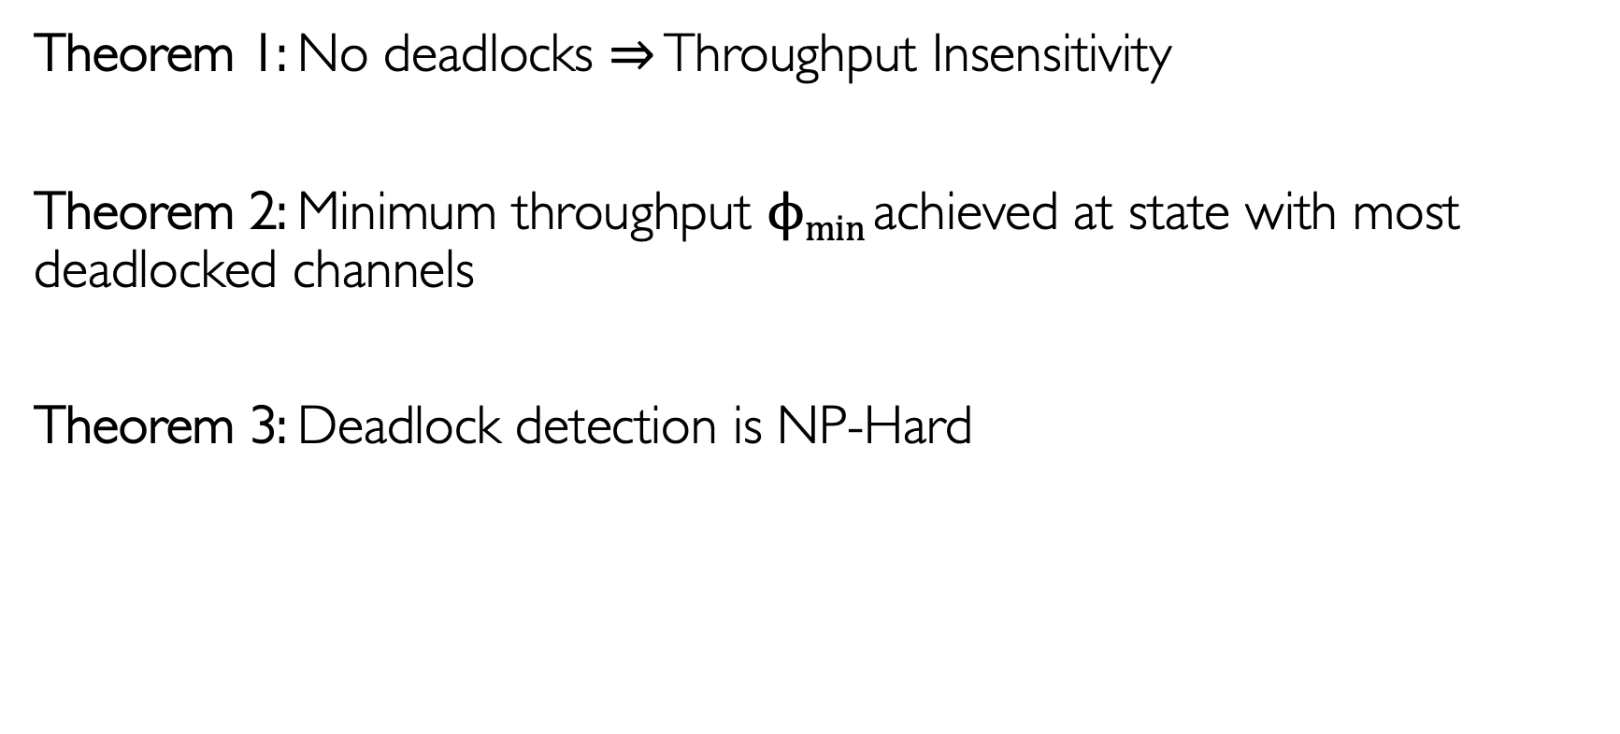
Deadlocks and Throughput Sensitivity
Theorem 1: No deadlocks $⇒$ Throughput Insensitivity
Theorem 2: Minimum throughput $ϕmin$achieved at state with most deadlocked channels
Theorem 3: Deadlock detection is NP-Hard
Notes:
Nice thing about these results is that you don’t have to think about entire state of possible balances, just can think about finite number of deadlocked states – 2**n
Does it really help up? No – here’s what we can do.
Can you add a visualization on corner points

Slide 11
Detecting Deadlocks
Alice
Charlie
Bob
Mary
C₁
Notes:
For example give this topology, demand pairs. How many channels are deadlocked
Consider a particular channel – many flows of different lengths
Dedicated flows are key
If it has flows of length 1, it can never be deadlocked in the opp dir
2 flows of length 1 in opp. Directions, never deadlocked
Consider other flows going through such directions, if you find a deadlock-free channel, they can ignore the deadlock-free channel.
Imagine you have a flow of length 2, you can treat it as a flow of degree 1, so you can now peel off a new channel and go on
Ultimate goal is to find channels with two dedicated flows and keep peeling.
NO NEED TO TALK ABOUT RANDOM DEMANDS

Slide 12
Detecting Deadlocks
Alice
f₂
Charlie
Bob
Mary
C₁
f₁
Notes:
Suppose you are given a topology and a set of flows, here's the process we can undertake- you have a demand and a set of routes

Slide 13
Detecting Deadlocks
f₃
Alice
f₂
Charlie
Bob
Mary
C₁
f₁
Notes:
Mention that peeling the paths of length 1 really helps convert flows of length 2 into length 1 if you have them
Suppose you are given a topology and a set of flows, here's the process we can undertake- you have a demand and a set of routes

Slide 14
Detecting Deadlocks
f₃
Charlie
Bob
Mary
Notes:
Consider the following example:
It may not always succeed - when it succeeds it tells you phi min
accuracy

Slide 15
Deadlock Peeling Algorithm
f₁
C₁
f₃
f₃
f₂
f₂
f₂
C₂
C₁
C₁
f₃
C₃
f₁
f₁
Channels
Flows
f₄
f₅
Notes:
Can be viewed on a bipartite graph where you keep looking for nodes of degree 1 and removing them. Aind you keep making progress. If all tokens
This kind of alg is called a peeling alg and similar algorithms are used in erasure code - - when you mention degree distribution – reinforce why that’s important
needs more visualization - with a map of the topology
ERASURE CODES CONNECTION

Slide 16
Deadlock Peeling Algorithm
f₁
C₁
f₃
f₂
C₂
f₃
C₃
Channels
Flows
f₄
f₅
Termination depends on path length distribution
Notes:
Can be viewed on a bipartite graph where you keep looking for nodes of degree 1 and removing them. Aind you keep making progress. If all tokens
This kind of alg is called a peeling alg and similar algorithms are used in erasure code - - when you mention degree distribution – reinforce why that’s important
needs more visualization - with a map of the topology

Slide 17
Peeling Algorithm Accuracy
Notes:
Now that we have this peeling tool, can we actually use it to extract useful tpt information
So we vary # of demand pairs on the x axis and compute the minimum tpt – turns out trends in number of edges peeled correlates well with the min tpt. Expected because the minimum tpt is computed using channels that are unpeeled
Animate it with

Slide 18
Peeling Algorithm Accuracy
Notes:
Now that we have this peeling tool, can we actually use it to extract useful tpt information
So we vary # of demand pairs on the x axis and compute the minimum tpt – turns out trends in number of edges peeled correlates well with the min tpt. Expected because the minimum tpt is computed using channels that are unpeeled
Animate it with

Slide 19
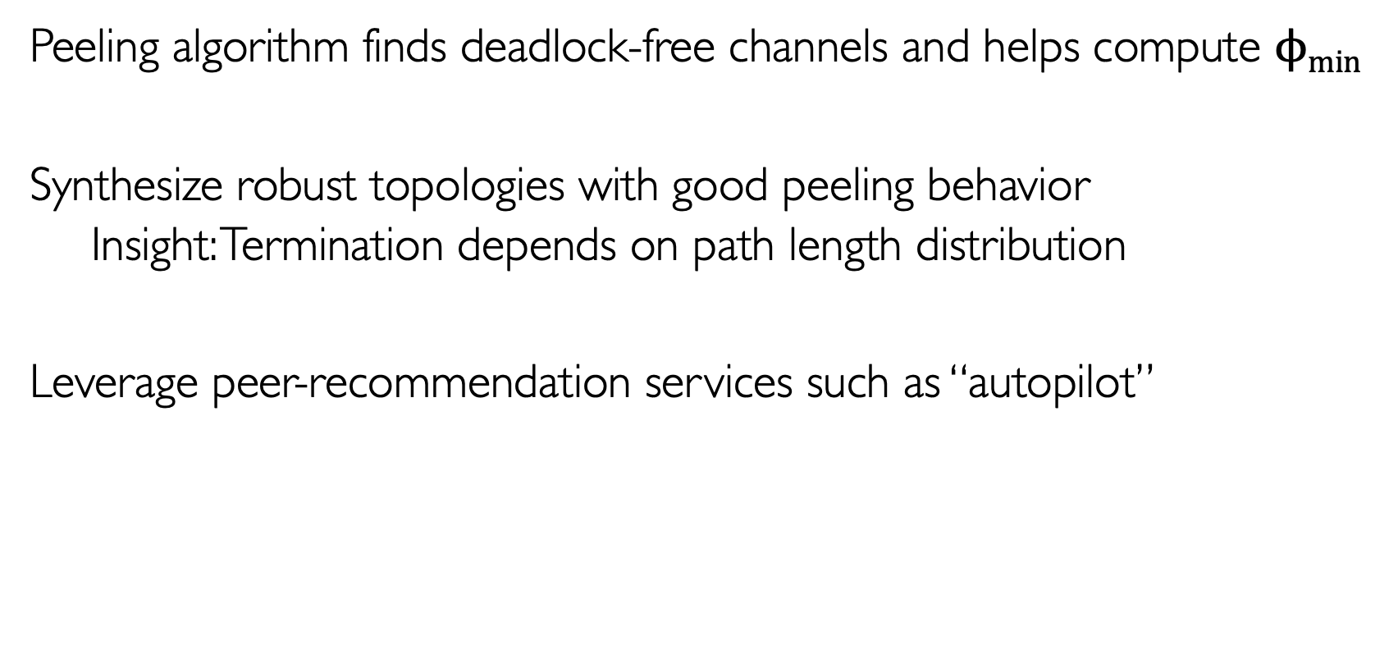
Topology Synthesis
Peeling algorithm finds deadlock-free channels and helps compute $ϕmin$
Synthesize robust topologies with good peeling behavior
Insight: Termination depends on path length distribution
Leverage peer-recommendation services such as “autopilot”
Notes:
Max tpt is achieved at center or perfectly balanced state. For min tpt, We first compute the deadlock-free edges based on the peeling algorithm and compute the tpt achievable if only those edges were used and treat all the other channels as deadlocked.
300 nodes, 1500 edges, single shortest path between a randomly sampled source-dest pair is a flow.
Regular graph has 10% better throughput with a larger number of flows while scale-free has better minimum tpt or is less prone to deadlocks at lower number of flows. We use a combination of degree distribution optimization for LT codes and graph synthesis to match the path length distribution to generate a synthesized graph. Its able to do better at minimum tpt than regular and better than both topologies at the higher number of flows, thus showing that such an approach has promise.
Can we synthesize topologies that are robust to deadlocks.
Autopilot that suggests peers to connect to to synthesize topologies
Why does this matter? Because these systems have a
GO slower - before 3250 there exists a giant deadlock

Slide 20
Topology Synthesis
Deadlock
Deadlock
Notes:
Before we look at the synthesized topology, we look at two classes of random regular graphs for their throughput behaviors. 300 nodes, 1500 edges
X axis varies number of randomly chosen demand pairs and we assign the shortest path on the underlying topology for each demand pair. Each demand pair thus gives a flow.
Regular graph has good throughput at large number of flows, but a deadlock on nearly the entire PCN upto 3250 flows. Giving us nearly 0 tpt in that regime.
Scale-free has better minimum tpt or is less prone to deadlocks at lower number of flows. Because it gets non-zero tpt even with a few flows.. However, its max tpt is about 10% lower than regular.
We use a combination of degree distribution optimization for LT codes and graph synthesis to match the path length distribution to generate a synthesized graph. Its able to do better at minimum tpt than regular (starting to see fewer deadlocks at 2750 flows) and better than both topologies at the higher number of flows, thus showing that such an approach has promise.

Slide 21
Summary
Credit networks enable money transfer through trust relationships
Potential for imbalance and deadlocks can cause discrepancies in throughput based on the starting configuration
Topology synthesis techniques can further improve the worst-case throughput behavior
Contact: vibhaa@mit.edu
Notes:
Schedule different based on payment priorities or reject large transactions
Routers want to maximize profits – might alter prices for this purpose
We assume perfect balance, but routers might add more funds if the perceived return is large
Privacy?
Source routing, end-hosts and routers differences, 0% circulation point - stochasticity
WHo is paying the routing fees?
Feedback:
LND - atomic shortest path routing
Circuit switched network vs packet switching

Slide 23
Optimized Distribution
Notes:
Can you do more? Can you design a good path length distribution that would peel well – literature from peeling theory
Notice the high density on paths of short length because these paths of length 2 and 3 are key to picking up on the initial degree 1 flows that release some channels and allow this peeling process to continue.
THis gives us a way to compute phi min and phi max. Can you go further
?
why does this matter - autopilot
peeling algorithm for erasure codes - Optimized distribution - key thing is this influences
Erasure codes also has parity two
you could just skip this
here's what came out of it

Slide 24
Topology Comparison
Notes:
Now that we have this peeling tool, can we actually use it to extract useful tpt information
So we vary # of demand pairs on the x axis and compute the minimum tpt – turns out trends in number of edges peeled correlates well with the min tpt. Expected because the minimum tpt is computed using channels that are unpeeled

Slide 25
Topology Comparison
Notes:
Does the evolution of the peeling algorithm explain the relative behaviors of these topologies at 7500 vs 10000 flows?
Explain what ripple is – it’s the number of unprocessed channels that are ready to be processed because they have dedicated flows in two directions
Essentially they are channels that enable the algorithm to make progress
If ripple disappears algorithm is stuck
You see that regular ripple disappears at 7500, so very poor tpt
Whereas at 10000 it extends further than scale free resulting in better tpt
Explaining this with path length probability:
Both have same number of paths of length 1, so same starting ripple size
Regular – so not able to get as Small number of degree 2 flows, crucial to letting the algorithm make progress
Scale-free higher degree 2 flows, so able to pick up and make progress
But larger correlations in paths because of hub and spoke structure
You can use the path length distribution to predict these trajectories

