Slide 1
IIM K ADSM
Batch 2, Group 3
Capstone Project – Idea
27-Jun-21

Slide 2
Agenda
Context
Use Case
Dataset
Problem Statement
Hands-on Opportunity
Data Preparation
EDA
Model
Statistical Analysis
Approach
Plan

Slide 3
Context
Capstone project :
hands-on projects that let you apply what you've learned in a Specialization.
Objective :
Implement learnings from ADSM course
Relevant business topic in market
Portfolio to showcase market readiness
Feasible in 8-10 weeks
Learn Marketing use case under Prof.‘s mentoring

Slide 4
Use case
Goal
Understand various factors influencing the buying behavior of Indian customers in different product categories, across geographic locations in India.
Predict the future behavior of users based on what they have done in the past.
Motivation
Growing retail market in India
Increase in purchasing power in young India
Availability of channels to purchase

Slide 5
Use case – Problem Statement
Customer Purchase Behavior
Customer Segmentation
Customer Lifetime value
Comparative Consumer behavior across Indian States & Regions
Comparative Consumer behavior based on demographics

Slide 6
Use case – Dataset
transaction |  | 1M Records
customer_id | Unique customer ID
tran_id | Unique transaction ID
tran_date | Transaction Date
tran_amount | Transaction Amount
merchant_name | Merchant Name
merchant_country | Merchant Country
merchant_city | Merchant City
mcc_code | Merchant category code
card_id | Unique card ID
Customer Demographics |  | 20,000 Records
customer_id | Unique customer ID
card_type | CardType | SILVER, GOLD, PLATINUM, WORLD
card_id | Unique card ID
mar_status | Marital Status | S, M, D
age | Customer Age
gender | Gender | M, F
customer_country | Customer Country
cr_lim_group | Credit limit
customer_city | Customer Ciy
customer_id_new | Unique customer ID
customer_uid | Unique customer ID
Transaction, 10,00,000
Customer Demographics,
20,000
Transactions without customer demographics,
300,000
Customer w/o transactions,
8,000
Transactions with customer demographics,
700,000

Slide 7
Hands-On Opportunity : Data Preparation
Feature Engineering
Categorical
Feature Engineering
Data Cleaning
String & Date conversions
Imputing missing values
Data Wrangling
Merging
Slicing
Feature Engineered
Product Category
Mer_city_grp
Mer_state
Merchant Region
Transaction id
Transaction Month
transaction |  | 1M
customer_id | Unique customer ID
card_id | Unique card ID
tran_id | Unique transaction ID
tran_date | Transaction Date
tran_amount | Transaction Amount
merchant_name | Merchant Name
merchant_country | Merchant Country
merchant_city | Merchant City
mcc_code | Merchant category code
Customer Demographics
customer_id | Unique customer ID
card_id | Unique card ID
card_type | CardType
mar_status | Marital Status
age | Customer Age
gender | Gender
customer_country | Customer Country
cr_lim_group | Credit limit
customer_city | Customer Ciy
customer_id_new | Unique customer ID
customer_uid | Unique customer ID
Categorical Features :
dummy_india
dummy_marital
dummy_gender
dummy_cardtype
dummy_crlimit
Feature Engineered
age_group
customer_city
Cust_city_grp
Cust_state
Cust_region

Slide 8
Hands-On Opportunity : EDA
Slice
Label
Classification

Slide 9
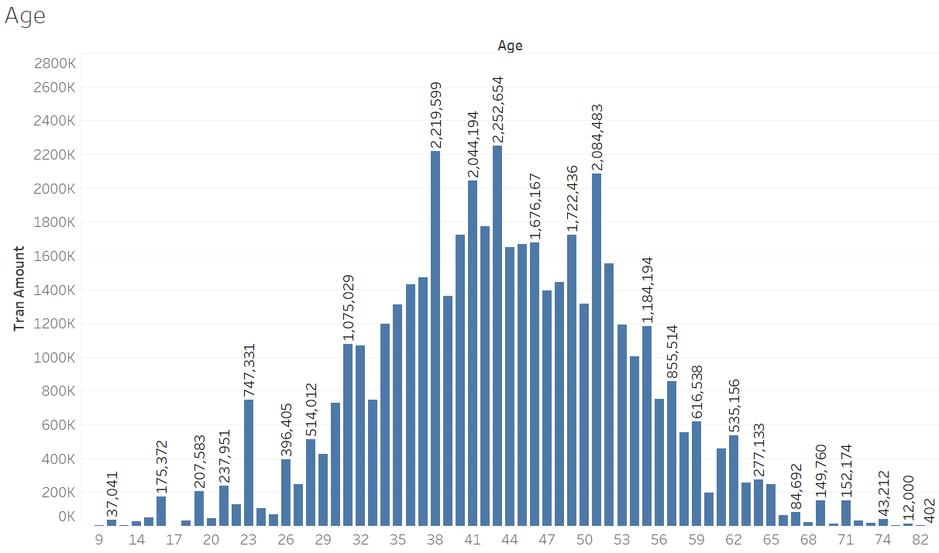
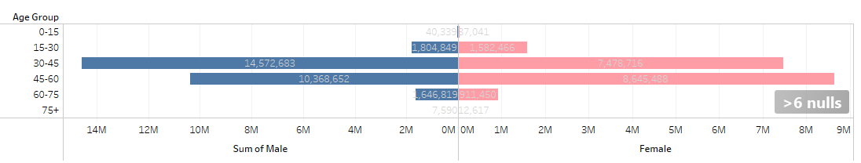
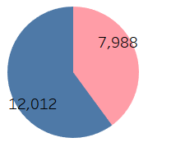
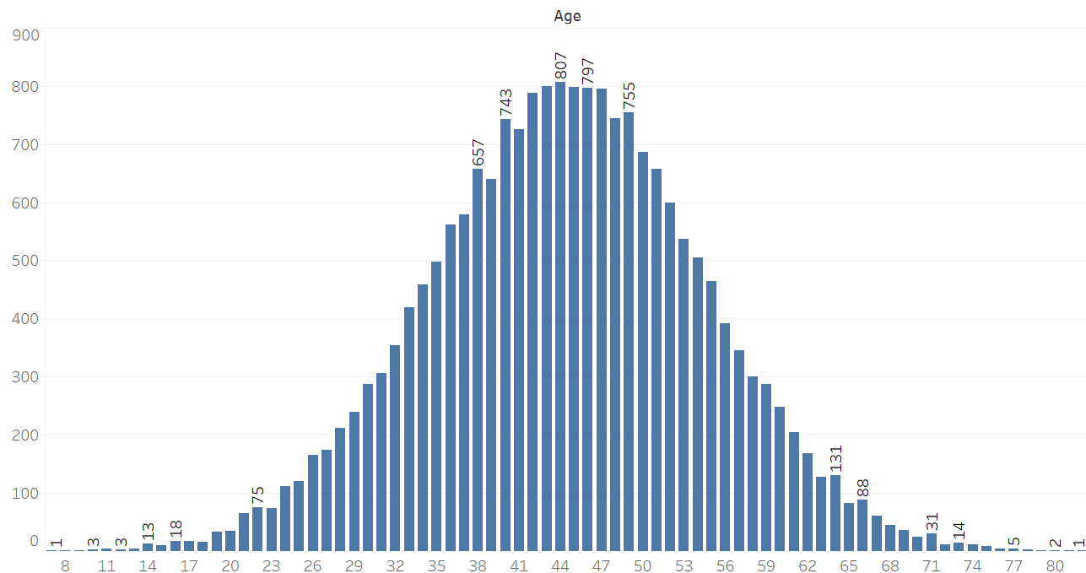
EDA insights
Male spent more than females in the age group 30-45,
but this trend changes drastically for age group 45-60 where total spent by females is very close to males in same age group
This clearly is a Normal curve
Customers between 35 and 55 years are big spenders

Slide 10
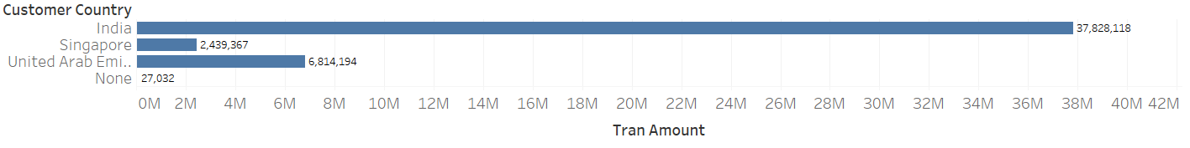
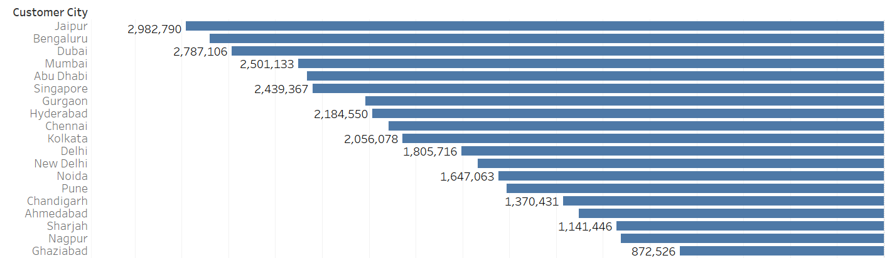
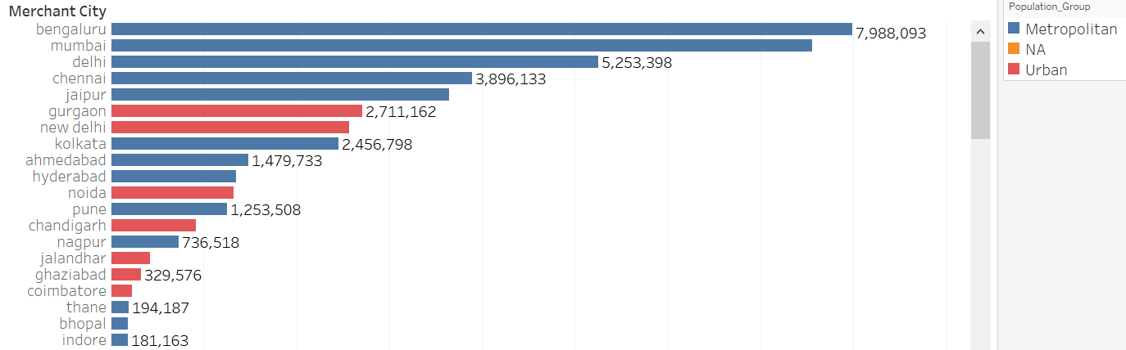
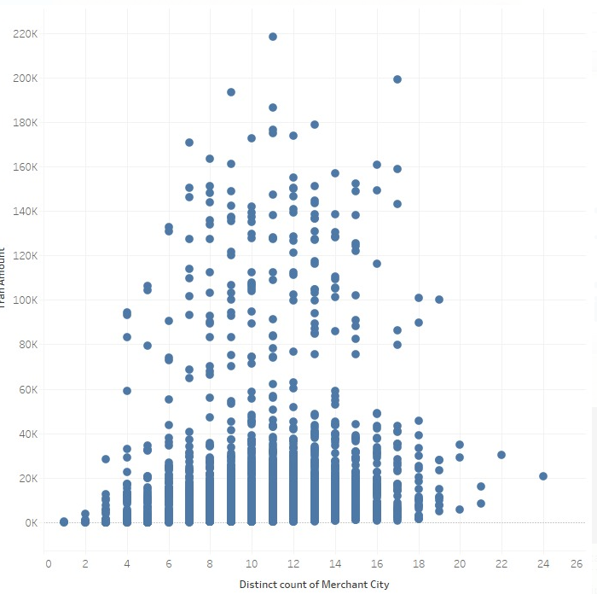
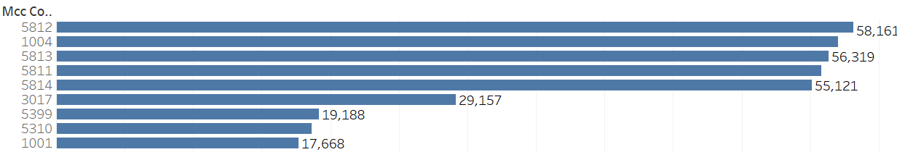
EDA insights
Customers from Jaipur are highest spenders and highest spending is in Bengaluru

Slide 11
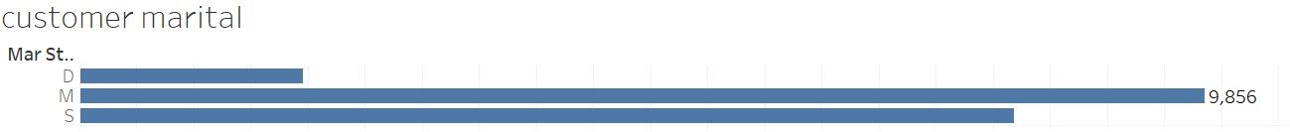
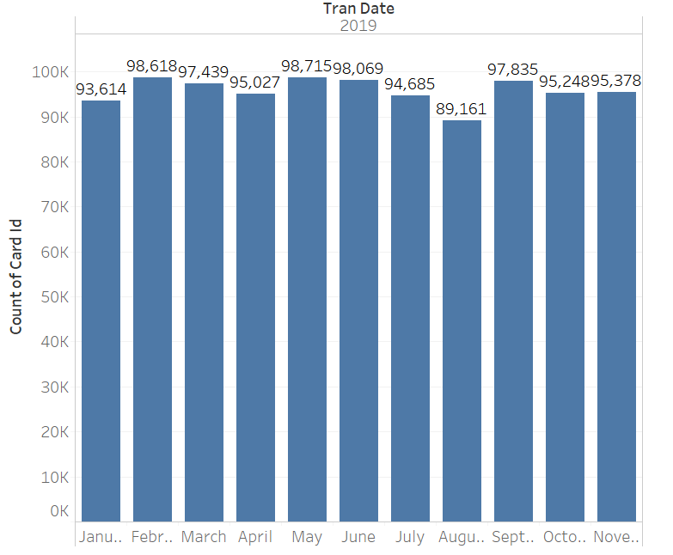
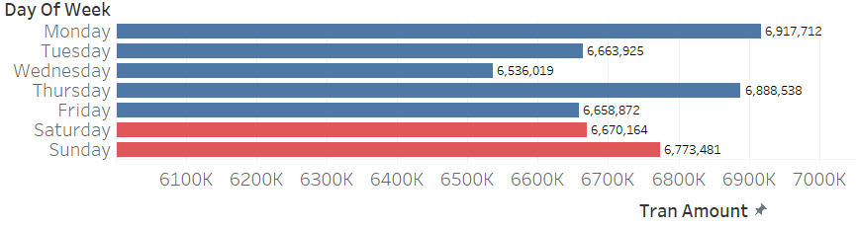
EDA insights
Married are spending highest followed by Single and then Divorced
Platinum card holders are spending most
Gross value of purchases is highest on Monday

Slide 12
Hands-On Opportunity : Models
Supervised Learning
Classification – Logistic, Decision Tree, Random Forest
Customer Churn
Regression – Linear Regression, Random Forest
Customer Lifetime value
Unsupervised Learning
Clustering - K - Means
Customer Segmentation

Slide 13
Hands-On Opportunity : Statistical Analysis
ANOVA
Comparative Consumer behavior across Indian States & Demographics

Slide 14


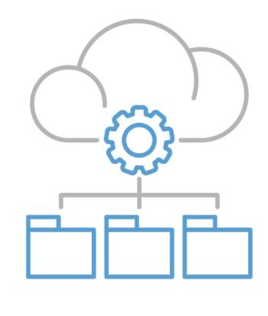


Approach
Frame
Business Problem
Formulate
Analytics Strategy
Data Processing
Modeling
Document

Slide 15


Approach
Frame
Business Problem
Formulate
Analytics Strategy
Data Processing
Modeling
Document
Hypothesis
Exploratory Data Analysis

Slide 16



Approach
Frame
Business Problem
Formulate
Analytics Strategy
Data Processing
Modeling
Document
Acquire Data
Transform
Feature Engineering

Slide 17





Approach
Frame
Business Problem
Formulate
Analytics Strategy
Data Processing
Modeling
Document
Algorithm
Model
Train
Test
Evaluate

Slide 18
Approach
Frame
Business Problem
Formulate
Analytics Strategy
Data Processing
Modeling
Document

Slide 19
Pipeline
Standardize
Enhance
Summarize
Date
Transaction
UniqueID
Month, day,
Realign
Card Type – Ordinal
Marital, Gender – Categorical
Age group - Bins
Credit Limit- Bins
Customer
Demographic
Freq-Spent
MCC Lookup
Imputation
City,
State,
Country,
Region
Region - Categorical
Purchase Interest Freq-Spent
Realign
Summarized Data
Month
Freq-Spent
City Lookup
Realign
Basedata0
Day of Week
Freq-Spent
Change in Location
Freq
Realign: Rename, Reorder, Drop, Sort

Slide 20
Pipeline
Summarize
Model
Demographic
Customer Segmentation
Clustering
Freq-Spent
Basedata0
Customer lifetime Value
Regression
Purchase Interest Freq-Spent
Month
Freq-Spent
Summarized Data
Day of Week
Freq-Spent
Change in Location
Freq
Patterns by Demographics
ANOVA
Demographic
Spent Data
Purchase Interest
Freq
Purchase Interest Freq-Spent
Purchase Prediction
Classification
Month
Freq
Purchase Data
Basedata1
Day of Week
Freq
Change in Location
Freq

Slide 21
Approach
Put in Action
Review Theory
Try each step individually
Collaborate
Consolidate learnings
Bring best solution as team
Review with Prof.
Incorporate feedback

Slide 22

Project RAW Progress 19-06-21
Frame Case Study
Data Processing
EDA
Model
Document
Weeks➔
1
2
3
4
5
6
7
8
Milestone
Review with Prof.

Slide 23
Appendix

Slide 24
Appendix
10 Months
11th Month
ID
Independent
Target
Demographics
Transaction pattern
Purchase

Slide 25
Literature Review
Research Papers
A Random Forest Approach for Predicting Online Buying Behavior of Indian Customers – IIM , Shillong, India [link]
Analyzing Customer Buying Behavior in Online Shopping Using Random Forest Classifier– IRJET [link]
Analyzing Customer Buying Behavior – Iowa State University [link]
Machine Learning Based Prediction of Consumer Purchasing Decisions: The Evidence and Its Significance – University of St Andrews, UK [link]

