Slide 1
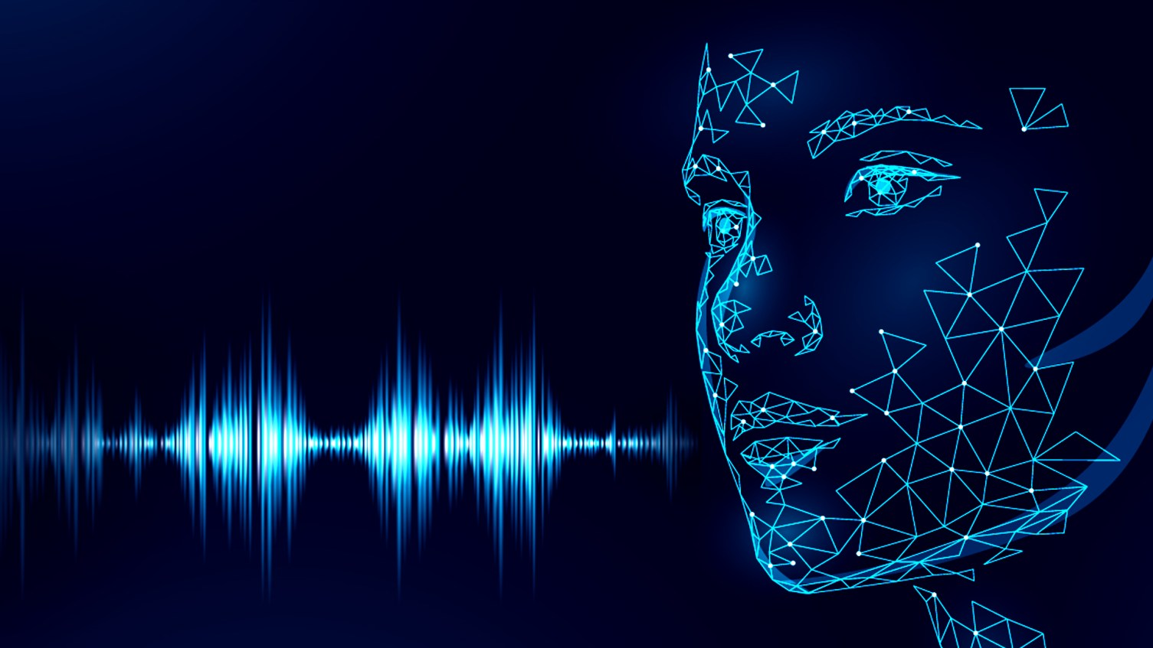
Meeting Summarization Using NLP
Guided by:--
Dr. Ram Mohan Reddy Ch
Presenting by:-
Sumedha Roy , Vibha B S

Slide 2
CONTENTS:
INTRODUCTION
EXISTING SYSTEM
PROPOSED SYSTEM
SOFTWARE AND HARDWARE REQUIRMENT
DEMONSTRATION
CONCLUSIONS

Slide 3
INTRODUCTION:
Recognize the human voice .
Record the Audio.
Recognize the human language(English).
Covert the Audio into text.
Generate date wise report.
Generate daily Word Cloud

Slide 4
EXISTING SYSTEM:
Manual writing of meeting discussion
Manual translation of Project summary
Time consuming analyzation of meeting outcome

Slide 5
PROPOSED SYSTEM:
Auto recording of Meeting discussion.
Auto summarization of meeting point.
Daily important point Word Cloud produce for faster data analyze.

Slide 6
SOFTWARE AND HARDWARE REQUIRMENT:
SOFTWARE REQUIREMENT
Operating System : Platform independent website
Technology Used: Flask framework, Python, Machine learning and Deep learning.
Libraries Needed: speech_recognition, matplotlib, wordcloud, numpy, PIL, scipy.
HARDWARE REQUIREMENT
Internet Connection : Not Required
RAM : 2GB minimum
Storage : 2GBminimum

Slide 7
DEMONSTRATION:
Lets start the demonstration of Meeting Summarization using NLP…

Slide 8
CONCLUSIONS:
Meeting Summarization Using NLP is solution for auto and faster way to record and analyze Meeting discussion.

Slide 9
THANK YOU

