Slide 1
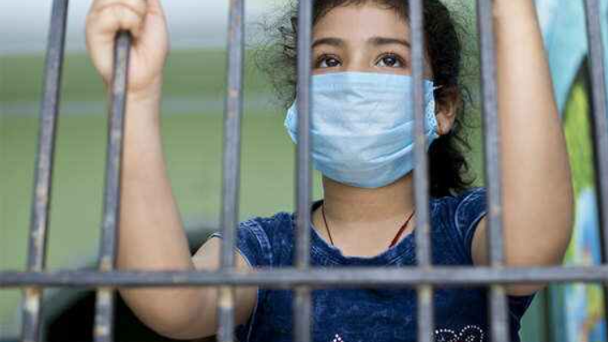
Problems Faced by Patients who are in Isolation.
Disconnection from the outside world
Desiring familiarity
Anxiety related to uncertainties
Fear of stigmatization
Need for communication

Slide 2
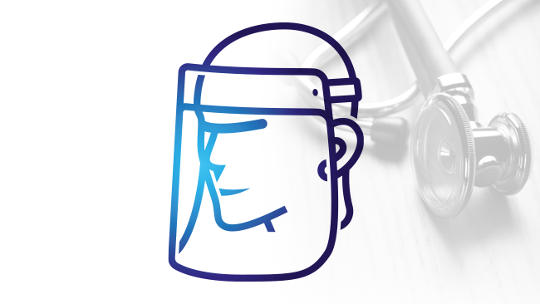
Solution is Our App.
It monitors your daily health by Routine Checkup.
It shows the progress charts of your health.
Timely reminder of medicines by alarm system.
Consultancy with the doctor.
Reference to nearest available hospital bed if required.
Helping the person to socialize with loved ones far away by reminding of them timely.
Briefing about the guidelines to be followed given by WHO.

Slide 3



Slide 4
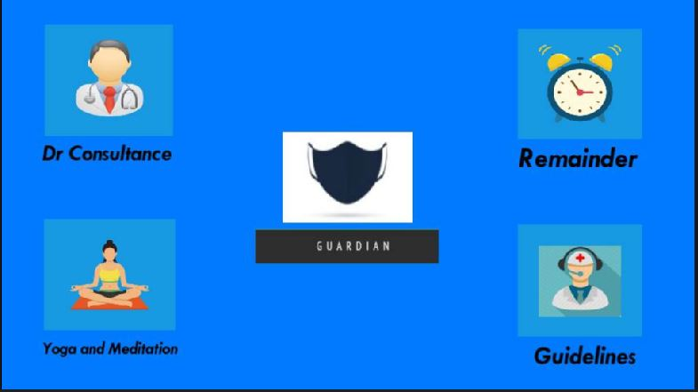
Some features of our application :

Slide 5

Doctor Consultancy
Medicine
Diet
Rest
Sleeping Hours
Expected Recovery
Family Health Details

Slide 6
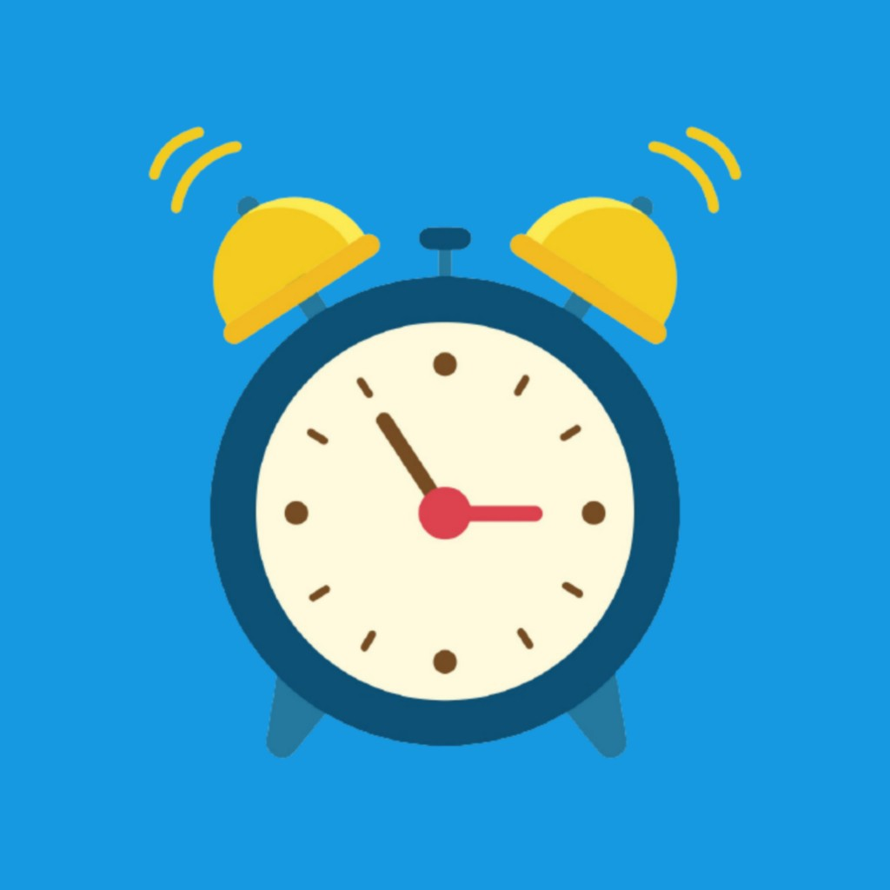
Alarm & Reminder
Insert label by voice
Set alarm
Check your daily tasks
Medicine
Office work
Breakfast
Assignments
Shows recorded data

Slide 7

Yoga & Meditation
Different yoga
Surya Namaskar
Pranayama
Bhujangasana, & so on.
Different meditation techniques
Mindfulness
Focused
Movement, & so on.

Slide 8
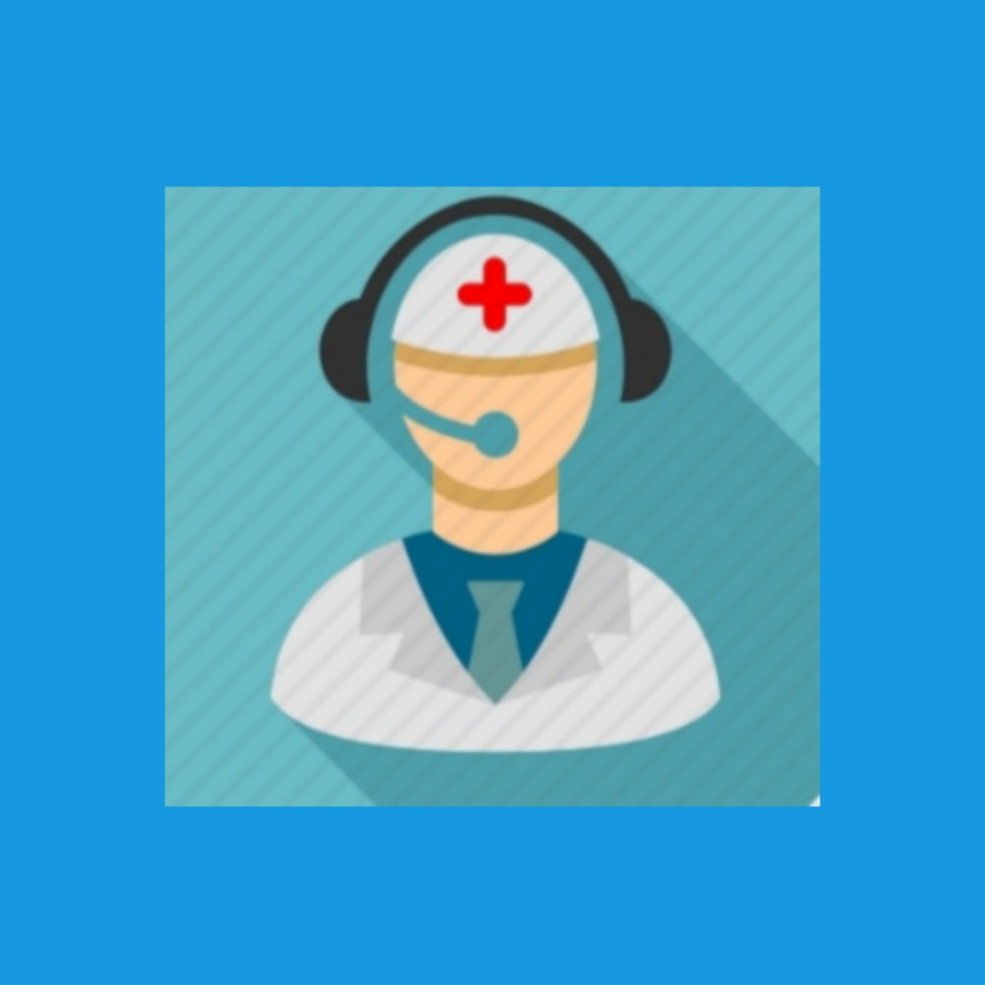
Guidelines
Do not leave home.
Stay in a separate, well-ventilated room
Wash hands with soap and water.
Use a tissue for sneezing.
Store and wash laundry separately. & so on…

Slide 9

Routine Checkup
Blood Pressure
Body Temperature
Oxygen Level
Sugar Level

Slide 10

Features
Helping the person to socialize with loved ones far away by reminding of them timely.
Reference to nearest available hospital bed if required.
Diet Chart of nutritious food.

Slide 11
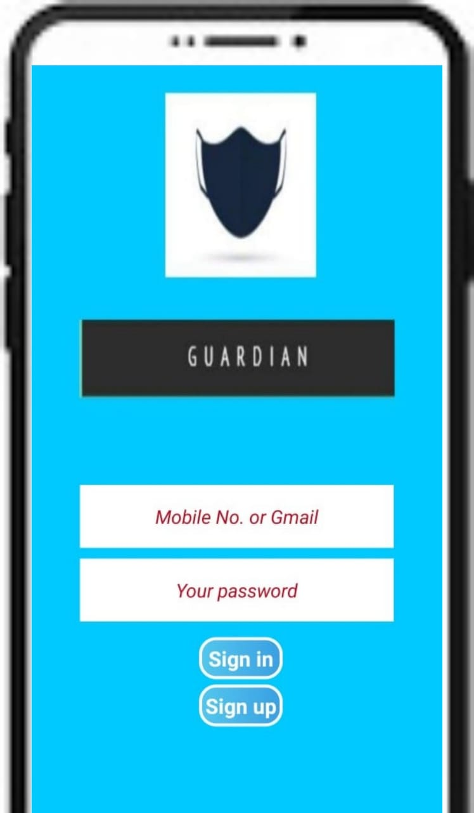

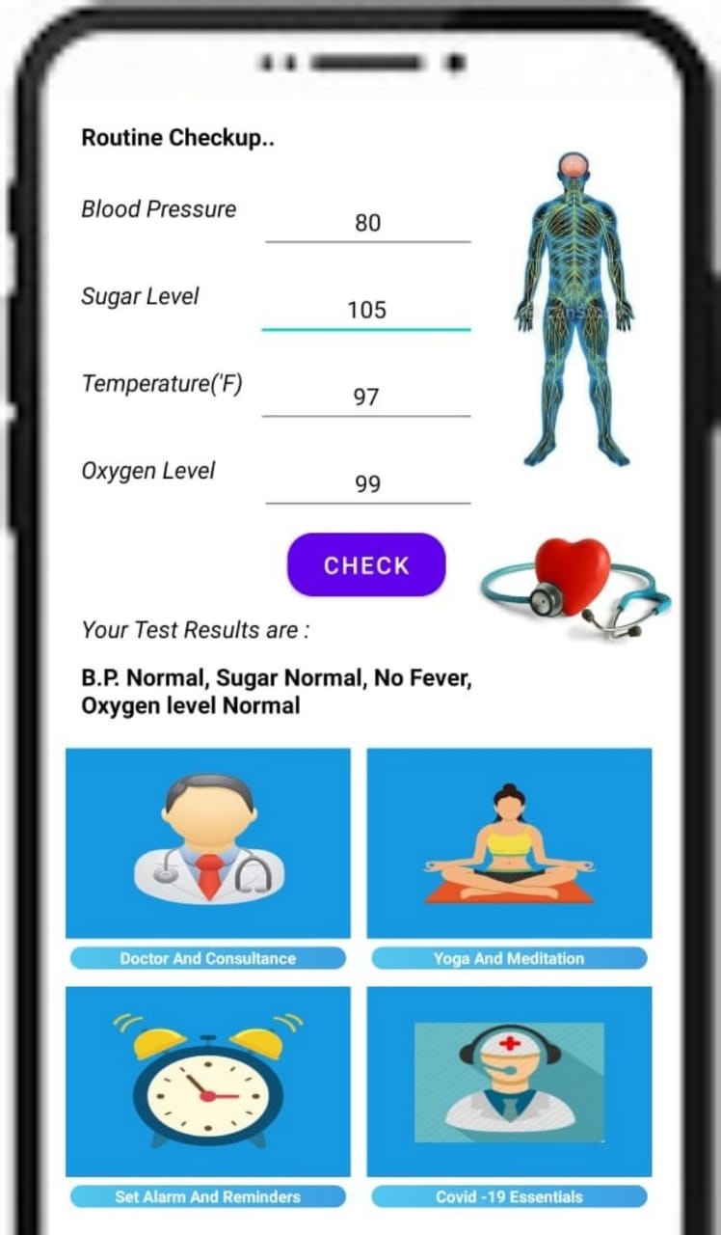
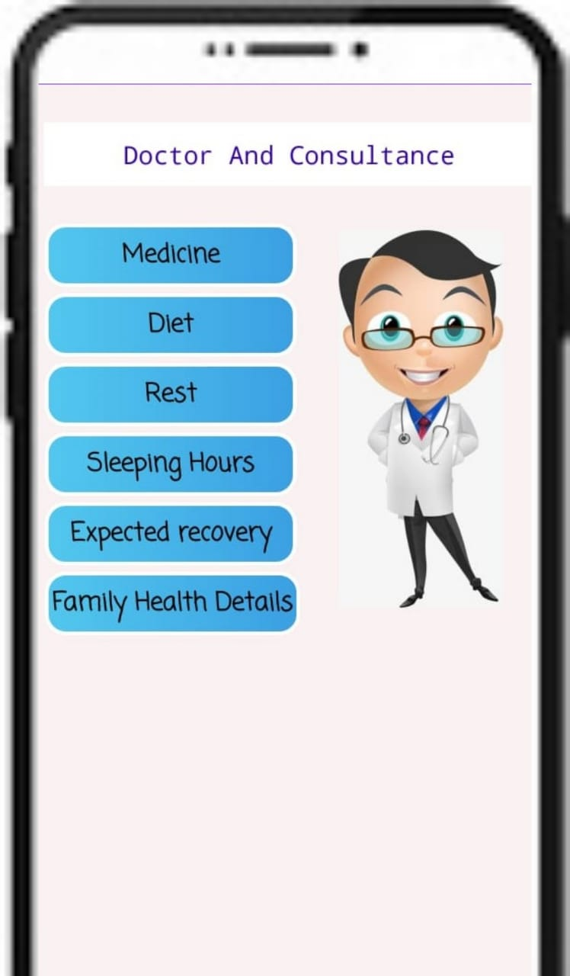
Insights of our Application :

Slide 12
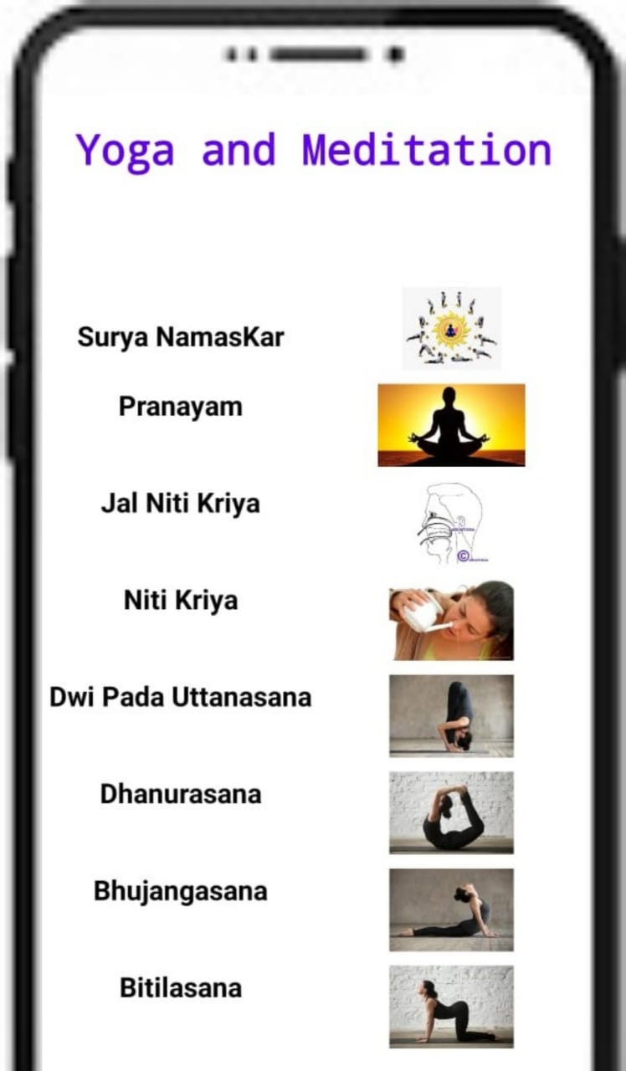
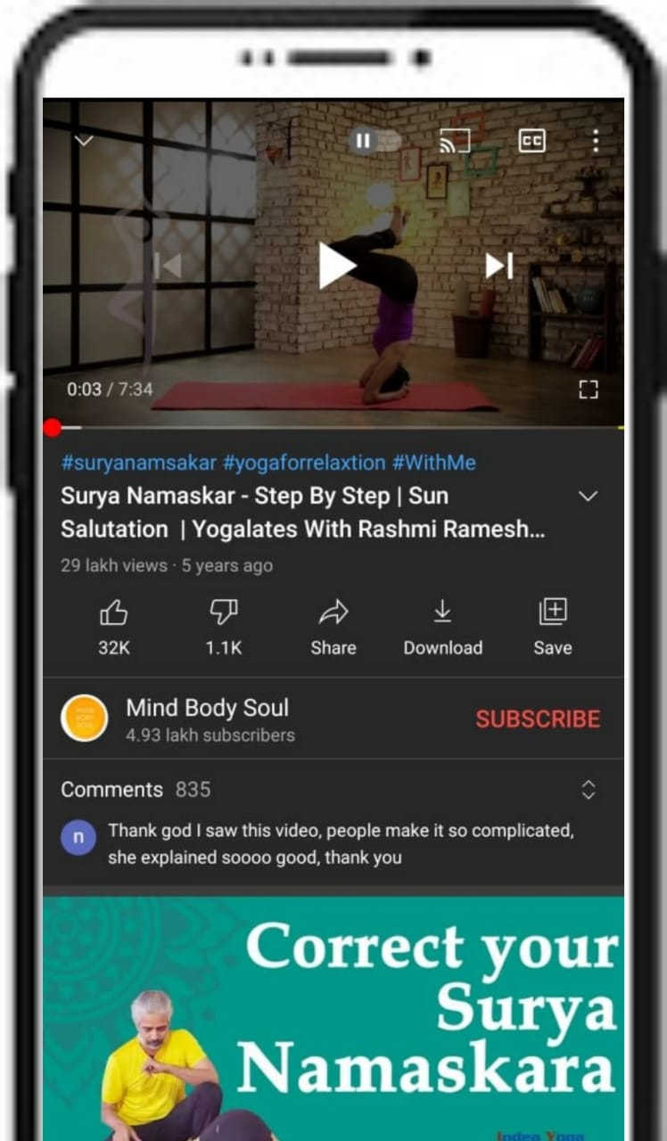
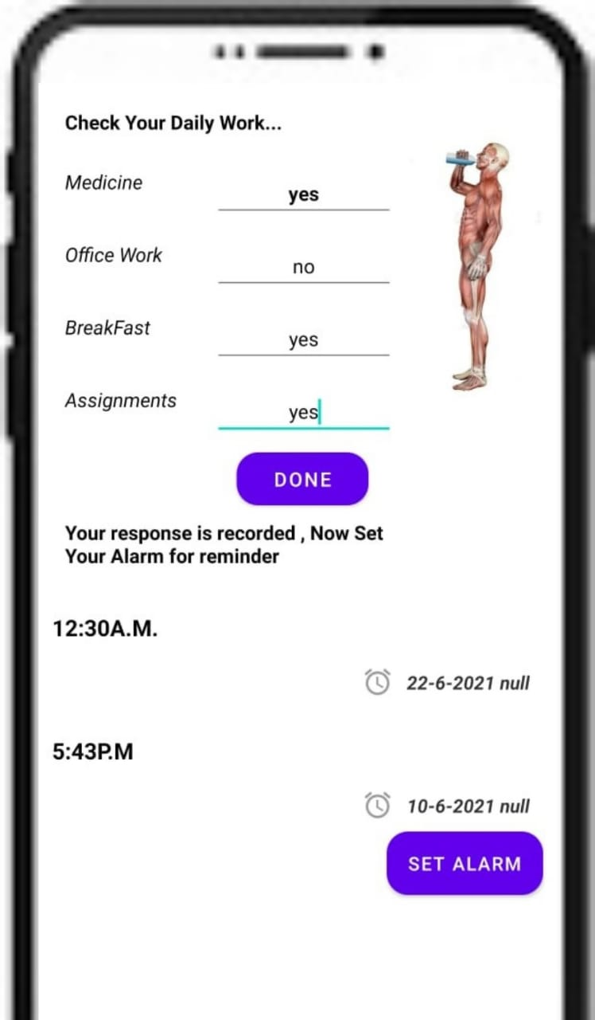
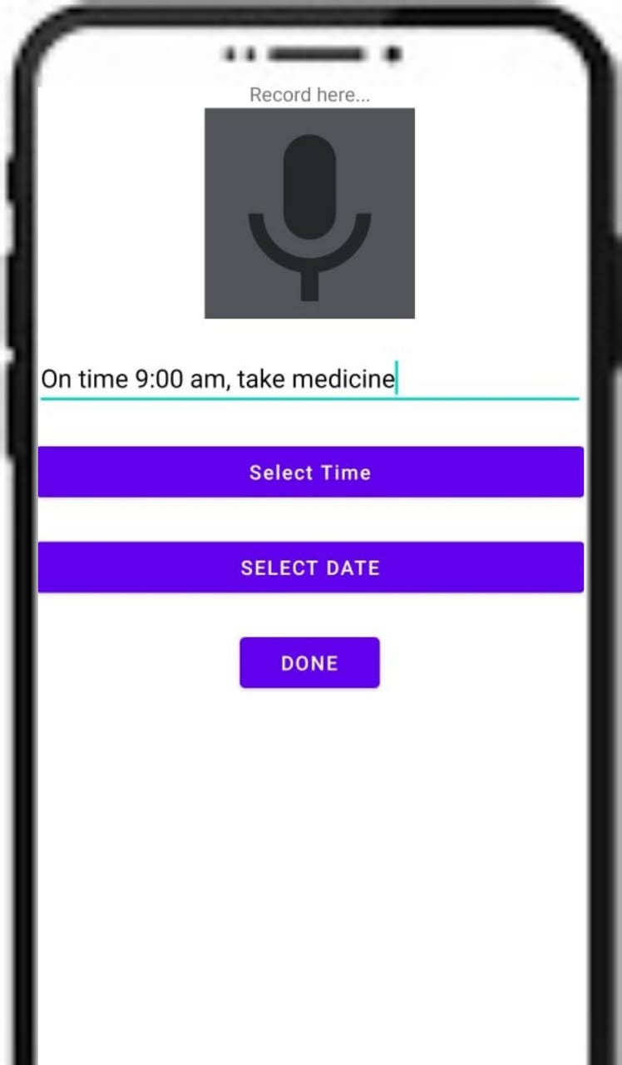
Insights of our Application :

Slide 13
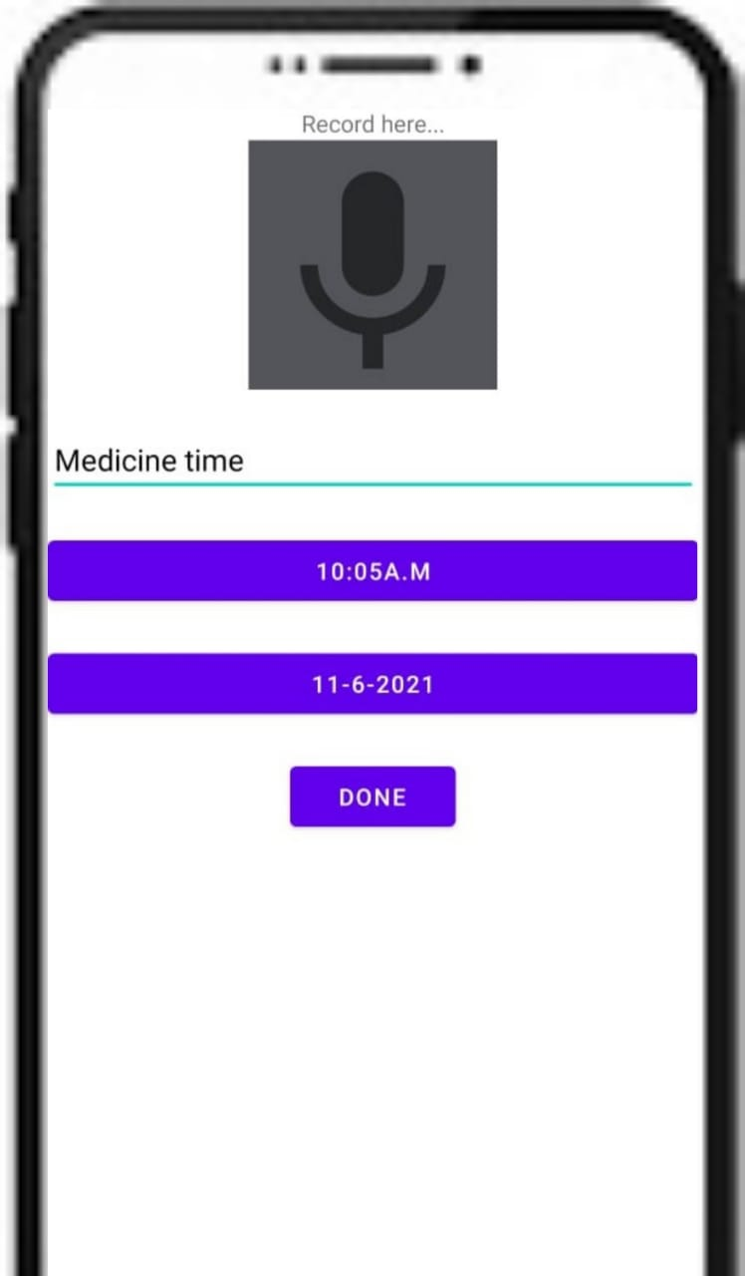
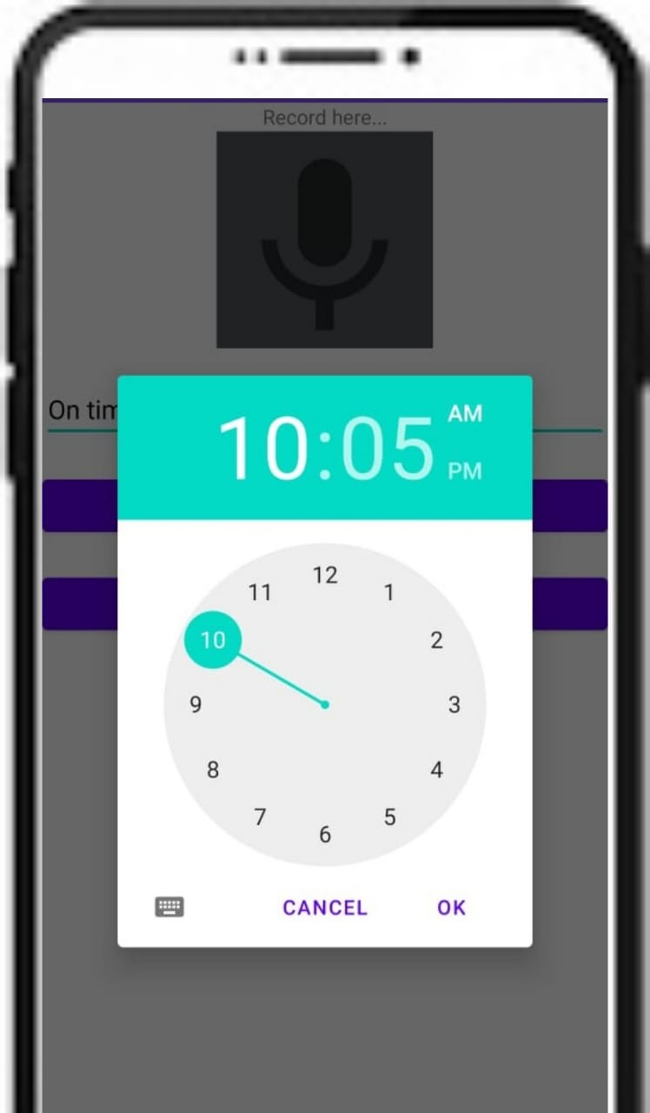
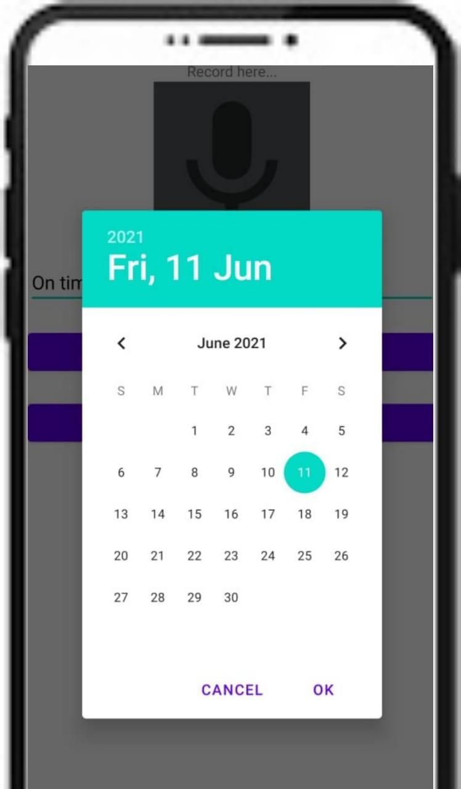
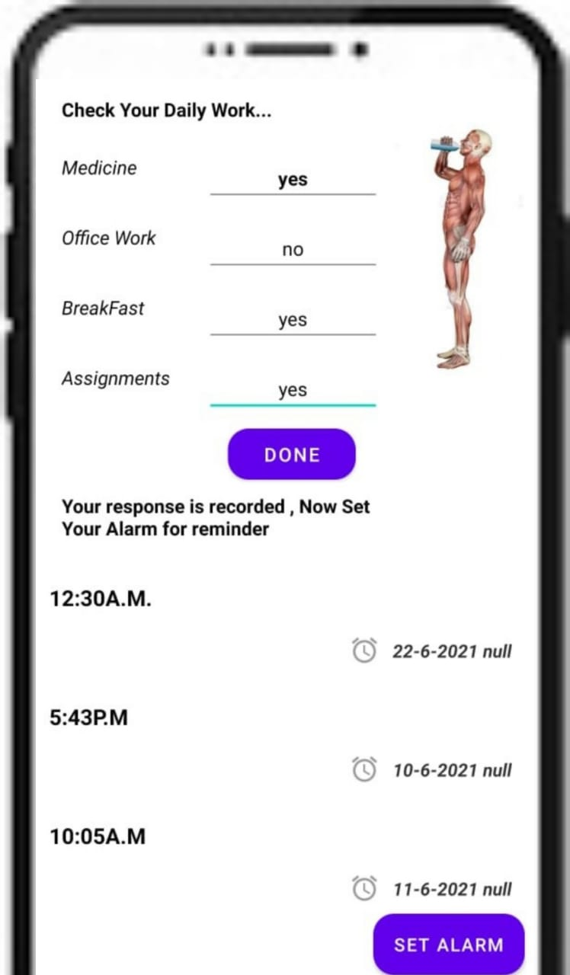
Insights of our Application :

Slide 14
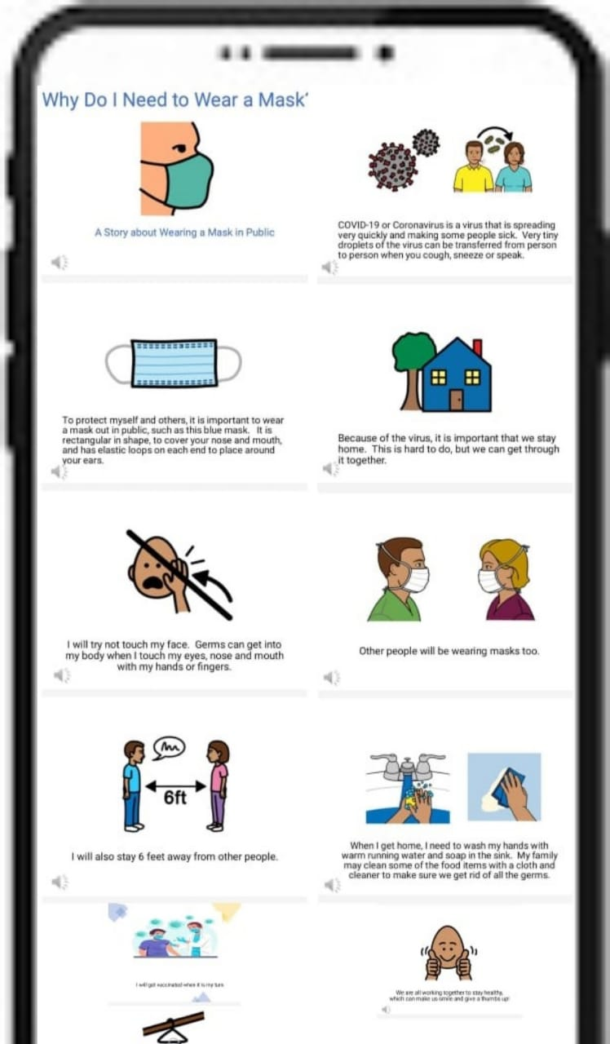
Insights of our Application :

