Slide 1
Fine-tuning NVIDIA GenMol
A Proof of Concept for Small-Molecule Design on Delaney / ESOL
Discrete-diffusion generation over SAFE sequences · One A100 GPU via Slurm
Objective: generate valid, novel, drug-like molecules aligned to the target chemical domain
Pipeline: prepare → fine-tune → generate / evaluate

Slide 2
PROJECT OVERVIEW
Objective & Deliverables
Objective
Deliverables
• Fine-tune the pretrained NVIDIA GenMol model on a focused small-molecule dataset
• Evaluate whether it generates valid, novel, drug-like molecules aligned to the domain
• Must run on one A100 GPU managed through Slurm
• Emphasis is on approach, not accuracy alone
• Source code + environment setup instructions
• Slurm submission scripts
• Data-preparation script + dataset description
• Presentation: dataset & preprocessing, fine-tuning config, base vs fine-tuned comparison, five example molecules, limitations, next steps
GenMol Fine-tuning PoC · Small Molecule Design (Delaney / ESOL)
2

Slide 3
APPROACH
Pipeline & Design Decisions
1 · Prepare
2 · Fine-tune
3 · Generate / Evaluate
Canonicalize, validity-filter,
dedupe, drug-like bounds,
Bemis–Murcko scaffold split,
SMILES → SAFE
Load pretrained GenMol + EMA,
lr 1e-4, up to 25 epochs,
validate every epoch,
select min val-loss best.ckpt
Base vs fine-tuned,
shared seeded length prior,
validity · novelty · QED · SA ·
diversity · similarity · FCD
Why these choices matter
• Frozen, scaffold-disjoint split — validation scaffolds never appear in training; written once and reused.
• Real validation — val.safe scored every epoch, averaging 4 diffusion-time samples to cut Monte-Carlo noise.
• Controlled sampling — base and fine-tuned draw from the same seeded SAFE length prior, isolating token-level changes.
GenMol Fine-tuning PoC · Small Molecule Design (Delaney / ESOL)
3

Slide 4
EXTENSIONS
Beyond the Assignment — What This PoC Adds
The brief asked for a fine-tuning run, Slurm scripts, data prep, and a presentation. This PoC also adds:
• Scaffold-disjoint validation
• Bemis–Murcko split keeps val scaffolds out of training; --split random fallback
• Reliable checkpoint selection
• Val every epoch, multi diffusion-time averaging, lowest-val-loss best.ckpt
• Upstream loader-bug workaround
• Scalar-indexed dataset instead of broken UserDataset; vendored GenMol untouched
• Controlled generation lengths
• Identical seeded SAFE-length draws isolate token-level changes from size
• Expanded evaluation
• FCD, nearest-val similarity, diversity, QED/MW/logP overlays, 5-molecule grid
• Small-data regularization
• --freeze-layers adapts only upper layers + MLM head, EMA-compatible
• Hyperparameter sweep
• Slurm array over freeze × lr; aggregate_sweep.py gates + ranks survivors
• Offline experiment tracking
• Per-run summary, loss history, checkpoint metadata, central run registry
• Held-out generation metrics
• Scaffold-held-out split drives val loss, selection, similarity, and FCD
• Reproducibility controls
• All stages seeded; deterministic Lightning where CUDA kernels allow
• End-to-end V1 / V2 support
• Checkpoint paths, SAFE mode, and sampling defaults switch together
• Smoke-test path
• SMOKE=1 runs a short end-to-end check before a full A100 job
GenMol Fine-tuning PoC · Small Molecule Design (Delaney / ESOL)
4

Slide 5
DELANEY / ESOL
Dataset & Preprocessing
• Source: DeepChem Delaney (ESOL) aqueous-solubility dataset — 1,128 molecules
• Uses only the SMILES column; solubility labels are not trained on or predicted
• RDKit canonicalize → validity filter → dedupe → drug-like bounds (5–60 heavy atoms, MW ≤ 750) → SAFE encoding
• Deterministic 90/10 Bemis–Murcko scaffold split
Domain descriptors
Descriptor | Mean | Range
Molecular weight | 209 Da | 68–589
logP | 2.53 | -7.6–10.4
QED | 0.56 | 0.15–0.93
Rings | 1.45 | 0–7
Heavy atoms | 13.7 | 5–42
Stage | Molecules
Raw records | 1,128
Duplicates removed | 11
Out-of-range removed | 61
Final dataset | 1,056
Train / validation | 951 / 105
Nature of the domain
A broad, compact, low-MW, lead-like distribution — not a target-specific chemotype.
Domain alignment = movement in fingerprint / property distributions, not improved activity or solubility.
GenMol Fine-tuning PoC · Small Molecule Design (Delaney / ESOL)
5

Slide 6
SETUP
Fine-tuning Configuration
Setting | Default | Purpose
Model | GenMol V2 | extended / bracket SAFE
Global batch | 64 | ~14 optimizer steps / epoch
Learning rate | 1e-4 | adapt without overwriting pretrained chemistry
Warmup | 50 steps | short warmup for small dataset
Max training | 25 epochs | cap ~375 optimizer steps
Validation | every epoch, 4 samples | stabilize val-loss ranking
Early stopping | patience 5 | stop after 5 epochs w/o improvement
EMA decay | 0.99 | track short-run adaptation
Precision / HW | bf16 / 1 A100 | target execution environment
Selection logic
Lowest val-loss EMA weights saved as best.ckpt and used for generation.
Baseline val-loss recorded before fitting as a step-zero reference.
Regularization option: --freeze-layers N adapts only upper layers + MLM head.
Upstream loader-bug workaround: scalar-indexed dataset, vendored GenMol unchanged.
GenMol Fine-tuning PoC · Small Molecule Design (Delaney / ESOL)
6

Slide 7
EXPERIMENT 1 · FULL FINE-TUNING, LR 1E-4
Base vs Fine-tuned — Quantitative Comparison
Metric | Base | Fine-tuned | Signal
Validity | 99.3% | 97.5% | 🟢 Preserved
Novelty | 93.9% | 85.0% | 🟢 Strong novelty retained
Uniqueness | 84.7% | 69.0% | 🟡 Main trade-off
Diversity | 0.909 | 0.865 | 🟡 Slightly reduced
QED | 0.572 | 0.664 | 🟡 Simplification, not alignment
SA score | 2.394 | 1.765 | 🟡 Simplification, not alignment
Drug-like fraction | 34.1% | 41.7% | 🟡 Confounded w/ simplification
Nearest-validation similarity | 0.203 | 0.289 | 🟢 Clear domain shift
FCD-to-validation | 24.44 | 22.40 | 🟢 Improved domain alignment
Best val loss 0.7213 at epoch 8 (baseline ≈ 0.83). Similarity (+0.086) and FCD (−2.0) are the genuine alignment signals; QED / SA gains reflect simplification.
GenMol Fine-tuning PoC · Small Molecule Design (Delaney / ESOL)
7

Slide 8
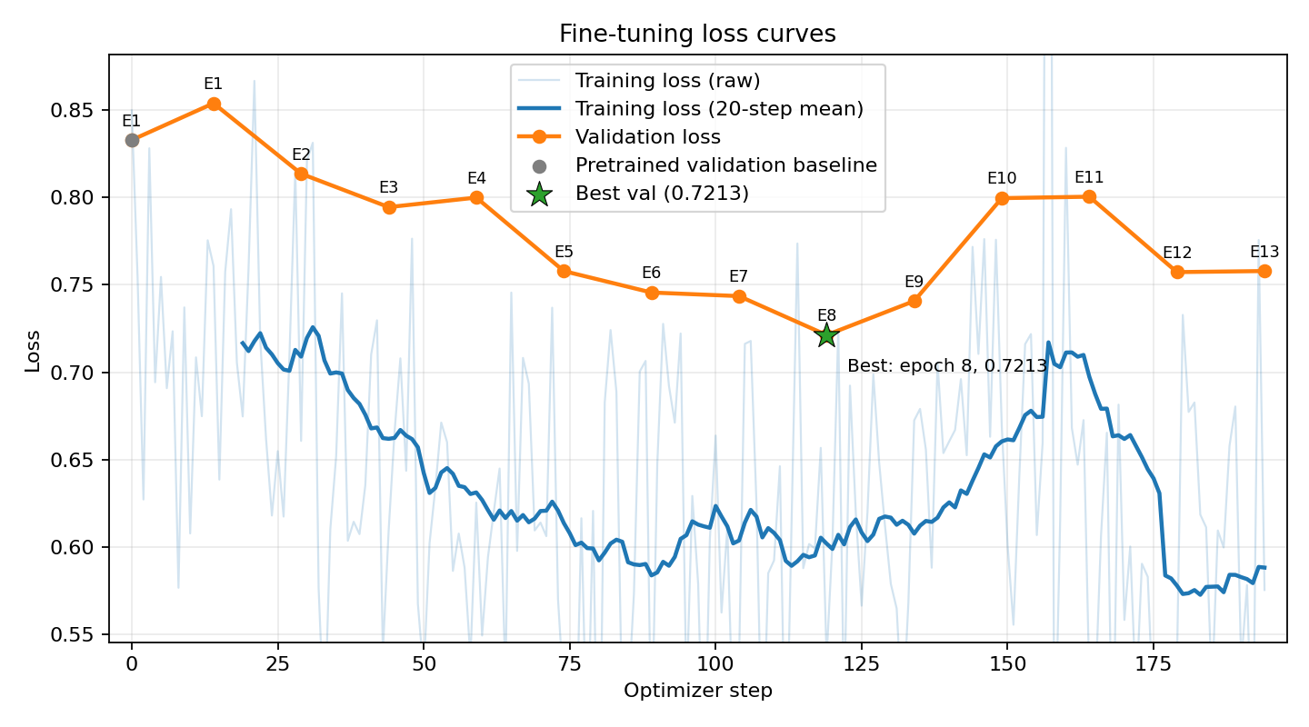
EXPERIMENT 1
Training & Validation Loss — Full Fine-tuning
• Validation loss falls substantially, reaching its minimum at epoch 8, then degrades — classic small-data overfitting.
• Early stopping (patience 5) + best.ckpt selection capture the min-val-loss snapshot.
GenMol Fine-tuning PoC · Small Molecule Design (Delaney / ESOL)
8

Slide 9
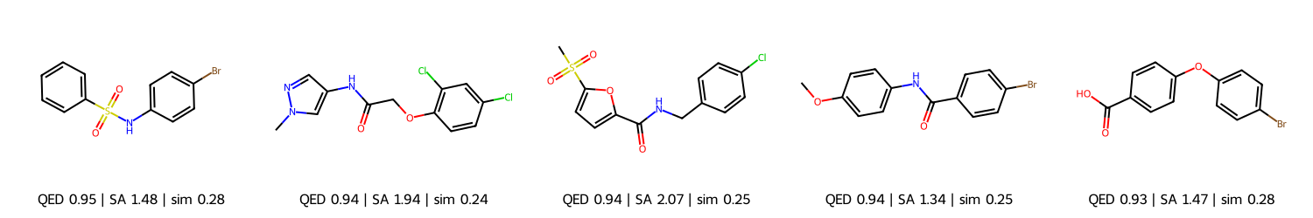
EXPERIMENT 1 · NOVEL SHOWCASE (QED ≥ 0.6, SA ≤ 4)
Five Example Generated Molecules
SMILES | QED | SA | Sim
O=S(=O)(Nc1ccc(Br)cc1)c1ccccc1 | 0.945 | 1.48 | 0.276
Cn1cc(NC(=O)COc2ccc(Cl)cc2Cl)cn1 | 0.944 | 1.94 | 0.242
CS(=O)(=O)c1ccc(C(=O)NCc2ccc(Cl)cc2)o1 | 0.939 | 2.07 | 0.254
COc1ccc(NC(=O)c2ccc(Br)cc2)cc1 | 0.939 | 1.34 | 0.250
O=C(O)c1ccc(Oc2ccc(Br)cc2)cc1 | 0.932 | 1.47 | 0.276
Sim = nearest-validation ECFP4 Tanimoto similarity. All five are novel, valid, and drug-like.
GenMol Fine-tuning PoC · Small Molecule Design (Delaney / ESOL)
9

Slide 10
EXPERIMENTS 1–3 · BASE→FINE-TUNED Δ
Experiment Comparison — LR & Layer Freezing
Metric (direction) | Original LR 1e-4 | Lower LR 2e-5 | Frozen-9 layers
Validity ↑ | -1.8 pp | +0.7 pp | -1.8 pp
Uniqueness ↑ | -15.7 pp | -12.6 pp | -19.2 pp
Novelty ↑ | -8.9 pp | -6.6 pp | -12.4 pp
QED ↑ | +0.092 | +0.055 | +0.055
SA ↓ | -0.629 | -0.316 | -0.647
Diversity ↑ | -0.044 | -0.016 | -0.034
Drug-like fraction ↑ | +7.6 pp | +1.4 pp | +1.5 pp
Nearest-validation similarity ↑ | +0.086 | +0.044 | +0.065
FCD-to-validation ↓ | -2.042 | -2.232 | -1.478
Original LR: strongest property / domain shift. Lower LR: best diversity + FCD. Frozen-9: strong SA but largest novelty/uniqueness loss.
Recommended: full fine-tuning at original or lower LR; freezing not preferred.
GenMol Fine-tuning PoC · Small Molecule Design (Delaney / ESOL)
10

Slide 11
READ RESULTS WITH CARE
Limitations
• Small, broad dataset (1,056 mols / 105 val) — variance and overfitting / mode-collapse risk
• Weak domain definition — ESOL is not a therapeutic series; solubility labels unused
• Limited generalizability — specific to GenMol, ESOL, this scaffold split
• Externally controlled length — isolates tokens but doesn't test length learning
• Proxy-only chemistry — QED/SA/FCD ≠ potency, ADMET, synthesizability
• Sampling sensitivity — temperature / randomness / min length shift metrics
• Stochastic uncertainty — bf16/CUDA limit exact repeatability; needs multi-seed
• Validation set double-used — drives both selection and alignment metrics (optimistic bias)
• No uncertainty quantification — single-seed point estimates, no confidence intervals
• Small FCD reference — 105 molecules is well below typical FCD sample sizes
GenMol Fine-tuning PoC · Small Molecule Design (Delaney / ESOL)
11

Slide 12
WHERE TO GO FROM HERE
Recommended Next Steps
# | Action | Decision / Output
1 | Replicate across ≥3 seeds; fixed diffusion-time grid | Verify stability of ranking and gains
2 | Expand freeze-layers × lr Slurm sweep | Select via health gate + composite score
3 | Sweep softmax_temp × randomness (both length priors) | Separate fine-tuning gains from sampling
4 | Replace broad ESOL with a sharper domain | Soluble subset / congeneric / ChEMBL target
5 | Compare full vs freeze vs LoRA/PEFT | Same seeds + evaluation protocol
6 | Add chemistry checks + generation guardrails | PAINS / Lipinski / retrosynthesis / ADMET
7 | Split off an untouched test set | Report final similarity + FCD on test
8 | Bootstrap confidence intervals on all metrics | Attach CIs before claiming improvement
GenMol Fine-tuning PoC · Small Molecule Design (Delaney / ESOL)
12

Slide 13
Conclusion
• GenMol can be fine-tuned on ESOL on one A100 via Slurm, measurably changing the generated distribution.
• Full fine-tuning at 1e-4 gave the strongest QED / SA / drug-like / similarity gains while retaining 97.5% validity and 85.0% novelty.
• Adaptation traded off uniqueness and diversity; nearest-validation similarity (+0.086) and FCD (−2.0) are the genuine alignment signals.
• Lower LR preserved diversity and achieved the best FCD; freezing 9 layers did not improve the trade-off.
• Feasibility demonstrated — multi-seed evaluation and an independent test set are required before stronger claims.
PoC successful — approach validated end-to-end.

