Slide 1
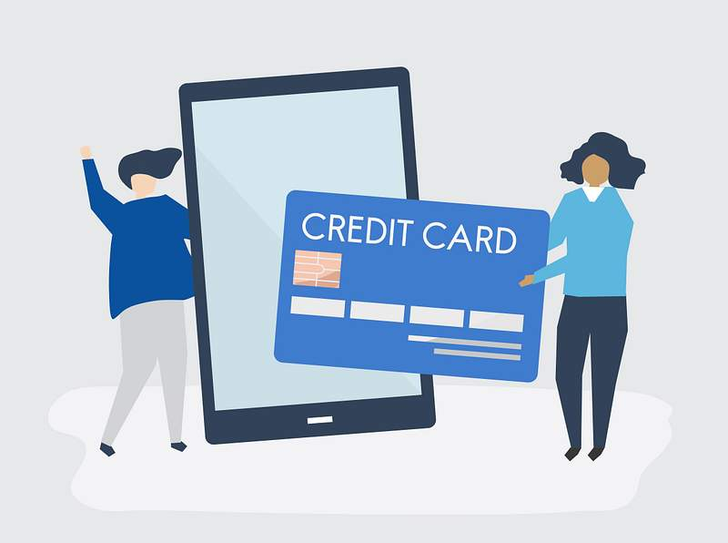
SMARTPAY ANALYTICS
Customer Growth, Transaction Performance & Risk Management Analysis Using SQL
PRESENTED BY:
VIBHA TELE

Slide 2

BUSINESS SCENARIO
SmartPay is a digital payment platform serving customers across multiple states and merchants.
As the business grew, management faced several challenges:
Identifying valuable and high-risk customers
Monitoring card portfolio health
Improving transaction success rates
Understanding where customers are concentrated
Understanding merchant revenue contribution
Management needed a data-driven approach to support business growth, reduce risk, and improve customer engagement.

Slide 3

Aim & Objectives:
Project Aim:
To analyze SmartPay customer and transaction data using SQL and provide insights that support business growth, operational efficiency, and risk management.
OBJECTIVES:
Analyze customer growth and engagement
✔ Identify financial and card-related risks
✔ Evaluate transaction performance and failures
✔ Measure merchant revenue contribution
✔ Discover high-value customer segments

Slide 4
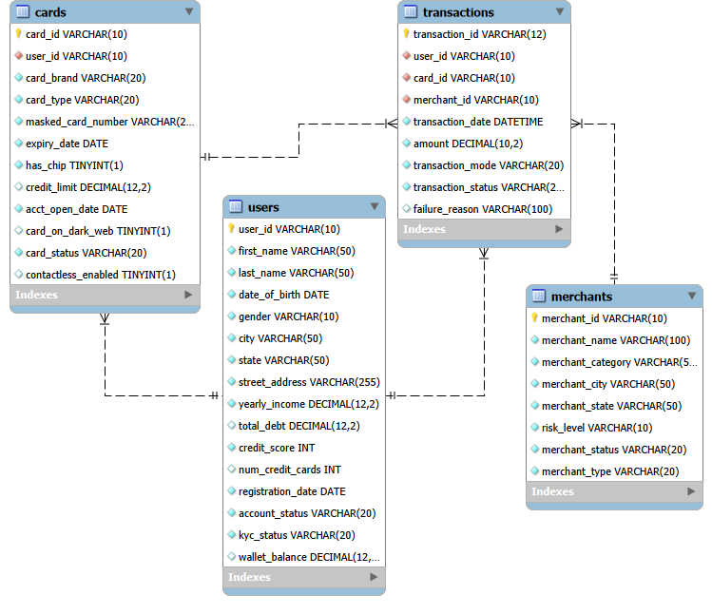
DATASET OVERVIEW:
Table | Records | Purpose
Users | 50 | Customer Information
Cards | 50 | Card Details & Status
Merchants | 50 | Merchant Information
Transactions | 50 | Payment Activity
Key Relationships
One User → One/Many Cards
One User → Many Transactions
One Merchant → Many Transactions
One Card → Many Transactions

Slide 5

Analysis Approach:
SQL Analysis Framework:
To solve SmartPay's business challenges, the analysis was divided into six key areas:
1.Customer Growth & Engagement
- User Distribution
- Wallet Balance Analysis
2.Risk Management
- High-Risk Customers
- Card Status Monitoring
3.Transaction Performance
- Success Rate Analysis
- Failure Reason Analysis
5. Merchant Performance
- Revenue Contribution
5 .Customer Value Analytics
- High-Spending Customers & Customer Ranking
6.Revenue Opportunity Analytics
- Above-Average Spenders
SQL Concepts Used
GROUP BY • JOINS • AGGREGATES • WINDOW FUNCTIONS • SUBQUERIES

Slide 6
1.CUSTOMER GROWTH & ENGAGEMENT
1.Which states contribute the most customers?
2.which customer segment has highest wallet balance?
STATE | TOTAL USERS
CALIFORNIA | 8
TEXAS | 7
NORTH COROLINA | 3
ARIZONA | 3
FLORIDA | 2
ACCOUNT STATUS | AVG_WALLET_BALANCE($)
ACTIVE | 3830.460938
INACTIVE | 394.55
BLOCKED | 200.65625
Finding :California leads with 8 users, followed by Texas with 7 users, while North Carolina and Arizona have 3 users each.
Business Insight :Customer adoption is concentrated in a few key states, creating strong regional growth opportunities.
Business solution : Expand merchant partnerships and marketing campaigns in California and Texas to maximize growth.
Finding :Active users hold the highest average wallet balance ($3,830), compared to Inactive ($395) and Blocked ($201) users.
Business Insight :Higher wallet balances indicate stronger engagement and greater platform usage among active customers.
Business solution : Launch reactivation campaigns and wallet incentives to increase engagement among inactive users.

Slide 7
1.CUSTOMER GROWTH & ENGAGEMENT
3.Who are the most valuable customers based on balance ?
USER_ID | FIRST_NAME | LAST_NAME | WALLET_BALANCE($)
USR 1031 | CHARLES | SCOTT | 9255
USR 1010 | ALEXANDER | FLORES | 9250
USR 1044 | JACK | JOHNSON | 8620
USR 1004 | PATRICIA | LEWIS | 8450
USR 1022 | KENNETH | WALKER | 7850
Finding :Top users maintain wallet balances above $7,800, led by Charles Scott ($9,255) and Alexander Flores ($9,250).
Business Insight : A small group of customers contributes a substantial share of wallet value on the platform.
Business solution : Launch VIP loyalty programs and personalized offers for high-value customers.

Slide 8
2.CREDIT & RISK MANAGEMENT
4.Which customers have low credit scores and high debt burdens?
5.What is the distribution of active, inactive, and blocked cards?
FIRST_NAME | LAST_NAME | CREDIT_SCORE | TOTAL_DEBT | YEARLY INCOME
ABIGAIL | WILLIAM | 637 | 154817 | 61746
BENJAMIN | HARRIS | 629 | 94016 | 45727
CHARLOTTE | HILL | 610 | 61826 | 34317
EMILY | WHITE | 627 | 104052 | 43638
JENNIFER | SMITH | 568 | 46379 | 25847
MIA | JACKSON | 599 | 32509 | 20513
CARD_STATUS | TOTAL_DISTRIBITION
ACTIVE | 32
INACTIVE | 10
BLOCKED | 8
Finding :6 customers have credit scores below 650 and debts significantly higher than their annual income.
Business Insight :These customers represent a higher credit and payment default risk for the platform.
Business solution : Implement risk monitoring and additional transaction controls for high-risk customer segments.
Finding :Out of 50 cards, 32 are Active, 10 Inactive, and 8 Blocked.
Business Insight :Most cards remain operational, while blocked cards may indicate fraud or security-related issues.
Business solution : Strengthen fraud monitoring and encourage inactive users to reactivate their cards.

Slide 9
3.TRANSACTION PERFORMANCE
6.What is the transaction success rate?
7.What are the top reasons for transaction failures?
TRANSACTION_STATUS | TRANSACTION_RATE
SUCCESS | 36
FAILED | 14
TRANSACTION_STATUS | FAILURE_REASONS | TRANSACTION_FAILURE
FAILED | SUSPECTED FRAUD | 5
FAILED | TECHNICAL ERROR | 3
FAILED | INSUFFICIENT BALANCE | 2
FAILED | CARD DECLINED | 2
FAILED | NETWORK ERROR | 1
Finding :Out of 50 transactions, 36 were successful and 14 failed, resulting in a 72% success rate.
Business Insight :Transaction failures directly impact customer experience and revenue generation.
Business solution :Focus on reducing failure causes to improve payment reliability and customer satisfaction.
Finding :Suspected Fraud (5 cases) was the leading failure reason, followed by Technical Errors (3 cases).
Business Insight :Security checks and operational issues are the primary barriers to successful transactions.
Business solution :Improve fraud detection accuracy and optimize payment infrastructure performance.

Slide 10
4.MERCHANT S PERFORMANCE
5.CUSTOMER VALUE ANALYTICS
8.Which merchant categories generate the highest revenue?
9.Who are the highest-spending customers?
HIGHEST_REVENUE ($) | MERCHANT_CATEGORY
26234.19 | ELECTRONICS
5419.34 | FASHION
2890 | LUXURY
USER_ID | FIRST_NAME | TOTAL_SPENT($) | SPENDING_RANK
USR 1031 | CHARLES | 2600 | 1
USR 1041 | HARPER | 2450.8 | 2
USR 1021 | ANDREW | 2345 | 3
USR 1049 | OLIVIA | 1590.3 | 4
USR 1029 | SAMUEL | 1475.9 | 5
Finding :Electronics generated $26,234, significantly outperforming Fashion ($5,419) and Luxury ($2,890).
Business Insight :Electronics merchants contribute the largest share of transaction revenue on the platform.
Business solution : Prioritize partnerships and promotional campaigns with high-performing electronics merchants.
Finding :Charles Scott ranked #1 with $2,600 spent, followed by Harper Robinson ($2,451) and Andrew Green ($2,345).
Business Insight :A small segment of customers generates the highest transaction value and revenue contribution
Business solution :Develop premium membership and personalized offers for top-spending customers.

Slide 11
6.REVENUE OPPORTUNITY ANALYSIS
10.Which customers spend above average?
USER_ID | FIRST_NAME | TOTAL_SPENT
USR1045 | HENRY | 2890
USR1046 | JENNNIFER | 2750
USR1047 | CHARLES | 2600
USR1048 | MIA | 2500
USR1049 | HARPES | 2450.8
Finding :Several customers spent more than $2,450, with Henry Roberts leading at $2,890.
Business Insight :Above-average spenders represent the platform's most profitable customer segment.
Business solution :Target these customers with exclusive rewards, cashback programs, and retention campaigns.

Slide 12
CONCLUSION
Key Insights from the Analysis
California and Texas emerged as SmartPay's strongest customer markets.
Active users maintain significantly higher wallet balances and engagement levels.
High-risk customers were identified through low credit scores and high debt exposure.
Smart Pay achieved a 72% transaction success rate, with fraud-related failures being the biggest challenge.
Electronics merchants generated the highest revenue contribution.
A small group of customers accounted for the highest wallet balances and spending activity.
Business Outcome
The analysis helped identify growth opportunities, improve customer targeting, strengthen risk management, enhance transaction performance, and uncover revenue-driving customer and merchant segments for SmartPay.

Slide 13
THANK YOU !

