Slide 1

Road Accidents by States
SpreedSheetSamurai
Galgotias University

Slide 2

Unique Team ID: IBM25PBL3238
Team Leader: Vibhav Raj
Email: thevibhav2005@gmail.com
Member 2: Lakshya Srivastava
Email: lakshyasrivastav14@gmail.com
Member 3: Aditya Kanaujiya
Email: Aditya886@proton.me
Member 4: Mukund Rai
Email: mukundrai2282@gmail.com

Slide 3
Introduction:
Road accidents remain one of the leading causes of death and injury in India, posing a significant threat to public safety and infrastructure. This analysis explores the state-wise distribution of road and railway accidents, examining key metrics such as total accident cases, fatalities, and injuries. By visualizing accident hotspots and comparing data across different states, the goal is to highlight critical areas of concern and support evidence-based policy-making to improve road safety nationwide.

Slide 4
Process:
Data Collected: from Online Source Link:https://data.gov.in/catalog/road-accidents-india.
Data Cleaning: Data is being cleaned from Excel Workshop and with the help of Python code.
Data Visualization: Done With the help of Power BI.

Slide 5
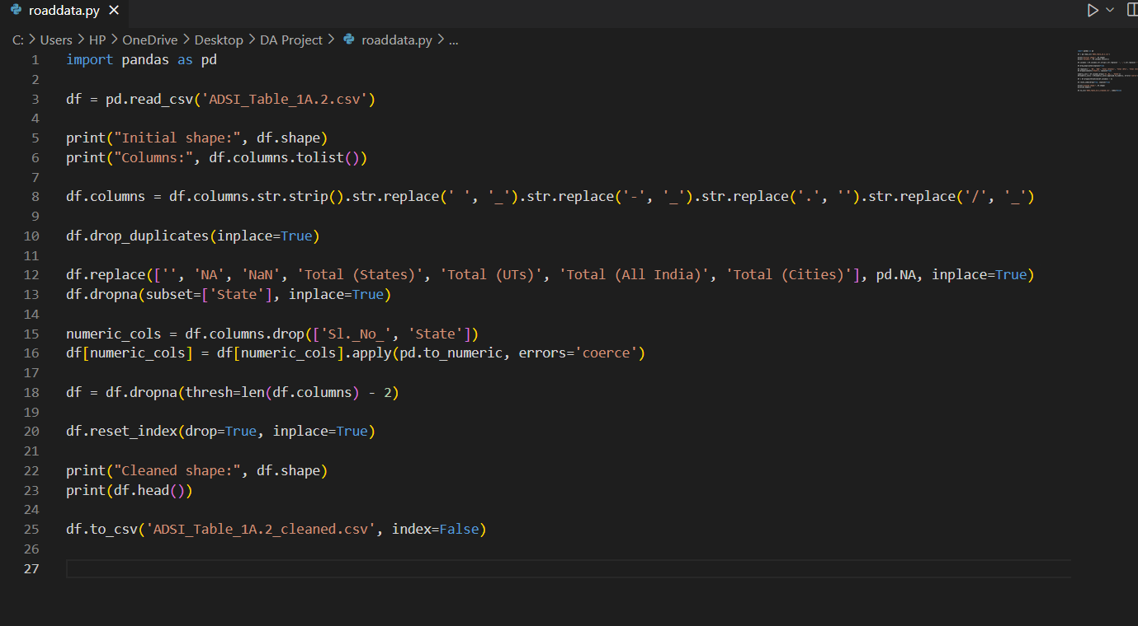
Python Code For Data Cleaning:

Slide 6
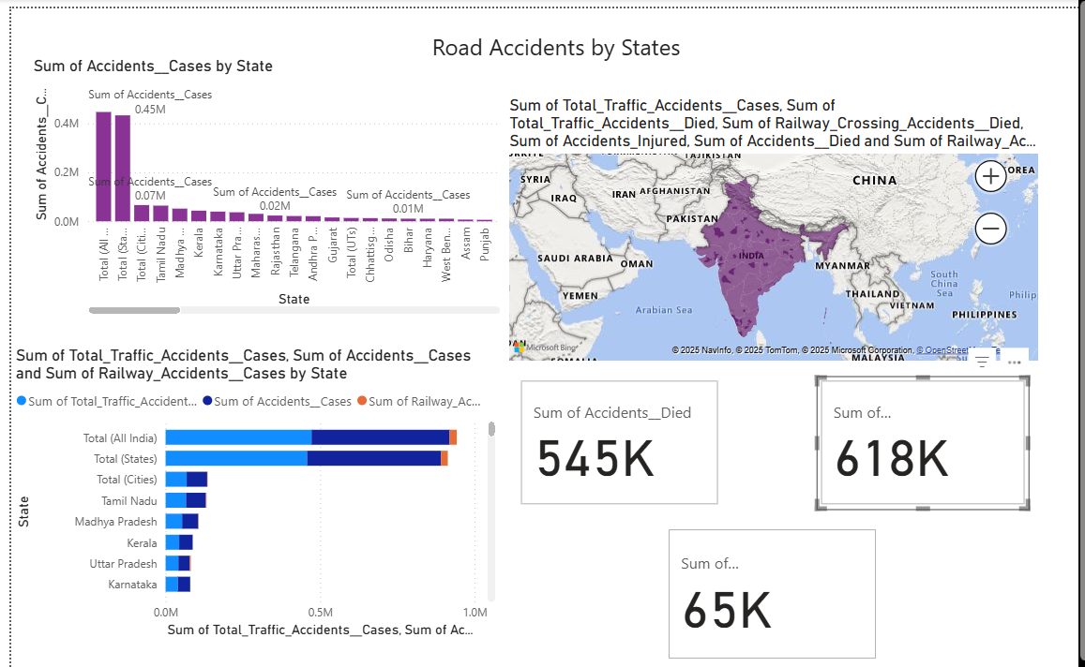
Power BI Dashboard

Slide 7
Summary:
Total Accidents Reported: 618K
Total Fatalities: 545K
Railway-related Accidents: 65K
Tamil Nadu and Madhya Pradesh have the highest case counts
Urgent need for awareness and stricter safety enforcement

