Slide 1
DATA ANALYTICS PROJECT
Customer Shopping Behavior Analysis
What 3,900 purchases tell us about who spends, what sells, and whether discounts and subscriptions are paying off.
Python · PostgreSQL · Power BI
Vibhav | October 2026
Notes:
Quick intro: this is a retail shopping dataset of 3,900 purchases. The aim was to figure out who the valuable customers are, what sells, and whether the levers the business pulls (discounts, subscriptions, express shipping) actually change spending.

Slide 2
01
Project overview & data
Contents
The business question and what the dataset holds
From a raw CSV to a dashboard and a short list of things to change.
02
Cleaning in Python
Imputation, feature engineering, loading to PostgreSQL
03
Ten questions in SQL
Gender, subscriptions, discounts, products, shipping, age
04
Power BI dashboard
Slicers, KPI cards and the category view
05
Recommendations
Six actions the numbers support
06
Limitations & next steps
Where the data stops being trustworthy

Slide 3




The business question
A retailer wants to know where its revenue really comes from, and which of its levers are working.
The company runs discounts, a subscription program and several shipping options, but has never checked whether any of them change how much people spend. This project answers that from the purchase data, in three stages: Python for cleaning, SQL for the questions, Power BI for the dashboard.
3,900
purchase records, one row each
Who spends most
What sells
Gender, age group and subscriber status
Products and categories by sales, rating, discount use
$233,081
Do the levers work
What to do next
total revenue across 25 items and 4 categories
Subscriptions, discounts and express shipping
Recommendations the business can act on

Slide 4



The dataset at a glance
3,900 rows and 18 columns covering who bought, what they bought, and how.
3,900
18
$59.76
3.75 / 5
rows (purchases)
columns
average purchase
average review rating
Customer demographics
Purchase details
Shopping behavior
Age 18 to 70, median 44
Gender (68% male)
Location: all 50 US states
Subscription status
Item purchased (25 items)
Category (4)
Purchase amount, $20 to $100
Season, size, color
Discount applied, promo code
Previous purchases, frequency
Review rating (37 missing)
Shipping type, payment method

Slide 5



Three tools, one pipeline
Each stage hands a cleaner, more useful version of the data to the next.
Clean & engineer
Store & query
Visualize
Python (pandas, Jupyter)
PostgreSQL, SQLAlchemy
Power BI Desktop
Load, explore, impute missing ratings, add derived columns
Hold the cleaned table and run ten business questions
One-page dashboard with slicers and KPI cards

Slide 6
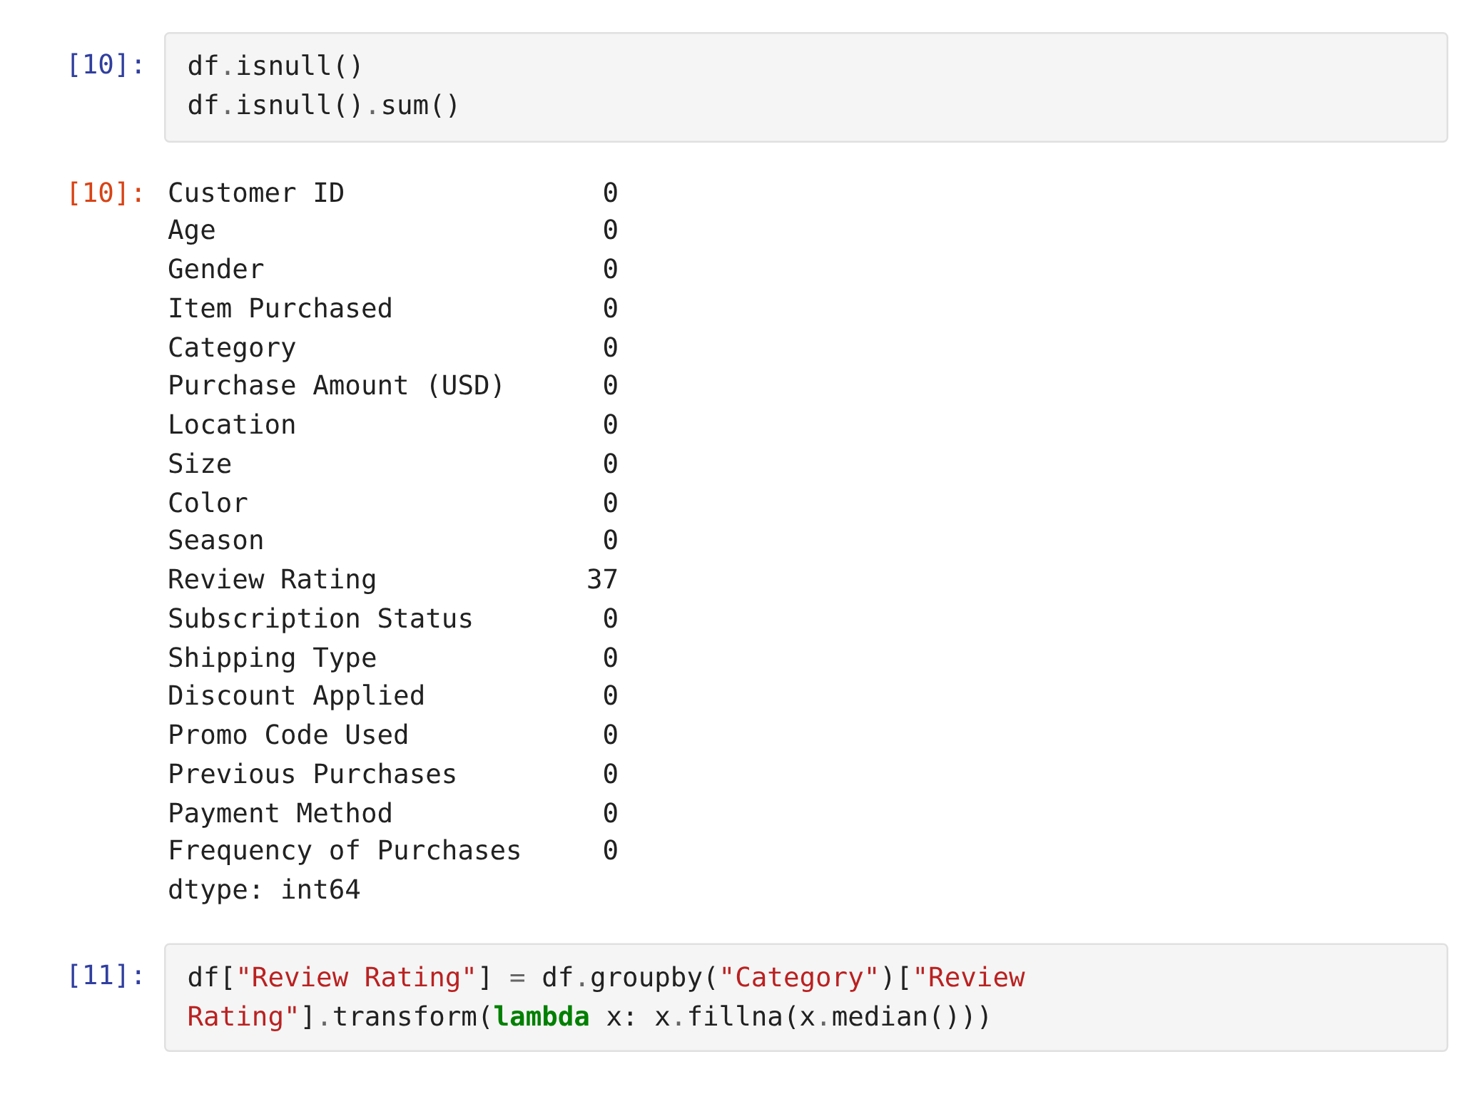
Preparing the data in Python
Five changes turned the raw CSV into a table that was ready for SQL.
01
Impute ratings
37 missing ratings filled with their own category's median
02
Rename columns
Lowercase snake_case, e.g. purchase_amount, for easier SQL
03
Add age groups
pd.qcut split age into 4 equal-sized bins
04
Frequency in days
Text like "Weekly" mapped to a number of days
05
Drop a duplicate
promo_code_used matched discount_applied on every row
Step 01 in the notebook: 37 nulls in Review Rating, filled per category

Slide 7
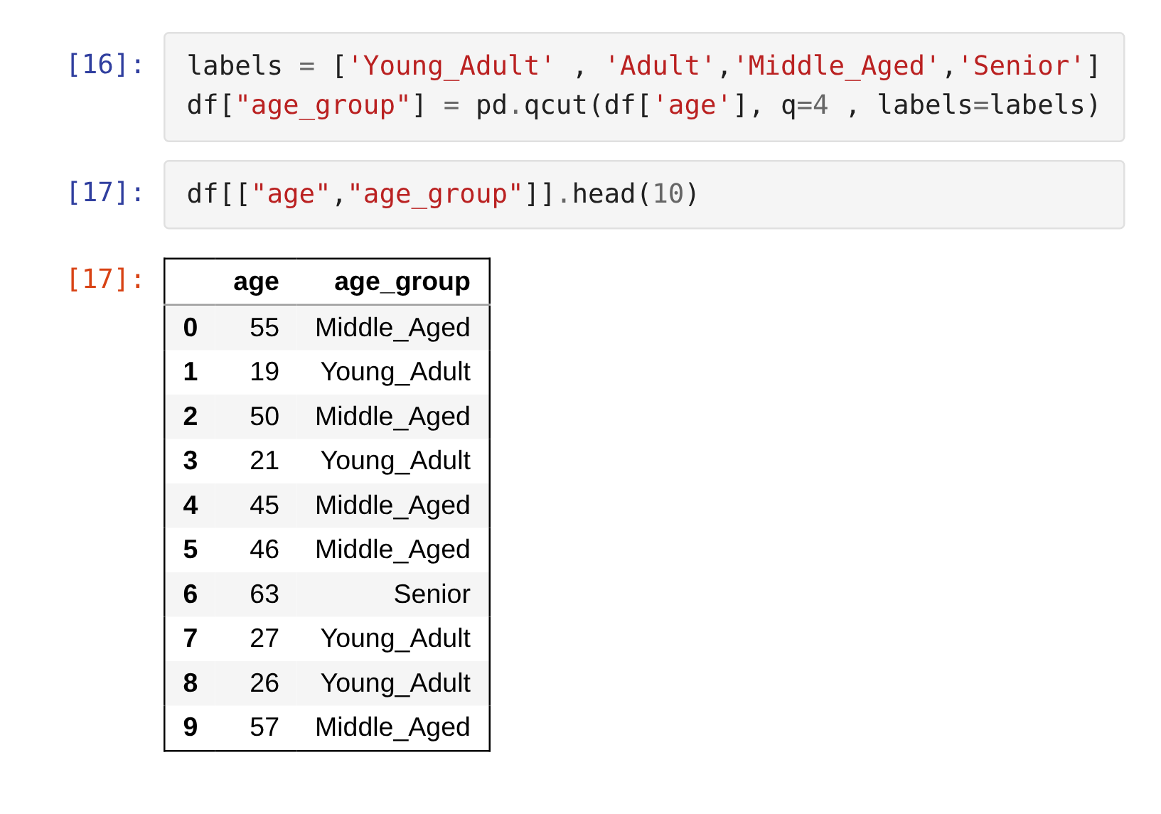
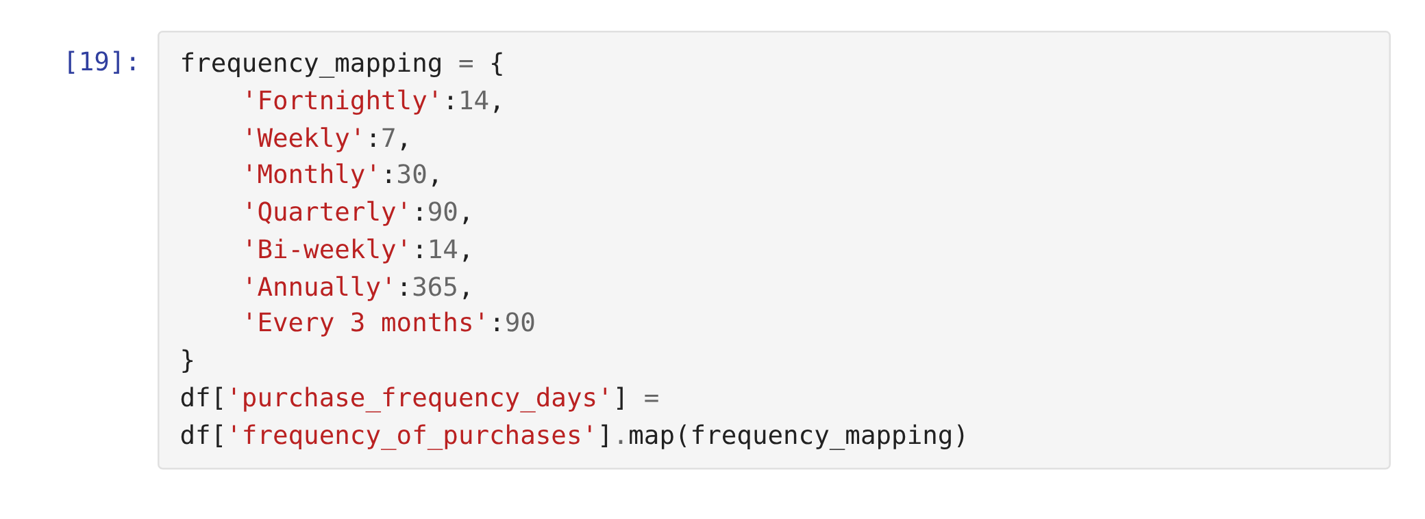

Feature engineering in the notebook
Age groups came out as planned. The frequency mapping missed two spellings.
Bug caught on review
The map says "Bi-weekly" and "Every 3 months", but the data says "Bi-Weekly" and "Every 3 Months". Because of the capital letters, 1,131 rows (29%) get an empty purchase_frequency_days. No SQL query uses that column, but fix the keys before reusing it.
pd.qcut puts roughly a quarter of customers in each of the four age groups.

Slide 8
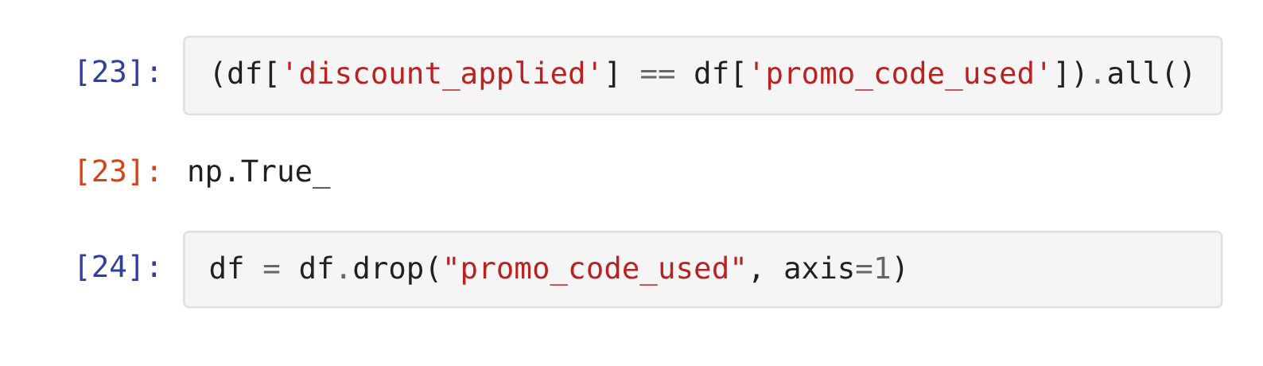
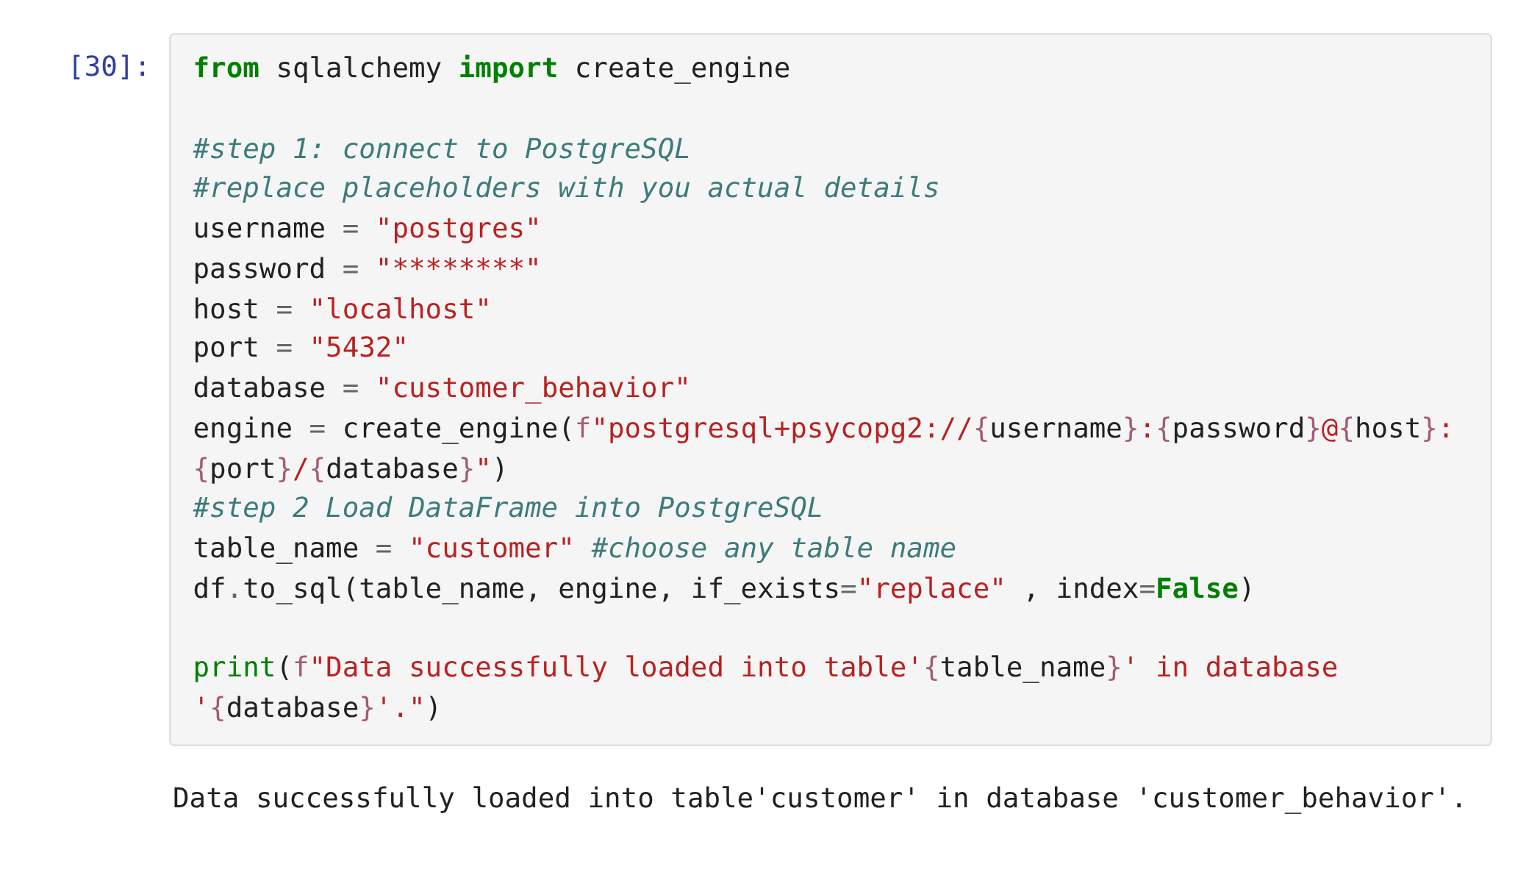
Final check, then load to PostgreSQL
One redundant column dropped, then the cleaned table went into PostgreSQL.
discount_applied and promo_code_used agree on all 3,900 rows, so one of them had to go.
3,900 × 19
rows and columns loaded into the customer table: 18 original columns, minus promo_code_used, plus age_group and purchase_frequency_days.
Notebook cell 30. Password masked for this slide.

Slide 9
Q1
Revenue by gender
Q6
Products with the highest discount rate
10
Q2
High-spending discount users
Q7
New, Returning and Loyal segments
Q3
Top 5 products by rating
Q8
Top 3 products in each category
business questions, answered in PostgreSQL
Q4
Standard vs Express shipping
Q9
Do repeat buyers subscribe more?
Every result was re-checked against the cleaned data.
Q5
Do subscribers spend more?
Q10
Revenue by age group

Slide 10
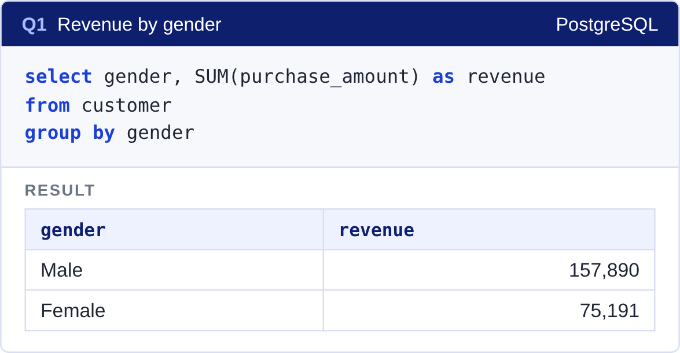
Revenue by gender
Q1 · Men bring in 68% of revenue, but that's headcount. Women spend slightly more per purchase.
Male
Female
Revenue
Revenue
$157,890
$75,191
Purchases
Purchases
2,652
1,248
The gap in revenue comes from the number of male customers, not how much each person spends. Read with care: every subscriber and discount user in this data is male (see Limitations).
Avg per purchase
Avg per purchase
$59.54
$60.25

Slide 11
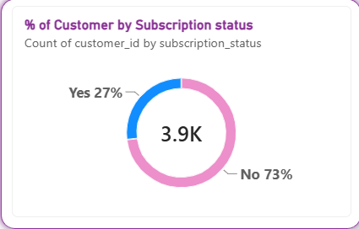
The subscription program isn't working
Q5 & Q9 · Subscribers don't spend more, and frequent buyers aren't any more likely to sign up.
Average spend per purchase
$59.49 subscribers
$59.87 everyone else
Share who subscribe
27.0% all customers
27.6% repeat buyers (>5)
From the Power BI dashboard: 27% of 3.9K customers subscribe.
2,518 repeat buyers haven't subscribed. They are the program's most obvious audience, and right now it gives them no reason to join.

Slide 12
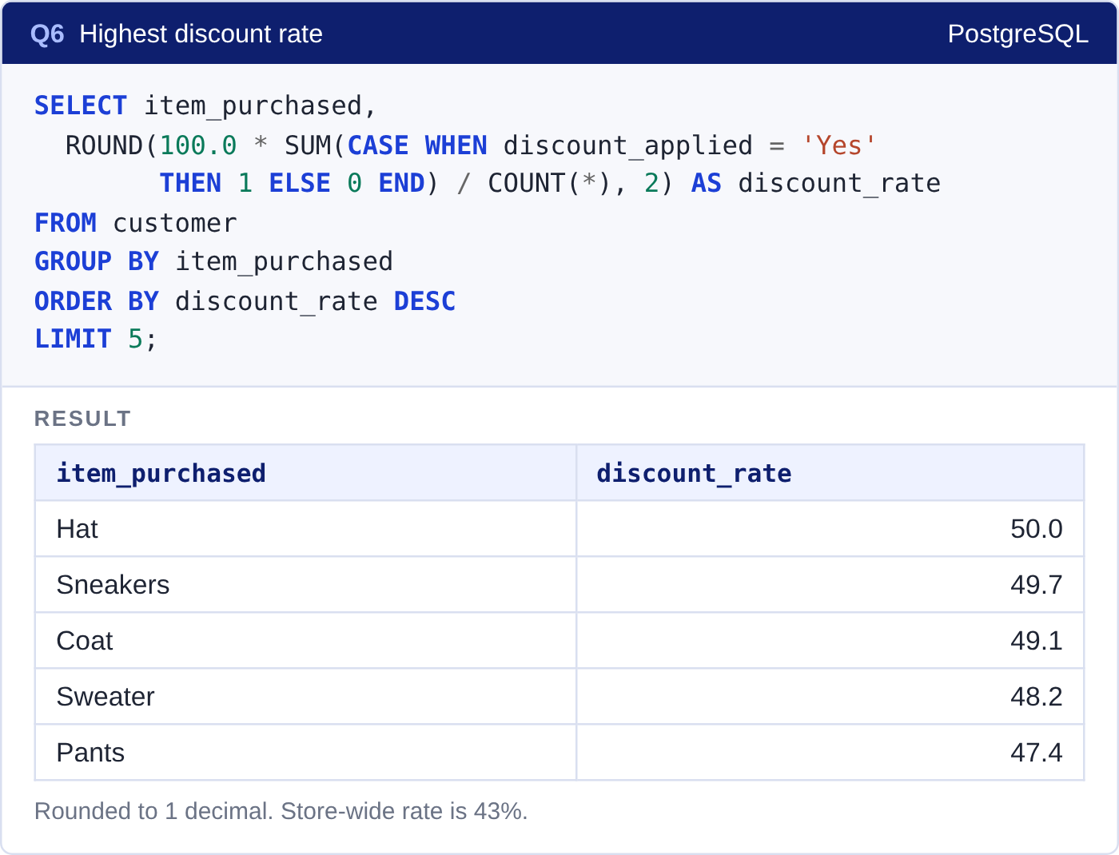
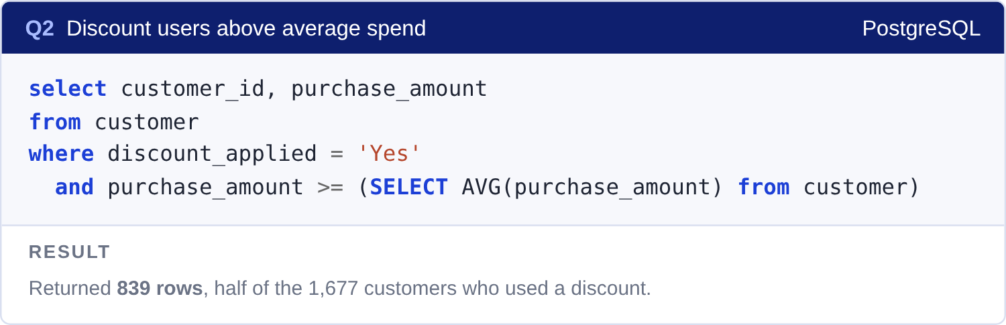
Some items may only sell on discount
Q2 & Q6 · About half of Hat and Sneakers sales use a discount, against 43% store-wide.
839
of 1,677 discount users still spent at or above the $59.76 average. Discounts aren't only pulling in bargain hunters.
If half these buyers would pay full price anyway, some of the discount on Hat, Sneakers and Coat is margin given away for nothing.

Slide 13
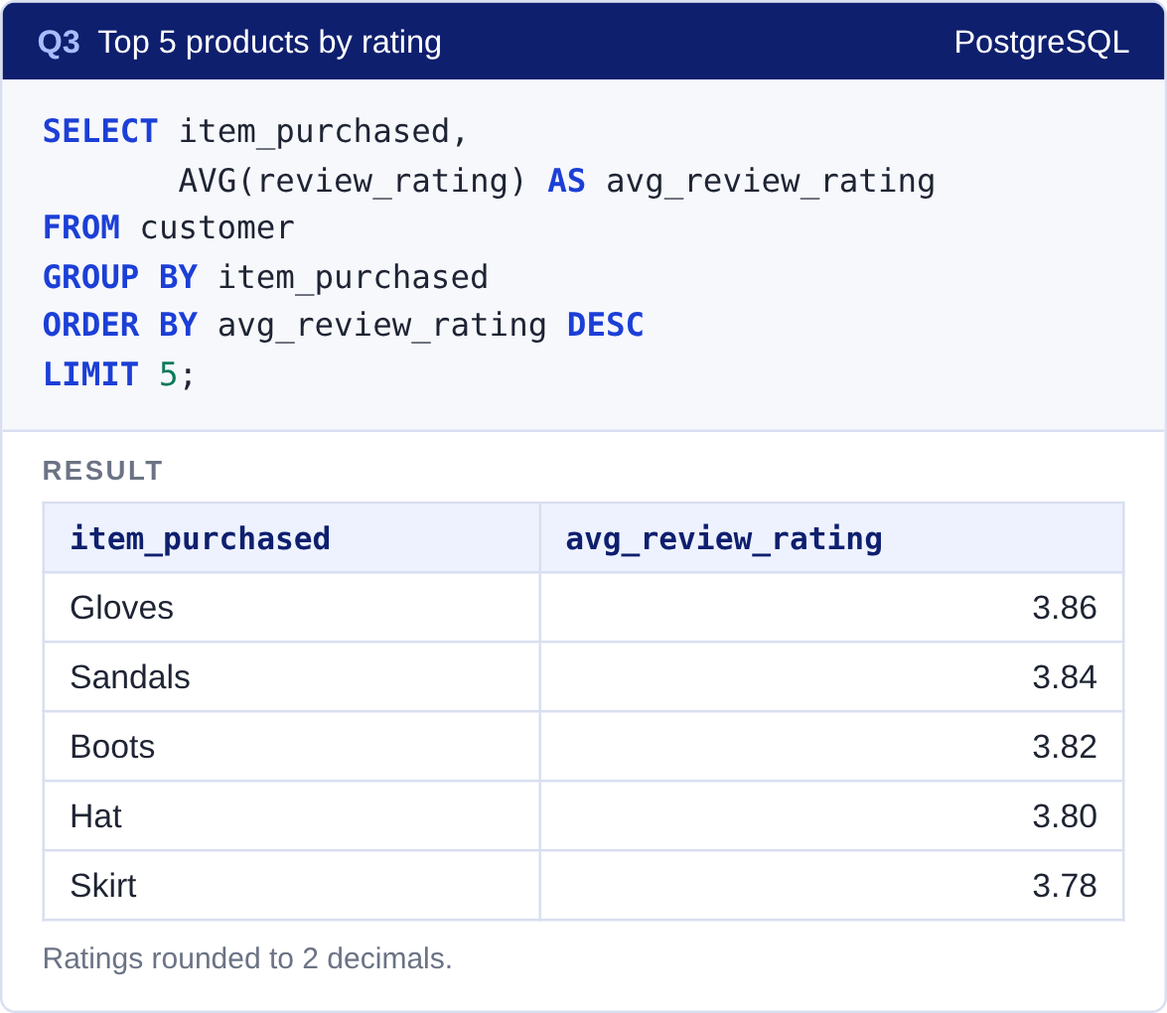
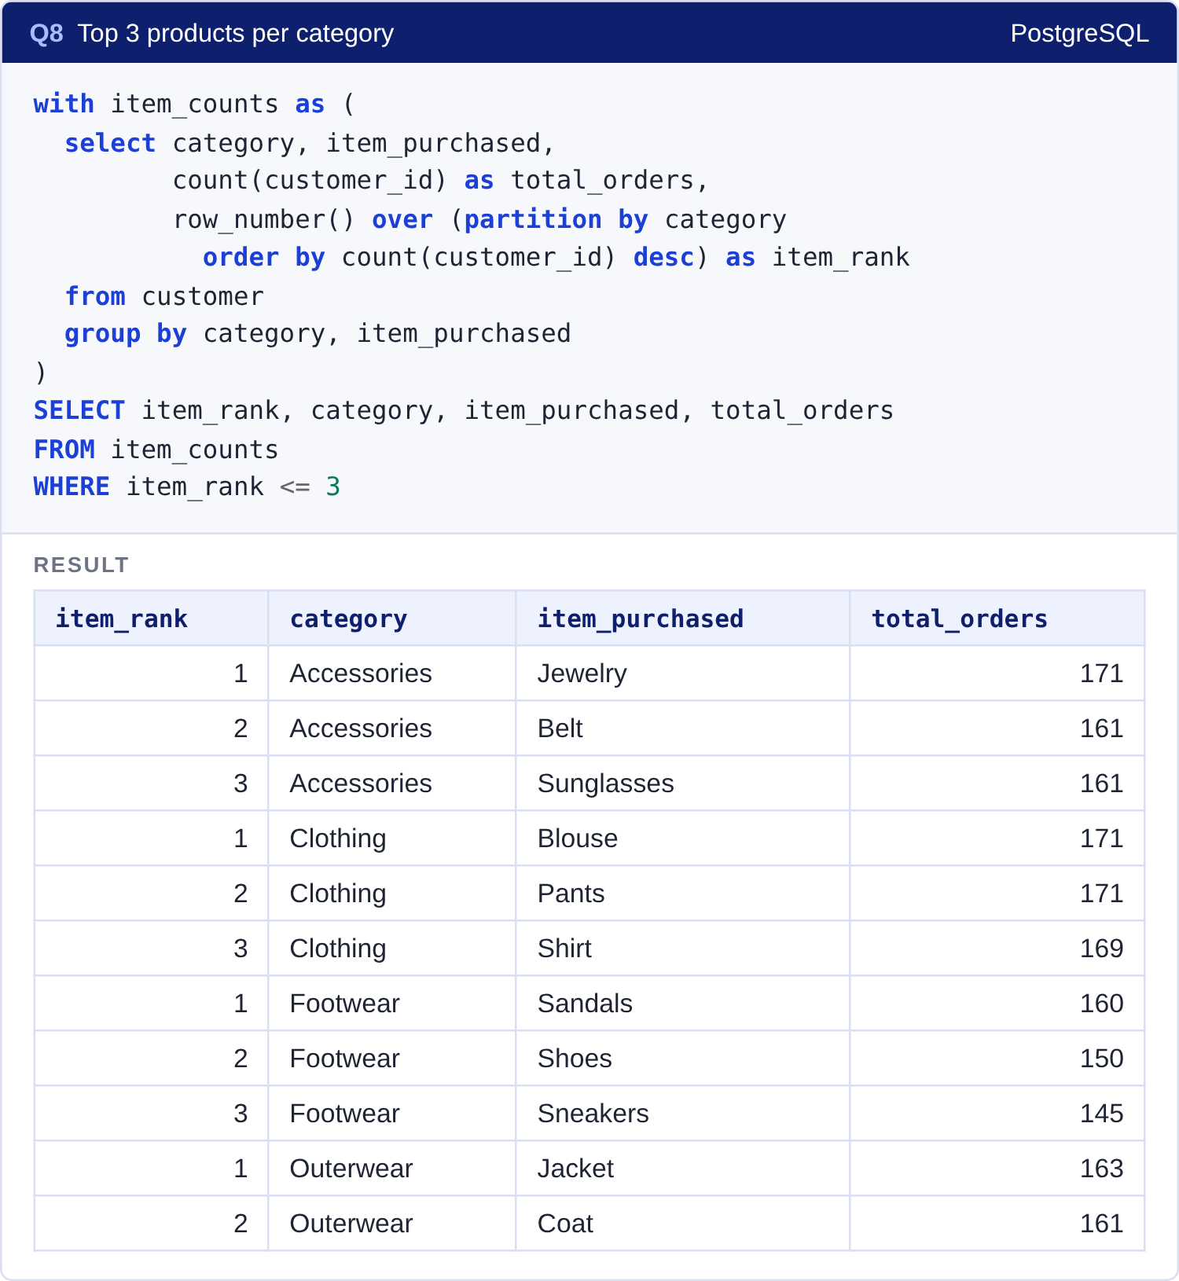
Products: ratings and best sellers
Q3 & Q8 · Ratings sit in a tight band. Even the lowest, Shirt (3.62), is only 0.24 behind Gloves.
Outerwear
Only two products, Jacket and Coat. That goes a long way to explaining why it's the smallest category.
Ties
Blouse and Pants both have 171 orders. ROW_NUMBER breaks ties arbitrarily, so their order can change.

Slide 14
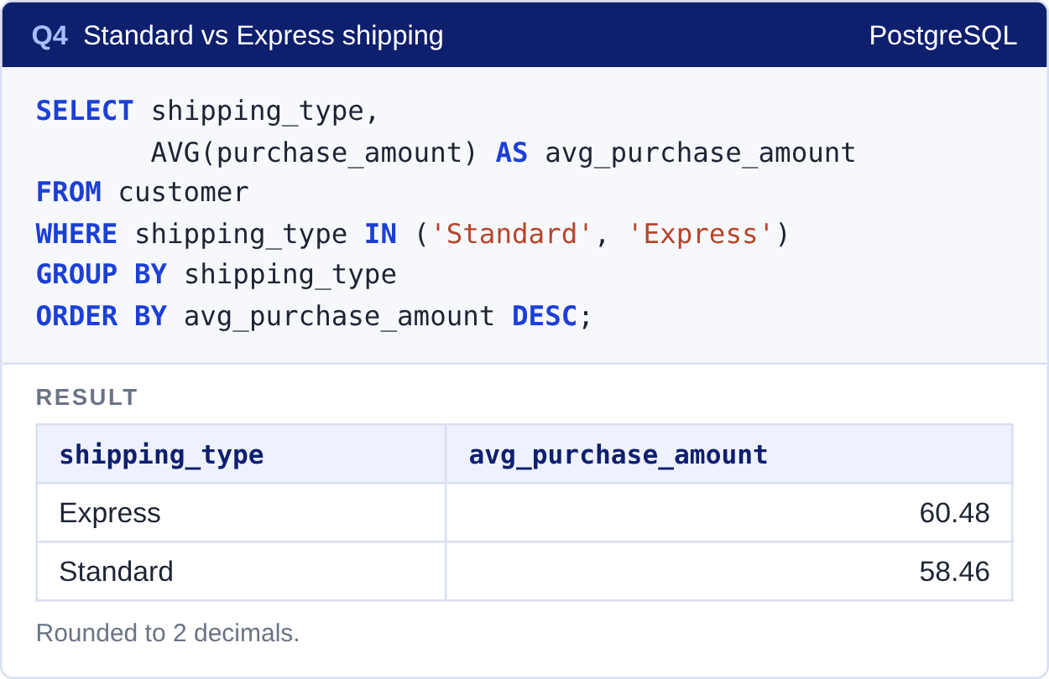
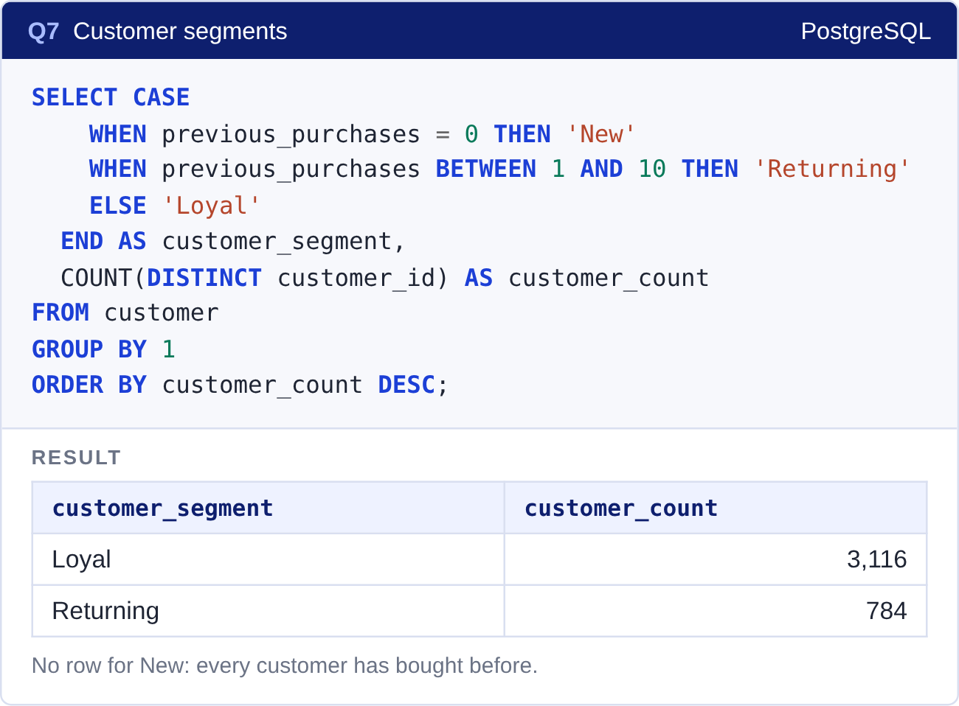
Shipping and customer loyalty
Q4 & Q7 · Express buyers spend a little more. Most customers are already loyal.
+$2.02
more per order for Express (+3.4%). Real, but small.
3,116
customers (80%) are Loyal, with more than 10 previous purchases. Nobody is New.

Slide 15
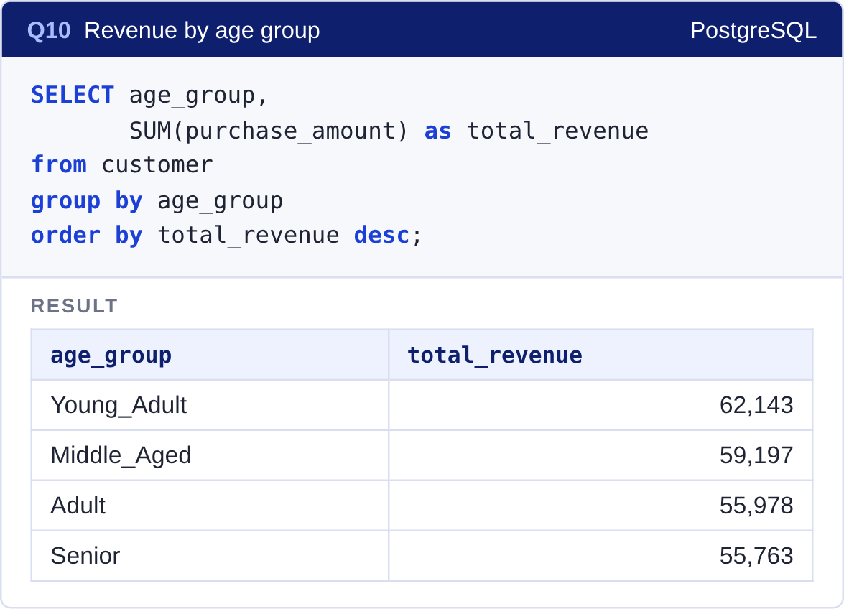
Revenue by age group
Q10 · Young adults lead by about $6,400, mostly because there are more of them.
Customers per group
Young adult
1,028
Middle-aged
986
Senior
944
Adult
942
Groups come from pd.qcut, so each holds roughly a quarter of customers. The revenue gap tracks the gap in headcount, not higher spending per person.

Slide 16
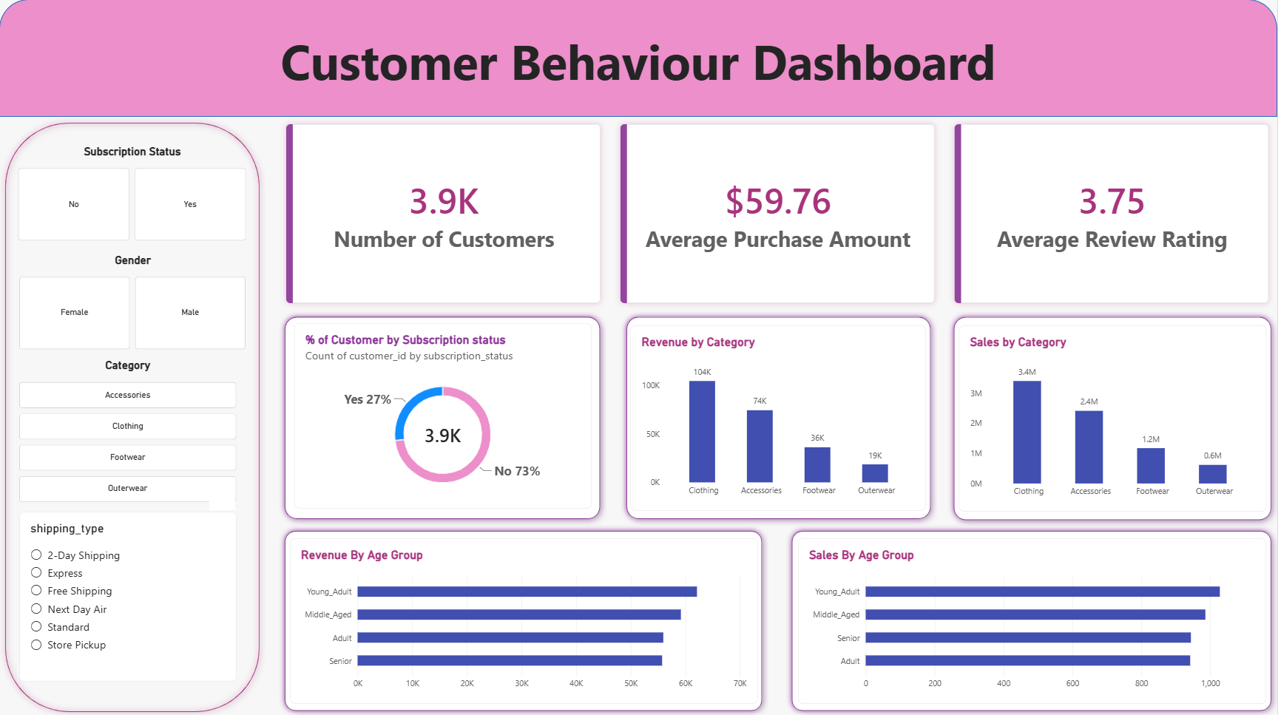



The Power BI dashboard
One page that management can filter without writing a query.
Slicers
Subscription, gender, category and shipping type
KPI cards
3.9K customers, $59.76 avg purchase, 3.75 rating
Five charts
Subscription share, category and age views
45% vs 8%
Clothing earns $104,264 from 1,737 sales; Outerwear $18,524 from 324. Order value is $57 to $60 everywhere.

Slide 17
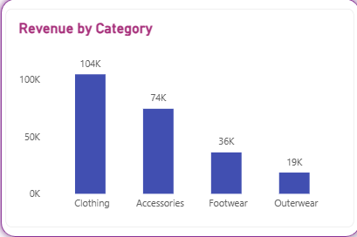
Categories differ in volume, not order value
Clothing and Accessories together bring in 77% of revenue.
45%
Clothing
1,737 sales
77%
Top two together
Clothing + Accessories
8%
Outerwear
324 sales, 2 products
Revenue by Category visual from the Power BI dashboard.

Slide 18
Six things the business should do
Ordered by how much the data backs them up.
1
Rework the subscription
2
Test smaller discounts
3
Grow Outerwear
Tie perks to spend, like free express shipping above a minimum order. Target the 2,518 repeat buyers first.
Cut discounts on Hat, Sneakers and Coat for a few weeks and watch whether sales actually drop.
Only Jacket and Coat today, 8% of revenue. Add a few products and push them in Fall and Winter.
4
Protect the top sellers
5
Focus on two age groups
6
Promote express at checkout
Clothing and Accessories are 77% of revenue. Blouse, Pants, Shirt and Jewelry should never run out.
18 to 31 and 45 to 57 earn the most. Use the age slicer to see what each group buys first.
Express orders run about $2 larger. Offer it free above a spending threshold.

Slide 19





Where the data runs out
Four things to keep in mind before pushing these findings further.
Skewed by gender
All subscribers and discount users are male; none of the 1,248 women. Likely how the data was generated, so read Q1, Q2 and Q5 with care.
No purchase dates
Next round of analysis
Season is the only time column, so trends over time can't be measured.
A dataset with purchase dates and a real mix of new and returning customers would open up trend and retention analysis, and let us test whether a reworked subscription actually changes behavior.
No first-time buyers
Every customer has bought before, so the "New" segment in Q7 is always empty.
One column is 29% empty
purchase_frequency_days, because of the capitalization bug in the mapping.

Slide 20
THE SHORT VERSION
Subscriptions and discounts aren't changing how much people spend. That's where to start.
Thank you · Questions?
Vibhav | Python · PostgreSQL · Power BI

