Slide 1
Parkinson detection
Guide : Prof.Dr.D.P Gaikwad
By :
Vibhav Joshi
Aditya Mengade
Pratik Patil

Slide 2
Content
Abstract
Goals & Objectives
Literature Survey
Existing System & it’s limitations
Proposed System
Model trained
CNN Algorithm
System Requirements
UML Diagrams
System Architecture
System Requirements
References
References

Slide 3
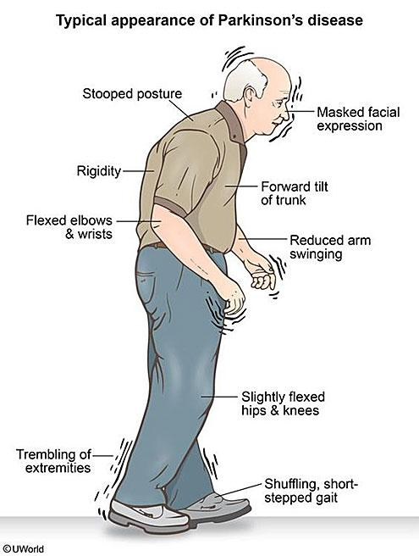
Abstract
Inside the life of a Parkinson Disease (PD) Subject
Suffers from a motor system disorder resulting from the loss of dopamine-producing brain cells.
Bradykinesia (Slowness of Movements)
Tremor
Rigidity
Postural Instability
But also non-motor symptoms:
Depression,
difficulty swallowing/speaking,
urinary disorders...
difficulty swallowing/speaking,
urinary disorders...
Notes:
First, What is Parkinson Disease? PD is a motor system disorder resulting from the loss of the brain cells producing dopamine. It is a neurodegenerative disease.
On the right, the usual symptoms experienced by a PD person: The picture chooses a old man, because men over 60 are the most common person affected by the disease.

Slide 4
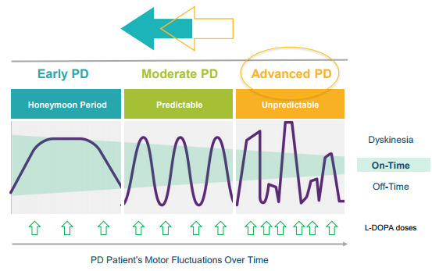
Motivation: why modelling Parkinson Disease Progression matters...
Parkinson is a neurodegenerative disease with complex motor fluctuations over time
and on/off cycles hard to anticipate and predict clinically, especially at the advanced stage...
Predicting disease progression benefits all stakeholders:
Patients:
Doctors: help for diagnosis, for scheduling next visits and for optimising treatments doses
Hospitals: enhanced operations management with anticipation of patients’ next visit, reduced costs in the patient management process

Slide 5
Goals & Objectives
Detection of Parkinson Disease using proper Biomarkers
Making a model with trained data to classify the the person if he is suffering from Parkinson or not?

Slide 6
Literature Survey
Literature Survey
Sr. No. | Paper Name | Year | Author | Description
1 | Deep Echo State Networks for Diagnosis of Parkinson’s Disease | 2018 | Claudio Gallicchio, Alessio Micheli and Luca Pedrelli | In this paper, we introduce a novel approach for diagnosis of Parkinson’s Disease (PD) based on deep Echo State Networks (ESNs). The identification of PD is performed by analyzing the whole time-series collected from a tablet device during the sketching of spiral tests, without the need for feature extraction and data preprocessing. We evaluated the proposed approach on a public dataset of spiral tests.
2 | Distinguishing Different Stages of Parkinson’s Disease Using Composite Index of Speed and Pen-Pressure of Sketching a Spiral | 2017 | Poonam Zam,Sanjay Raghav | Parkinson disease is associated with movement disorder symptoms, such as tremor, rigidity, bradykinesia, and postural instability . The manifestation of bradykinesia and rigidity is often in the early stages of the disease . These have a noticeable effect on the handwriting and sketching abilities of patients, and micrographia has been used for early-stage diagnosis of Parkinson’s disease (PD) .

Slide 7
Existing System & Limitations
Use of the Composite Index of Speed and Pen-pressure (CISP) of sketching as a feature for analyzing the severity of PD.
Limitations :
Less Accuracy
The correlation of speed, pen-pressure, and CISP with the severity of PD was −0.415, −0.584, and −0.641, respectively
Time Consuming
No Integrated Application

Slide 8
Proposed system
To detect if the person has Parkinson's disease and make the process easy
Study the dataset and build a model to classify the drawings of a healthy and affected person
Once we take the input which is the shapes drawn by the user then the model will classify the shapes according to the previous data and give output as result
Use the training dataset to make prediction and help patient for further diagnosis.
We take input from the user the shapes he draws on paper in the form of image.
We use OpenCV to read and process data and and convert it to analyse
We classify if the person has Parkinson disease or not on the model we have trained on the dataset

Slide 9
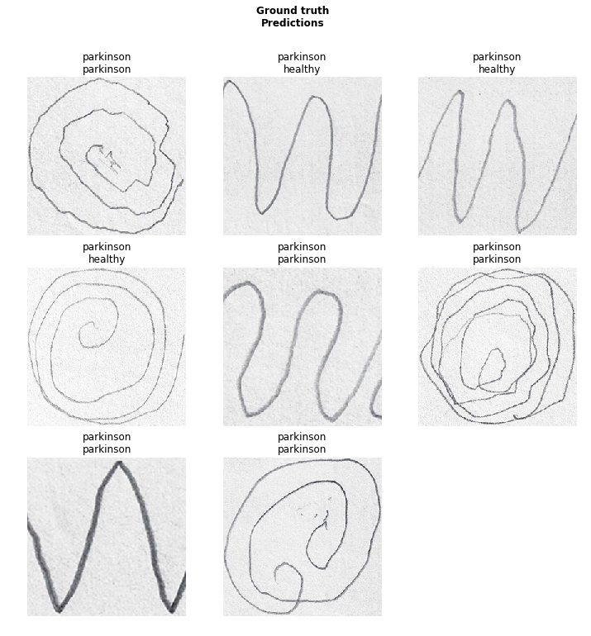
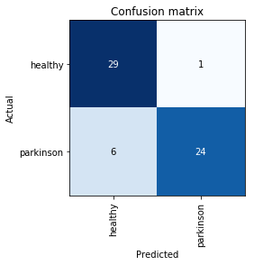
We will use deep learning and Convolutional Neural networks to Train the model on the dataset
The data set is divided in two partition images of healthy people and images of people who have parkinson
We will train the data and build a model and make our prediction

Slide 10
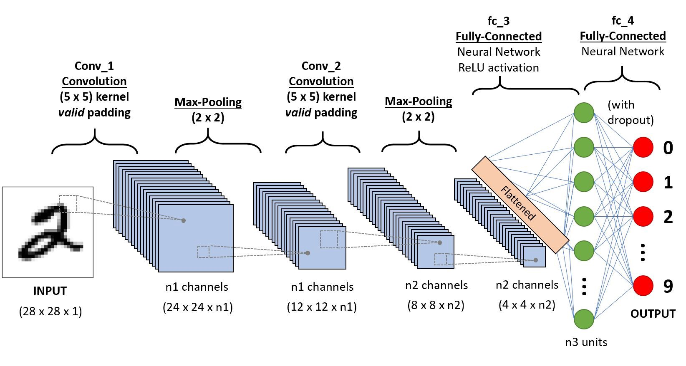
Convolutional Neural Network

Slide 11
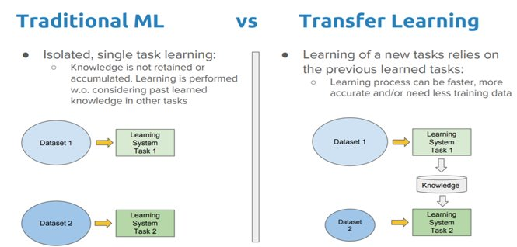
We Use Transfer Learning to build our model​
We can give the new dataset to fine tune the pre-trained CNN. Consider that the new dataset is almost similar to the original dataset used for pre-training.​
Since the new dataset is similar, the same weights can be used for extracting the features from the new dataset.
​ If the new dataset is very small, it’s better to train only the final layers of the network to avoid overfitting, keeping all other layers fixed. ​
So remove the final layers of the pre-trained network. Add new layers . Retrain only the new layers. If the new dataset is very much large, retrain the whole network with initial weights from the pretrained model.​ ​

Slide 12
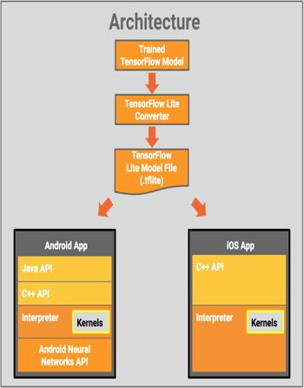
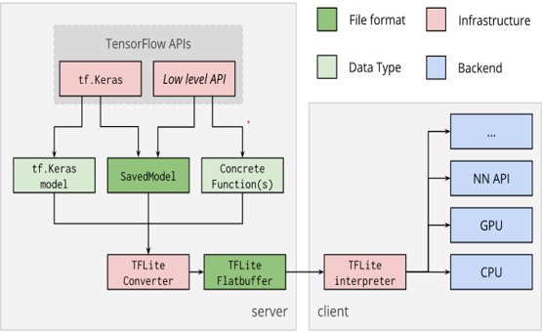
The Tensorflow Model is Converted to Tensorflow Lite Model and Used in Android App​
​ TensorFlow Lite is comprised of a runtime on which you can run pre-existing models, and a suite of tools that you can use to prepare your models for use on mobile and embedded devices.​ ​
It’s presently supported on Android and iOS via a C++ API, as well as having a Java Wrapper for Android Developers.
Additionally, on Android Devices that support it, the interpreter can also use the Android Neural Networks API for hardware acceleration, otherwise it will default to the CPU for execution.

Slide 13
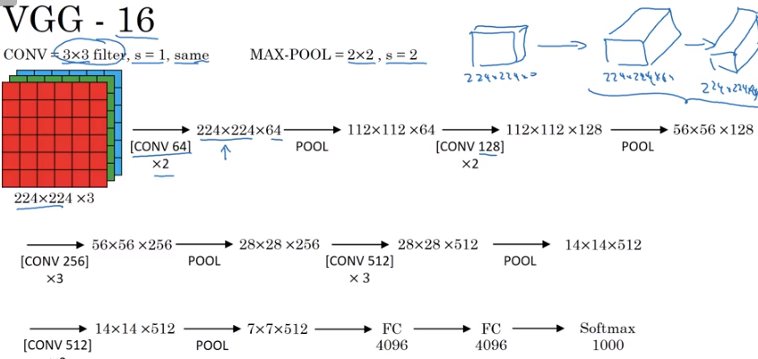
VGG-16 | CNN model
The ImageNet Large Scale Visual Recognition Challenge (ILSVRC) is an annual computer vision competition. Each year, teams compete on two tasks. The first is to detect objects within an image coming from 200 classes, which is called object localization. The second is to classify images, each labeled with one of 1000 categories, which is called image classification. VGG 16 was proposed by Karen Simonyan and Andrew Zisserman of the Visual Geometry Group Lab of Oxford University in 2014 in the paper “VERY DEEP CONVOLUTIONAL NETWORKS FOR LARGE-SCALE IMAGE RECOGNITION”. This model won the 1st and 2nd place on the above categories in 2014 ILSVRC challenge.
This model achieves 92.7% top-5 test accuracy on ImageNet dataset which contains 14 million images belonging to 1000 classes.

Slide 14
Layers used to build ConvNets
A covnets is a sequence of layers, and every layer transforms one volume to another through differentiable function.
Types of layers:
Input Layer: This layer holds the raw input of image with width 32, height 32 and depth 3
Convolution Layer: This layer computes the output volume by computing dot product between all filters and image patch. Suppose we use total 12 filters for this layer we’ll get output volume of dimension 32 x 32 x 12.
Activation Function Layer: This layer will apply element wise activation function to the output of convolution layer. Some common activation functions are RELU: max(0, x), Sigmoid: 1/(1+e^-x), Tanh, Leaky RELU, etc. The volume remains unchanged hence output volume will have dimension 32 x 32 x 12.
Pool Layer: This layer is periodically inserted in the covnets and its main function is to reduce the size of volume which makes the computation fast reduces memory and also prevents from overfitting. Two common types of pooling layers are max pooling and average pooling. If we use a max pool with 2 x 2 filters and stride 2, the resultant volume will be of dimension 16x16x12.
Fully-Connected Layer: This layer is regular neural network layer which takes input from the previous layer and computes the class scores and outputs the 1-D array of size equal to the number of classes.

Slide 15
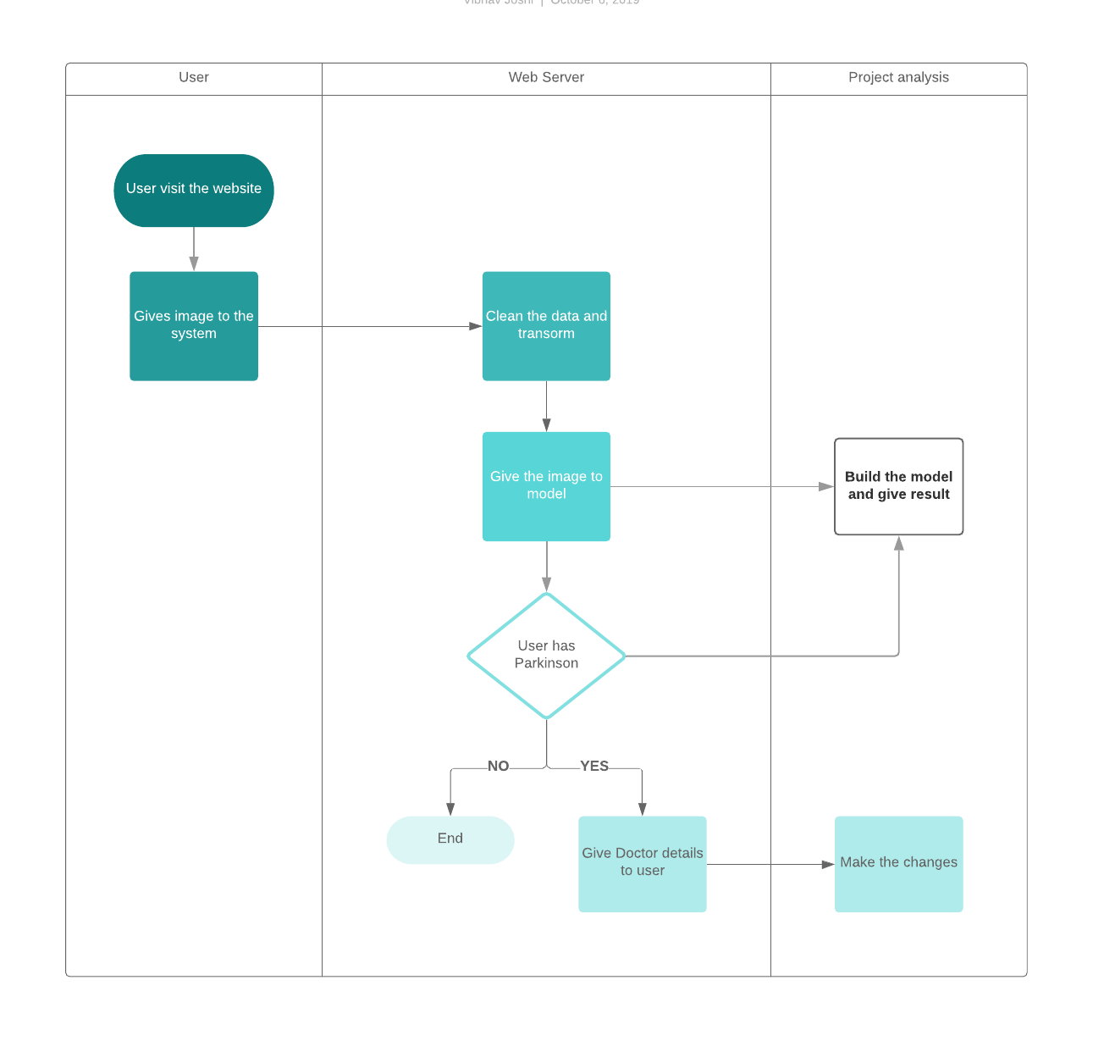
System Architecture

Slide 16
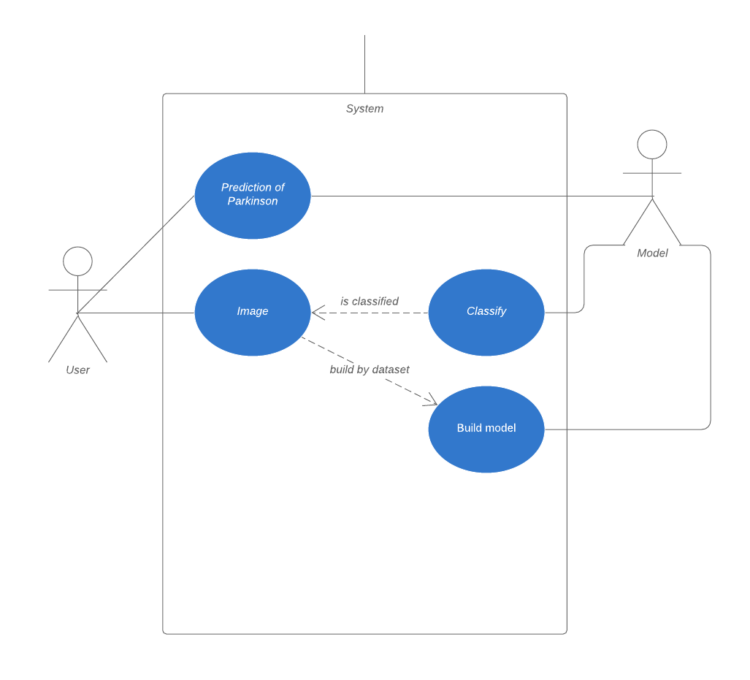
Uml Diagram

Slide 17
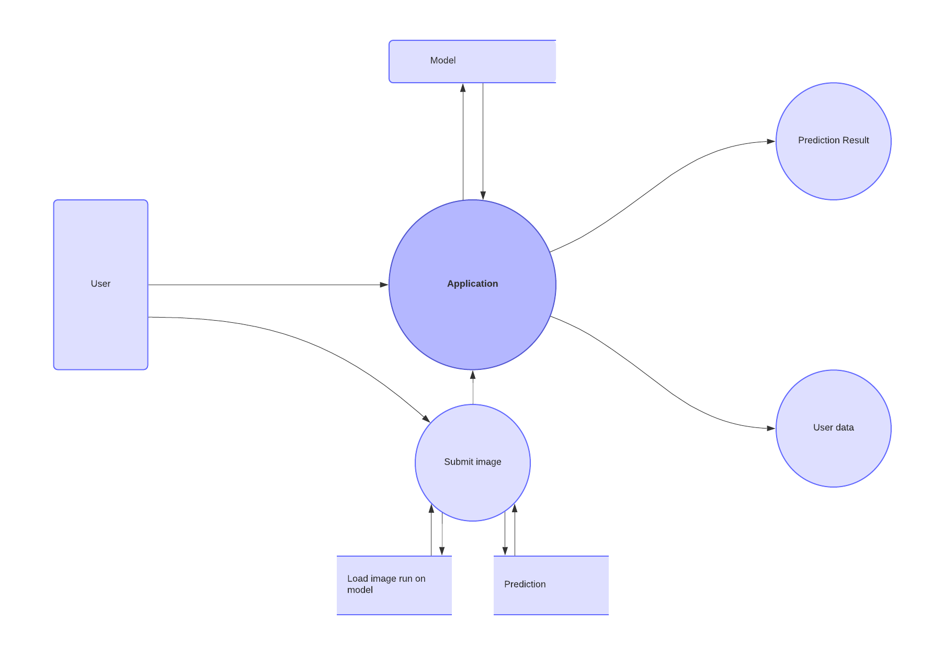
Data flow diagram

Slide 18
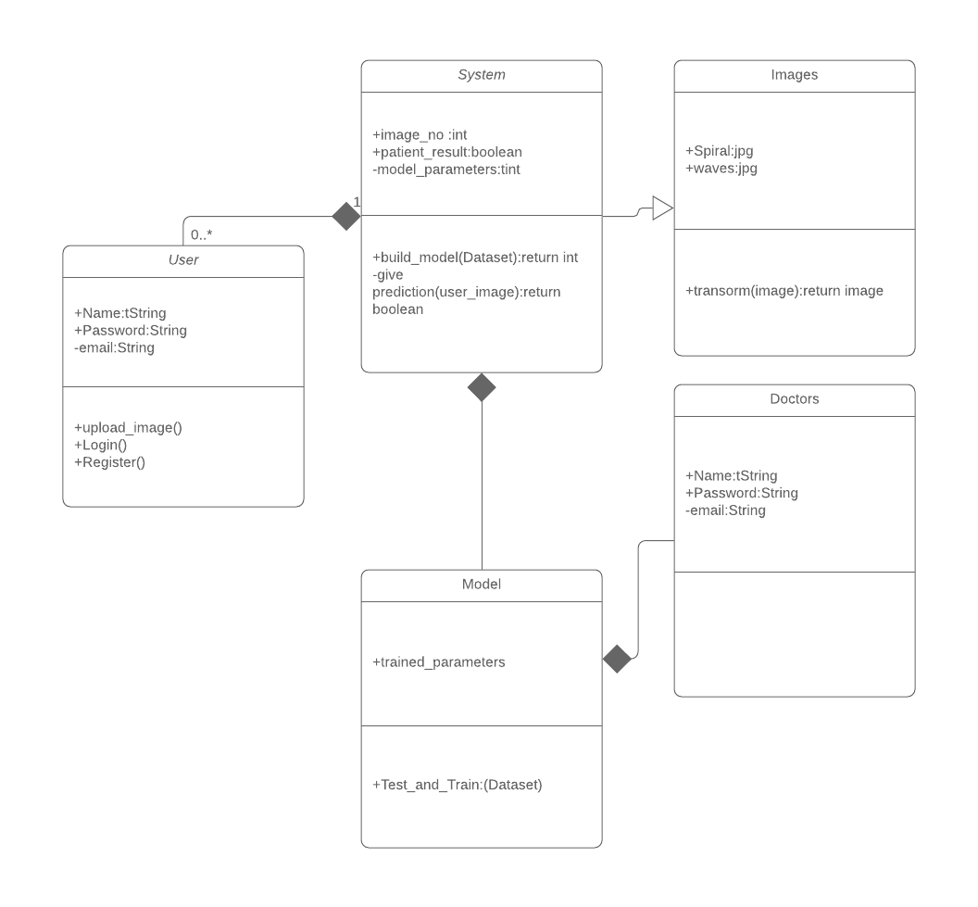
Class diagram

Slide 19
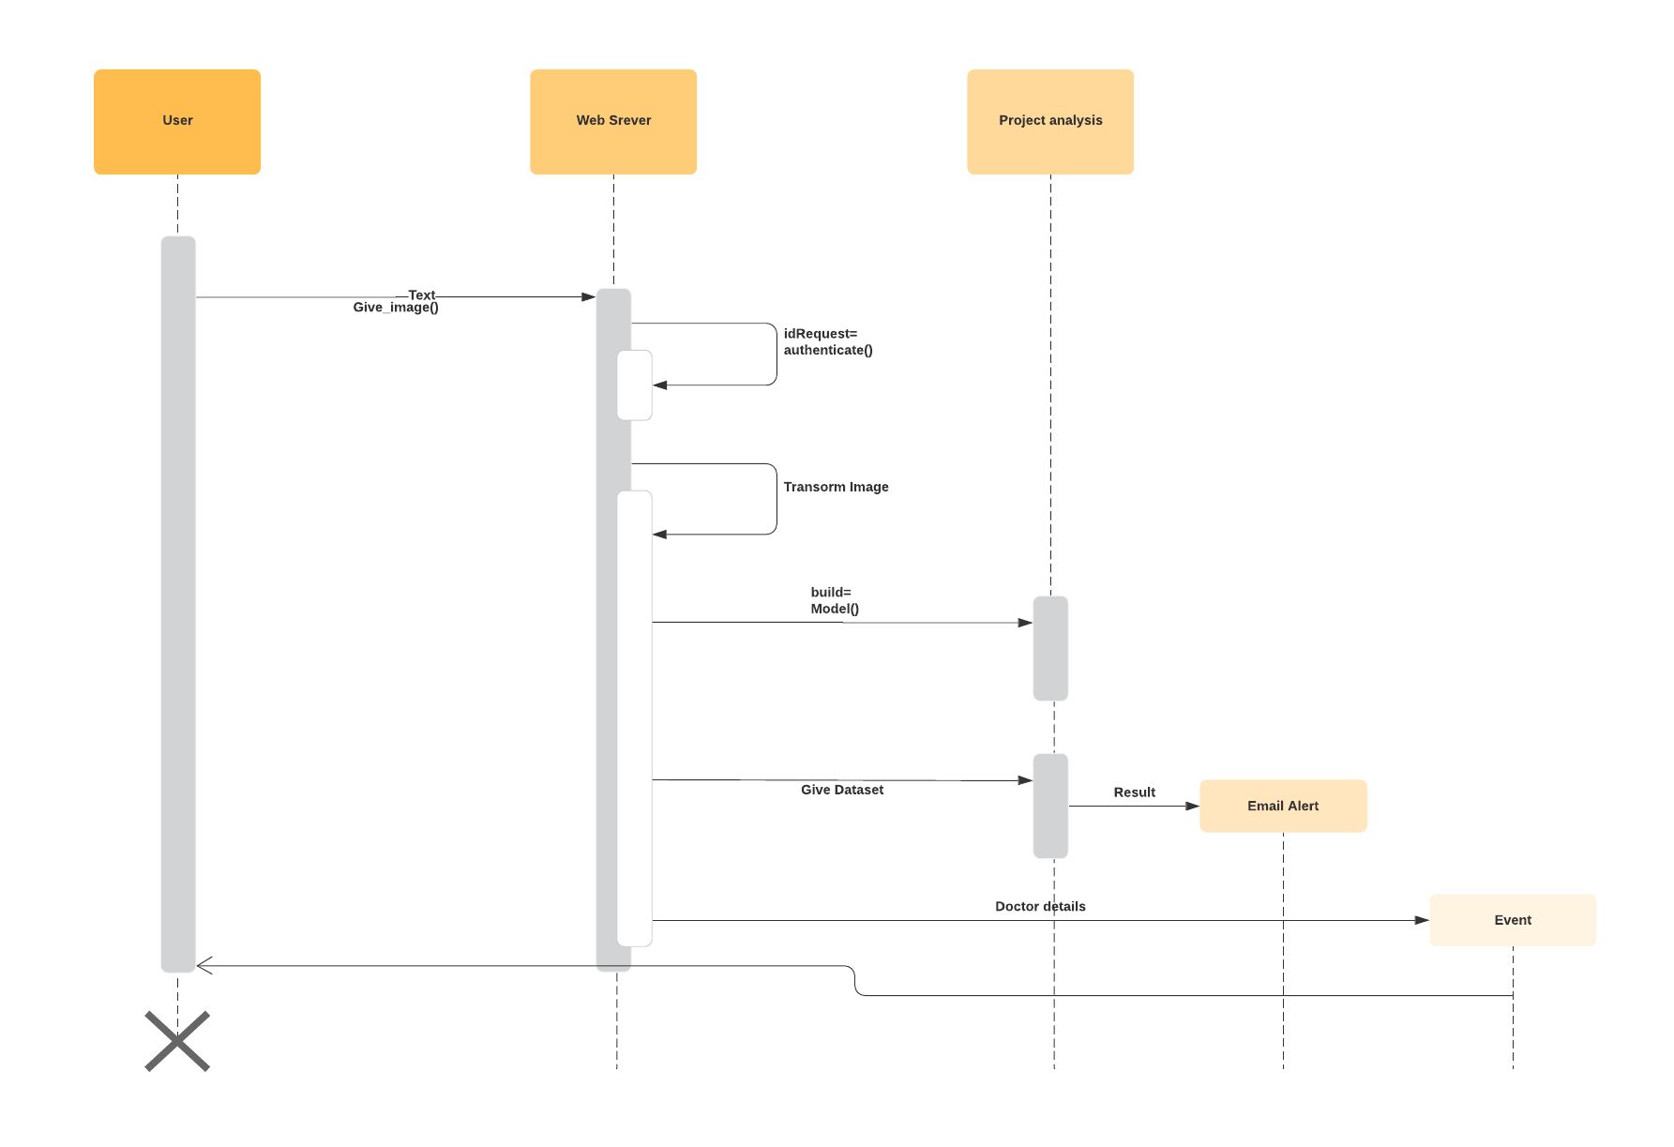
Sequence Diagram

Slide 20
System requirements
OpenCV: To read process and transform data
Convolutional Neural Networks(CNN):To build the neural networks to learn and build the model
Camera:To get the image of the shape drawn
Numpy: used for mathematics
Scikit-learn:To use classifiers

Slide 21
Conclusion
We have build a model which has good accuracy which has been trained on dataset
The user can submit his image of hand drawn shape and submit it to application which will train that image on model and give prediction on Parkinson
Thus if user has Parkinson then he will be given information of Treatment and Doctor for further diagnosis

Slide 22
References
[1] J. Jankovic. Parkinson’s disease: clinical features and diagnosis. Journal of Neurology, Neurosurgery & Psychiatry, 79(4):368–376, 2008.
R. Saunders-Pullman, C. Derby, K. Stanley, A. Floyd, S. Bressman, R. B. Lipton, A. Deligtisch, L. Severt, Q. Yu, M. Kurtis, and S. L. Pullman. Validity of spiral analysis in early parkinson’s disease. Movement disorders, 23(4):531–537, 2008.
C. R. Pereira, D. R. Pereira, J. P. Papa, G. H. Rosa, and X. Yang. Convolutional neural networks applied for parkinson’s disease identification. In Machine Learning for Health Informatics, pages 377–390. Springer, 2016.
P. Zham, D. K. Kumar, P. Dabnichki, S. Poosapadi Arjunan, and S. Raghav. Distinguishing different stages of parkinson’s disease using composite index of speed and pen-pressure of sketching a spiral. Frontiers in Neurology, 8:435, 2017.
H. Jaeger, M. Lukoˇseviˇcius, D. Popovici, and U. Siewert. Optimization and applications of echo state networks with leaky-integrator neurons. Neural Networks, 20(3):335–352, 2007.
D. Verstraeten, B. Schrauwen, M. d’Haene, and D. Stroobandt. An experimental unification of reservoir computing methods. Neural networks, 20(3):391–403, 2007.

