Slide 1

POWER OF VISION USING CONVOLUTIONAL NEURAL NETWORKS

Slide 2

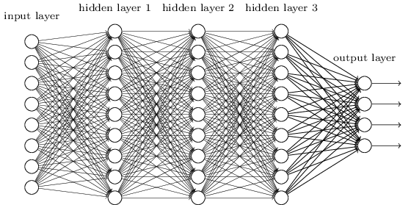
NEURAL NETWORKS : THE BACKBONE OF AI
Neural networks are a set of algorithms, modeled loosely after the human brain, that are designed to recognize patterns. They interpret sensory data through a kind of machine perception, labeling or clustering raw input. The patterns they recognize are numerical, contained in vectors, into which all real-world data, be it images, sound, text or time series, must be translated.
Neural networks help us cluster and classify. You can think of them as a clustering and classification layer on top of the data you store and manage.

Slide 3
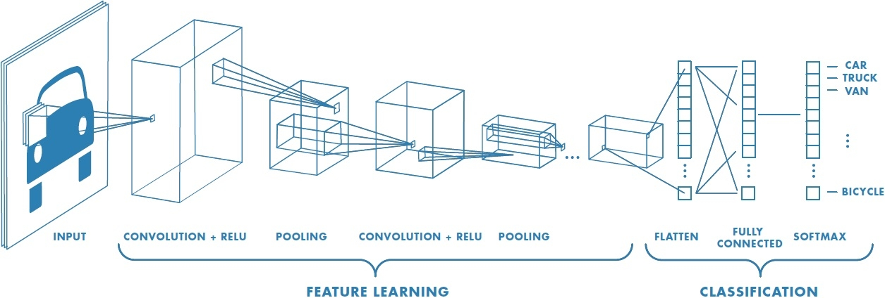
Okay, but what is a Convulotional Neural Network? How different are they from Simple Neural Networks
They are made up of neurons that have learnable weights and biases. Each neuron receives some inputs, performs a dot product and optionally follows it with a non-linearity.
ConvNet architectures make the explicit assumption that the inputs are images, which allows us to encode certain properties into the architecture. These then make the forward function more efficient to implement and vastly reduce the amount of parameters in the network.

Slide 4
How is my model different than other out there? Why is it faster?
My model has several advantages over classifier-based systems. It looks at the whole image at test time so its predictions are informed by global context in the image. It also makes predictions with a single network evaluation unlike systems like R-CNN which require thousands for a single image. This makes it extremely fast, more than 1000x faster than R-CNN and 100x faster than Fast R-CNN.
THE TRICK THAT MADE THE DIFFERENCE : BOUNDING BOX
The network predicts 4 coordinates for each bounding box, tx,ty, tw, th. If the cell is offset from the top left corner of theimage by (cx, cy) and the bounding box prior has width and height pw, ph.
My model predicts an objectness score for each bounding box using logistic regression. This should be 1 if the bounding box prior overlaps a ground truth object by more than any other bounding box prior.
If the bounding box prior is not the best but does overlap a ground truth object by more than some threshold I ignored the prediction.
Source of inspiration
1] J. Huang, V. Rathod, C. Sun, M. Zhu, A. Korattikara, A. Fathi, I. Fischer, Z. Wojna, Y. Song, S. Guadarrama, et al. Speed/accuracy trade-offs for modern convolutional object detectors.
2] I. Krasin, T. Duerig, N. Alldrin, V. Ferrari, S. Abu-El-Haija, A. Kuznetsova, H. Rom, J. Uijlings, S. Popov, A. Veit, S. Belongie, V. Gomes, A. Gupta, C. Sun, G. Chechik, D. Cai, Z. Feng, D. Narayanan, and K. Murphy. Openimages: A public dataset for large-scale multi-label and multi-class image classification

Slide 5
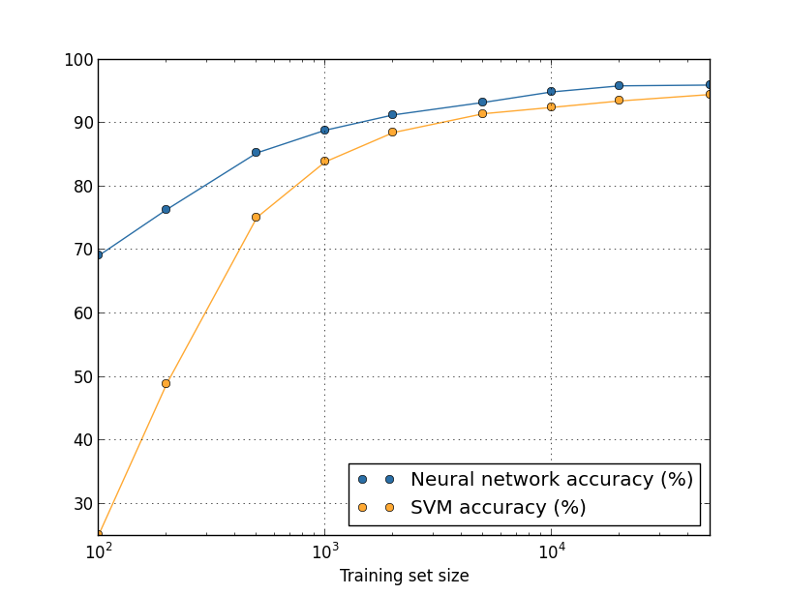
Right on the business!
X-axis (accuracy in 99.xx %)
Y-axis (each step of 10 units)

