Slide 1
BIG DATA MANAGEMENT | SEMESTER VII
QuakeWatch
Spatial and temporal analysis of global earthquakes
USGS ComCat · MongoDB · Flask · React · BI dashboard
Anurag 2023IMG-008 · Kushagra 2023IMG-030 · Kshitij 2023IMG-029 · Vibhor 2023IMG-054
ABV-IIITM Gwalior · IMG (Integrated B.Tech + MBA) · November 2026
Notes:
Introduce the team and the project: we took a public earthquake catalogue and built a MongoDB-backed web app and a BI dashboard on it.

Slide 2
Five questions drive the project
1
When do earthquakes occur?
Volume by month, hour of day and weekday
2
Which conditions have more strong events?
Depth, magnitude type, network, region
3
Where do events concentrate?
Counts versus strong-event concentration
4
What do indexes save?
Including a geospatial 2dsphere query
5
One dataset, two front ends?
Web app and BI dashboard from the same data
Notes:
These mirror the questions in the report. Question 3 and 4 are where MongoDB features matter most.

Slide 3
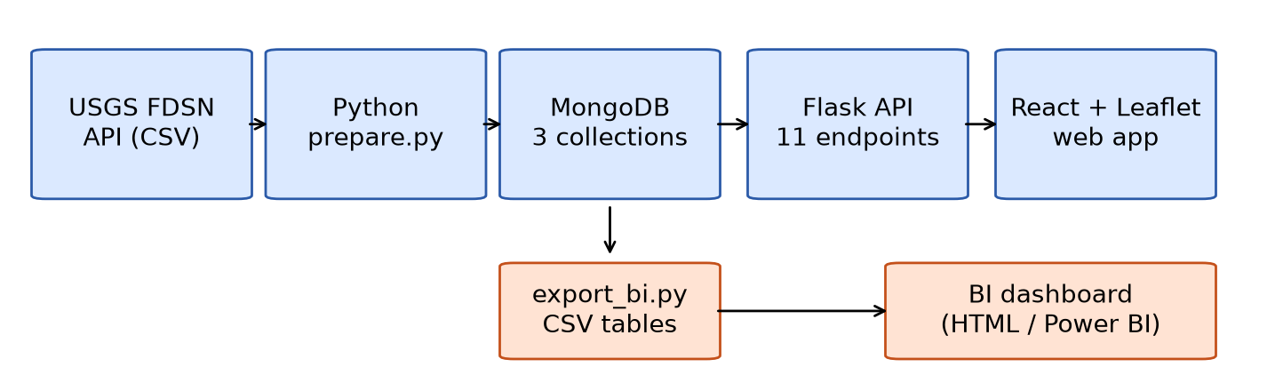
From USGS API to app and dashboard
54,394
53,952
55,152
11
raw USGS rows, 24 files
earthquakes kept
MongoDB documents
Flask API endpoints
442 non-earthquake events (mostly mining explosions) removed; 0 duplicates, 0 bad coordinates.
Notes:
Data: USGS FDSN event service, magnitude 2.5 and above, 2024 and 2025. Three collections: earthquakes, daily_summary, region_summary.

Slide 4
Headline numbers
53,952
3,636
6.74%
M8.8
earthquakes M2.5+
strong events, M ≥ 5.0
strong share
Kamchatka, 29 Jul 2025
2024: 24,954 events, 6.04% strong, largest M7.5
2025: 28,998 events, 7.34% strong, largest M8.8
M6+ events rose from 99 to 145; M7+ from 10 to 16
Counts fall about ten-fold per magnitude unit (b ≈ 1.2)
Notes:
Strong share is M5 and above divided by all catalogued events. It describes the catalogue, not hazard.

Slide 5
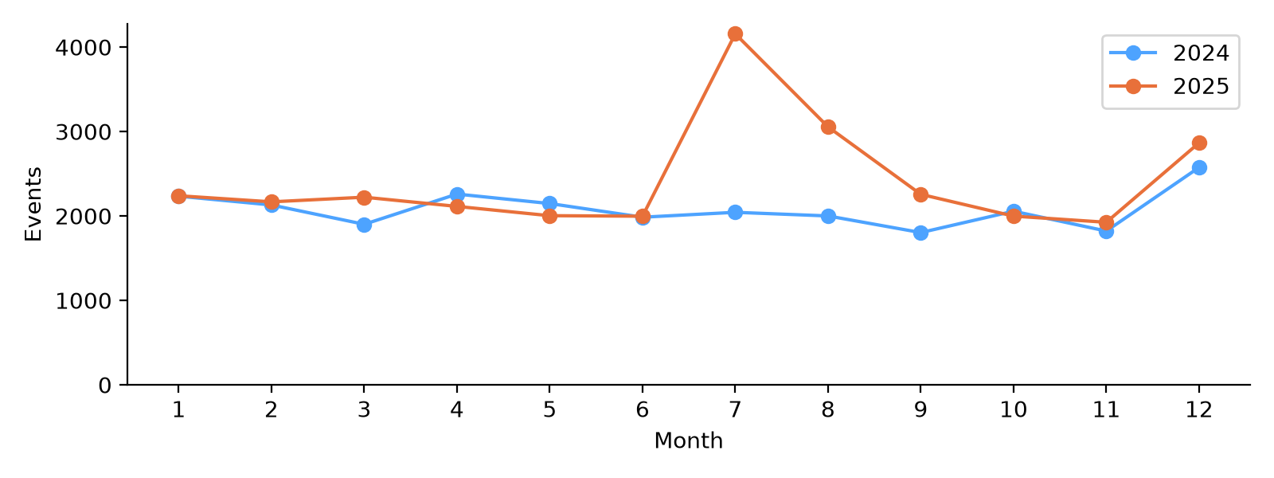
One earthquake reshaped 2025
4,157
events in Jul 2025 vs 2,043
82.6%
of 2025 radiated energy
14×
2025 energy vs 2024
Excluding the Kamchatka window, 2025 strong share falls from 7.34% to 6.84%.
Notes:
The M8.8 mainshock was at 23:24 UTC on 29 July 2025 off Kamchatka, depth 35 km. 1,731 events within two weeks in the rectangle, 263 of them strong. Energy uses log10 E = 1.5 M + 4.8.

Slide 6
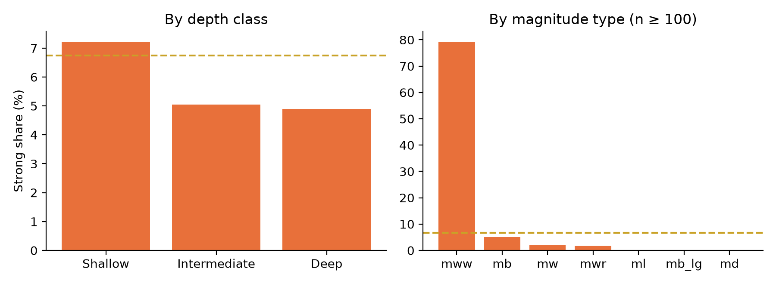
Strong share reflects reporting
mww 79.3% vs ml 0.07%: moment magnitudes exist mainly for larger events
US network 8.64% strong; Alaska 0.35%, Puerto Rico 0.16%
Like for like (mb): shallow 6.39% vs deep 1.46%, a ratio of 4.4
Compare within one magnitude type and contributor, or use M ≥ 4.5 where the catalogue is complete.
Notes:
Depth: shallow 7.22%, intermediate 5.05%, deep 4.90%. All 644 automatic (unreviewed) events are below M5.

Slide 7
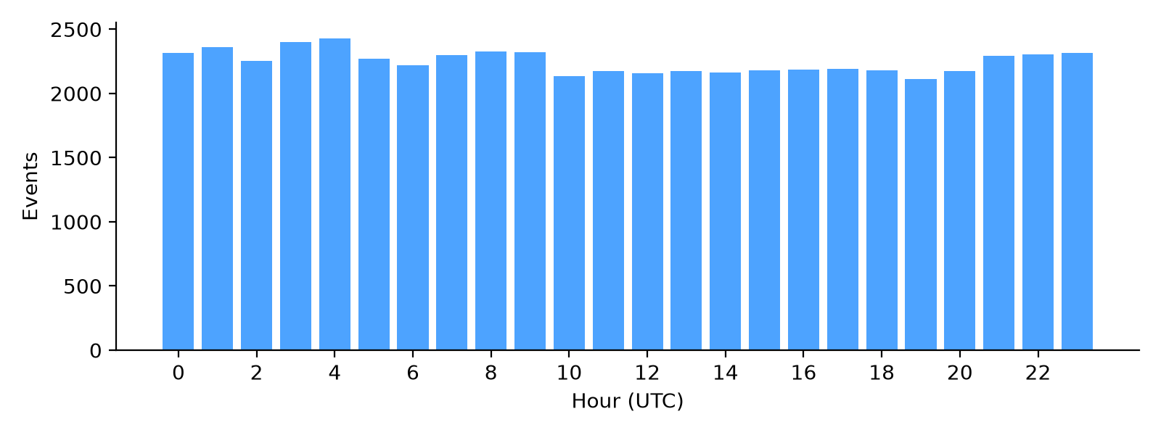
Earthquakes keep no clock
2,115–2,431
events per hour, flat
7,552–8,028
events per weekday
A flat profile is the expected result and confirms the pipeline's time handling.
Notes:
Contrast with road collisions or crime, which show rush-hour peaks. Weekday strong share ranges 5.99% to 7.60% but one large sequence drives that, not a weekly cycle.

Slide 8
Indexes: 25× to 54,000× less work
0 ms
indexed (below timer resolution)
12–41 ms
collection scan, 5-run median
MongoDB 8.0.34, 53,952 docs, explain(executionStats). The 2dsphere index with a bounded $geoWithin query is selective: 570 keys for 427 matches.
Document-count ratios transfer to larger data; absolute times at this size do not.
Notes:
Sub-millisecond times are truncated to 0 ms by the server timer, so we do not compute speed-up ratios from them. Indexes: year+strong, date+strong, grid+year, magnitude, region+year and 2dsphere on location.

Slide 9
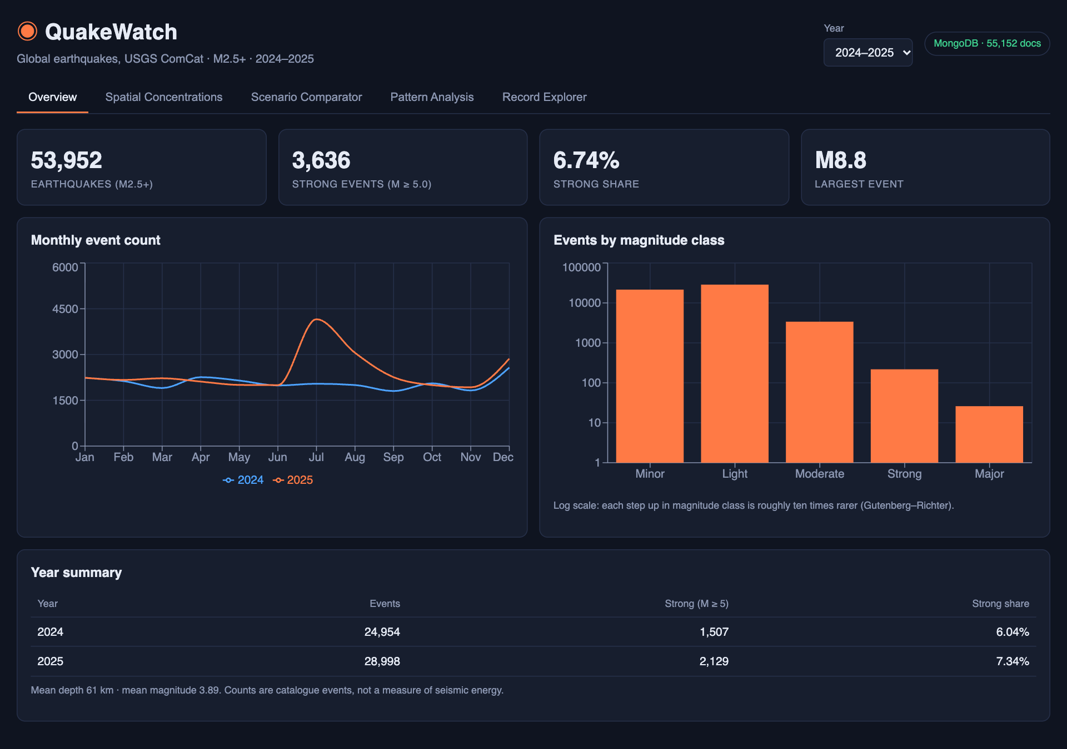
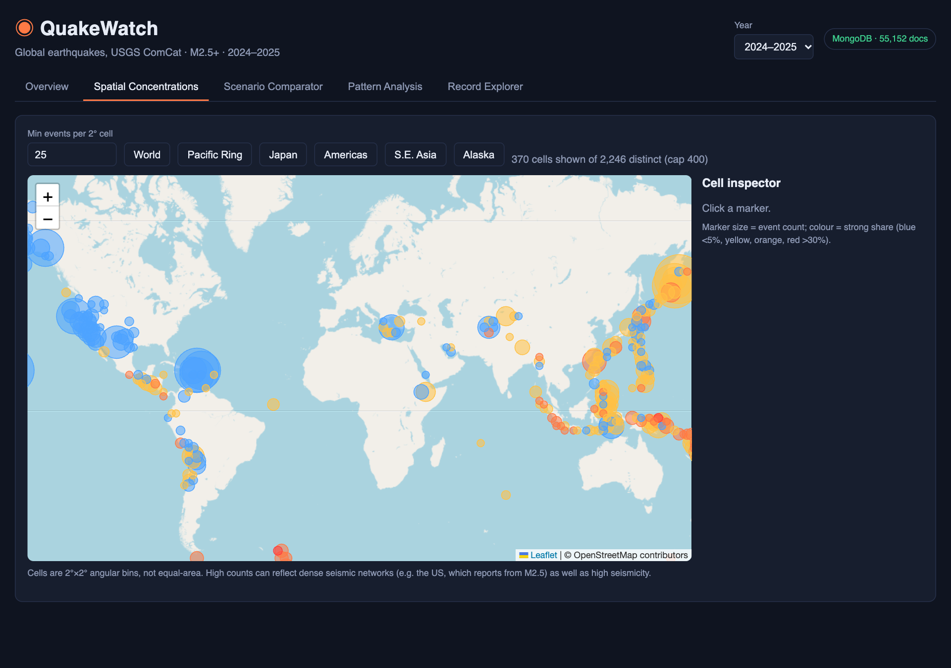
Web app: overview and map
React + TypeScript + Leaflet over a Flask API; five screens, one year control.
Notes:
Overview shows KPIs and monthly lines. The map shows 2 degree cells; size is event count, colour is strong share. 370 of 2,246 cells shown at a minimum of 25 events, capped at 400.

Slide 10
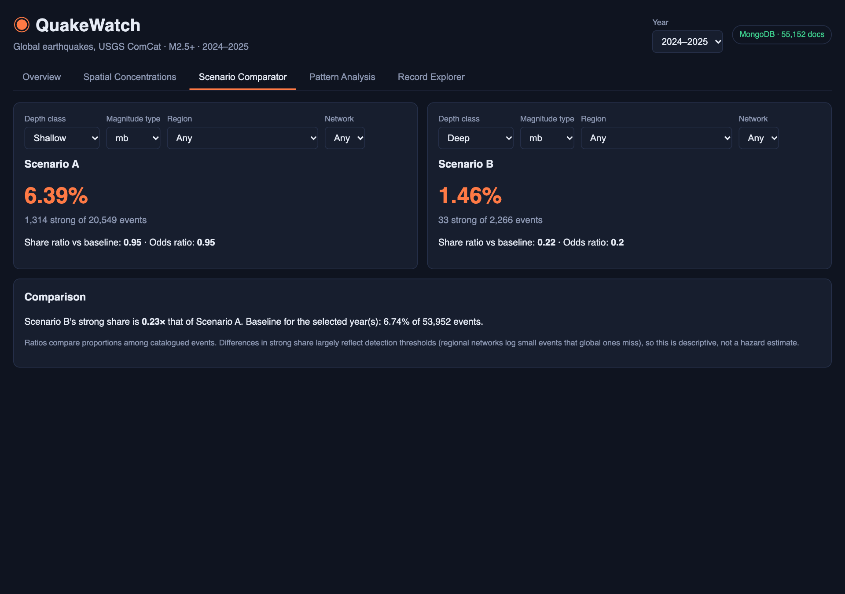
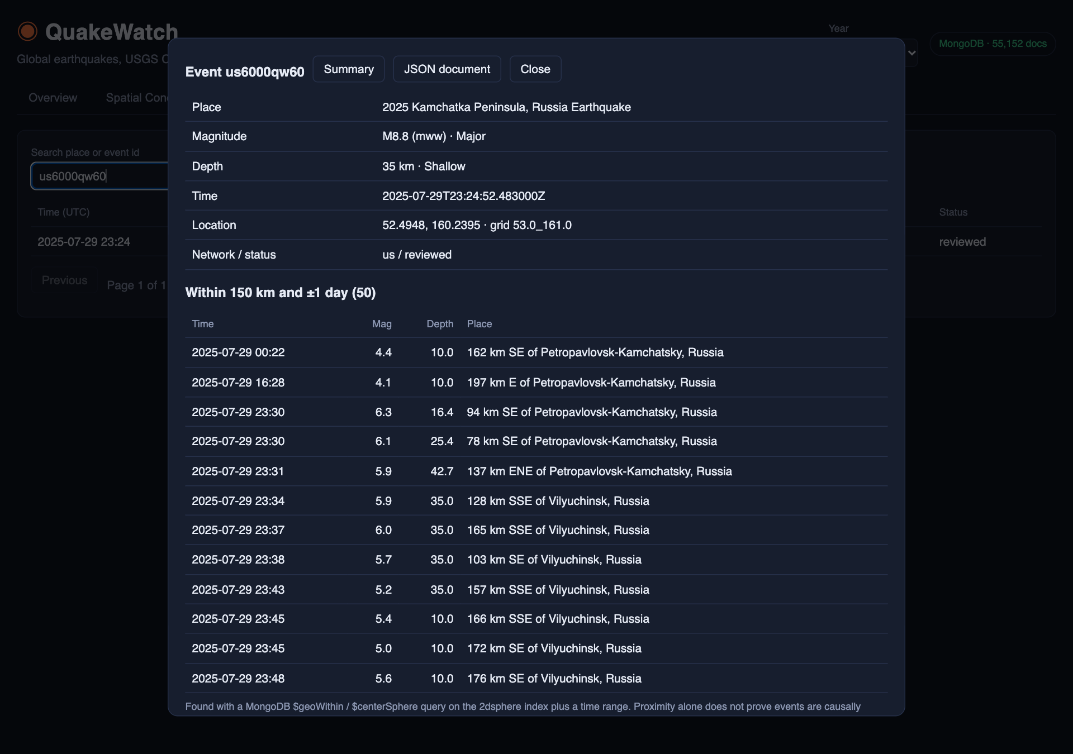
Compare scenarios, inspect events
Share and odds ratios against the baseline; $geoWithin finds events within 150 km and one day.
Notes:
Scenario A shallow mb versus Scenario B deep mb: 6.39% versus 1.46%. The inspector shows M8.8 us6000qw60 and the M6.3, M6.1 and M6.0 aftershocks within minutes.

Slide 11
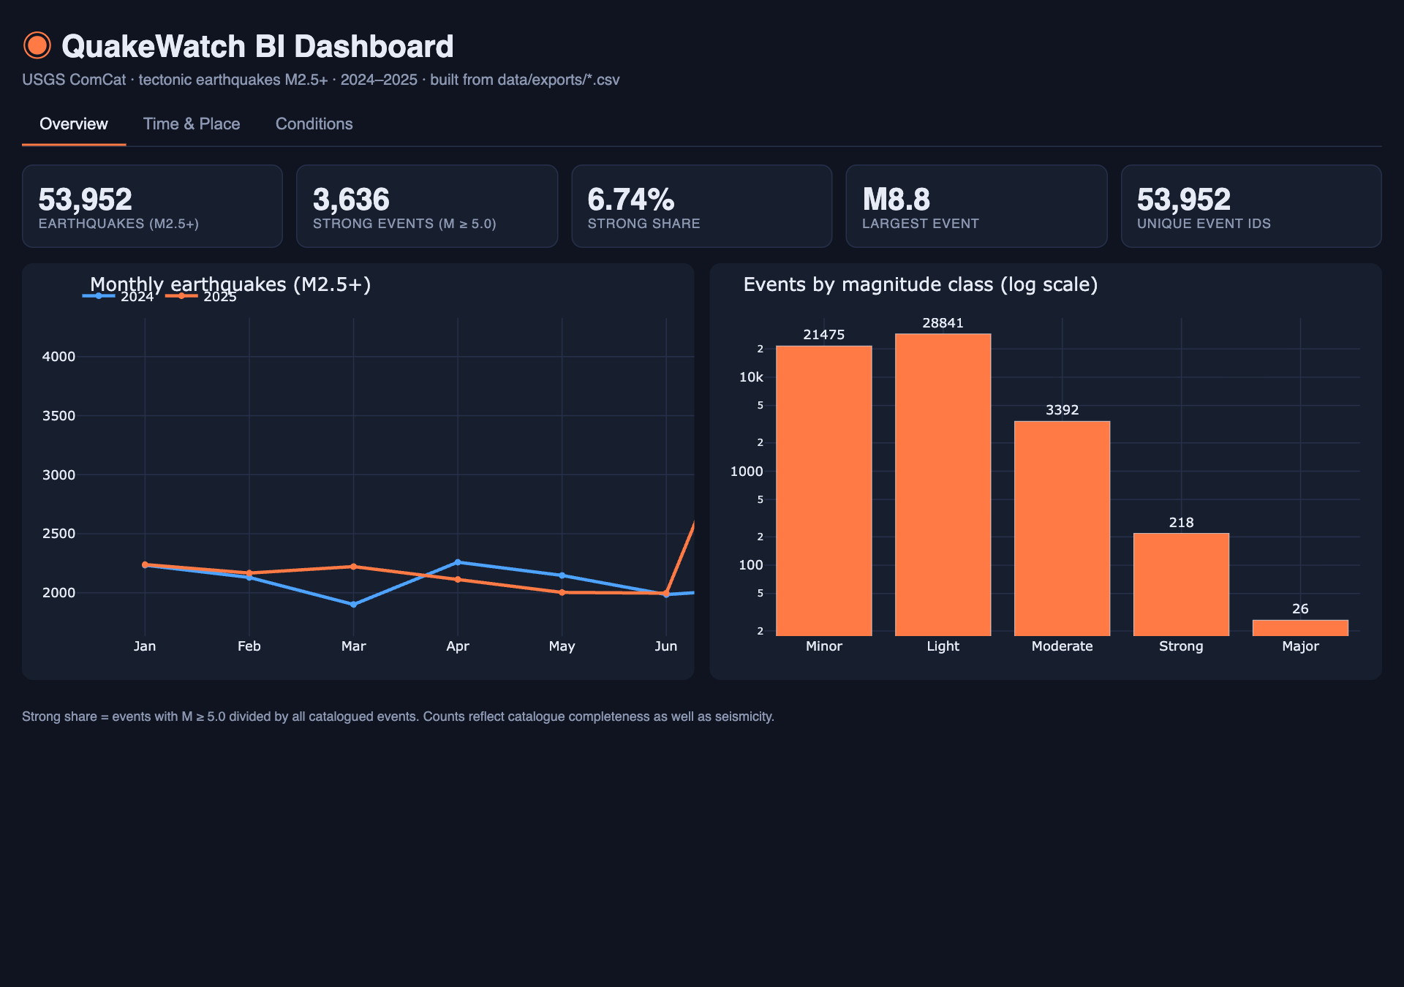
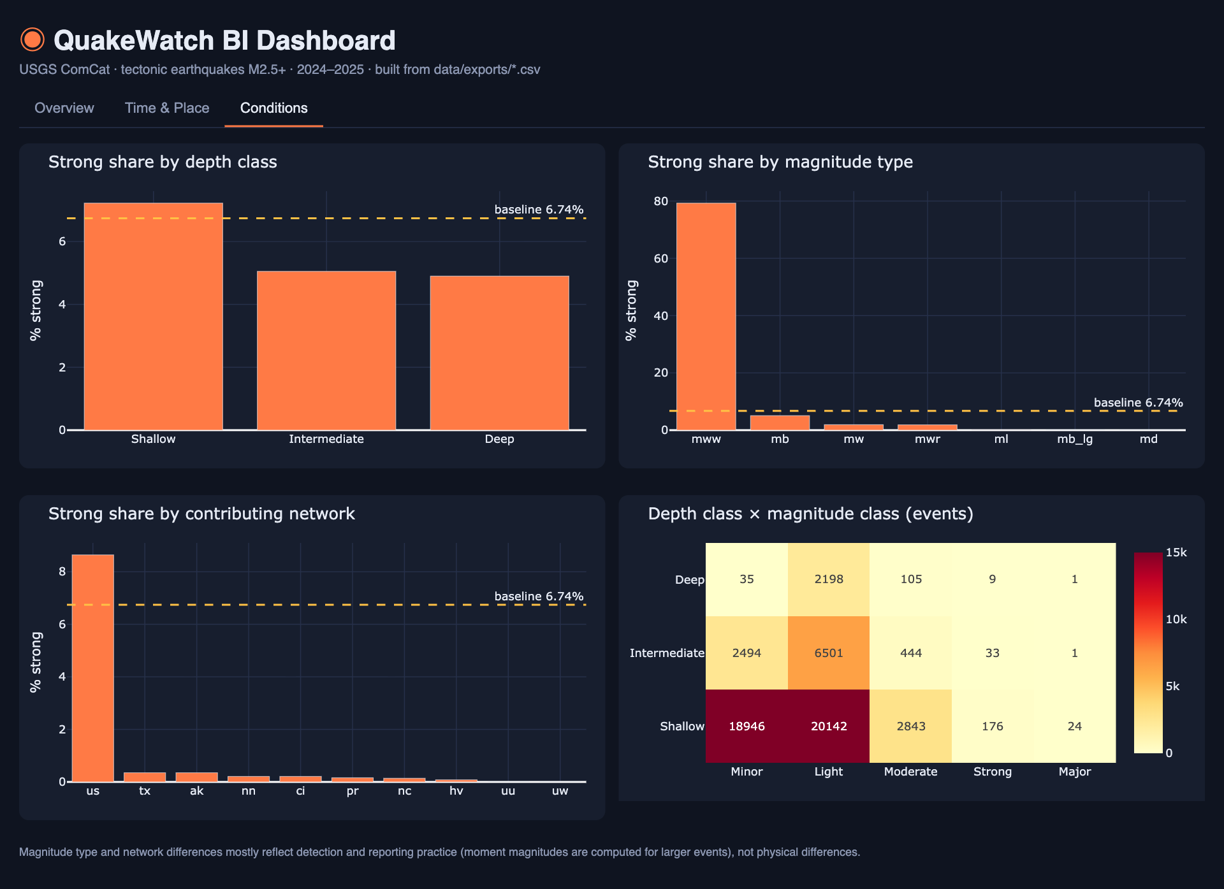
BI dashboard from the same data
Star-schema CSVs plus DAX measures for Power BI; bundled HTML build mirrors the three pages.
Notes:
Tables: fact_earthquakes 53,952; dim_calendar 731; agg_hotspots_grid 1,382; agg_conditions 69; agg_regions 274; agg_depth_mag_matrix 28.

Slide 12
What the findings do not show
Catalogue completeness
Two years only
Networks detect different minimum magnitudes, so counts mix reporting and seismicity.
One M8.8 sequence dominates 2025; no trend can be claimed.
Heuristics
Dashboard format
Regions parsed from text; 2° cells are not equal-area; no completeness or hazard model.
HTML build shipped; the Power BI file is assembled from the provided tables and DAX.
Notes:
Next steps: per-region completeness magnitude, gazetteer or plate polygons for regions, hexagonal cells, declustering, and a published Power BI file with scheduled refresh.

Slide 13
Conclusion
A public catalogue became a queryable MongoDB database, a web app and a dashboard
Frequency, magnitude and energy tell different stories
Reporting practice shapes apparent patterns; compare like with like
Indexes, including 2dsphere, cut documents examined by 1 to 4 orders of magnitude
Code: github.com/vibhor-5/quakewatch-bdm
Report: github.com/vibhor-5/quakewatch-bdm-report
Notes:
Thank the audience and invite questions.

