Slide 1
Assignment 4 Classification
Decision Tree, Random Forest, XGBoost, and AdaBoost

Slide 2
Workflow
Data cleaning -> stratified 80/20 split -> 5-fold CV -> held-out test evaluation.
Preprocessing
Median/mode imputation inside the modeling pipeline
IQR clipping for numeric outliers
One-hot encoding for categorical banking features
PCA projection used only for visual decision-boundary plots

Slide 3
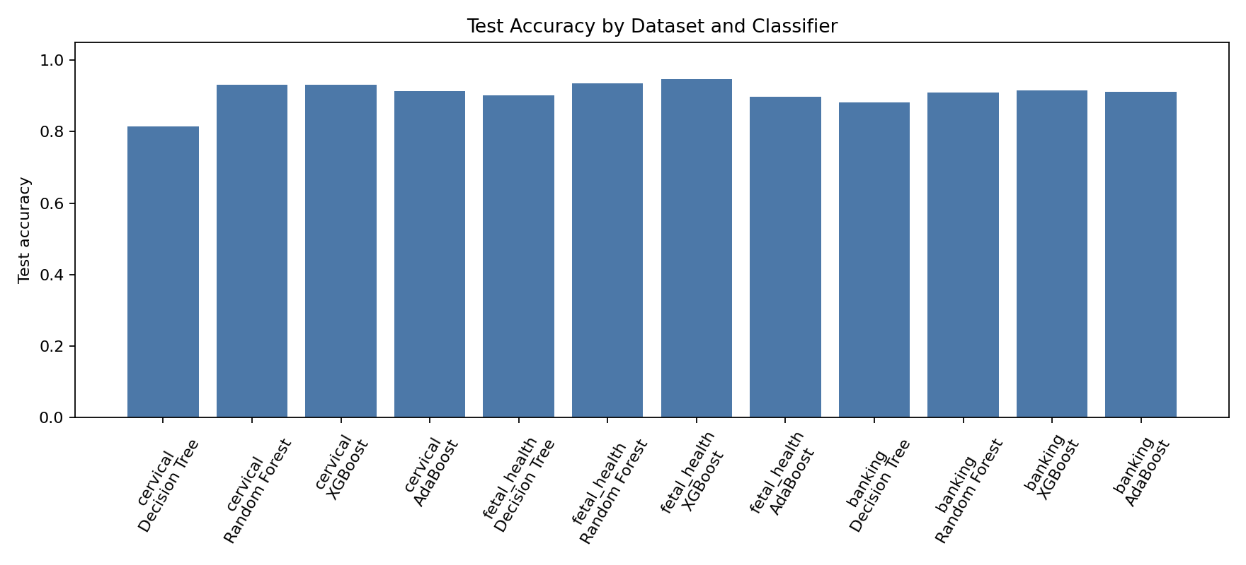
Test Accuracy

Slide 4
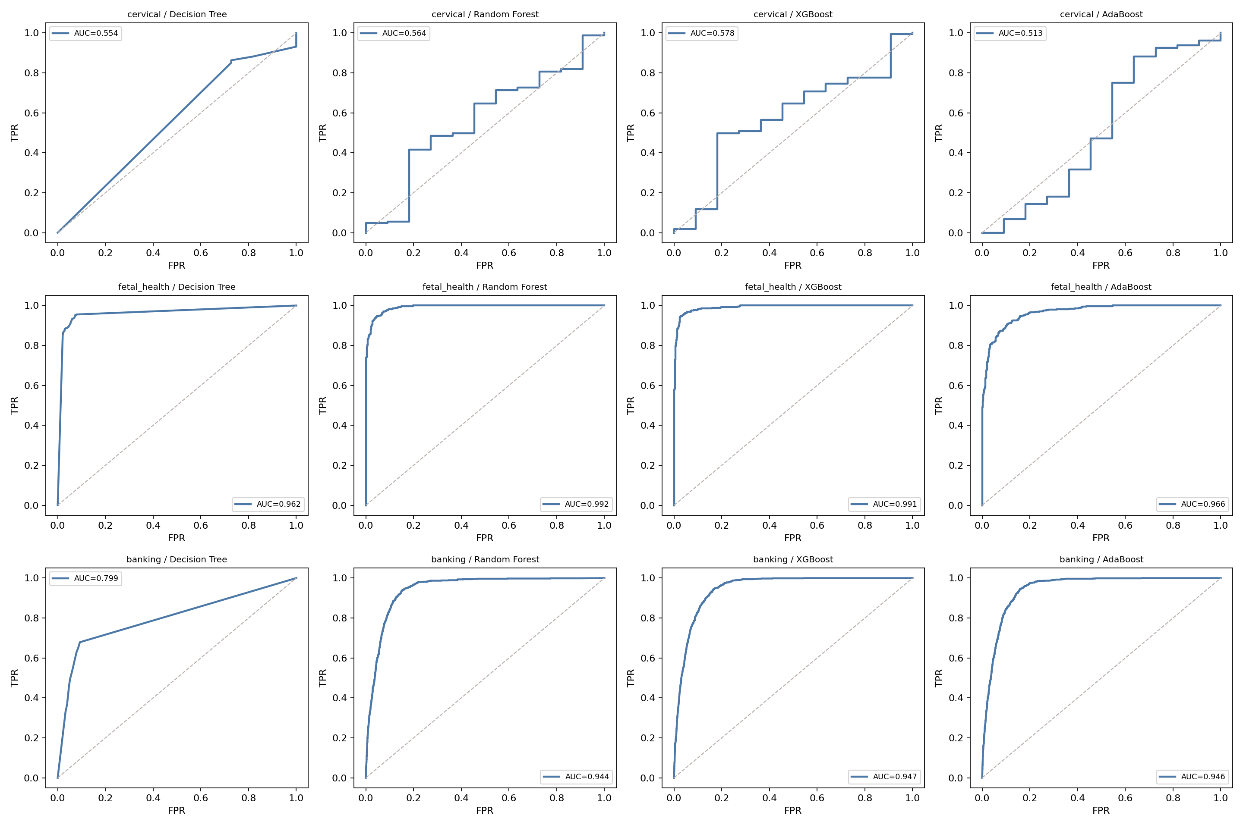
ROC Curves

Slide 5
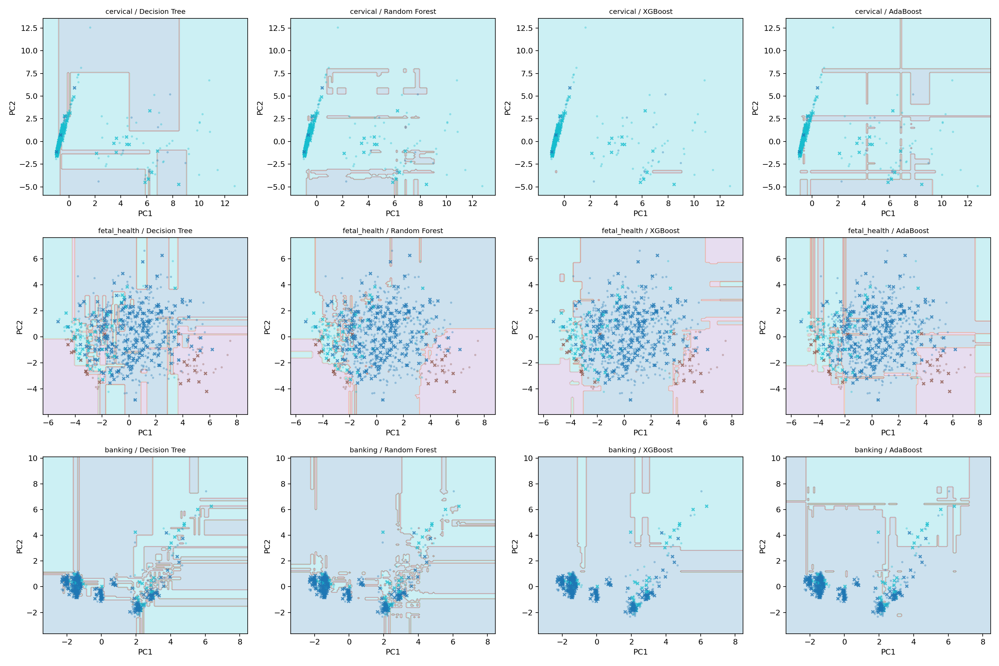
Decision Boundaries

Slide 6
Best Test Models
Top held-out results
banking: XGBoost accuracy 0.915, AUC 0.947
cervical: Random Forest accuracy 0.930, AUC 0.564
fetal_health: XGBoost accuracy 0.946, AUC 0.980

