Slide 1

Thermodynamics
Dr. Saurav Prasad

Slide 2
Thermodynamics
Science of thermodynamics: Industrial revolution in the late 1700s or early 1800s
Up till then, heavy work was performed by horses: horsepower
Fantastic new invention: Heat Engine, thermodynamics: to gain the maximum efficiency from such heat engines
Successful science: modern day heat engines, Bugatti Veyron: world’s fastest production car, 883 kilowatts, 1184 brake horsepower, 268 miles/hour

Slide 3
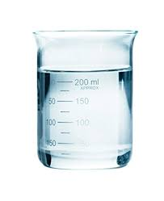
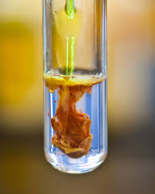
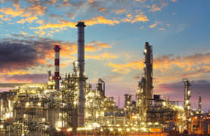
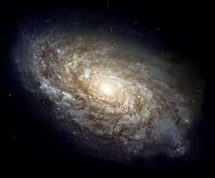
Thermodynamic Definitions
Thermodynamic System
A thermodynamic system is defined as any part of the Universe under consideration.
It may be something as similar as a beaker of water, a chemical reaction taking place in a test tube, oil refinery or as complicated as an entire galaxy.

Slide 4
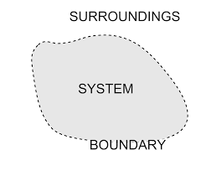
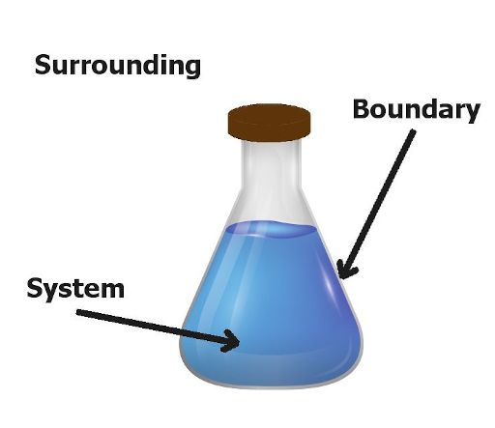
Thermodynamic Definitions
Thermodynamic Surroundings
Thermodynamics surroundings are defined as everything other than the thermodynamic system.
In other words, the entire rest of the universe.
The Universe
The universe is therefore the system plus the surroundings.

Slide 5
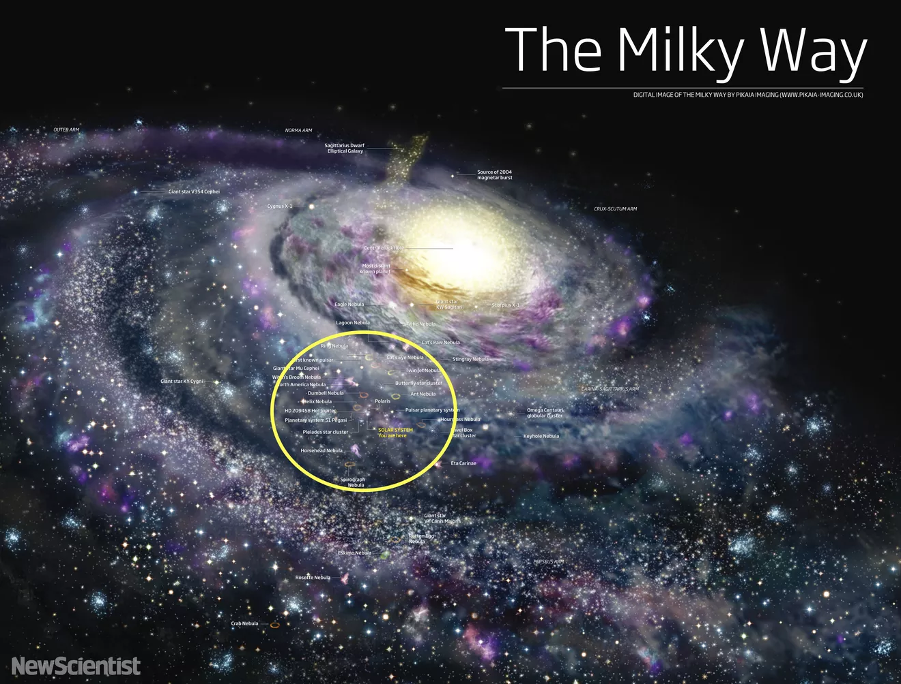
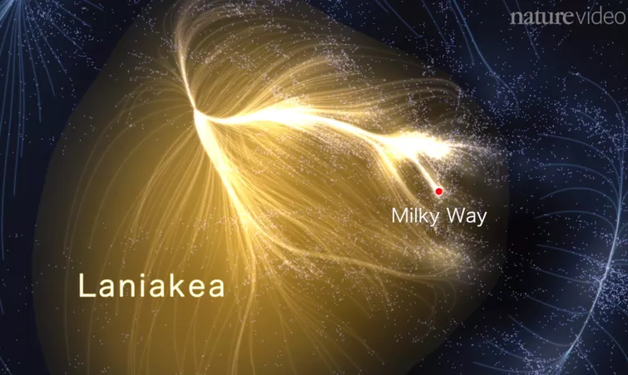
Thermodynamic Definitions
The Vastness of the Universe
Milky Way is just one of billions of galaxies in the universe. Recently, scientists mapped the 100,000 or so galaxies near the Milky Way and found that it's part of a broader supercluster called Laniakea.
The observable Universe:
Sphere with a radius 4.66 x 10¹⁰ light years, a light years is 9.46 x 10¹⁵ m.

Slide 6
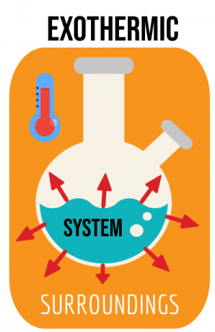
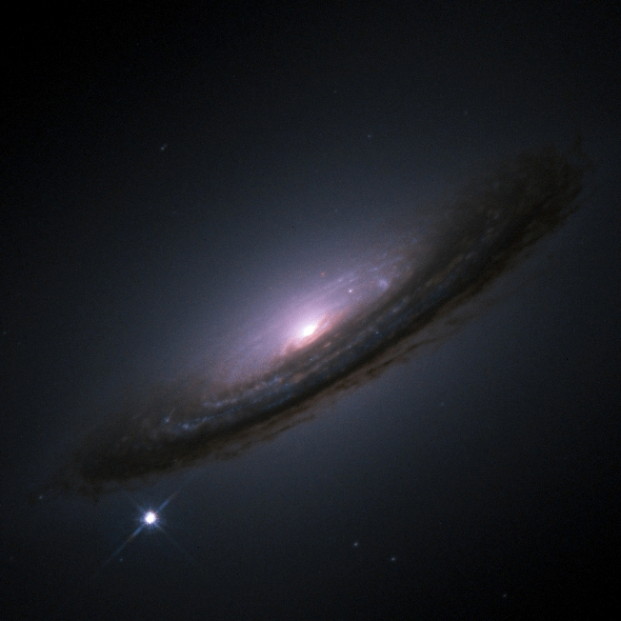

Thermodynamic Definitions
Thermodynamic Surroundings
Thermite reaction: Intensely exothermic, used even today to weld railway lines in remote location.
Large amount of energy released, but impact of this on next town is negligible.
Supernova explosion: most violent energetic process, dying stars explode
The impact on distant galaxies is negligible. How many times you have observed this phenomena in your life?
$$Fe_{2}O_{3}+2Al→2Fe+Al_{2}O_{3}$$

Slide 7
Thermodynamic Definitions
Thermodynamic Surroundings
Surroundings are assumed to be infinite and remain at constant temperature and pressure.
The vast size of the universe validates this assumption.
Boundary Conditions
The boundary may be actual or notional.
It controls transfer of work, heat, and matter from the system to the surroundings and vice-versa.
The boundary may or may not impose restrictions on such transfers.

Slide 8
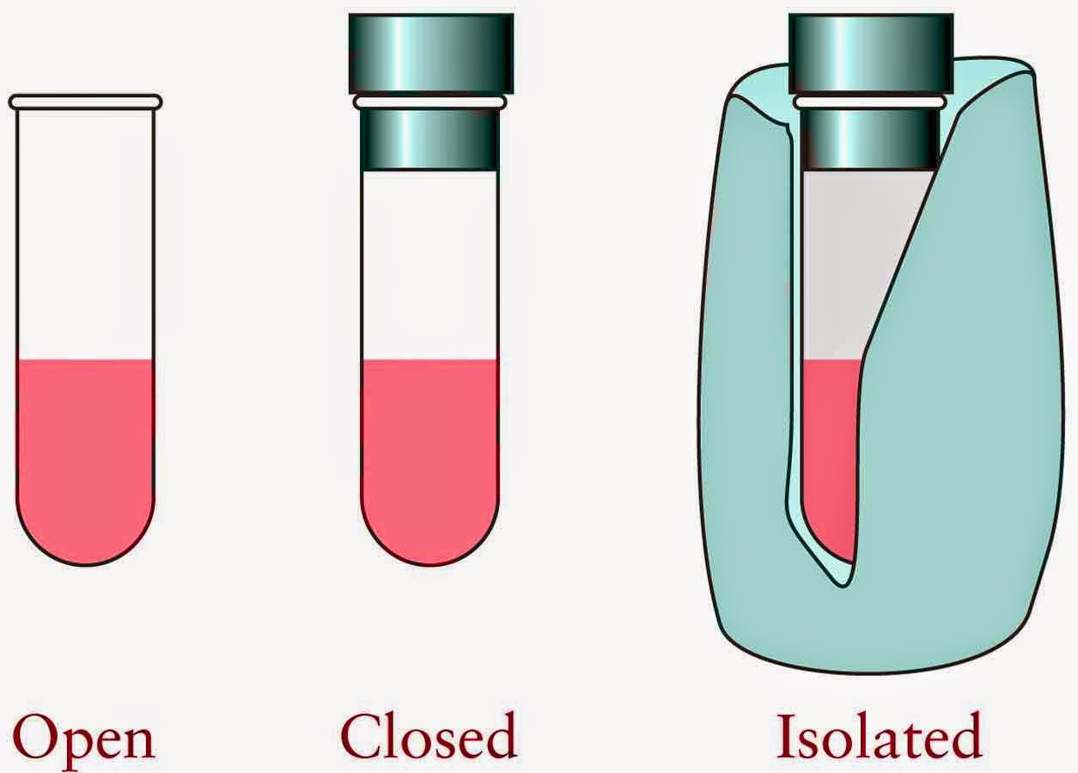
Thermodynamic Definitions
Open, Closed, and Isolated Systems
Open System: An open system may exchange both energy and matter with its surroundings. Changes in composition are therefore possible.
Closed System: A closed system may exchange energy but not matter with its surroundings. Pressure build-up is a distinct possibility.
Isolated System: An isolated system may exchange neither energy nor matter with its surroundings. Pressure build-up is a possibility.

Slide 9
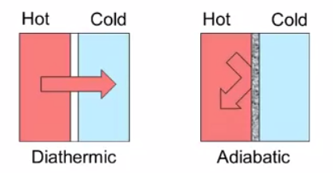
Thermodynamic Definitions
Diathermic and Adiabatic Systems/Walls
A diathermic system allows heat flow into or out of the system.
An adiabatic system prevents heat flow into or out of the system.

Slide 10
Thermodynamic Definitions
Isothermal, Isobaric, and Isochoric Processes
Isothermal implies constant temperature, T.
Isobaric implies constant pressure, P.
Isochoric implies constant volume, V.
State Functions
A state function describes the state of the system.
The following are all state functions:
Pressure, P; Volume, V; Temperature, T; Mass, m; Quantity, n
Internal Energy, U; Enthalpy, H; Entropy, S; Gibbs Energy, G

Slide 11
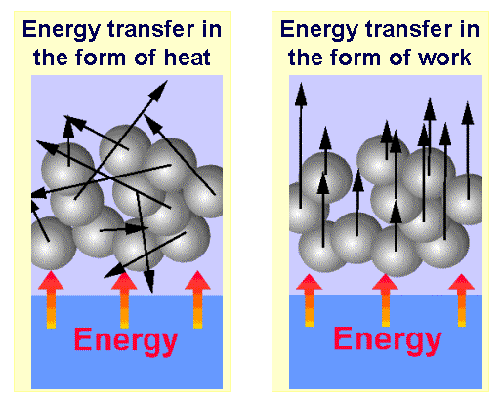
Thermodynamic Definitions
Path Functions
A state function describes the current state of a system.
How the system came to be in that particular state is of no consequence.
Functions governing transition between the states are called path functions.
Heat, q & Work, w: are both forms of energy. State of a system is changed by supply or removal of energy in the form of heat or work.
Random molecular motion
Uniform molecular motion

Slide 12
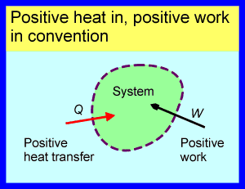
Thermodynamic Definitions
Heat and Work Conventions
Path functions are positive when energy enters the system.
Path functions are negative when energy leaves the system.
They are often defined as:
Heat supplied to the system, q_{in}
Mechanical work done on the system, W_{on}

Slide 13
Laws of Thermodynamics
The Zeroth Law of Thermodynamics and Temperature
Ironically named 0th law; last of the four laws to be discovered.
Gives true meaning of temperature.
The First Law of Thermodynamics
Developed around 1850 by Rudolf Clausius.
Adaption of the Law of Conservation of Energy for Thermodynamic Systems.
Defined change in the state function, internal energy of the system based on the energy flow into or out of the system
Lead to the definition of a new state function called enthalpy.

Slide 14
Laws of Thermodynamics
The Second Law of Thermodynamics
Developed around 1850 by Rudolf Clausius by following initial work of Sadi Carnot in 1824.
Describes the direction in which all processes spontaneously occur, e. g. a hot object loses heat to the surroundings.
New state function: Entropy, fundamentally measures disorder
Third Law of Thermodynamics
Developed by German chemist Walter Nernst in 1912; While considering the behaviour of matter at absolute zero.
Lead to the definition of zero on the entropy scale; determination of absolute entropy.

Slide 15
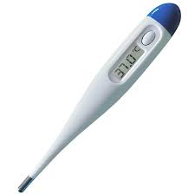
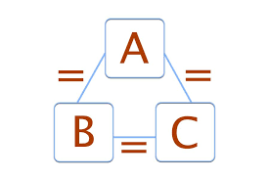
The Zeroth Law of Thermodynamics
Measurement of Temperature
Measured routinely by a thermometer; Think how the thermometer works?
Zeroth Law
When two objects are separately in thermodynamic equilibrium with a third object, they are in thermodynamic equilibrium with each other.
Whenever two objects are in contact with one another, energy will flow between them until they reach a state of thermodynamic equilibrium. Upon reaching this state we say that the two objects are at the same temperature.

Slide 16
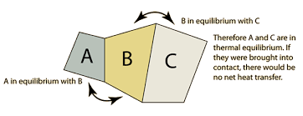
The Zeroth Law of Thermodynamics
This sounds obvious but it has vital ramifications for the measurement of temperature by thermometer.
The obvious nature of this statement explains why it did not become a law of thermodynamics until well after the other three laws.

Slide 17
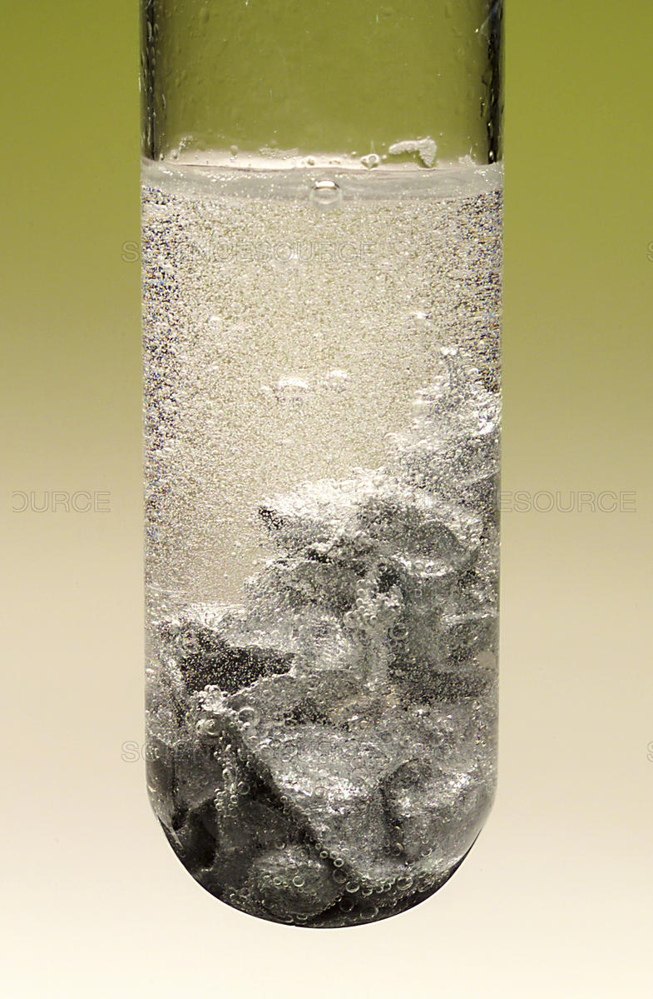

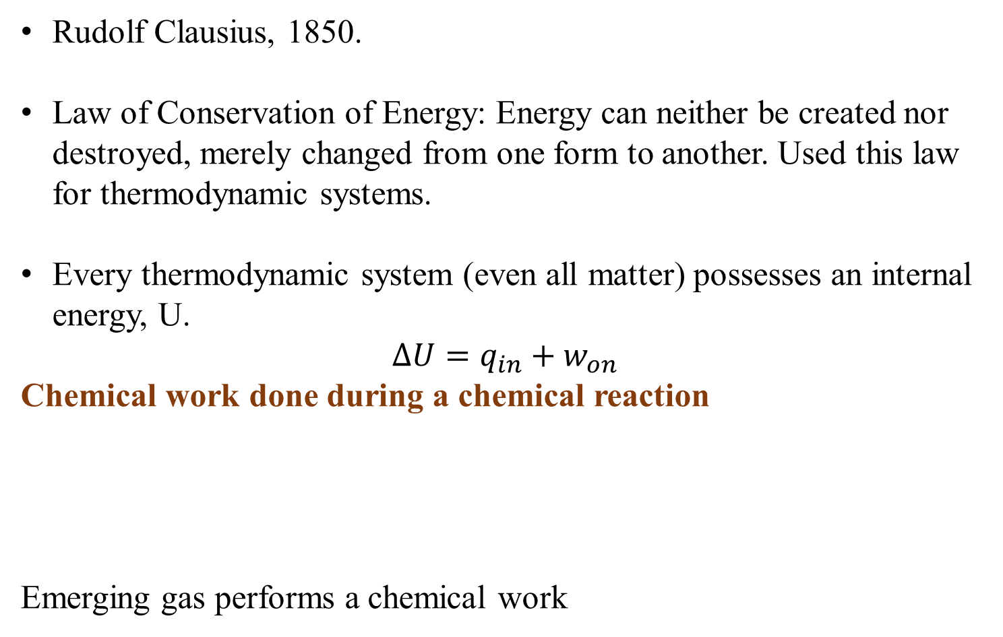
The First Law of Thermodynamics and Enthalpy
Rudolf Clausius, 1850.
Law of Conservation of Energy: Energy can neither be created nor destroyed, merely changed from one form to another. Used this law for thermodynamic systems.
Every thermodynamic system (even all matter) possesses an internal energy, U.
$$ΔU=q_{in}+w_{on}$$
Chemical work done during a chemical reaction
Emerging gas performs a chemical work

Slide 18
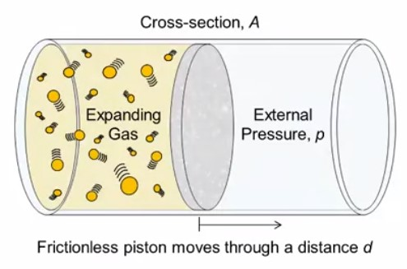
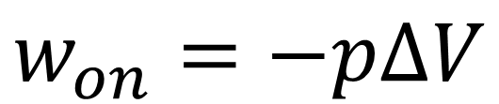
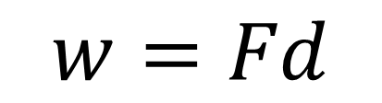
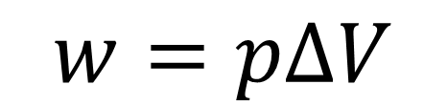
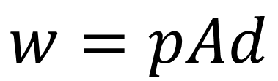
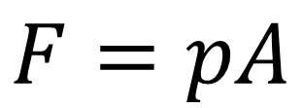

The Work Done by an Expanding gas
$$w=Fd$$
$$p=\frac{F}{A}$$
$$F=pA$$
$$w=pAd$$
$$w_{on}=−pΔV$$
$$w=pΔV$$

Slide 19
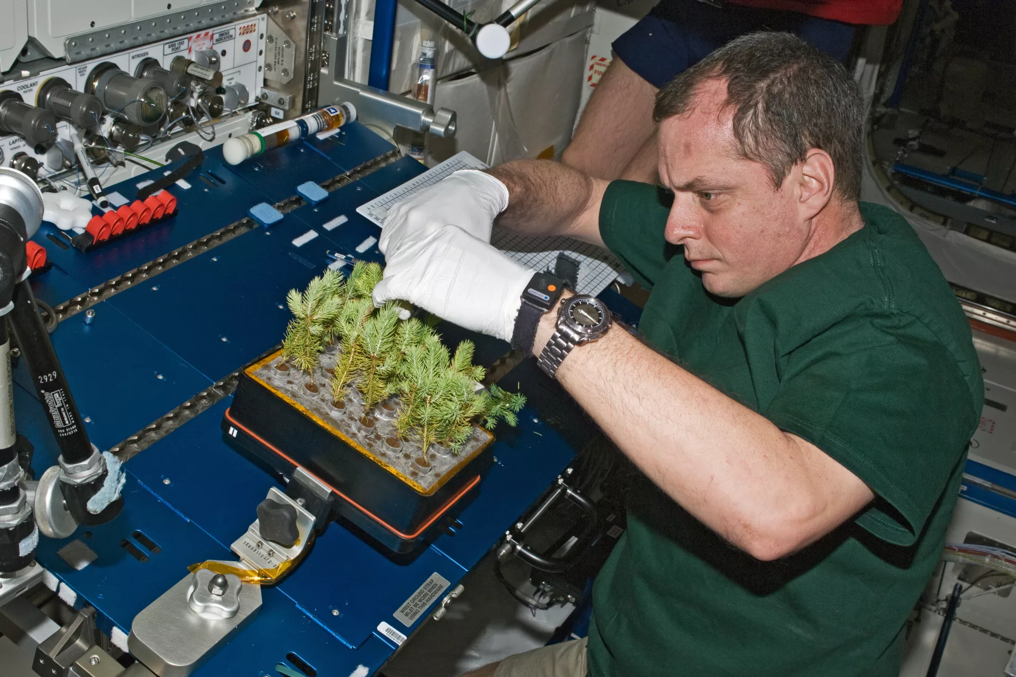
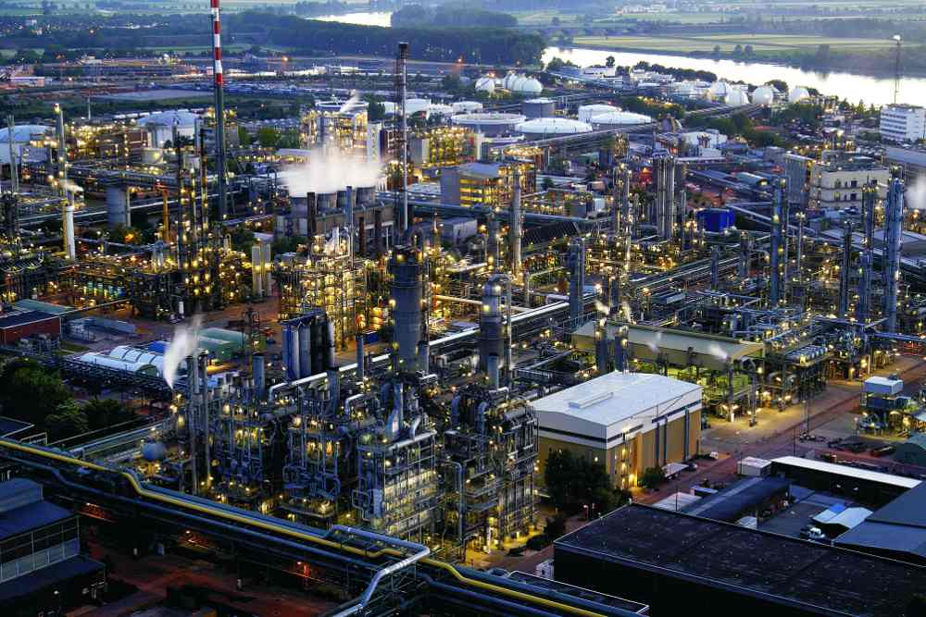
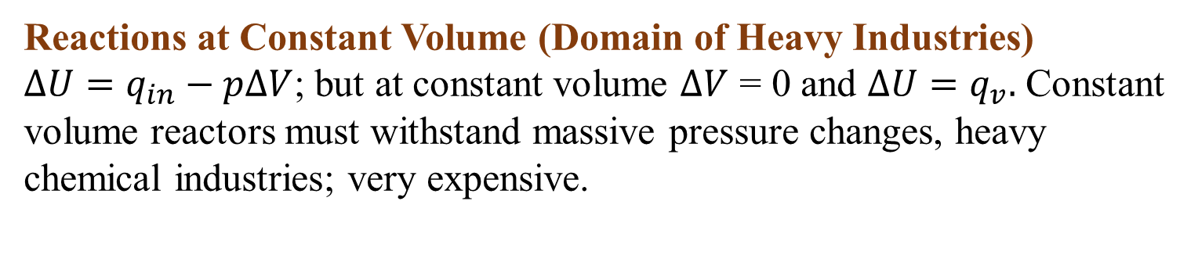

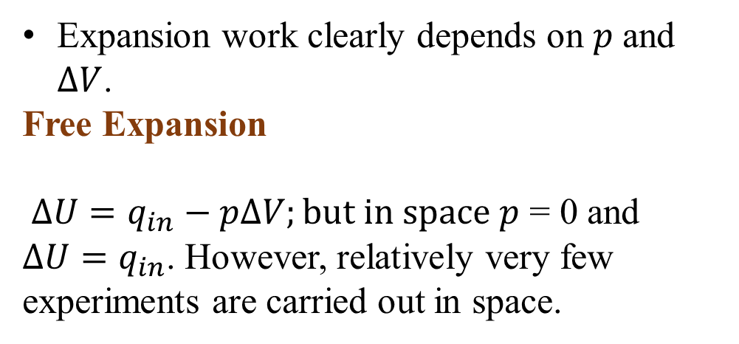


The First Law of Thermodynamics
$$ΔU=q_{in}+w_{on}$$
$$w_{on}=−pΔV$$
$ΔU=q_{in}$ $− pΔV$
Expansion work clearly depends on $p$ and $ΔV$.
Free Expansion
$ΔU=q_{in}$ $− pΔV;but in space p$ = 0 and $ΔU=q_{in}$. However, relatively very few experiments are carried out in space.
Reactions at Constant Volume (Domain of Heavy Industries)
$ΔU=q_{in}$ $− pΔV$; but at constant volume $ΔV$ = 0 and $ΔU=q_{v}.$ Constant volume reactors must withstand massive pressure changes, heavy chemical industries; very expensive.

Slide 20
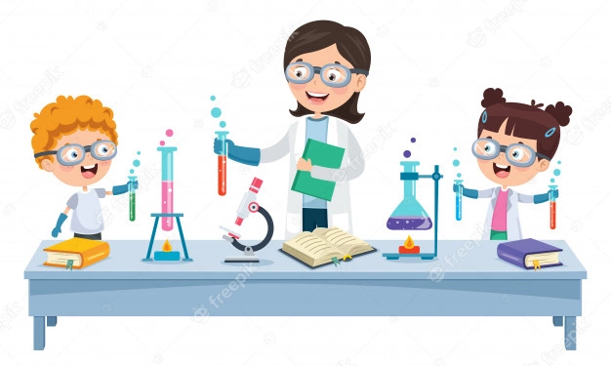
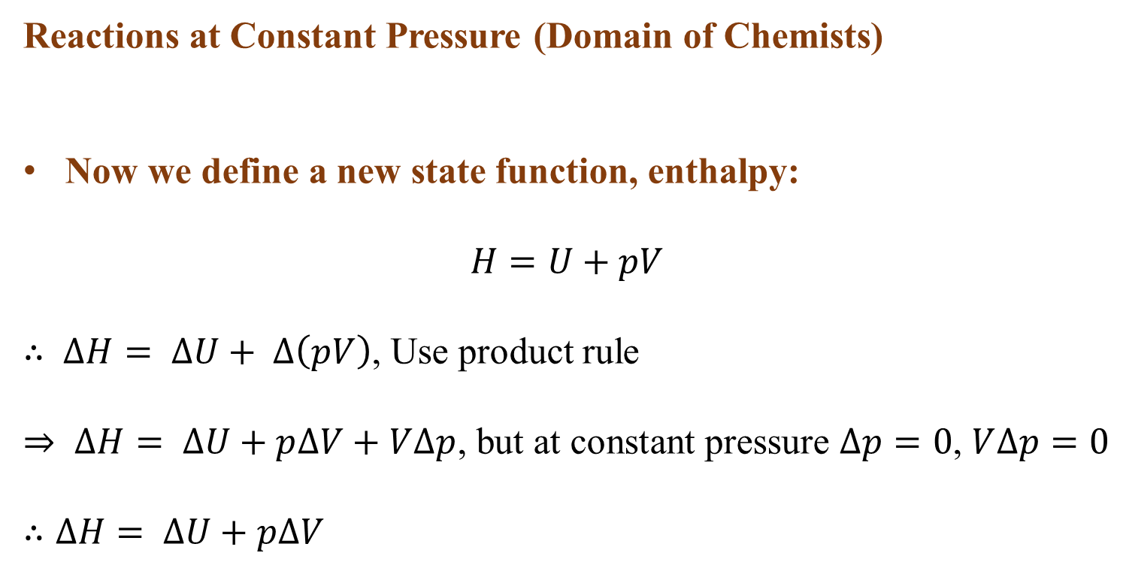

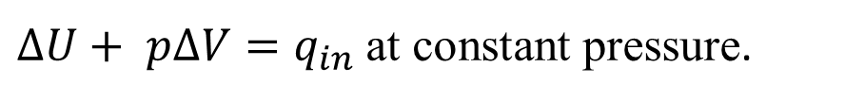

The First Law of Thermodynamics
Reactions at Constant Pressure (Domain of Chemists)
Now we define a new state function, enthalpy:
$$H=U+pV$$
$∴ ∆H= ∆U+ ∆\left(pV\right)$, Use product rule
$⇒ ∆H= ∆U+p∆V+V∆p$, but at constant pressure $∆p=0$, $V∆p=0$
$$∴∆H= ∆U+p∆V$$
$ΔU=q_{in}$ $− pΔV$
$ΔU+ pΔV=q_{in}$ at constant pressure.
$$∆H=q_{p}$$

Slide 21
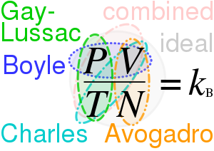
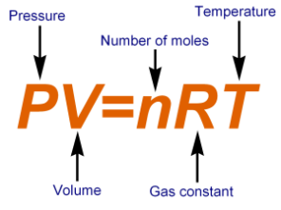
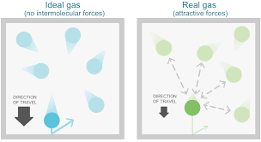
Ideal Gas Vs Real Gas
Ideal Gas
Follows gas laws, completely abide kinetic molecular theory
Occupy zero volume; no attractive forces
No true ideal gas
Real Gas
Does not behave according to the kinetic molecular theory

Slide 22
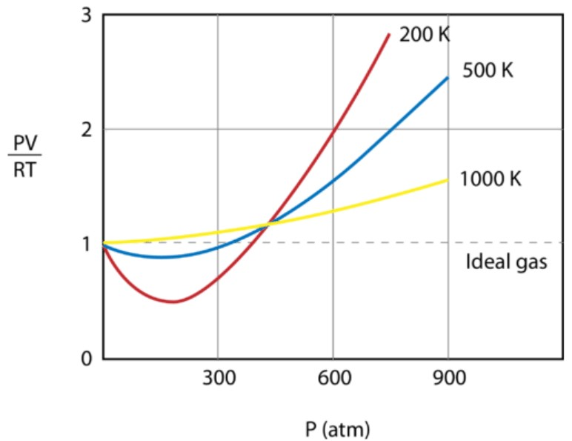
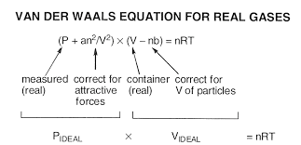
Deviation from Ideal Gas; Compressibility Factor (Z)
PV/RT plotted against pressure for 1mol of a gas at three different temperatures
An ideal gas would have a value of 1 for that ratio at all temperatures and pressures and the graph would simply be a horizontal line.
The magnitude of the deviations from ideality is greatest for the gas at 200 K and least for the gas at 1000 K .

Slide 23
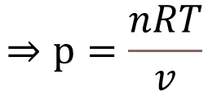
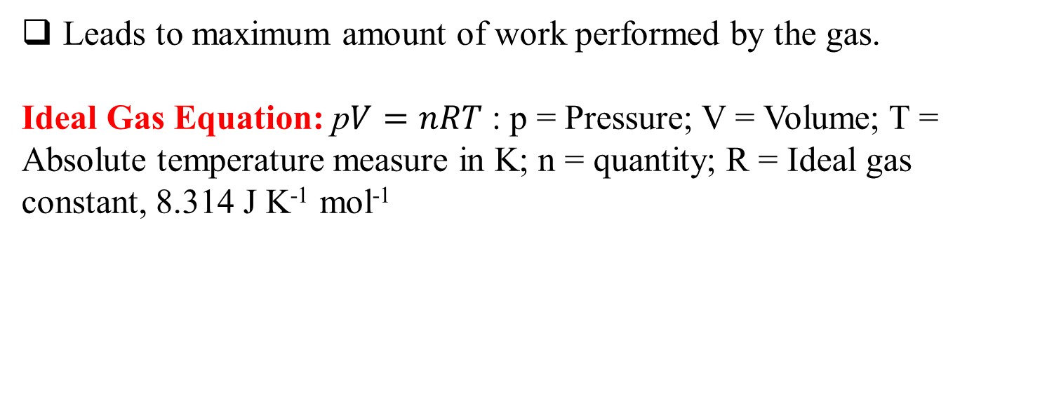
Reversible Isothermal Expansion of an Ideal Gas
Leads to maximum amount of work performed by the gas.
Ideal Gas Equation: p$V=nRT$ : p = Pressure; V = Volume; T = Absolute temperature measure in K; n = quantity; R = Ideal gas constant, 8.314 J K⁻¹ mol⁻¹
$$⇒p=\frac{nRT}{v}$$
Consider 1 mol an ideal gas at 298 K
p = 2477.572 J/V
Using the above equation, calculate the pressure of the gas for volumes 1, 3, 5, 7, 9, and 11 m³.

Slide 24
Isothermal Expansion
External pressure, p = 2478 Pa Volume = 1 m³.
Now imagine the gas pressure suddenly drops to 826 Pa. What happens to the gas?

Slide 25
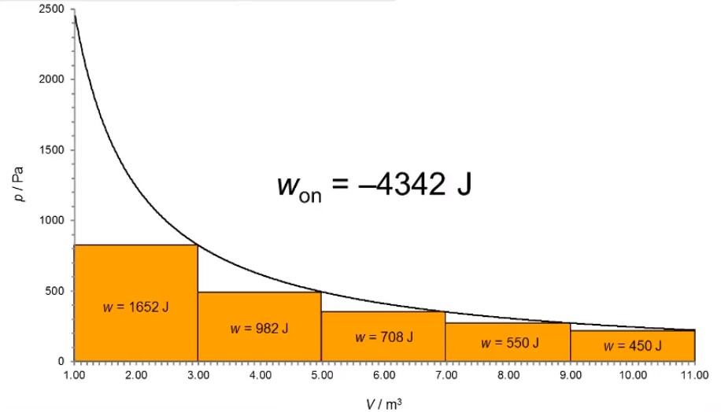
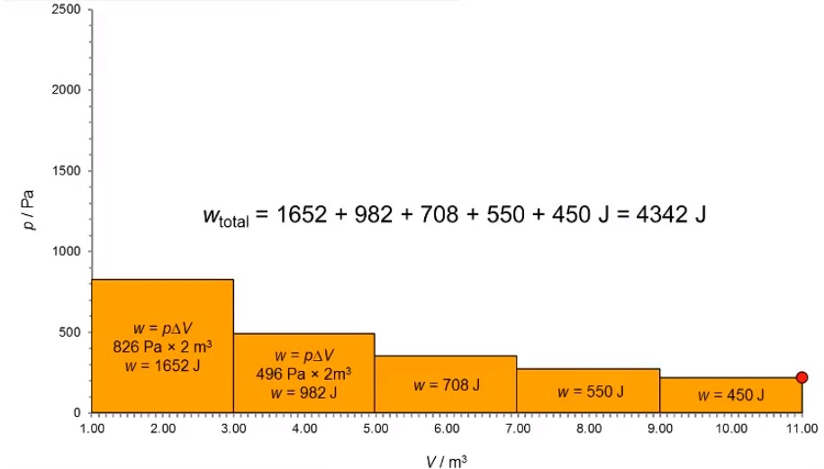
Isothermal Expansion
Fits ideal gas equation perfectly
The gas is performing work as it expands; the system is performing work: W_{on} = ??

Slide 26
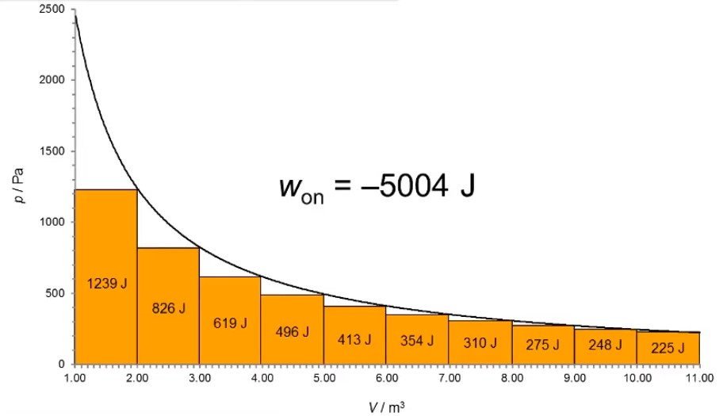
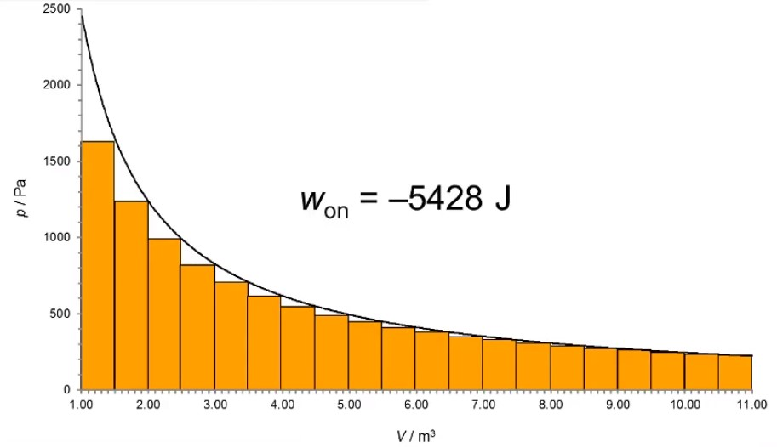
Isothermal Expansion
How to change the expansion, so that the gas performs more work?

Slide 27
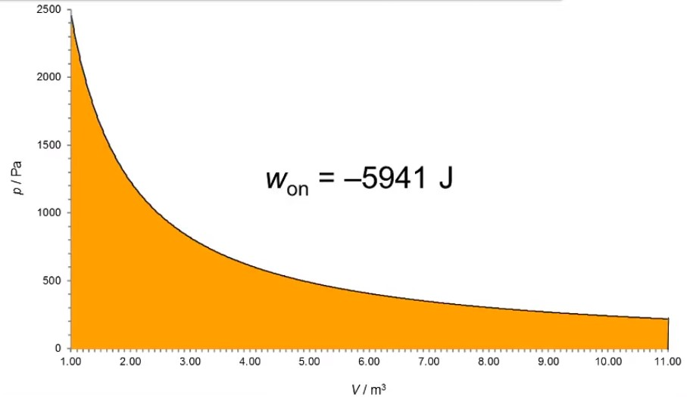
Reversible Isothermal Expansion

Slide 28
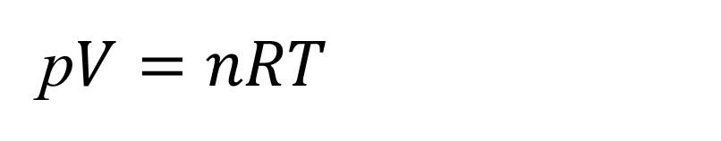

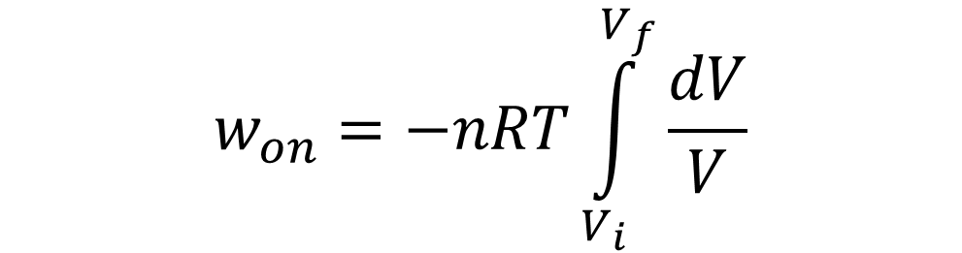

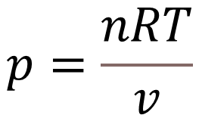
w_{on} for Reversible Isothermal Expansion
From previous slides
But,
So,
$$w_{on}=−pdV$$
p$V=nRT$
$$p=\frac{nRT}{v}$$
$$w_{on}=−\left(\frac{nRT}{v}\right)dV$$
Now consider an expansion from Vi to Vf
$$w_{on}=−nRT\int_{V_{i}}^{V_{f}}{\frac{dV}{V}}$$

Slide 29

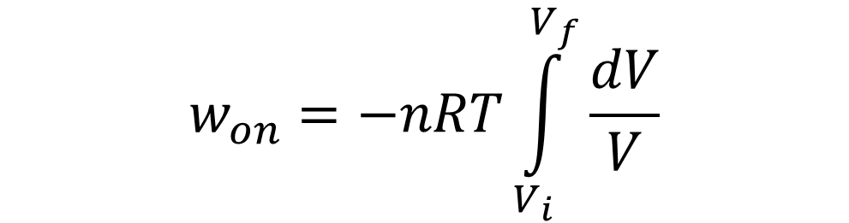

w_{on} for Reversible Isothermal Expansion
$$w_{on}=−nRT\int_{V_{i}}^{V_{f}}{\frac{dV}{V}}$$
$$w_{on}=−nRT\ln{\frac{V_{f}}{V_{i}}}$$
$w_{on}=$ - 1 mol × 8.314 J K⁻¹ mol⁻¹ × 298 K × ln(11)
$$w_{on}= ??$$
Reversible change is a theoretical construct.
Determines maximum possible expansion work.

Slide 30
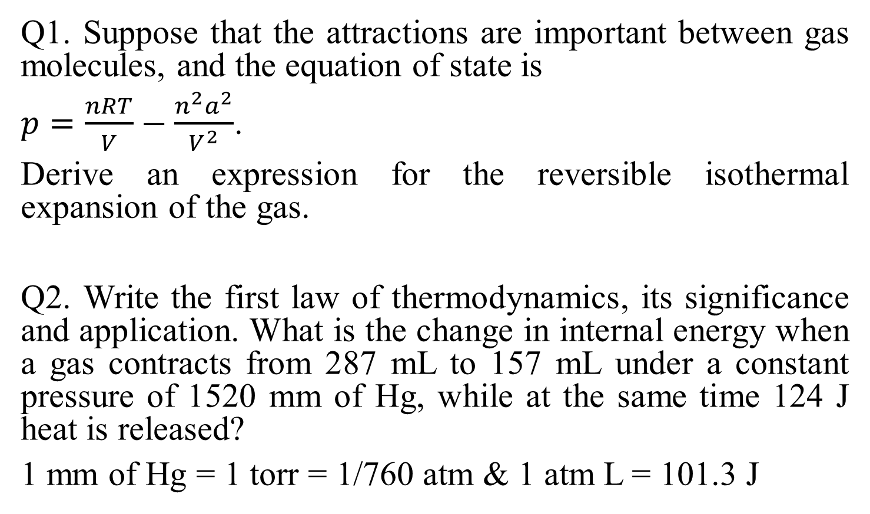
Question
Q1. Suppose that the attractions are important between gas molecules, and the equation of state is
$p=\frac{nRT}{V}−\frac{n^{2}a^{2}}{V^{2}}$.
Derive an expression for the reversible isothermal expansion of the gas.
Q2. Write the first law of thermodynamics, its significance and application. What is the change in internal energy when a gas contracts from 287 mL to 157 mL under a constant pressure of 1520 mm of Hg, while at the same time 124 J heat is released?
1 mm of Hg = 1 torr = 1/760 atm & 1 atm L = 101.3 J

Slide 31
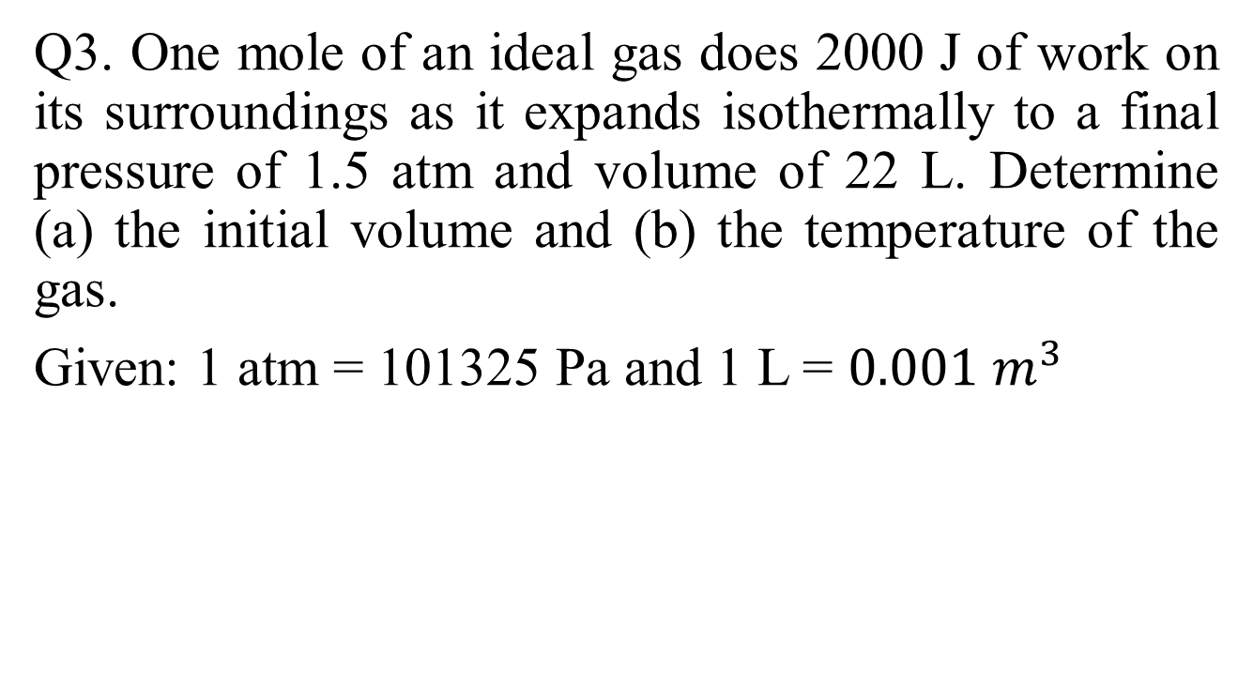
Q3. One mole of an ideal gas does 2000 J of work on its surroundings as it expands isothermally to a final pressure of 1.5 atm and volume of 22 L. Determine (a) the initial volume and (b) the temperature of the gas.
Given: 1 atm = 101325 Pa and 1 L = $0.001 m^{3}$

Slide 32


Heating Objects: Heat Capacity
Heat capacity, C, is the heat energy required to raise the temperature of an object by 1º C or 1 K.
Measured in J/K.
$$C=q/ΔT$$

Slide 33


Slide 34


Slide 35


Slide 36


Slide 37


Slide 38


Slide 39


Slide 40


Slide 41


Slide 42


Slide 43

Entropy and Time!!

Slide 44


Slide 45


Slide 46


Slide 47



Slide 48


Slide 49


Slide 50


Slide 51


Slide 52


Slide 53



Slide 54


Slide 55


Slide 56


Slide 57
Hess’s Law

Slide 58


Slide 59


Slide 60



Slide 62


Slide 63


Slide 64


Slide 65


Slide 66


Slide 67


Slide 68


Self-Study: Maxwell Relations and Gibbs Helmholtz Equation

Slide 69
Thank you!

