Slide 1

Intermolecular Forces and Potential Energy Surfaces
Dr. Saurav Prasad

Slide 2
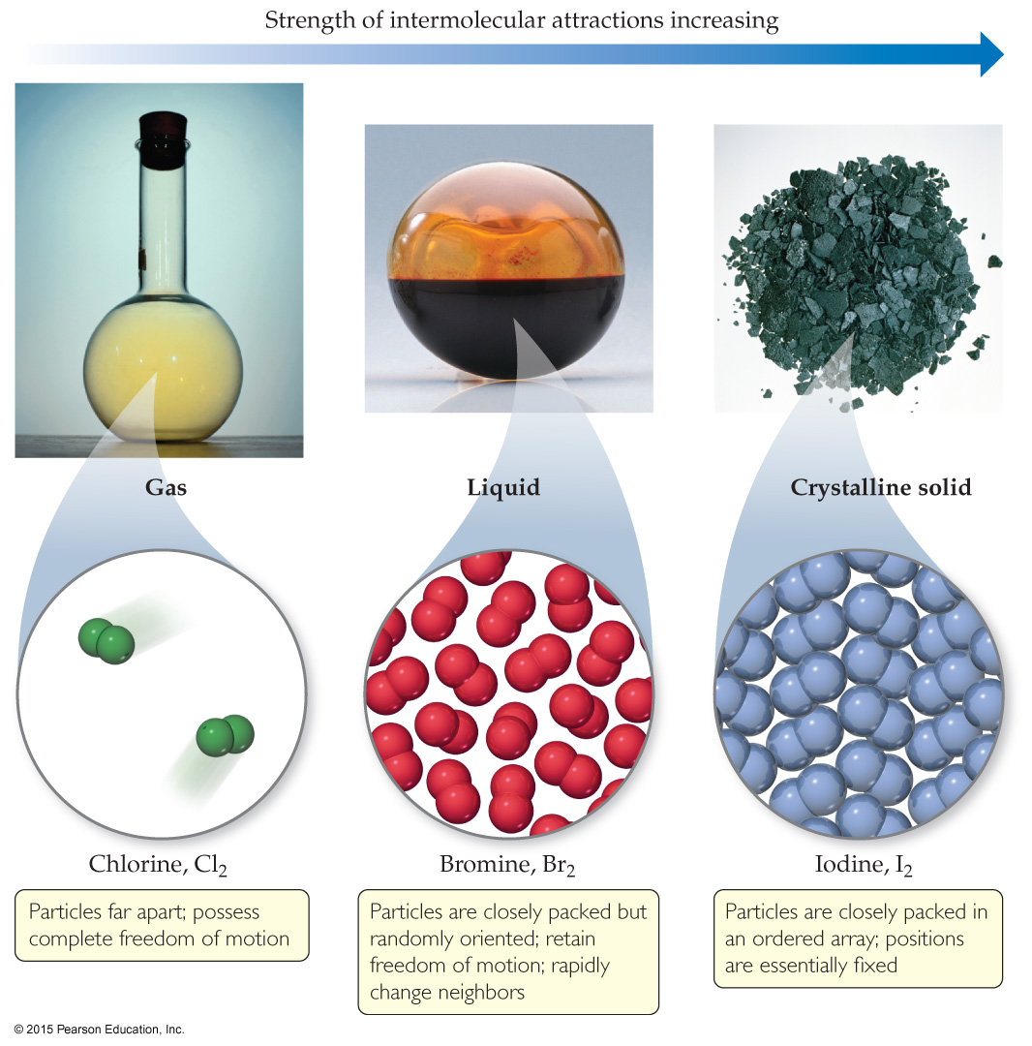
States of Matter
The fundamental difference between states of matter is the strength of the intermolecular forces of attraction.
Stronger forces bring molecules closer together.
Solids and liquids are referred to as the condensed phases.

Slide 3
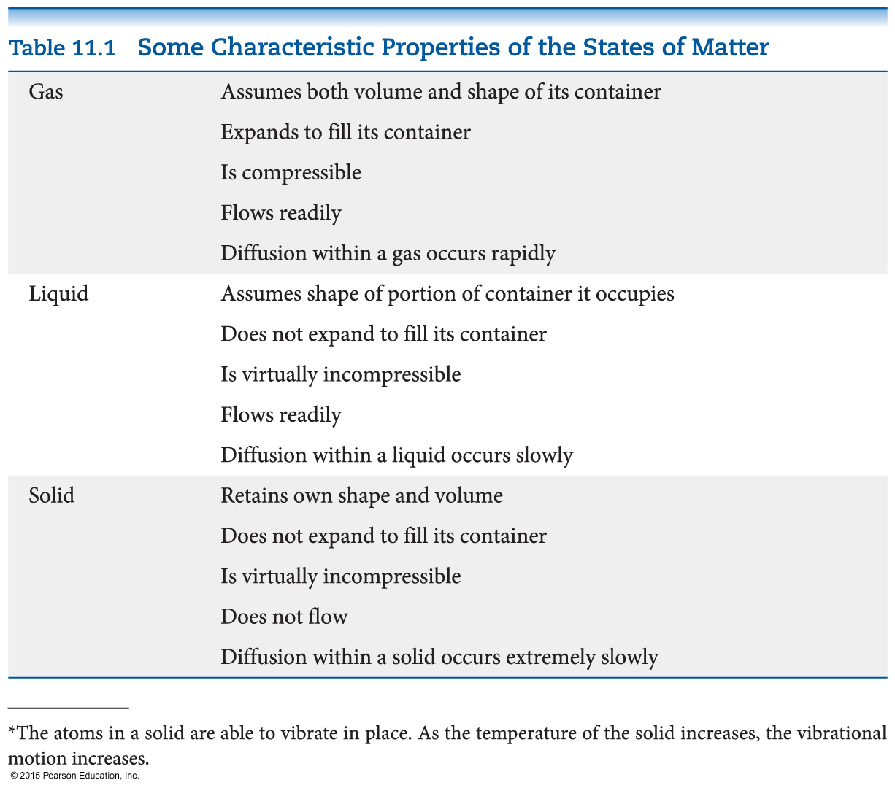
Differences in the States of Matter

Slide 4
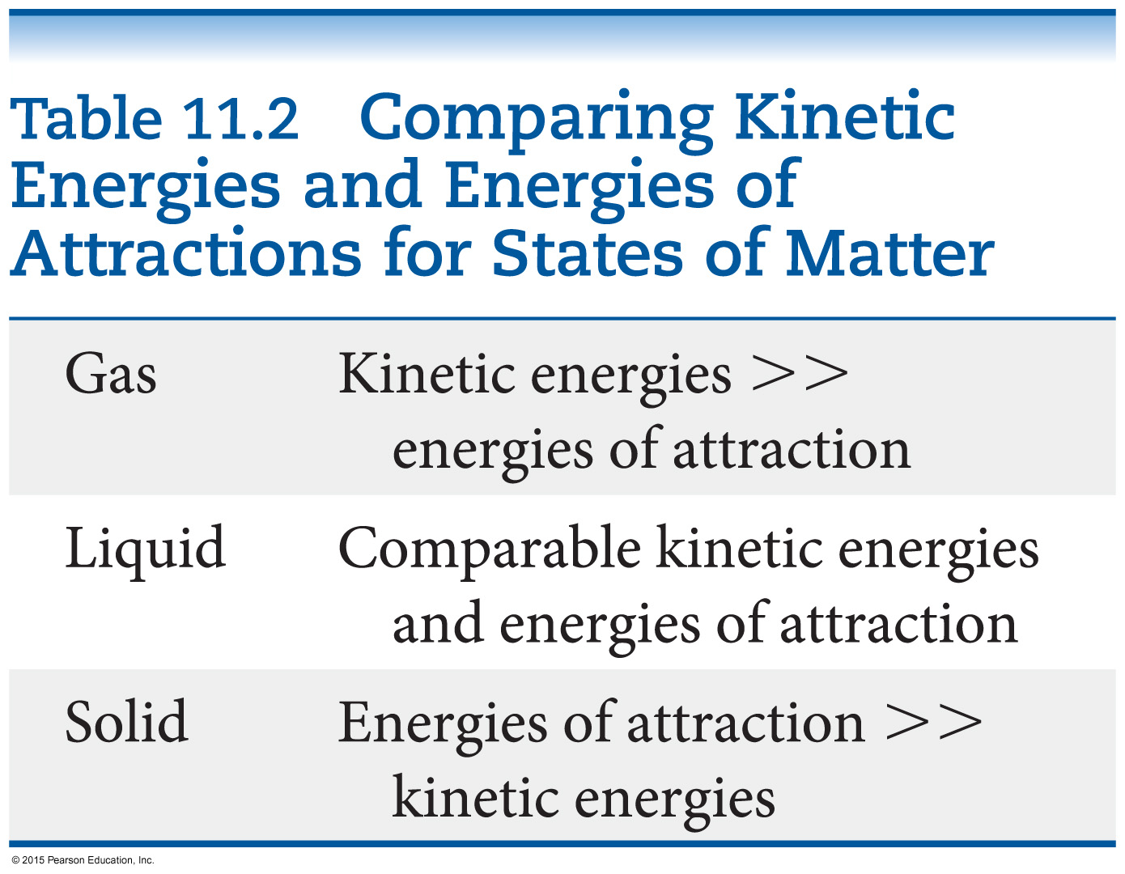
Which State of Matter?
The answer to this question largely relies on the
balance between the kinetic energies of the particles.
interparticle energies of attraction.

Slide 5
intER vs. intRA molecular forces
Intramolecular forces are the forces within a molecule or ionic compound
  Example: Individual therapy
  NaCl Ionic bond between atom of Na and atom of Cl
Intermolecular forces are the forces between molecules or ions and molecules
Example: couples therapy
Solid liquid gas
.

Slide 6
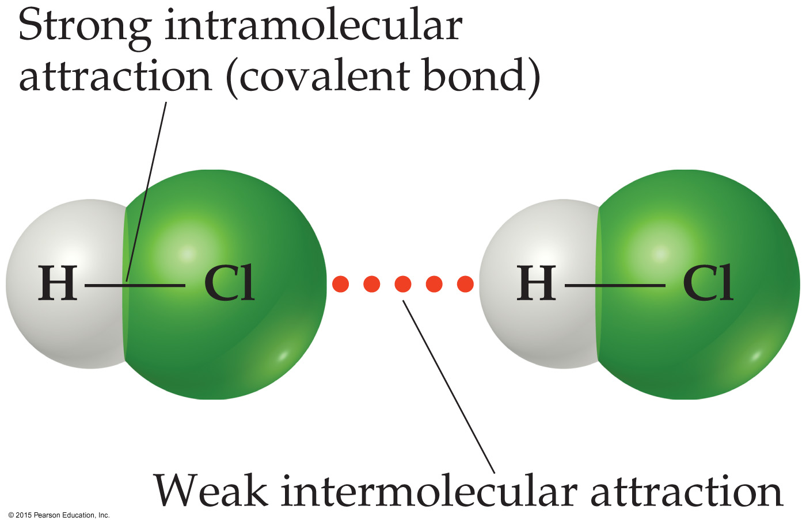
Intermolecular Forces
The attractions between molecules are not nearly as strong as the intramolecular attractions (bonds) that hold compounds together.
Many physical properties reflect intermolecular forces, like boiling points, melting points, viscosity, surface tension, and capillary action.

Slide 7
Types of Intermolecular Force
Weakest to strongest forces:
dispersion forces (or London dispersion forces)
dipole–dipole forces
hydrogen bonding (a special dipole–dipole force)
ion–dipole forces
Note: The first two types are also referred to collectively as van der Waals forces.

Slide 8
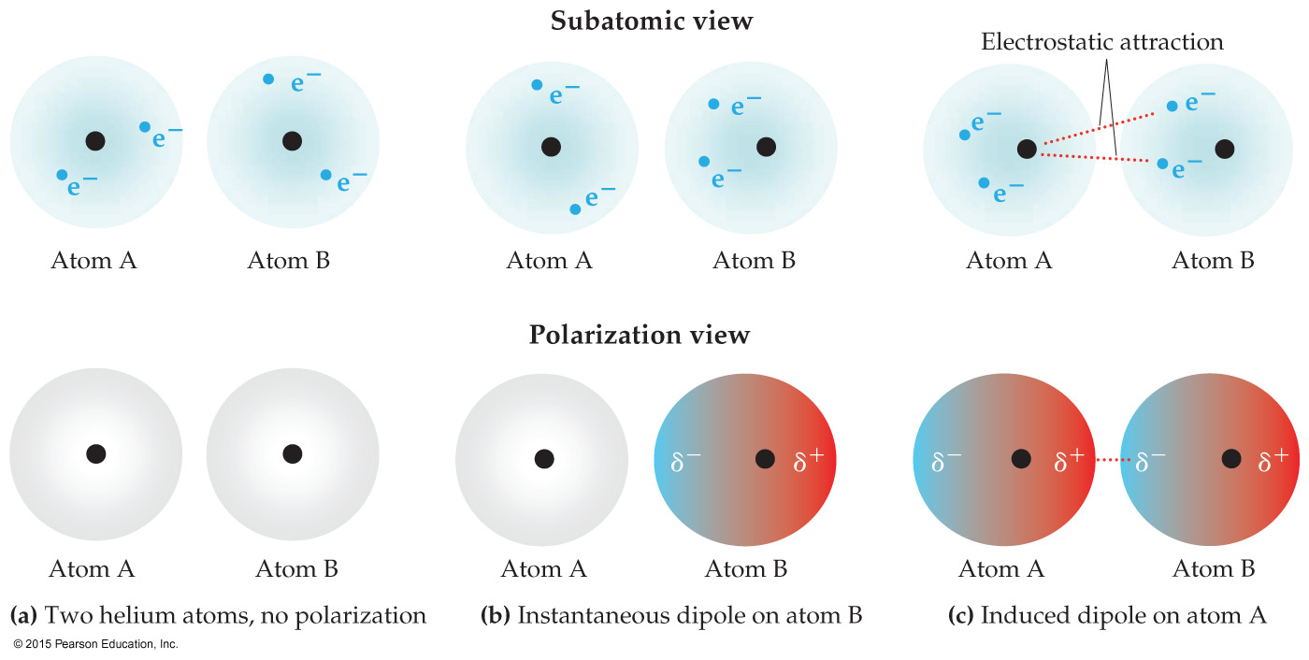
Dispersion Forces
The figure below shows how a nonpolar particle
(in this case a helium atom) can be temporarily polarized to allow dispersion force to form.
The tendency of an electron cloud to distort is
called its polarizability.

Slide 9
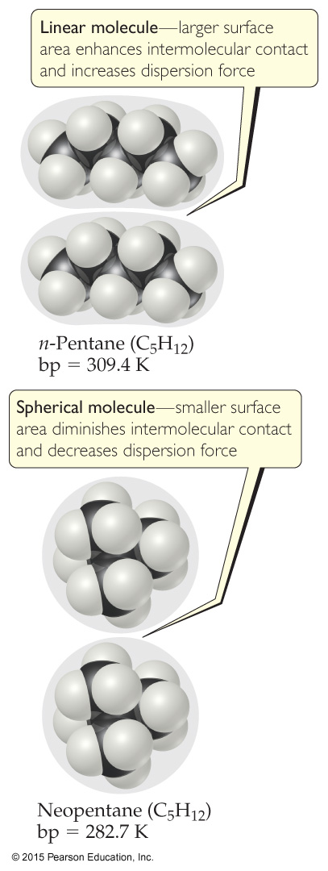
Factors Which Affect Amount of Dispersion Force in a Molecule
number of electrons in an atom (more electrons, more dispersion force)
size of atom or molecule/molecular weight
shape of molecules with similar masses (more compact, less dispersion force)

Slide 10
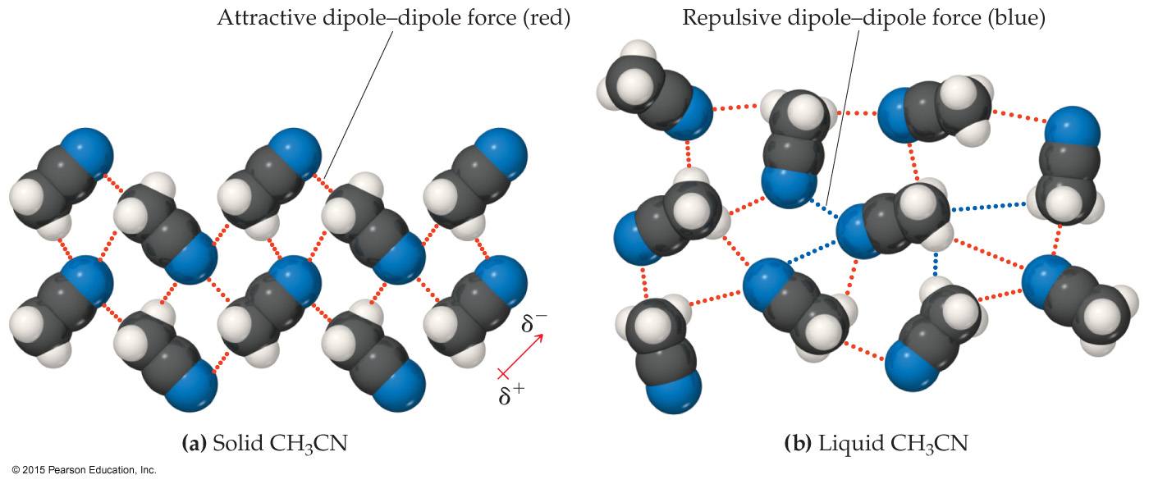
Dipole–Dipole Interactions
Polar molecules have a more positive and a more negative end–a dipole (two poles, δ⁺ and δ⁻).
The oppositely charged ends attract each other.

Slide 11
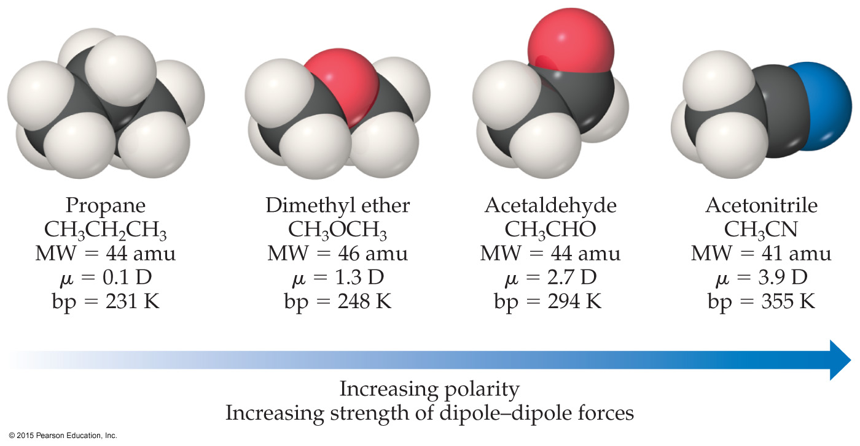
Dipole–Dipole Interactions
For molecules of approximately equal mass and size, the more polar the molecule, the higher its boiling point.

Slide 12
Question
1. Calculate the dipole moment of a water model having following characteristics: r_{OH} = 0.97 Å, HOH angle = 104.5º, q_{O} = -0.6e and q_{H} = +0.3e.

Slide 13
Which Have a Greater Effect:
Dipole–Dipole Interactions or Dispersion Forces?
If two molecules are of comparable size and shape, dipole–dipole interactions will likely be the dominating force.
If one molecule is much larger than another, dispersion forces will likely determine its physical properties.

Slide 14
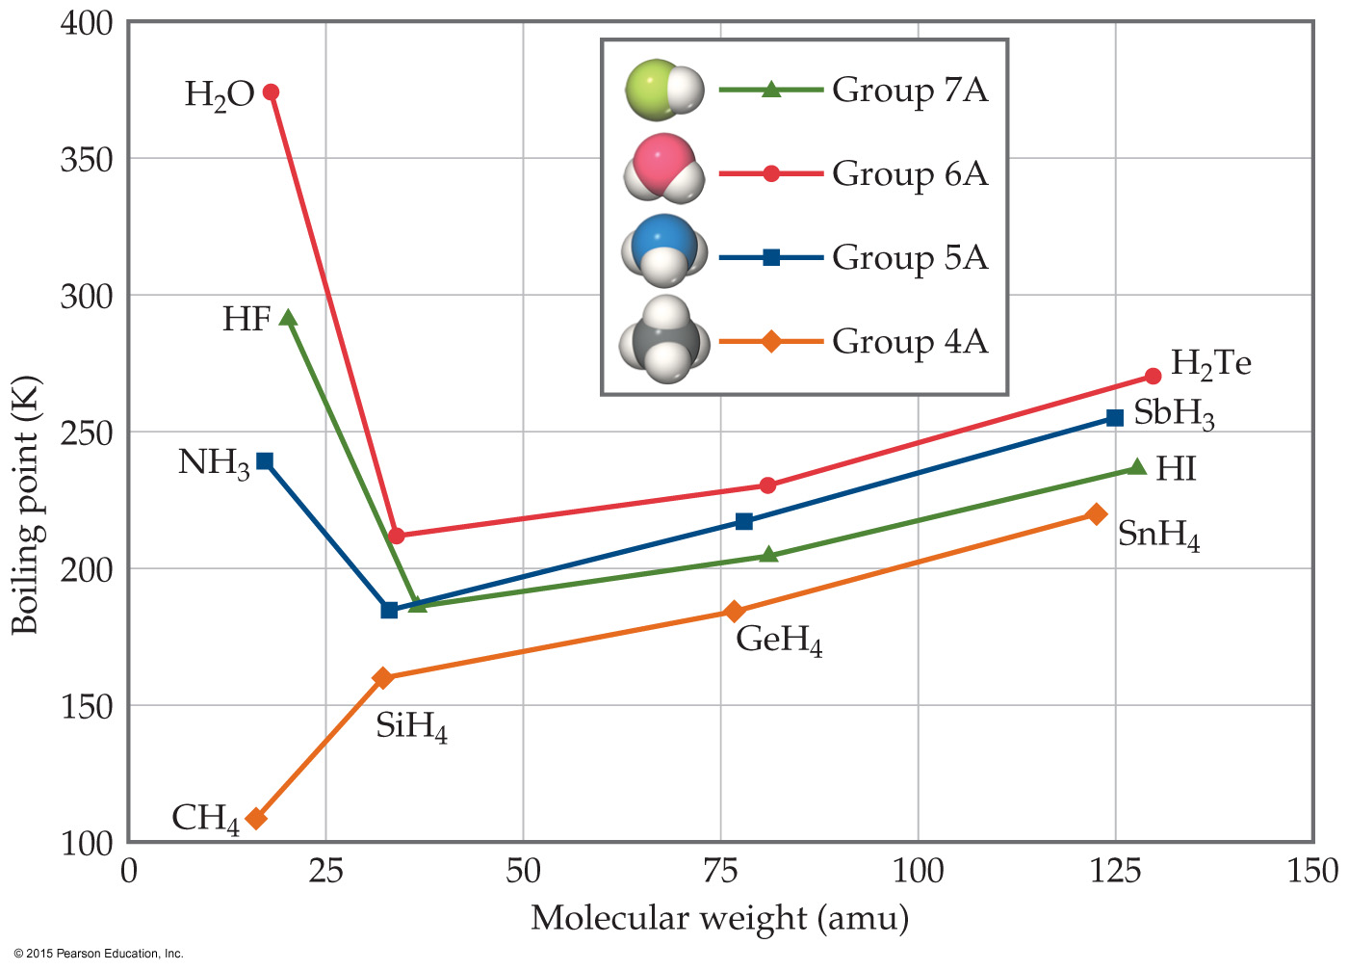
What Does This Graph Show Us?
In a group, the period 3/4/5 elements have higher boiling points as the group member gets larger.
What happens with the period 2 elements? For group 4A, the trend is continued. What about for the other groups?

Slide 15
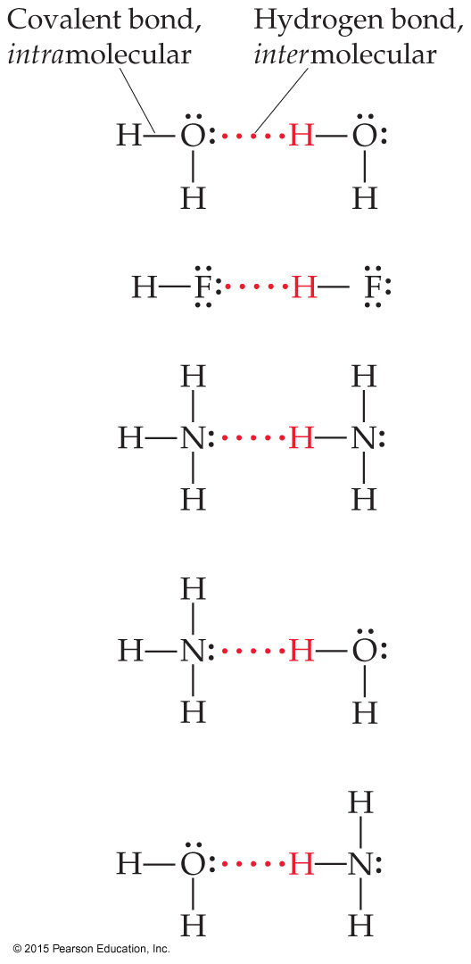
Hydrogen Bonding
The dipole–dipole interactions experienced when H is bonded to N, O, or F are unusually strong.
We call these interactions hydrogen bonds.
A hydrogen bond is an attraction between a hydrogen atom attached to a highly electronegative atom and a nearby small electronegative atom in another molecule or chemical group.

Slide 16

What Forms Hydrogen Bonds?
Hydrogen bonding arises in part from the high electronegativity of nitrogen, oxygen, and fluorine.
These atoms interact with a nearly bare nucleus (which contains one proton).

Slide 17
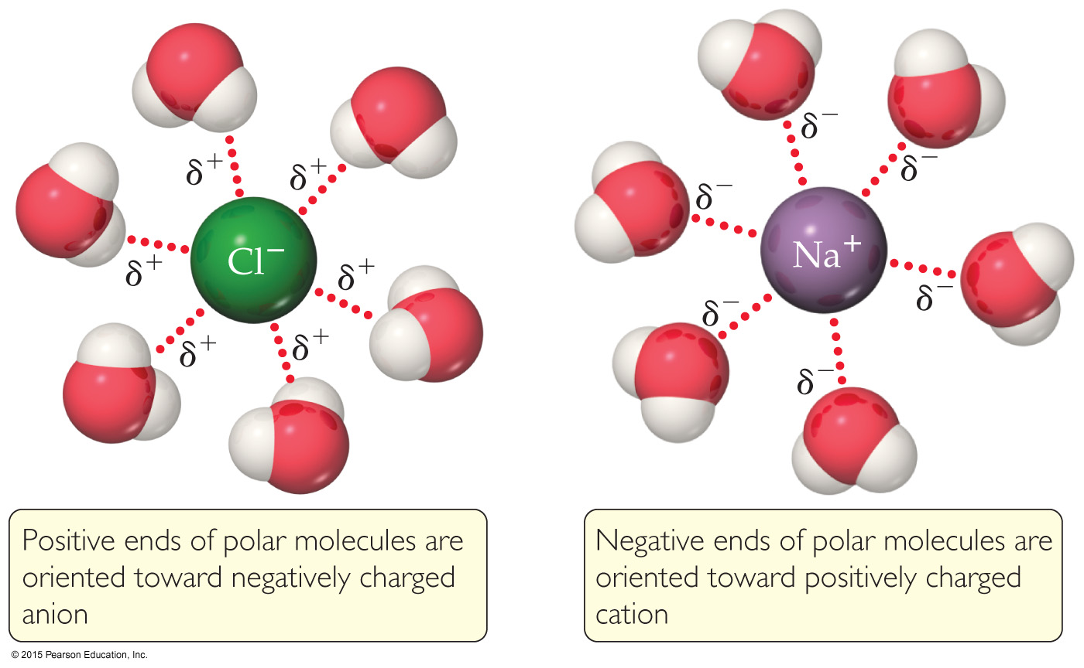
Ion–Dipole Interactions
Ion–dipole interactions are found in solutions of ions.
The strength of these forces is what makes it possible for ionic substances to dissolve in polar solvents.

Slide 18
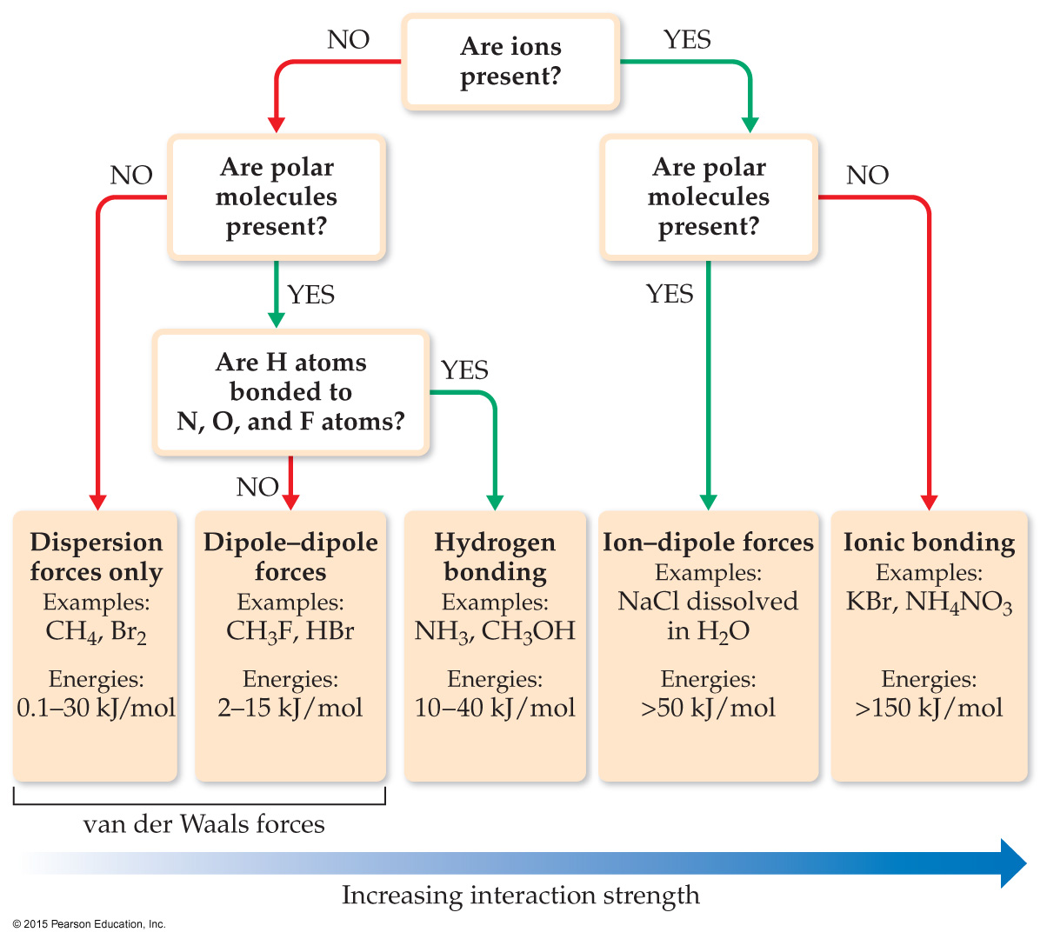
Summarizing Intermolecular Forces

Slide 19
Liquid Properties Affected by Intermolecular Forces
boiling point (previously discussed) and melting point
viscosity
surface tension
capillary action

Slide 20
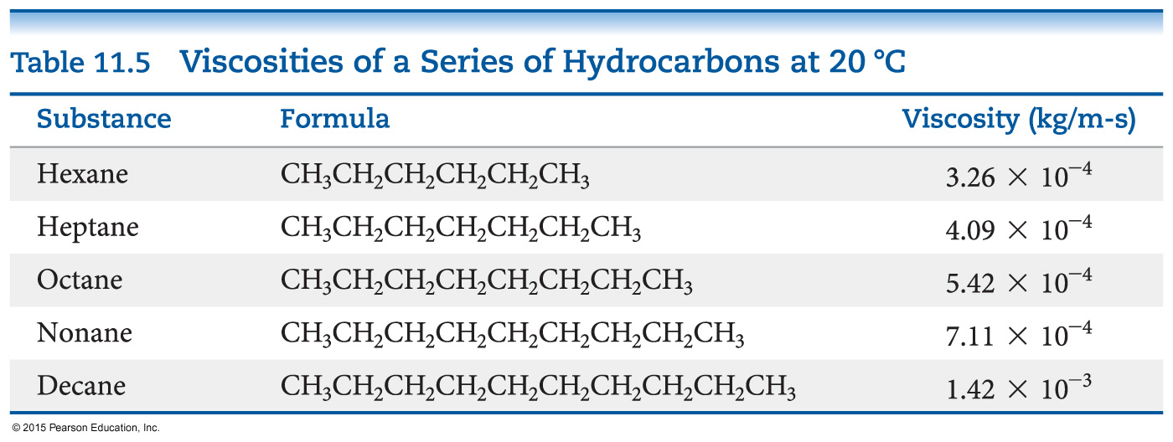
Viscosity
Resistance of a liquid to flow is called viscosity.
It is related to the ease with which molecules can move past each other.
Viscosity increases with stronger intermolecular forces and decreases with higher temperature.

Slide 21
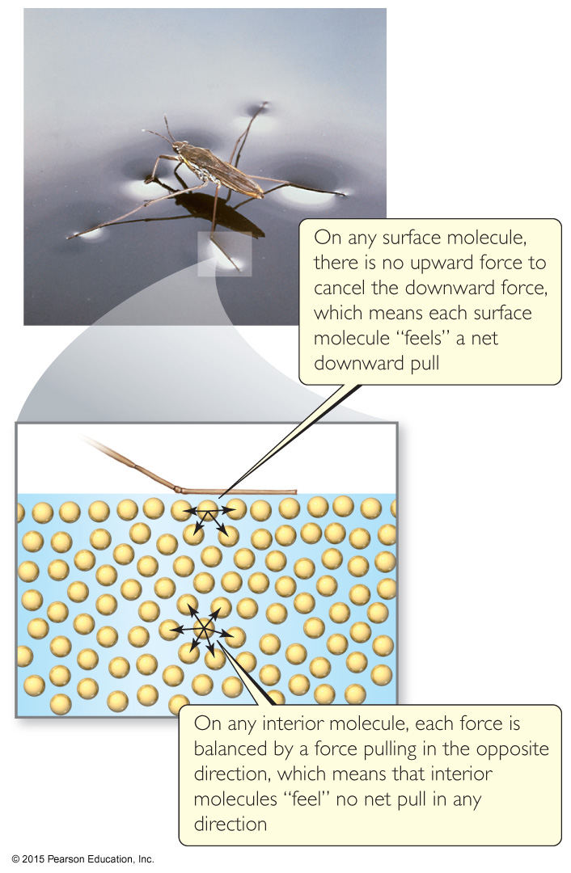
Surface Tension
Water acts as if it has a “skin” on it due to extra inward forces on its surface. Those forces are called the surface tension.

Slide 22
Cohesion and Adhesion
Intermolecular forces that bind similar molecules to one another are called cohesive forces.
Intermolecular forces that bind a substance to a surface are called adhesive forces.
These forces are important in capillary action.

Slide 23
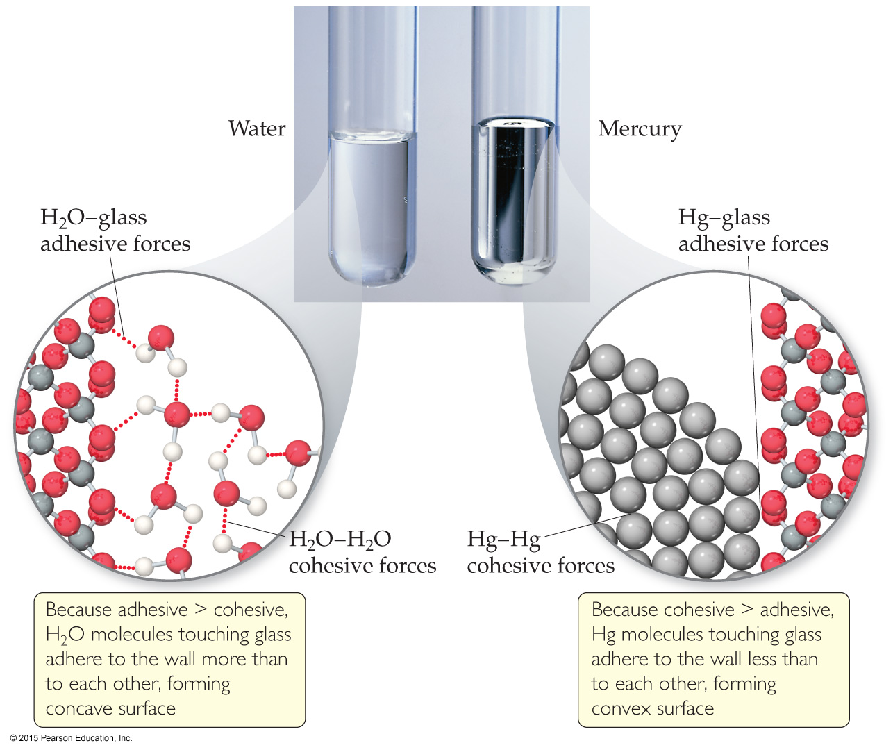
Capillary Action
The rise of liquids up narrow tubes is called capillary action.
Adhesive forces attract
the liquid to the wall of
the tube.
Cohesive forces attract
the liquid to itself.
Water has stronger adhesive forces with glass; mercury has stronger cohesive forces with itself.

Slide 24
CONCEPT CHECK!
Which molecule is capable of forming stronger intermolecular forces?
N₂ H₂O
Explain.
Notes:
H₂O has the stronger intermolecular forces because it exhibits hydrogen bonding, whereas N₂ only exhibits London dispersion forces.

Slide 25
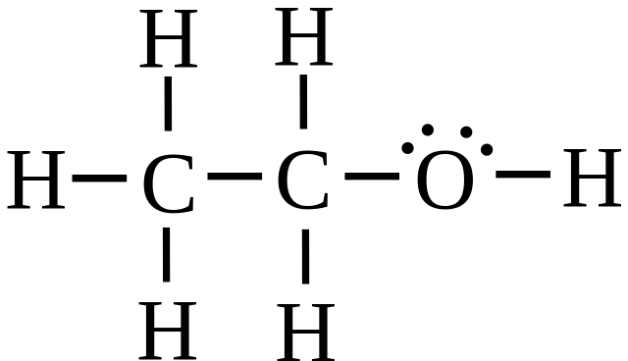
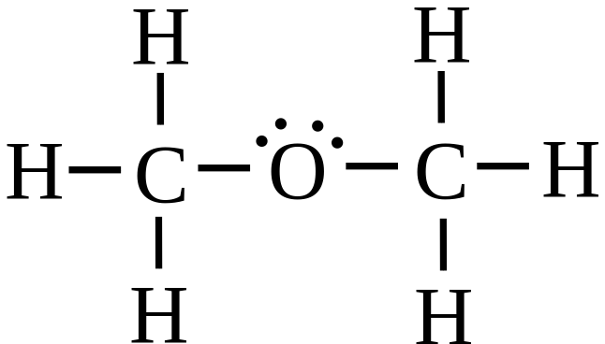
CONCEPT CHECK!
Draw two Lewis structures for the formula C₂H₆O and compare the boiling points of the two molecules.
Notes:
One Lewis structure could be ethanol and one Lewis structure could be dimethyl ether. Ethanol will have a higher boiling point than dimethyl ether because ethanol exhibits hydrogen bonding and dimethyl ether exhibits dipole-dipole interactions. Hydrogen bonding is an especially strong type of dipole-dipole interaction and will thus raise the boiling point of ethanol.

Slide 26
CONCEPT CHECK!
Which gas would behave more ideally at the same conditions of P and T?
CO or N₂
Why?
Notes:
N₂ would behave more ideally because it is nonpolar and only exhibits London dispersion forces, therefore the intermolecular forces between N₂ molecules are weak (and thus the collisions will be more “elastic”). CO also exhibits dipole-dipole interactions.

Slide 27

CONCEPT CHECK!
What type(s) of intermolecular forces exist between the following pairs?
HBr and H₂S
Cl₂ and CBr₄
I₂ and
NH₃ and C₆H₆

Slide 28
CONCEPT CHECK!
Which of the following can form hydrogen bonds with water?
CH₃OCH₃
CH₄
F₂
HCOOH
Na⁺

Slide 29
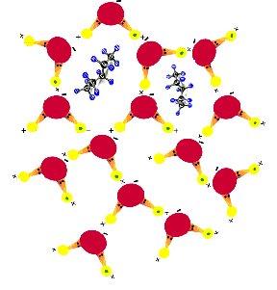
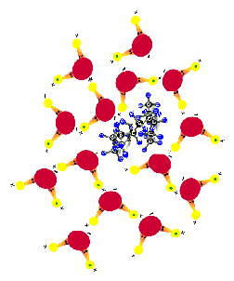
Hydrophobic Effect
The hydrophobic effect is an entropically-driven association of hydrophobic molecules that is a direct consequence of the polar nature of water and it propensity for hydrogen bonding.

Slide 30
Reading Materials and Simulation Link
https://www.labxchange.org/library/pathway/lx-pathway:d434428e-91c2-4aac-9d4d-9e110fb97734/items/lx-pb:d434428e-91c2-4aac-9d4d-9e110fb97734:video:e8f4301c
https://www.wisc-online.com/learn/natural-science/chemistry/gch6804/intermolecular-forces
https://courses.lumenlearning.com/trident-boundless-chemistry/chapter/intermolecular-forces/

Slide 31
Potential Energy Surface
Atoms in a molecule are held together by chemical bonds. When the atom is distorted, the bonds are stretched or compressed, in which increases the potential energy of its system.
As the new geometry is formed, the molecule stays stationary. Therefore, the energy of the system is not caused by the kinetic energy, but depending on the position of the atoms (potential).
Energy of a molecule is a function of the position of the nuclei. When nuclei moves, electron readjusts quickly. The relationship between this molecular energy and molecular geometry (position) is mapped out with potential energy surface.

Slide 32
Potential Energy Surface
A potential energy surface is a mathematical function that gives the energy of a molecule as a function of its geometry.
  Does not change if it translated or rotated in space
  Depends on a molecule’s internal coordinates

Slide 33
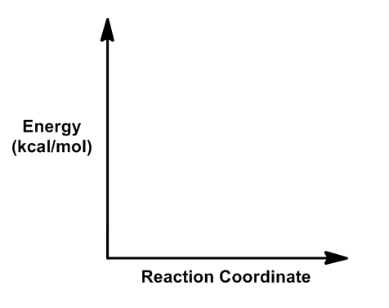
Potential Energy Surface
A potential energy surface (PES) represents the relationship between the energy of a molecule and its geometry.
The y-axis is energy of the molecule, which relates how stable two molecules or two conformations of the same molecule are in relation to one another. The more negative a molecule's energy, or the lower on the y-axis, the more stable it is.

Slide 34
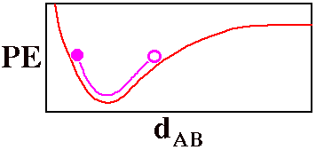
Potential Energy Surface
Fully specifying the location of a diatomic molecule, AB, would require specifying six numbers, the x, y, and z coordinates of each of its atoms.
Potential energy (PE) of the molecule as a function of the distance between the two atoms d_{AB}.

Slide 35
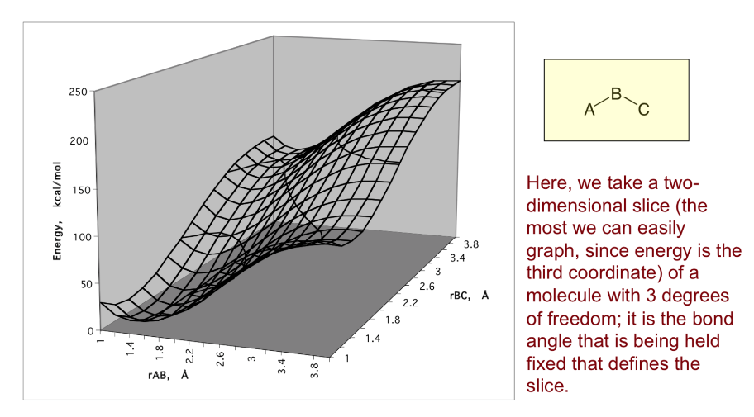
Potential Energy Surface

Slide 36
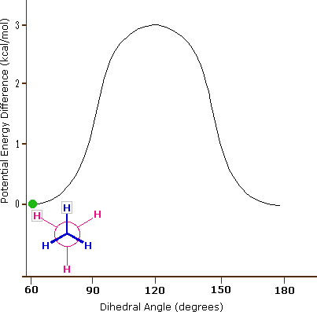
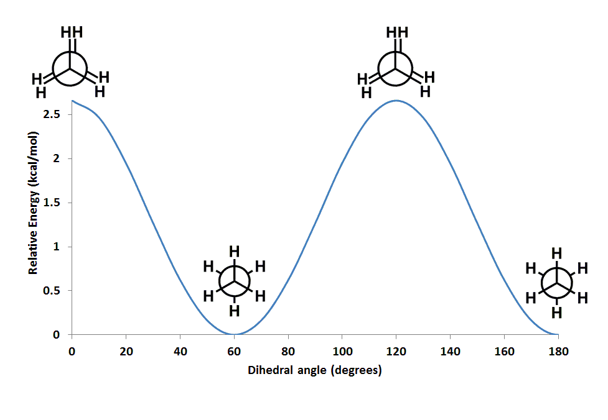
Potential Energy Surface
This PES shows the energy differences between the two conformations of ethane. The eclipsed conformation with the hydrogen atoms overlapping one another is about 2.6 kcal/mol higher in energy than the staggered conformation.

Slide 37
Force-field
A Force field is a computational method that is used to estimate the forces between atoms within molecules and also between molecules.
It refers to the functional form and parameter sets used to calculate the potential energy of a system of atoms or coarse-grained particles in molecular mechanics, molecular dynamics, or Monte Carlo simulations.
The parameters for a chosen energy function may be derived from experiments in physics and chemistry, calculations in quantum mechanics, or both.
Force fields are interatomic potentials and utilize the same concept as force fields in classical physics, with the difference that the force field parameters in chemistry describe the energy landscape, from which the acting forces on every particle are derived as a gradient of the potential energy with respect to the particle coordinates.

Slide 38
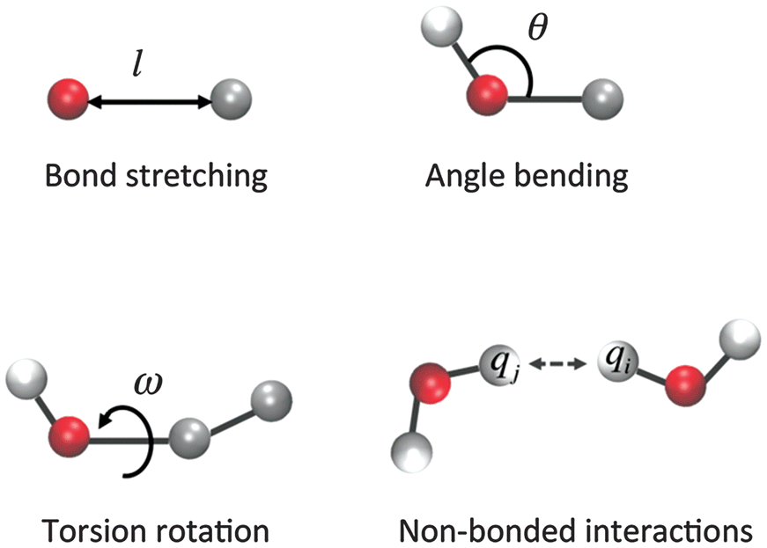
Interactions in molecules

Slide 39
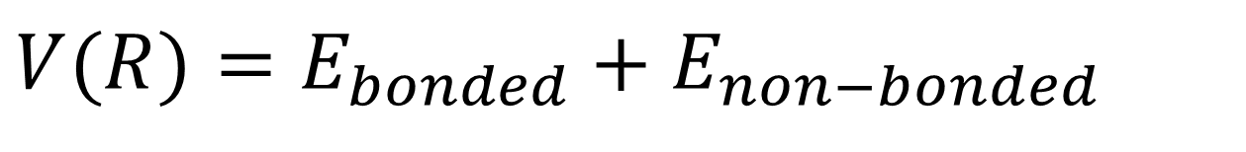
What is the Potential?
A single atom will be affected by the potential energy functions of every atom in the system:
Bonded Neighbors
Non-Bonded Atoms (either other atoms in the same molecule, or atoms from different molecules)
$$V(R)=E_{bonded}+E_{non−bonded}$$

Slide 40

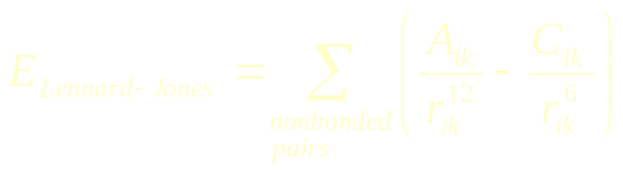
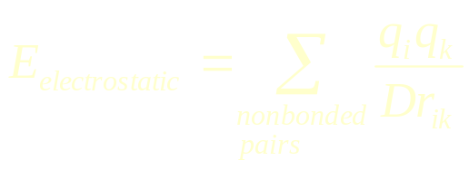
Non-Bonded Atoms
There are two potential functions between non-bonded atoms that we need to know:
van der Waals Potential
Electrostatic Potential
One of the most widely used functions for the van der Waals potential is the Lennard-Jones. Constants A and C depend on the atom types and are derived from experimental data.
Opposite Charges Attract
Like Charges Repel

Slide 41
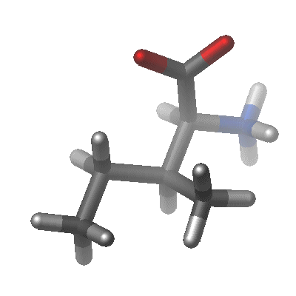
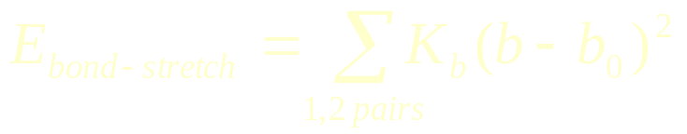
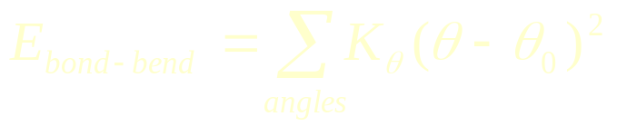
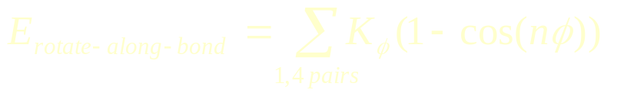
Bonded Atoms
There are three types of interaction between bonded atoms:
Stretching along the bond
Bending between bonds
Rotating around bonds (Torsions)

Slide 42
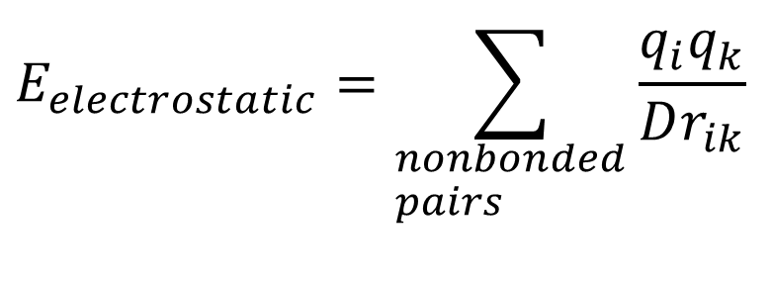
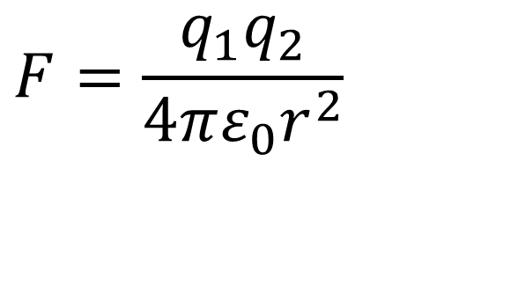
The Electrostatic Potential
Opposite Charges Attract
Like Charges Repel
The force of the attraction is inversely proportional to the square of the distance
$$E_{electrostatic}=\sum_{\begin{aligned}&nonbonded \\ &pairs\end{aligned}}{\frac{q_{i}q_{k}}{Dr_{ik}}}$$
$$F=\frac{q_{1}q_{2}}{4πε_{0}r^{2}}$$

Slide 43
The van der Waals Potential
Atoms with no net electrostatic charge will still tend to attract each other at short distances, as long as they don’t get too close.
Once the atoms are close enough to have overlapping electron clouds, they will repel each other with astounding force

Slide 44
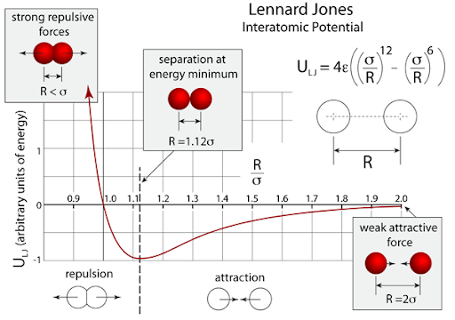

Slide 45
Bonded Atoms
There are three types of interaction between bonded atoms:
Stretching along the bond
Bending between bonds
Rotating around bonds
$$E_{bonded}=E_{bond−stretch}+E_{angle−bend}+E_{rotate−along−bond}$$

Slide 46
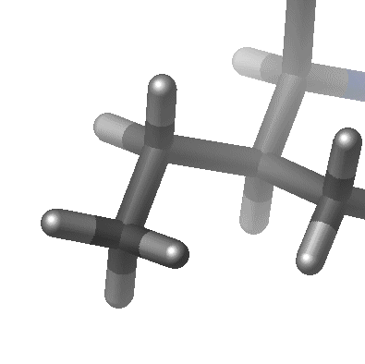
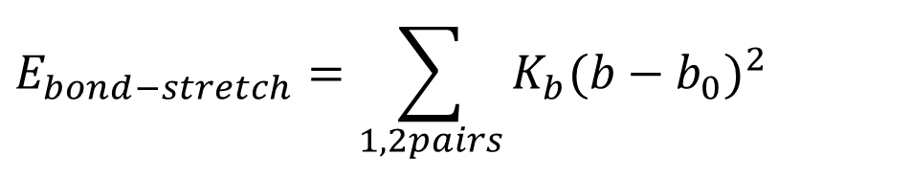
Bond Length Potentials
Both the spring constant and the ideal bond length are dependent on the atoms involved.
This is the approximation to the energy of a bond as a function of displacement from the ideal bond length, b₀. The force constant, K_{b}, determines the strength of the bond. Both ideal bond lengths b₀ and force constants K_{b} are specific for each pair of bound atoms, i.e. depend on chemical type of atoms-constituents.
$$E_{bond−stretch}=\sum_{1,2pairs}{K_{b}(b−b_{0})^{2}}$$

Slide 47
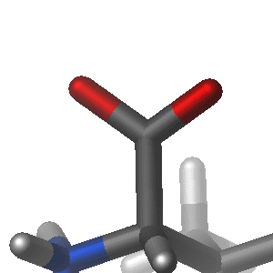
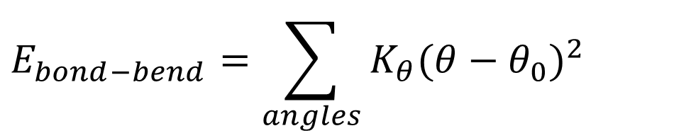
Bond Angle Potentials
The spring constant and the ideal angle are also dependent on the chemical type of the atoms.
It is the alteration of bond angles theta from ideal values q₀ , which is also represented by a harmonic potential.
Values of q₀ and K_{q} depend on chemical type of atoms constituting the angle.
$$E_{bond−bend}=\sum_{angles}{K_{θ}(θ−θ_{0})^{2}}$$

Slide 48
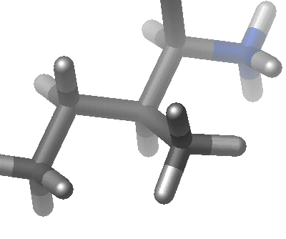
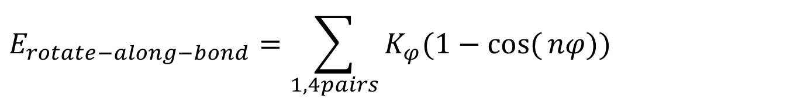
Torsional Potentials
Described by a dihedral angle and coefficient of symmetry (n=1,2,3), around the middle bond.
$$E_{rotate−along−bond}=\sum_{1,4pairs}{K_{φ}(1−\cos{(}nφ))^{}}$$

Slide 49
Pair-wise additivity
An approximation introduced to decrease the computational demand is the pair-wise additive approximation, i.e., interaction energy between one atom and the rest of the system is calculated as a sum of pair-wise (on atom to one atom) interactions, or as if the pair of atoms do not see the other atoms in the system.
The simultaneous interaction between three or more atoms is not calculated, so certain polarization effects are not explicitly included in the force field.
This can lead to subtle differences between calculated and experimental results, for example, in the calculation of experimentally observable pK shifts of ionizable amino acid residue side chains induced by electrostatic field of the whole protein .

Slide 50

Thank you

