Slide 1

Molecular Dynamics
Dr. Saurav Prasad

Slide 2
Molecular Dynamics
Molecular Dynamics is a computer simulation of physical movements of atoms and molecules. The trajectories of molecules and atoms are determined by numerically solving the classical equations of motion (Newton’s equations) for a system of interacting particles, where forces between the particles and potential energy are defined by molecular mechanics force fields.
This was first accomplished in 1957 and 1959 for a system of hard spheres by Adler. Now is applied mostly in materials science and modeling of biomolecules.

Slide 3

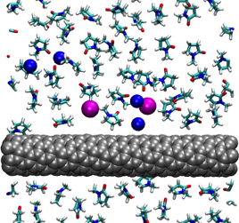

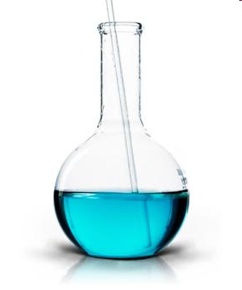
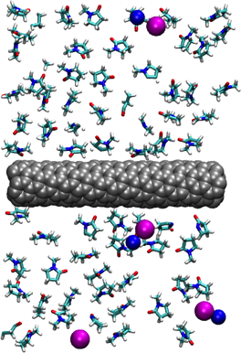

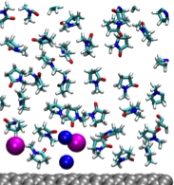
Molecular Dynamics
MD is a computational microscope. Understanding how things work on a detailed molecular level ranging from electronic structures to long-time phase behavior of molecules

Slide 4
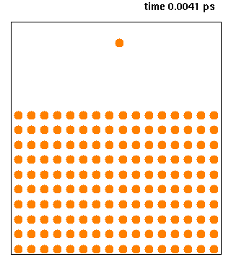
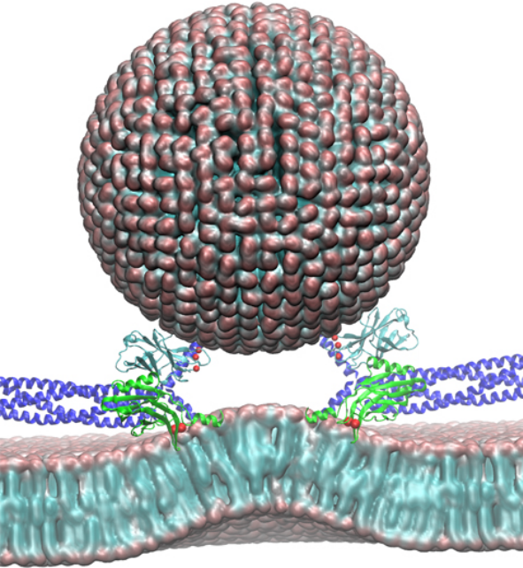
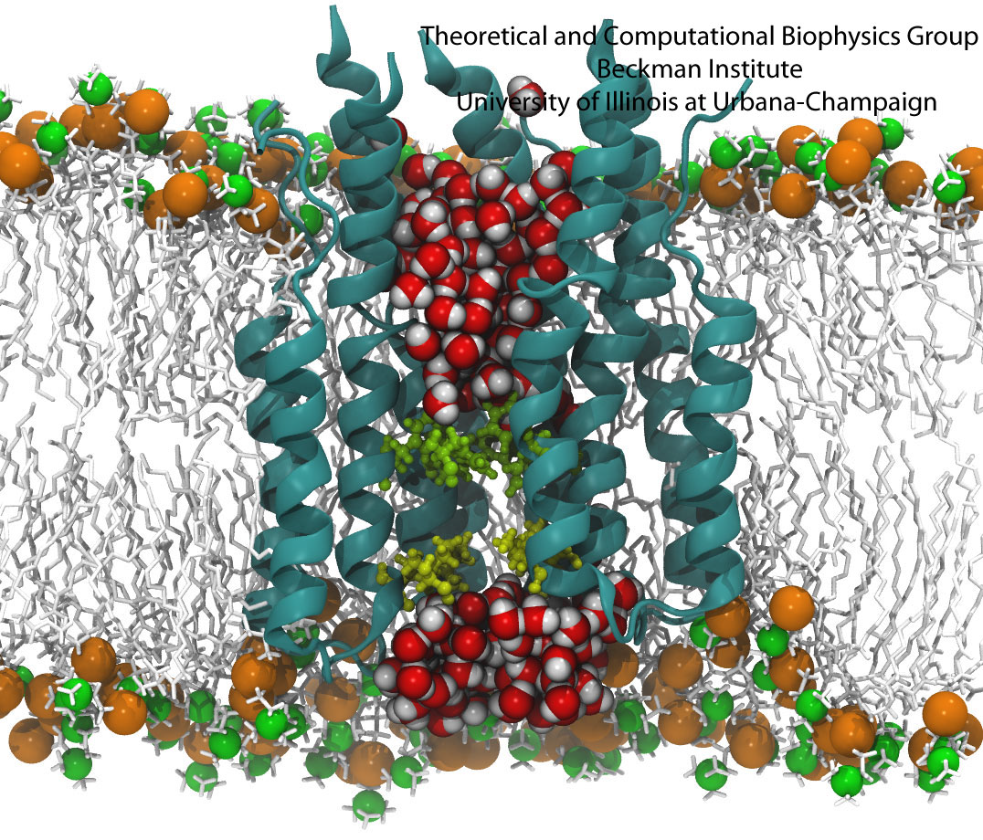
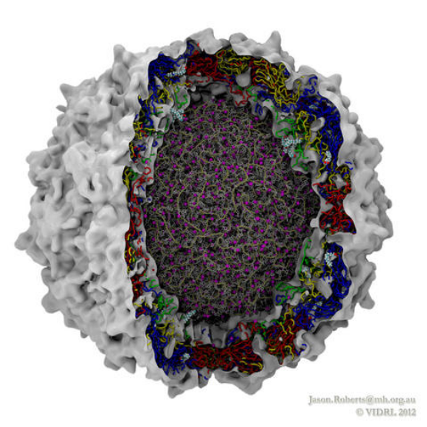
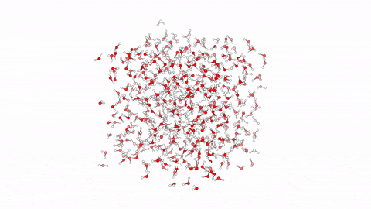
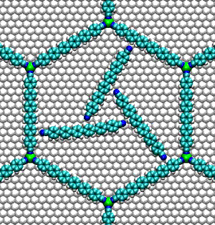
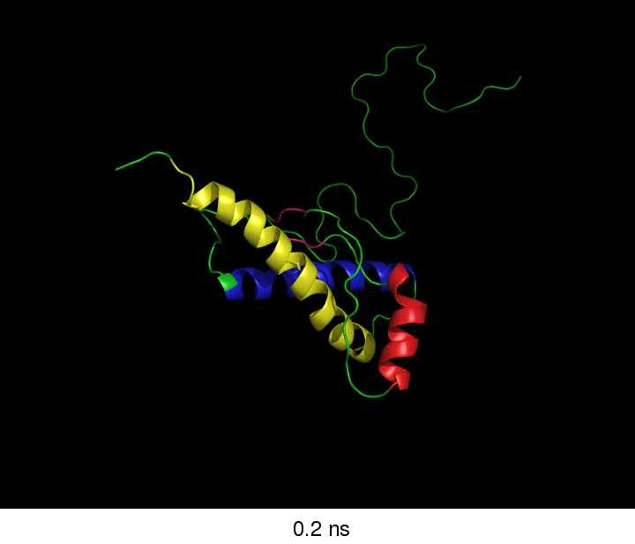
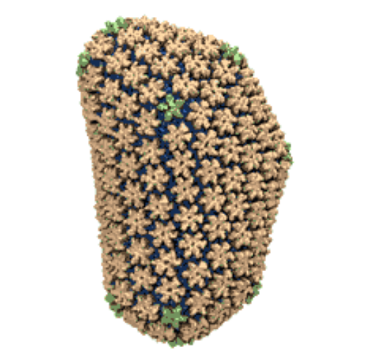
MD Systems

Slide 5
Molecular dynamics -Motivation
The computer experiment.
In a computer experiment, a model is still provided by theorists, but the calculations are carried out by the machine by following a recipe (the algorithm, implemented in a suitable programming language).
In this way, complexity can be introduced (with caution!) and more realistic systems can be investigated, opening a road towards a better understanding of real experiments.

Slide 6
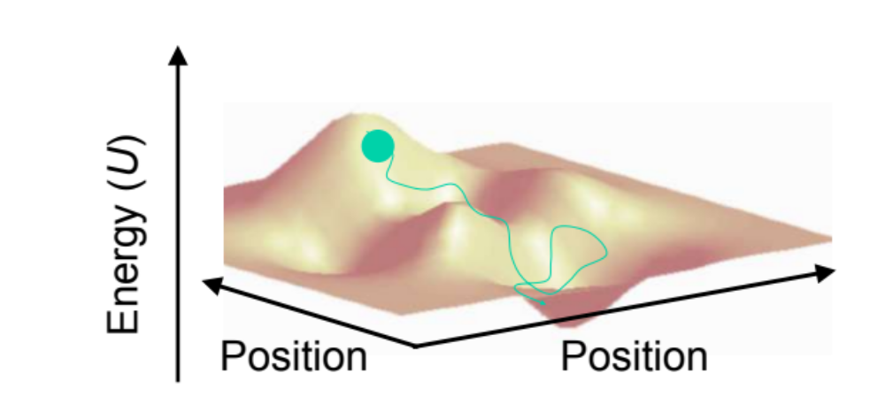
Molecular Dynamics Simulations
Build realistic atomistic model of the system
Simulate the behavior of your system over time using specific conditions (temperature, pressure, volume, etc.)

Slide 7
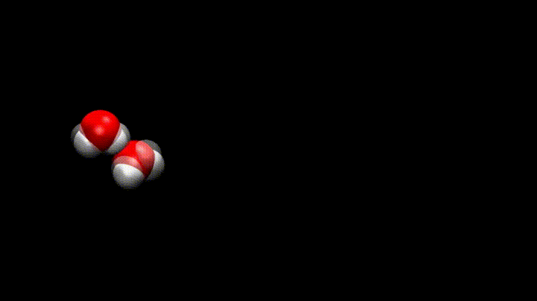
How?
MD simulations model the motion of some group of particles by solving the classical equations of motion.
Atoms and molecules will ‘move’ in the computer, bumping into each other, vibrating about a mean position or wandering around, oscillating in waves in concert with their neighbours, perhaps evaporating away from the system if there is a free surface, and so on, in a way similar to what real atoms and molecules would do.

Slide 8
Equation of Motion
Newton’s second law or the equation of motion, F = m a, where F is the force exerted on the particle, m is its mass and a is its acceleration.
From a knowledge of the force on each atom, it is possible to determine the acceleration of each atom in the system.
Integration of the equations of motion then yields a trajectory that describes the positions, velocities and accelerations of the particles as they vary with time.
From this trajectory, the average values of properties can be determined.
The method is deterministic; once the positions and velocities of each atom are known, the state of the system can be predicted at any time in the future or the past.

Slide 9
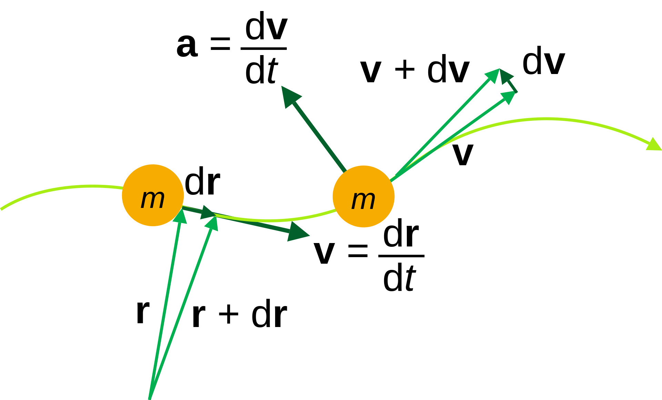
Equation of Motion

Slide 10
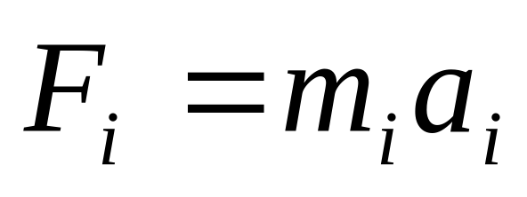
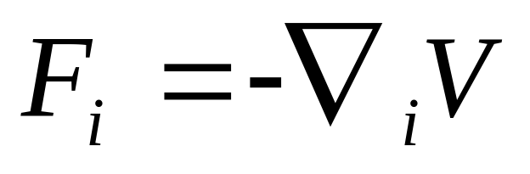
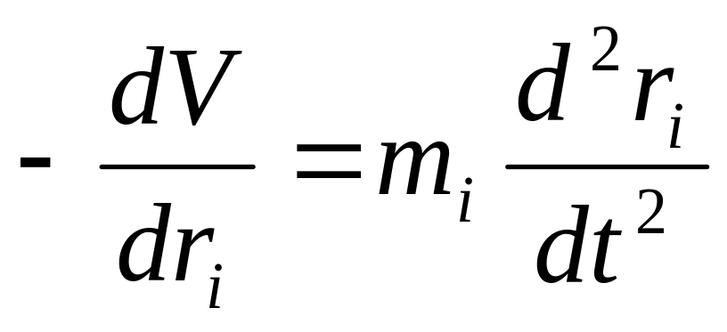
From Potential to Movement
To run the simulation, we need the force on each particle.
We use the gradient of the potential energy function.
Now we can find the acceleration.

Slide 11
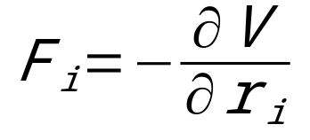

MD algorithm
1. Input:
a) r₀ → positions of all
atoms in the system.
b) v₀ → velocities of all
atoms in the system.
2. Computation of forces:
3.Update configuration:
a) velocity-verlet
b) leap-frog
4. Output:
r_{t}, v_{t}, F_{t}, P_{t}, T_{t} etc

Slide 12
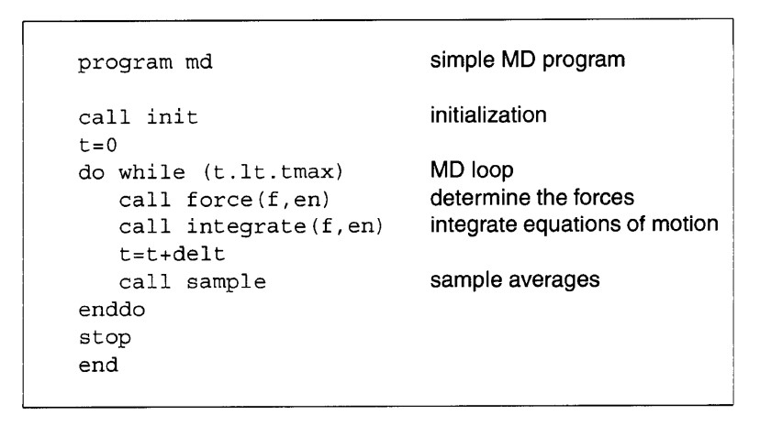
The structure of a simple MD code

Slide 13
Initialization
For each atom in every molecule, we need:
Position (r) : X-ray, NMR, predicted models
Velocities: Maxwell distribution at certain T
Charge : QM based, parameterization

Slide 14
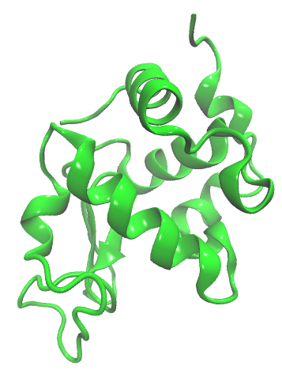
Position
  X-ray, NMR, simulation or analytical calculation

Slide 15
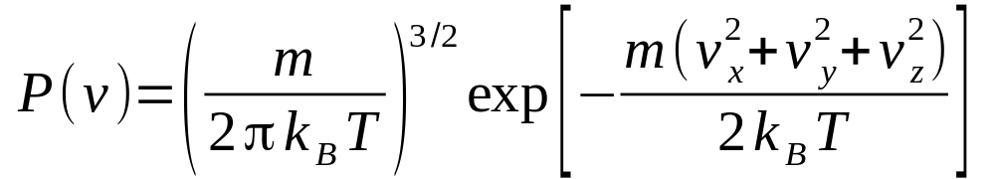
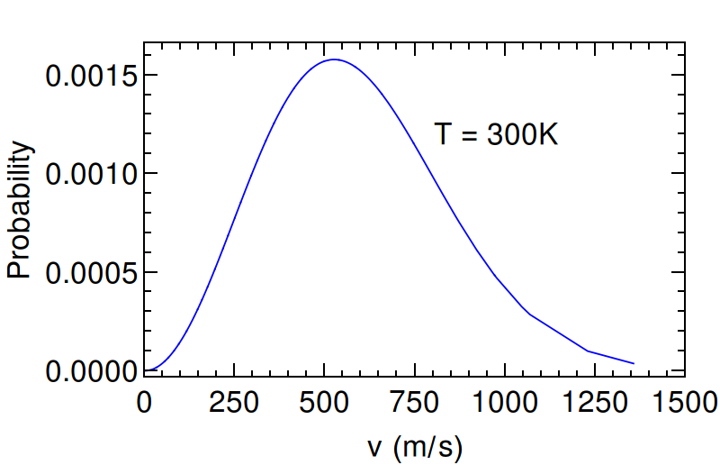
Velocity
The initial velocities are assigned taking them from a Maxwell distribution at a certain temperature

Slide 16
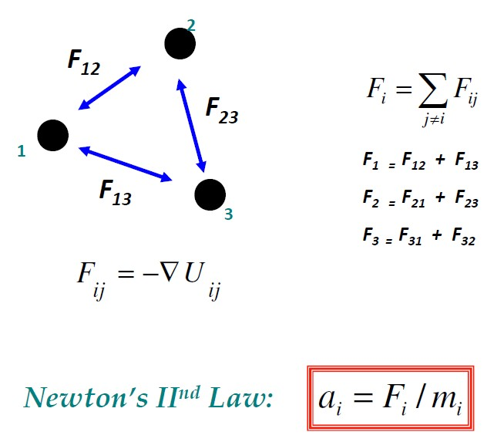
Three Atoms

Slide 17
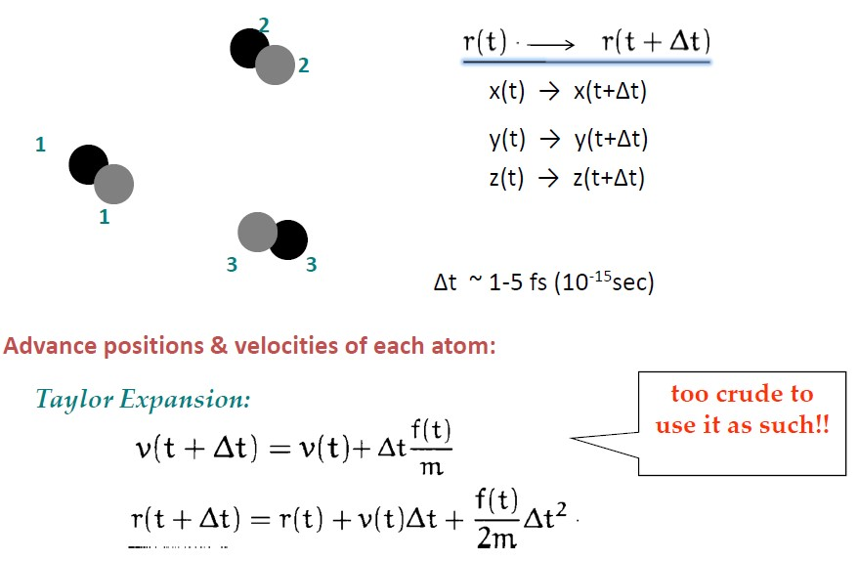
Progress in time

Slide 18
Integration Algorithms
The potential energy is a function of the atomic positions (3N) of all the atoms in the system.
Due to the complicated nature of this function, there is no analytical solution to the equations of motion; they must be solved numerically.
Numerous numerical algorithms have been developed for integrating the equations of motion, such as
Verlet algorithm
Velocity Verlet
Leap-frog algorithm

Slide 19
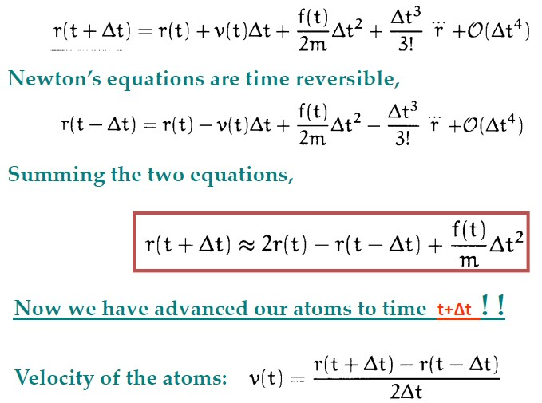
Verlet Scheme: A good integrator

Slide 20
Verlet Algorithm
Pros:
Simple & Effective
Low Memory & CPU Requirements (don’t need to store velocities or perform multiple force calculations)
Time Reversible
Very stable even with large numbers of interacting particles
Cons:
Moderate precision

Slide 21
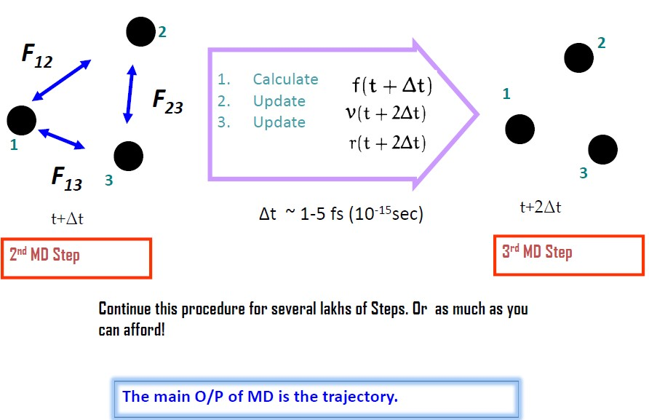
Atoms move forward in time

Slide 22
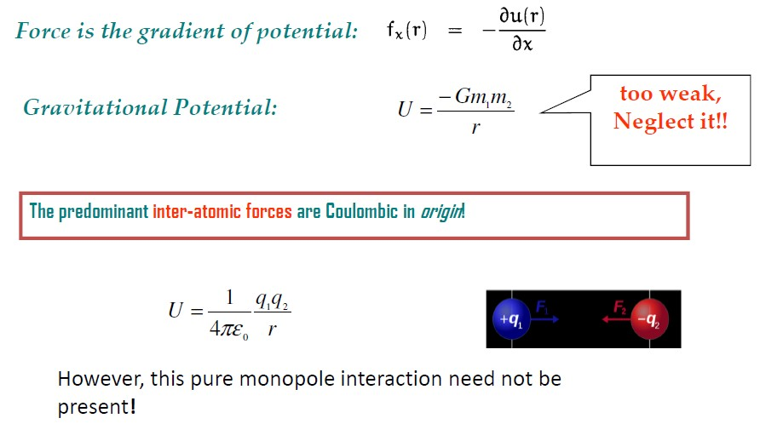
Forces

Slide 23
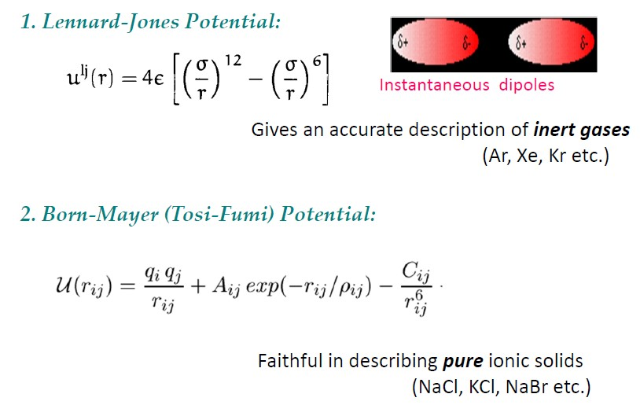
Simple Interatomic Potentials

Slide 24
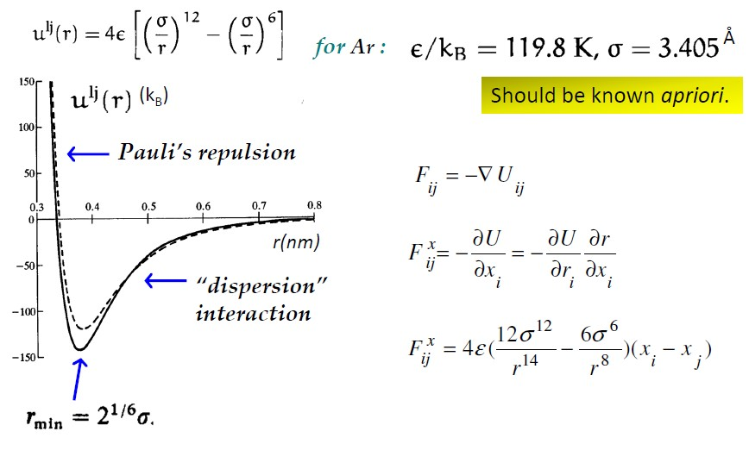
Lennard-Jones Potential

Slide 25
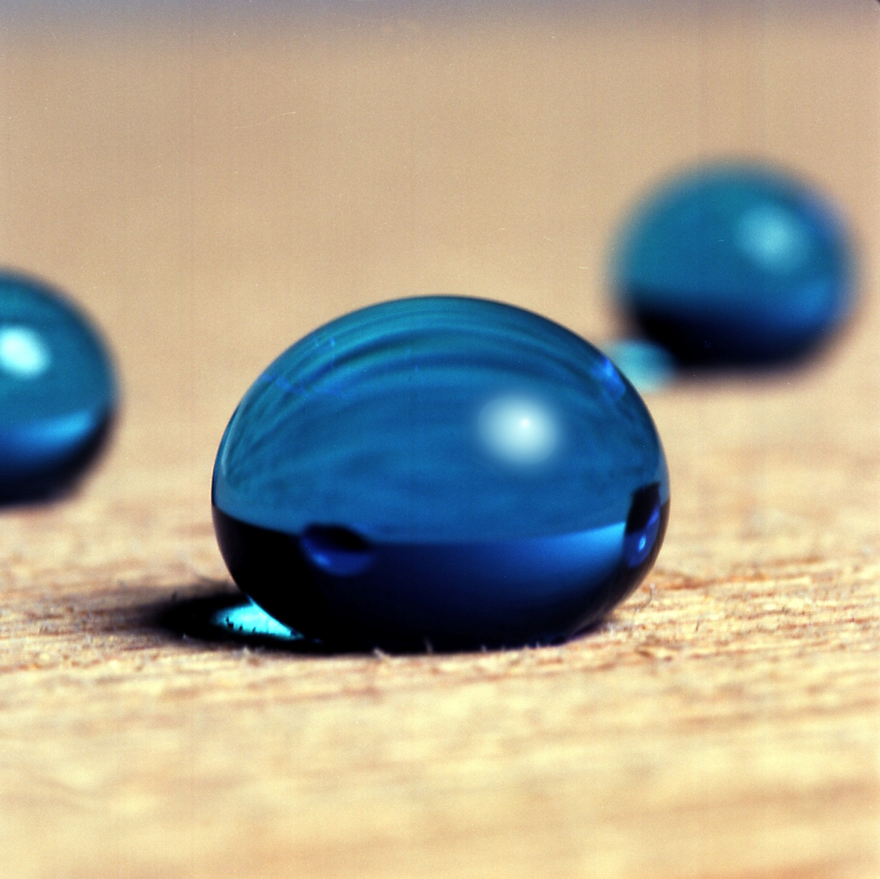

Geometry and boundary conditions
Most simulations probe the structural and thermodynamic properties of a system of a few thousand particles.
For such small systems the choice of boundary conditions can strongly affect the measured properties.
For example, in a cubic crystal of 1000 atoms, 49% of the atoms are at the surface. For a crystal of 1,000,000 atoms, only 6% of them are at the surface.

Slide 26
Geometry and boundary conditions
What should we do at the boundaries of our simulated system?
If nothing special is done, atoms near the boundary would have less neighbours than atoms inside.
This causes surface effects in the simulation to be much more important than they are in the real system.
Finite systems: use open boundary conditions, i.e. no boundaries at all, just N particles in space
Macroscopic systems: real macroscopic systems have a much larger number of particles (∼10²³) than can be handled in a simulation

Slide 27
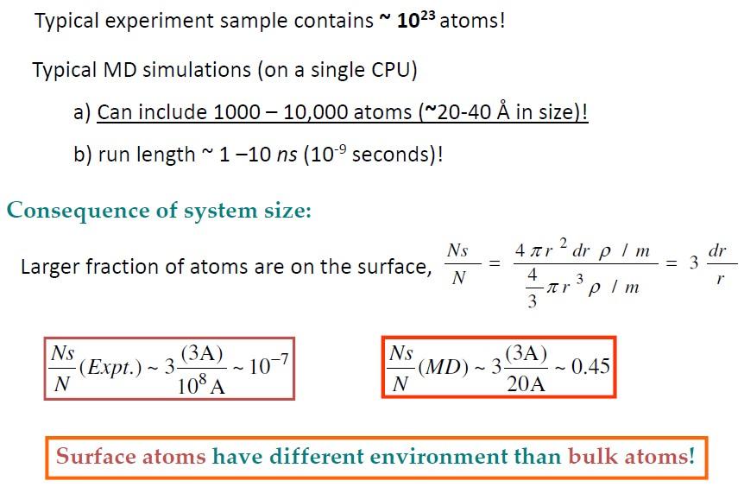
Length and time scales: MD Simulations

Slide 28
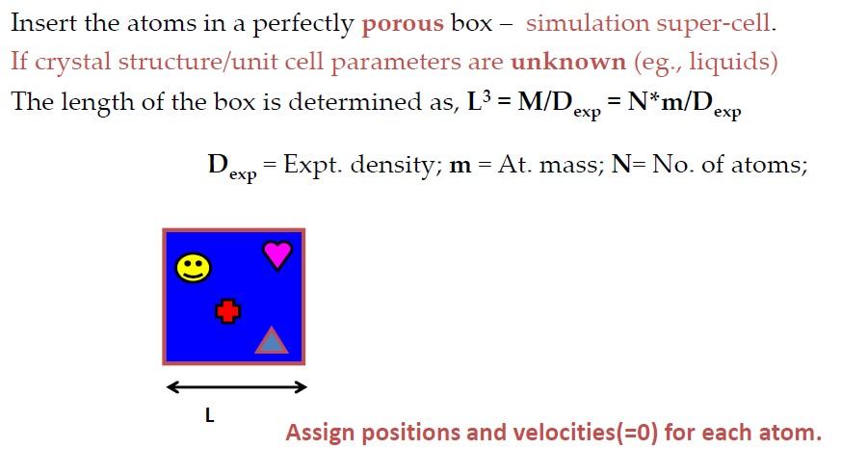
The Simulation Cell

Slide 29
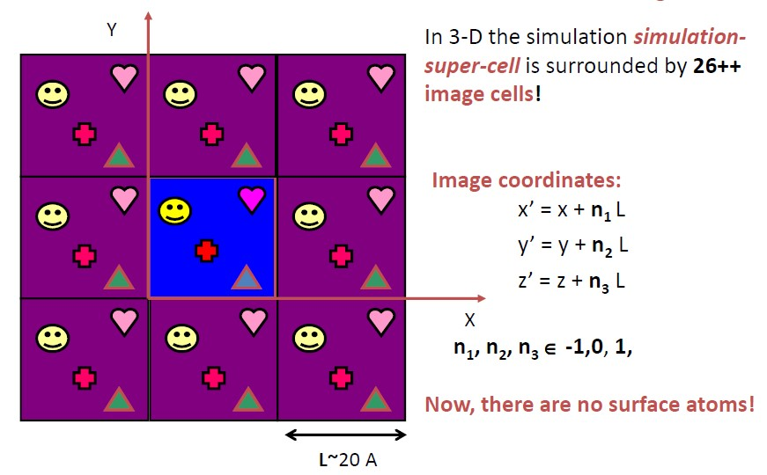
Periodic Boundary Conditions

Slide 30
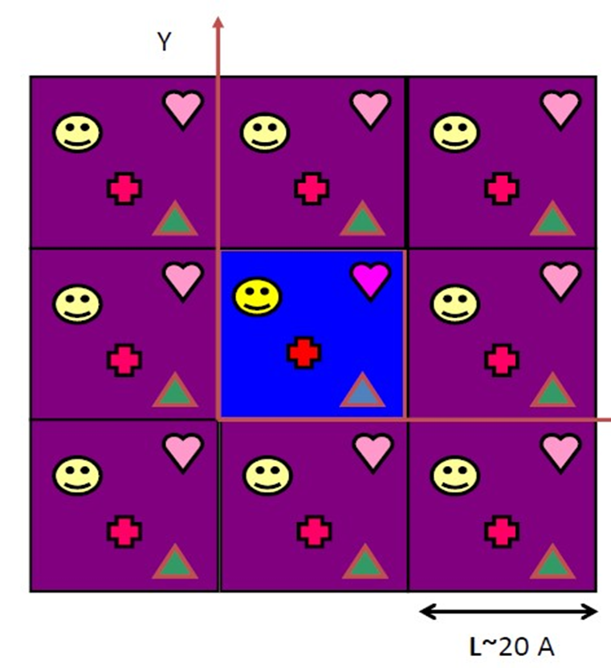
Periodic Boundary Conditions
Simulation box replicated to form an infinite lattice.
Periodic images of a particle in the simulation box move with the same orientation.
Nullify the surface effects and study the bulk properties of the system with small number of particles.
Linear momentum of the system under PBC is conserved.
Minimum image convention is adopted in order to prevent particles interacting with their own images during the simulation.

Slide 31
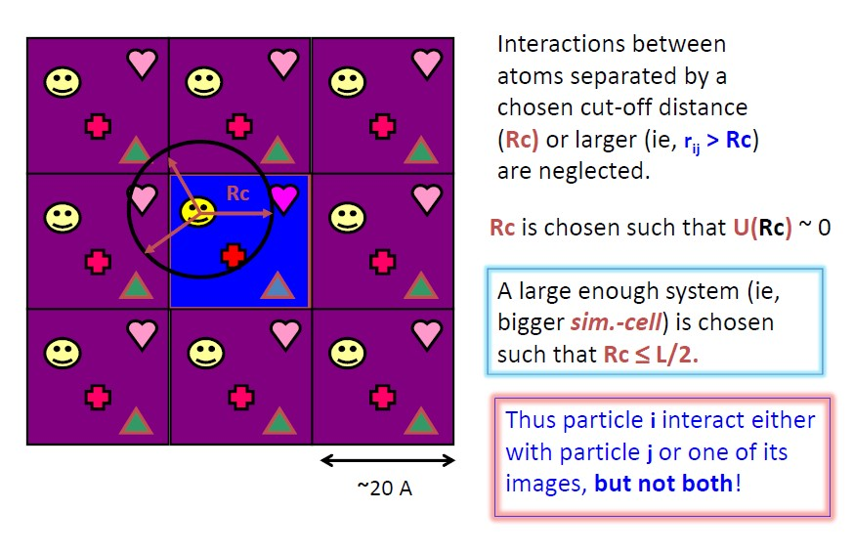
Minimum Image Convention

Slide 32
Simulation Procedures
Minimization
Minimize the energy of the system in order to reach the most favorable configuration
Equilibration
The point of the equilibration phase is to run the simulation until the structure, pressure, temperature and energy become stable with respect to time.
Dynamics
  Normal/Periodic boundary condition
  Single/Multiple time stepping
  Integrators
  Electrostatics
Analyses

Slide 33
MD – Shortcomings
Quality of the force-field
Size and Time – atomistic simulations can be performed only for systems of a few tenths of angstroms on the length scale and for a few nanoseconds on the time scale
Conformational freedom of the molecule – the number of possible conformations a molecule can adopt is enormous, growing exponentially with the number or rotatable bonds.
Only applicable to systems that have been parameterized
Connectivity of atoms cannot change during dynamics – no chemical reactions.

Slide 34


