Slide 1
Hackathon 2018
Presented By:
Team JCoC
(Vibhor Taneja
Sheetal Varshney)

Slide 2

Java CoC
We are developers from Java CoC,

Slide 3
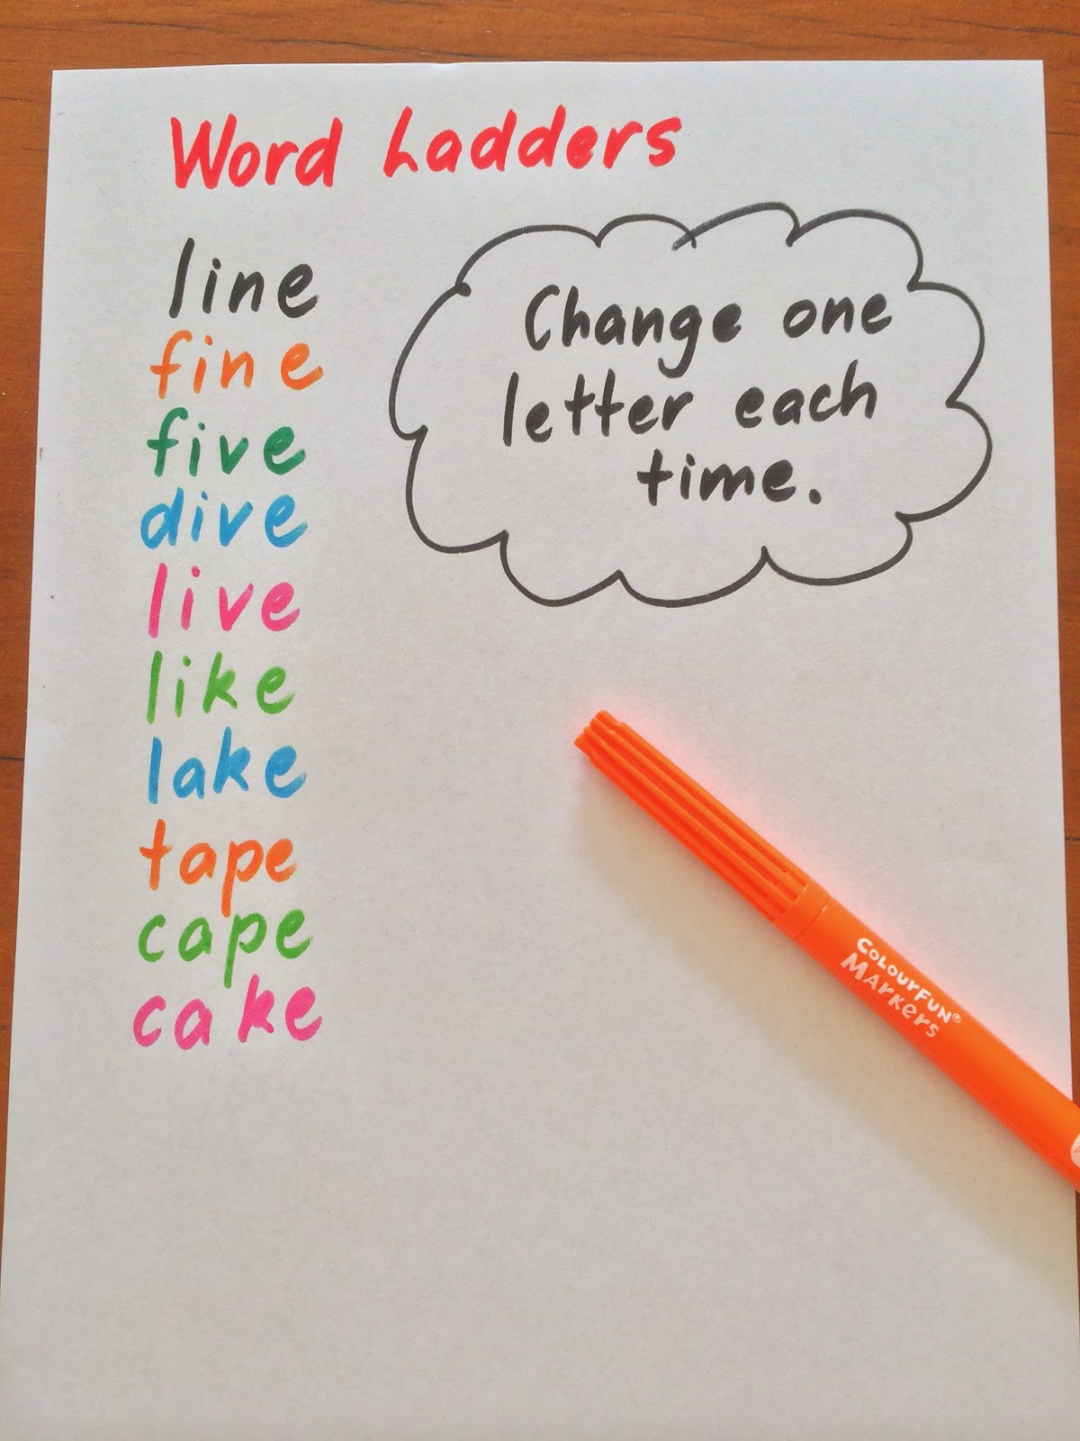

This to that
Question was?
Program to take the starting and the ending words as input and suggest a shortest sequence to change from start to end. In the example above, the second sequence is valid but longer.
Our approach

Slide 4

What Twitter said about Demonetization?
Question was?
What is the general sentiment of tweets?
Can you plot the trend of sentiment over the period of tweets?
Can you map the sentiment with segment of users(based on the field “from_user_description”)? And any other interesting insights which you may identify.
Our approach
Something

Slide 5
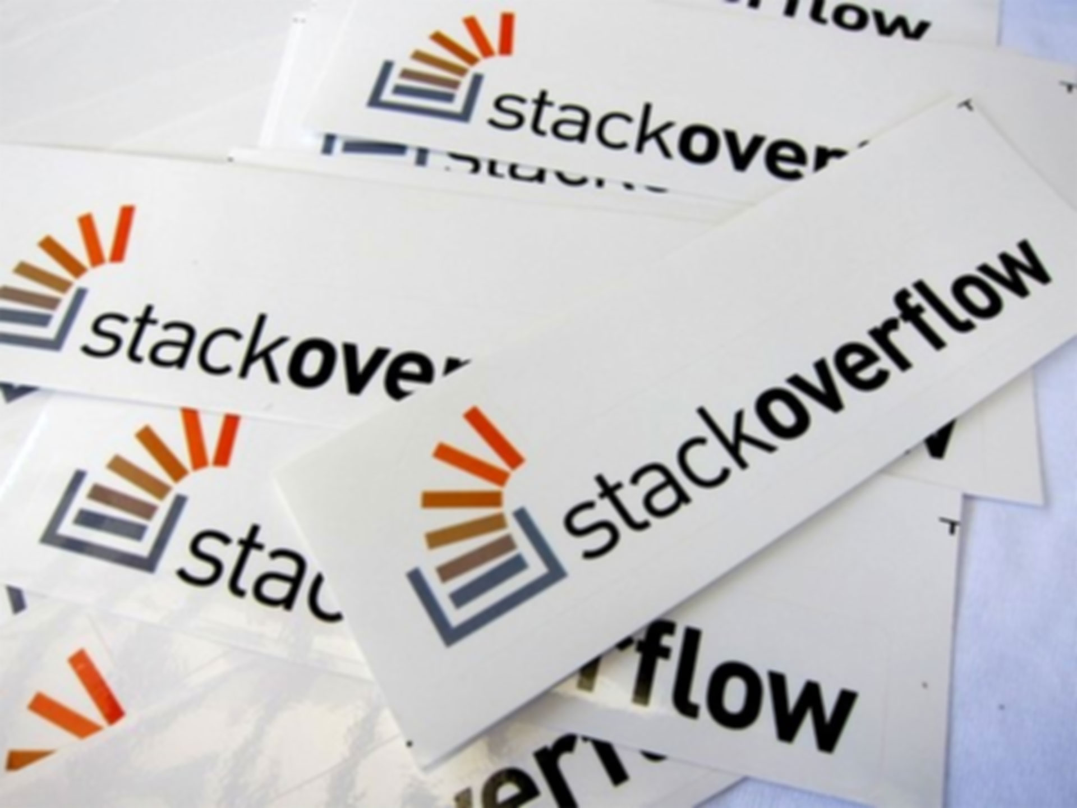
What sets Stack overflow contributors apart?
Question was?
Can you analyze this data to find out the characteristics of people who contribute the answers? Like for ex: People from Angola, Comoras hardly contribute to the answers whereas 50% of Indians give back to the community.
Our approach
something

Slide 6
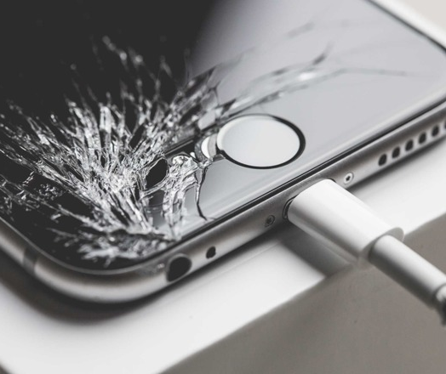
Can you identify cracks on mobile screen?
Question was?
Using images of mobile phone, can you classify the extent of crack on the mobile screen? A suggested classification could be:
Heavily cracked
Moderately cracked
Free of any cracks
Our approach
To find cracks on a mobile screen, first the image was converted into grayscale. From which the amount of grayscale on an image is found, which classify the screen accordingly.

Slide 7


